Slide 1

TRISH MORISON, MPH, Lecturer at UCOL
t.morison@ucol.ac.nz

Slide 2
WHEN PREGNANCY IS NO LONGER THE ISSUE:
BARRIERS TO SAFER SEX AS PERCEIVED BY MIDLIFE AND
OLDER WOMEN RESIDING IN NEW ZEALAND

Slide 3
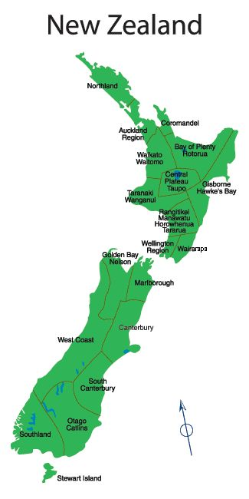
Population and context
4.5 Million - European (70%); Maori (10-15%); Asian (8-10%); Pacifica (8%). Life expectancy 81.4 years; Median age 37
Christian (50%); no religion (40%); Hindu (5%); Muslim (3%); Sikh (2%). Very permissive of casual sexual relationships
Popular media – UK; America; Australia.
Portray midlife women as sexually liberated.
Dating sites geared to this group.
Divorce 1 in 3.

Slide 4
Rationale for study
Anecdotal evidence suggested midlife people taking sexual health risks
STI surveillance showed a steady rise in the over 40 population relative to other population groups
Similar rising trends among middle age and older people had been seen in Britain, United States and Australia
Figures don’t truly reflect the extent of the problem! (not all GPs included; smaller pop of singles)

Slide 5
More recently (post study)
2010-2014
Chlamydia: decreasing since 2014 except in the over 40 male population. In over 40s rates rose from 58-62 (per 100,000)
Gonorrhea: 32% increase in rate in over 40s male population; increasing trend in female over 40 population
Genital Herpes: significant increasing trend in over 30s females and over 40s males; slightly increasing trend in over 40s females.

Slide 6
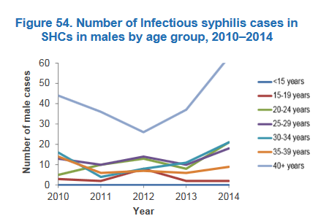
Genital Warts: decreasing (particularly in younger population groups); stable in older groups (HPV vaccine – 6,11,16,18)
Mean age HIV diagnosis - 45
Infectious Syphilis: cases rose from 82 to 140 from 2013 to 2014 (from 37 to 63 cases in over 40s males).

Slide 7
Methodology
Interpretative Phenomenological analysis
(Smith, 1996)
IPA is concerned with trying to understand how participants themselves make sense of their experiences, in order to gain insight into a particular phenomenon.
Lends itself to a particular method of analysis – iterative and idiographic, thematic, inductive.
Theory of Gender and Power
(Connell, 1987)
Three social structures influence power structures within a relationship: labor (workplace inequities), power (representation of women) and cathexis (gender norms of behaviour)
Study involved 8 women, one geographical area, self selection

Slide 8
Findings
Eight key themes were identified:
silent clinicians;
health belief versus health behaviour;
alcohol and sexual health;
the barriers of barrier methods;
‘rose tinted lenses of love’;
separation and vulnerability;
empowered talk versus action;
the mid-life context.

Slide 9
1. Silent Clinicians
Evidence of a lack of general practitioner (GP) initiated discussion…..even when alerted to a change of relationship…..
R: When you went to your GP earlier on when you first became single and got the contraceptive pill, did your GP talk to you about STI’s and safe sex?
Mary: No I can’t remember that.
… or a prime opportunity presents itself…
Louise: Yes I go for my smears, to a doctors, yes but no they have never asked (about safer sex practices), they did when I went to get checked for STIs at the clinic. They said I needed to make sure I used condoms.

Slide 10
Silent Clinicians ….
    None of the women were aware of any sexual health promotion material geared to older population groups
    Many held misconceptions about STI transmission
    Clear lack of age appropriate health promotion activity:
    https://www.youtube.com/watch?v=SiGBiNleU_g “no rubba, no hubba hubba”

Slide 11
2. Health belief versus health behaviour
Belief that older women should protect themselves from STIs and that they themselves should be more cautious. Yet all engaged in sexual activity where they are vulnerable to STI risk.
(Acknowledge a likely researcher effect!)
Mary: Yeah, maybe I slipped once or twice and then I got caught [contracted an STI] again.

Slide 12
Health belief versus health behaviour….
Appear to have an understanding of STI risk but believed their circumstances put them out of the high risk group
R: So if he made an effort, if he was a guy interested in dating you, how long into that relationship would you feel comfortable sleeping with him?
Monica: Well it could be straight away or after a few dates if the feelings are there. You know whether someone is genuine.
R: But you don’t use condoms?
Monica: No, I don’t sleep with that sort of guy.

Slide 13
3. Alcohol and sexual health
Most admitted to unsafe sexual activity as a consequence of alcohol consumption.
Clear in their belief that alcohol was an important influence.
Sharon: The big thing is alcohol has a huge thing to do with it, because I remember one in particular earlier on, went home extremely drunk, went for gold, woke up in the morning thinking shit what I have done, even though it was great. The barriers are down because of the alcohol.
R: So what was the difference between the ones you used condoms with and the ones you didn’t?
Kate: Depending how pissed I was and that was the thing

Slide 14
4. The barriers of barrier methods
The women stated they disliked condoms because:
They don’t like the smell, the taste, the feel or the “stuff” that is on them.
They suggested that sex with a condom is less pleasurable, believing condoms “interrupted the flow of sex”/”spoilt the moment”
They bring in a clinical aspect
They are a barrier to closeness
“If you love someone you want them to enjoy”

Slide 15
5. Rose tinted lenses of love
For a number of reasons romantic love reduces the likelihood of condoms being used.
Impacts on a woman’s perception of risk
Increases the desire for a more intimate sexual encounter
Jackie: He has been married three times and I didn’t think he had been promiscuous, you know, had casual relationships.
Jackie: If you care for someone you want them to enjoy it

Slide 16
Rose tinted lenses of love….
Reduces the likelihood of the woman insisting on condom use if she feels it would jeopardise her relationship
R: Yes. So do you think your feelings for him made you less likely to want to rock the boat?
Louise: Yes definitely, in that case.
R: What would have happened if you had insisted?
Louise: Oh he probably would have got sick of it and left.

Slide 17
6. Separation and vulnerability
Period of heightened sexual activity not about a new found sexual freedom more about trying to find a way through this emotionally difficult time.
Mary: In the last three years there has been not much emotion involved. It’s just purely for the sex. There were just no feelings. I was just a bit hurt after my separation and I just went nuts to start off with.
Kate: I have been talking to my friends, I think we go a bit wild because we are sort looking for a bit of fun because we got hurt, it’s like we are grieving or something.

Slide 18
Separation and vulnerability…..
Louise: Well one said he would never use one, so I never bought it up again
R: Why not?
Louise: Well that was the first one after (husband) left and so, well I was, well I didn’t want to disappoint, kind of thing.

Slide 19
7. Empowered talk versus action
All of the women believed that they, or other women in their mid-life or older years would not find the negotiation of safer sex difficult.
Most contradicted stated belief
R: Do you think women find it quite difficult to raise or negotiate protective measures?
Sharon: Well it shouldn’t be. You know, I mean you are old enough. ‘Flippin eck’
Sharon: We are getting on with it and then I suddenly thought, oh no, and I said stop, and he didn’t and we carried on

Slide 20
Empowered talk versus action…..
R:So what was it about him that made you not use a condom?
Kate: It was because he didn’t like them.
R: Has there ever been a time when you wanted to use a condom and they didn’t.
Kate: No because if that was the case I am ballsy enough to say.

Slide 21
Empowered talk versus action…
Many examples of this…
Gender power issues evident!
Anne: This guy last night. I did say it, I did suggest it but he just ignored me.
R: So you did raise it and he didn’t respond to it?
Anne: That’s right
R: What happened then?
Anne: We just carried on

Slide 22
8. The mid-life context
In youth preventing unwanted pregnancy was the concern (and now no longer an issue!)
Decades in long term relationships sheltered them from health promotion messages
Sharon: Yes, I guess in our younger days we were more worried about getting pregnant and not STIs.
Louise: When you have been married for so long, it’s not something you think about. Then you are out in the crowd, it’s not something you necessarily have in the back of your mind. When you have been in a relationship for so long it’s not something I have thought about

Slide 23
Theory of Gender and Power
(1) Labour – does not appear to be factor
(2) Power – sometimes blatant, sometimes about not wanting to create tension/jeopardise. Particularly in situations of vulnerability or romantic attachment.
(3) Cathexis - older women more likely to want to adhere to traditional gender constructs. Raising the topic of safer sex – perceived as unfeminine or promiscuous.

Slide 24
Conclusions
Older women are aware of STIs but rationalise their own unsafe sexual activity believing the men they are with to be low risk.
There is insufficient STI prevention information and promotion to enable older people to make informed sexual health decisions.
The romantic attachment of women to men, through a number of conduits reduces the likelihood of safer sex
Aspects of condom use reduce sexual pleasure.
Alcohol use influences sexual health decision making.

Slide 25
Conclusions
Older women believe they are sufficiently empowered to negotiate safer sex but perceived gender roles or contextual or relational factors impact on their ability to initiate or insist on condom use
Sociocultural factors related to being in the midlife or older years reduce risk awareness and lowers the expectation of condom use.
There is a period of vulnerability following separation or divorce which is associated higher risk sexual activity.
For older people the responsibility for initiating safer sex discussions falls primarily on women

Slide 26
Recommendations
A similar study involving men in their midlife and older years is undertaken
A study within the primary health care setting that investigates barriers to and potential strategies of sexual health promotion to older women is undertaken
Strategies are developed to support women in their sexual health decision making following a separation or divorce.
Strategies are developed that empower older women with skills that enable them to incorporate condoms into the sexual encounter with the minimum disruption to arousal and intimacy.

