Slide 1
CURRENT TRENDS IN
PHYSICAL MEDICINE AND REHABILITATION
THE EVOLVING PHYSIOTHERAPIST:
A CLINICIAN'S PERSPECTIVE

Slide 2
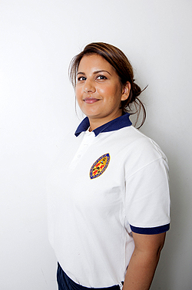
THE EVOLVING PHYSIOTHERAPIST
Miss Tripti Gyan MCSP HCPC REG
MSc Physiotherapy, BSc (Hons) Physiotherapy
TG Physiotherapy Care, Nottingham, England, UK

Slide 3
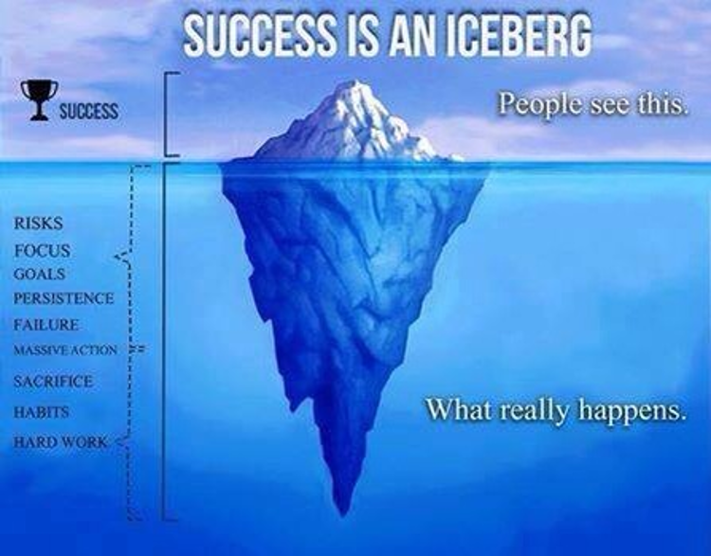
Our professions’ success is an accumulation of all our efforts, and those before us.
THE EVOLVING PHYSIOTHERAPIST

Slide 4
THE HISTORY OF PHYSIOTHERAPY
How far have we come?
How did we get here?
Why does it matter anyway?
THE EVOLVING PHYSIOTHERAPIST

Slide 5
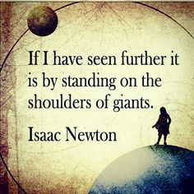
THE EVOLVING PHYSIOTHERAPIST

Slide 6
MILESTONES
Then:
Founded by four nurses in 1894, the CSP was awarded its Royal Charter in 1920 and has become the profession's leading membership organisation in the UK.
THE EVOLVING PHYSIOTHERAPIST

Slide 7
MILESTONES
Now:
On 20 August 2013 the senior Health Minister for England signed the Statutory Instrument No 1855 Medicines: The Human Medicines (Amendment) Regulations 2013 giving physiotherapists and podiatrists the right to undertake full independent prescribing after suitable training.
THE EVOLVING PHYSIOTHERAPIST

Slide 8
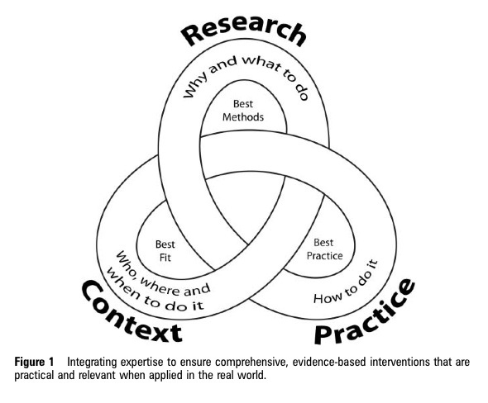
Research catalyzed the physiotherapy (physical therapy) movement
Ref: Tom Groom
THE EVOLVING PHYSIOTHERAPIST

Slide 9

THE EVOLVING PHYSIOTHERAPIST

Slide 10
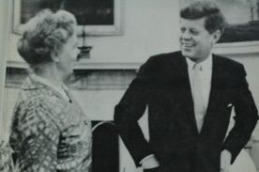
THE GAME-CHANGERS
THE EVOLVING PHYSIOTHERAPIST

Slide 11
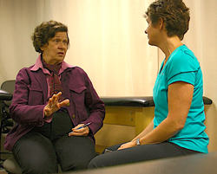
THE GAME-CHANGERS
THE EVOLVING PHYSIOTHERAPIST

Slide 12
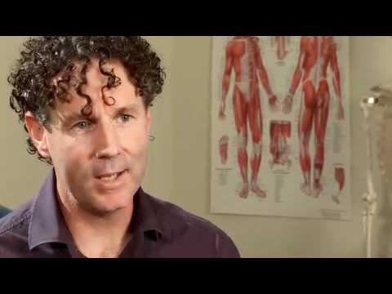
THE GAME-CHANGERS
THE EVOLVING PHYSIOTHERAPIST

Slide 13
OUR CURRENT PROFESSIONAL STANDING
What does it really mean to be a modern physiotherapist?
• Personalised Care
• Leaders in Patient Education
• Pro-active Care
• Longer Term Intervention
THE EVOLVING PHYSIOTHERAPIST

Slide 14
THE FUTURE….
External Factors
Internal Factors
THE EVOLVING PHYSIOTHERAPIST

Slide 15

HOW ARE WE GOING TO GET THERE?
Our Vision
THE EVOLVING PHYSIOTHERAPIST

Slide 16
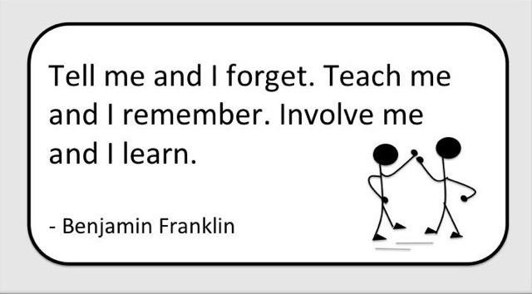
THE FUTURE OF PHYSIOTHERAPY IS EXCITING
THE EVOLVING PHYSIOTHERAPIST

Slide 17
FINAL THOUGHTS
Continue To Be Excellent!
Embrace Change, Contradictions And Celebrate Uncertainties
Ask Different Questions
Challenge Ourselves
Keep Up To Date
Evolve
THE EVOLVING PHYSIOTHERAPIST

Slide 18
ACKNOWLEDGEMENTS
Thank you to all our patients, colleagues and mentors who share our journey and challenge us to keep learning, thinking, feeling and questioning so that we can help our patients live the highest quality of life possible.
THE EVOLVING PHYSIOTHERAPIST

Slide 19

BE YOUR OWN INSIPIRATIONAL
STORY OF SUCCESS
THE EVOLVING PHYSIOTHERAPIST

Slide 20
THANK YOU
VERY MUCH
FOR LISTENING
QUESTIONS?
THE EVOLVING PHYSIOTHERAPIST

Slide 21





THE EVOLVING PHYSIOTHERAPIST
CONNECT WITH ME
Miss Tripti Gyan MCSP HCPC REG
www.triptigyan.com
Tripti@triptigyan.com
@TriptiGyan, Physio
www.linkedin.com/in/triptigyanphysiotherapist
https://plus.google.com/+TriptigyanPhysiotherapist/

Slide 22
Finis
Good Bye
THE EVOLVING PHYSIOTHERAPIST

