Slide 1
Effect of intake of butter with different level of medium chain fatty acids in combination with different types of milk proteins on the observed metabolites in human biofluids
Assessed by an untargeted metabolomics approach using LC- an GC Q-ToF
Associate prof. Trine Kastrup Dalsgaard
Department of Food Science
Aarhus University
Phone: +45 87 15 60 00
Direct: +45 87 15 79 98
Email: trine.dalsgaard@food.au.dk
Web: food.au.dk
Field of omic techniques:
Peptidomics
Proteomics
Oxidomics
Metabolomics

Slide 2
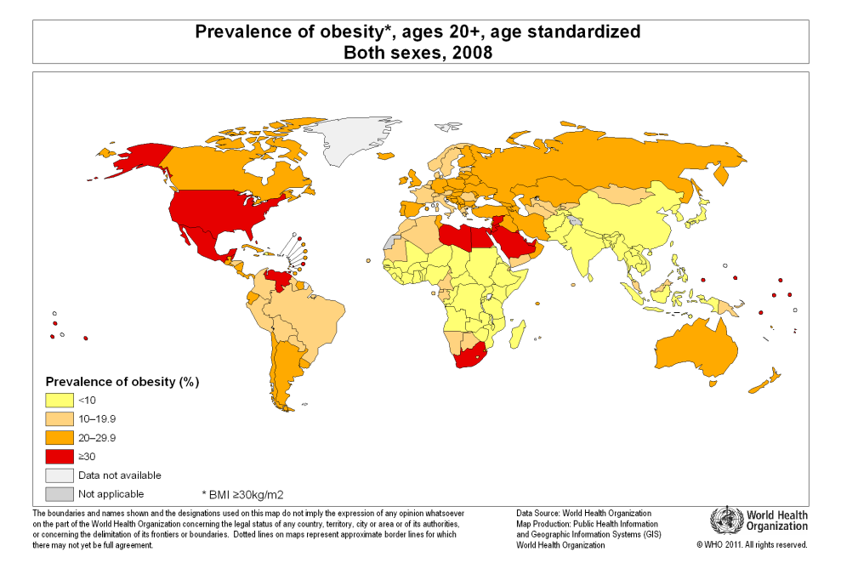

Background
Source: WHO
Consequence:
Obesity, blood pressure, insulin resistance, diabetes mellitus II, cardiovascular disease

Slide 3
Background
Saturated fat has been considered unhealthy with respect to development of obesity and metabolic syndrome (abdominal obesity, insulin resistance, dyslipidemia, and elevated blood pressure)
Dairy products, high in saturated fat, have therefore been reduced in fat content
Saturated fatty acids differs in their uptake and metabolism and medium chain fatty acids (C6-C12) may have a beneficial effect on weight
Whey proteins are known stimulate insulin secretion thus suppressing postprandial blood glucose
Whey protein has a positive effect on lean body mass

Slide 4
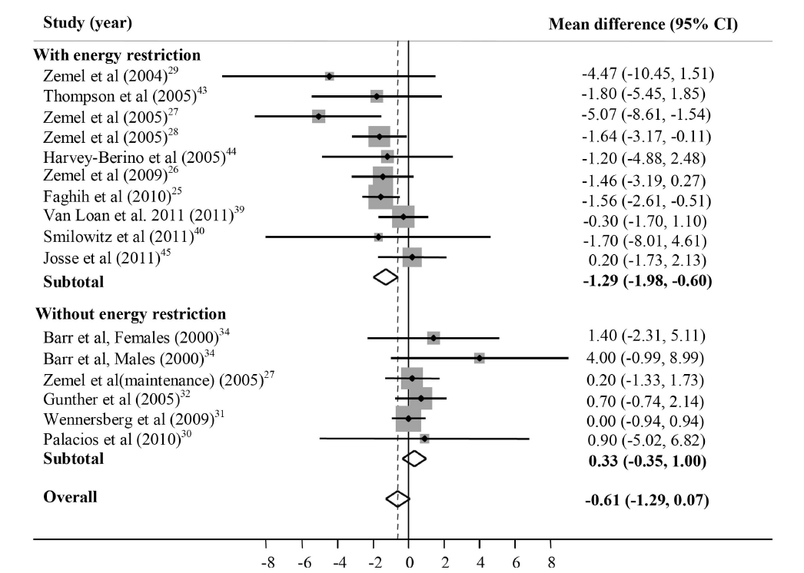
Dairy intake and weight
Int J Obes (Lond), 2012. 36, 1485-93

Slide 5
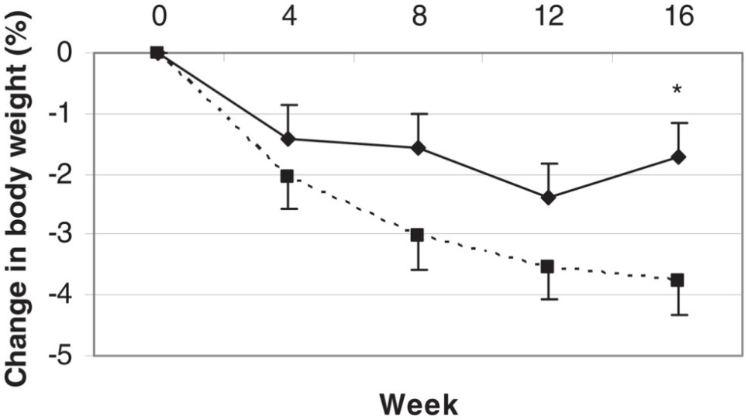
Effect of intake of medium chain fatty acids
Olive oil
MCT oil
31 overweight men and women, 19-50 y, 16 weeks parallel intervention, 18-24 g/d medium-chain triglycerides (MCT) or olive oil
Am J Clin Nutr 2008, 87(3): 621–626.

Slide 6
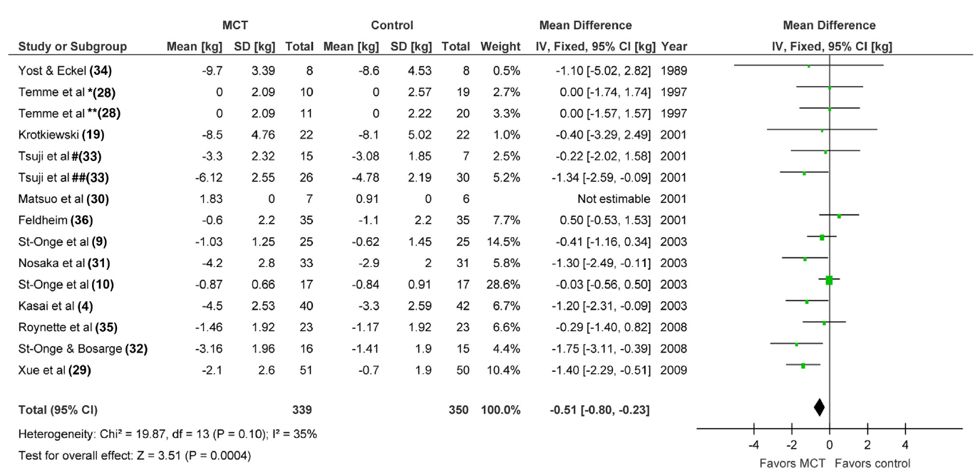
Effect of medium chain fatty acids on weight
J Acad Nutr Diet 2015;115:249-63

Slide 7
Objective
Investigate the long term effect of whey and casein in combination with low and high level of medium chain fatty acids on the metabolic profile in biofluids

Slide 8

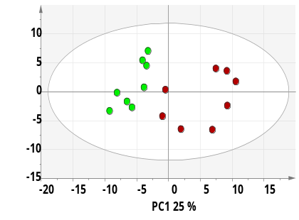
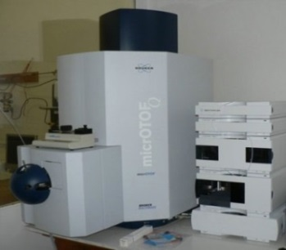
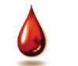
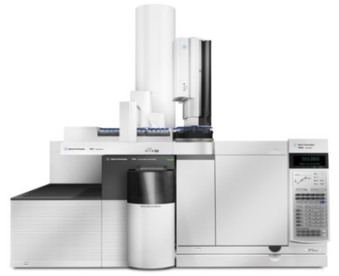
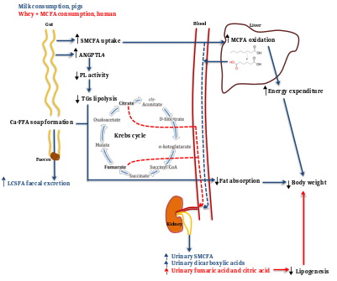
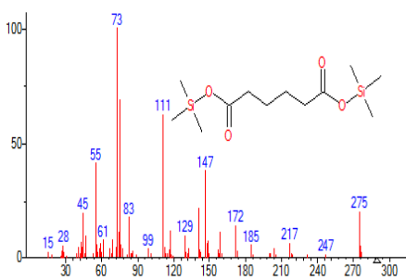
NMR, LC- and GC-MS metabolomics platform for untargeted analysis
Bruker, 600 MHz NMR
NMR
Multivariate data analysis
(PCA & PLS-DA)
LC/MS
GC/MS
(Bruker, LC-MS mikrOToF-Q)
(Agilent Technologies, QQQ LC/MS 6495)
(Agilent Technologies, 2D-LC-MS IMToF 6560)
Metabolites identification
Pathway analysis
(Agilent Technologies, 7200 Q-ToF GC/MS)

Slide 9
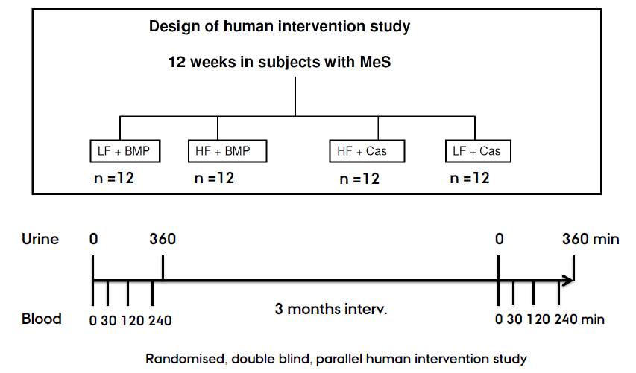
Dairy Health – Human intervention
LF + Whey
HF + Whey

Slide 10
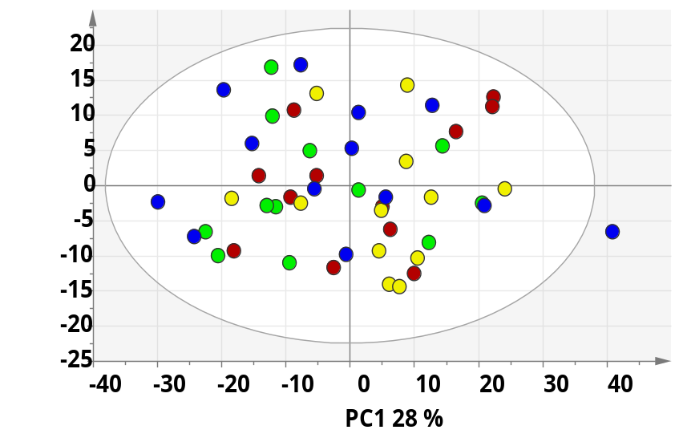
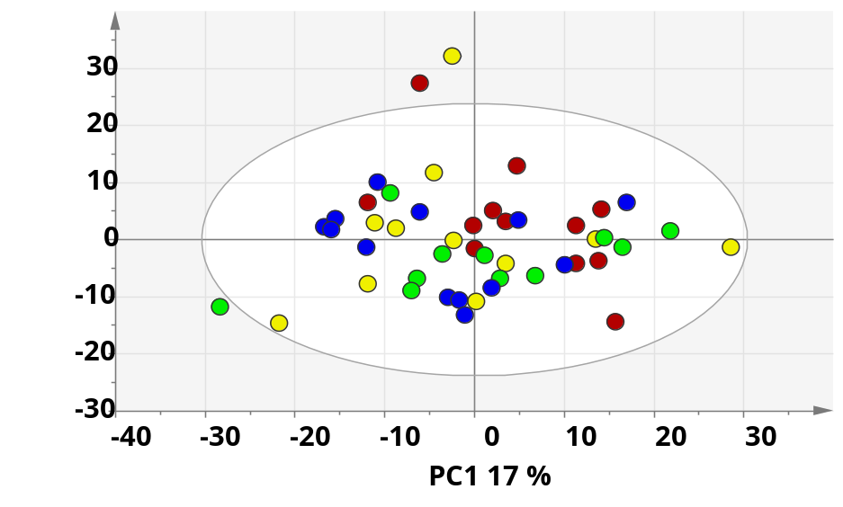


NMR analysis: metabolome after 12 weeks of intervention
plasma
urine
No differences in metabolic profiles

Slide 11
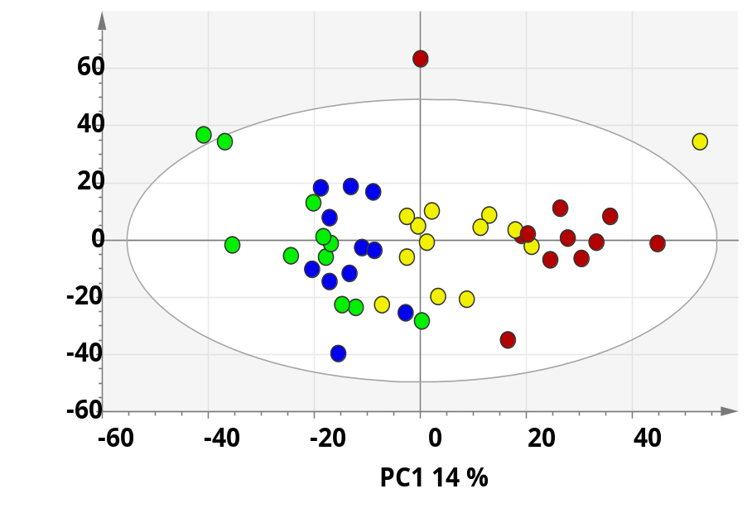
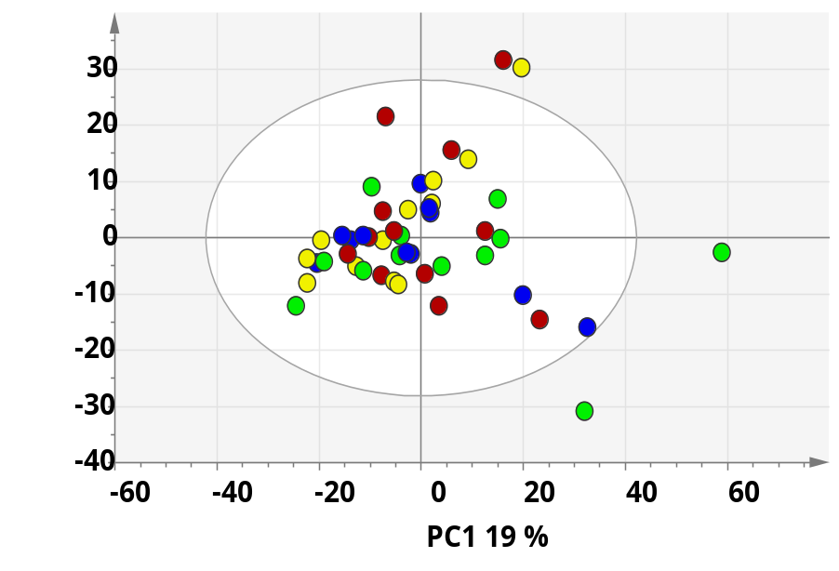
LC-MS: Metabolome after 12 weeks intervention
plasma
urine
Synergistic effect of whey and level of medium chain fatty acids in plasma

Slide 12
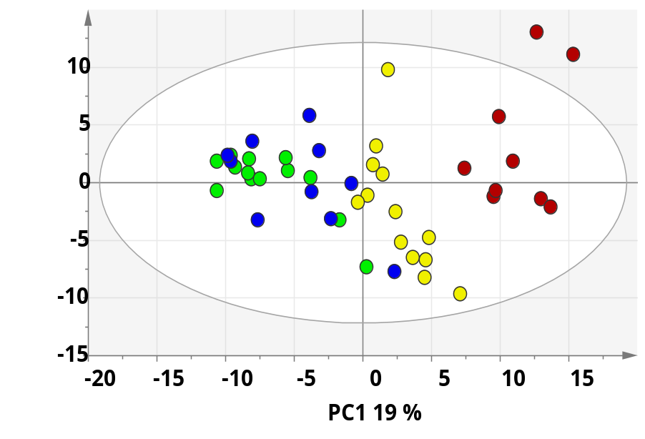
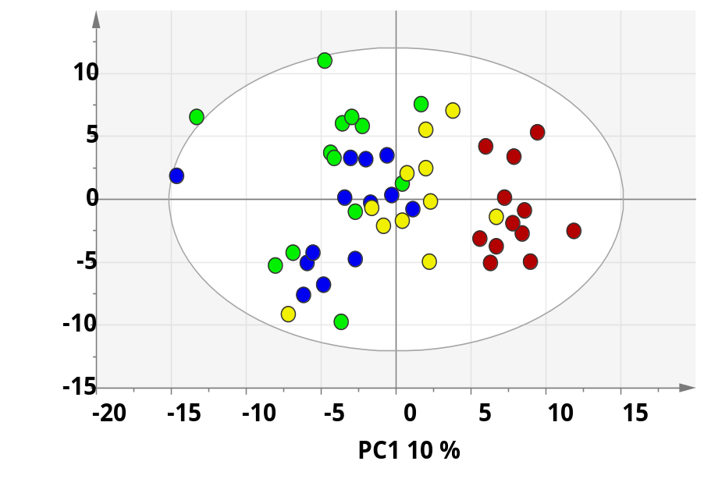
GC-MS: Metabolome after 12 weeks of intervention
plasma
urine
0 30 120 240
3 months interv.
0 30 120 240 min
Synergistic effect of whey and level of medium chain fatty acids

Slide 13
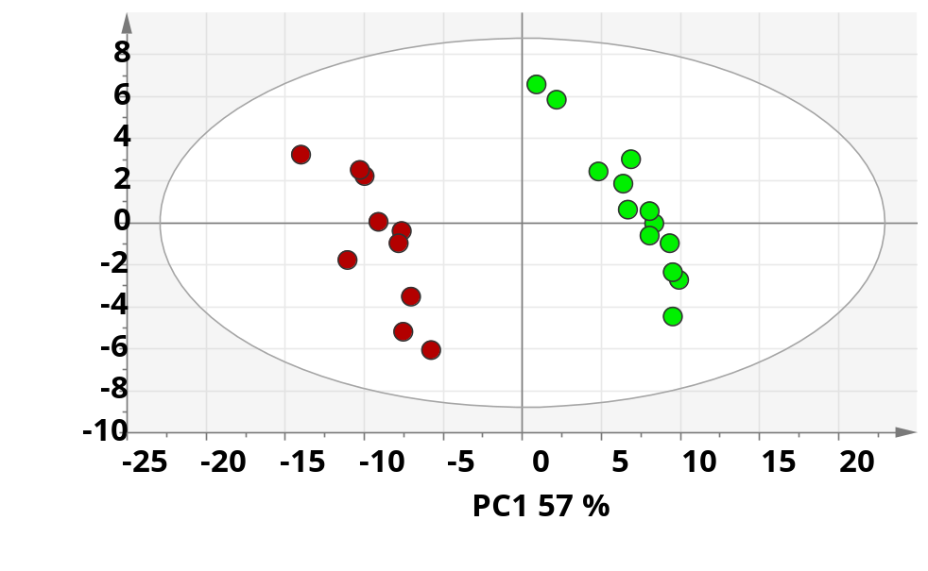
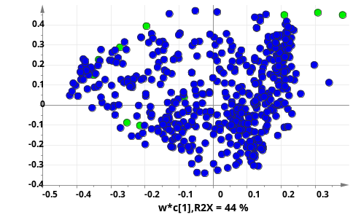
For identification of metabolites a PLS-DA model was used
WH
CH
  -1 1
VIP>1

Slide 14
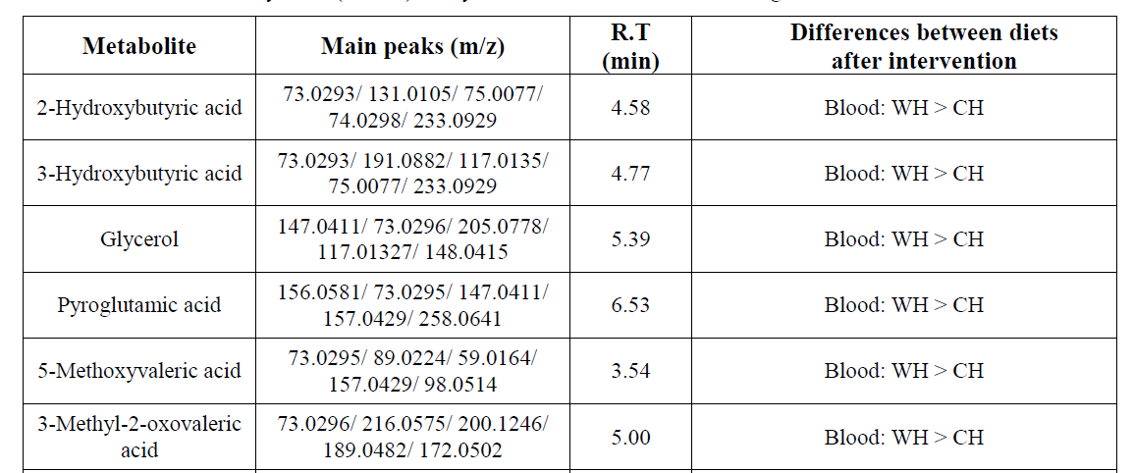

Slide 15
Effect of intervention

Slide 16
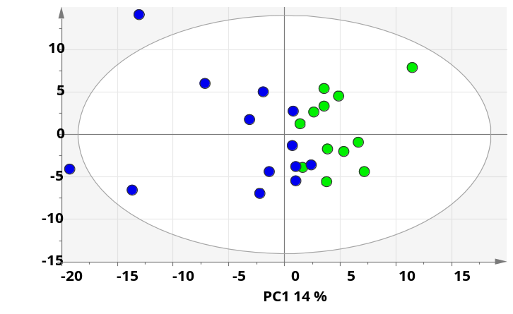
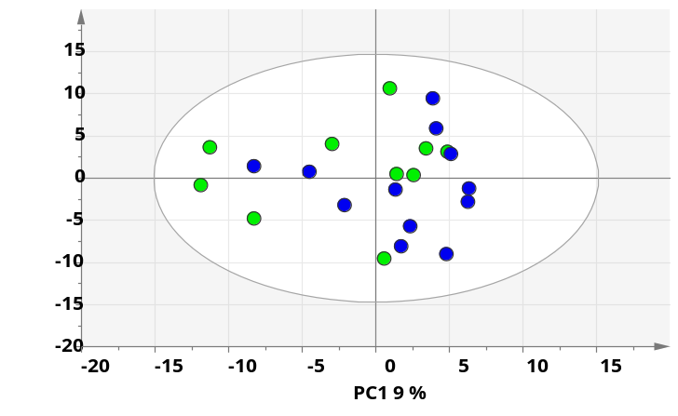
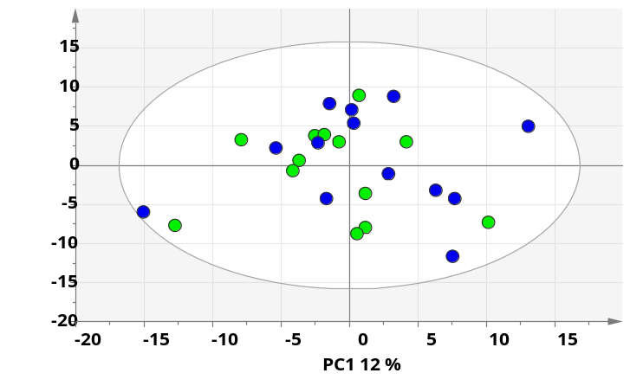
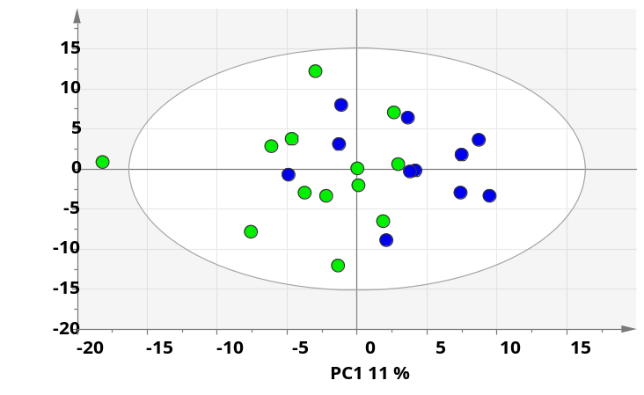

GC-MS: Long term effect of diets on urine metabolome, PCA
WH
WL
PC2 8 %
PC2 9 %
PC1 14 %
CH
PC1 9 %
CL
PC2 10 %
PC2 9 %
PC1 12 %
PC1 11 %

Slide 17
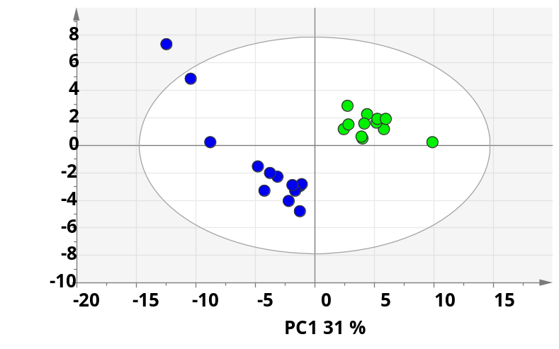
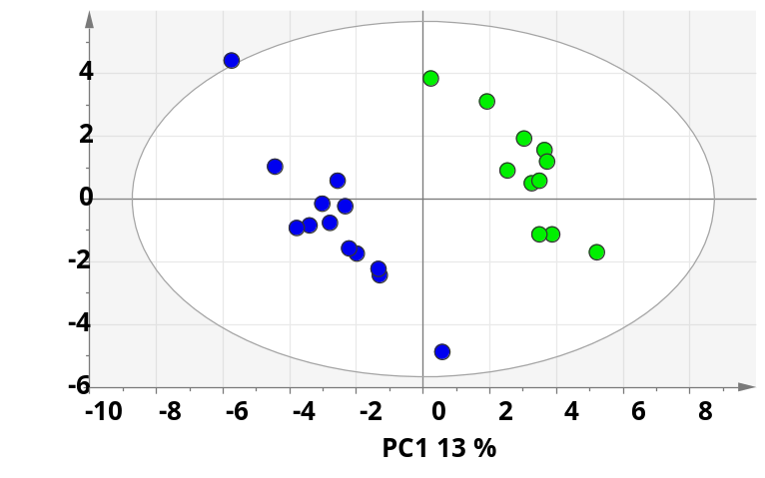
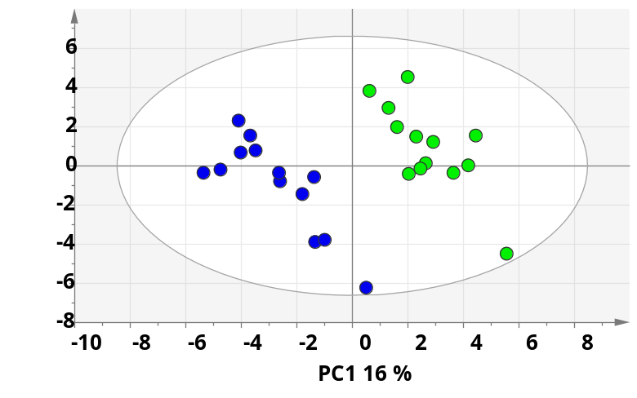
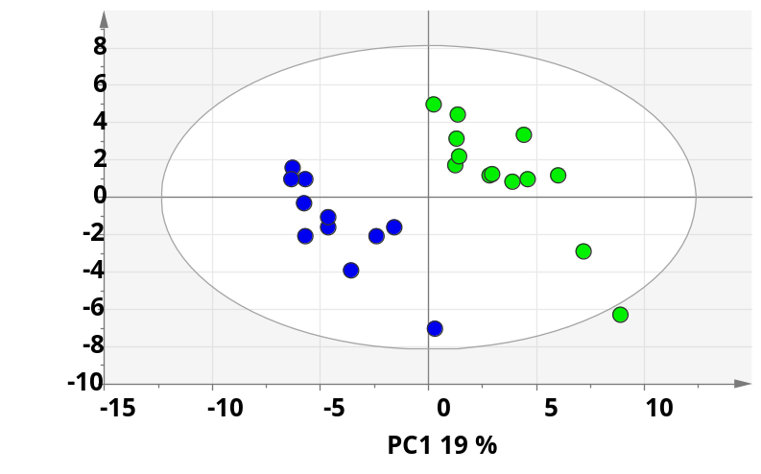
GC-MS: Long term effect of diets on urine metabolome, PLS-DA
A
WH
WL
Q² = 0.83
Q² = 0.74
CH
CL
Q² = 0.73
Q² = 0.65
VIP>1

Slide 18
Metabolites that changes in urine after 12 weeks intervention
metabolite | decreased | increased | technique
5-Hydroxyhexanoic acid |  | WH, CH | GC-QToF
Adipic acid |  | WH, CH | GC-QToF
Fumaric acid |  | WH | GC-QToF
Citric acid |  | WH | GC-QToF

Slide 19
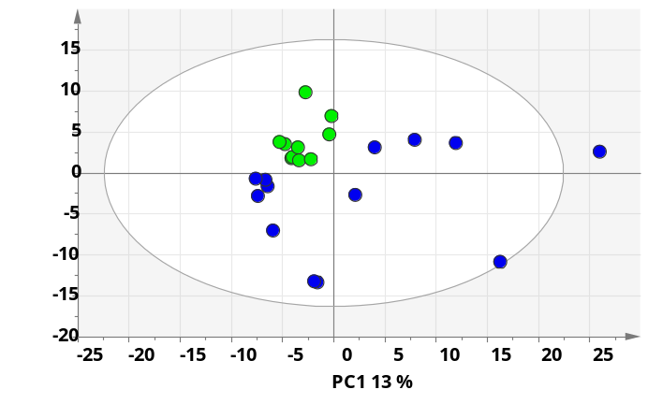
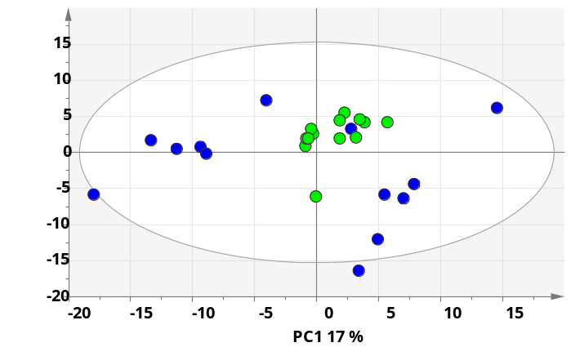
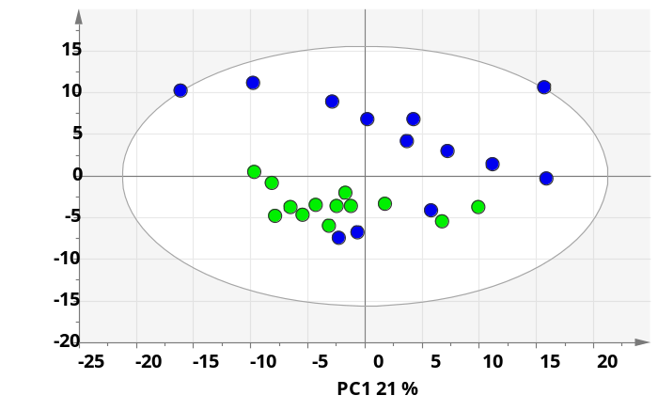
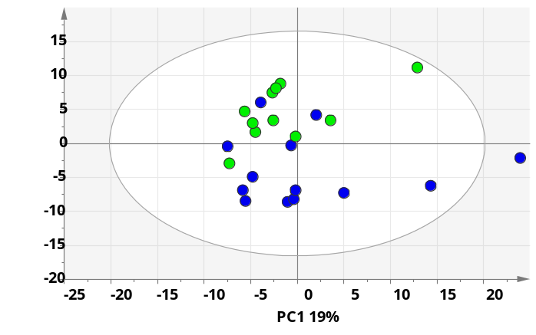

GC-MS: Long term effect of diet on blood metabolome, PCA
WH
WL
CH
CL

Slide 20
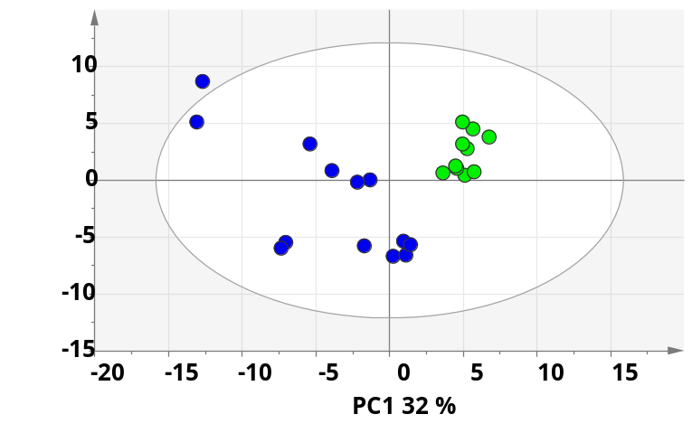
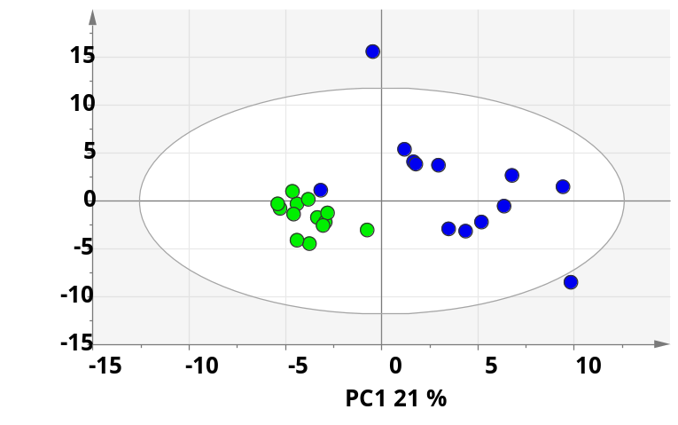
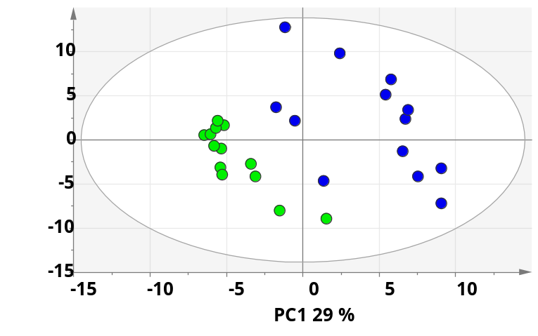
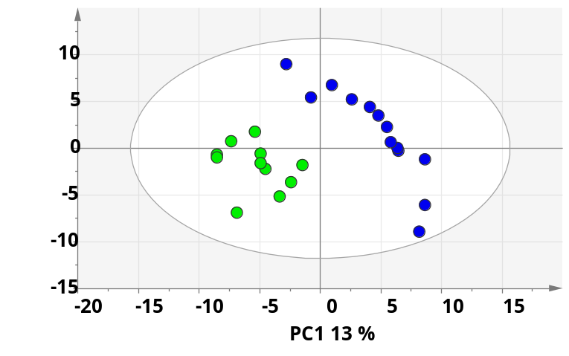
GC-MS: Before and after intervention, blood PLS-DA
C
A
WH
WL
Q² = 0.73
Q² = 0.57
CH
CL
Q² = 0.72
Q² = 0.41
VIP>1
Figure S2, PLS-DA scores plots of metabolites detected with GC-ToF MS on fasted plasma samples before (blue) and after (green) 12 weeks of intervention with the four diet groups and have variable importance for the projection (VIP) value > 1, A) high amount of MCFA (H-MCFA) + Whey, B) low amount of MCFA (L-MCFA) + Whey, C) H-MCFA + Casein, and D) L-MCFA + Casein.

Slide 21
Metabolites changes in blood after 12 weeks intervention
Metabolites | decreased | increased | technique
2-Hydroxybutyric acid | CH |  | GC-QToF
3-Hydroxybutyric acid | CH |  | GC-QToF
Glycerol |  | WH | GC-QToF
Sarcosine |  | WH | GC-QToF
5-Methoxyvaleric acid | CH, CL | WH | GC-QToF
3-Methyl-2-oxovaleric acid |  | WH | GC-QToF
Threonic acid |  | WH | GC-QToF
Lactose | CL |  | GC-QToF
Octanoic acid | CL |  | GC-QToF
3-Phenyllactic acid | WH |  | LC-QToF
3-Hydroxymandelic acid | WH |  | LC-QToF
Acetyl-N-formyl-5-methoxykynurenamine | WL |  | LC-QToF
4-Hydroxyandrostenedione glucuronide | WL |  | LC-QToF
2,3-Diaminosyliclic acid | CH |  | LC-QToF
PC(16:0/22:5(4Z,7Z,10Z,13Z,16Z) Phosphatidylcholine | CH |  | LC-QToF

Slide 22
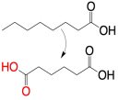
Important altered metabolites
Blood
Whey + High Medium Chain Fatty Acid:
Liver
Urinary Fumaric acid, Citric acid and Adipic acid
Glycerol in blood
MCFAs oxidation
cis- Aconitate
D-Isocitrate
α-ketoglutarate
Succinyl-CoA
Succinate
Fumarate
Malate
Oxaloacetate
Citrate
Casein + High Medium Chain Fatty Acids
Urinary adipic acid and 5-Hydroxyhexanoic acid
Urinary 2- and 3-hydroxybutyric acid
Energy expenditure
Krebs cycle
Body weight
Kidney
Urinary fumaric acid and citric acid
Lipogenesis
Urinary adipic and 5-hydroxyhexanoic acid

Slide 23










Acknowlegdement
Bashar Amer
AU – Food Science
Hanne C. Bertram
AU – Food Science
Kjeld Hermansen
AU Hospital
Mette K. Larsen
AU – Food Science
Morten R. Clausen
AU – Food Science
Thomas Skov
KU –Food Science
Hong Zheng
AU – Food Science
Caroline Nebel
AU – Food Science
Mette Bohl Larsen
AU Hospital
The Danish Dairy Research Foundation

Slide 24
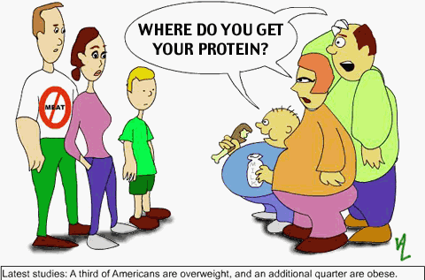
Thank you for your attention
Field of omic techniques:
Peptidomics
Proteomics
Oxidomics
Metabolomics

