Slide 1


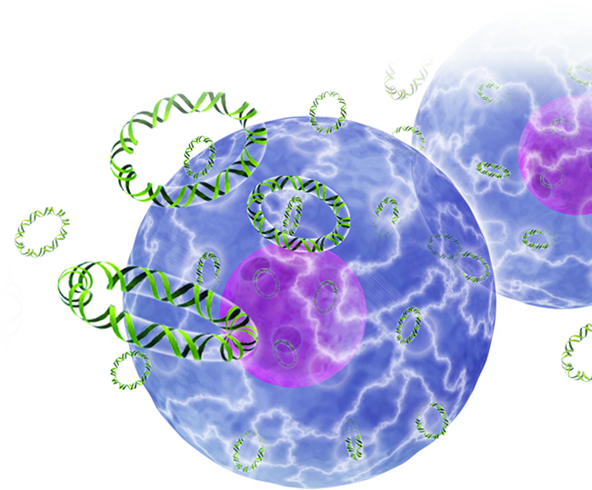
Generation of robust immunity following DNA vaccination enhanced by intradermal electroporation
Cell & Gene Therapy 2014,
Las Vegas, NV
October 27–29, 2014
Trevor Smith, PhD

Slide 2
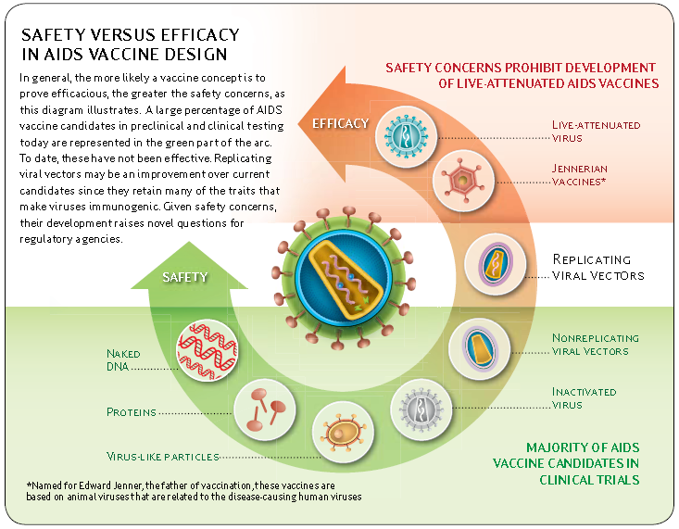

Vaccines: Safety vs. Efficacy
IAVI Blueprint for AIDS Vaccine Report, 2008

Slide 3
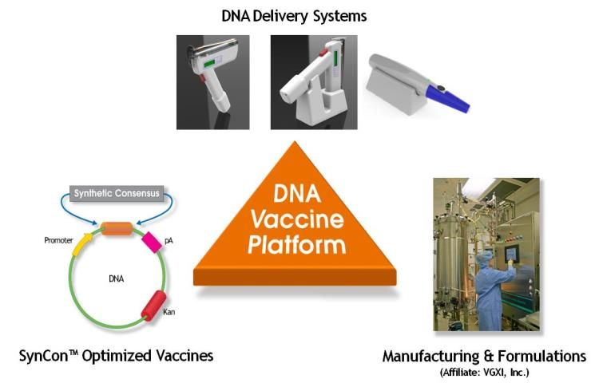
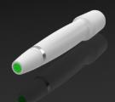
Inovio: Fulfilling the promise of DNA Vaccines

Slide 4
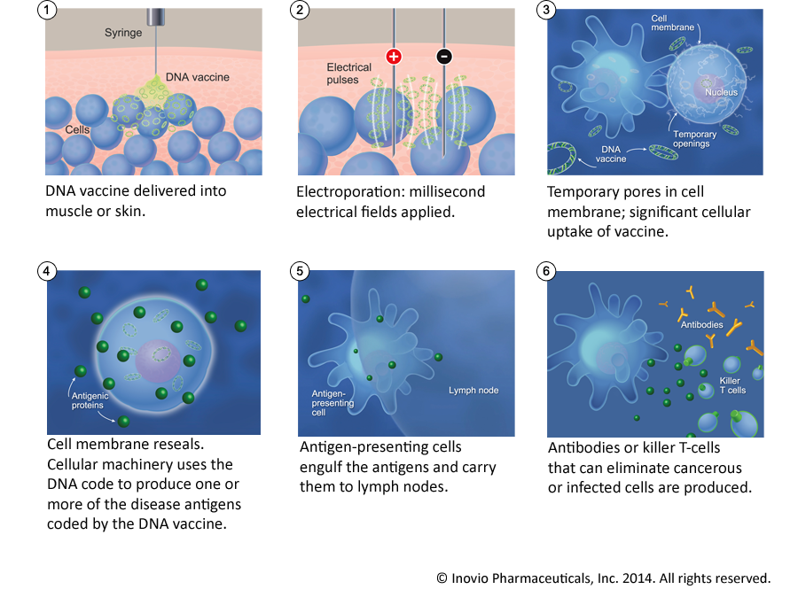
Enhanced DNA Delivery: in vivo Electroporation

Slide 5
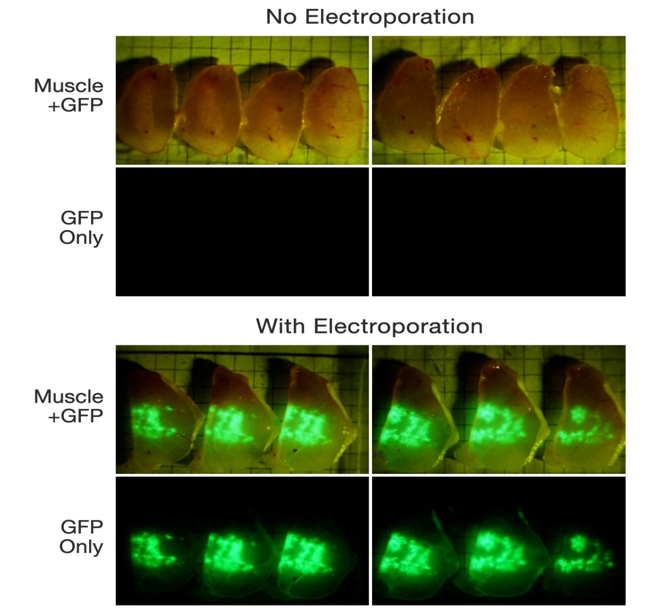
Electroporation Enhanced Transfection
Sardesai and Weiner, Curr. Opin. Immunol. 2011

Slide 6
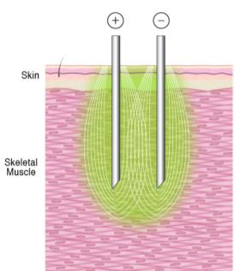
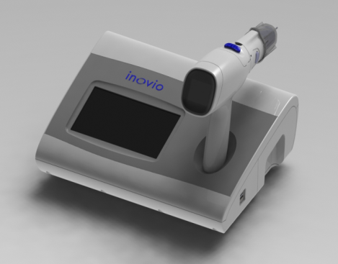
Muscle EP Device – In the clinic: CELLECTRA®-5P
Phase II efficacy:
Lesion regression + viral clearance
40.2 %
IM-Electroporation
Percent
14.3 %
Number patients treated - 520+
Total immunizations - 1300+
VGX-3100
Placebo
Therapeutic Phase I
HPV-001 Inovio
HPV-002 Inovio
HIV-001 UPenn – PennVax B
HPV-004 Inovio (open IND)
HPV-005 Inovio (open IND)
HPV-006 Inovio (Open IND)
Therapeutic Phase II
HPV-003 Inovio Cervical Dysplasia
VGX-3100 (HPV16/18 E6 & E7 oncoproteins)
Prophylactic Phase I
HIV-080 HVTN – PennVax B
FLU-001 Inovio (US)
FLU-001 Inovio (Korea)
RV-262 Army – PennVax B and G
Phase III Device

Slide 7
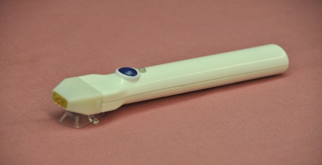
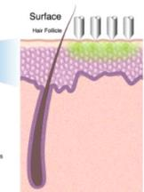

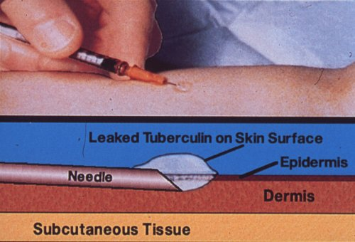
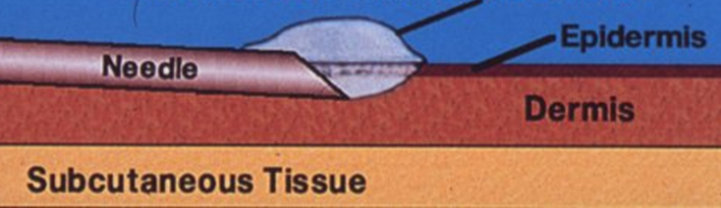
Skin EP Device – preclinical: SEP
Surface EP System
Intradermal Electroporation
ID injection + SEP procedure:
pGFP
GFP
1. Mantoux injection to admin. pDNA
2. EP to allow pDNA transfection
x20
x20

Slide 8
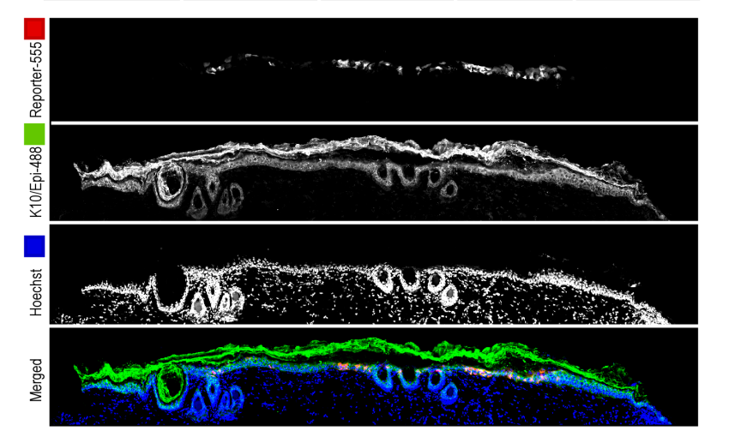
Surface EP specifically targets the Epidermis
K10/RFP/Hoescht
Stratum corneum
Epidermis
Dermis
Smith TRF et al, Mol. Ther. – Methods & Clinical Dev. In press

Slide 9
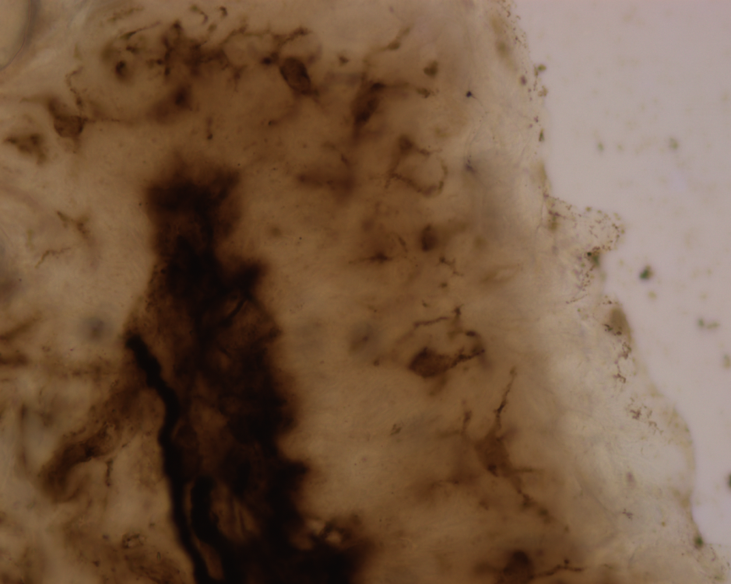
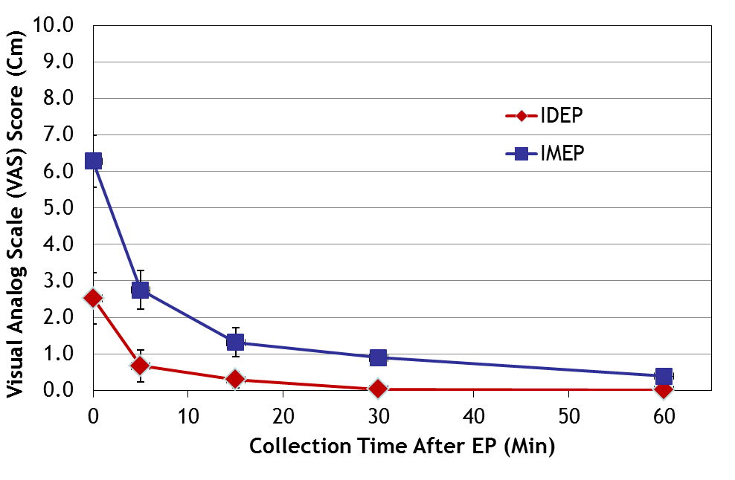
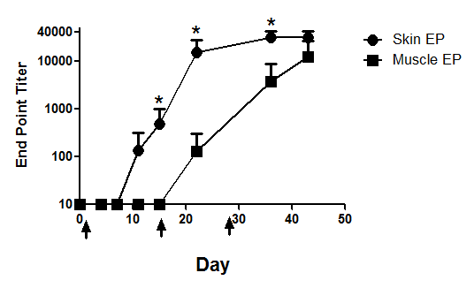
Advantages of vaccinating in the skin
Immunocompetence:
Accessibility
Monitoring
Dendritic
cells
epidermis
Tolerability:
Diehl MC et al, Hum Vacc. Imm. 2013

Slide 10
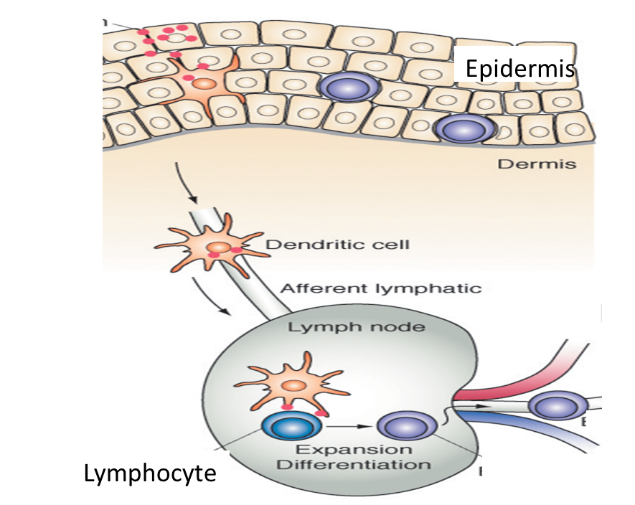
Proposed Mechanism

Slide 11
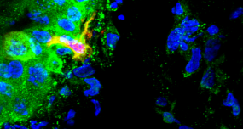
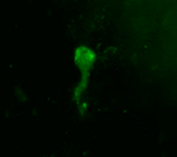
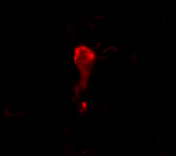
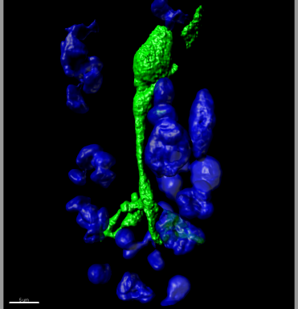
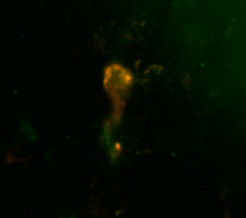
Directly transfecting Dendritic Cells
Epidermis:
Dendritic cell staining in dermis:
RFP positive dendritic cell
GFP
MsGp2
x 60
Dermis:
Color merged
GFP
MsGp2
GFP positive dendritic cell
IMARIS-3D Rendered
Amante D et al, Human Gene Therapy. In press

Slide 12
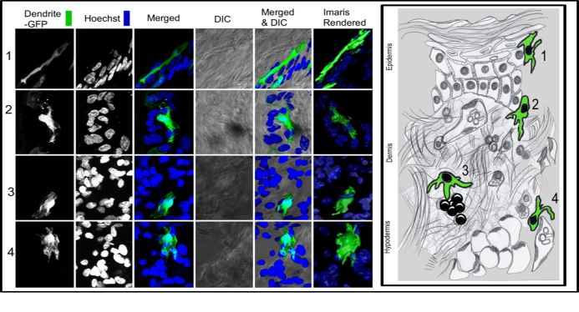
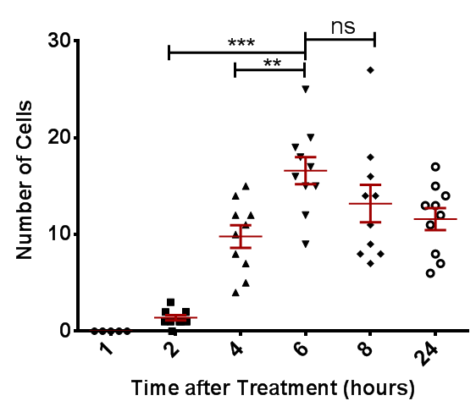
Kinetics of DC migration into the dermis
Number of GFP+ cells
In the dermis:

Slide 13
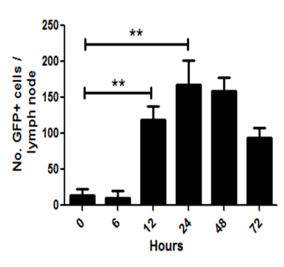
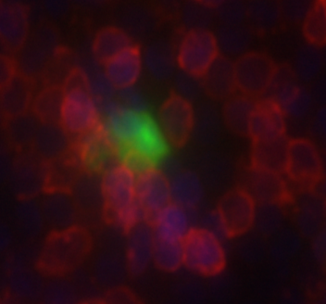
GFP+ cells in the draining lymph nodes
CD4/GFP/Dapi
GFP+ cell in the T cell zone of the cortex in the inguinal lymph node

Slide 14
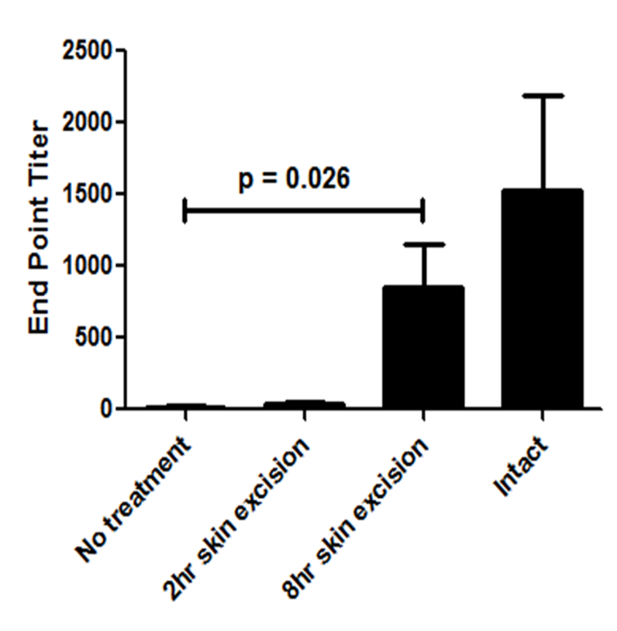
Treatment site excision and host immune responses

Slide 15
Summary
Surface EP
Transfection of
epidermal DCs
Vaccine
Indications:
Influenza
Ebola
Travel vaccines
Migration into
dermis
Traffic to the
DLN
Prime Immune
Response

Slide 16



Acknowledgments
Kate Broderick
Jay McCoy
Janess Mendoza
Dinah Amante
Katherine Schultheis
Alan Gomez
Laurent Humeau
Niranjan Sardesai
J. Joseph Kim
Bill Kiosses
This work was supported in part by US Army grant W23RYX-8141-N604: #08023003 and US Army SBIR W81XWH-11-C-0051:# 1031550133.
Additional funding support from DTRA and NIH/NIAID

Slide 17
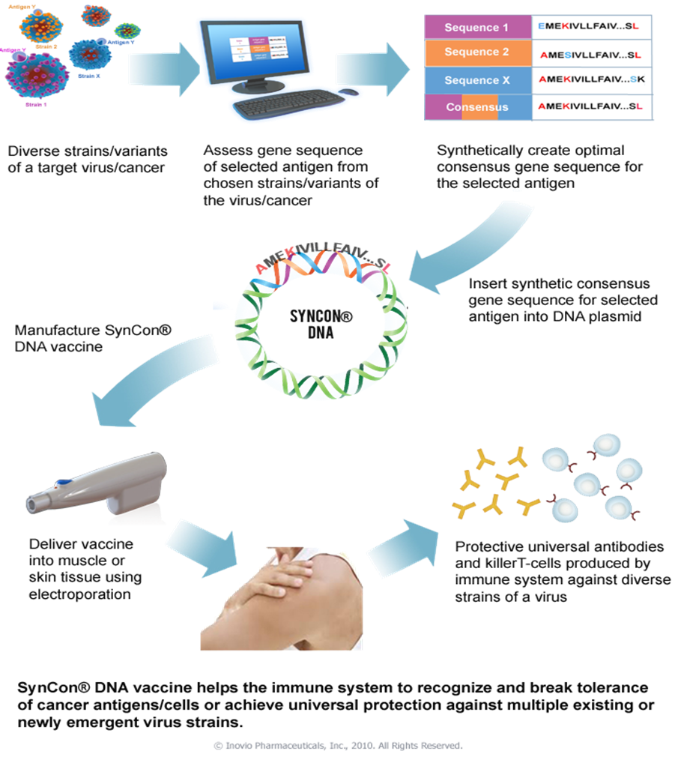

Slide 18
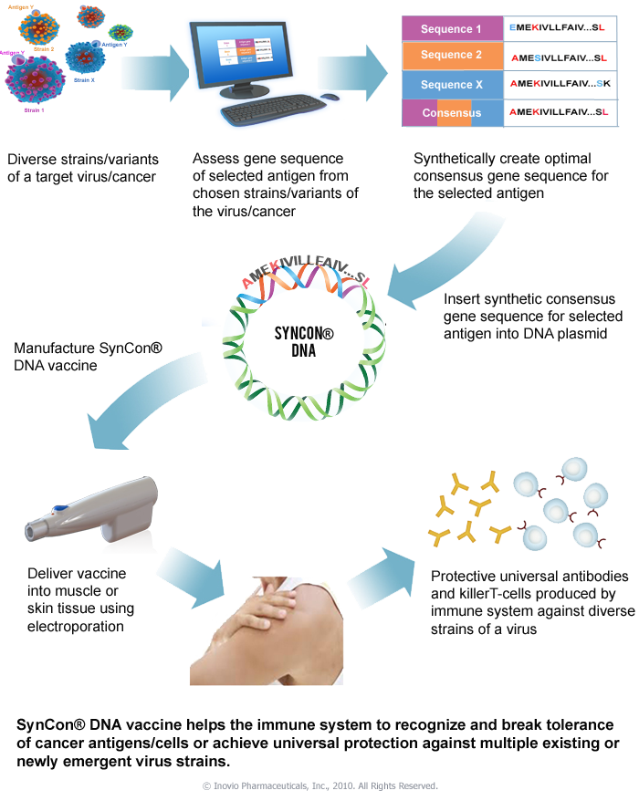
Inovio combines optimized DNA with safe & effective delivery to generate significant T cells with killing activity
Notes:
Development of an effective DNA vaccine has been elusive
One of the key barriers has been effective delivery of plasmid into the cell.
Inovio has been able to overcome this by delivering its plasmids via electroporation.
Further optimized platform by utilizing full length gene sequences that have been optimized for expression and optimized to break tolerance.

Slide 19
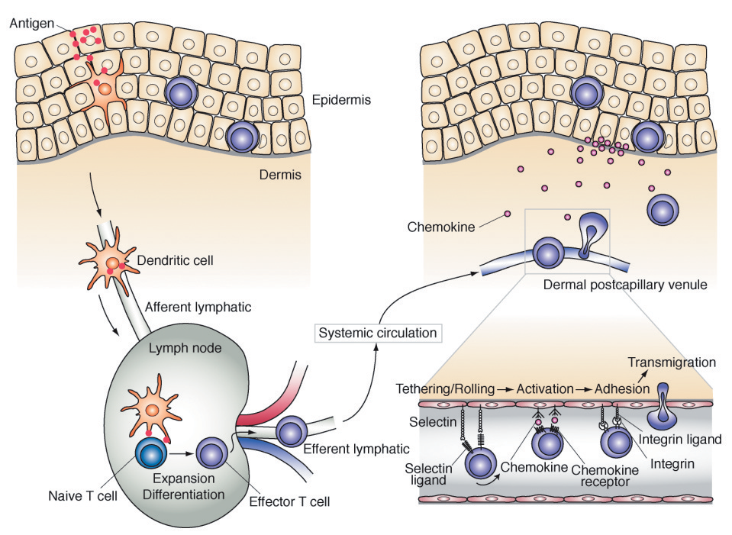

Epidermis

Slide 20
Overall Histopathologic Regression* and Virological (HPV Type 16 or 18) Clearance Incidence
Per-Protocol** Population (N=142)
Percent
VGX-3100
Placebo

Slide 21
Inovio: Fulfilling the promise of DNA Vaccines

Slide 22


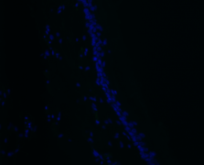
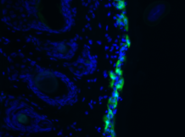


Skin EP Device – preclinical: SEP
Surface EP System
Intradermal Electroporation
pGFP
GFP
1. Mantoux injection to admin. pDNA
2. EP to allow pDNA transfection
x20
x20
GFP expression on skin surface
GFP expression in epidermis
x40
- EP
+ EP
- EP
+ EP

