Slide 1
Developing Gerontological Nursing Competencies:
An eDelphi Study
Tracey Osmond, Nicole Britten, Associate Professor Victoria Traynor & Professor Lyn Chenweth
Notes:
During this presentation I will be presenting the process we went through to develop the Gerontological Nursing Competencies and finally the competencies we achieved for use across nursing homes and community care settings.

Slide 2

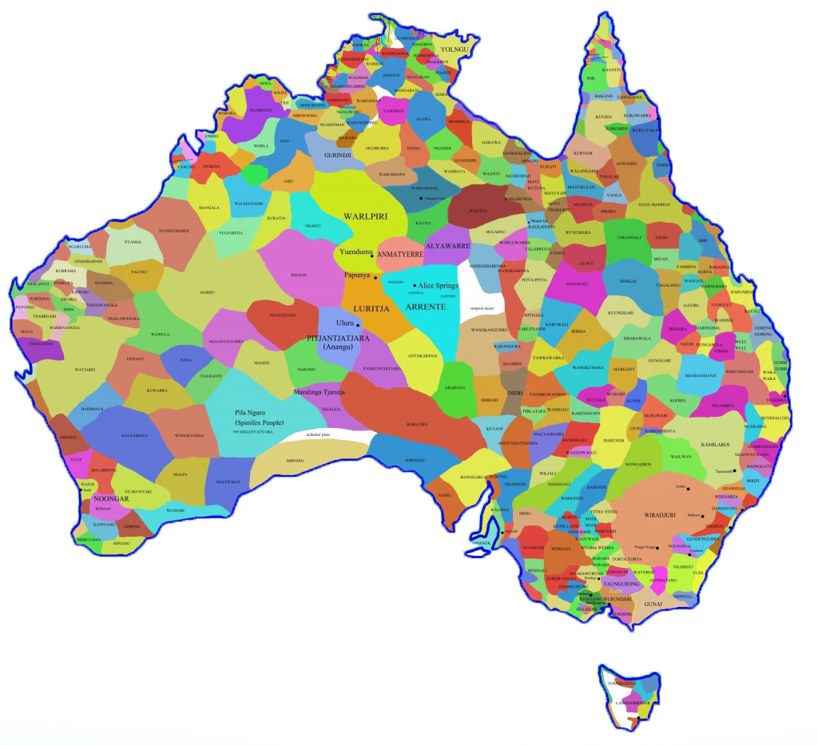
Acknowledgement of Country
Dharrawal People, Illawarra, NSW, Australia

Slide 3
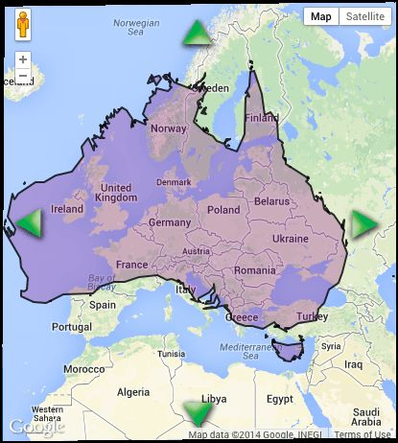
Who are we?

Slide 4

Who are we?
University
of wollongong

Slide 5


Who are we?

Slide 6





The Aged Care Collaborative

Slide 7
Aged care in Australia
What does aged care look like in Australia
Australian Bureau of Statistics (ABS 2013) predicts that by 2061 22% of the Australian population is expected to be aged 65 years or over.
Productivity Commission (2017) report the number of registered nurses has remained static

Slide 8
Aged care in Australia Collaborative
7.8%
of the Australian population aged 65 and over, or 270,559 people, were in residential aged care at some point over the 2013–14 financial year.

Slide 9


Aged care in Australia Collaborative
2 in 3
people in permanent residential aged care at 30 June 2014 (69%) were women. The average age for women was 85.8, compared to 81.6 for men.

Slide 10
Aged care in Australia
2.4%
of the Australian population aged 65 and over, or 83,481 people, received home care at some point over the 2013–14 financial year

Slide 11
Aged care in Australia
263,788
Government-subsidised operational places were available in Australian aged care at 30 June 2014, a 3.5% increase from the previous year

Slide 12
Overview of project activities
Literature Review
Workshop
eDelphi
Implementation

Slide 13
Literature Review
Workshop
eDelphi
Implementation
International literature review
Only one published in the USA
Need identified by the Aged Care Collaborative

Slide 14
Literature Review
Workshop
eDelphi
Implementation
Face to face stakeholders
Reviewed findings from literature review
Conclusion drafted list of 11 core competencies and 33 domains of practice

Slide 15
Literature Review
Workshop
eDelphi
Implementation
The study is using the principles of a eDelphi
Sample recruited using snowball technique
Circulated using Survey Monkey

Slide 16
Rounds of eDelphi
Core competencies and domains of practice
Content analysis and finalise
Attempt consensus on the statements 95% agreement gained.
Delphi round 1
Delphi round 2
Determine levels of practice for domains of practice (Essential, enhanced and expert)
Inform participants outcome from Delphi round 2
Determine levels of practice for domains of practice (Essential, enhanced and expert)
Delphi round 3
Inform participants outcome from Delphi round 3
Determine level of practice (Essential, enhanced and expert). Achieve 60% agreement on level of practice on 27 domains of practice
Delphi round 4
Delphi round 5
Finalise 9 domains of practice that we do not have 60% agreement on
Levels of practice modified (essential and enhanced)

Slide 17
eDelphi Responses
Survey Number | Number of Respondents | Number of emails sent | Response rate
Pilot | 29 | 80 | 36%
1 | 409 | 502 | 81%
2 | 247 | 619 | 40%
3 | 146 | 692 | 21%
4 | 139 | 692 | 20%

Slide 18
Participant demographics
Participation rate range 409 Round 1 to 139 round 5
Over Half the participants had post graduate qualification (57%)
Notes:
The eDelphi participation rate ranged from 409 in round 1 to 139 in round 5
Profession of respondents registered nurses (57%), managers (30%) academics (13%)
Responses came from 10 countries (90% in Australia).
Over half of the participants had postgraduate qualifications or above (56%).

Slide 19
Participant demographics
Respondents came from 10 countries:
  Australia: 93% (n=369)
  United Kingdom: 2.5% (n=10)
  USA: 2% (n=8)
  New Zealand: 1% (n=3)
  Other countries: Austria, china, India, Netherlands, United Republic of Tanzania

Slide 20
Results
Level of agreement of 98% (SD±2) on the wording of the competencies
Went from three levels of practice to two Essential and enhanced
Minimum level of agreement on level of practice being 60%
Notes:
At the conclusion of Round two we had a minimal level of agreement of 98% (SD±2) on the wording of the competencies and domains of practice
Determined after 2 rounds that there was only two levels of practice required
At the completion of the final round we had agreement above 60% for all levels of practice

Slide 21
Core competencies
CORE COMPETENCIES
1 | Living well for older people across communities and groups
2 | Maximising health outcomes
3 | Communication effectively
4 | Facilitating transitions in care
5 | Facilitating choices within legal and ethical frameworks
6 | Partnering with family carers
7 | Promoting mental health and psychological wellbeing
8 | Providing evidence-based dementia care
9 | Providing optimal pain management
10 | Providing palliative care
11 | Enabling access to technology

Slide 22
Levels of practice
Enhanced
Essential

Slide 23
Literature Review
Workshop
eDelphi
Implementation
Identify Mentor
Self Assessment
Action plan
Evidence gathering
Portfolio

Slide 24

Where to from here?
Trial implementation through the five not for profit aged care facilities
Website development
Promotion of resource
Publications
Results from implementation trial will be out mid 2018

Slide 25
Nursing in aged care collaborative members
Name | Organisation | Position
Kris Rice | Anglicare | GM Quality and Service Support
Tracey Osmond | Scalabrini Village | Director, Clinical Governance and Quality
Jolan Stokes | HammondCare | Hammond College Manager, Health and Hospitals
Susie Pairman | HammondCare | RN Professional Development
Toni Donaghy | Uniting | Learning @ Uniting Lead
Carolyn Moir | BaptistCare | Care Improvement Consultant
Donna Lennon | BaptistCare | Care Improvement Consultant
Mary McConachie | Anglicare | Quality and Compliance Manager - Residential
Elaine Griffin | Scalabrini Village | Director, People, Learning and Culture
Invitees
Victoria Traynor | UoW | Associate Professor
Nicole Britten | UoW | Project Manager
Lynn Chenoweth | UNSW | Professor of Nursing, Centre for Healthy Brain Ageing

Slide 26
Questions and
comments…

Slide 27


adhere.org.au

Slide 28

Aged and Dementia Health Research and Education (ADHERe)
Associate Professor Victoria Traynor
School of Nursing
Sciences Building 41
University of Wollongong
Northfields Avenue
Wollongong
NSW 2522
+61 (0)2 4221 3471
victoria_traynor@uow.edu.au
Tracey Osmond FACN, AFACHSM
RN, GradCert Experiential Learning, MEd
Director Clinical Governance and Quality

