Slide 1
About OMICS Group
OMICS Group International is an amalgamation of Open Access publications and worldwide international science conferences and events. Established in the year 2007 with the sole aim of making the information on Sciences and technology ‘Open Access’, OMICS Group publishes 400 online open access scholarly journals in all aspects of Science, Engineering, Management and Technology journals. OMICS Group has been instrumental in taking the knowledge on Science & technology to the doorsteps of ordinary men and women. Research Scholars, Students, Libraries, Educational Institutions, Research centers and the industry are main stakeholders that benefitted greatly from this knowledge dissemination. OMICS Group also organizes 300 International conferences annually across the globe, where knowledge transfer takes place through debates, round table discussions, poster presentations, workshops, symposia and exhibitions.

Slide 2
About OMICS Group Conferences
OMICS Group International is a pioneer and leading science event organizer, which publishes around 400 open access journals and conducts over 300 Medical, Clinical, Engineering, Life Sciences, Phrama scientific conferences all over the globe annually with the support of more than 1000 scientific associations and 30,000 editorial board members and 3.5 million followers to its credit.
OMICS Group has organized 500 conferences, workshops and national symposiums across the major cities including San Francisco, Las Vegas, San Antonio, Omaha, Orlando, Raleigh, Santa Clara, Chicago, Philadelphia, Baltimore, United Kingdom, Valencia, Dubai, Beijing, Hyderabad, Bengaluru and Mumbai.

Slide 3
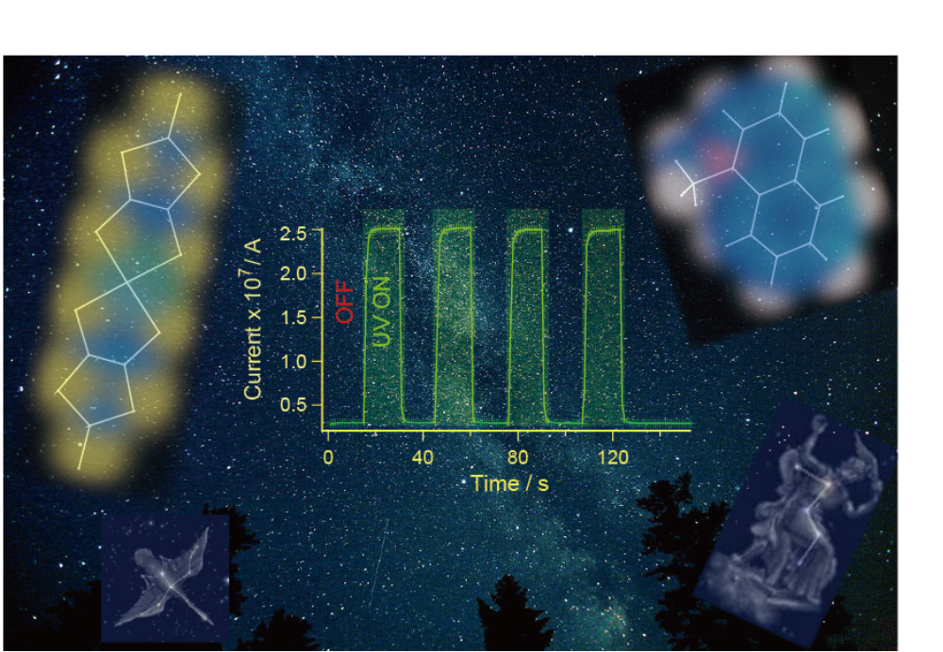
Giant Photoconductivity in Organic Materials by UV Irradiation
Toshio Naito
Ehime University

Slide 4

・ Found in Se (1870’s)
・ Explained (1930’s)
・ Applied to Electronics (1950’s)
Photoconductors
ex. CdS, PbS, etc
Conduction Band
e⁻
e⁻
Photoconductor
hν (> E_{g})
Battery
Battery
Valence Band
Applied to
various imaging & sensor devices
ex.) Laser Printer, Photocopy, Solar Cell, Sensor, CMOS, etc
New (additional) Functions
Information / Communication Technology

Slide 5
Purpose
New PCs with additional functions*
Wavelength-selectivity of response
Different responses to different wavelengths
Photo-magnetic-conductors
etc
New Mechanism
*
・・・・・
・・・・・
Standard mechanism of photoconductivity
2+
(2+δ)+
A
-
A
Charge disproportionation
(e.g.) AX
δe
2+
(2-δ)+
A
A
2+
(2+δ)+
A
A
Cation A
or
Anion X
e⁻
2+
(2-δ)+
LUMO
A
hν
A
2+
(2+δ)+
A
A
hν
2+
(2-δ)+
A
A
Cation A
or
Anion X
(2+δ)+
2+
A
h⁺
HOMO
A
・・・・・
・・・・・

Slide 6
Our strategy
Merits
NO disproportionation
(for high conductivity)
Standard mechanism
Proposed (New) mechanism
(Localized spins)
Cation
or
Anion
Anion
or
Cation
e⁻
e⁻
(1-δ)+
(1+δ)-
Cat
An
hν
hν
Cation
or
Anion
Cation
or
Anion
Cat
(1+δ)+
Cat
(1+δ)+
h⁺
h⁺
A-A or C-C Charge Transfer (CT)
C-A Charge Transfer (CT)

Slide 7
C[Ni(dmit)₂]_{X}
Abbre.
C (= Cations)
X ref
2
（α−, β−）
MV
Adv. Mater.,
6153 (2012)
BPY
2, 6
JACS
18656 (2012)
NMQ
1
（α−, β−）
Eur. J. Inorg.
Chem. (2014)
DiCC
1
（ α−, β− ）
Chem. Lett.
1119 (2014)

Slide 8
[Ni(dmit)₂]⁻ salts
Conductivity Ratio ( R_{C} )
R_{C}
Carrier Doping
(A⁻ C⁺ A^{(1-δ)-} C^{(1-δ)+})
Charge Disproportionation
(A⁻ A⁻ A^{(1-δ)-} A^{(1+δ)-})
=
Photoconductivity (σ_{ph})
Dark conductivity (σ_{dark})
δe⁻
δe⁻
C-A CT
A-A CT
(Almost) No CT
MV
BPY
DiCC
(n-C₄H₉)₄N
Ru(bpy)₃
・・・・
Cations
NMQ
R_{C}
10-1000
40-880
< 2-3

Slide 9
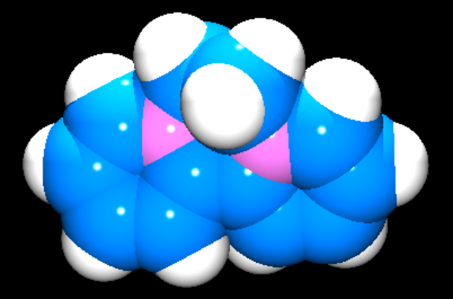
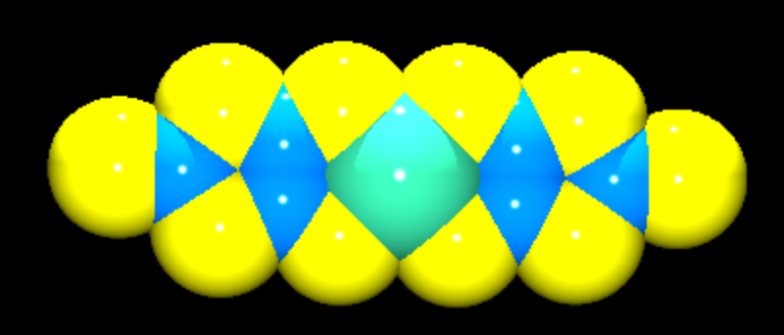
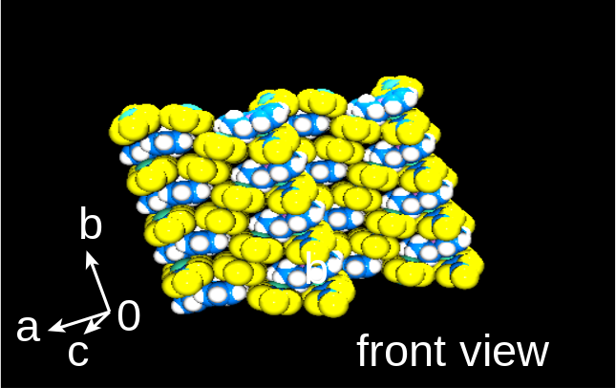
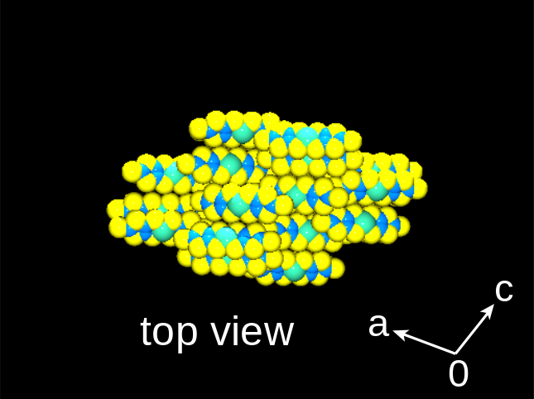
C-A CT
BPY²⁺
[Ni(dmit)₂]⁻
[Ni(dmit)₂]⁻ = conduction

Slide 10
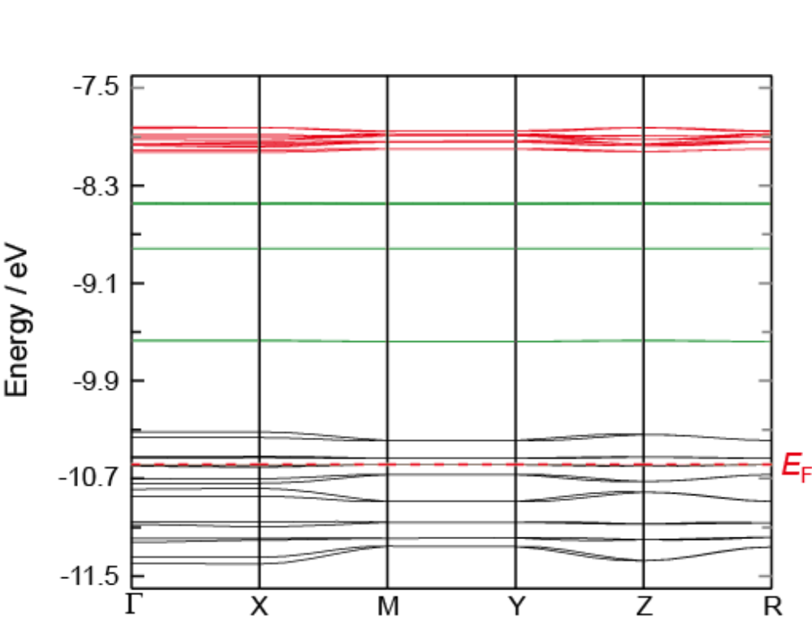
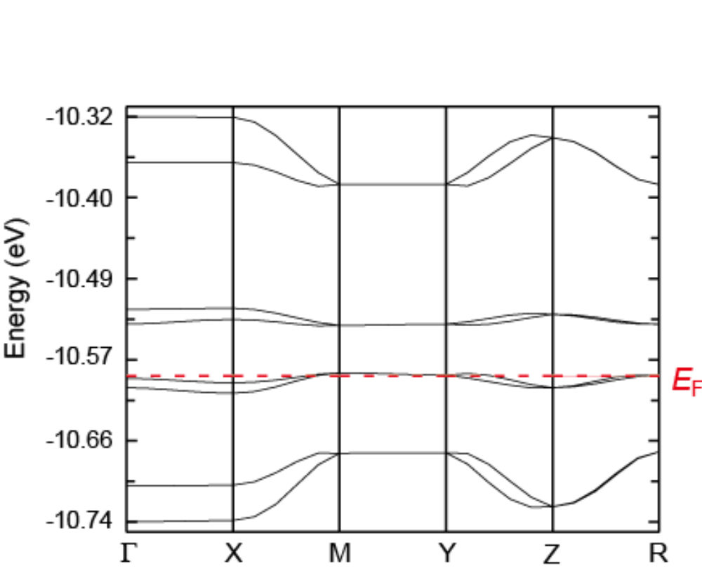
BPY[Ni(dmit)₂]₂ Band Calculation（ Extended Hückel Method ）
Red（16 bands）；
（e.g.）～37% [Ni(dmit)₂]⁻
Green； ～100% BPY²⁺
Black； ～100% [Ni(dmit)₂]⁻
Anion-Cation Mixed Bands
UV
(～ a few eV)

Slide 11
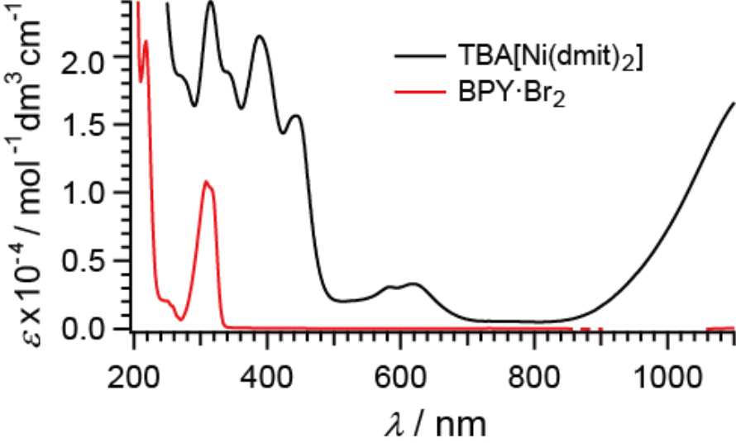
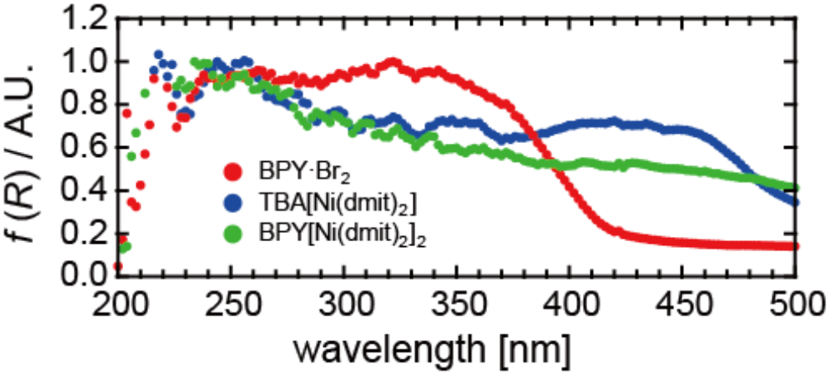
BPY[Ni(dmit)₂]₂ Solid State & Solution Spectra
Solution
（Absorption）
Solid State
（Diffuse
Reflection）

Slide 12
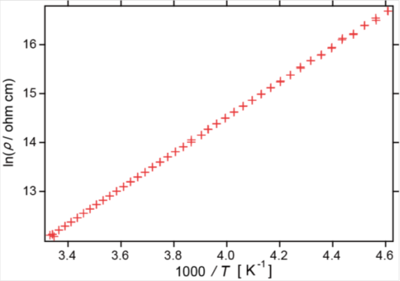
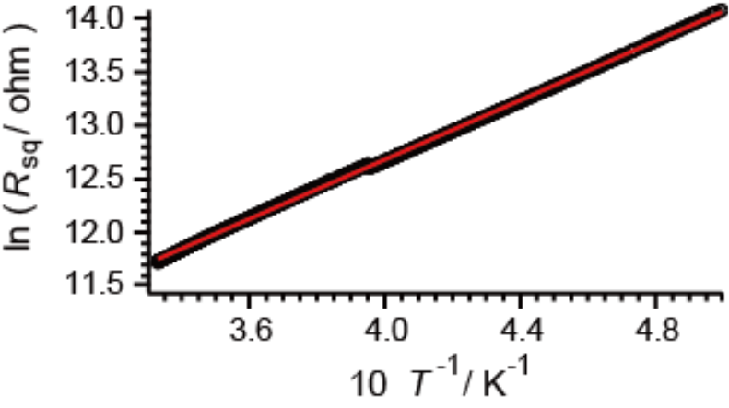
A[Ni(dmit)₂]₂
Conduction
Ground state = insulating
(A = BPY, MV)
（Single Crystal）
（dark）
+
+
MV
E_{a} = 0.28 eV
(ρ_{RT} = 2×10⁵ Ω cm)
E_{a} = 0.12 eV
(ρ_{RT} = 63 Ω cm)
Thermally activated behavior

Slide 13
A[Ni(dmit)₂]₂ Conduction
Ground state = insulating
(A = BPY, MV)
（Single Crystal）
（dark）
+
+
MV
E_{a} = 0.28 eV
(ρ_{RT} = 2×10⁵ Ω cm)
E_{a} = 0.12 eV
(ρ_{RT} = 63 Ω cm)
Thermally activated behavior
E_{g} (cond) = 0.24 eV
E_{g} (cond) = 0.56 eV
cf. E_{g} (band) ~ 0.06 eV
cf. E_{g} (band) ~ 0.05 eV

Slide 14
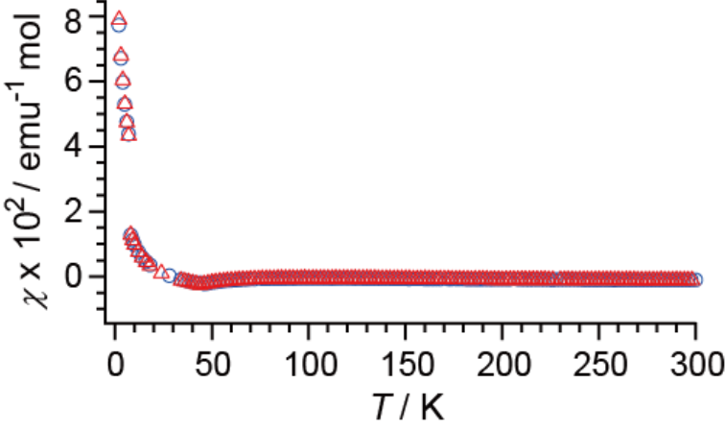
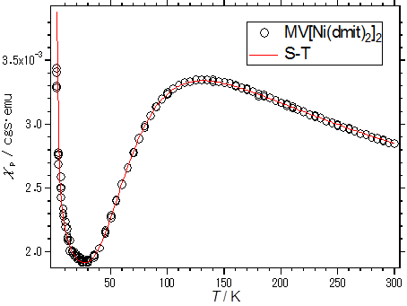
A[Ni(dmit)₂]₂
Mag. Susceptibility
（Polycrystal）
(A = BPY, MV)
Ground state = diamagnetic
(non-magnetic)
+
+
dark
MV
χ ∼ − 1 × 10⁻³ emu mol⁻¹
J_{AF} ～ 110 K

Slide 15
A[Ni(dmit)₂]₂ Mag. Susceptibility
（Polycrystal）
(A = BPY, MV)
Ground state = diamagnetic
(non-magnetic)
+
+
dark
MV
χ ∼ − 1 × 10⁻³ emu mol⁻¹
J_{AF} ～ 110 K
(e.g.) MV
E_{g} (cond) = 0.56 eV
E_{g} (mag) ～ 0.02 eV
E_{g} (band) ~ 0.05 eV

Slide 16
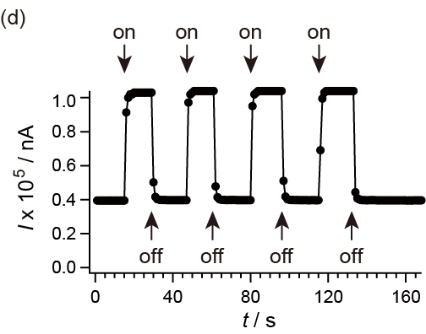
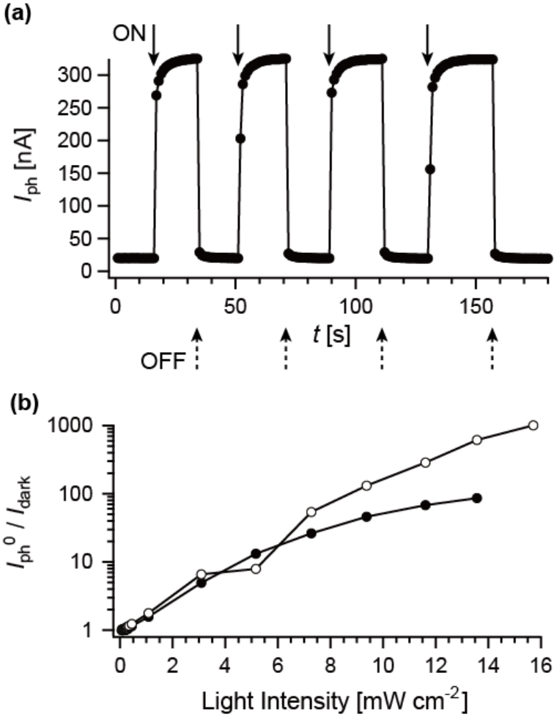
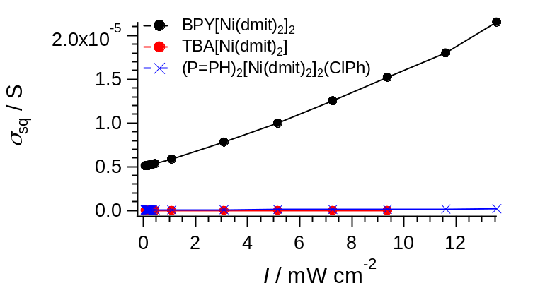
A[Ni(dmit)₂]₂ ; photoconductivity
（Single Crystal）
（375 nm, 11.6 mW cm⁻² , 300 K, in vacuo）
A = MV²⁺
A = BPY²⁺
UV
UV
Photoconduction is negligible
in many Ni(dmit)₂ salts.
UV
Comparison
(375 nm)
200 K
（BPY salt）
300 K
(n-C₄H₉)₄N salt
10⁻¹⁰ S
（σ_{ph}/σ_{dark} ≤ 2）

Slide 17
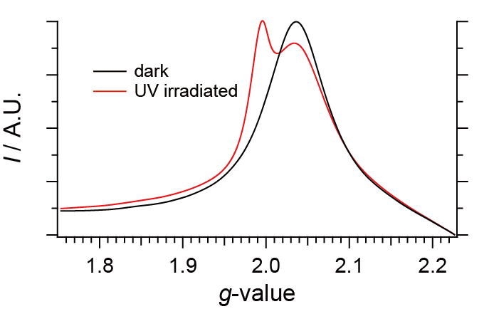
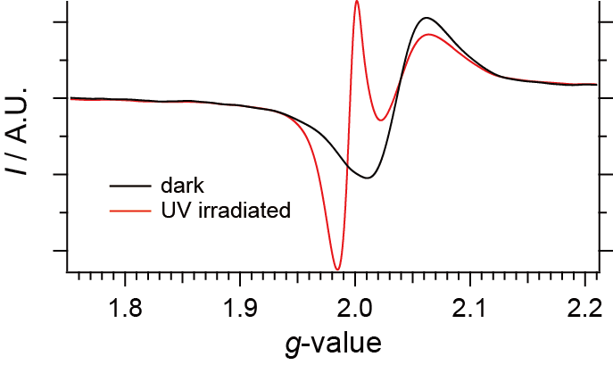
A[Ni(dmit)₂]₂ ESR
（single crystal, ）
H ⊥ [010]
under dark
under UV
A = BPY²⁺
BPY²⁺
153 K
[Ni(dmit)₂]⁻
(integrated)
BPY²⁺
[Ni(dmit)₂]⁻
hν
hν

Slide 18
A[Ni(dmit)₂]₂ ESR
（single crystal, ）
H ⊥ [010]
< under dark vs. under UV >
A = BPY²⁺
BPY²⁺
153 K
[Ni(dmit)₂]⁻
(integrated)
BPY²⁺
[Ni(dmit)₂]⁻
hν
hν
-
e
UV
[Ni(dmit)₂]⁻ + BPY²⁺ [Ni(dmit)₂]^{(1-δ)-} + BPY^{(2-δ)+}
δ ≅ 0.1
(Consistent with band calc. & UV spectra)

Slide 19
A[Ni(dmit)₂]₂ ; photoconductivity – I- & T-dependences
（Single Crystal）
（375 nm, in vauo）
C-A CT type salts
New Features in Photoconduction σ
(1) σ = σ_{dark} + aI + bI²
(I : light intensity)
(2) Wavelength selectivity (Responsive ONLY to ～250-450 nm)
C-A CT bands
Photoconduction mechanism is different from the known mechanism

Slide 20
[Ni(dmit)₂]⁻ salts
Conductivity Ratio ( R_{C})
R_{C}
Photoconductivity (σ_{ph})
Dark conductivity (σ_{dark})
C-A CT
A-A CT
(Almost) No CT
MV
BPY
DiCC
(n-C₄H₉)₄N
Ru(bpy)₃
・・・・
Cations
NMQ
R_{C}
10-1000
40-880
< 2-3
(RT) (200 K)

Slide 21
A-A CT-based PC
( A = Anion, C = Cation )
(A)
NMQ[Ni(dmit)₂]*
Unique PC
Sharp wavelength-selectivity
Large
(Only ~ 375 nm)
unusually
(C)
σ_{UV} / σ_{dark}
(eg. ~ 40 @300 K, ~ 880 @200 K)
* (in regard to synthesis, crystal structure, and dark conductivity)
J. P. Cornelissen, et al. Inorg. Chim. Acta 1991, 185, 97-102.

Slide 22
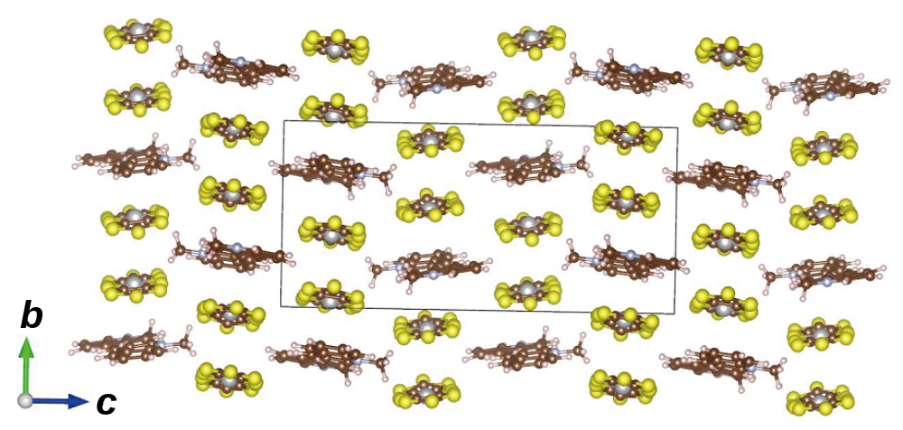
Crystal Structure
ca. 0.121 eV
[Ni(dmit)₂]⁻
NMQ⁺
ca 0.012 eV
Negligible C-A interactions

Slide 23
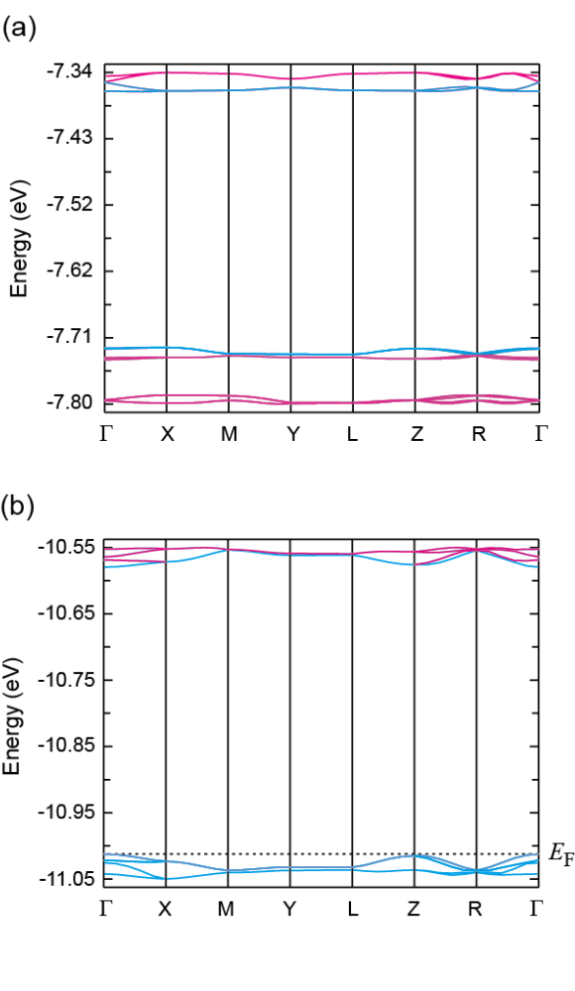
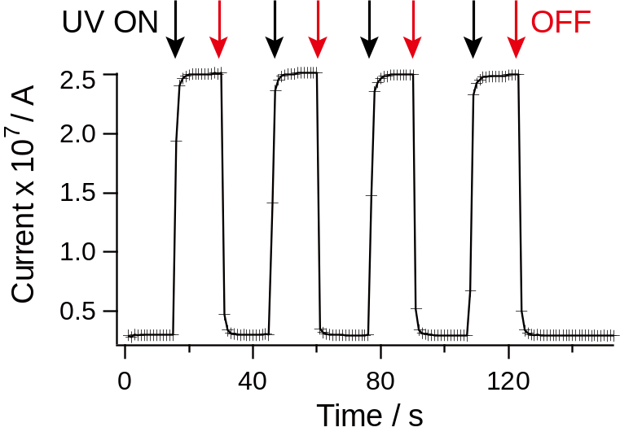
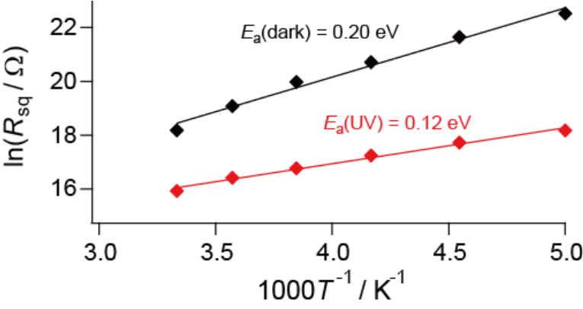
Band Structure & Conductivity
Ni(dmit)₂ band
NMQ
band
300 K
375 nm
11.6 mWcm⁻²
DC 2 V
2-probe
X 40
E_{a} (dark) = 0.20 eV
375 nm
(3.3 eV)
E_{a} (UV) = 0.12 eV

Slide 24
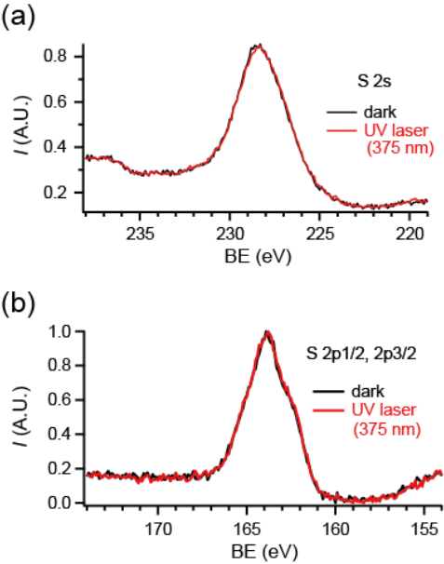
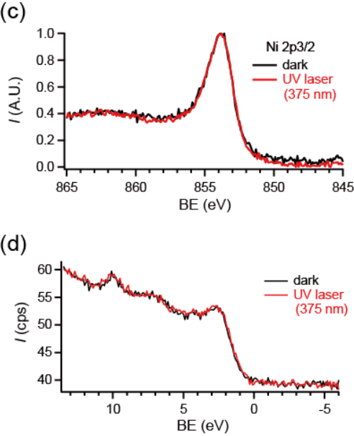
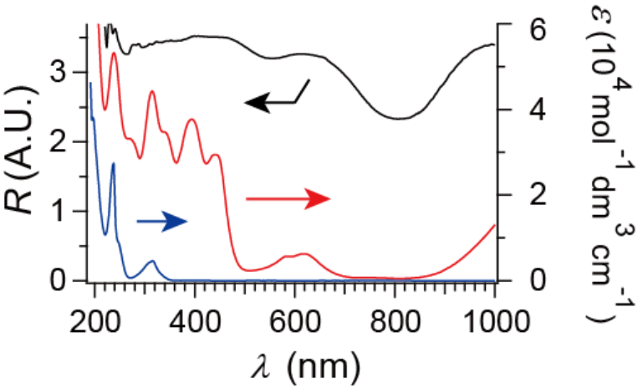
XPS & UV-Vis-NIR Spectra
Ni 2p
S 2s
(375 nm)
C-A
S 2p
E_{F}
A-A
C-C
Under UV-irradiation (375 nm)
Under dark
NMQ[Ni(dmit)₂] (powder)
(C₄H₉)₄N[Ni(dmit)₂] (in CH₃CN)
NMQ·I (in CH₃CN)
XPS (Ni, S, E_{F}) do NOT change
(under dark and UV)
CT between A-A (not C-A or C-C)

Slide 25
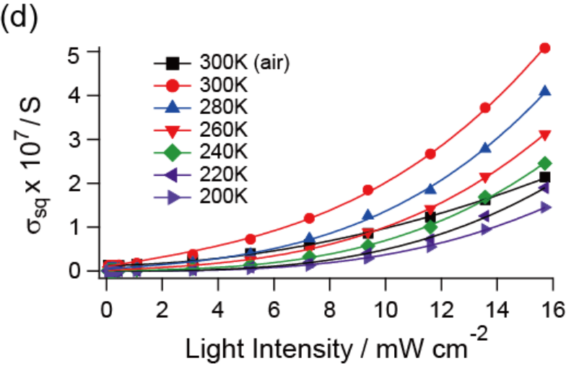
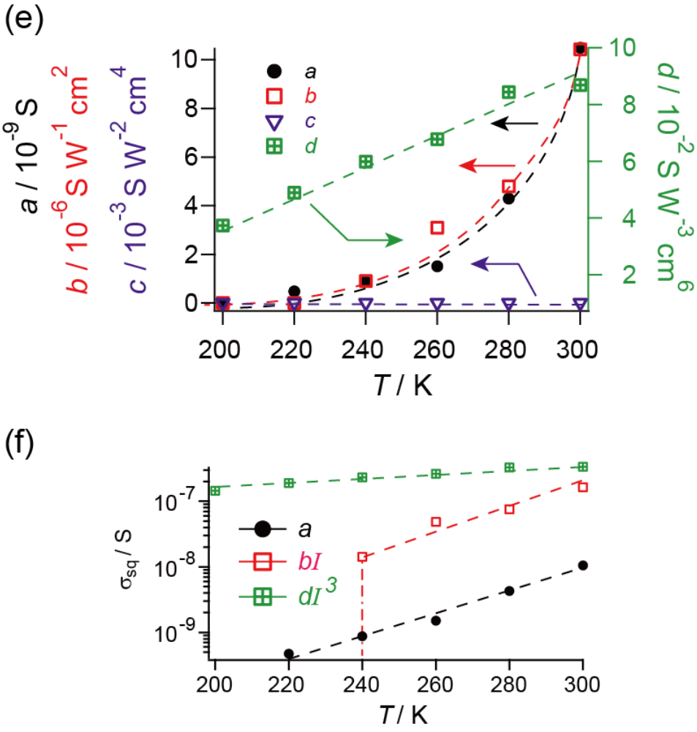

New contribution in PC
(I)
= 0
R_{C} ≅ 880
σ
$$σ_{sq}=a+bI+cI^{2}+ dI^{3}$$
Ph, new
σ
Ph, std
σ
σ
dark
Ph, new
Σ
σ
σ
σ
dark
Ph, std
sq
R_{C} =
2nd photoconduction
σ
dark
( I = 15.71 mW cm⁻² )

Slide 26
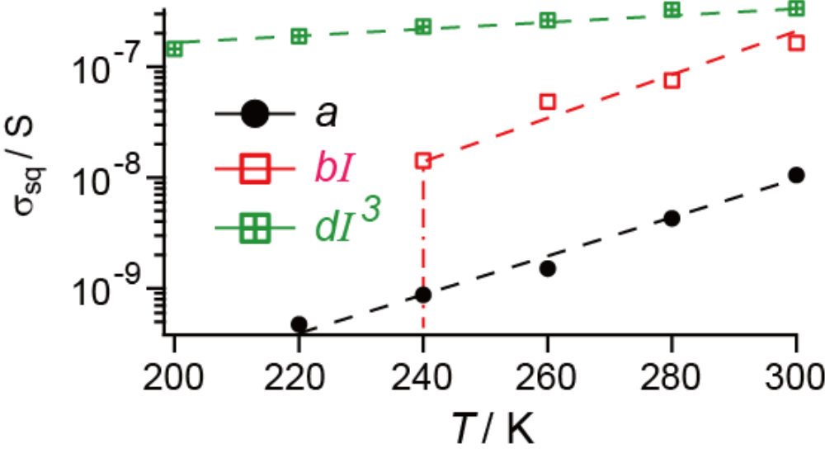

Summary; A-A CT
On the verge (or in the middle) of melting of charge-ordered state?
NMQ[Ni(dmit)₂]
σ (ph) / σ (dark) = 40 (RT) − 880 (200 K)
(15.7 mWcm⁻²)
Remains to be clarified
Coexistence of three kinds of (photo)conduction
$$σ_{sq}=a+bI+dI^{3}$$
σ
Ph, new
σ
Ph, std
σ
dark

Slide 27
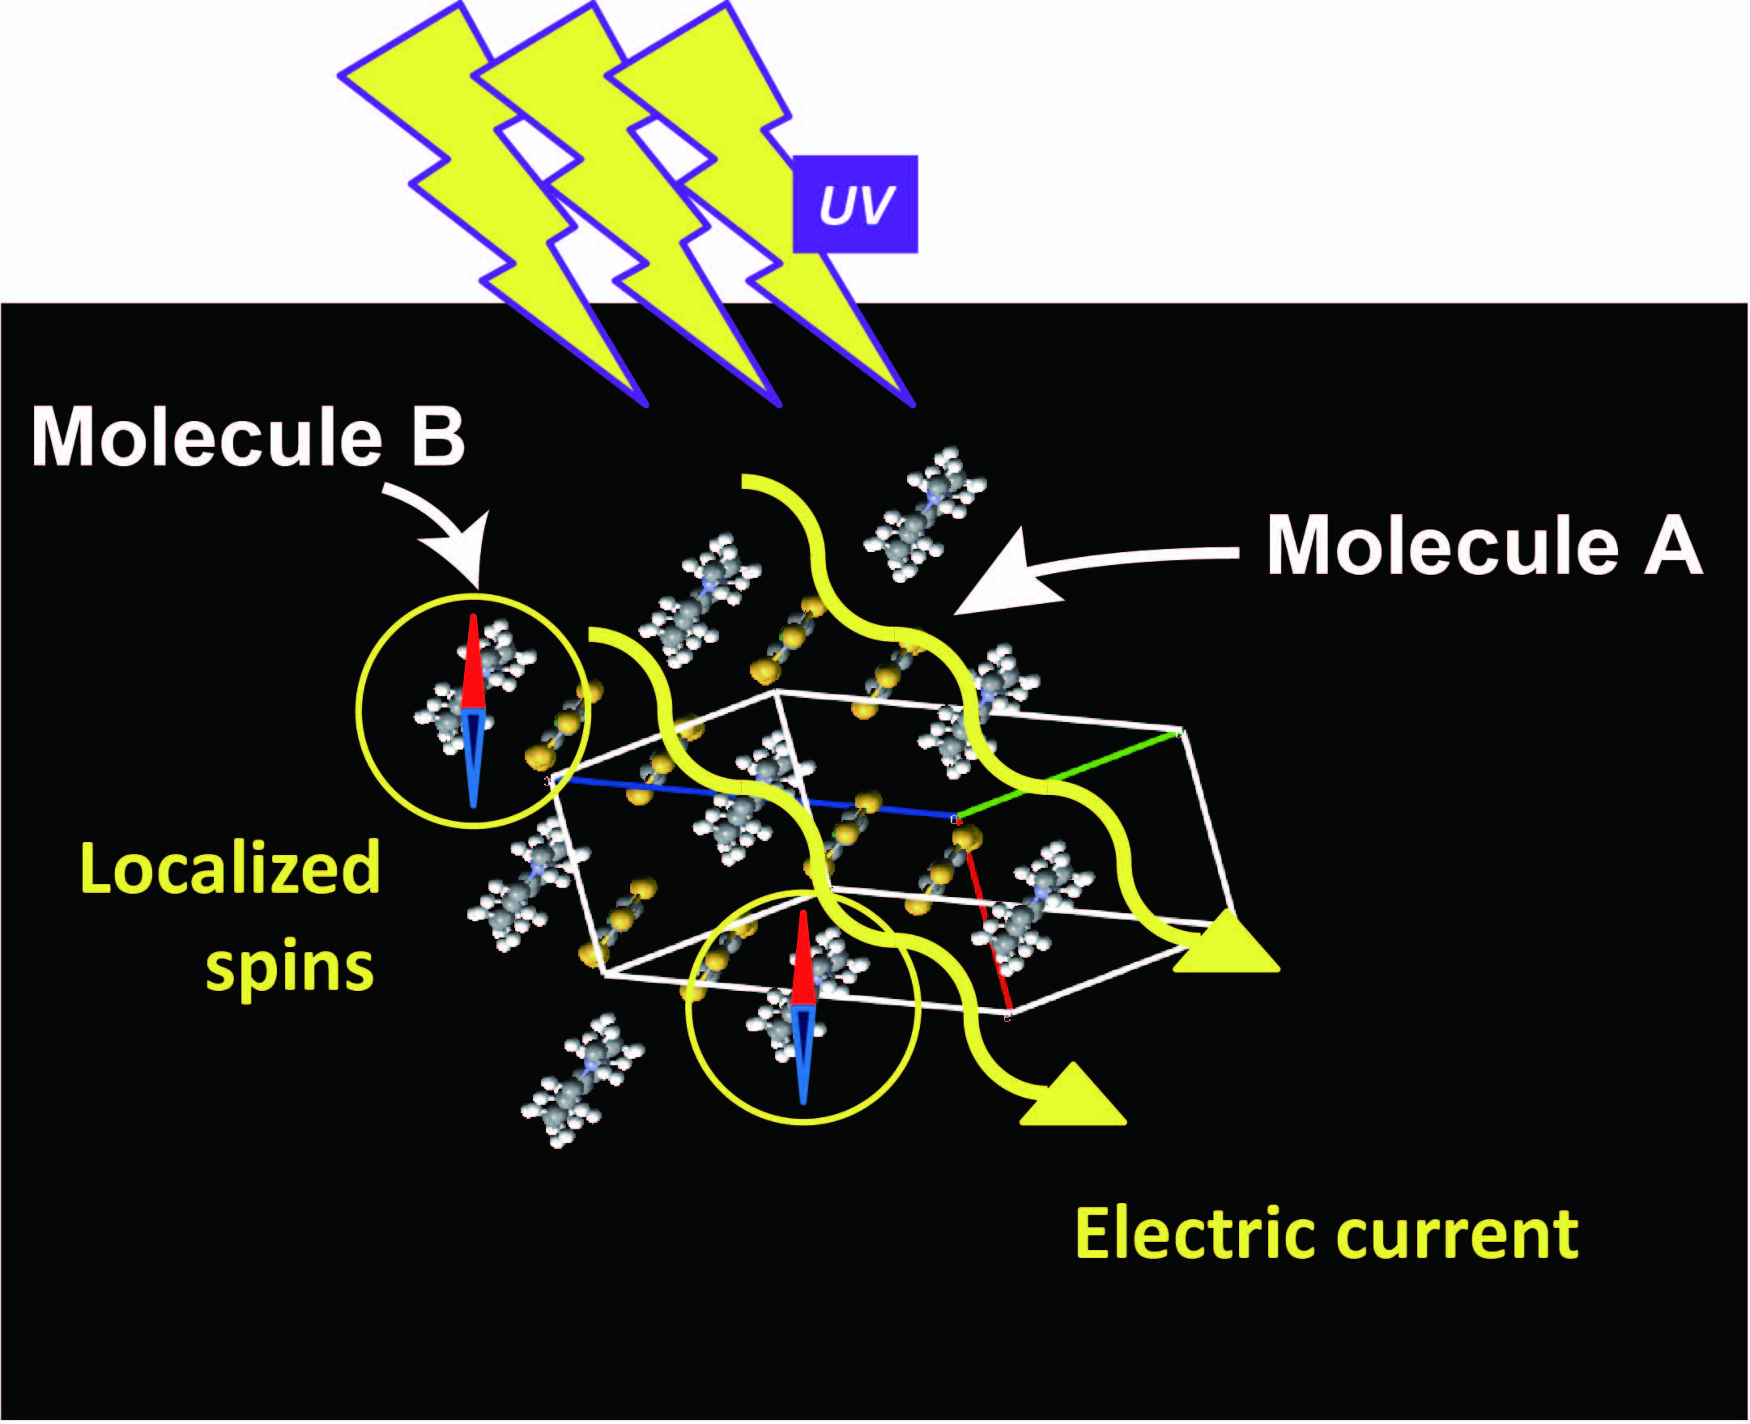
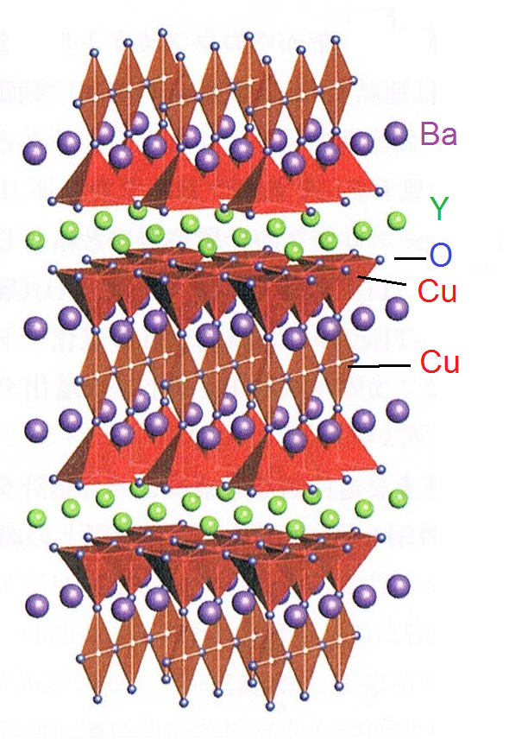
Optical Doping
MV[Ni(dmit)₂]₂
YBa₂Cu₃O_{7-δ} (T_{C} = 90 K)
Chemical doping → Metastable State
（930 ºC、5 h ） → Oxygen deficiency （irrev.）
Irradiation → Photoexcited State
→ CT trans. （rev.）

Slide 28
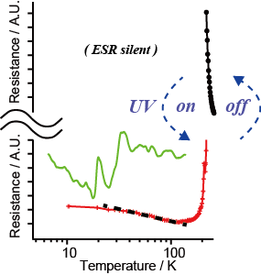
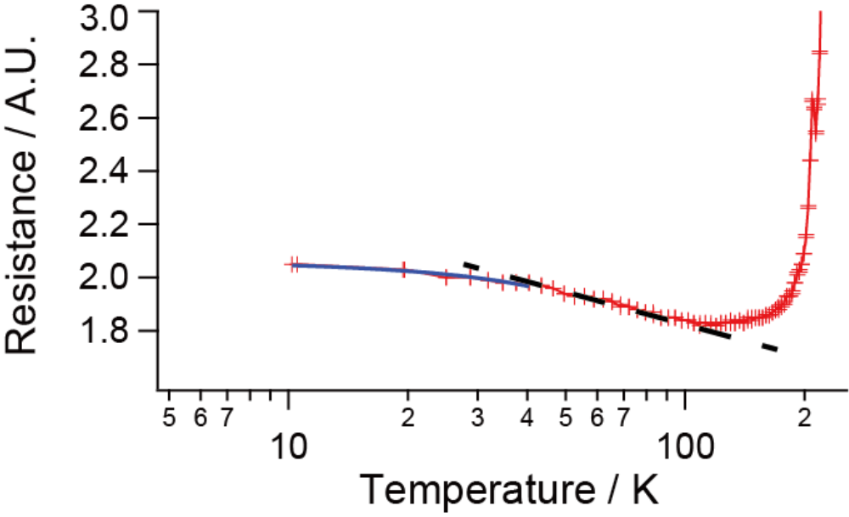
Photomagnetic conductors
2
∝ log T
∝ T
(Possible Kondo Effect under UV)
T. Naito et al, Adv. Mater., 24 (46), 6153-6157 (2012)
T. Naito et al, J. Am. Chem. Soc., 134(45), 18656-18666 (2012)

Slide 29

Acknowledgments
Collaborators
Thank you
Mr. T. Karasudani, Dr. S. Mori, Porfs. K. Ohara, K. Konishi
& T. Yamamoto (Ehime University)
Mr. T. Takano, Dr. Y. Takahashi, Prof. T. Inabe (Hokkaido University)
Profs. S. Nishihara & K. Inoue (Hiroshima University)
Profs. K. Furukawa* & T. Nakamura (IMS) (*present Niigata Univ.)
Financial Support JSPS (No. 23540432)
Ito Science Foundation
Japan Securities Scholorship
Ehime Univ. GP
Ehime Univ. Grant for Interdisciplinary Research

Slide 30
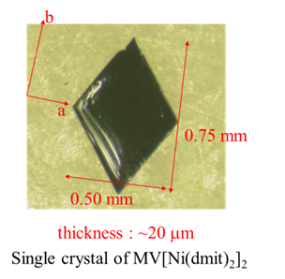
Synthesis（Crystallization）
Step 1
BPY·Br₂
A[Ni(dmit)₂]_{X}
Step 2
(n-C₄H₉)₄N[Ni(dmit)₂] (10 mg) / CH₃CN (20 ml)
BPY·Br₂
(10 mg) / CH₃CN (20 ml)
A
X
2
filtration
filtration
(MV²⁺)
T. Naito et al, Adv. Mater. 24, 6153 (2012)
Container（50 ml；sealed）
Stand still（20ºC, dark）
2, 6
a few days –
a few weeks
(BPY²⁺)
（shiny platelets ）
T. Naito et al., J. Am. Chem. Soc. 134, 18656 (2012)

Slide 31
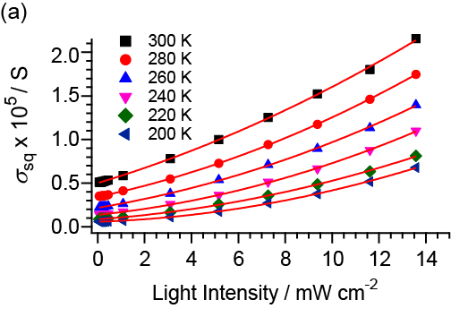
Case 1; D-A CT (3)
< ESR under dark vs. under UV >
New Features for PC
BPY
Non-linear behavior
153 K
Ni(dmit)₂
375 nm
T. Naito et al, J. Am. Chem. Soc., 134(45), 18656-18666 (2012)

Slide 32
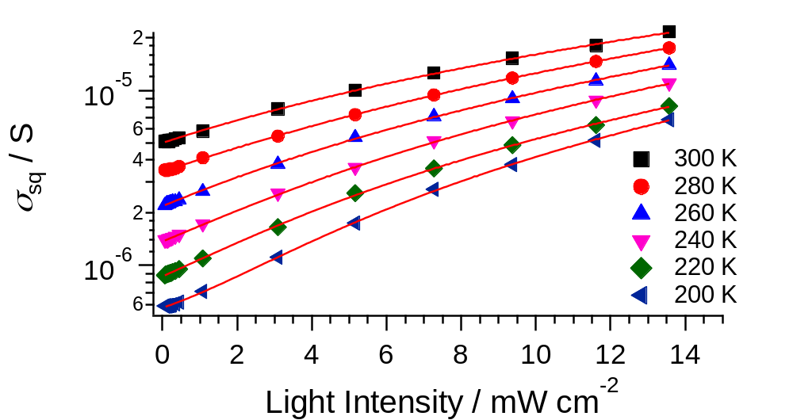
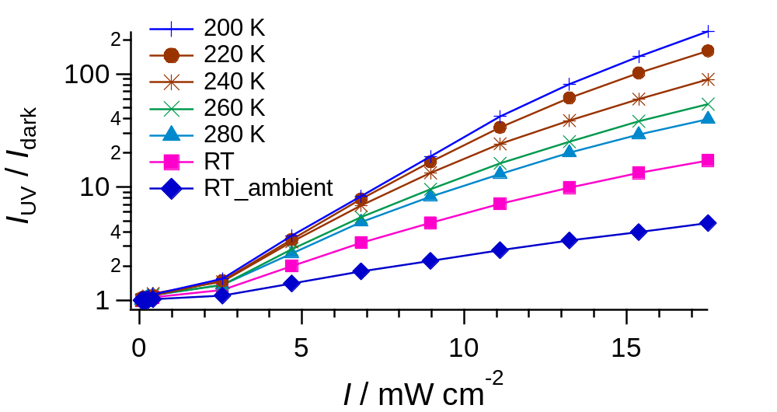
BPY
∞
n
x
x
e =
Σ
n = 0
n!
MV

Slide 33
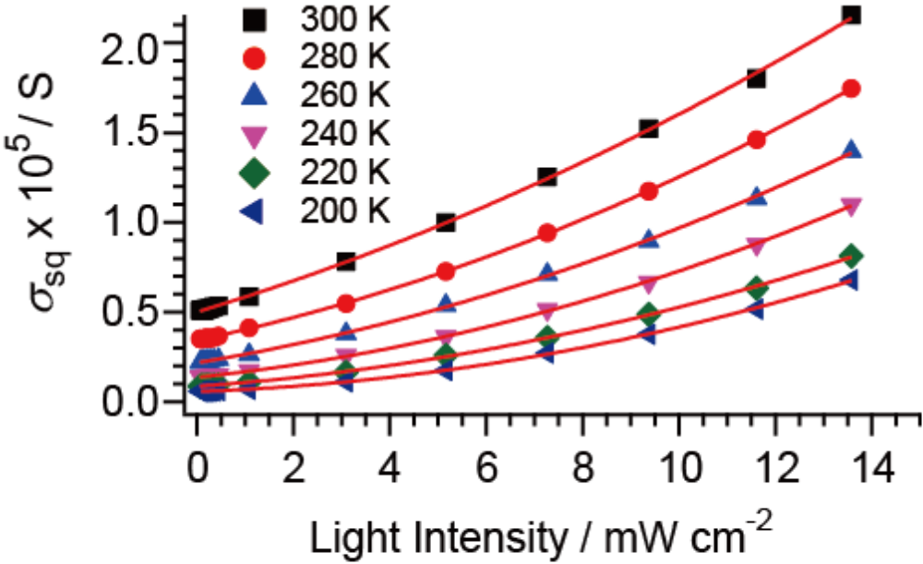
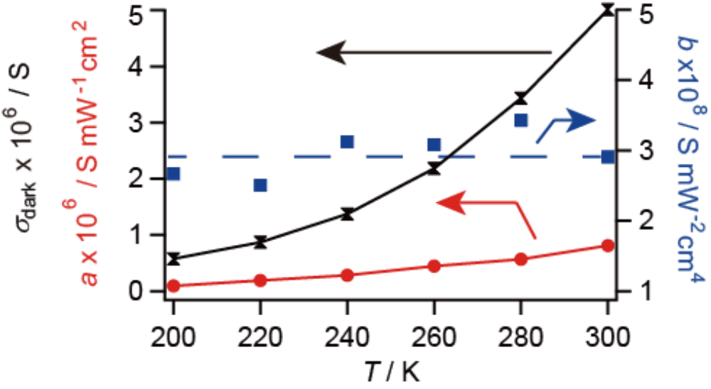
A[Ni(dmit)₂]₂ ; photoconductivity – I- & T-dependences
A = BPY
（Single Crystal）
（375 nm, in vauo）
σ_{sq} = σ_{dark} + aI + bI²
bI ² : Nearly T-independent
1. Thermally inaccessible to the dark states
2. Metallic conduction
aI : known/standard mechanism
bI ² : a new mechanism
σ : Non-linear dependence on I
Importance of cooperative effect*
* Yonemitsu, K. J. Phys. Soc. Jpn. 2004, 73, 2868-2878.

Slide 34
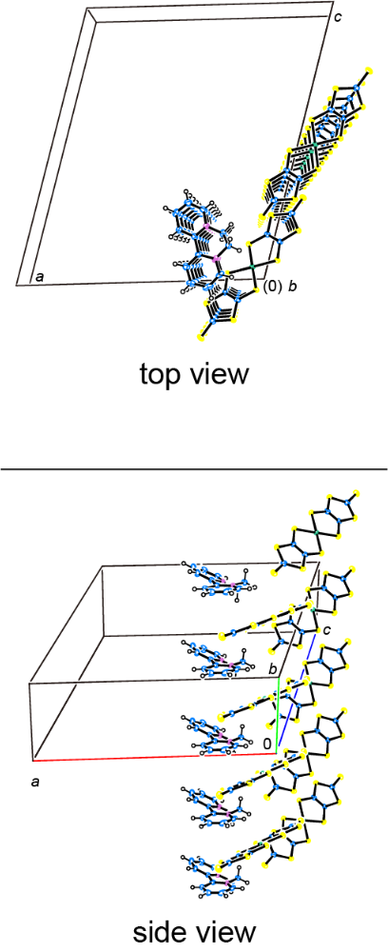
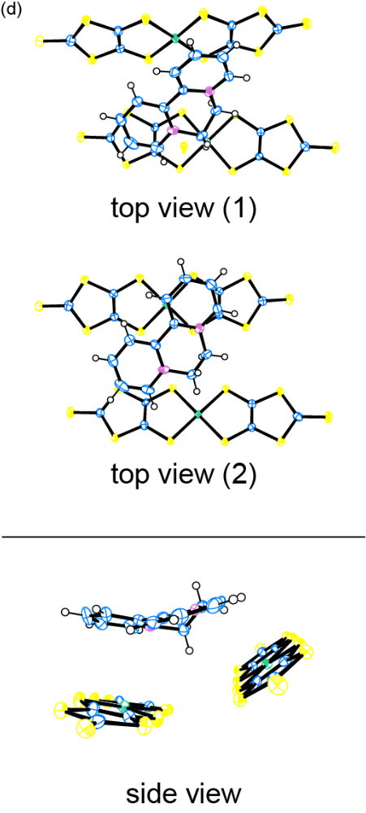
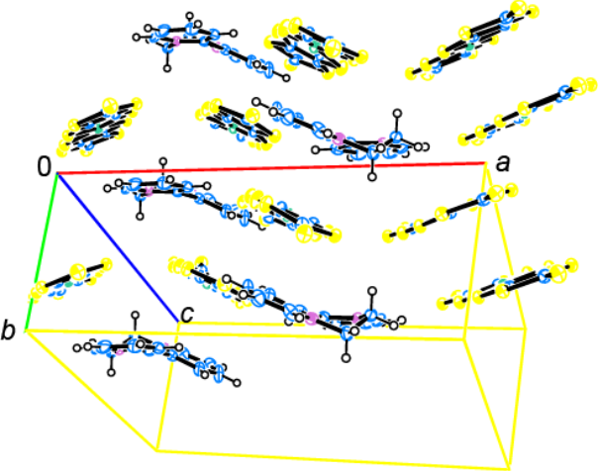
2+
1-
BPY[Ni(dmit)₂]₂
c
S = 0
S = 1/2
0
a
(0) b
b
c
a
Monoclinic, P2₁/c (#14) (MV)
a = 20.856(5) Å (11.4125(9) Å)
b = 7.466(2) Å β = 105.585(4)º
c = 24.162(7) Å
V = 3624(2) Å³ (1882.7(3) Å³)
Z = 4 (Z = 2)
～3.4 Å
～3.5 Å
c
b
a
0
JACS, 18656 (2012)

Slide 35
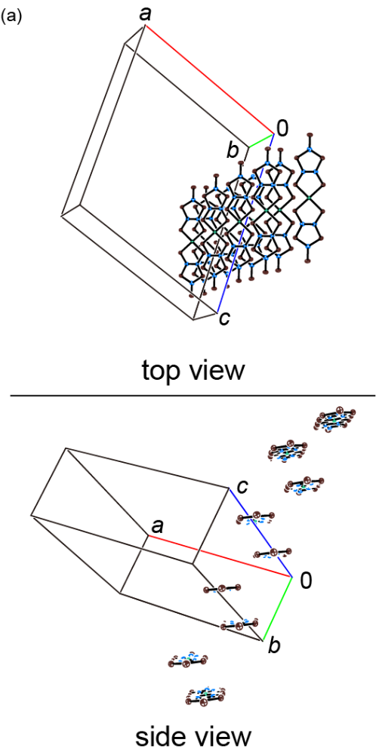
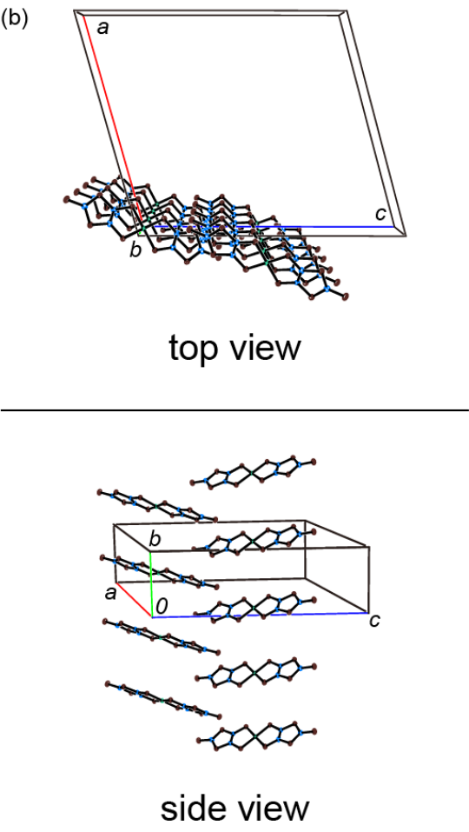
BPY[Ni(dmit)₂]₂
a
b
0
a
c
0
c
b
c
a
0
b
a
b
c
0
JACS, 18656 (2012)

Slide 36
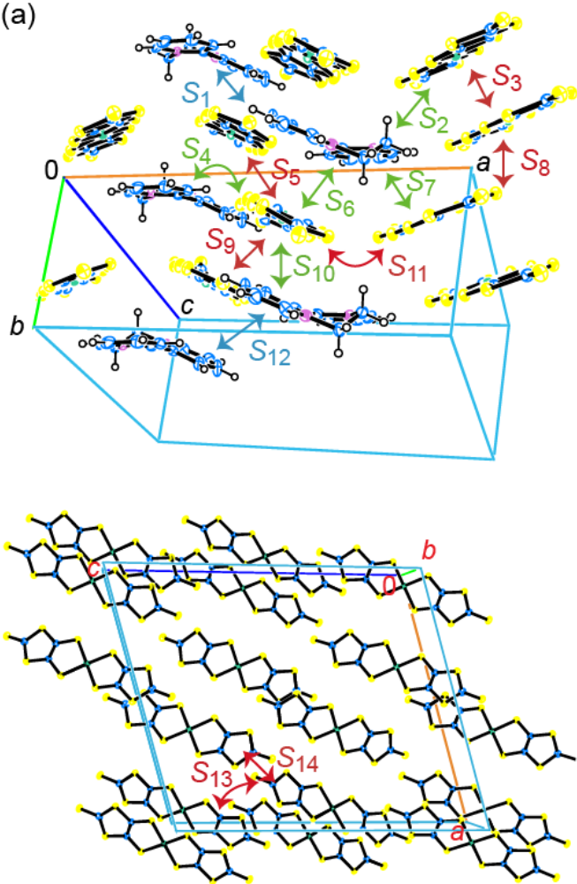
BPY[Ni(dmit)₂]₂ Intermolecular Interactions （Extended Hückel Method）
Ni(dmit)₂-Ni(dmit)₂
BPY-Ni(dmit)₂
S₃ ～ 0.015
S₂, S₆～ 0.001
S₉ ～ - 0.004
S₇～ 0.002
S₁₀～ 0.009
S₅, S₈ ～ 0.002
S₁₁, S₁₃, S₁₄ ≤ 0.001

Slide 37

BPY[Ni(dmit)₂]₂ Band Calculation（ Extended Hückel Method ）
Red：（e.g.）～37% Ni(dmit)₂
Green：～100% BPY
Black：～100% Ni(dmit)₂
Feat. 1) Anion-Cation Mixed Bands
3 eV
(400 nm)
(Fermi level)
JACS, 18656 (2012)

Slide 38
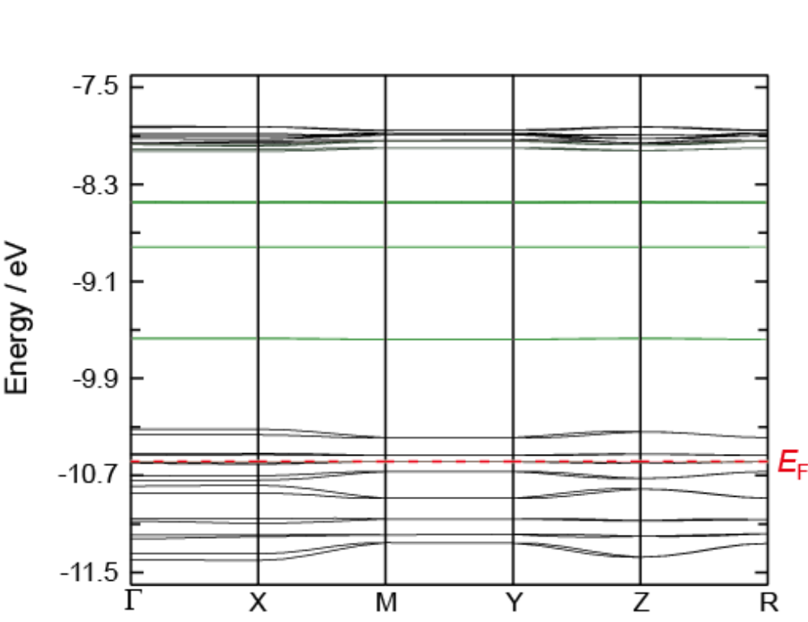
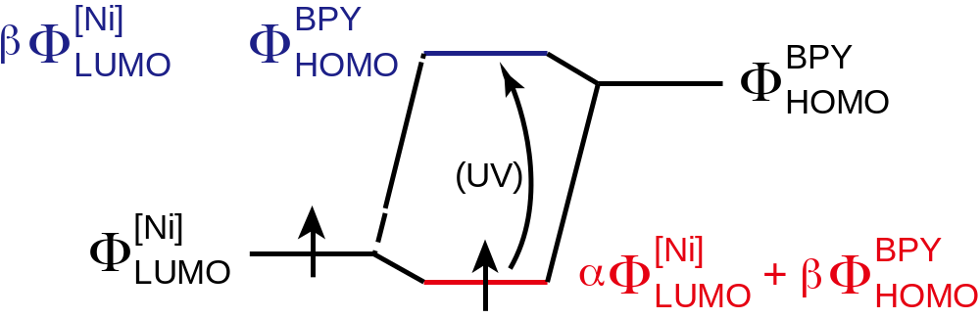
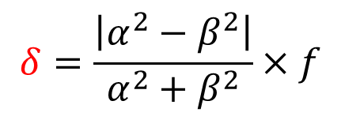
BPY[Ni(dmit)₂]₂ Band Structure（ Calc. Extended Hückel Method ）
Feat. 2) Interband transitions = CT between anion and cation
$$δ=\frac{\left|α^{2}−β^{2}\right|}{α^{2}+β^{2}}×f$$
[Ni(dmit)₂]⁻ → [Ni(dmit)₂]^{(1-δ)-}

Slide 39
BPY[Ni(dmit)₂]₂ Band Structure（ Calc. Extended Hückel Method ）
Black：Ni(dmit)₂
Green：BPY
Feat. 3) CT ∈ UV region (~ a few eV)
Primary contribution
e.g.) 3 eV
(400 nm)

Slide 40
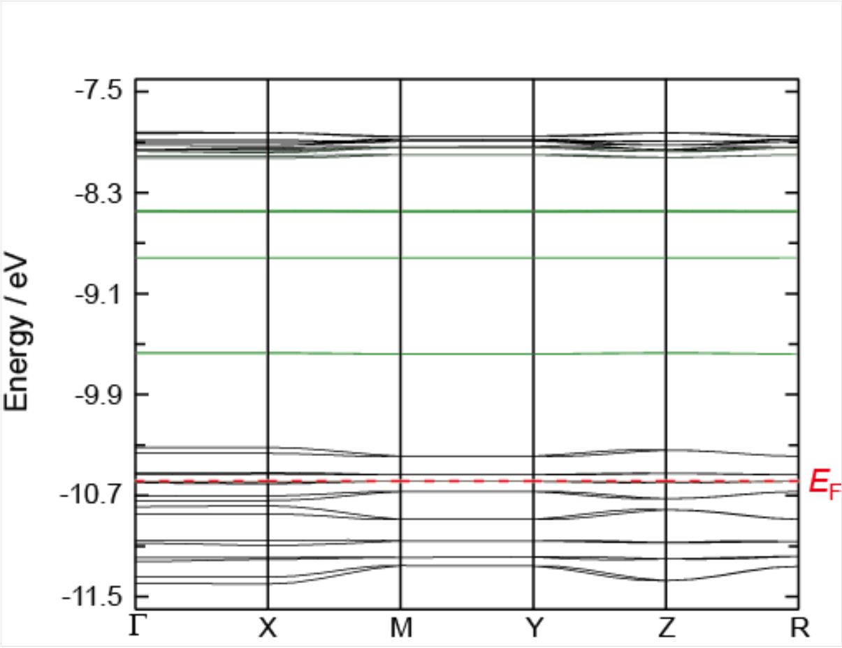
BPY[Ni(dmit)₂]₂ Band Structure（ Calc. Extended Hückel Method ）
Feat. 4) Narrow and relatively isotropic band at E_{F}
Black：Ni(dmit)₂
Green：BPY
Primary contribution

Slide 41
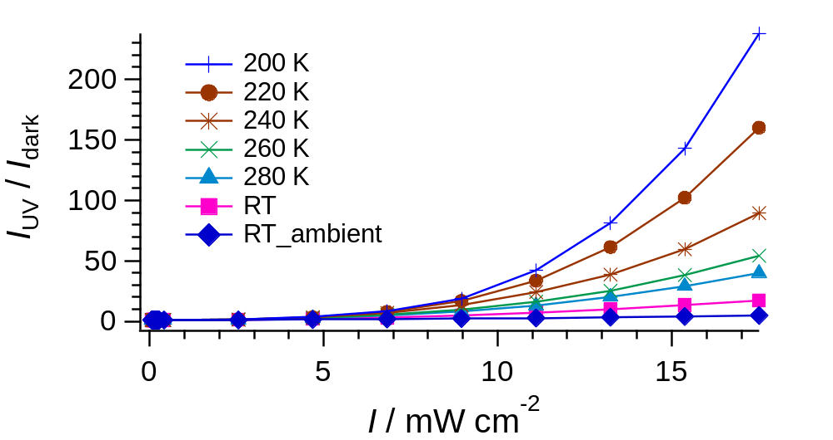
A[Ni(dmit)₂]₂ ; photoconductivity – I- & T-dependences
（Single Crystal）
（375 nm, in vauo）
A = BPY
Non-linear
A = MV

Slide 42
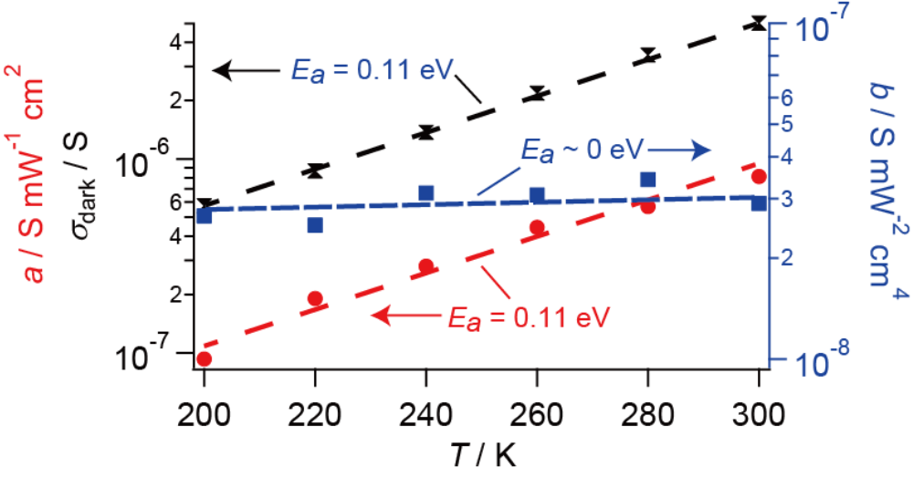
A[Ni(dmit)₂]₂ ; photoconductivity – I- & T-dependences
A = BPY
（Single Crystal）
（375 nm, in vauo）
σ_{sq} = σ_{dark} + aI + bI²
bI ² : Nearly T-independent
1. Thermally inaccessible to the dark states
2. Metallic conduction
aI : known/standard mechanism
bI ² : a new mechanism
σ : Non-linear dependence on I
Importance of cooperative effect*
* Yonemitsu, K. J. Phys. Soc. Jpn. 2004, 73, 2868-2878.

Slide 43

Photoconductivity – I-dependence (General behavior)
Pentacene
（Single Crystal）

Slide 44


Table S3. ESR simulation parameters for BPY[Ni(dmit)₂]₂ (measured on the single crystal with H // [010] at 153 K).
Spin # | 1 (on Ni(dmit)₂) | 2 (on BPY)
Relative Intensity | 110 | 4.0
Nuclear Spin I | 1/2 (¹H) | 1 (¹⁵N)
Electron Spin S | 1/2 | 1/2
g_{x} | 2.035 | 1.988
g_{y} | 2.020 | 1.992
g_{z} | 2.040 | 2.001
A_{x} [mT] | 2.50 | 1.30
A_{y} [mT] | 3.50 | 0.50
A_{z} [mT] | 6.00 | 0.50
Γ_{x} [mT] | 12.5 | 2.50
Γ_{y} [mT] | 8.50 | 2.50
Γ_{z} [mT] | 9.20 | 2.50
Gaussian/Lorenzian | 0/100 | 100/0
integrated

Slide 45
Our previous work; C-A CT
New Features for PC
-
Metallic conduction
(Possible) Kondo Effect
Non-linear dependence on I
e
under continuous UV irradiation
375 nm
2
∝ log T
∝ T
T. Naito et al, Adv. Mater., 24 (46), 6153-6157 (2012)
cf. T. Naito et al, J. Am. Chem. Soc., 134(45), 18656-18666 (2012)

Slide 46


MV[Ni(dmit)₂]₂
T-dependence of R
（single crystal）
Evidence for Interaction between carriers and localized spins
dark
under continuous UV irradiation
∝ log T
∝ log T
2
UV
∝ T
Semiconducting
Kondo Effect ?
Metallic
UV
[Ni(dmit)₂]⁻ [Ni(dmit)₂]^{0.98−}
( Estimated from band calc. & UV spectra )

Slide 47
Kondo Effect
Metallic electronic system
(unpaired electrons for Conduction)
Localized spin system
(unpaired electrons for Magnetism)
INTERACTION
Dilute localized spin system (on MV)
Carriers (on Ni(dmit)₂)

Slide 48

電荷移動＝Charge Transfer (CT)
D-A 相互作用で混じったバンド （各寄与がバンド毎に異なる）
（例）
ドナー（D）分子
[Ni(dmit)₂] ([Ni])
アクセプター（A）分子
BPY²⁺ (BPY)
-

Slide 49



A[Ni(dmit)₂]₂ （A = MV, BPY）; 光応答（単結晶）
e⁻
MV²⁺ [Ni(dmit)₂]-
光電流
( 300 K, 375 nm, 11.6 mW cm⁻² )
照射条件（強度, 波長, 温度, 雰囲気） を検討
[Ni]⁻
主に紫外光～250-450 nmにのみ応答
(E_{g} ≈ 5000-10000 nm)
MV[Ni]₂
CT が集中
MV²⁺
（ESR応答の強さは、
光の単位強度当たりとして表示）
Ni(dmit)₂
ESR
UV
伝導性の光応答と
局在スピンの光応答が連動
BPY

Slide 50
A[Ni(dmit)₂]₂ (A = BPY, MV)
Summary & Conclusion
Crystal Structure 3D closely packed [Ni(dmit)₂]－ accommodating
photochemical redox active BPY²⁺ / MV²⁺
Electronic Structure Isotropic
Strongly correlated (Narrow bands around E_{F})
strong Ni(dmit)₂―cation interaction
Electronic Properties
Dark semiconducting & diamagnetic
UV irradiated Unpaired electrons on both of cation & Ni(dmit)₂
（cation ≈ Loc. Spins, Ni(dmit)₂ ≈ Carriers）
cf. Kondo effect (MV salt)

Slide 51
Let Us Meet Again
We welcome you all to our future conferences of OMICS Group International
Please Visit:
http://materialsscience.conferenceseries.com/
Contact us at
materialsscience.conference@omicsgroup.us
materialsscience@omicsgroup.com

