Slide 1




Towards a more resilient nation

Slide 2


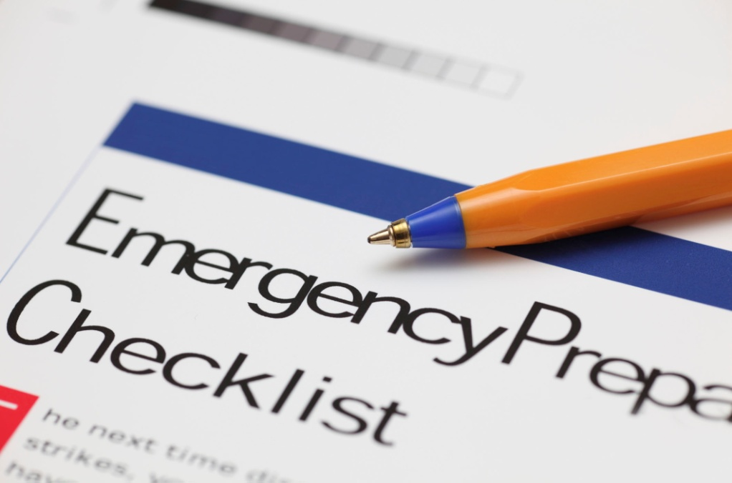

The Competing Pressures Paradigm (CPP):
A Conceptual Model for Improving Emergency & Business Continuity Plans
By Tony McAleavy PhD
2nd International Conference on Natural Hazards & Disaster Management, July 26th-27th 2018, Melbourne, Australia

Slide 3

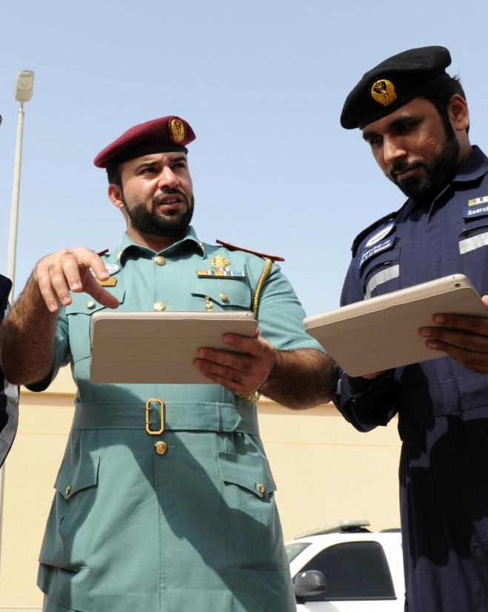
Scope of the Presentation
Scope of the Lecture
Why Plan?
What is a Plan?
Validation & Audit Processes
The Competing Pressures Paradigm
The Art of Emergency Planning
Practical Tips for Emergency Planning
Just a Nice Picture…

Slide 4
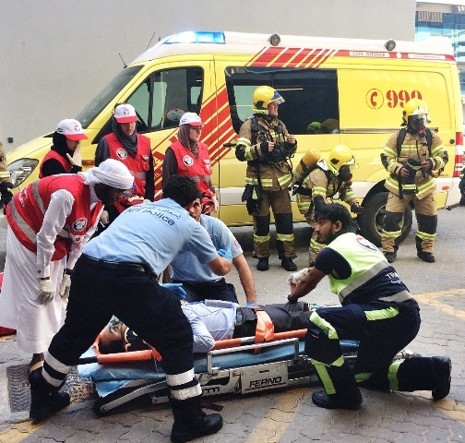
Why Plan?
Question: Why Plan?
Reasons for planning include:
- Legal or procedural compliance
- Ensure response efficiencies & effectiveness
- Identifying needs, tasks, priorities & coordination issues
- Aid risk identification, assessment & management
- Simplify complex operations
(Adapted from Alexander 2016)

Slide 5

What is a Plan?
Question: What is a Plan?
A plan is a document that:
- Assigns responsibility to act
- Defines relationships & authority
- Identifies personnel, equipment, facilities, supplies & other resources
- Protects vulnerable persons
- Reconciles jurisdictional issues (CPG 2010)
Question: What is the purpose of an Emergency Plan?
“To inform, instruct & direct participants about what procedures & emergency resources to use”
(Alexander 2002)

Slide 6
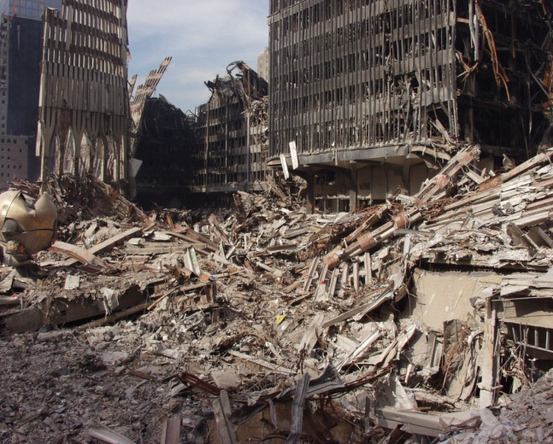
The NCEMA IEM/Disaster Management (DM) Cycle
PREVENTION & PROTECTION
< This is the UAE approach; there are other DM Cycles used internationally
RECOVERY
PREPAREDNESSS
Planning underpins ALL phases of the cycle
Coetzee & van Niekerk (2012)
RESPONSE

Slide 7
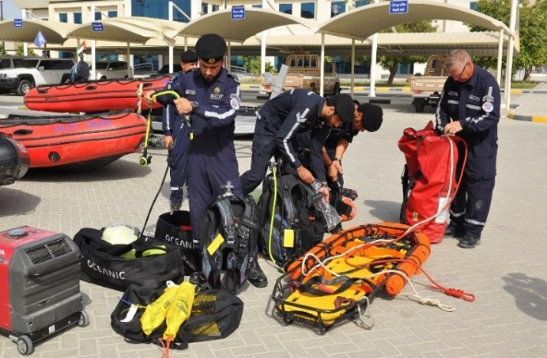
Validation & Audit Processes
AUDIT/DRAFT
LIVE-PLAY EX
AWARENESS
PLAN REVISON
TRAINING/MICRO EX
WALKTHROUGH
TABLETOP EX
(Adapted from Cabinet Office 2011)
PLAN REVISON

Slide 8



The Competing Pressures Paradigm
A Plan/Plan Writer will be squeezed by competing pressures & requirements
An effective planner holistically & artistically manages ALL these issues
THE BOSS
END
USER
THE LAW
THE ORG/S
Survivors are the primary focus

Slide 9
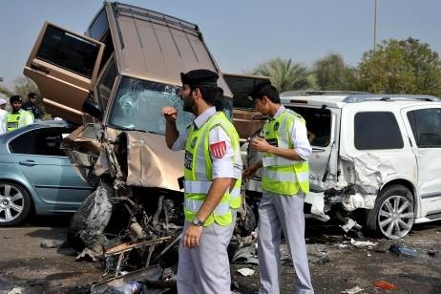
The Art Emergency Planning
Planning is arguably an artistic rather than scientific endeavor
No template or approach will guarantee success everywhere all of the time
Planners need to adjust continually to the specific local PESTEL conditions
Political Environmental
Social Technological
Economic Legal
Degrees are often BSc or MSc…

Slide 10
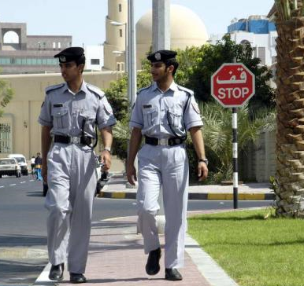
Practical Tips for Emergency Planning
1) KISS - “Keep it Simple Stupid”
2) Less is (often) more
3) Plans are about people, capabilities & resources not just a “tick in the box”
4) End-User primacy
5) Plan for spontaneity (McEntire 2013)
6) Challenge assumptions & be innovative
“The key to a successful governmental response depends upon the extent to which post disaster human behaviour corresponds to prior governmental expectations and planning”
(Schneider 1992)

Slide 11

Just a Nice Picture…
Any questions?

Slide 12
References
Alexander D. (2016) “How to Write an Emergency Plan” Dunedin Academic Press, London, UK
Alexander D. (2002) “Principles of Emergency Planning & Management”, Oxford University Press, Oxford, UK
Cabinet Office (2011) “Emergency Preparedness – Chapter 5 (Emergency Planning – Revision”https://www.gov.uk/government/uploads/system/uploads/attachment_data/file/61028/Emergency_Preparedness_chapter5_amends_21112011.pdf
Coetzee C. & Van Niekerk D. (2012) “Tracking the evolution of the disaster management cycle: A general system theory approach”, Jamba, Journal of Disaster Risk Studies, Vol 4,No 1, p1-9
Federal Emergency Management Agency (2010) “Developing and Maintaining Emergency Operations Plans – Comprehensive Planning Guide Version 2.0” https://www.fema.gov/media-library-data/20130726-1828-25045-0014/cpg_101_comprehensive_preparedness_guide_developing_and_maintaining_emergency_operations_plans_2010.pdf
McEntire D. (2013) “Spontaneous Planning after the San Bruno Gas Pipeline Explosion: A Case Study of Anticipation and Improvisation during Response and Recovery Operations”, Journal of Homeland Security and Emergency Management
Schneider K. (1992) “Governmental response to disasters: The conflict between bureaucratic procedures and emergent norms", Public Administration Review, 52, 2, p135-145

Slide 13


