Slide 1
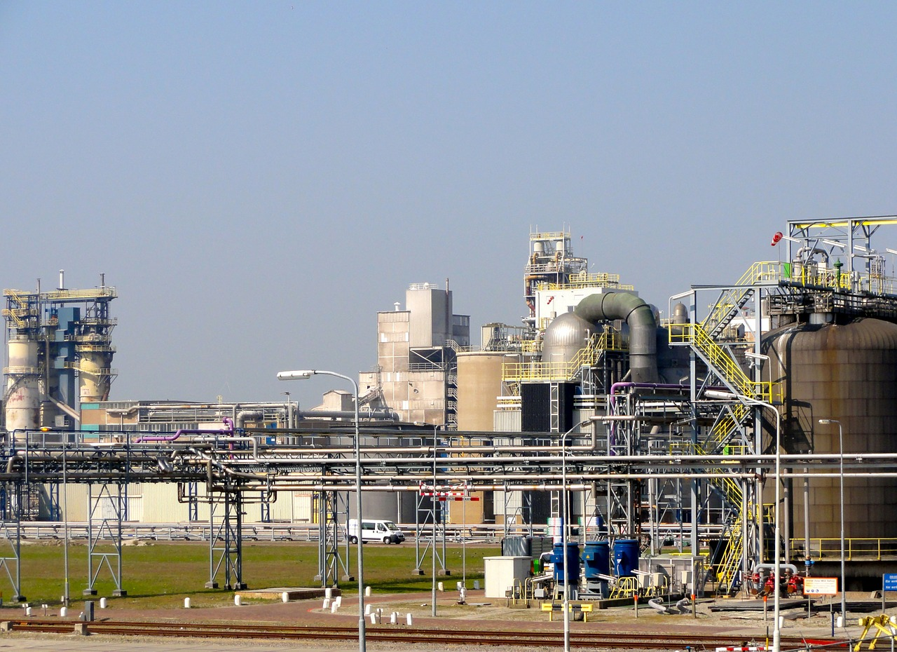

“Chemical Engineers - Untold Contributions to Humanity”
International Conference of Chemical Engineering
Tuesday September 13, 2016 by
Tony Green
Copyright 2016 @ Speaking Green Communications

Slide 2

Agenda
1. What has been achieved?
2. The job is not done
3. What Chemical Engineers can do to get the job completed…..
Copyright @ Speaking Green Communications 2016

Slide 3

"Oh, that's not a technical problem, so I have nothing to contribute.”
Copyright 2016 @ Speaking Green Communications

Slide 4

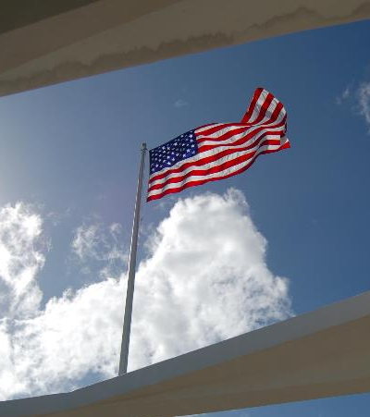

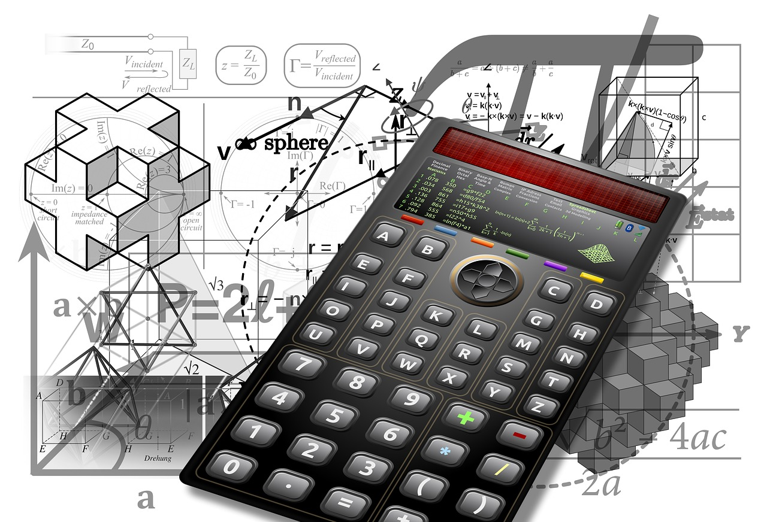
Copyright 2016 @ Speaking Green Communications

Slide 5
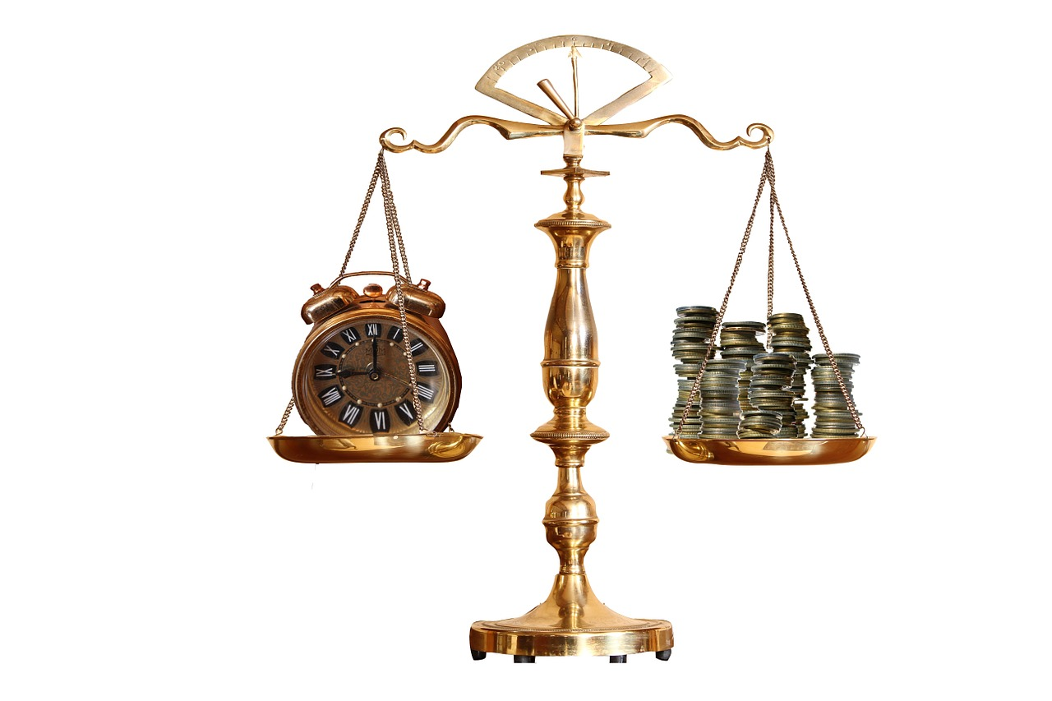
Copyright 2016 @ Speaking Green Communications

Slide 6

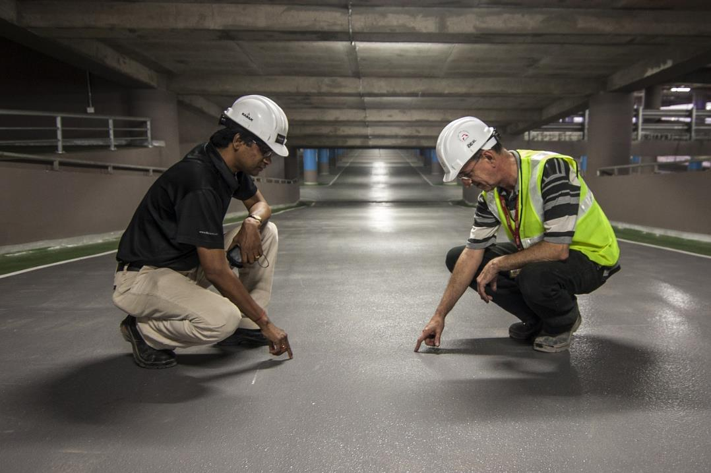
Copyright 2016 @ Speaking Green Communications

Slide 7
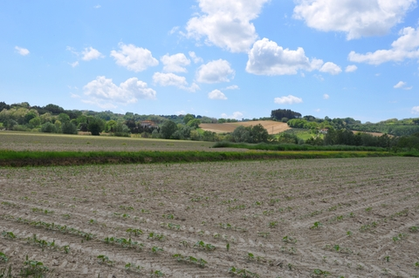
Haber Process
N₂ (gas) + H₂ (gas)
NH₃ (gas)
Copyright 2016 @ Speaking Green Communications

Slide 8
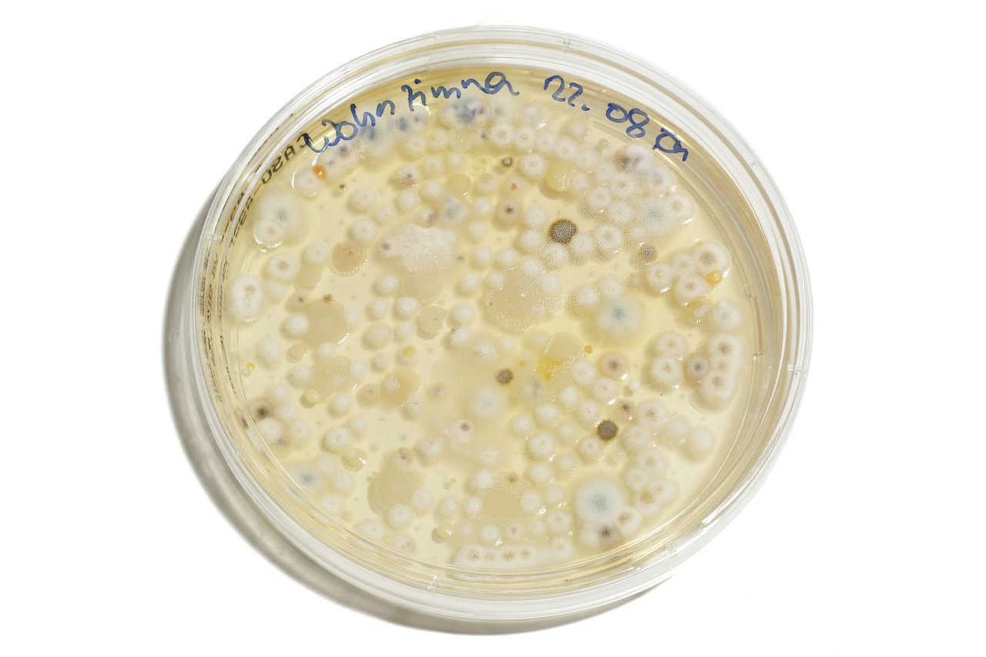

Copyright @ Speaking Green Communications 2016

Slide 9
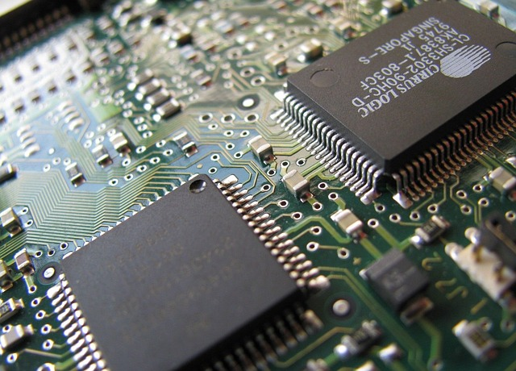
Computer Age
Chemical Vapor Deposition
Etching
Ashing
Atomic Layer Deposition
Cleaning
Copyright @ Speaking Green Communications 2016

Slide 10
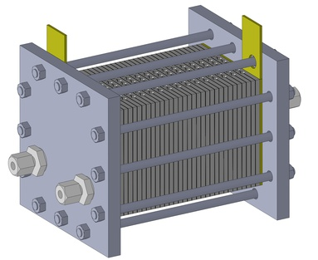
Fuel Cell
Anode side (an oxidation reaction):
2H2 => 4H++ 4e-
Cathode side (a reduction reaction):
O2 + 4H+ + 4e- => 2H2O
Net reaction (the "redox" reaction):
2H2 + O2 => 2H2O
Copyright @ Speaking Green Communications 2016

Slide 11
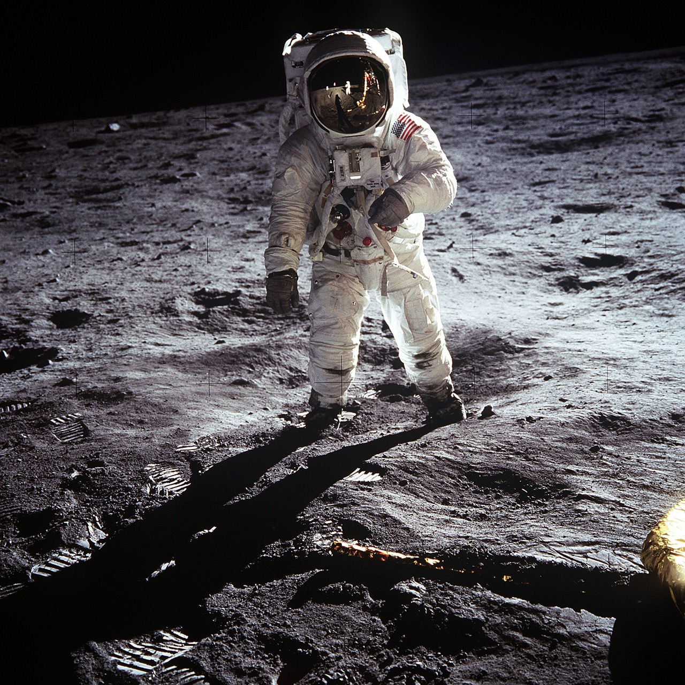
Space Travel
Copyright @ Speaking Green Communications 2016

Slide 12

Copyright @ Speaking Green Communications 2016

Slide 13

Copyright @ Speaking Green Communications 2016

Slide 14
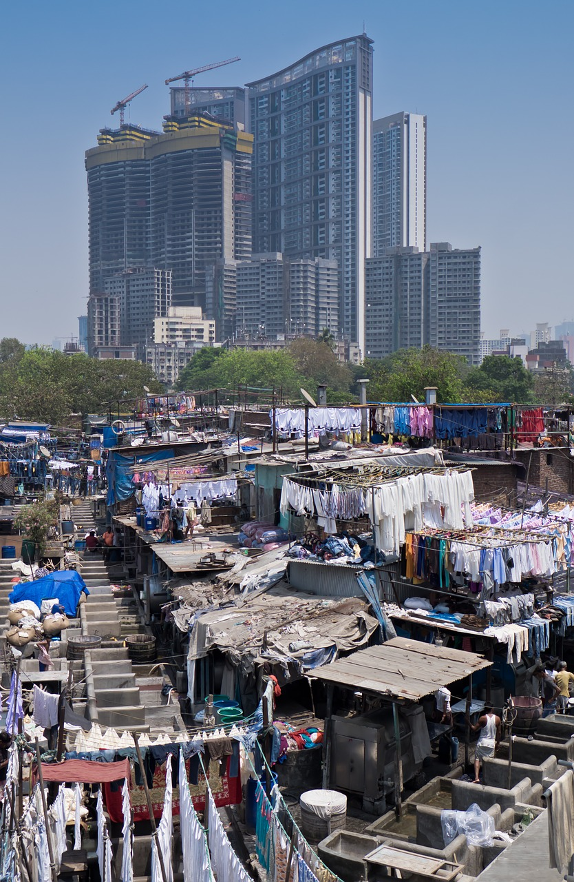

The Bottom Billion
limited access to clean water and energy and live in urban slums.
Copyright @ Speaking Green Communications 2016

Slide 15
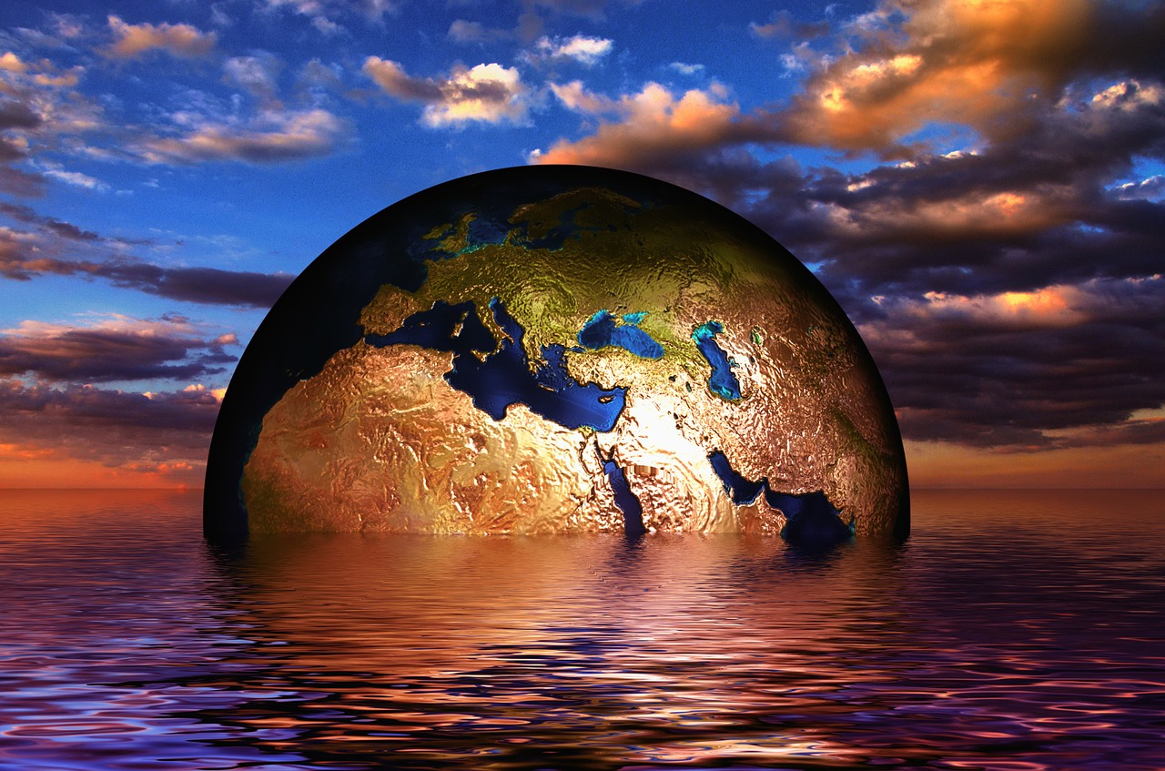
Climate Change
Copyright @ Speaking Green Communications 2016

Slide 16

Copyright @ Speaking Green Communications 2016

Slide 17
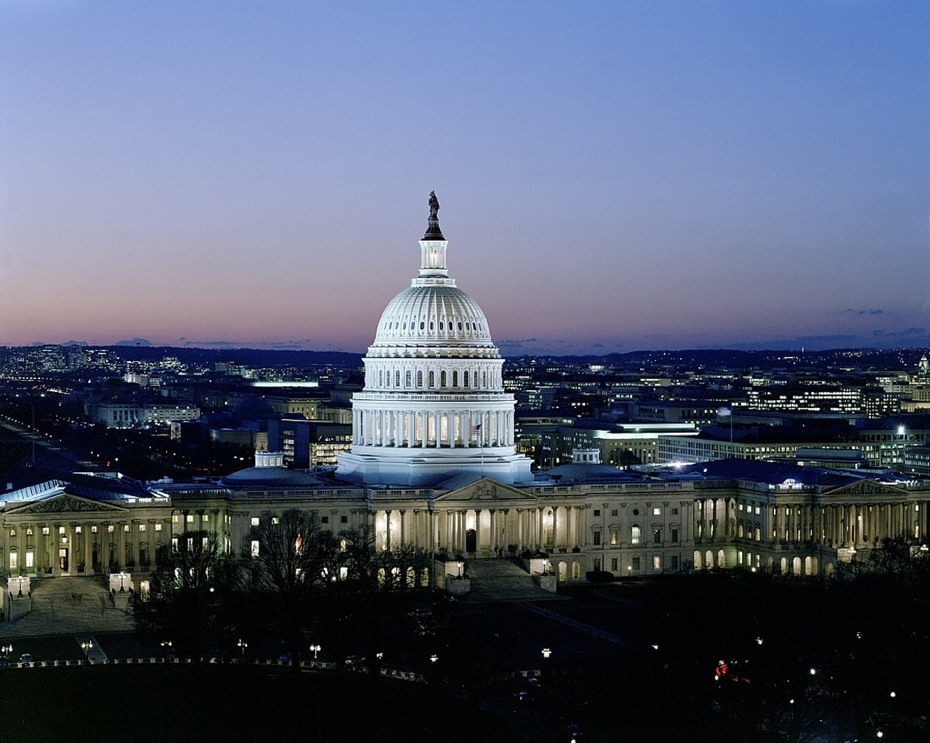
Politics
Copyright @ Speaking Green Communications 2016
Copyright @ Speaking Green Communications 2016

Slide 18
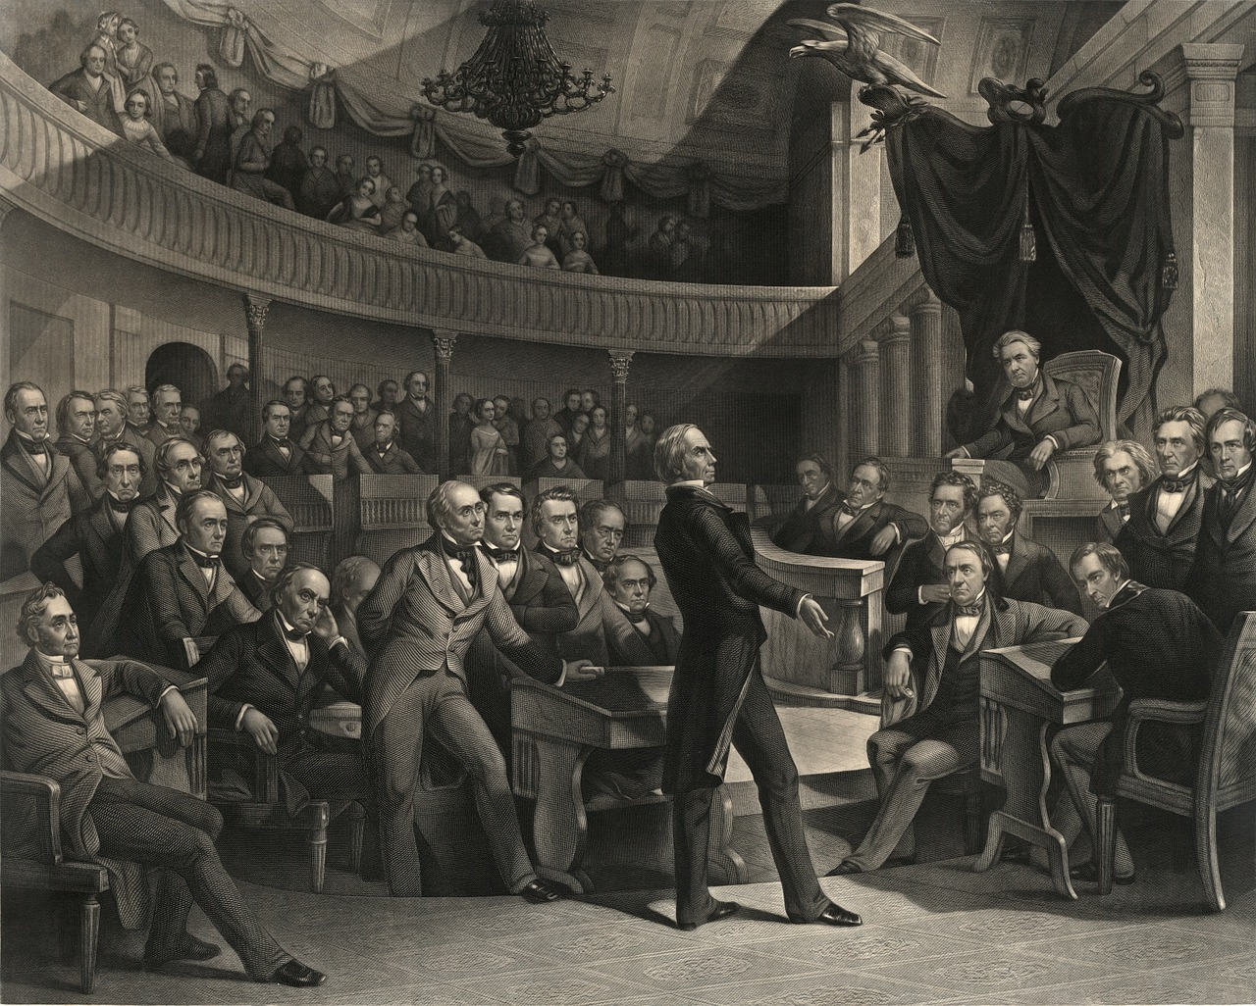
Politics
Copyright @ Speaking Green Communications 2016

Slide 19

Copyright @ Speaking Green Communications 2016

Slide 20

“It is not what engineers do, but how they think about the world that makes them different.”
Copyright @ Speaking Green Communications 2016

Slide 21
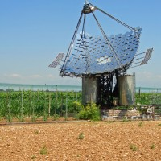

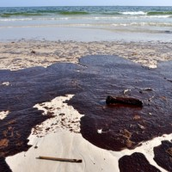
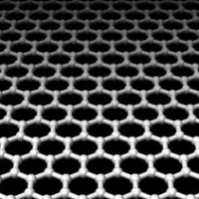
Speaking Green Communications
The Voice of sustainability
Alternative Energy
“I believe if people in general had a better understanding of how alternative/clean technologies worked there would much less comprehension and fear toward adopting these technologies.”
Water Conservation
Environment
Advanced Materials
Copyright @ Speaking Green Communications 2016

Slide 22
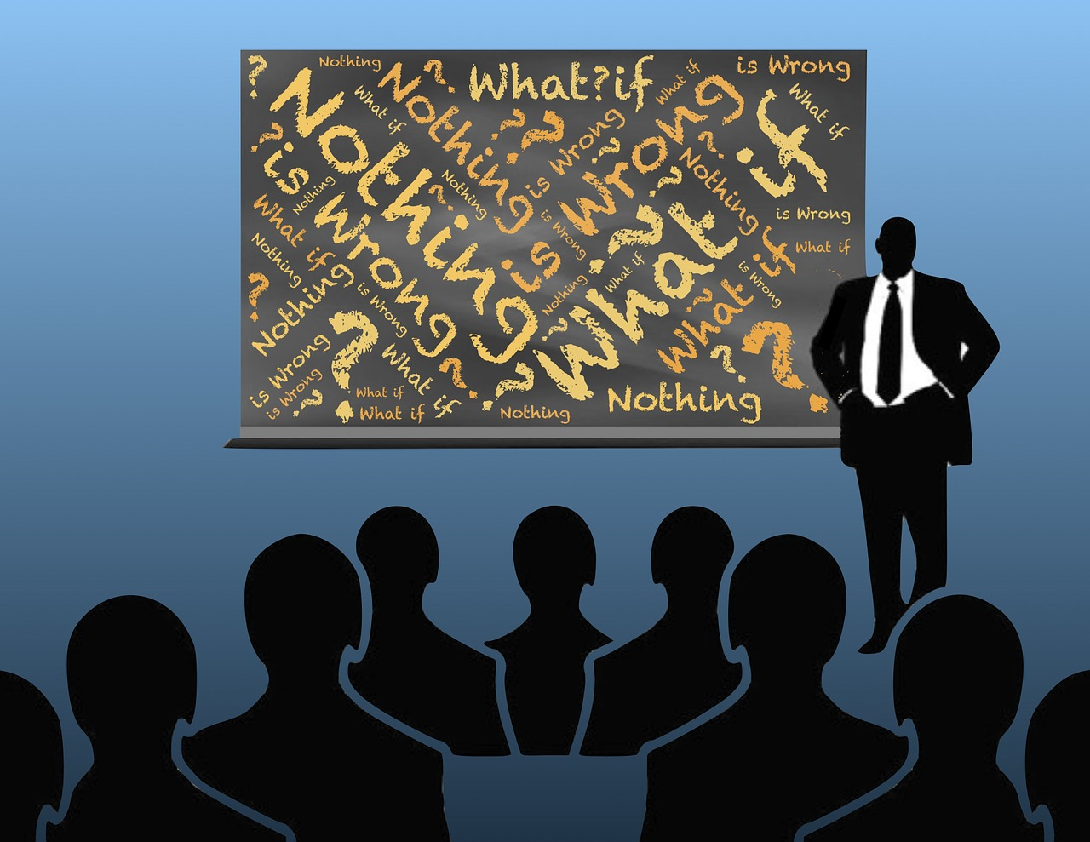
Questions and
Answers ?
Copyright @ Speaking Green Communications 2016

