Slide 1
Standardised Encryption Key Management for Smart Grids with KMIP
Tony Cox
VP, Partners, Alliances & Standards - Cryptsoft
tony.cox@cryptsoft.com

Slide 2


Introduction – Tony Cox
VP Partners, Alliances & Standards
Co-Chair KMIP Technical Committee
Co-Author KMIP Specification (v1.3, v1.4, v2.0)
Co-Chair PKCS#11 Technical Committee
Notes:
Insert hi level titles/quals etc

Slide 3























Cryptsoft
Established in 1996
Privately owned
Australian based OEM security technology supplier
ISO 9001 quality assured company
Notes:
Established by 2 individuals working on an SSL implementation
Formed Cryptsoft at the same time as OpenSSL was open sourced
A range of customers

Slide 4
OASIS
OASIS is a nonprofit consortium that drives the development, convergence and adoption of open standards for the global information society.
Established in 1993 as SGML Open (“Standardised General Markup Lanugauge”)
Changed to OASIS in 1998 with expanded scope as “Organization for the Advancement of Structured Information Standards”
Over 100 standards completed and in use
Over 60 active Technical Committees
Links to other standards bodies including ISO for standards publication
Notes:
OASIS describes themselves as “a nonprofit consortium that drives the development, convergence and adoption of open standards for the global information society.”
Established as SGML (a markup language for documentation designed to capture and manage document metedata)

Slide 5


OASIS Membership
3 Member levels
  Foundational Sponsor
  Sponsor Member
  Contributor Member
Foundational Sponsors
Over 65 Sponsor members
Over 195 Contributor members
Well established Technical Committee processes
Formal, structured standards publication & review process

Slide 6
Overview
Cybersecurity Landscape
Keys & Certificates in a Smart Grid System
Key and Certificate Management
Key Management History
KMIP – Overview and History
KMIP – Profiles & Testing
KMIP & Smart Grid

Slide 7
Cybersecurity Landscape

Slide 8
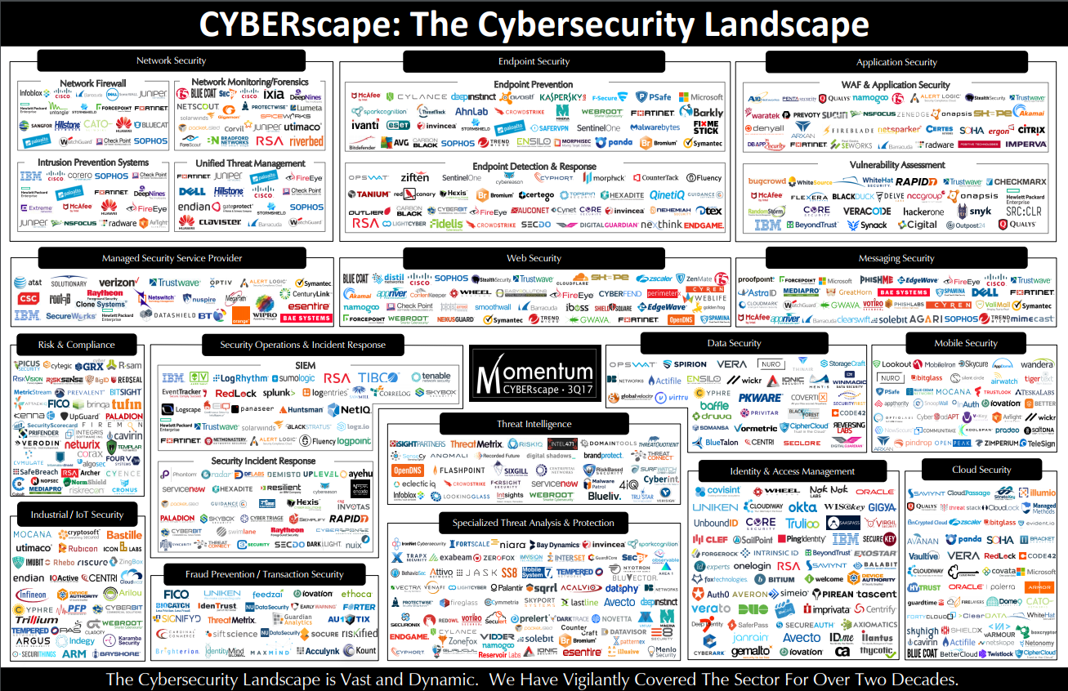
Cybersecurity context
* Source: Momentum Partners
Notes:
Very large marketplace of cybersecurity vendors.

Slide 9
Cybersecurity context
5 main Areas of focus
  Identification
  Protection
  Detection
  Response
  Recovery
Focus on protection:
  Assets
  Information
  Authentication & Encryption
Notes:
Identification – Of critical assets requiring protection
Protection – of critical assets via appropriate processes and controls
Detection – of real and potential cybersecurity threats including threat identification and categorization
Response – Containment and treatment of threats as they arise based on response plans
Recovery – restoration of affected systems
Focus on Protection

Slide 10
Keys and Certificates in Smart Grid Systems

Slide 11
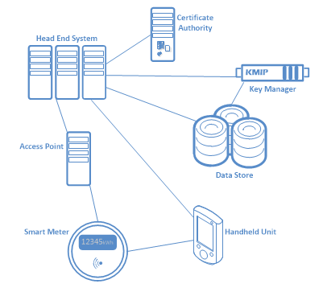
Keys & Certificates in a Smart Grid System
Major components
  Smart Meters
  Access Points
  Handheld Units
  Head End Systems
  Data Stores
  Key Management System

Slide 12
Keys & Certificates in a Smart Grid System
Smart meters
  Manufacturer Keys & Certificates
  Operator encryption keys
  Authentication keys & certificates
  Generally 5-12 Security Objects

Slide 13
Keys & Certificates in a Smart Grid System
Hand Held Unit
  Manufacturer Keys & Certificates
  Operator encryption keys
  Authentication keys & certificates
  Variable number of Security Objects

Slide 14
Keys & Certificates in a Smart Grid System
Access Point & Head End Systems
  Manufacturer Keys & Certificates
  Operator encryption keys
  Authentication keys & certificates
  Large number of Security Objects

Slide 15
Keys & Certificates in a Smart Grid System
Data Store
  Data encryption keys
  Operator encryption keys
  Authentication keys & certificates
  Very large number of Security Objects

Slide 16
Keys & Certificates in a Smart Grid System
Key Management System requirements
  Capacity to store 10e6 to 10e8 of
  Security objects
  Full lifecycle management
  Multiple, discrete partitions or domains
  Usually offer redundancy & high
  availability via multi-node replicating
  clusters

Slide 17
Key and Certificate Management

Slide 18
Key and Certificate Management
Lifecycle
  Provisioning
  Use
  Deprovisioning
  Standards
Metadata associated with:
  lifecycle events
  Data
  System
  User
  Authority

Slide 19
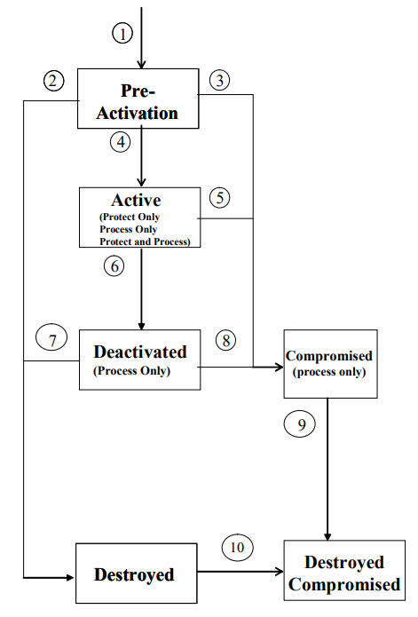
Key and Certificate Management
NIST Special Publication 800-57 Pt 1
(r1-2005)
States
  Pre-Activation
  Active
  Deactivated
  Destroyed
  Compromised
  Destroyed Compromised
Source: http://csrc.nist.gov/publications/nistpubs/800-57/sp800-57-Part1-revised2_Mar08-2007.pdf

Slide 20
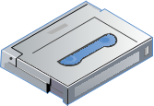

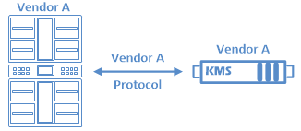
Key Management History
Started with data storage (tape)
  Key per tape
  Key per file later
Vendor proprietary protocols
  Decrypt & re-encrypt on change of vendor
  Changing vendors was costly and difficult
Push for standardisation
  Started by one vendor

Slide 21
KMIP – History & Overview

Slide 22
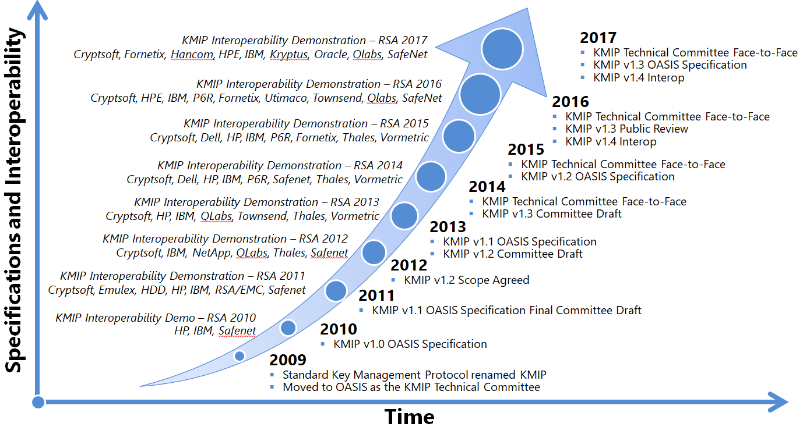
KMIP Timeline
* Source: Cryptsoft
Notes:
Mid 2008 – 4 horsemen (HP, IBM, EMC/RSA * nCipher) started SKMP – release as v0.98
Early 2009 – Moved to OASIS and named KMIP
The standards body activities are pretty intensive – with annual public demonstrations at the RSA conference and in-between vendor neutral plug-fests.
The specification versions are developed overlapping (drafts are worked on for the next version while the previous version goes through the formal OASIS process).

Slide 23
KMIP Product Types
Storage
Infrastructure and Security
Cloud and IoT
Disk Arrays, Flash Storage Arrays
NAS Appliances
Tape Libraries
Virtual Tape Libraries
Encrypting Switches
Storage Key Managers
Storage Controllers
Storage Operating Systems
Key Managers & HSMs
Databases
Encryption Gateways
Virtualization Managers
Virtual Storage Controllers
Network Computing Appliances
Critical Infrastructure
Cloud Key Managers
Compliance Platforms
Information Managers
Enterprise Gateways and Security
Enterprise Authentication
Endpoint Security

Slide 24
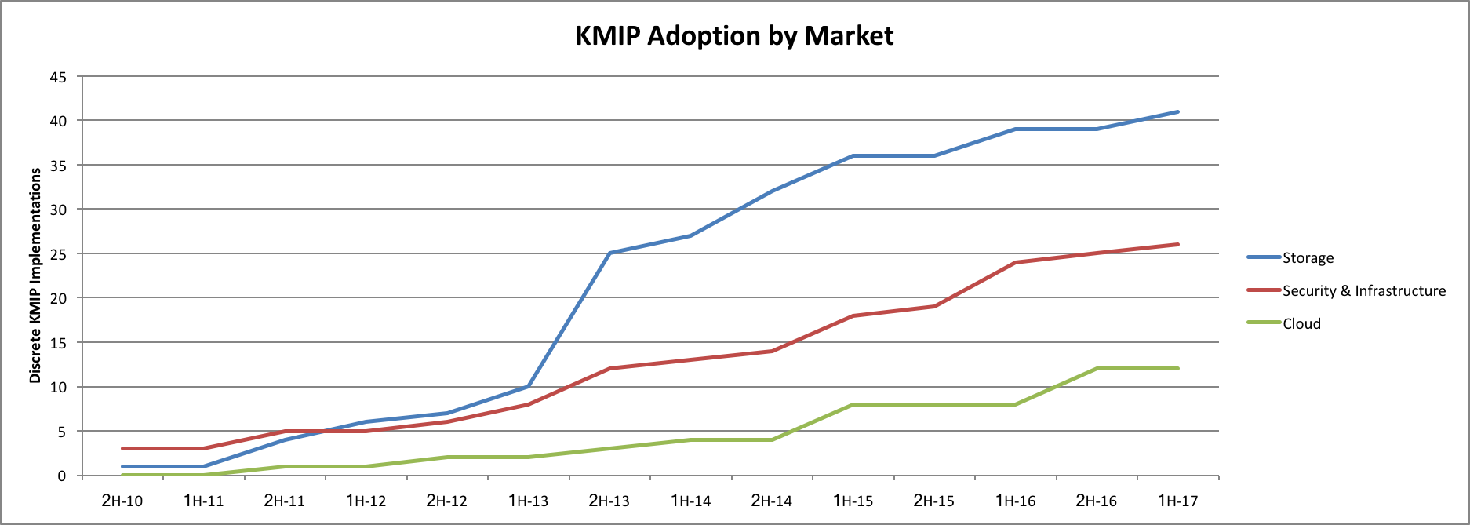
KMIP Growth

Slide 25




































KMIP Vendors
* Source: Cryptsoft

Slide 26
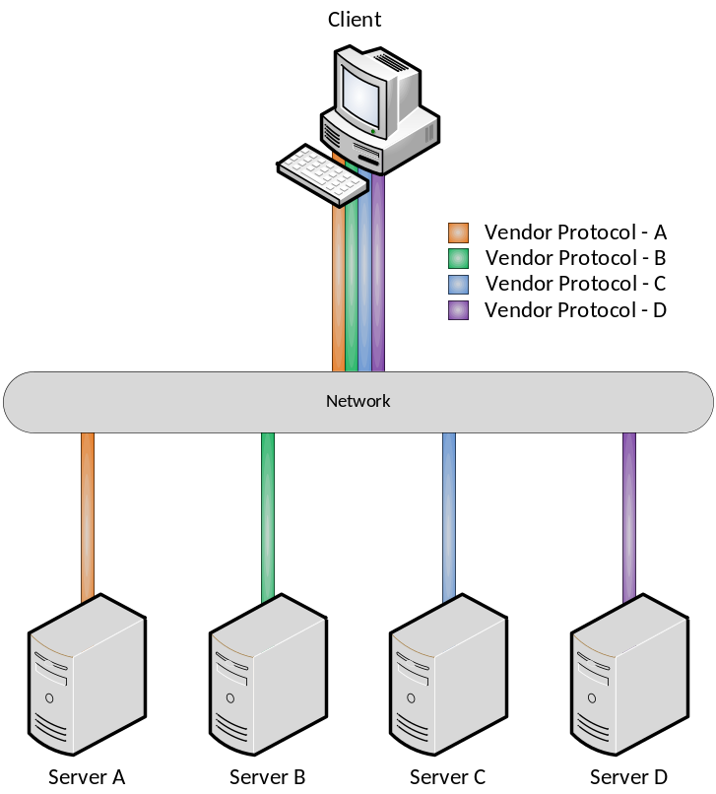
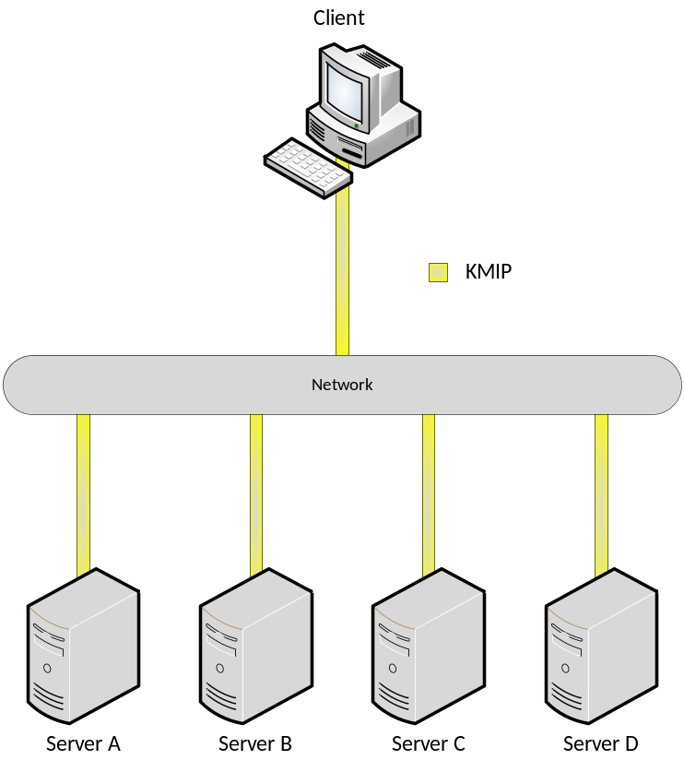
KMIP 101
Prior to KMIP each application had to support each vendor protocol
With KMIP each application only requires support for one protocol
* Source: Cryptsoft

Slide 27
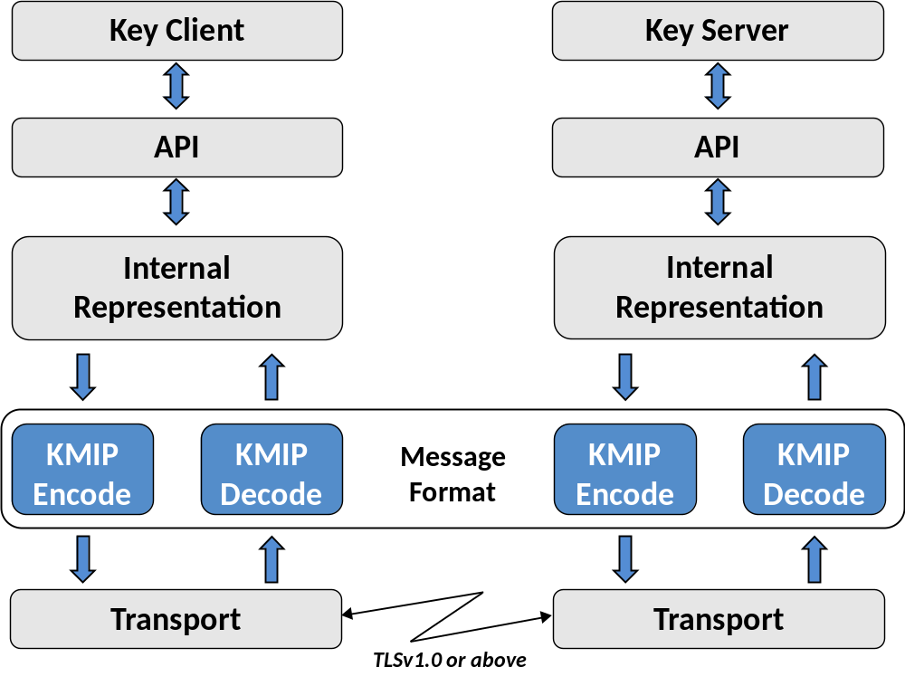
KMIP 101
* Source: Cryptsoft

Slide 28
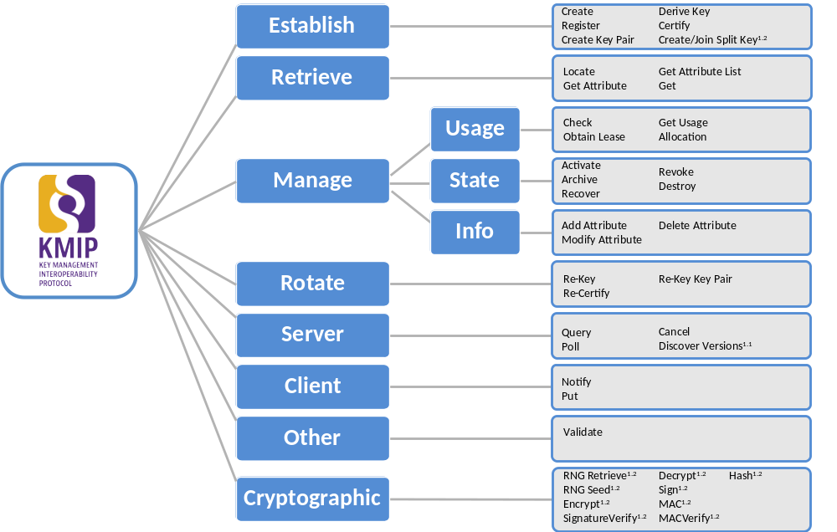
KMIP 101
* Source: Cryptsoft

Slide 29
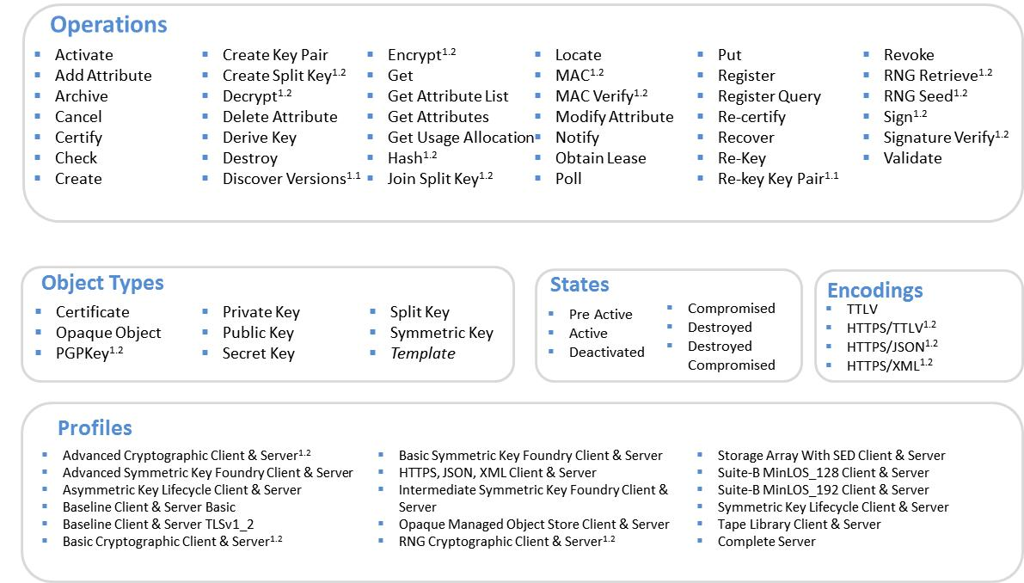
KMIP 101
* Source: Cryptsoft

Slide 30
KMIP 101
Ver | Specification Status | Market Status | Main Features
v1.2 | Published May 2015 | Widely deployed Many customer utilising the enhanced capability and interoperability Deployed to SNIA SSIF conformance testing program (using Cryptsoft Test Suite) Multiple vendors through formal testing program | Cryptographic Services Profiles expansion Suite B support Additional Interoperability Updates
v1.3 | Published December 2016 | Expanded deployment Deployment to SNIA SSIF conformance testing program (using Cryptsoft Test Suite) in Q3-2016 Multiple products interop tested & demonstrated at RSA Conference 2015. | Suite B updates Automated client registration Limited deprecations Additional Cryptographic Services
v1.4 | Undergoing final public review Target publication November 2017 | Initial deployments expanding Automation and scalability benefits driving faster adoption Multiple products interop tested & demonstrated at RSA Conference 2016. | Automated client registration enhancements Additional profiles PKCS#12 handling Further deprecations Additional Interoperability Updates
v2.0 | Drafting underway Target publication Q1 -2018 | Technical members gathering and analysing specific demands from the market and finalising scope | Deprecated items removed Fine-grained attribute-based access control Alternate protocol and message handling Post-Quantum Computing measures
* Source: Cryptsoft

Slide 31
KMIP – Profiles and Testing

Slide 32
KMIP Profiles
Profiles outline a mandatory (with some allowed variation) set of conformance requirements.
Requirements are usually a subset of specific operations, attributes and other items combined with one or more request/response traces.
Over 100 discrete profiles for clients and servers including:
  Tape Library
  Storage Array with SED
  Suite B
  Cryptographic Services
  Opaque Managed Object Store
A range of new profiles under construction

Slide 33
KMIP Profiles
Profiles outline a mandatory (with some allowed variation) set of conformance requirements.
Requirements are usually a subset of specific operations, attributes and other items combined with one or more request/response traces.
Over 100 discrete profiles for clients and servers including:
  Tape Library
  Storage Array with SED
  Suite B
  Cryptographic Services
  Opaque Managed Object Store
A range of new profiles under construction

Slide 34
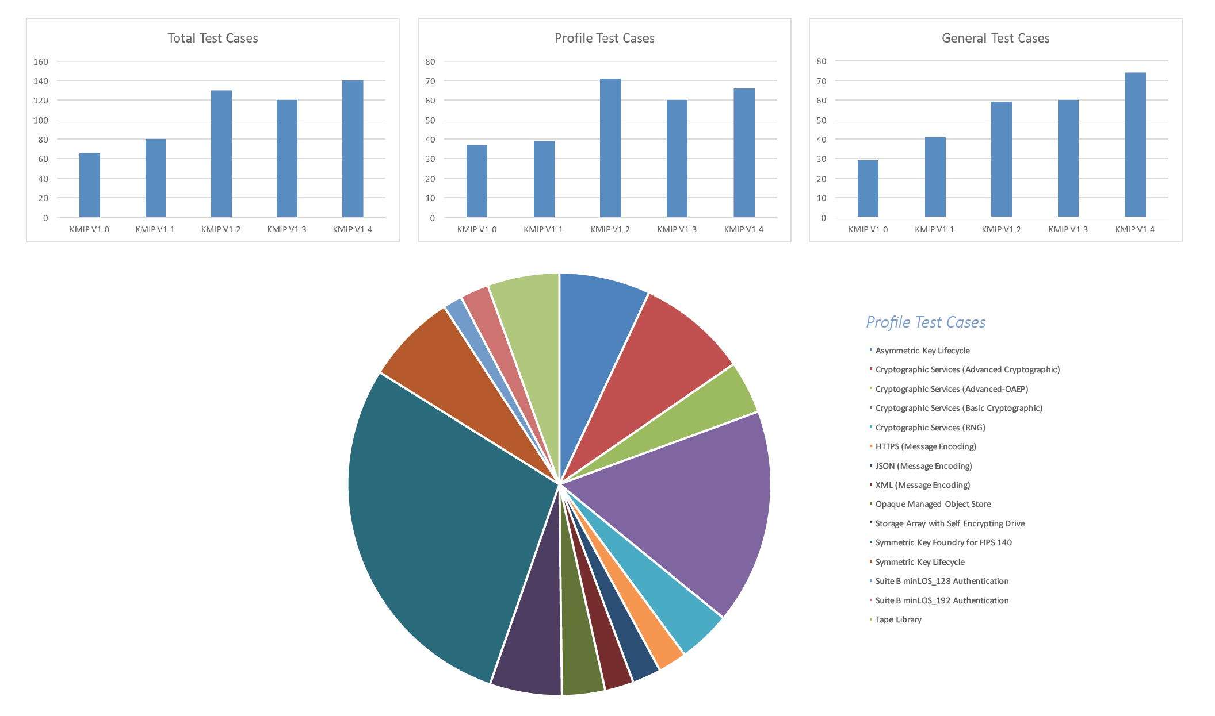
KMIP Profiles
* Source: Cryptsoft

Slide 35
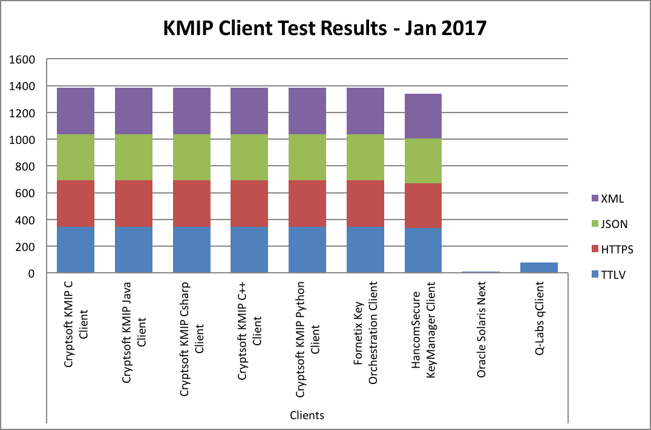
KMIP Interoperability – Client testing
* Source: Cryptsoft

Slide 36
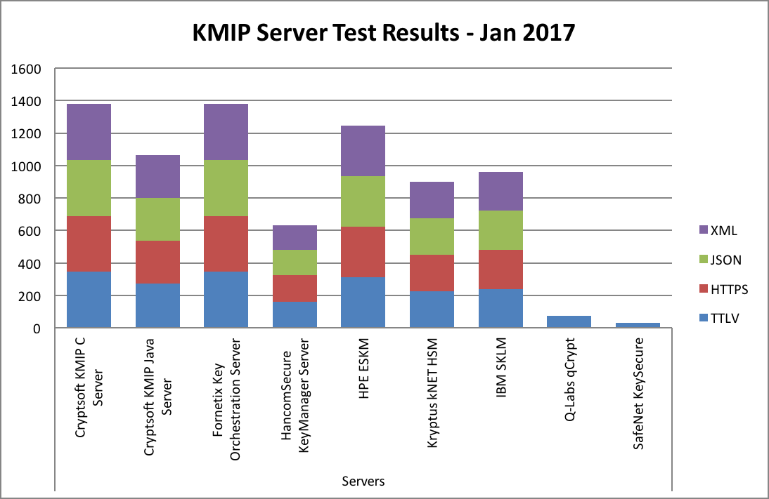
KMIP Interoperability – Server testing
* Source: Cryptsoft

Slide 37
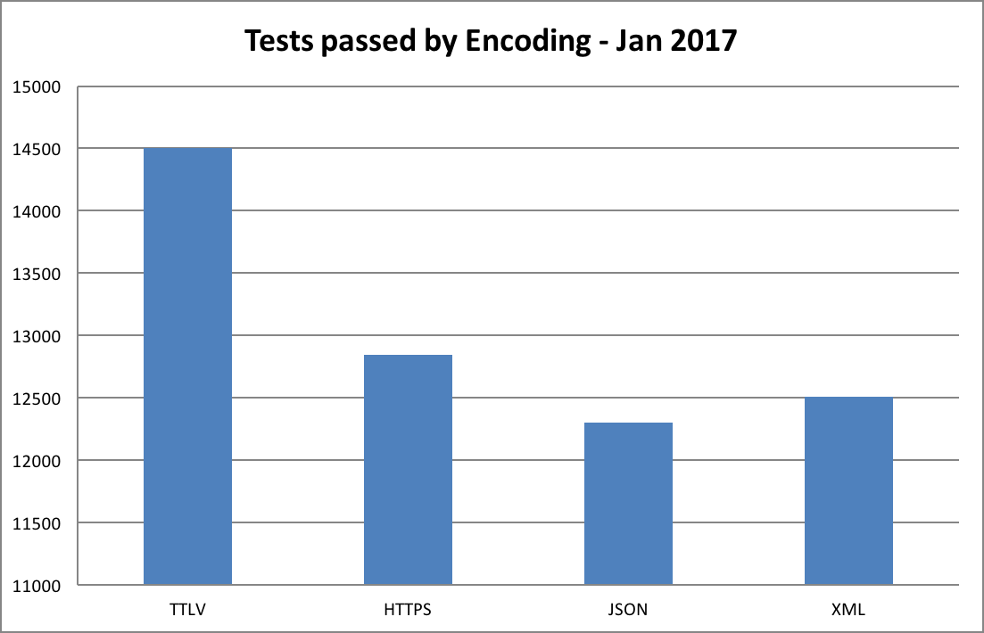
KMIP Interoperability Testing
* Source: Cryptsoft
Notes:
Over 50,000 tests passed just this year alone

Slide 38
KMIP - Where to from here?
KMIP Technical Committee is focused on KMIP v2.0 with particular attention to:
  PQC response to ensure ongoing, interoperable security
  Greater volume of industry-specific profiles
  Streamlined, secure deployment and registration of KMIP clients:
    Cloud context
    Critical Infrastructure context

Slide 39
KMIP & Smart Grid

Slide 40
Smart Grid KMIP Deployment
Key management platform for DLMS/COSEM
Multiple server vendors gearing to support implementations
  Common requirement for FIPS 140-2, level 3
Multiple procurement events underway in Europe
Interest from the US Smart Grid market
Main focus on support for Symmetric keys, with some certificates and asymmetric key pairs also in use
Work ongoing for managing authentication credentials

Slide 41
Summary – KMIP Benefits for Smart Grid
An active Cybersecurity community developing security products to meet current and future needs for Smart Grid and IOT.
Reduced investment in developing and researching complex, fixed, key hierarchy models
Increased redundancy through use of common infrastructure using off-the-shelf products
Greater ROI through re-use of existing integrations and greater competition between vendors
Increased levels of security as the same vendors are working to meeting increasing data & privacy requirements.

Slide 42
Further work with the KMIP TC
Requirements are always welcome:
  Join OASIS and contribute directly
  Pass requirements through existing relationships with existing members
  Contribute via email (see https://www.oasis-open.org/committees/comments/index.php?wg_abbrev=kmip)
Other Technical Committees focused on other areas of Smart Cities & Smart Grids (see https://www.oasis-open.org/

Slide 43
Questions?
Thank You!
tony.cox@cryptsoft.com

