Slide 1


Childhood obesity and
obesity reduction program
Tohatyova, A. ¹, Schusterova, I ^{1,2}, Jarcuskova, M. ¹
Mentor: Assoc. Prof. Ingrid Schusterova, MD, PhD.
¹Department of Paediatrics and Adolescent, Faculty of Medicine, P. J. Šafárik University in Kosice, Slovakia
²Eastern Heart Institute , Kosice, Slovakia
This research was supported by the Grant project of the Ministry of Education, science, research and sport of the SR
Project title: „Origin and pathogenesis of obesity in relation to non-traditional obesity risk factors“

Slide 2

Obesity
Childhood obesity → most serious public health challenges of the 21st century
Obese children → obese into adulthood and more likely to develop noncommunicable diseases (diabetes, cardiovascular diseases) at a younger age
Overweight and obesity, as well as their related diseases, are largely preventable !!!

Slide 3
Etiology, Determinants and Risk Factors
Genetic Variation
Epigenetics
Endocrine Disease
Central Nervous System Pathology
Intrauterine Exposures
BMI Rebound
Diet
Sleep
Infection
Iatrogenic
Ethnic Origin
Country of Birth
Urban Versus Rural Area of Residence
Socioeconomic Level
Endogenous obesity in children represents ONLY 5 % of obesity
Neslihan Kovuncuoglu Güngör et al. Overweight and Obesity in Children and Adolescents.
J Clin Res Pediatr Endocrinol, 2014

Slide 4
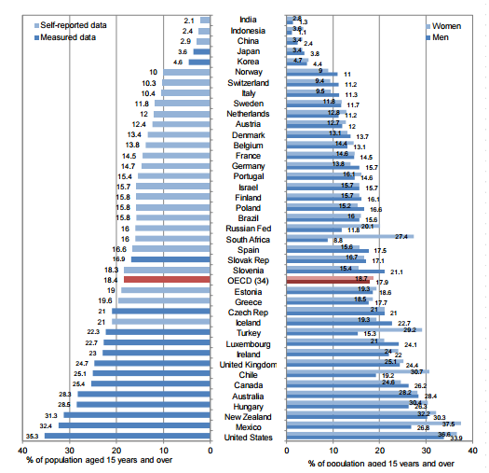
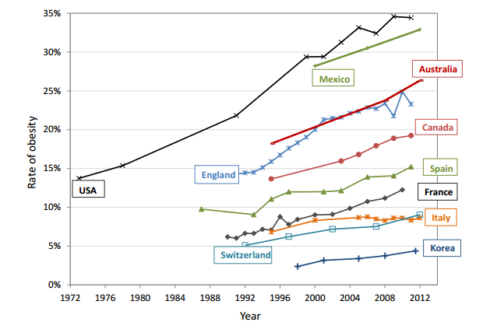

Obesity epidemic continues
Trends in obesity
Obesity among adults

Slide 5
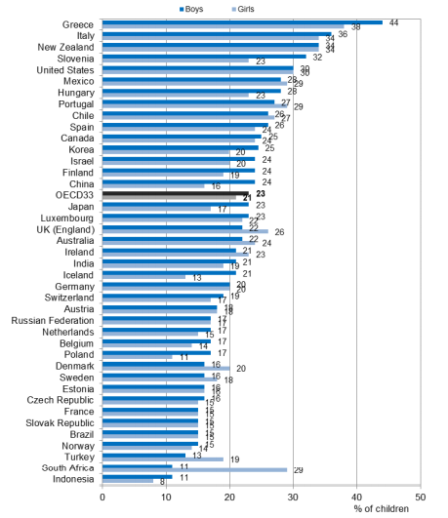
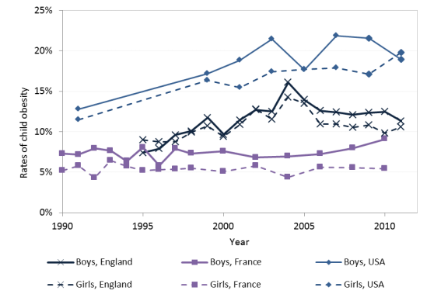
Obesity epidemic continues
Trends in child obesity, age 3-17
Measured overweight (including obesity) among children aged 5-17

Slide 6
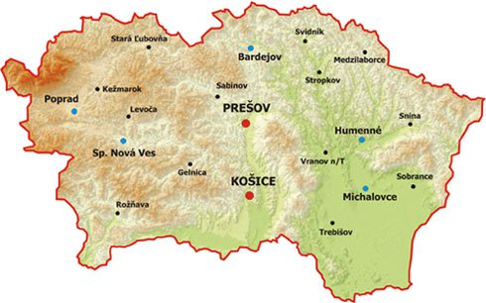
Healthy high-school students in Eastern Slovakia- Our results
Prevalence of overweight and obesity 23.66%
Prevalence of insulin resistance 13.94%
      8.9% in normal weight adolescents
      30% in obese and overweight adolescents

Slide 7
Healthy high-school students in Eastern Slovakia- Our results
Antropometric parameters | Girls (N=120) | Boys (N=104) | p-value
Body weight (kg) | 60.33 ± 11.04 | 75.46 ± 15.34 | <0.0001
Body height (cm) | 165.64 ± 6.15 | 181.18 ± 6.70 | <0.0001
BMI | 21.95 ± 3.76 | 22.94 ± 4.38 | 0.06
BMI percentil | 51.60 ± 31.74 | 54.86 ± 31.84 | 0.44
WHR | 0.81 ± 0.10 | 0.83 ± 0.06 | 0.25
Body fat mass (kg) | 16.74 ± 9.98 | 13.66 ± 8.86 | 0.30
Body musle mass (kg) | 23.93 ± 3.09 | 37.18 ± 3.84 | <0.0001
Body fat percentile (%) | 26.17 ± 8.86 | 16.26 ± 7.94 | <0.001
Visceral fat mass (cm²) | 97.71 ± 111.18 | 95.57 ± 102.83 | 0.94
Basal metabolic rate (kcal) | 1310.19 ± 110.12 | 1786.94 ± 134.83 | <0.0001

Slide 8
Obesity treatment
The aim of the obesity treatment in children is not to achieve fast and short-term weight reduction (‘yo-yo effect’), BUT to achieve a long-term and sustainable stabilization of adequate body weight → the clear long-term strategy
Focuses on the support of the quality of children’s life and life enjoyment, encouragement of their self-confidence
Measures in lifestyle
Modifications of eating habits
! The choice of a proper therapy for the child
Reinehr, T., et al. Therapie der Adipositas im Kindes- und Jugendalter, 2010

Slide 9


Obesity treatment
At first, stabilization of weight
Then, a slow weight reduction
(approximately 0.5 kg/month)
Suppression of anti-regulatory mechanisms (basal metabolism reduction, etc.)
Reinehr, T., et al. Therapie der Adipositas im Kindes- und Jugendalter, 2010

Slide 10
Forms of obesity treatment in children in Slovakia
In-patient treatment at the beginning of diagnosis
Spa treatment to initiate and strengthen their lifestyle and dietary habits
Outpatient treatment (simple training programs) is preferred; it is carried out by a team of experts: (paediatrician, dietologist, psychologist, sports trainer, cardiologist)

Slide 11
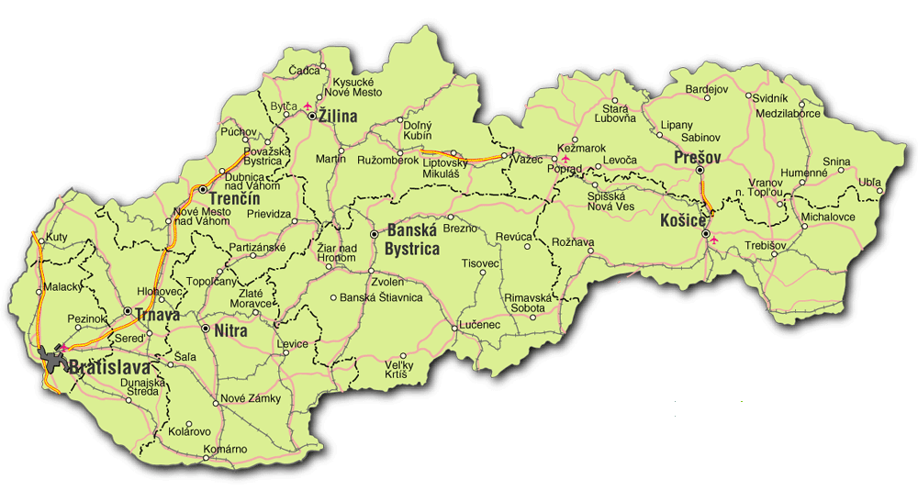
Clinic for preventive cardiology and
lipid metabolism disorders
Children faculty hospital, Kosice

Slide 12
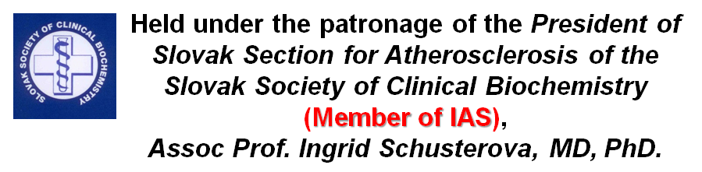

„School of Obesity”- Obesity reduction program
Based on a training program OBELDICKS
Interdisciplinary outpatient program
(Highly organized team of specialists )

Slide 13
„School of Obesity”- Obesity reduction program
Focuses on the same sex/ age groups of children and adolescent
Family based strategies to control weight changes include
    Controlling the child’s environment
    Monitoring behavior
    Setting goals
    Rewarding successful behavior changes

Slide 14
The goal is to win the fight against obesity- prevention of cardiovascular disease associated with obesity, and treatment of childhood obesity by new way
Role of
Cardiologist
Weight
management
„School of Obesity”
Role of
Endocrinologist
Physical
Activity
Group Exercise
Role of
Psychologist
Role of
Dietologist

Slide 15
Physical activity
Group Exercise
Professional / fitness instructor-led exercise
Promote physical activity
Reduce sedentary behaviors in children
Provide guidance to children and adolescents, their parents, caregivers on healthy body size, physical activity, sleep behaviors

Slide 16
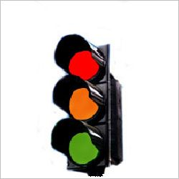
"GOOD" (adequate) FOOD
Role of Dietologist
"BAD" (inadequate) FOOD
"NOT BAD – NOT GOOD" FOOD
Provide clear guidance and support to caregivers to avoid specific categories of foods (e.g. sugarsweetened milks and fruit juices or energy-dense, nutrient-poor foods) for the prevention of excess weight gain

Slide 17
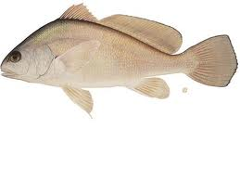
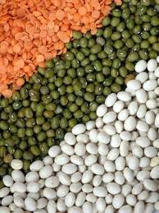

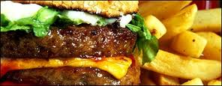

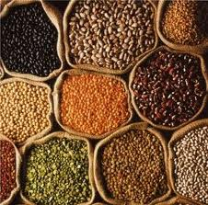
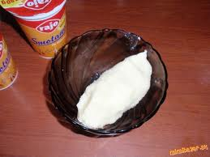

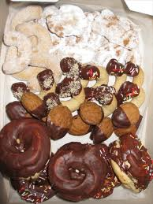





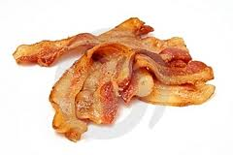
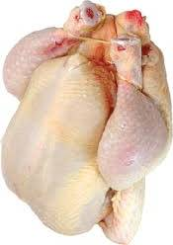


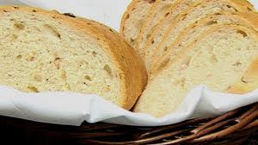
Recommended food
Not recommended food

Slide 18
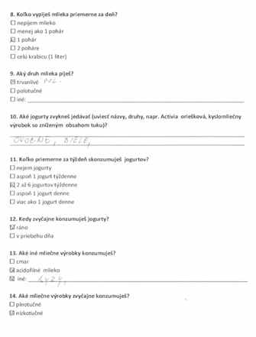
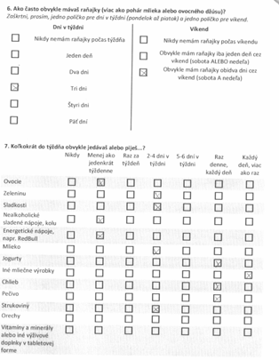

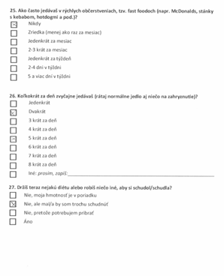
Role of Dietologist
Dietary Intake Questionnaire
Questionnaire that asks participants to report the frequency of consumption of a defined list of foods

Slide 19
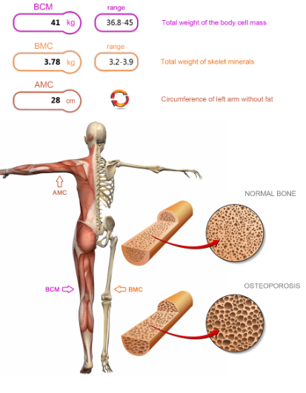
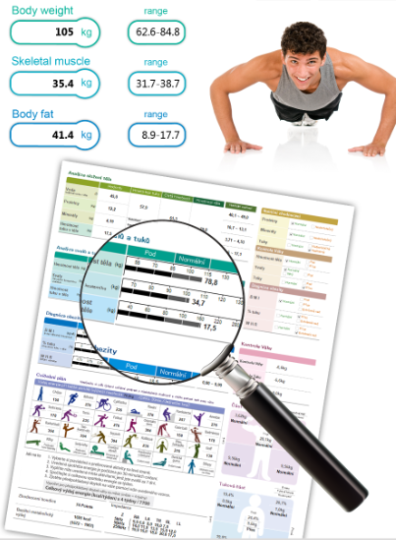
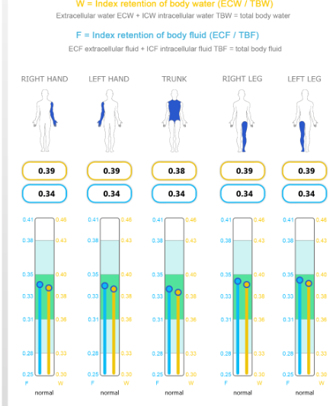
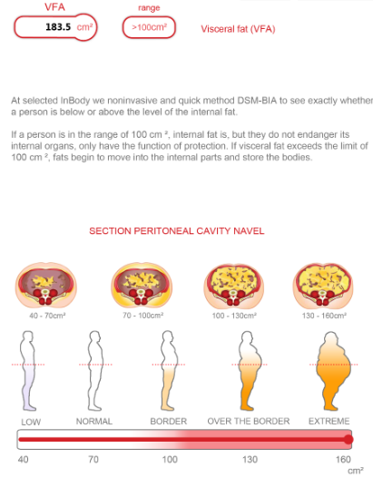
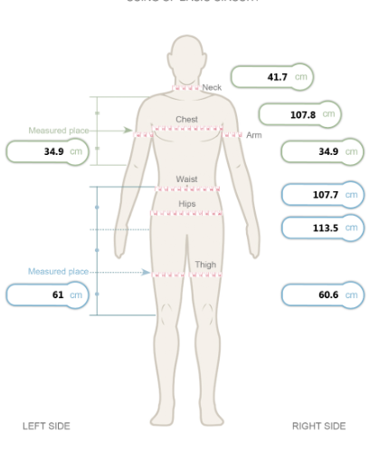
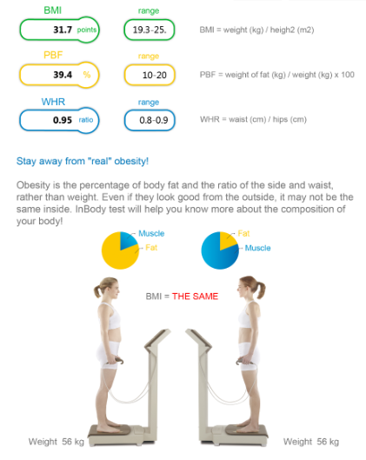
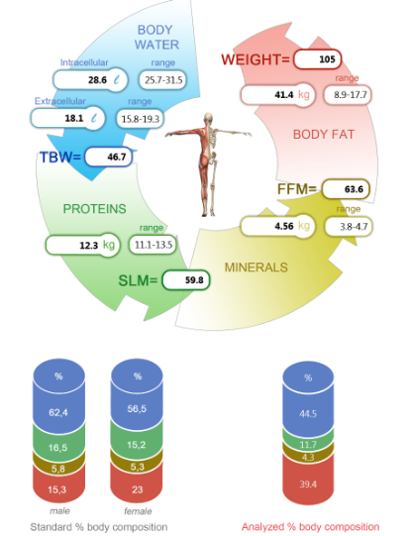
Weight management
Every 2 months

Slide 20
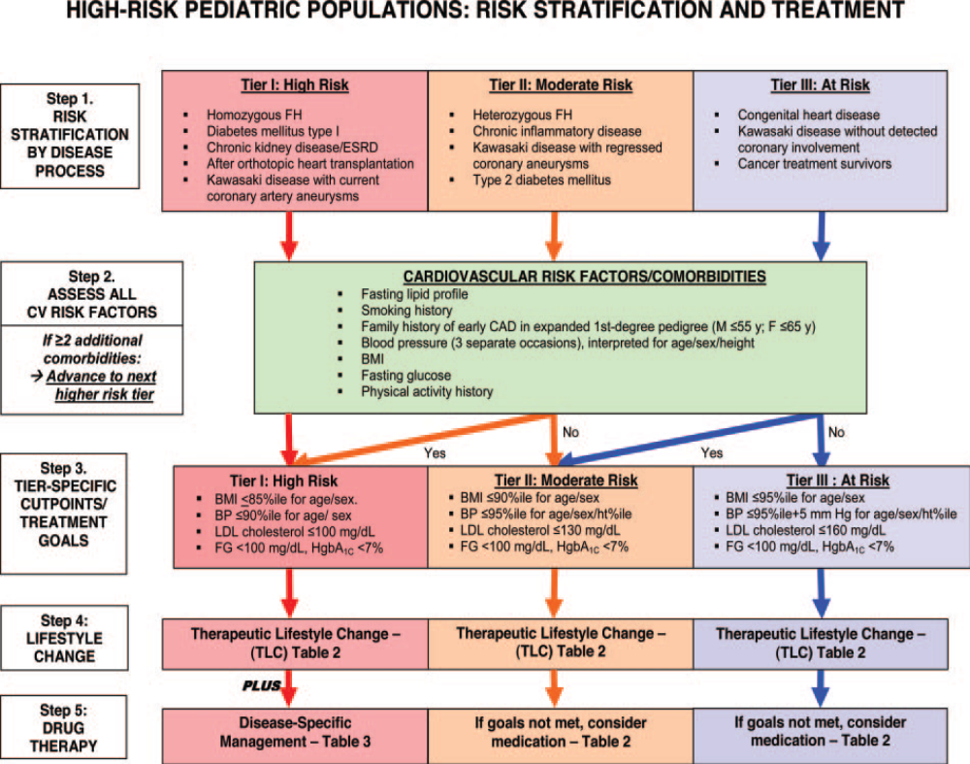
Role of Cardiologist
Primary prevention of cardiovascular comorbidities and complications of childhood obesity

Slide 21
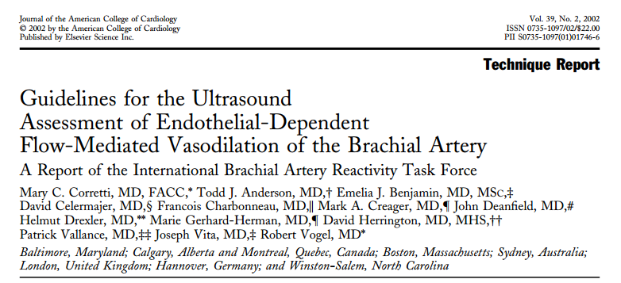
FMD
Endothelial function is thought to be an important factor in pathogenesis of atherosclerosis, hypertension and heart failure
In the 1990s, high-frequency ultrasonographic imaging of the brachial artery to assess endothelium-dependent flow-mediated vasodilation was developed

Slide 22
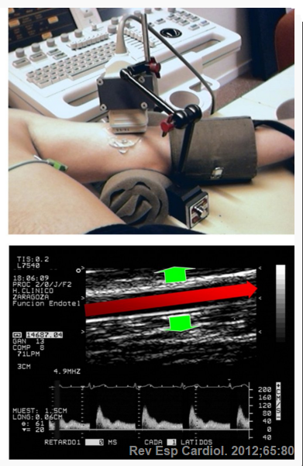
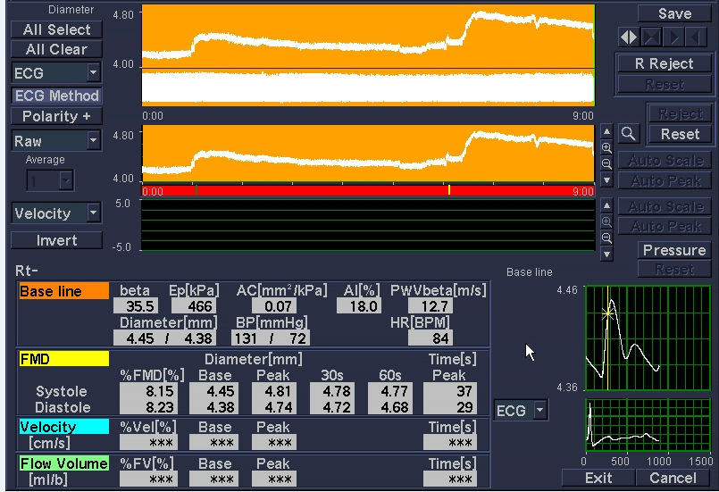
FMD
baseline
diameter
cuff deflation
after cuff deflation
FMD typically expressed as the change in post- stimulus as a percentage of the baseline diameter
Corretti, MC. Journal of the American Collage of Cardiology, 2002

Slide 23
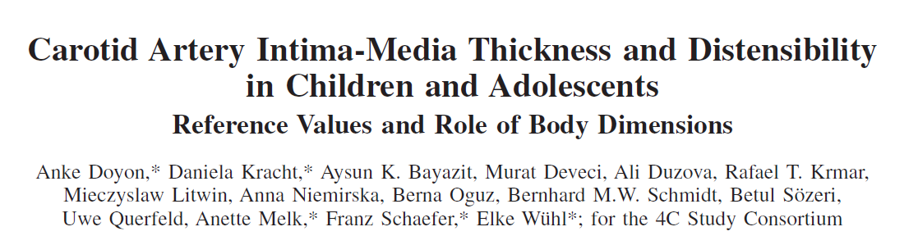

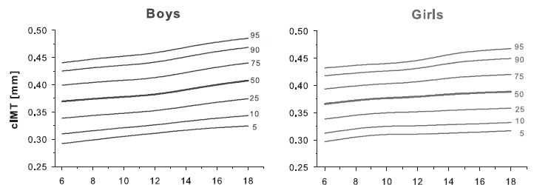
Reliable screening methods for vascular alterations and the assessment of cardiovascular risk in adult and pediatric cohorts
Doyon, A., et al. Hypertension., 2013

Slide 24
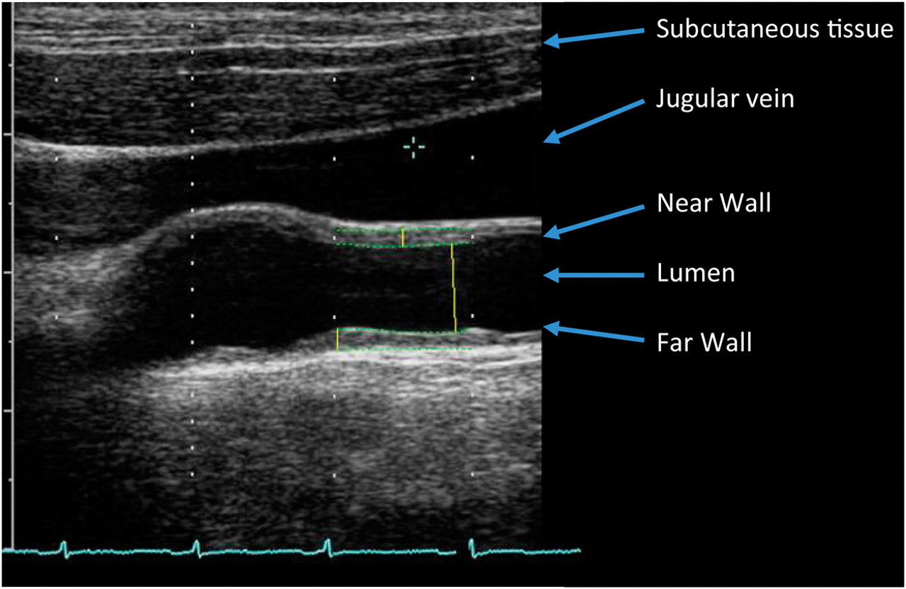
cIMT
Doyon,A., et al. Hypertension, 2013

Slide 25
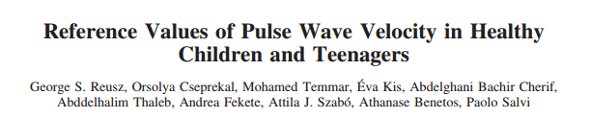
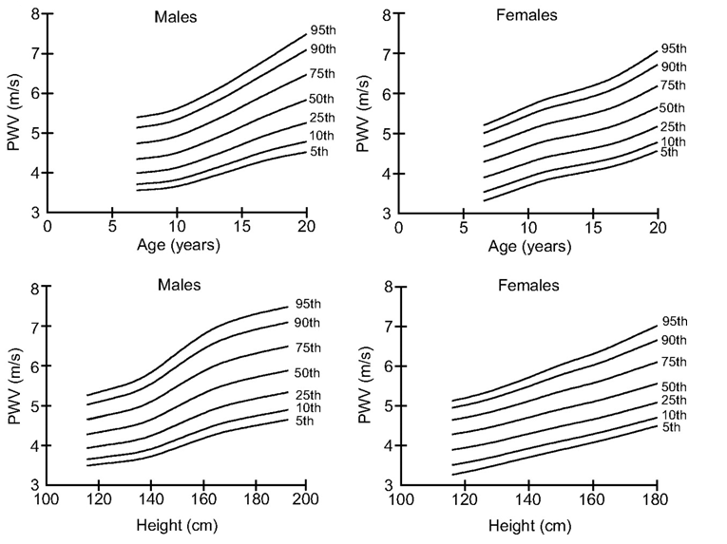

PWV (Aortic Pulse Wave Velocity)
PWV is a sensitive marker of arterial stiffness and, consequently, of cardiovascular outcome
Reference database
Reusz, GS., et al. Hypertension, 2010

Slide 26
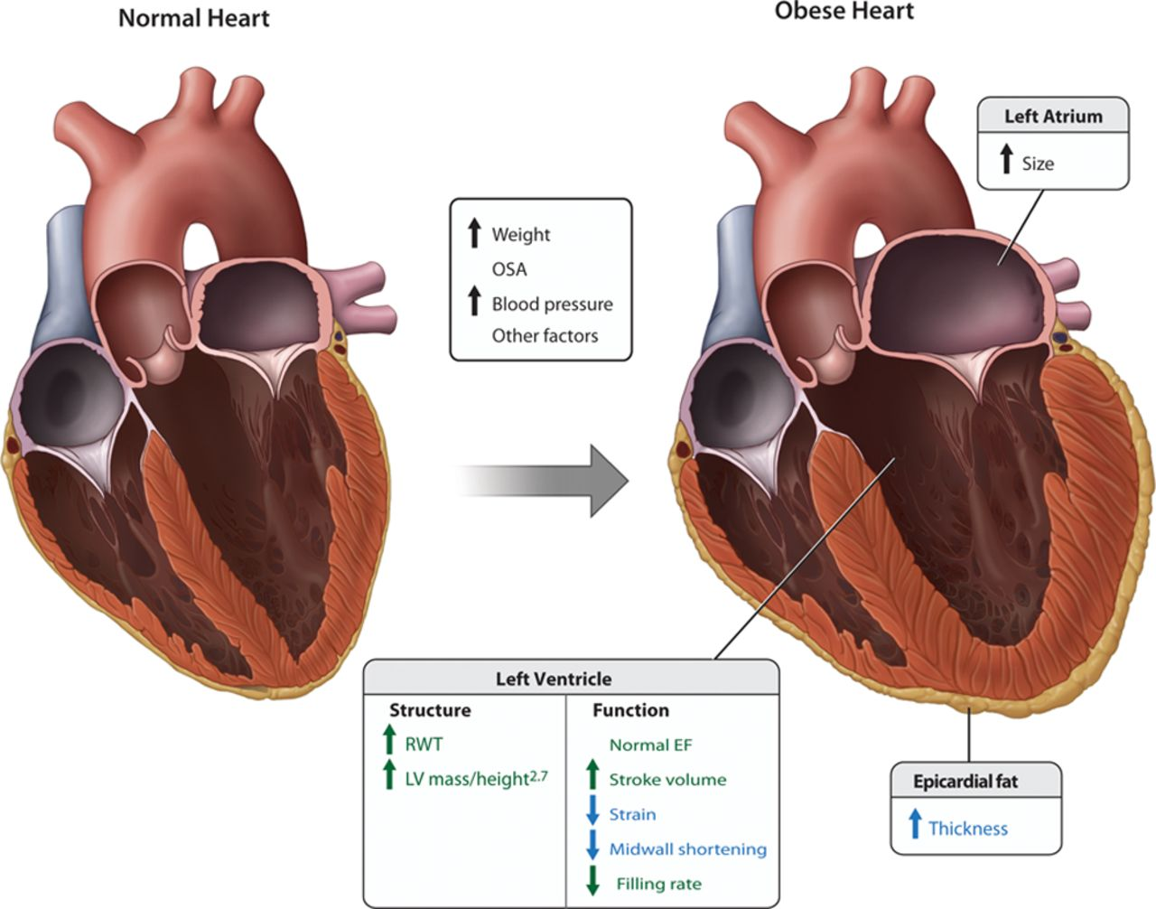
ECHO „Obesity cardiomyophathy “
„Obesity
cardiomyophathy “
Schusterova, I. Cardiomyopathy associated with obesity: Obesity Cardiomyopathy, In Abdominal Obesity, Risk factors, Weight Reduction and Long- Term Health Effects, 2015
Gerard, P., et al. Cardiac remodeling in Obesity, Circulation, 2013

Slide 27
Role of Endocrinologist
A, Glucose metabolism
Insulin resistance Prediabetes (impaired fasting glucose/ impaired glucose tolerance) Type 2 diabetes mellitus Metabolic syndrome
B, Growth- and puberty- related issue
Girls Hyperandrogenism/ polycystic ovarian syndrome Earlier menarche Boys Later pubertal onset Pseudo- micropenis (hidden penis) Reduced circulating androgens
C, Thyroid function aberrations
Diagnosis and management of endocrine comorbidities and complications of childhood obesity

Slide 28
Role of Psychologist
Diagnosis of psychosocial complications
  Body dissatisfaction
  Symptoms of depression
  Loss- of- control in eating
  Unhealthy and extreme weight control behaviors,
  Impaired social relationships decreased health-
  related quality of life
Management of psychosocial complications
Important tools :
  Motivational interviewing
  Patient talking points
  Brief screening measures

Slide 29
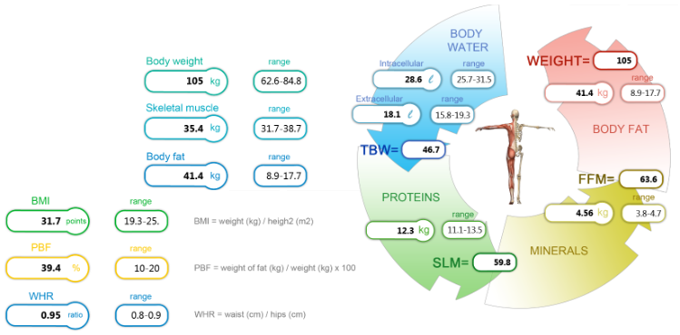
Johanes (14y.)
Biochemical parameters
Glucose (mmol L⁻¹) | 4.82
Uric acid (umol L⁻¹) | 414.2
Total cholesterol (mmol L⁻¹) | 3.98
TAG (mmol L⁻¹) | 1.87
HDL cholesterol (mmol L⁻¹) | 0.94
LDL cholesterol (mmol L⁻¹) | 2.70
Inzulin (uIU/ml) | 24.2
HOMA-index | 5.18
Childhood obesity
Hyperuricemia
Elevated TAG
Insulin resistance
Prehypertension ( BP: 130/82 mmHg )

Slide 30
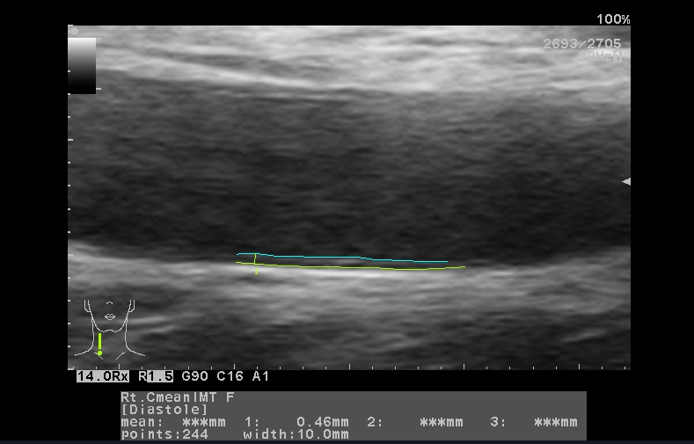
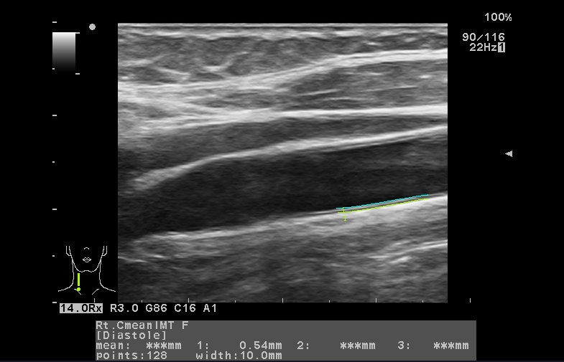
Johanes (14y.)
Cardiovascular risk factors:
  Obesity
  Elevated TAG
  Insulin resistance
  Prehypertension
  Hyperuricemia
Elevated mean cIMT
(≥90th percentile)

Slide 31
SUCCESSFUL TREATMENT
Cooperation between the entire family and siblings is crucial!!!
Changes in children’s lifestyle
Encouraging child’s awareness of:
- Negative impacts of obesity
- Making them aware of difficulties it causes
- Explaining mistakes made in the choice of food, distribution of meals during a day, and in the choice of out-of-school and leisure activities

Slide 32


Thank you for your attention

