Slide 1

Personal Protective Equipment; Dressing in the Dark.
Todd Bell, M.D.
Center for Tropical Medicine and Infectious Diseases
Texas Tech University Health Science Center, Amarillo

Slide 2
No financial disclosures

Slide 3
Objectives
Briefly review EVD PPE recommendations
Review evaluation concepts as they apply to PPE
Review some studies related to EVD PPE
Present opinion regarding local PPE evaluations

Slide 4
Ebola Virus Disease (EVD) 2014-15
27,000+ Cases
11,400+ Deaths
Healthcare workers 860+ infections
Healthcare workers 500+ deaths

Slide 5
Ebola Mode(s?) of Transmission
Direct contact with virus laden bodily fluids
Respiratory / Aerosalization?

Slide 6
Current PPE guidelines - CDC
N-95 or Powered Air-purifying Respirator (PAPR)
Goggles or face shield
Head cover
Double gloves
  Outer pair beyond wrist
Waterproof gown or coverall
Disposable apron
Waterproof foot covering
Structured donning/doffing procedure

Slide 7
Current PPE guidelines - WHO
Surgical mask
Goggles or face shield
Head cover – Optional
Double gloves
  Outer pair beyond wrist
Waterproof gown or coverall
Disposable apron
Waterproof foot covering
Structured donning/doffing procedure

Slide 8
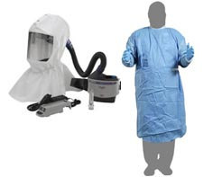
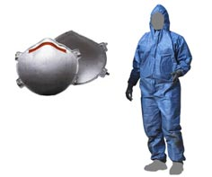
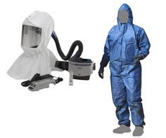
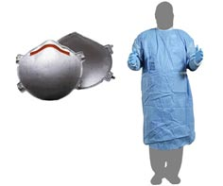
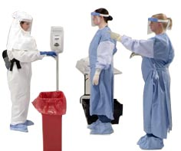
“Select Your PPE Combination”
www.CDC.gov

Slide 9
PPE Options
www.grainger.com
1908 Coverall options
34 Gown options
957 Glove options
204 Foot coverings
37 Eye protectors
468,598,740,192 Possible combinations

Slide 10
PPE Options
www.grainger.com
1908 Coverall options
34 Gown options
957 Glove options
204 Foot coverings
37 Eye protectors
468,598,740,192 Possible combinations
Effect of Donning/ Doffing Procedure?

Slide 11
PPE Recommendations
Good, Better, Best?
Data?
How to compare?

Slide 12
Testing?
Virtually no data comparing different bundles of components for Ebola
Very little data comparing training mechanisms

Slide 13

Component testing

Slide 14
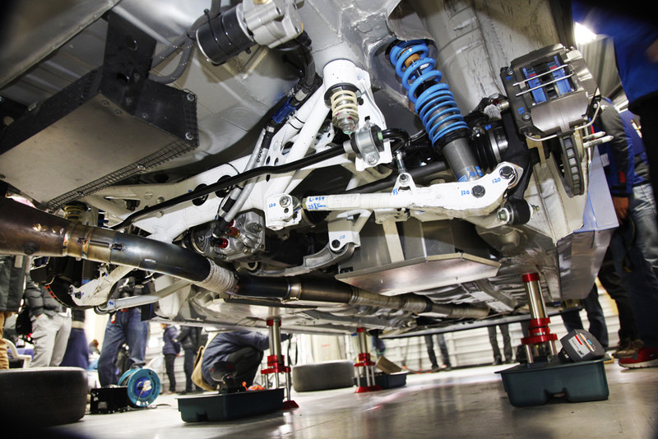
Bundle Testing

Slide 15
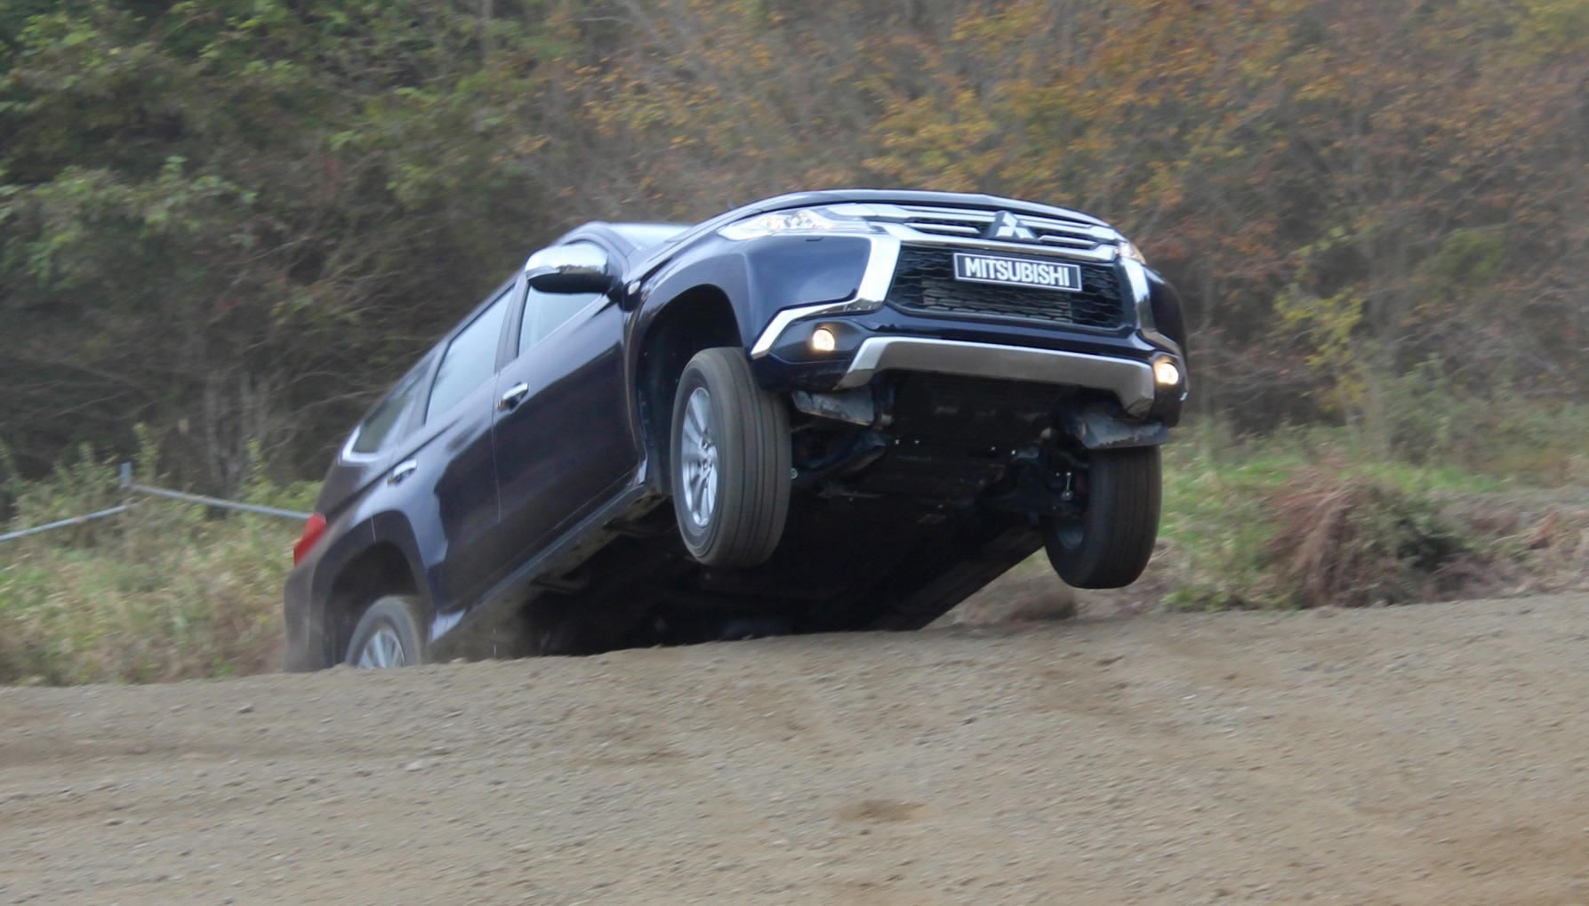
System Testing

Slide 16
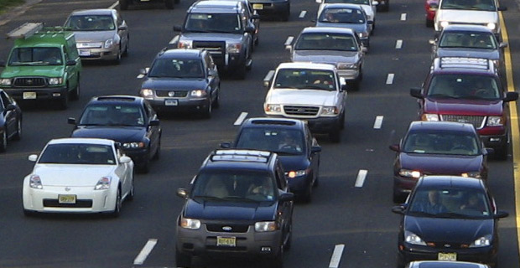
Real World Application

Slide 17

Component testing - PPE

Slide 18

Bundle Testing - PPE

Slide 19
System Testing - PPE

Slide 20
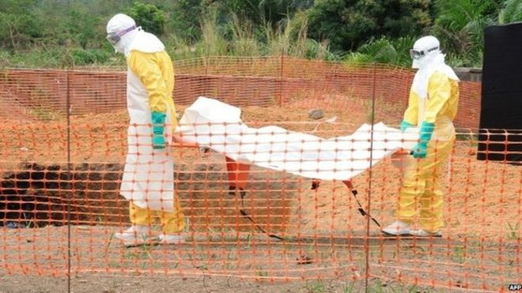
Real World Application - PPE

Slide 21





Slide 22
Comparison of Training Techniques
Casalino et al., 2015
120 PPE “naïve” learners
2 PPE bundles
2 Training techniques
Uniform 1 hour didactic
3 hands on training sessions
Outcome: Errors identified during tasks (“Process outcome”)

Slide 23
Comparison of Training Techniques - Casalino et al., 2015
Conventional training –
  Instructor observed pairs of learners performing donning/doffing tasks
  Instructor intervened when noted error
Reinforced training –
  Instructor verbally iterated each step of the donning/doffing process
  Instructor intervened when noted error
  End of session debriefing

Slide 24
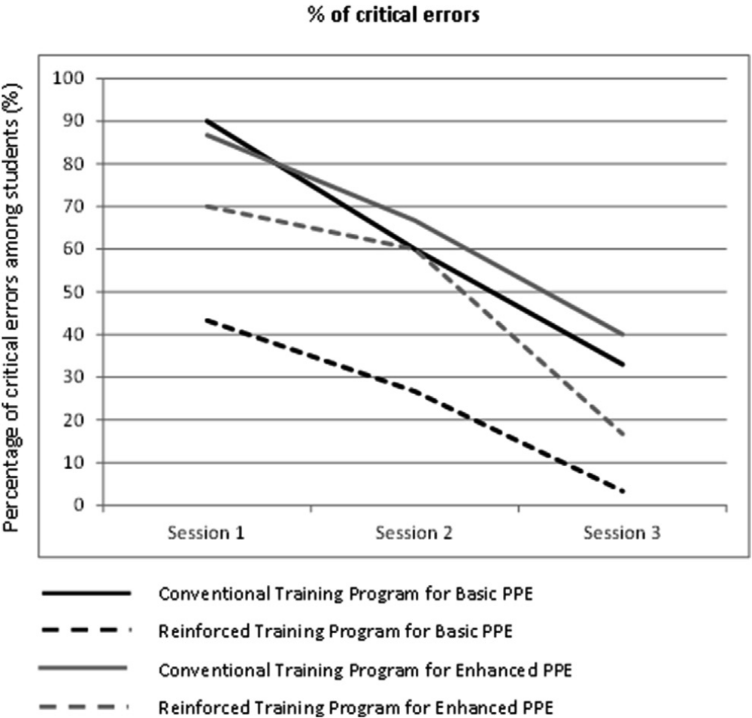
Comparison of Training Techniques - Casalino et al., 2015
Casalino, 2015.
Figure 1

Slide 25
Casalino 2015 – “Take home points”
Repetition of training decreases errors in process
More complex PPE may not equal greater protection

Slide 26
Fluorescents as Contamination Markers - Bell et al, 2015
8 PPE “naïve” learners
2 PPE bundles
Uniform training techniques
1 hour didactic
Instructor assistance with donning/doffing
Participants performed 15 minutes of medical tasks in simulation center with fluorescent contaminated mannequin
Outcome: Contamination of skin visible under blacklight examination (“Event outcome”)

Slide 27
Fluorescents as Contamination Markers - Bell et al, 2015
Conventional PPE bundle
  PAPR – CDC guidelines
  Commercial components
  $6700/ ensemble
Alternate PPE bundle
  N95 mask – CDC guidelines
  Used components readily available in facility or local department store
  $25/ ensemble

Slide 28
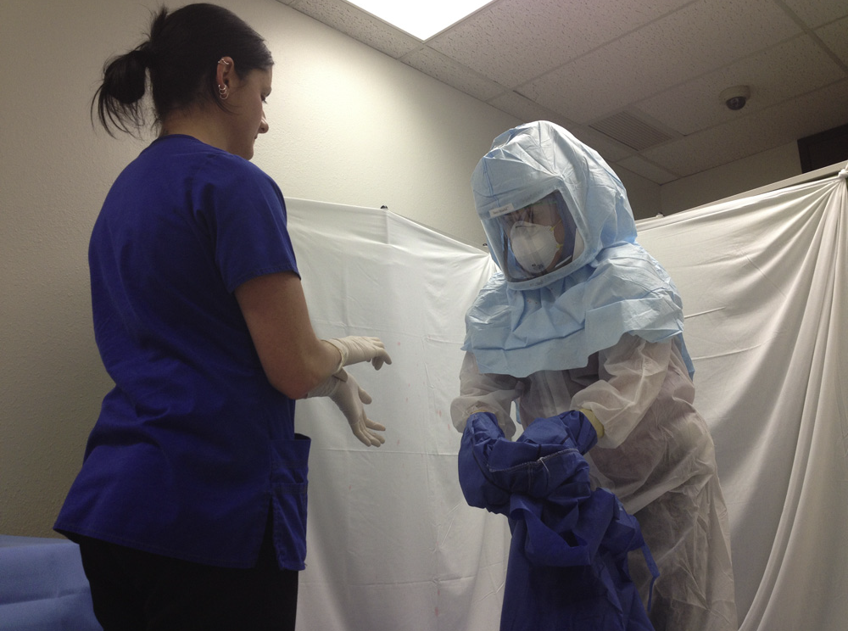
Fluorescents as Contamination Markers - Bell et al, 2015

Slide 29
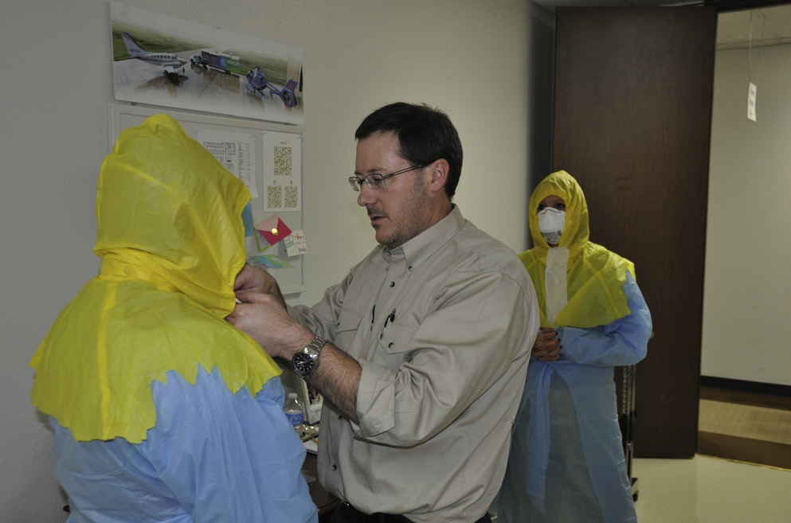
Fluorescents as Contamination Markers - Bell et al, 2015

Slide 30
Fluorescents as Contamination Markers - Bell et al, 2015
Conventional PPE bundle
  1 participant had visible contamination
Alternate PPE bundle
  1 participant had visible contamination

Slide 31

Fluorescents as Contamination Markers - Bell et al, 2015

Slide 32
Bell 2015 – “Take home points”
Fluorescents may be marker for evaluating training/ PPE systems
Commercial PPE components may not be better?

Slide 33
EVD PPE - Summary
What We Know
What We Don’t Know
Transmission primarily via contact
Not all transmission can be explained by contact
Repetition of training decreases process errors
“Ideal” PPE bundle
“Ideal” PPE training
Number of training events
Frequency of training events
How do individual components coordinate
Impact of body habitus
What about ancillary? Bleach sprays, taping, etc.

Slide 34
Strategies for “Grassroots” PPE testing (my opinion)
Determine PPE components to be used and don’t change without a compelling reason
Choose components compatible with available resources
Train multiple times with same components
Quantify process errors during training exercises
Utilize simulation to determine “event outcomes” if possible
Retrain periodically

Slide 35
Thank you for your time.

