Slide 1
5th International Congress on Virology
December 7-9, 2015 Atlanta Ga
Symposium on Anti-HIV Drug Combination Strategies
December 9th, 2015 9-10AM
Chair by Ting-Chao Chou & M. Intakhab Alam

Slide 2
Computerized Simulation of Anti-HIV Drug
Synergy in Vitro and in Clinical Trials Using the
Chou-Talalay Combination Index Method
Ting-Chao Chou, Ph.D.
PD Science, LLC USA
(Retired Professor from Cornell/MSKCC)
5th World Congress on Virology
December 7-9, 2015 Atlanta, Ga
Symposium on Anti-HIV Drug Combination Strategies
12.9.2015 9:00-9:30 AM

Slide 3
The Outlines for Today
To Refresh/Review the Principle & Theory
of Chou-Talalay Combination Index (CI)
Method.
To Show Why CI<1 (Synergism), CI=1 (Additive) and CI>1 (Antagonism)
To Give Specific Example: AZT+IFN Combination Step-By-Step Analysis

Slide 4
Effect of rIFNαA and AZT Singly or in Combination on RT (cpm/10⁶ cells x 10³) in Expt. 2, Day 10*
AZT (μM) | 0 | 8 | IFN 16 | (U/ml) 32 | 64 | 128
0 | 205 | 173 | 150 | 193 | 169 | 151
0.01 | 159 | 85
0.02 | 110 |  | 42
0.04 | 71 |  |  | 10
0.08 | 31 |  |  |  | 4
0.16 | 7 |  |  |  |  | 1
* From Hartshorn et al, Antimicrob. Agents Chemother. 31: 168-172, 1987
(MGH, Harvard Medical School/Chou, MSKCC) (Cited by 252 articles)

Slide 5
“Synergy Definition” for Drug
Combination
(Controversy for Over 100 Years)
Drug Combination: Widely Used in Cancer , AIDS & Chinese Medicine
Synergism: 20 Different Synergy Definitions
  None Supports the Others !!
Challenge: If No Clear Definition for Synergy: NIH, FDA, USPTO
  and Journal Editors have No Basis to Judge or to Regulate
  the “Synergy Claims”
Combination Index Theorem: Chou and Talalay, 1984, Quantitative Determines
CI <1, Synergism CI=1, Additive Effect CI>1, Antagonism
― The Dispel of the Century-Old Controversy of “Synergy Claims”
Chou TC: The CI Method Prevailed. The Most Cited Method of All Time
Pharmacol. Rev. 58:621-681, 2006 ( Review , 61-pages)
Adv. Enz. Regul. 22:27-55, 1984 (Created the CI Theory)
Cancer Res. 70: 440-446, 2010 (Perspectives)
[3 Articles with a Total of >6,000 Citations]

Slide 6
Setbacks in Anti-HIV Drug Combinations – in Chou’s Views
Confusions in Synergy Definition
Drug Combination Clinical Trials Design Errors
Inappropriate Experimental Design & Data Analysis
Lack of Econo-Green Consideration
Obsessed with Statistics, PK, and “Intermediary Steps”, and Neglected Final “PD”
IP Settles with Lesser Choices and Insufficient Coordination/Collaboration Among Pharmas

Slide 7
The Tales of Two Anti-HIV Clinical Trials
AZT + 3TC
AZT + INF_{α}
Authors
J.J. Eron et al. (9 authors + Northern Am. HIV Working Party
D. Mildvan et al. (21 authors)
Publication
N. Engl. J. Med. 333: 1662-1669, 1995
Antiviral Therapy 1(2): 77-88, 1996
Journal
Impact Factor
28.5
3.1
366
36
Number of Patients
[Wrong Design & Wrong Analysis]
Surrogate Marker
CD₄⁺ , HIV-RNA
P24 Antigen, CD₄⁺
Treatment Design
Fractionated Repeated Doses
Fractionated Repeated Doses
AZT Single Dose, 3TC 2 Doses
Both Drugs have 3 Doses
What They
Have Proved
“Combination Effect is Greater than Each Drug Alone”
A+B > A or A+B > B (p<0.001) Does Not Need A Proof ! Not Possible to Claim Synergism
“Quantitative Determination of Synergism Using Combination Index Method” (CI < 1 indicate synergism) Use Chou-Talalay Method. Adv. Enz. Regul. 22: 27-55, 1984
Conclusion:
Synergy is Not determined by p values but rather with the CI values
Synergy is Not a Statistical Issue but rather a Mass-Action Law Issue

Slide 8
Anti-HIV Drug Combinations
Integrase
Inhibitor
NRTI
NNRTI
Maturation
Inhibitor
Etc.
Protease
Inhibitor
AZT
NEV
Lopinavir
IFN
Combivir
GSK 09/26/97
Kaletra
3TC
ABT 9/15/00
Trizivir
Epizicom
Ritonavir
GSK 11/15/00
Abacarvir
GSK 08/2/04
Raltegravir
Efavirenz
Darunavir
Inhibitor of
Entry
Uncoating
Transcription
Translation
Atazanavir
Tenofovir
Travada
Gilead 8/2/04
Embicitabine
Atirpla
Gilead, BMS 7/12/06
2009
2009
2009
; Fixed dose combination in single pill
; Preferred initial regiments in the US (DHHS) as of 2009

Slide 9
Trends of Drug Combination Methods for Synergy Determination, 1900-2015*
Method, Main Theory and Reference Source | Thomson Reuters
 | Web of Science Citation DataBase
 | Trend of Citation |  |  |  | Total Citations Since Publication | Average Citations per year
 | 2011 | 2012 | 2013 | 2014
A. Chou, TC & Talalay, P Adv. Eng. Regul. 1984; 22:27-55 [CI Method] | 289 | 257 | 283 | 325 | 3,597 | 116.0
B. Chou, TC Pharmacol. Rev. 2006;58: 621-681 [CI Method] | 119 | 146 | 158 | 205 | 1,016 | 112.9
C. Berenbaum, MC Pharmacol. Rev. 1989; 41: 93-141 | 42 | 37 | 46 | 42 | 912 | 33.8
D. Bliss, CI Ann. Appl. Biol. 1939; 26: 585-615 | 48 | 70 | 68 | 76 | 705 | 9.2
E. Steel GG & Peekham MJ Int. J. Radiant. Oncol. BioPhys. 1979; 5: 85-91 | 16 | 22 | 14 | 15 | 680 | 18.4
F. Greco, WR et al Pharamacol. Rev. 1995; 47: 331-385 | 33 | 38 | 56 | 56 | 614 | 29.2
Chou TC Cancer Res. 2010; 70: 440-446 [CI Method] | 41 | 75 | 123 | 174 | 582 | 116.4
H. Elion GB, Singer S & Hitchings GH J. Biol. Chem. 1954; 208: 477-488 | 3 | 9 | 4 | 4 | 449 | 7.2
I. Tallarida, RJ J. Pharmacol. Exp. Ther. 2001; 298: 865-872 | 26 | 26 | 34 | 34 | 353 | 23.5
J. Prichard, MN & Shipman C Jr Antiviral Res. 1990; 14: 181-205 | 16 | 18 | 16 | 24 | 342 | 13.2
K. Webb J.L. Acad. Press. 1963; 1: 66-79, 488-512 | 8 | 9 | 12 | 6 | #262 | 5.1
L. Loewe, S Pharmacol. Rev. 1957; 9: 237-242 | 3 | 0 | 4 | 5 | 118 | 2.0
*Based on Thomson Reuters Web of Science All Database Collection, as of June 3, 2015. (Updated 12.4.2015)
#Based on Google Scholar Citations, as of June 3, 2015.

Slide 10
Time Course of Cumulative Citations of Chou TC & Talalay P
Adv. Enz. Regul. 22: 27-55, 1984 (Thomson-Reuters Web of Science)
[ It received 1 citation in 1st year, 6 citations in 2nd year. Now, 31 years later, it received a total of 4,444 citations. Unlike physical or e-Technology, new conceptual/theoretical Truth is hard to be accepted, but to pay the high price. The “Paradigm Shift” is difficult. It took many centuries to convince people and scientists that the Earth is not flat, and Sun is not circulating the Earth! Why mainly chasing “trivia” and neglect the “fundamentals”?
Number of Cumulative Citations

Slide 11
The Unified Theory
Derivation of Major Biochemical and Biophysical Equations from the Median-Effect Equation
[Chou T.C. Pharmacol. Rev. 58: 621-681, 2006]
Henderson-Hasselbalch equation
log [H⁺] = log K_{a} + log ^{[HA]}
^{[A–]}
pH = pK_{a} + log ^{[A–]}
^{[HA]}
Michaelis-Menten equation
v/V_{max} = [1+(K_{m}/S)]^{–1}
( )
f_{a}
f_{u}
_{m}
=
D
D_{m}
The Median-Effect Equation
Chou, J. Theor. Biol. 59: 253-276, 1976
f_{a} /(1–f_{a} ) = (D/D_{m})^{m}
f_{a} = [1+(D_{m}/D)^{m} ]^{–1}
f_{a} = [1+(D_{m}/D)^{m} ]^{–1}
log [( f_{a}/(1–f_{a})] = m[log(D) – logD_{m}]
log [( f_{a}/(1–f_{a})] = m[log(D) – logD_{m}]
log [( f_{a})^{–1}–1]^{–1} = m log(D) – m logD_{m}
log [( f_{a})^{–1}–1]^{–1} = m log(D) – m logD_{m}
f_{a}/f_{u} = D/D_{m}
f_{a}/f_{u} = D/D_{m}
Hill equation
log [v/(V_{max} –v)] = n log(S) – log (K)
Scatchard equation
[L]_{b =} n[M]_{t –} [L]_{b}
[L]_{f} K_{d} K_{d}

Slide 12
Algorithm for Computerized Simulation of Synergism, Additivism and Antagonism of the Effect of Multiple Drugs
The Median Effect Equation
(1) f_{a}/f_{u} = (D/D_{m})^{m}
(2) Log( f_{a}/f_{u}) = mlog(D) – mlog(D_{m})
(3) f_{a} = 1/[1+(D_{m}/D)^{m}]
D = Dose
f_{a} = fraction affected
f_{u} = fraction unaffected
D_{m} = median-effect dose
m = slope, Hill-type coefficient
or kinetic order
(4) D_{x} = D_{m}[f_{a} /(1–f_{a} )]^{1/m}
(4) D_{x} = D_{m}[f_{a} /(1–f_{a} )]^{1/m}
₍₅₎ _{CI =} (D)₁ ₊ (D)₂ ₌ 1 ₊ 1
(D_{x})₁ (D_{x})₂ (DRI)₁ (DRI)₂
₍₅₎ _{CI =} (D)₁ ₊ (D)₂ ₌ 1 ₊ 1
(D_{x})₁ (D_{x})₂ (DRI)₁ (DRI)₂
CI : Combination Index
CI = 1 (summation)
< 1 (synergism)
> 1 (antagonism)
DRI: Dose-Reduction Index
_{(DRI)1 =} (D_{x})_{1 , (DRI)2 =} (D_{x})₂
(D)₁ (D)₂
(D_{x})_{1,2} = (D)₁+ (D)₂
and (D)₁/(D)₂ = P/Q
(D)₁ = (D_{x})_{1,2} x P/(P+Q)
(D)₂ = (D_{x})_{1,2} x Q/(P+Q)
D1: D2 = P : Q
For n Drug Combinations:
CI = _{Σ} ^{(D)j}
^{( Dx)j}
n
J=1

Slide 13
CompuSyn
For Single Drug and Drug Combinations
A Computer Program for Quantitation of
Synergism and Antagonism in Drug Combinations,
and the Determination of IC₅₀ , ED₅₀ and LD₅₀ Values.
By Ting-Chao Chou (MSKCC)
and Nick Martin (MIT)
Published and Distributed by ComboSyn, Inc.
©Copyright 2004, $399/Software (2004-2012)
Offered for Free Download upon Registration: Beginning : 8/1/2012
[As of 12/4/2015: 12,509 Downloads from scientists in 92 Countries]
http://www.combosyn.com ( For Download, User’s Guide, Refs. Video Demo, Slide Presentation, & Example of Illustrations) – PD Science, LLC
Notes:
33. CompuSyn is the 3rd generation software originally published and distributed by CompoSyn Inc. for $400 per set. Beginning Aug. 2012, it was offered for free download upon registration at www.combosyn.com. It has Download, User’s Guide, Refs, Video, Slide Presentation & Examples of illustrations. You may download from you lab or home, or contact me during this Conference.
I am pleased to announce that as of this week, there have been over 12,900 download by scientists from 92 countries.

Slide 14
(Chou-Talalay Plot)
Diagnostic Plots
Fa-CI Plot: Effect-Oriented
[Combination Index]
CI < 1: Synergism
CI = 1: Additive
CI > 1: Antagonism
Isobologram: Dose- Oriented
Points on Line: Additive
Points on Lower Left: Synergism
Points on the Upper Right: Antagonism
Both are Two-Sides of the Same Coin
Chou TC, Pharmacol. Rev. 58:621-681, 2006 (61 pages)

Slide 15
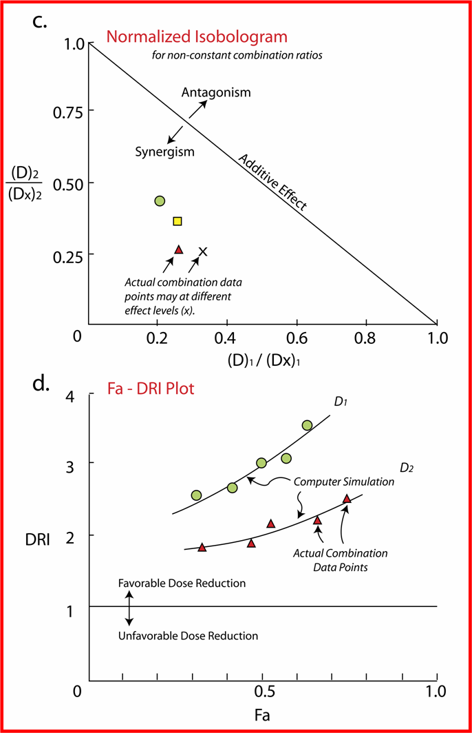
(Chou-Chou Plot)
Diagnostic Plots
Dose Normalized Isobol
Dose Reduction Index
DRI = 1 No dose reduction
DRI > 1 Favorable Dose Reduction
DRI < 1 Not Favorable Dose Reduction
[Reduce Dose Leads to Reducing Toxicity]
(Chou-Martin Plot)

Slide 16
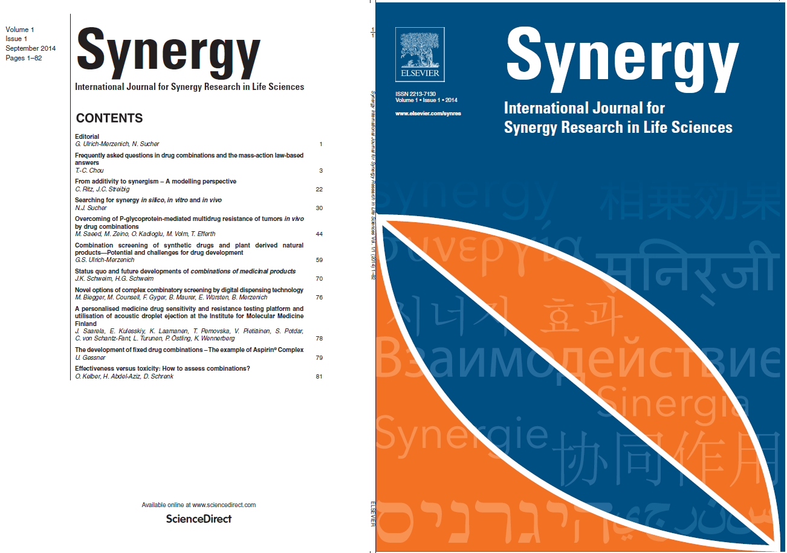
Journal Inauguration Announcement
September 23, 2014
Mip-Tec, Basel, Switzerland

Slide 17
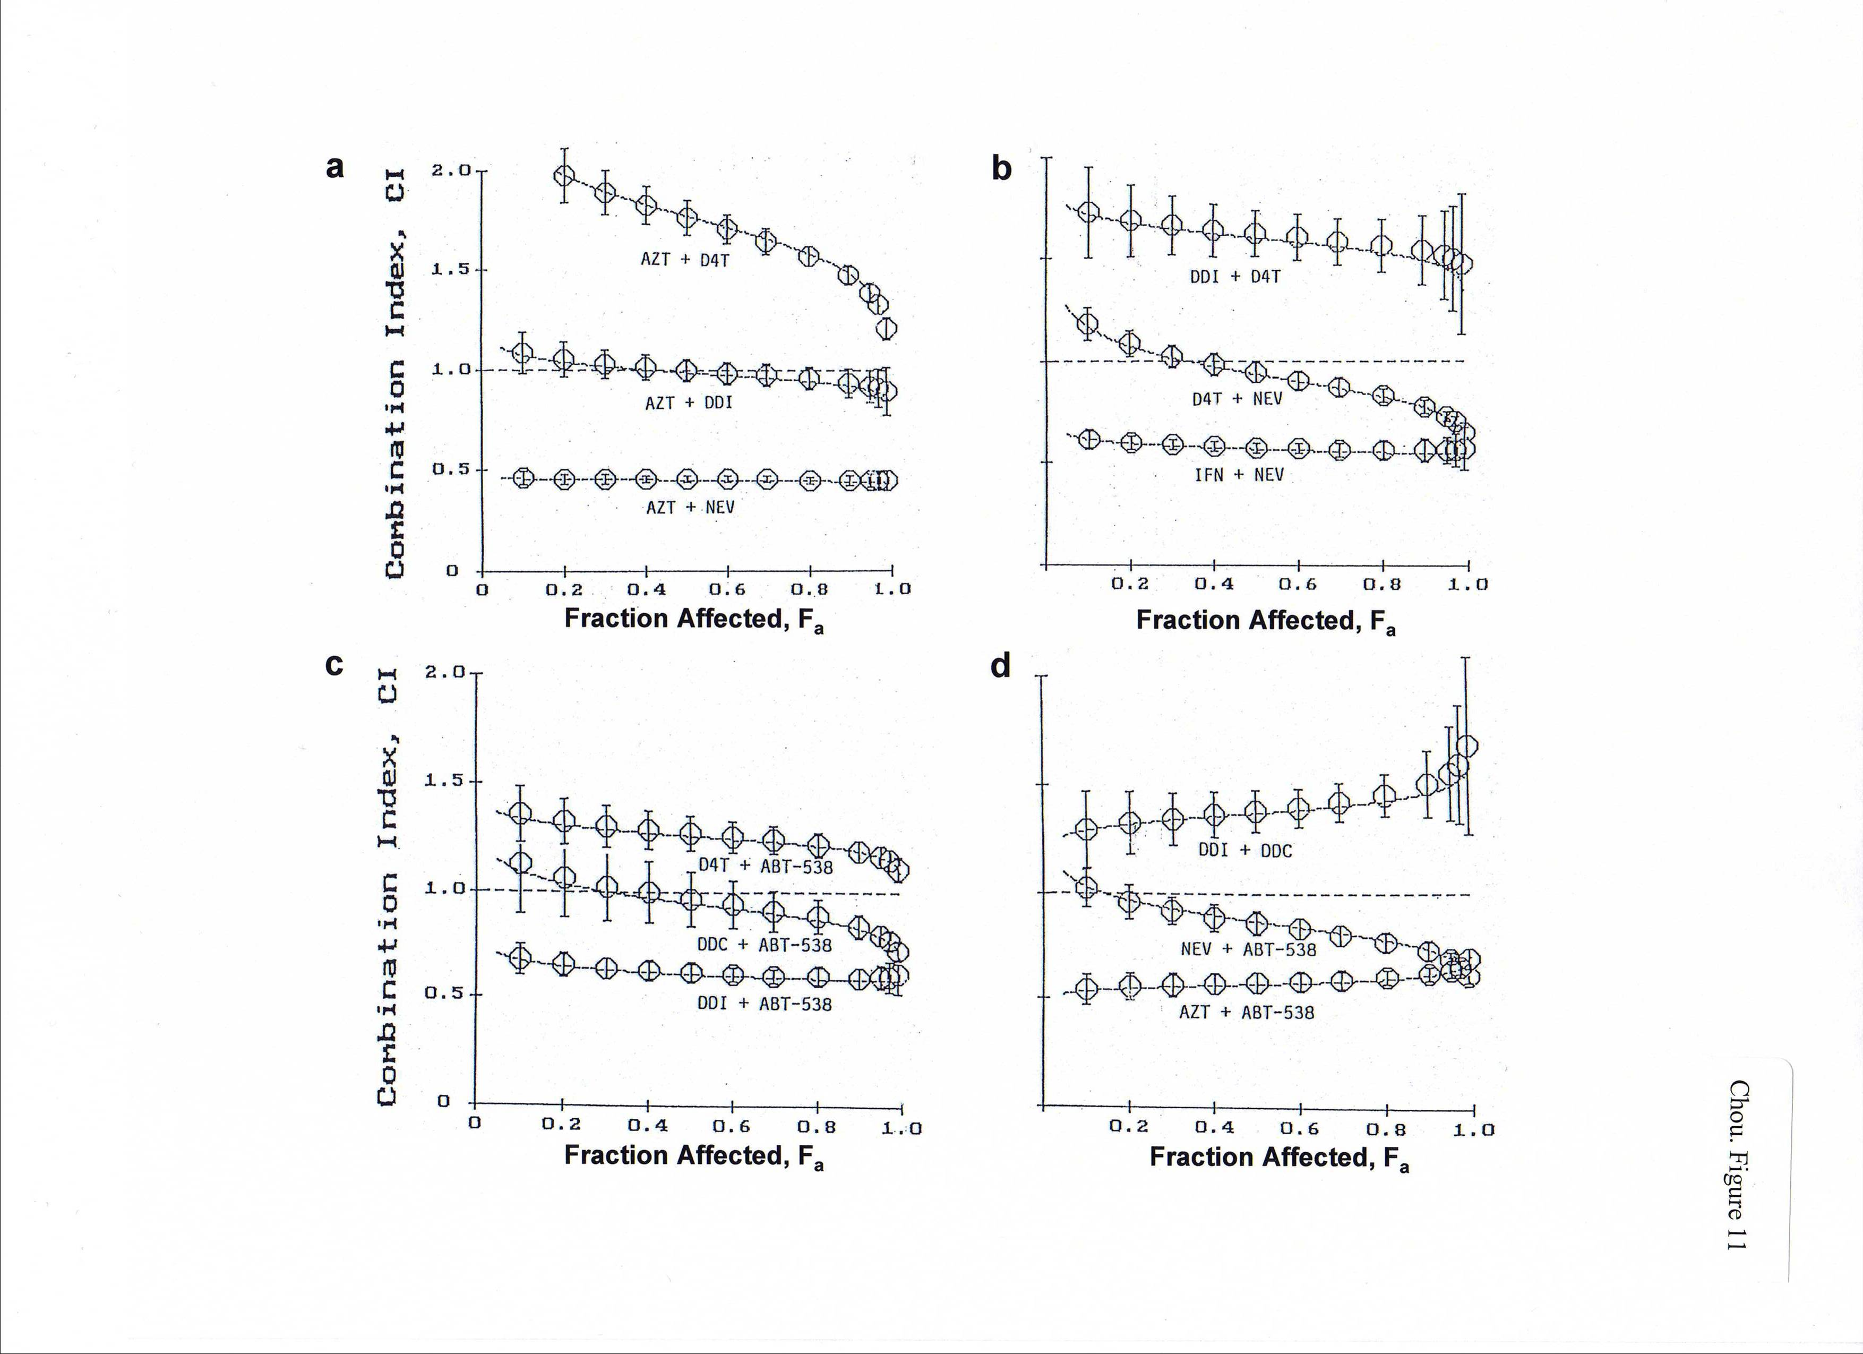

Slide 18
Typical example of changes in DRI values and their relationship
to CI values in two to five drug combinations
Drug Combinations |  | DRIª values at |  |  |  |  | CI^{b} values at
 |  | EC₅₀ | EC₇₅ | EC₉₀ | EC₉₅ |  | EC₅₀ | EC₇₅ | EC₉₀ | EC₉₅
AZT + |  | 3.87 | 3.85 | 3.83 | 3.82 |  | 0.455 | 0.451 | 0.446 | 0.444
NEV (1:40) |  | 5.09 | 5.24 | 5.40 | 5.50
AZT + |  | 5.43 | 5.12 | 4.89 | 4.74
NEV + |  | 7.08 | 6.97 | 6.86 | 6.79 |  | 0.368 | 0.371 | 0.377 | 0.381
IFN (1:40:16) |  | 24.36 | 30.76 | 38.90 | 45.57
AZT + |  | 3.80 | 4.14 | 4.33 | 4.56
NEV + |  | 5.06 | 5.57 | 6.14 | 6.55 |  | 0.602 | 0.574 | 0.548 | 0.532
ABT-538 (1:40:4) |  | 6.87 | 6.61 | 6.38 | 6.20
AZT + |  | 6.0 | 6.0 | 6.0 | 6.05
NEV + |  | 7.81 | 8.16 | 8.52 | 8.79 |  | 0.426 | 0.420 | 0.418 | 0.416
ABT-538 + |  | 10.61 | 9.68 | 8.87 | 8.33
IFN (1:40:4:16) |  | 26.89 | 36.00 | 48.26 | 58.93
AZT + |  | 5.18 | 5.80 | 6.29 | 6.62
NEV + |  | 6.99 | 7.84 | 8.79 | 9.51
ABT-538 + |  | 9.50 | 9.28 | 9.13 | 9.00 |  | 0.609 | 0.539 | 0.485 | 0.455
IFN + |  | 23.95 | 34.65 | 49.83 | 63.78
DDI + (1:40:4:16:1600) |  | 7.90 | 9.77 | 12.09 | 13.97
ª Dose reduction index (DRI) provides a measure of how much (fold) the dose of each drug in a synergistic combination may be reduced at a given
effect level compared with the doses of each drug alone. The relationship of CI and DRI is depicted in Eq. 16.
^{b} CI values are obtained from Tables 22 and 23.

Slide 19
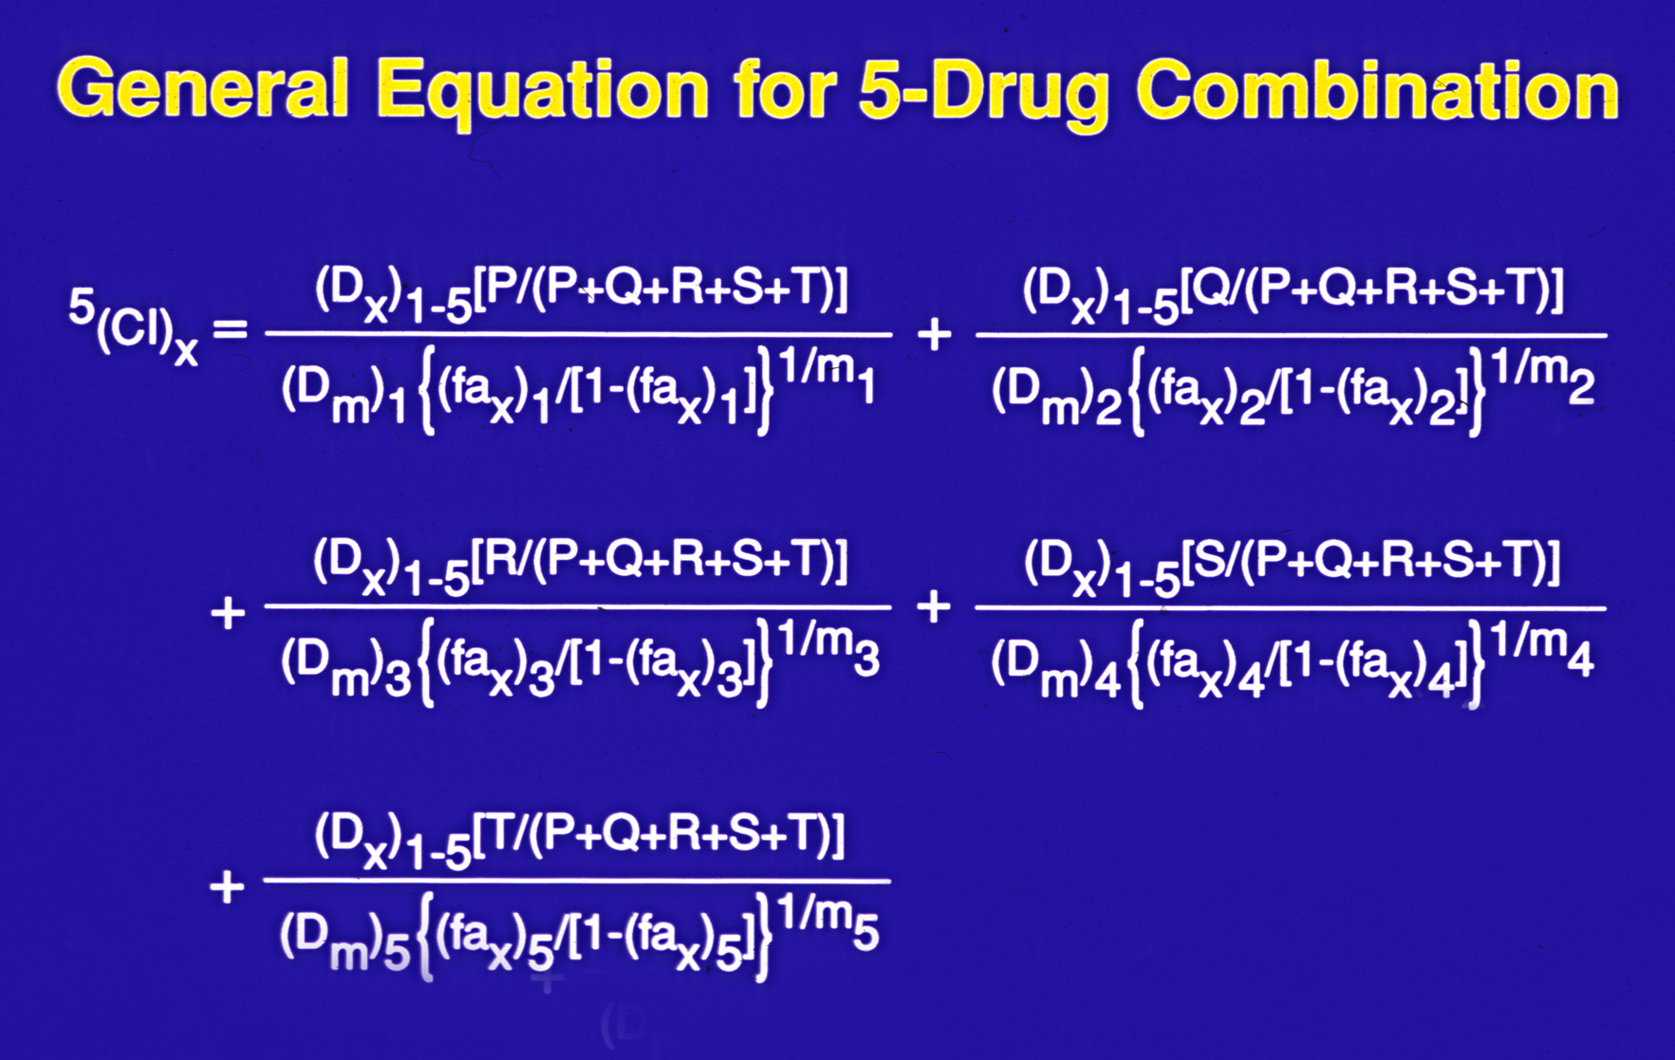
(Chou TC, Pharmacol. Rev. 58: 621-681, 2006)

Slide 20
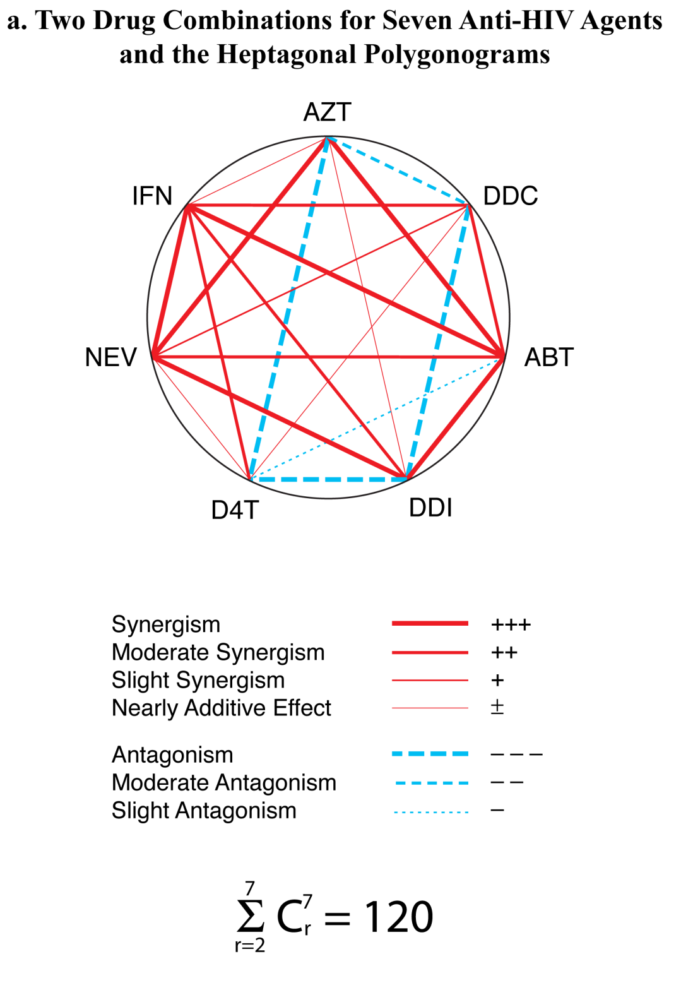
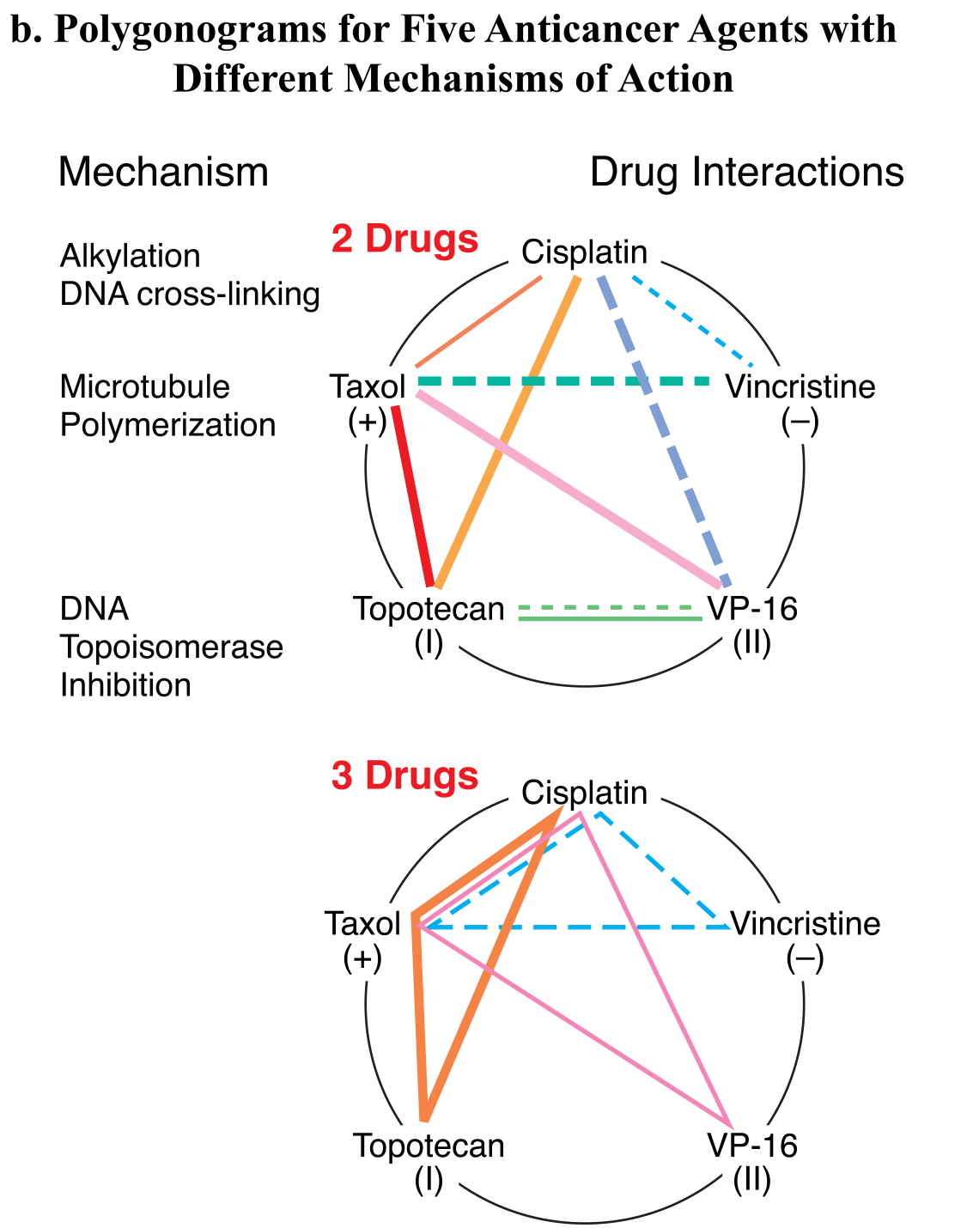

Slide 21
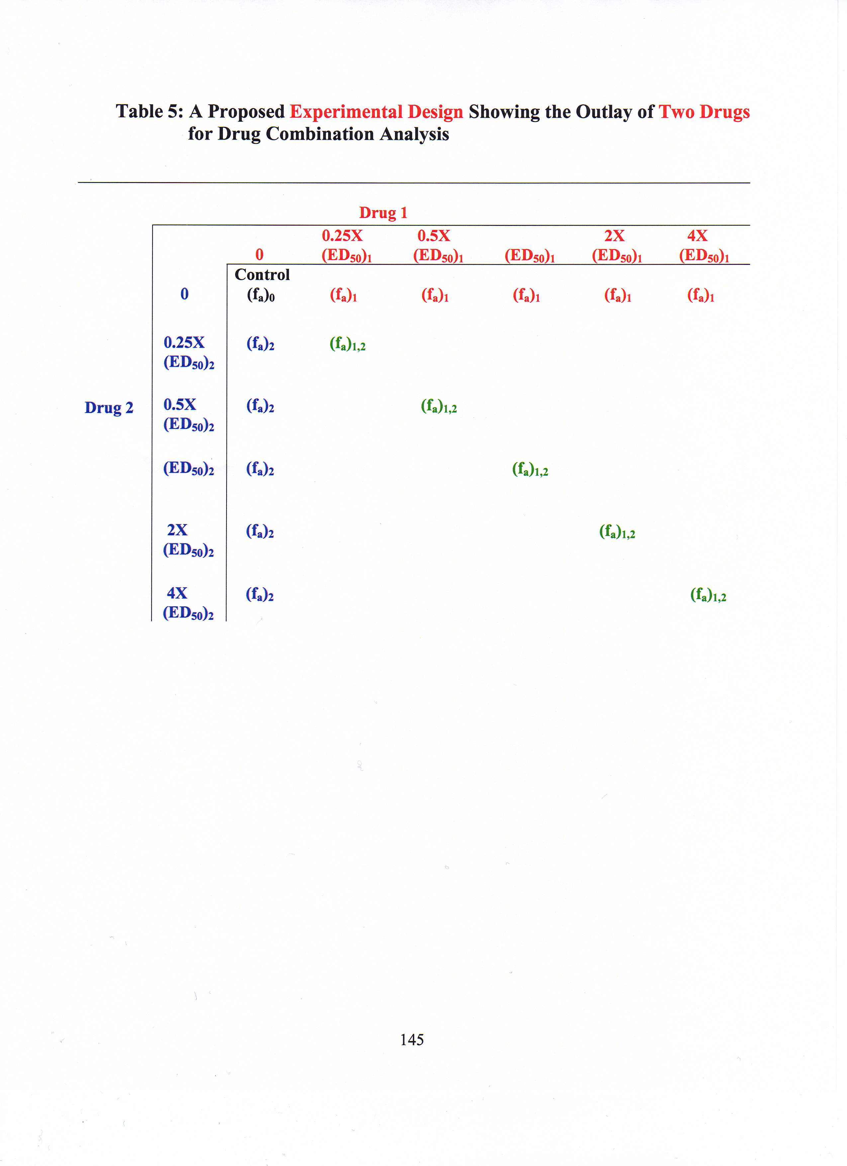
The Typical Constant-Ratio Experimental Design Showing the Scheme for Two Drug Combinations in Vitro

Slide 22
Effect of rIFNαA and AZT Singly or in Combination on RT (cpm/10⁶ cells x 10³) in Expt. 2, Day 10*
AZT (μM) | 0 (fa) | 8 | rIFNαA 16 | (U/ml) 32 | 64 | 128
0 | 205 (0) | 173(.156) | 150(.268) | 93(.059) | 169(.176) | 151(.263)
0.01 | 159(.225) | 85(.585)
0.02 | 110(.463) |  | 42(795)
0.04 | 71 (.654) |  |  | 10(.951)
0.08 | 31(.649) |  |  |  | 4 (.980)
0.16 | 7(.966) |  |  |  |  | 1(.995)
* From Hartshorn et al, Antimicrob. Agents Chemother. 31: 168-172, 1987
(MGH, Harvard Medical School/Chou, MSKCC) (Cited by 252 articles)

Slide 23
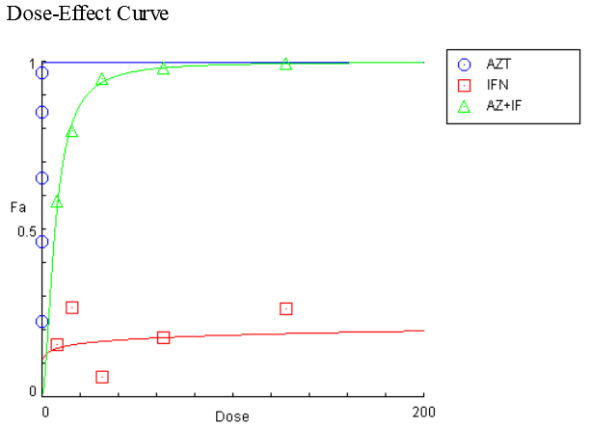
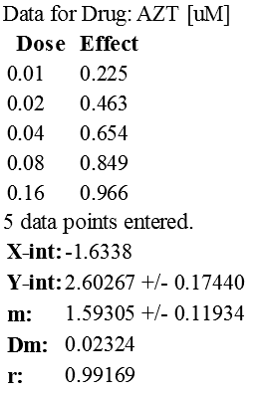
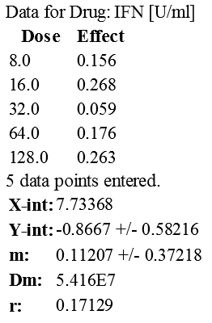
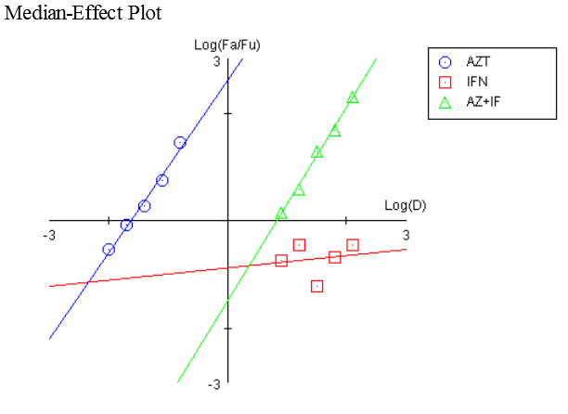
CompuSyn Report
P.1
Experiment Name: AZT+IFN Combo
Date: 11.18.2015
File Name: C:\Users\TingChaoChou\Desktop\AZT.IFN.1987.cse
Description: Collaboration between MS Hirsch, MGH Harvard and TC Chou, MSKCC. Antimicrob Agents Chemother 31: 168-172, 1987. RT Assays.Exp.2 Day10.
Drug: AZT (AZT) [uM]
Drug: IFN-aA (IFN) [U/ml]
Drug Combo: AZT+IFN (AZ+IF) (AZT+IFN [1:800])

Slide 24
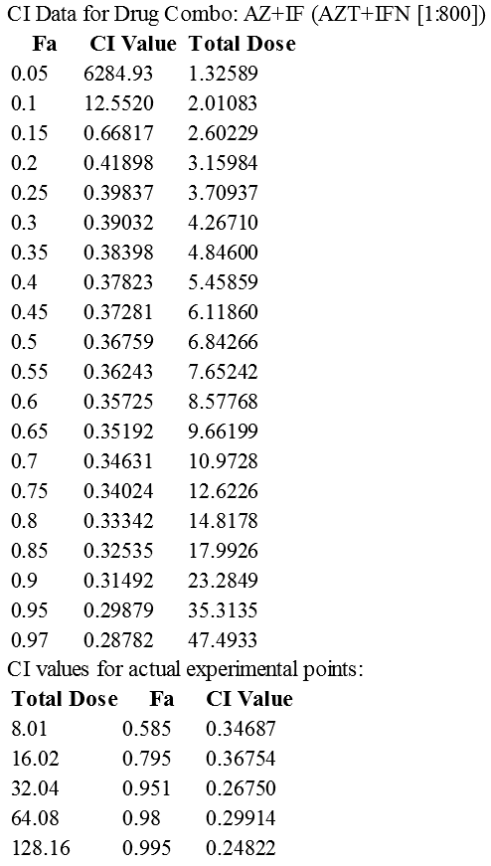
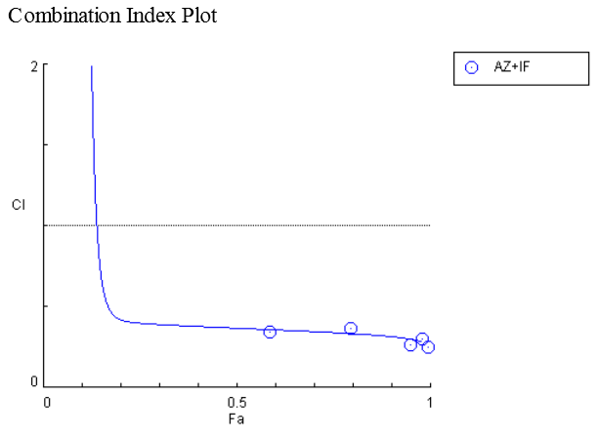
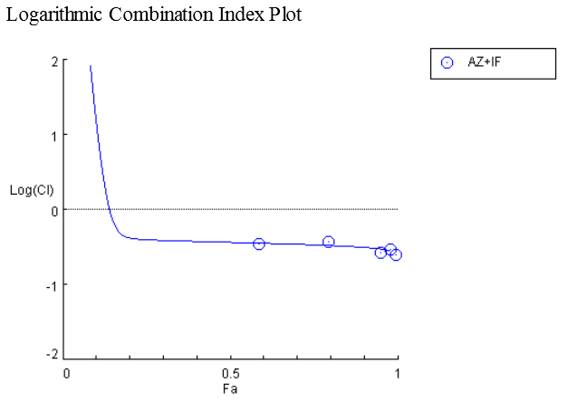
P.2

Slide 25
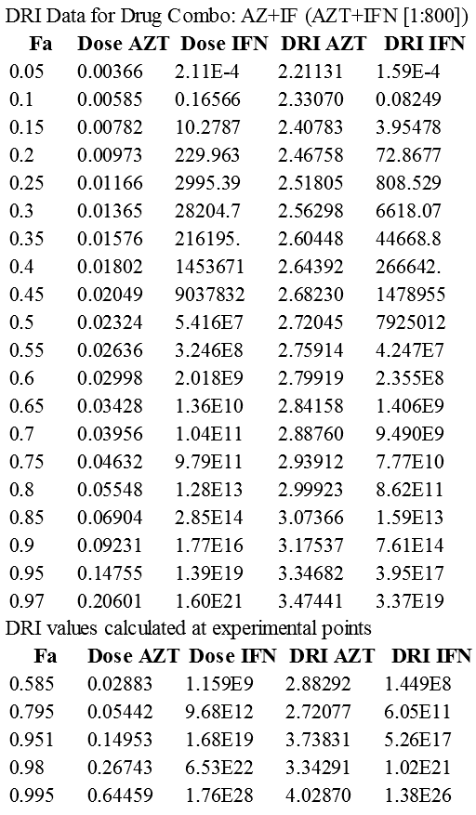
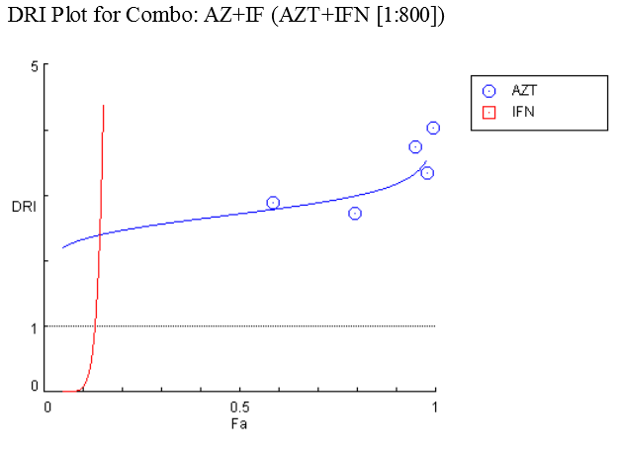
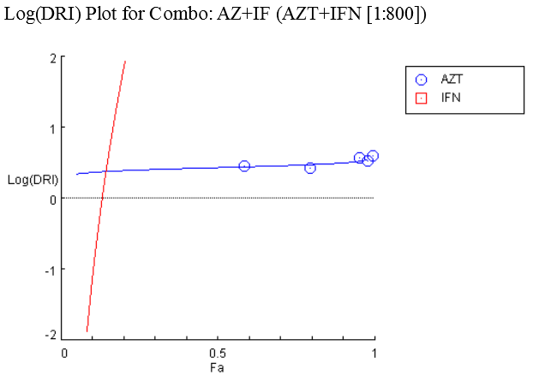
P.3

Slide 26
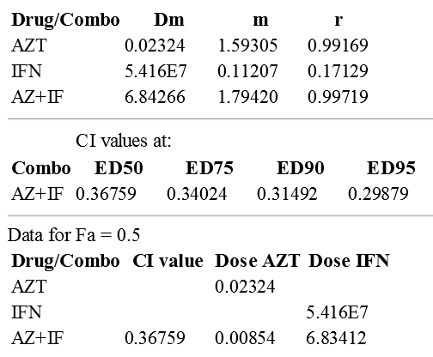
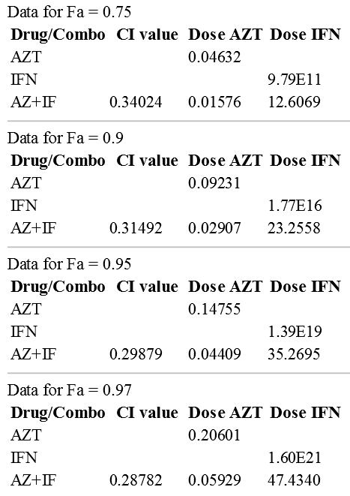
Summary Table
P.4
Experiment Name: AZT+IFN Combo
Date: 11.18.2015
File Name: C:\Users\TingChaoChou\Desktop\AZT.IFN.1987.cse
Description: Collaboration between MS Hirsch, MGH Harvard and TC Chou, MSKCC. Antimicrob Agents Chemother 31: 168-172, 1987. RT Assays.Exp.2 Day10.
Drug: AZT (AZT) [uM]
Drug: IFN-aA (IFN) [U/ml]
Drug Combo: AZT+IFN (AZ+IF) (AZT+IFN [1:800])

Slide 27
Comparison of Two-Drug Combinations for Anti-Cancer Agents
[Using Econo-Green Small Size Experimentation]
 |  | In Vitro | In Animal | In Clinical Trials
Time & Effort |  | 2 weeks | 2 months | 6 months~2 year
Non-wage Cost |  | $200 [cells and chemicals] | $3,000 [nude mice] | Expensive Trials [$ 10s Millions]
Sample Size |  | > 2 x 10⁶ [cells] | > 65* [nude mice] [Chou-Talalay method] | > 36# [vary] [Chou-Talalay Method]
Quantitative “Synergy” Determination |  | Very Easy [But frequently not done properly in the past] | ^{Not So Difficult} ^{[Rarely properly done} ^{in the past]} | Difficult Use Surrogate Markers and Fractional Doses
[Chou TC, Am J Cancer Res 1(7): 925-954, 2011] *Conservation of Laboratory Animals
[Chou TC, Integrative Biol 3: 548-559, 2011] #Efficient Small Size Clinical Trials
[Chou TC, Synergy, 1: 3-21, 2014] Computerized Simulations

Slide 28
Computerized Simulation of Synergism/Antagonism
[CI Theorem: “Econo” & “Quantitative” Bio-Informatics]
Primary Questions:
Are there any synergism?
How much synergism?
Synergism at what dose levels?
Synergism at what effect levels?
What the exhibited isobologram looks like?
How many folds dose reduction for each drug
as results of synergism?
Other Questions:
Optimal combination ratio
Schedule dependency
Selectivity of synergism
Condition directed synergism

Slide 29

Thanks

