Slide 1

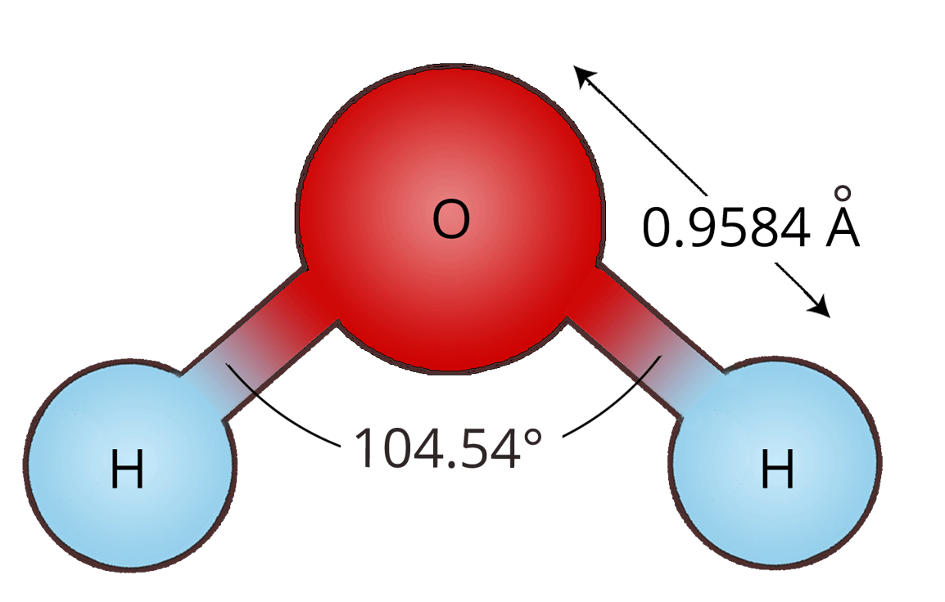
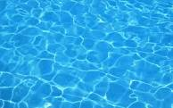
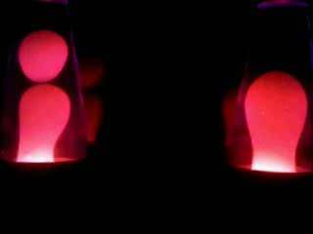
Basic Research Ltd., UK
Structured Water and Inflammation

Slide 2
Basic Research Ltd., UK
Timothy Winey
Basic Research Ltd.
basicresearchLtd@gmail.com

Slide 3
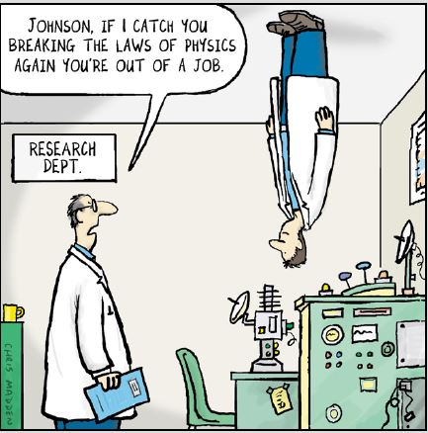
Basic Research Ltd., UK

Slide 4
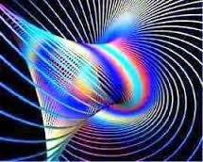

Slide 5

Dynamic Torsion Fields

Slide 6
Basic Research Ltd., UK
I have made a discovery regarding the structuring of water and other liquids based on an obscure physics field called torsion.
Following a series of unexpected experimental results, the following questions have been raised.

Slide 7
Basic Research Ltd., UK
Could the structure of water be the source of disease rather than a mere symptom?
Could water be structured in order to prevent, or even reverse, disease?
How would "healthy" water differ from "sick" water?

Slide 8

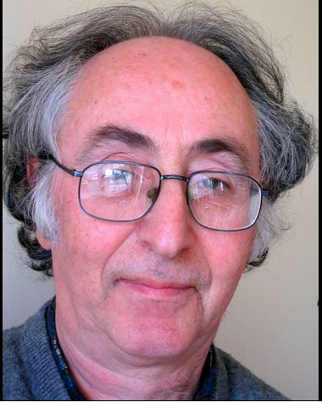

Slide 9
Best known for his pioneering work on superconductivity and quantum tunnelling, he was awarded the Nobel Prize in Physics in 1973 for his prediction of the Josephson effect, made in 1962 when he was a 22-year-old PhD student at Cambridge.

Slide 10
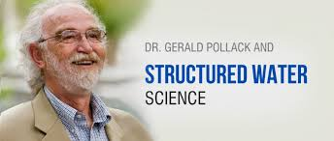
www.waterconf.org/

Slide 11
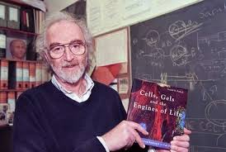

Slide 12
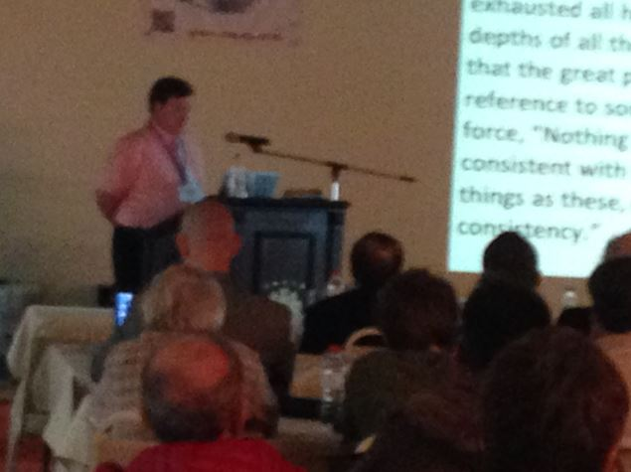
www.waterconf.org/

Slide 13
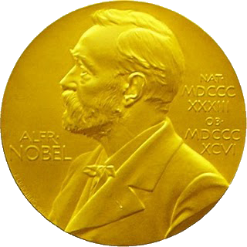

Slide 14


Slide 15
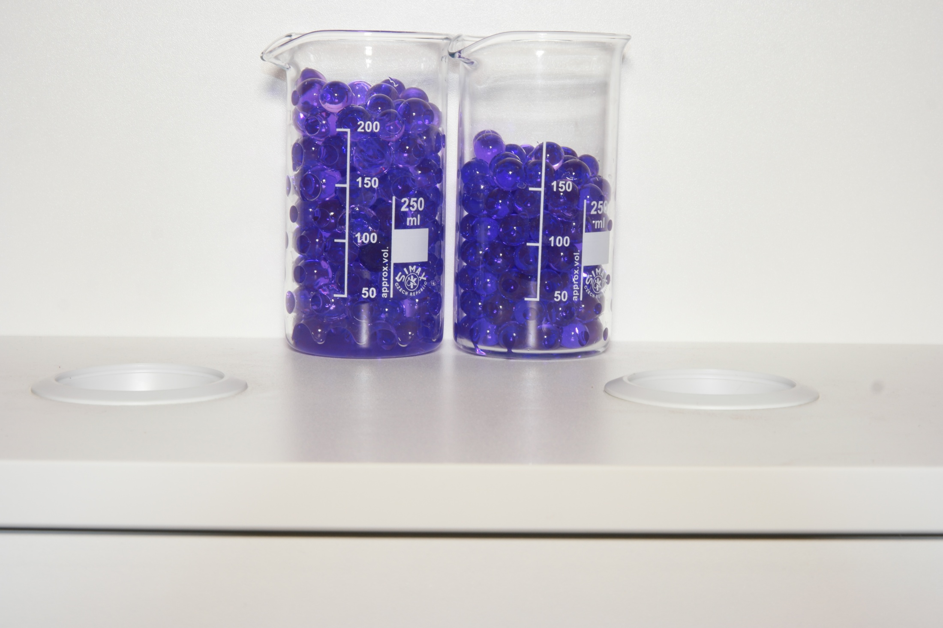
Structured

Slide 16

Structured

Slide 17
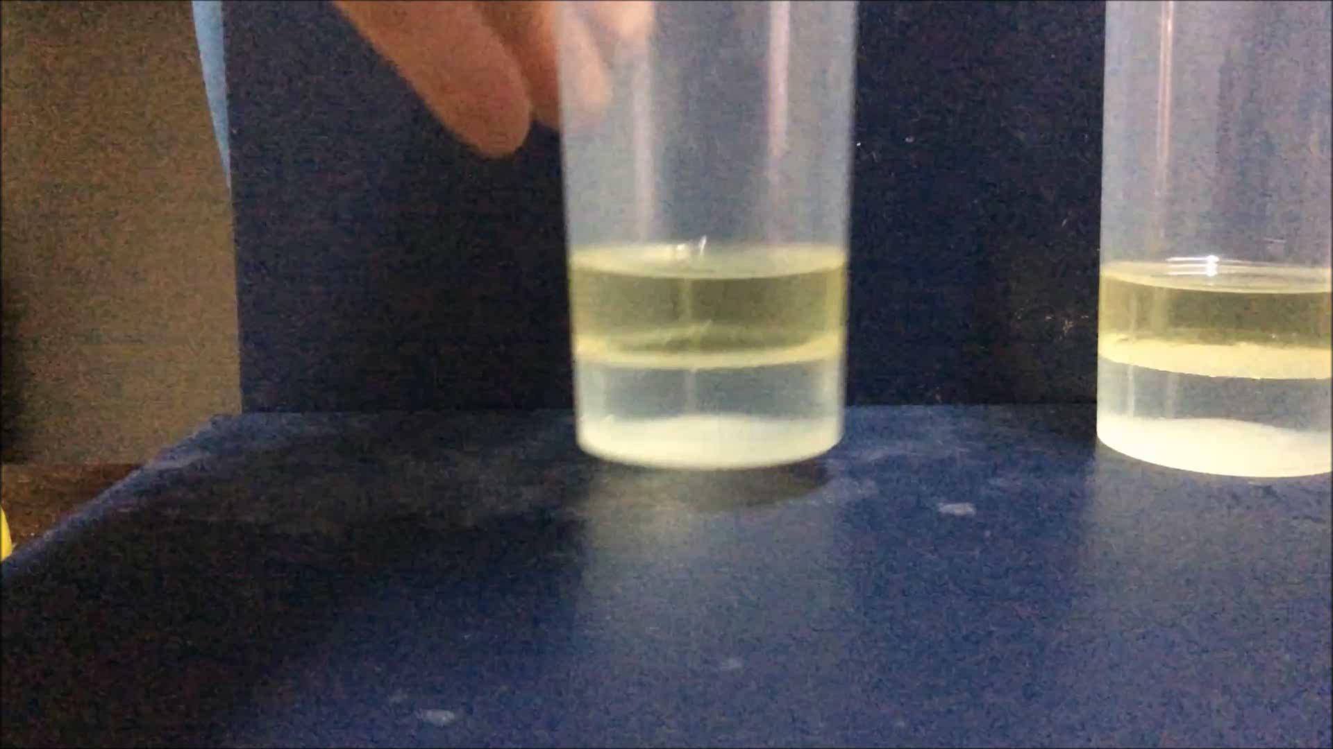
Structured

Slide 18

Structured

Slide 19
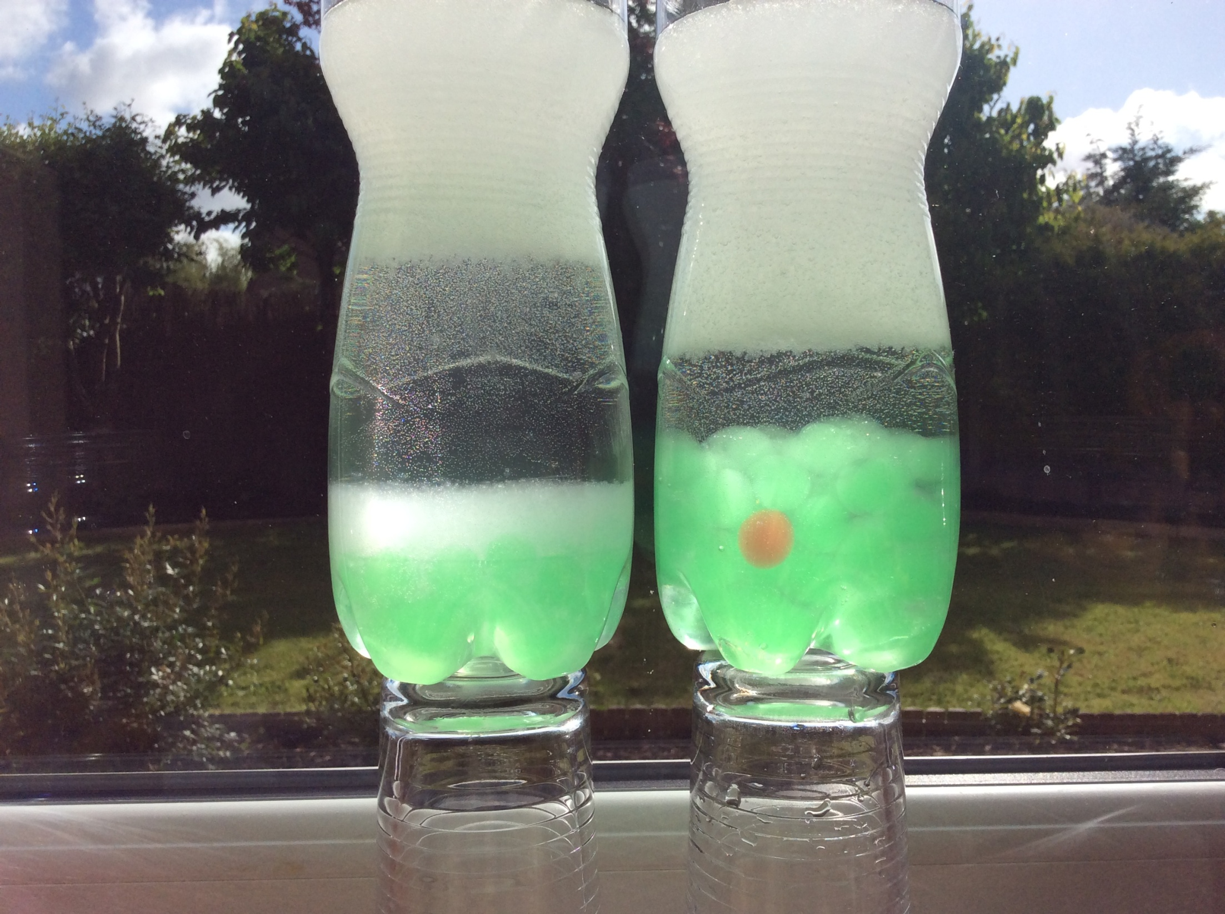
Structured

Slide 20


Slide 21
Extensive research during the last two decades has revealed the mechanism by which continued oxidative stress can lead to chronic inflammation, which in turn could mediate most chronic diseases including cancer, diabetes, cardiovascular, neurological and pulmonary diseases.

Slide 22
The link between inflammation and cancer has been suggested by epidemiological and experimental data and confirmed by anti-inflammatory therapies that show efficacy in cancer prevention and treatment.
The fact that continuous irritation over long periods of time can lead to cancer had already been described in the traditional Ayurvedic medical system, written as far back as 5000 years ago.

Slide 23
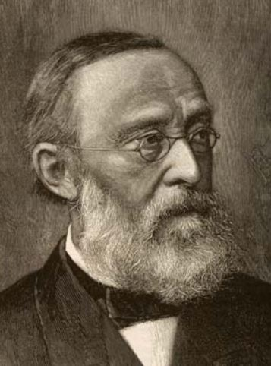
Rudolf Virchow 1821-1902 first noted that inflammatory cells are present within tumors and that tumors arise at sites of chronic inflammation (chronic irritation theory).

Slide 24
It was only towards the end of the 20th century that Virchow's theory was taken seriously. It was realised that specific cancers (including those of mesothelioma, lung, prostate, bladder, pancreatic, cervical, esophageal, melanoma, and head and neck) are indeed strongly associated with long-term inflammation. In addition, it became clear that long-term use of anti-inflammatory drugs, such as aspirin, reduced cancer risk. Experiment also shows drugs that block inflammation simultaneously inhibit tumour formation and development.

Slide 25
During inflammation, mast cells and leukocytes are recruited to the site of damage, which leads to a ‘respiratory burst’ due to an increased uptake of oxygen, and thus, an increased release and accumulation of reactive oxygen species (ROS) at the site of damage.

Slide 26
Inflammatory cells also produce soluble mediators, such as metabolites of arachidonic acid, cytokines and chemokines, which act by further recruiting inflammatory cells to the site of damage and producing more reactive species. This sustained inflammatory/oxidative environment leads to a vicious circle, which can damage healthy neighboring epithelial and stromal cells and over a long period of time may lead to carcinogenesis.

Slide 27
Basic Research Ltd., UK
The properties of EZs described by Pollack and coworkers overlap to some extent with those of water “coherence domains” (CDs) proposed by del Giudice et al. based on quantum field theory calculations. “Coherence domains” provide a “redox pile” of “quasi-free electrons.” This means that organized water itself can, and most likely does, function as an antioxidant.

Slide 28
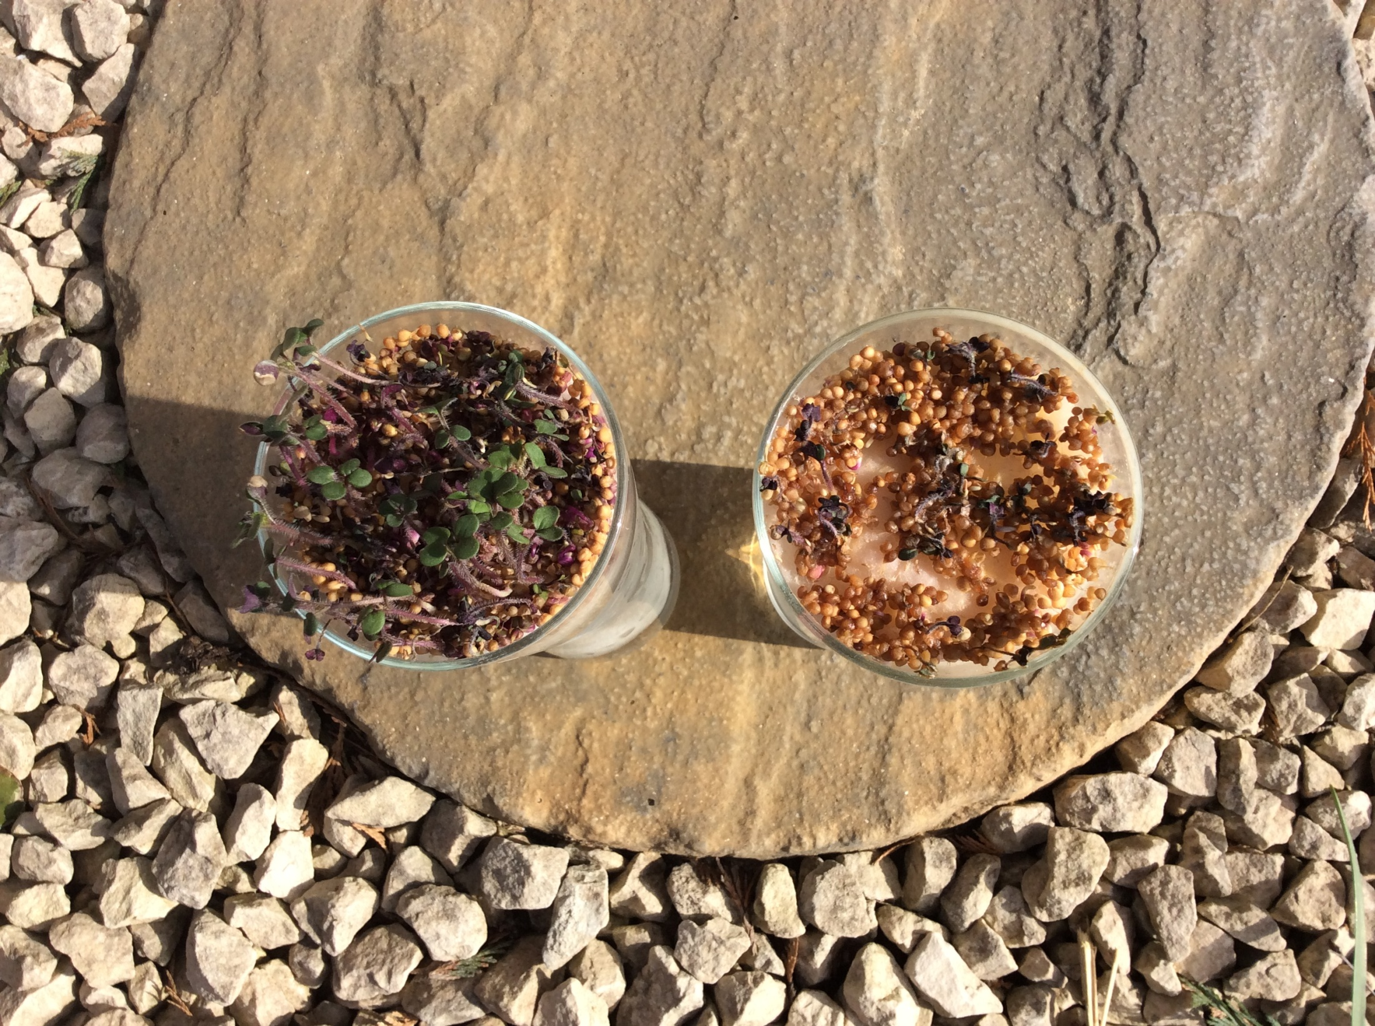
Structured

Slide 29
Pollack was also able to show that aspirin for example, dramatically enlarged the exclusion zone (EZ) in water whereas anesthetics such a lidocaine, collapsed it.
Thinking back to the correlation of aspirin with reduced inflammation and concomitant lowering of cancer risk, substances that “mask pain” while collapsing the exclusion zone (EZ), a zone correlated with normal (non-inflamed) function, may warrant caution.

Slide 30
Proteolytic enzymes also have a long history of reducing inflammation and even reversing advanced cancer (Dr. Beard discovered this in the late 1800’s). Perhaps digestive enzymes also somehow work to expand the exclusion zone of water?
Despite the controversy his enzyme thesis created, in 1906 he was nominated for the Nobel Prize for his work in embryology.

Slide 31
In 1911, he published The Enzyme Treatment of Cancer and Its Scientific Basis to favourable reviews. Though in his lifetime the scientific community never embraced his ideas about cancer—he died in relative obscurity in 1924—in recent years, evidence from molecular biology and stem cell research increasingly confirms many of Dr. Beard’s fundamental precepts.

Slide 32
Dr. Jack Kruse
Water, it turns out, is the medium and the message used to integrate life in a cell, but it also forms the direct means of life in all living things. The medium and message are controlled by physics, and the means is controlled by chemistry, but the sum of all, forms the biology of quantum water dynamics which rewrites cell theory as we know it. Yes, it changes everything you know.

Slide 33
Could we be asking the wrong questions about water?
Q1. Am I getting enough water?
Q2. Am I getting enough of the right kind of water?
To my mind, within Q1. is the built in assumption that all reasonably uncontaminated water is more or less of equal benefit.
Q2. Seems to suggest that not only does water meaningfully differ, but that there must be an objective method for comparing the relative healthful “qualities” of competing waters.

Slide 34
Dehydration signs aren't always obvious. Some surprising dehydration signs include fever, bad breath, and cravings for sweets.

Slide 35

While you can crave anything from chocolate to a salty snack, when you’re dehydrated, cravings for sweets are more common because your body may be experiencing difficulty with glycogen production.

Slide 36
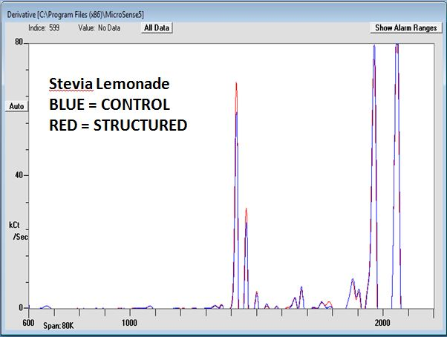

Slide 37
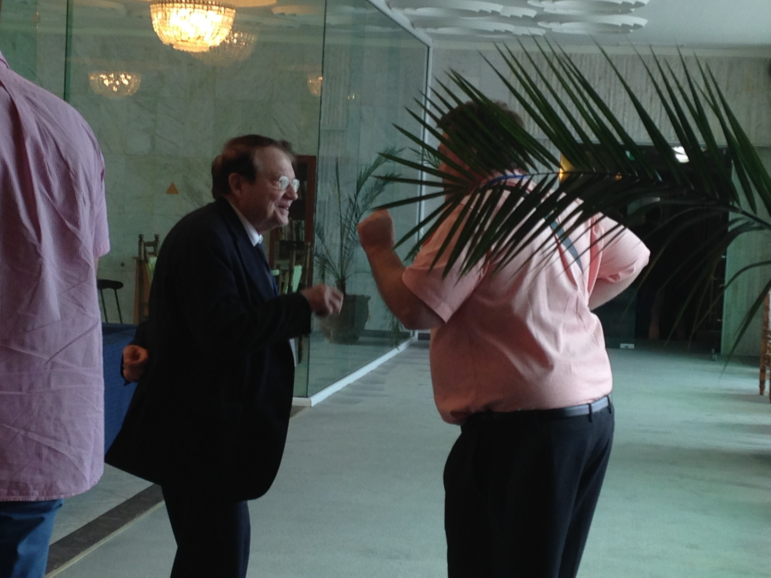
Basic Research Ltd., UK
Notes:
Friendly chat with Luc Montagnier

Slide 38
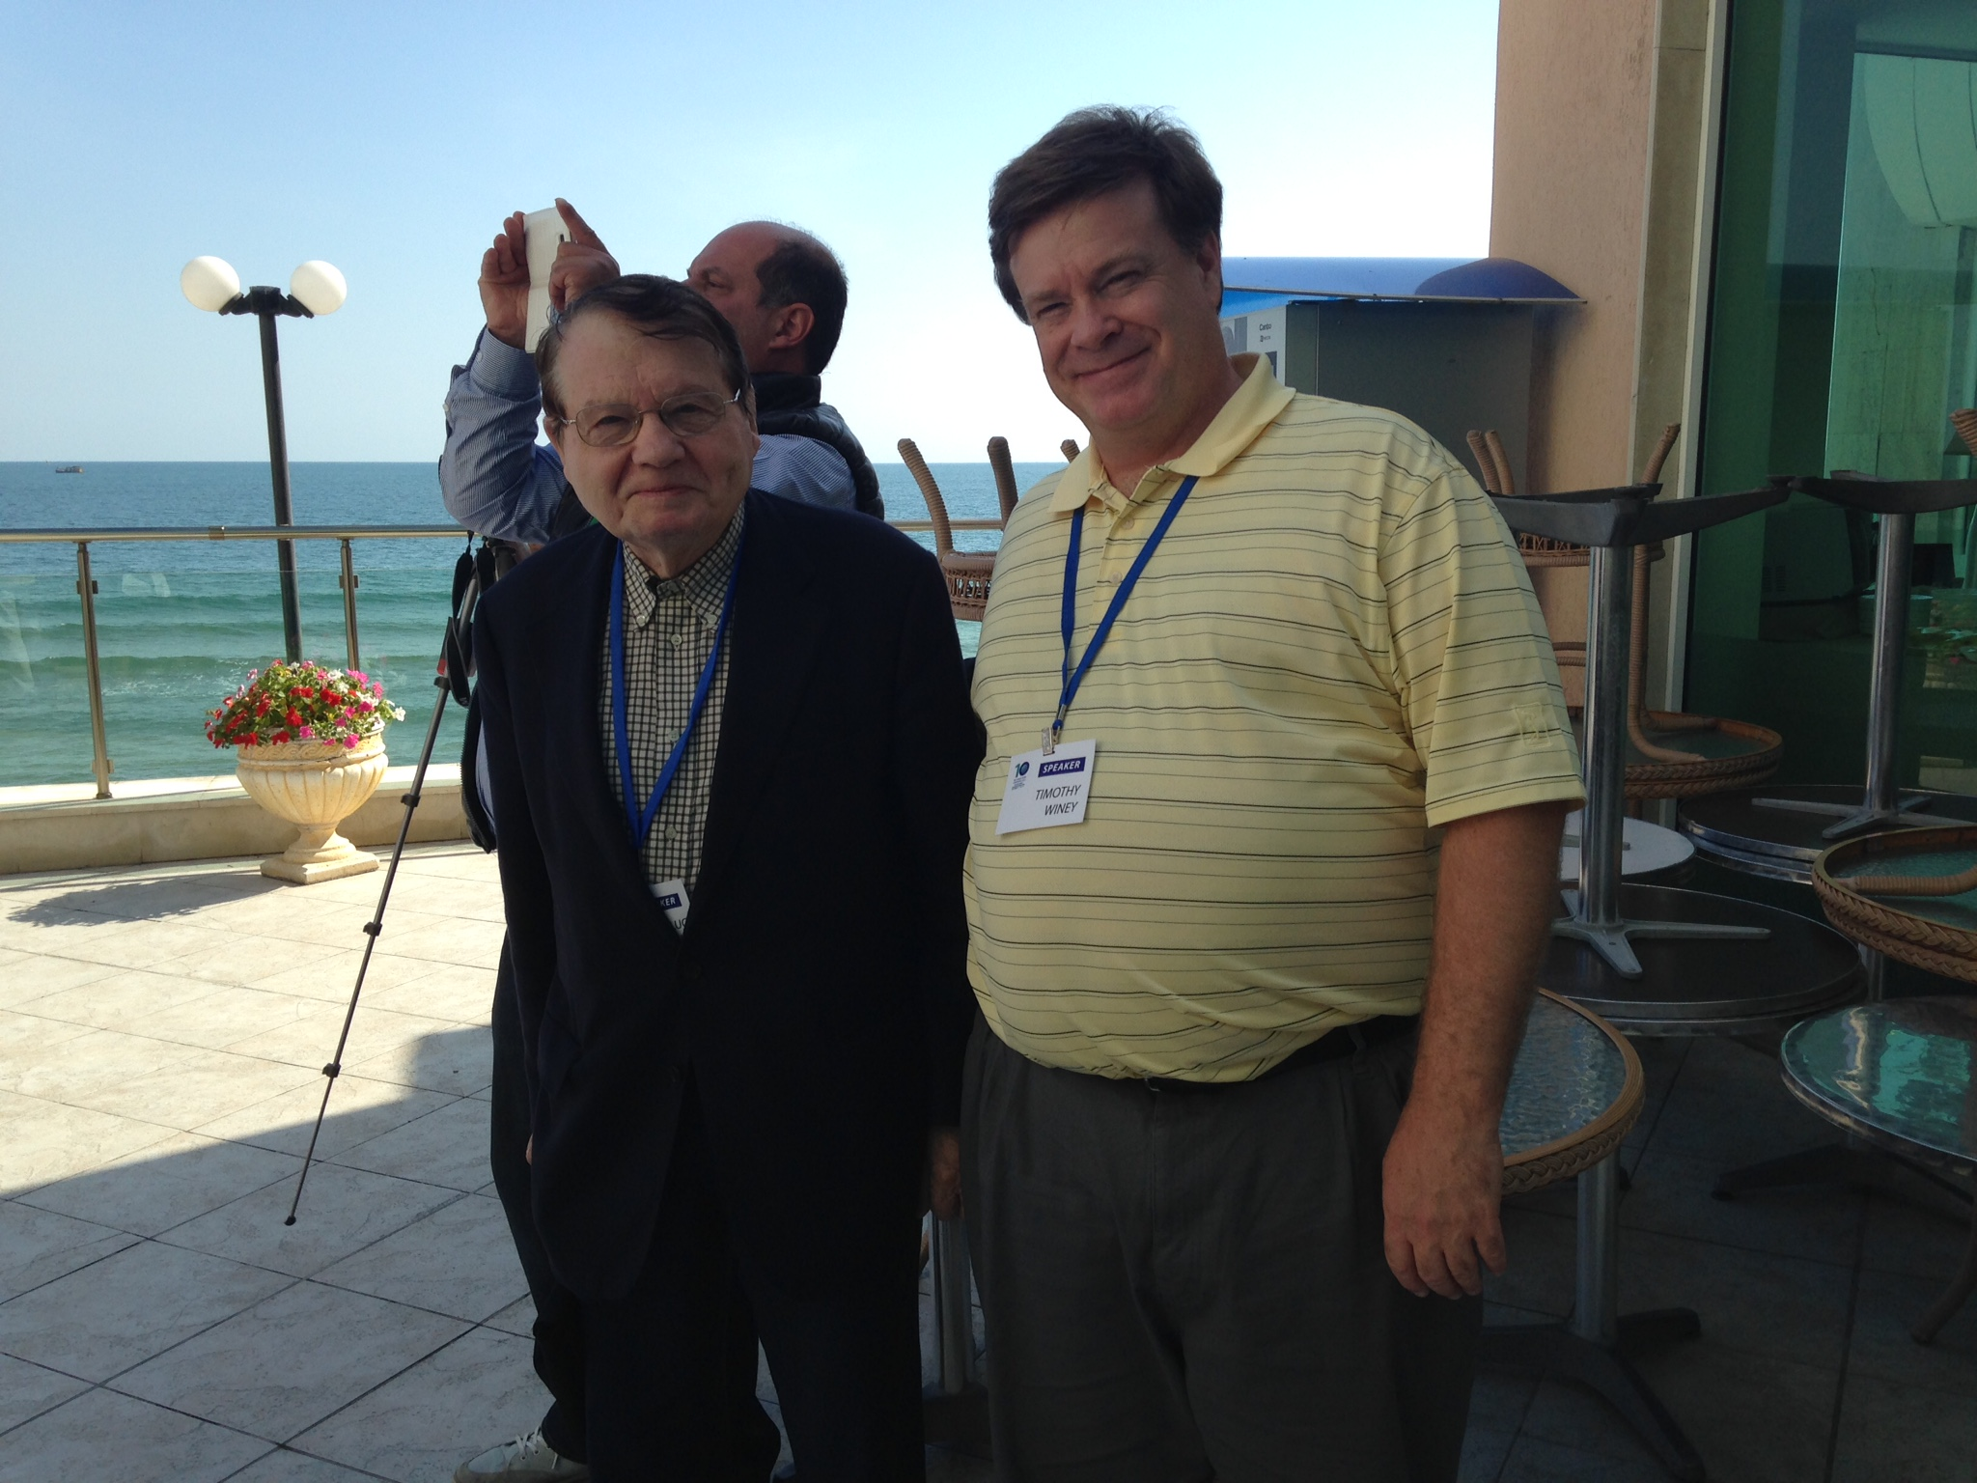
www.waterconf.org/
Basic Research Ltd., UK

Slide 39
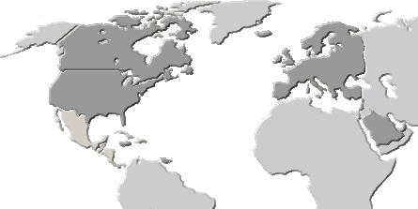
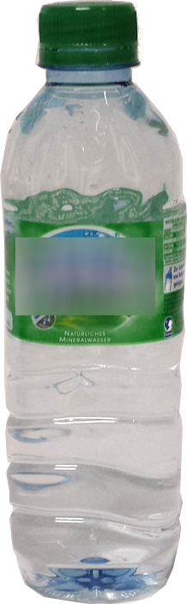
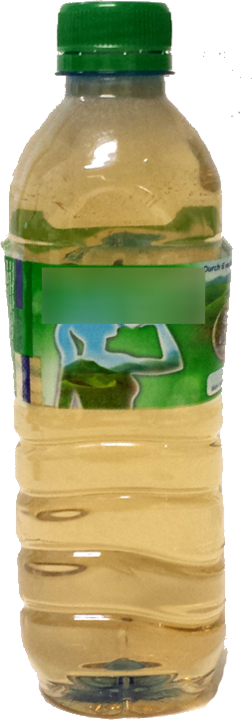



Basic Research Ltd., UK
www.waterconf.org/
before
after

Slide 40

Basic Research Ltd., UK

Slide 41
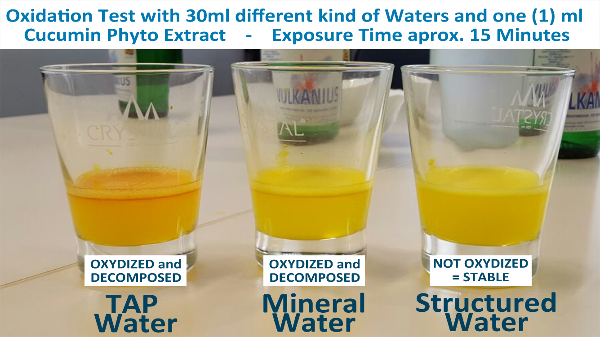

Slide 42
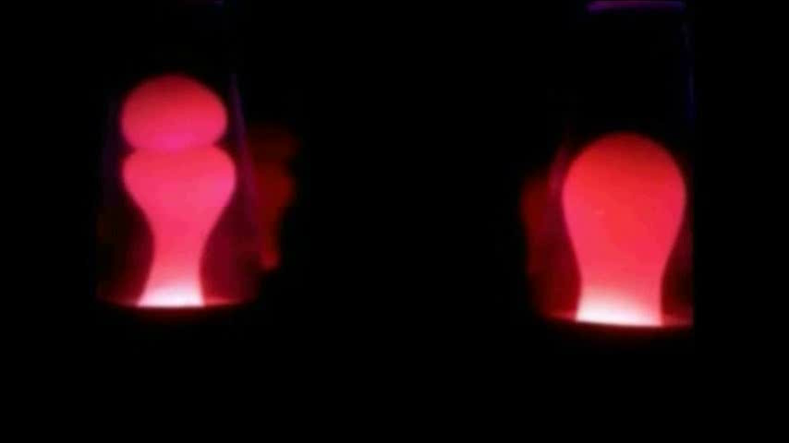
Structured

Slide 43
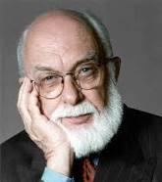
Skeptic

Slide 44
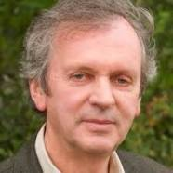

Slide 45
“The atoms or elementary particles themselves are not real; they form a world of potentialities or possibilities rather than one of things or facts.”
– Werner Heisenberg
“Everything we call real is made of things that cannot be regarded as real.”
– Niels Bohr

Slide 46
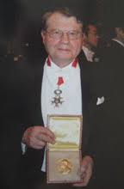

Slide 47
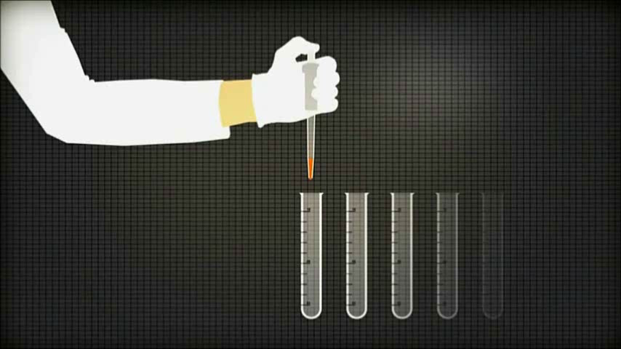

Slide 48
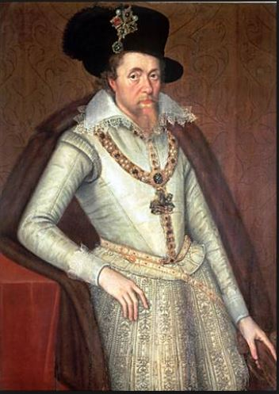

Slide 49
A custome lothsome to the eye, hatefull to the Nose, harmefull to the braine, dangerous to the Lungs, and in the blacke stinking fume thereof, neerest resembling the horrible Stigian (Hades) smoke of the pit that is bottomelesse.
— King James I 1604

Slide 50
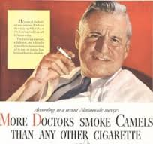

Slide 51
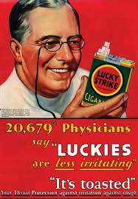

Slide 52
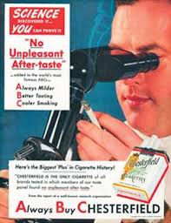

Slide 53
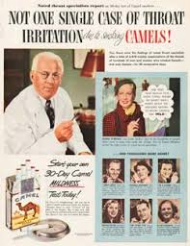

Slide 54


Slide 55


Slide 56
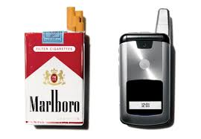

Slide 57
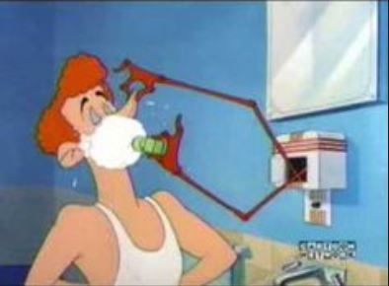

Slide 58

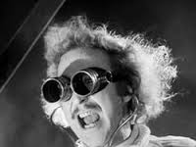
What have I done!

Slide 59
From Dr. Jack Kruse:
Pulsed EMF’s disrupt the blood brain barrier (BBB) and dehydrate the patient over time. Dr. Allan Frey described this BBB disruption with EMF’s close to 50 years ago.
www.jackkruse.com

Slide 60
What are some of the biologic links made to Dr. Frey’s work?
Increased cell growth of brain cancer cells
A doubling of the rate of lymphoma in mice
Changes in tumor growth in rats
An increased number of tumors in rats
www.jackkruse.com

Slide 61
Increased single and double-strand breaks in DNA, our genetic material
2 to 4 times as many cancers in Polish soldiers exposed to RF
More childhood leukemia in children exposed to RF
Changes in sleep patterns and REM type sleep
Headaches caused by RF/MW radiation exposure
www.jackkruse.com

Slide 62
Neurologic changes including:
  Changes in the blood-brain-barrier
  Changes in cellular morphology (including cell death)
  Changes in neural electrophysiology (EEG)
  Changes in neurotransmitters (which affect motivation and pain perception)
www.jackkruse.com

Slide 63
Retarded learning in rats indicating a deficit in spatial “working memory”
Increased blood pressure in healthy men
Damage to eye cells when combined with commonly used glaucoma medications
www.jackkruse.com

Slide 64
Metabolic changes (of calcium ions, for instance)
Cytogenetic effects (which can affect cancer, Alzheimer’s, neurodegenerative diseases)
Decreased memory, attention, and slower reaction time in school children
www.jackkruse.com

Slide 65
The most fascinating part of what Dr. Frey did was to show definitively that the brain was directly affected by pulsed EMF. Long ago, with the Office of Naval Research, Dr. Frey wanted to see what the biologic affects one might expect with the military uses of EMF in the USA.
www.jackkruse.com

Slide 66
If you read his public statements on what he found, they are nothing short of shocking. No one seems to know this because his work has been buried by industry. If you use technology you would do well to do some of your own homework and you might realize why you really have medical issues you can’t seem to shake.
www.jackkruse.com

Slide 67
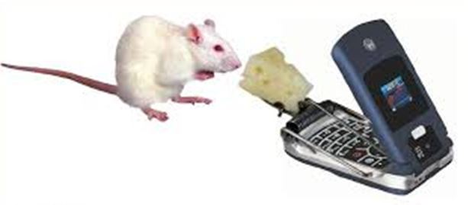

Slide 68
Dr. Frey injected methylene blue dye into the veins of rats. The dye was absorbed in all the tissues except for the brain. That is because we are all equipped with a blood-brain barrier, designed to protect our brains from foreign substances.
www.jackkruse.com

Slide 69
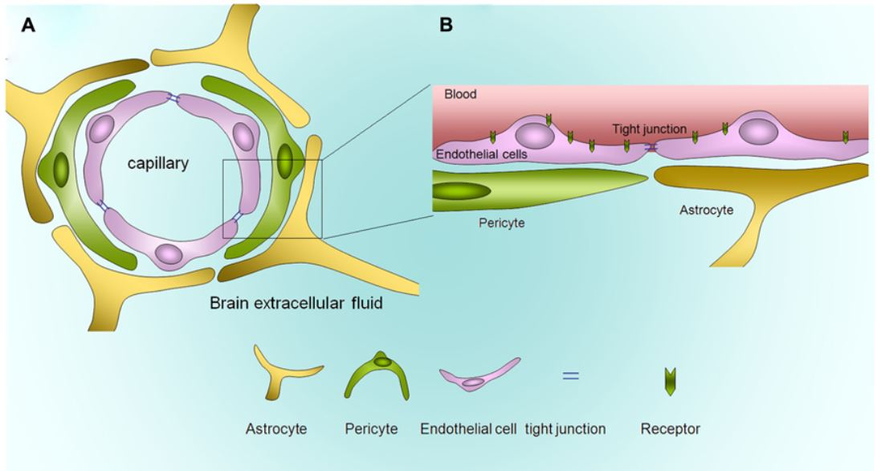

Slide 70
He then exposed the rats brains to pulsed EMF in the range one would find in most cellphone and other wireless technology of today, and he found that the rat brains turned blue from the dye because the EMF made the BBB permeable at quite low doses.
www.jackkruse.com

Slide 71
Frey showed quite convincingly that EMF weakened the blood brain barrier and could allow many toxins normally excluded from the brain’s circulation to enter and affect it. This is precisely how fluoride now permeates the modern human brain unimpeded to cause cognitive haze because of the dielectric effect of fluoride on iodine in the brain’s semiconductive pathways.
www.jackkruse.com

Slide 72
It has also been shown to make the gut membrane permeable as well, and I believe this is the number one cause of a leaky gut in our modern world. It is also why many people with a leaky gut never get better because they do not realize their gut is made leaky by the technology people lay on their laps or in their pockets of clothes daily.
www.jackkruse.com

Slide 73
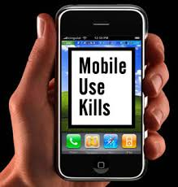

Slide 74


Slide 75
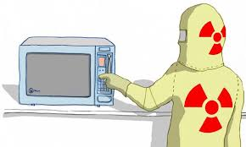

68% of Americans say they simply can’t live without microwave ovens.

Slide 76
Structured

Slide 77
A recent Australian study showed that microwaves cause a higher degree of "protein unfolding" than conventional heating.
George D F, Bilek M M, and McKenzie D R. "Non-thermal effects in the microwave induced unfolding of proteins observed by chaperone binding, “

Slide 78
In early 1991, word leaked out about a lawsuit in Oklahoma. A woman named Norma Levitt had hip surgery, only to be killed by a simple blood transfusion when a nurse "warmed the blood for the transfusion in a microwave oven"! Logic suggests that if heating or cooking is all there is to it, then it doesn't matter what mode of heating technology one uses. However, it is quite apparent that there is more to 'heating' with microwaves than we've been led to believe.

Slide 79
Blood for transfusions is routinely warmed-but not in microwave ovens! In the case of Mrs. Levitt, the microwaving altered the blood, and it killed her.

Slide 80
What role/s does structured water play in biology?
Basic Research Ltd., UK

Slide 81
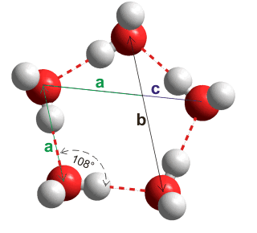

Slide 82
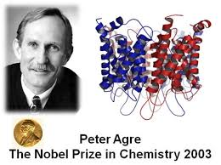

Slide 83
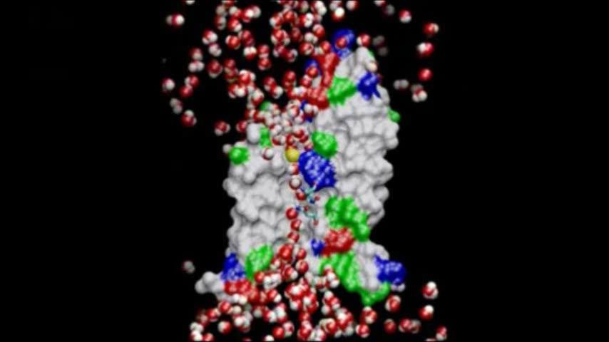

Slide 84
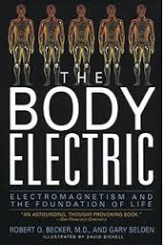

Slide 85
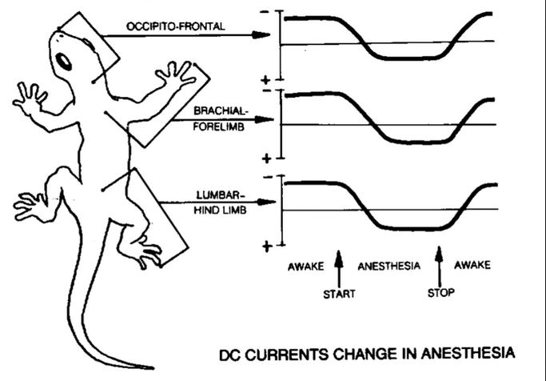

Slide 86
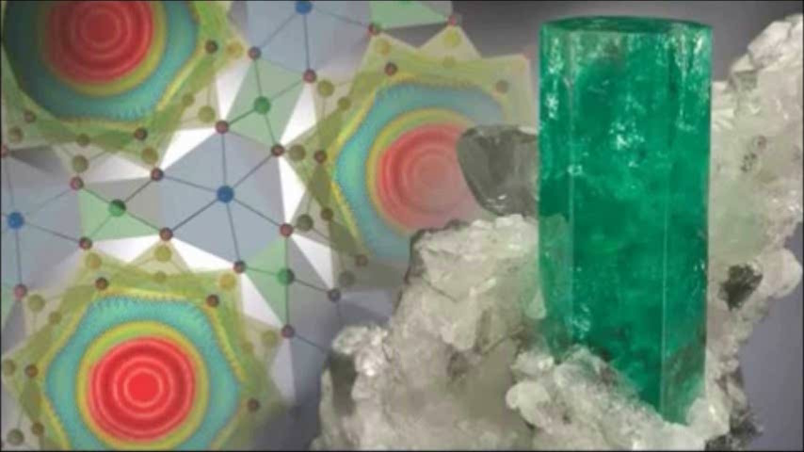

Slide 87
Basic Research Ltd., UK
While the human body is 70 percent water by weight, the normal human brain is nearly 90 percent water. It is possible that this quantum-coherent dynamical Jahn-Teller system of water clusters confined within the hollow inner cores of brain microtubules may be relevant to conscious thought processes, consistent with ideas promoted by Penrose and Hameroff. This in turn may at least partially explain why even slight dehydration often produces such dramatic cognitive impairment.

Slide 88
In 1948 the Dutch theoretical physicist Hendrik Casimir was studying colloidal solutions at Philips Research Laboratories, when he discovered what is now known as the “Casimir Effect.” The force between the mirrors most of us are taught in school is known as the Casimir force and was postulated as a theoretical construct by Casimir after his colloid discovery.
It was not until 1997, however, that a direct experiment, by S. Lamoreaux, described above, quantitatively measured the force (to within 15% of the value predicted by the theory.

Slide 89
Colloids are microscopic particles so small that they move diffusively when dispersed in a fluid, exhibiting Brownian motion, controlled by the temperature of the system, like atoms. However, unlike atoms, colloids are big enough to see with light, so they can be probed with microscopes and laser light scattering.

Slide 90
The interactions between atoms are fixed, dictated by quantum mechanics, but those in colloids can be very finely tuned. This makes them an ideal model system for investigating the structure and properties of all sorts of materials, constructed from colloidal particle building blocks, such as crystals, glasses, gels, fluids and gases.

Slide 91
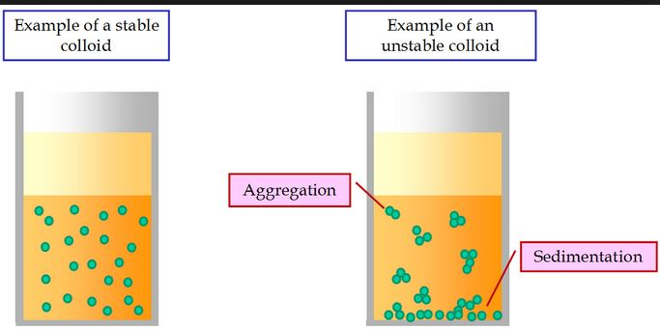
Colloid Experiment

Slide 92

Basic Research Ltd., UK

Slide 93
Precipitate formation in a Dissolved Oxygen Test
A test of dissolved O2 was conducted on CS (silica) water using a JBL water test kit. The test was performed 3 times with identical results. While the coloration (tan) was the same in each test, the size of the precipitates differed dramatically between control and structured samples, with the non-structured CS water showing much larger and less diffuse agglomerations.

Slide 94
As expected, the larger agglomerations began to settle out more quickly in each of the 3 tests. These results were a complete surprise, as we were only interested in measuring dissolved O2 with no expectation that the precipitates would form so differently.

Slide 95
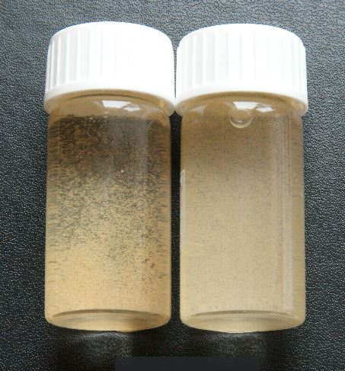
Structured

Slide 96
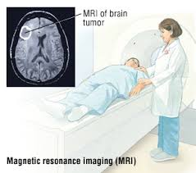
What can water behavior tell us about health?

Slide 97
water in cancer cells is measurably less ordered than corresponding water in healthy cells.
Since the resonating entity in the MRI is primarily water protons, the contrast variation results from changes in the water environment (and water density) between malignant and healthy tissue (1), with the relaxation times of the water protons of the malignant tissue being significantly longer than that of the healthy tissue.

Slide 98
Basic Research Ltd., UK
In 1971 Raymond Damadian had a revolutionary discovery in cancer research: it was shown that cancerous tissue is markedly over-hydrated and can be much as 90% water, while in normal cells it can be typically 70-73%. “Magnetic Resonance” method which was suggested by him for the detection of cell over hydration serves as an early tumor detection diagnostic method (Damadian, 1971).

Slide 99
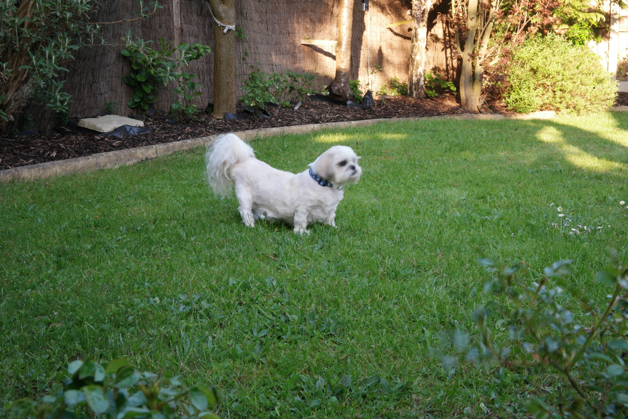


Slide 100
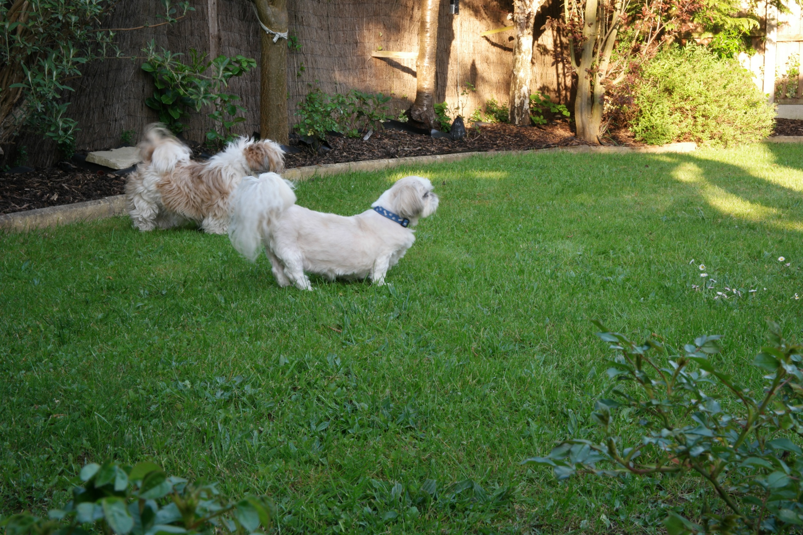
Alfie and his lady friend

Slide 101

Alfie and me sunbathing

Slide 102


The Embattled Maverick Scientist

Slide 103
Will structured water ever make it to the grown-up table of modern science? Should government regulate water structure (keeping in mind that the US Government can’t even keep lead out of water in Detroit, or come clean about its failure to do so)?

Slide 104
It bears repeating that in the US, it is, for the most part, illegal, I repeat illegal, to treat cancer with anything but knives, poison, or radiation.
Take a moment to reflect on that. Where does government derive the consent of the governed to so narrowly define the parameters of scientific inquiry? We are supposed to be fighting an all-out scientific “war on cancer,” and the rules of engagement restrict us to these three crude weapons?

Slide 105
We readily accept that money corrupts politics, yet reduce the possibility of the same contamination of science-based medicine to a conspiracy theory… Of course, science being more erudite than politics, rarely stoops to the crude tactics of cash-stuffed brown paper bags passed under greasy diner tables. No, science stacks the invisible deck in much subtler ways beginning with the monopolization of education (see the Flexner report).

Slide 106
If you had the choice of throwing someone sinking in quicksand a section of rope or barbed wire, which would you choose? What if the law forbade rope and said it’s barbed wire or nothing? Would you break the law to throw the rope, knowing that the bacteria in the stagnant bog would most likely eventually kill the victim by infecting his "FDA-approved" cuts?

Slide 107
Basic Research Ltd., UK
An ounce of prevention is worth a pound of cure.

Slide 108


Slide 110


Slide 111

www.jackkruse.com

Slide 112
Basic Research Ltd., UK
Timothy Winey
Basic Research Ltd.
basicresearchLtd@gmail.com

