Slide 1

Novel bufadienolides with rearranged skeletons from traditional Chinese medicine ChanSu
Tian Hai-Yan
Jinan University
Notes:
Hello everyone, it’s my honor to have the opportunity to report to you all my recent work. My topic is Bufadienolides from toads.

Slide 2
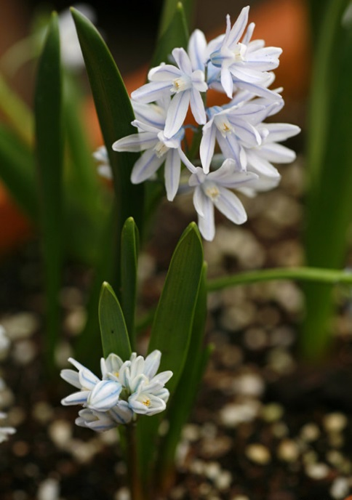
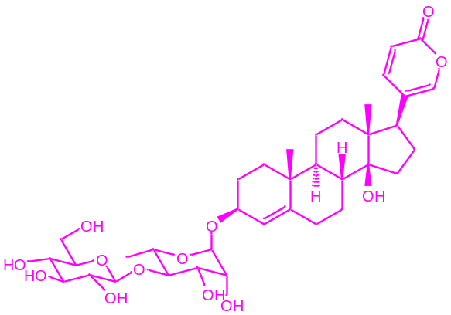
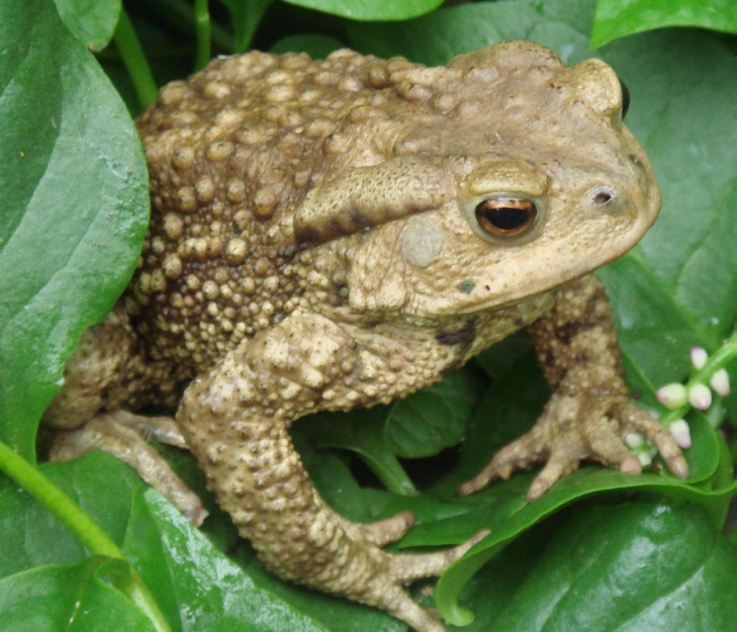
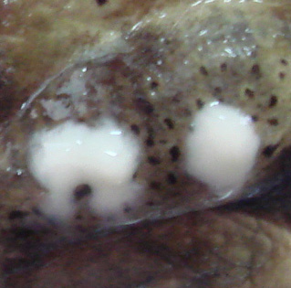
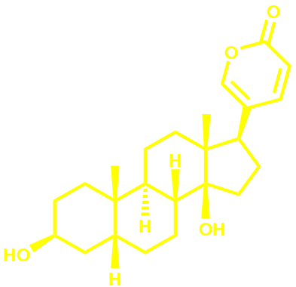
Back Ground
The first bufadienolide, scillaren A, was isolated from squill, a herbal medicinal in the treatment of heart disease in ancient Egypt. Its structure was elucidated unambiguously in 1933.
In the animal kingdom, they are widespread in the Bufo species (Bufanidae).
Nat Prod Rep. 1998; Nat Prod Rep. 2011;Phytochemistry. 1998
Notes:
Bufadinolides are an important group of polyhydroxy C-24 steroids and their glycosides. They are characterized by the presence of a six-membered lactone ring at C-17 position. …Generally, these animals were called toads.

Slide 3
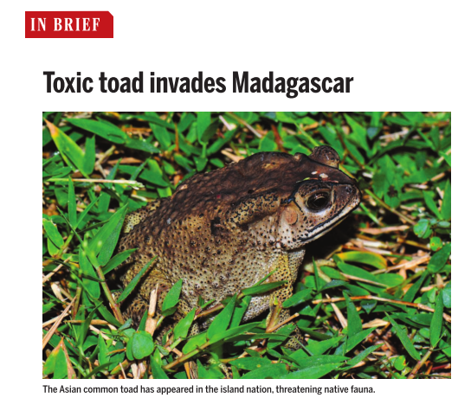
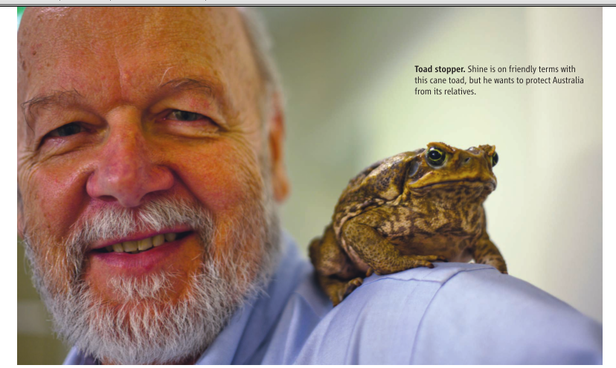
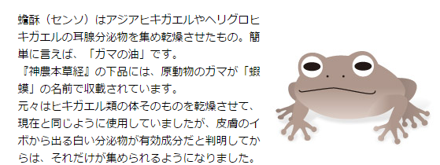
Toads outside China
In Australia, Madagascar, etc, toads are harmful invaders. They are a big threat to the native wildlife.
However, in Japan or Korea, the toad venom were used for preparation of Asian remedies, such as Senso.
Science. 2014; Science.2012; Nature, 2014. NPR 1998.

Slide 4
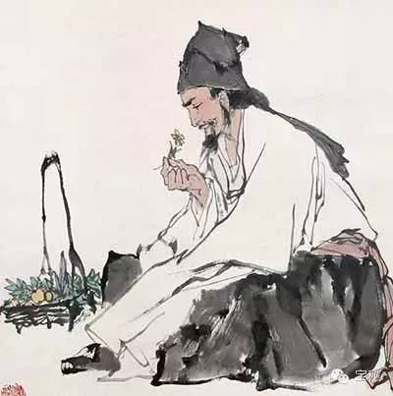
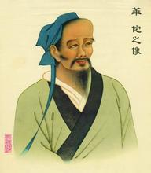
Toads in China
There are mainly three genus including eighteen species in China. The three dominant species are Bufo bufo gargarizans Cantor, Bufo bufo andrewsi Schmidt and Bufo melanostitus Schneider.
Toads have an indelible function in medical history in ancient China, and have been recorded in Zhang Zhongjing’s Classical Prescriptions, Sun Simiao’s “Valuable Prescriptions for Emergencies”, Hua Tuo’s “Hua Tuo Reengineering”, and Li Shizhen’s “Compendium of Materia Medica”.
Li Shi-Zhen
Hua Tuo
Am J Transl Res 2015.
Notes:
In China, there are mainly three…of toads. Among these, They are all famous physicians and pharmacologists in the history of China.

Slide 5
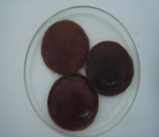
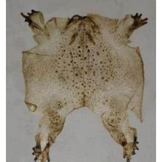
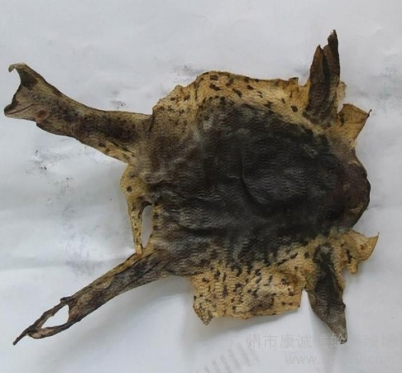
Toads in China
The medicinal parts of toads are mainly toad venom, toad skin, and toad clothing. About 50 varieties of medicines are used in the clinical treatment of various complicated diseases in China, such as “Liushen pills”, which was popular in the whole world. Huachansu injection, the water extraction part of toad skin, was used to treat various cancers.
Toad venom
Toad clothing
Am J Transl Res 2015.
Toads skin

Slide 6
Recent Progress in Our Group
Chemical investigation on toad venom, toad skin,
toad bile and toad eggs.
The anti-cancer effects of bufadienolides
The analgesic effects of bufadienolides
Notes:
Recent years, our group mainly focused on the following three parts.

Slide 7
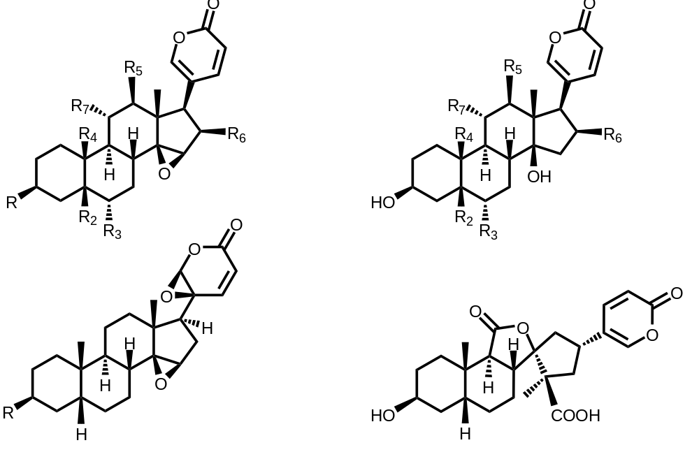
The structural features of bufadienlides in toads
1
2
3
4
Notes:
The bufadienolides in toads have structural features with 14,15-epoxy or 14-hydroxyl groups. There are also those with variations at the lactone ring or the sterol core.

Slide 8
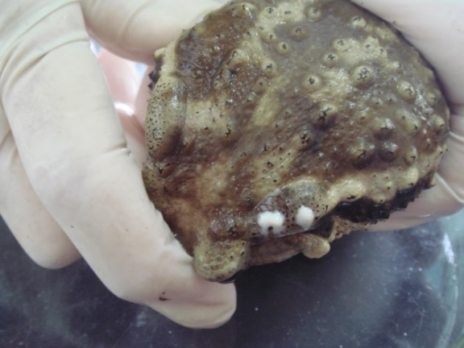

Toad venom
Toad venom, locally called Chansu in China, were the secretion of the postauricular glands of Bufo bufo gargarizans Cantor and Bufo melanostictus Schneider. It has been widely used as a traditional Chinese medicine in the treatment of odotagia and skin cancers.
It was reported that the main active components in ChanSu are Bufadienolides.
Notes:
We first investigated the chemical components in toad venom

Slide 9
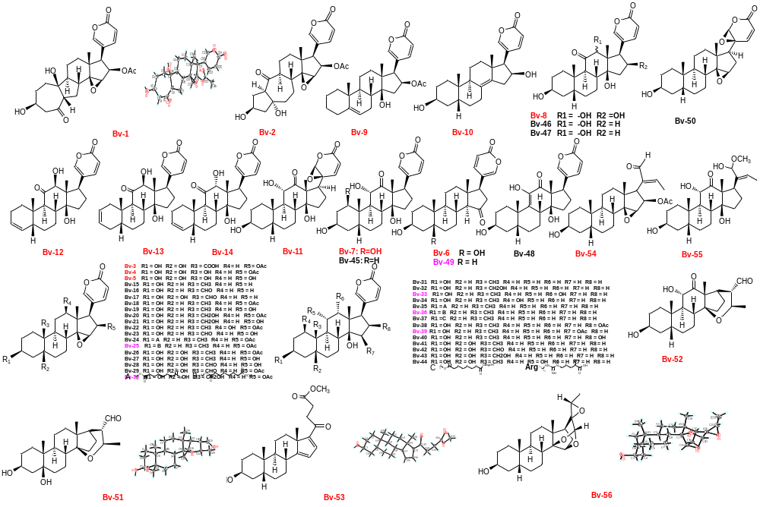
Chem. Eur. J. 2010, 16: 10989-10993; Steroids, 2010, 75 (12): 884-890. J Nat Prod. 2013, 76 (10), 1842-1847.
Chinese Chemistry Letters, 2014. Natural product Commucitions, 2015.
Notes:
We isolated a series of bufadienolides and their related derivatives from toad venom, including more than 20 new compounds.

Slide 10
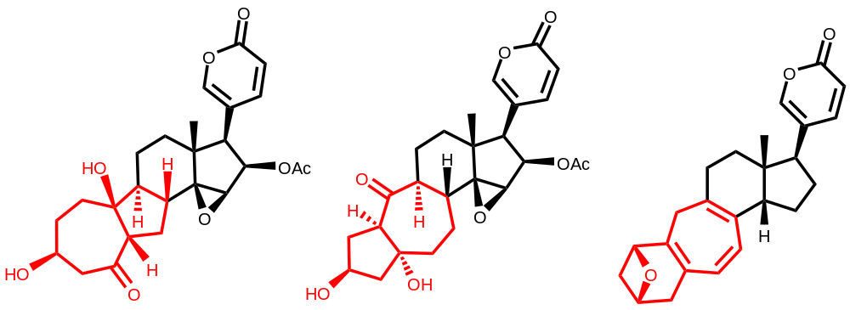
Novel bufadienolides with rearranged skeletons from toad venom
Bufogargarizin A
Bufogargarizin B
Bufogargarizin C
Unprecedented 7/5/6/5/6, 5/7/6/5/6 and 6/7/6/5/6 ring systems
Notes:
Among these bufadienolides from toad, we have identified three novel A/B ring rearranged ones for the first time. They have unprecedented 7/5/6/5/6, 5/7/6/5/6 and 6/7/6/5/6 ring systems instead of the 6/6/6/5/6 skeleton presented in common bufadienolides.

Slide 11
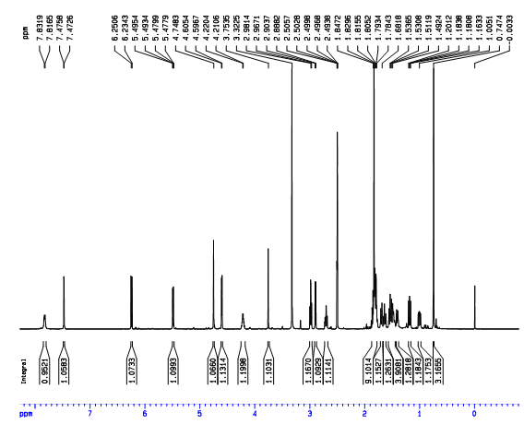
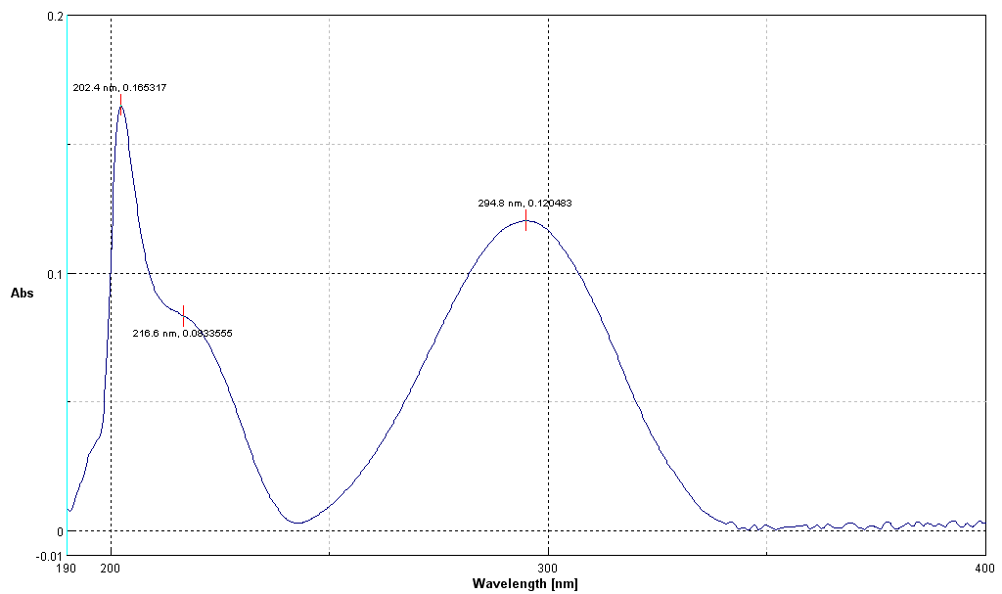
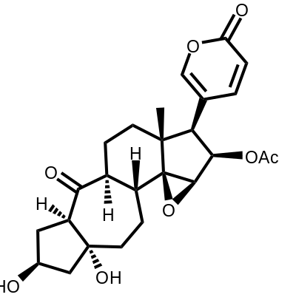
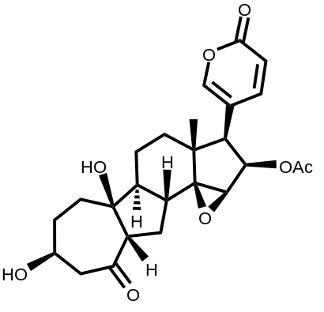
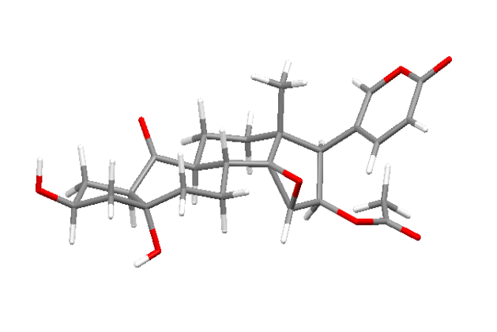
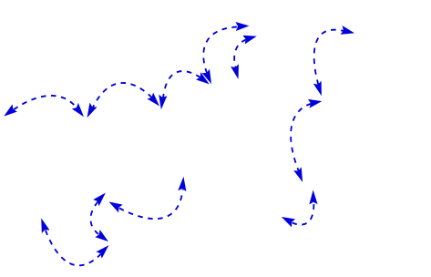
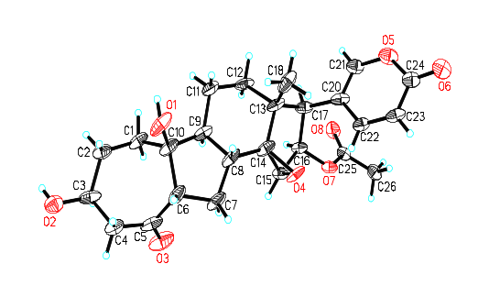
λ_{max} (logε) 295 nm (2.7)
Absolute configuration using
mosher’s methods
HR-ESI-MS [M+H]⁺ 459.2017
(calcd for C₂₅H₃₁O₈: 459.2013)
Chem. Eur. J. 2010, 16: 10989-10993

Slide 12
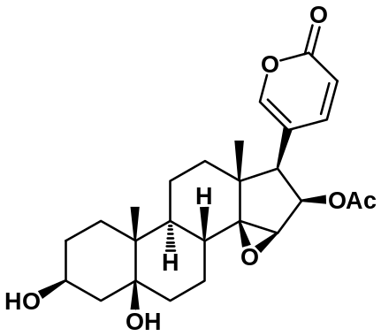
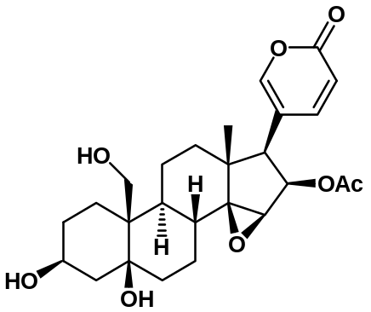
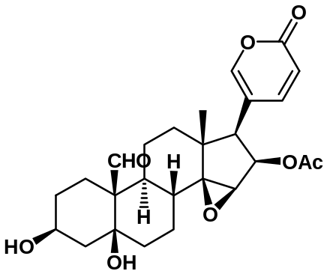
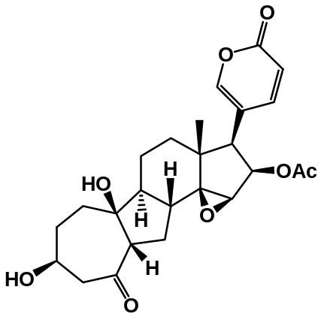
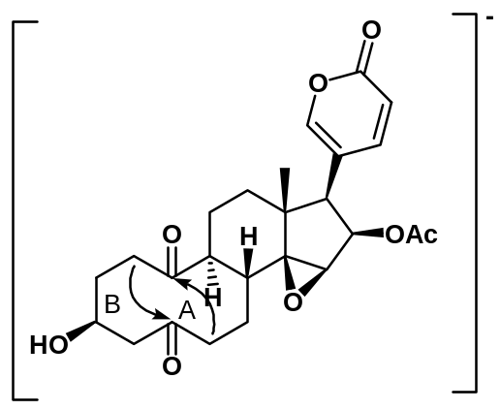
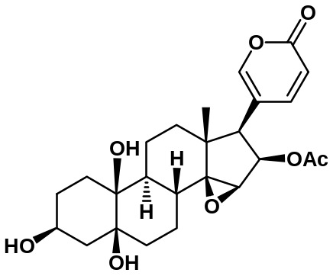
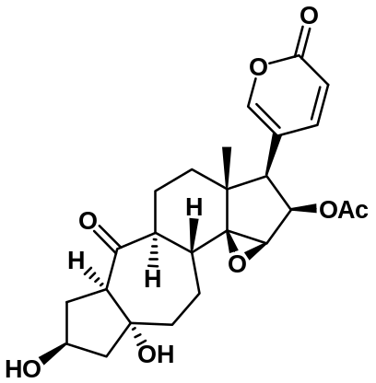
The biosynthetic pathways of Bufagargarizin A and B
1
2
3
O
O
Bufagargarizin A
Baeyer-Villige
A
4
O
aldol
condensation
Bufagargarizin B
B
Key intermediate with di-ketone unit
Notes:
The identification of these interesting novel compounds interested us to presume the biogenetic pathway among these compounds. Cinobufotalin (6), 19-hydroxylcinobufotalin (5) and 19-oxocinobufotalin (4) were three known ingredients of toad venom.[15] The aldehyde group at C-10 in 3 should be formed by oxidation of the corresponding hydroxymethyl group in 2, which was an oxide of 1, as the formation of resibufagin and hellebrigenin.[5,6a,16] Then 3 might be changed into 4, a new 19-norbufadienolide, through a Baeyer–Villiger reaction.[17] After undergoing an oxidation procedure of 4, an presumably intermediate with diketone unit was formed.[18] Finally, 1 and 2 should be yielded through two intramolecular aldol condensation procedures of the intermediate (Scheme 3).[19]

Slide 13
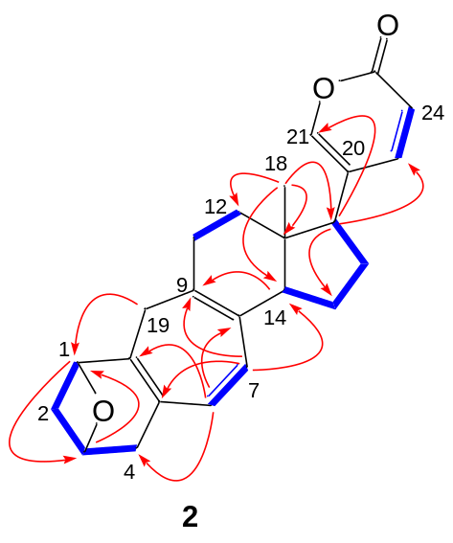
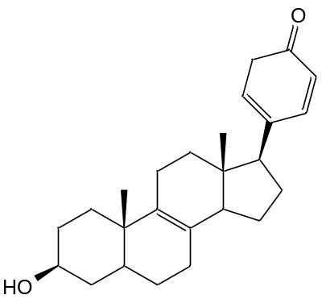
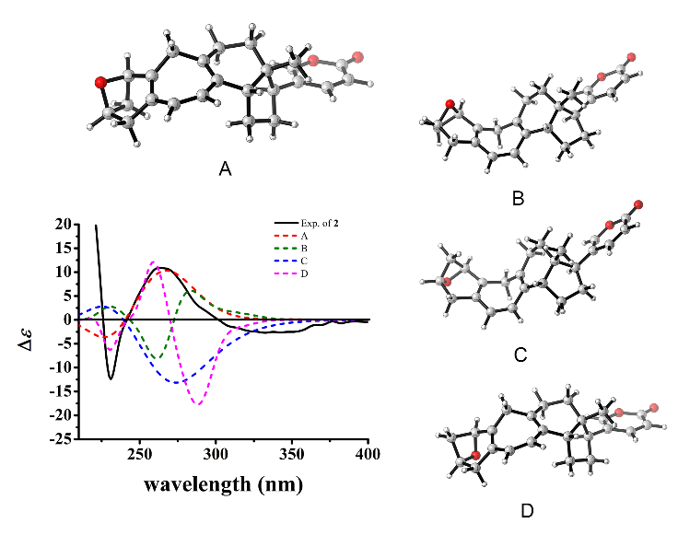
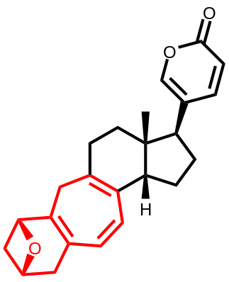
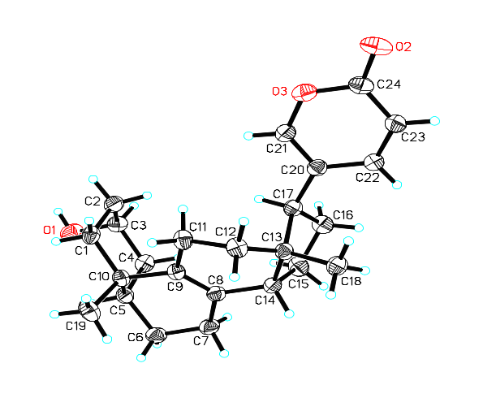
Bufagargarizin C
Unpublished data
Notes:
The partial relative configuration of 2 could be determined by a ROESY experiment (Supplementary Information, Fig. S2). The NOE correlations between H₃-18 and H-14 indicated these protons were β-oriented. However, the configuration of the epoxy group in ring A was still unclear due to an uncertain conformation of rings A/B. In order to establish the fully configurations of 2, a quantum chemical calculation was carried out. Aiming to get one reasonable configuration, four optimized stereoisomers A-D (Fig. 4) were built based on the X-ray single crystal structure of our previously synthesized bufadienolide Δ^{8,9}-14-dehyrobufalin with the same C, D and E rings as 2 (Supplementary Information, Fig. S3 and S4). Furthermore, their ECD spectra were calculated at the level of PBE0/6-311++G (2d, 2p) with the PCM solvent continuum model and methanol as the solvent, and the arch-shaped stereoisomer A with configurations of 1R, 3R (Fig. 4) matched well with the experimental spectrum, which was the strong evidence that it was the most reasonable absolute configuration.

Slide 14
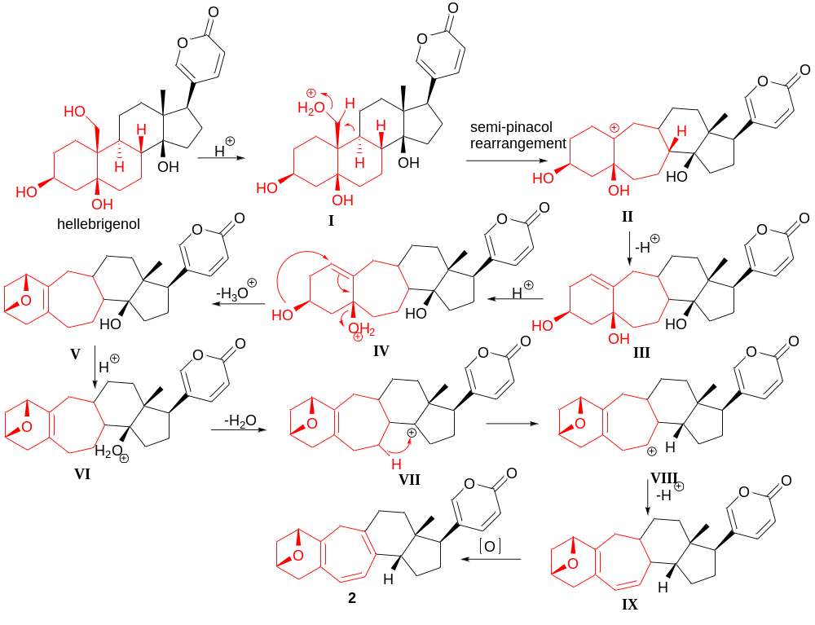
The proposed biosynthetic pathways of Bufagargarizin C
Notes:
Bufagargarizins C should be biosynthesized from a normal bufadienolide hellebrigenol,¹⁶ which experienced a ring expansion like 1 by a semipinacol rearrangement to form a carbonium ion II via a 19-hydroxy protonated intermediate I.¹⁷ Then the deprotonation of II may lead to the formation of the key intermediate III. Further the protonation of III yielded IV, which might initiate dehydration, double bond migration and intra-molecular nucleophilic addition to produce V featured with an oxygen bridge between C-1 and C-3.¹⁸ The intermediate V then might undergo the protonation of 14-hydroxy group to form VI, which could subsequently initiate a series of dehydration (VII), 1,3-hydride shift (VIII) and dehydrogenation (IX) to yield 2 with a cycloheptatriene ring B (Scheme 2).^{13,19} The biosynthetic pathways of 2 included many interesting enzyme-dependent and spontaneous reactions like ring expansion, expoxide ring formation and hydride transfer. We used theoretical study to verify the key steps of these probable procedures. The computational relative free energy profiles well supported the rationality of our proposal (Supplementary Information).

Slide 15
Fig. S6. The key reactions in the proposed biosynthetic pathway of 2, including (a) the ring expansion, (b) epoxide ring formation and (c) one difficult hydride transfer. All the calculations were done at the level of B3LYP/6-31G* and all the structures were drawn by CYLview.
Notes:
The computational relative free energy profiles well supported the rationality of our proposal (Supplementary Information).

Slide 16
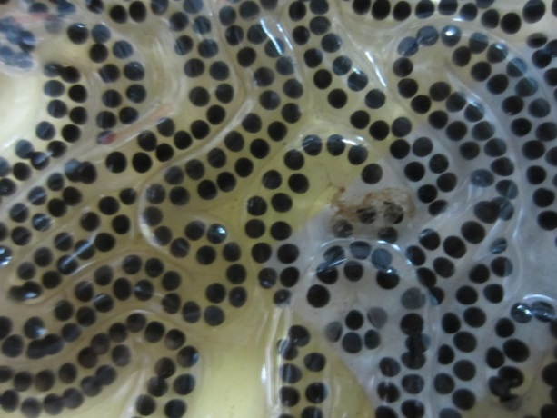
Toad skin, eggs and bile
It was reported that there are also abundant bufadienolides in the skins, eggs and bile of toads.
Toad eggs
J.Nat.Prod. 1998, 61, 1476 1481; Nat Prod Rep. 1998.
Toad gallbladder

Slide 17
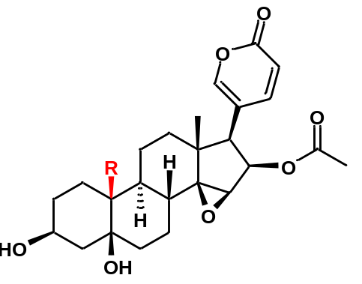
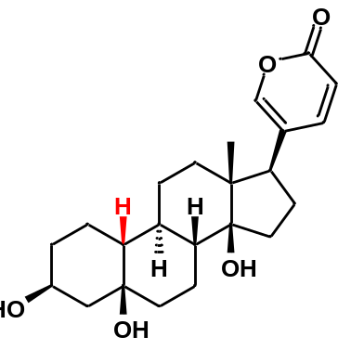
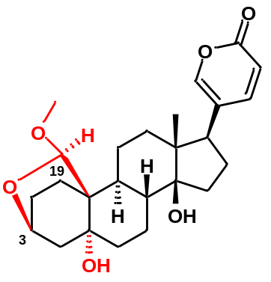
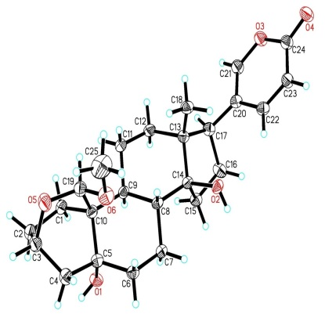
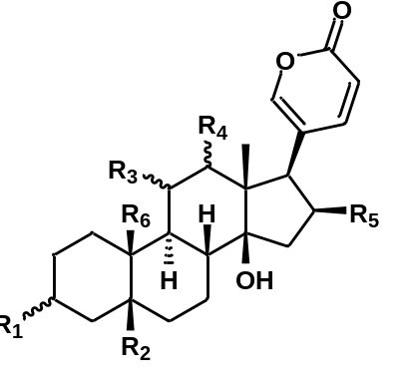
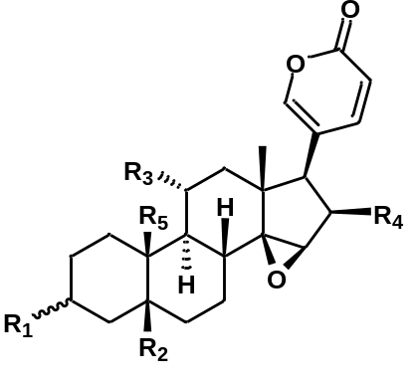
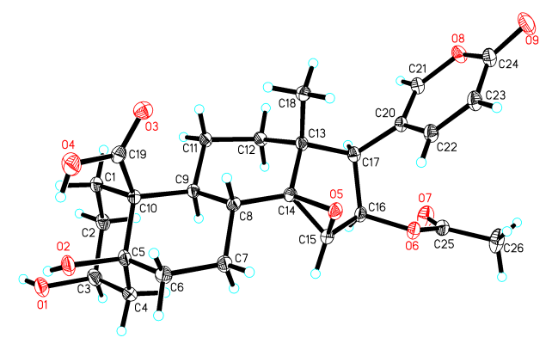
Toad skin
Sbb-4
 | R₁ | R₂ | R₃ | R₄ | R₅ | R₆
Sbb-5 ⃰ | β-OH | OH | H | H | H | CHO
Sbb-26 | β-OH | OH | H | H | H | CH₃
Sbb-27 | β-OH | OH | H | H | H | CHO
Sbb-28 | β-OH | H | H | H | H | CH₃
Sbb-29 | α-OH | H | H | H | H | CH₃
Sbb-30 | β-OH | H | H | H | H | CH₂OH
Sbb-31 | β-OH | H | H | H | OH | CH₃
Sbb-32 | β-OH | H | H | H | OAc | CH₃
Sbb-33 | β-O-suberate | H | H | H | OAc | CH₃
Sbb-34 | =O | H | H | H | OAc | CH₃
Sbb-35 | β-OH | H | α-OH | H | H | CH₃
Sbb-36 | β-OH | H | α-OH | =O | H | CH₃
Sbb-37 | =O | H | α-OH | =O | H | CH₃
Sbb-38 | β-OH | =O | =O | β-OH | H | CH₃
Sbb-39 | β-OH | H | =O | α-OH | H | CH₃
Sbb-40 | =O | H | =O | α-OH | H | CH₃
 | R₁ | R₂ | R₃ | R₄ | R₅
Sbb-4 ⃰ | β-OH | OH | H | OAc | COOH
Sbb-14 | β-OH | OH | H | OAc | CH₃
Sbb-15 | β-OH | OH | H | OH | CH₃
Sbb-16 | β-OH | OH | H | H | CHO
Sbb-17 | β-OH | OH | H | OH | CHO
Sbb-18 | β-OH | OH | H | OAc | CHO
Sbb-19 | β-OH | H | H | OH | CH₃
Sbb-20 | β-OH | H | H | OAc | CH₃
Sbb-21 | β-OH | H | OH | OAc | CH₃
Sbb-22 | α-OH | H | H | H | CH₃
Sbb-23 | α-OH | H | H | OH | CH₃
Sbb-24 | =O | H | H | OH | CH₃
Sbb-25 | =O | H | H | OAc | CH₃
Fitoterapia, 2015
18
Notes:
Most of the bufadienolides in toad skin are also present in the venom. But we also identified some new bufadienlides, as ssb-1, with a rare 3,19 ether bridge.

Slide 18
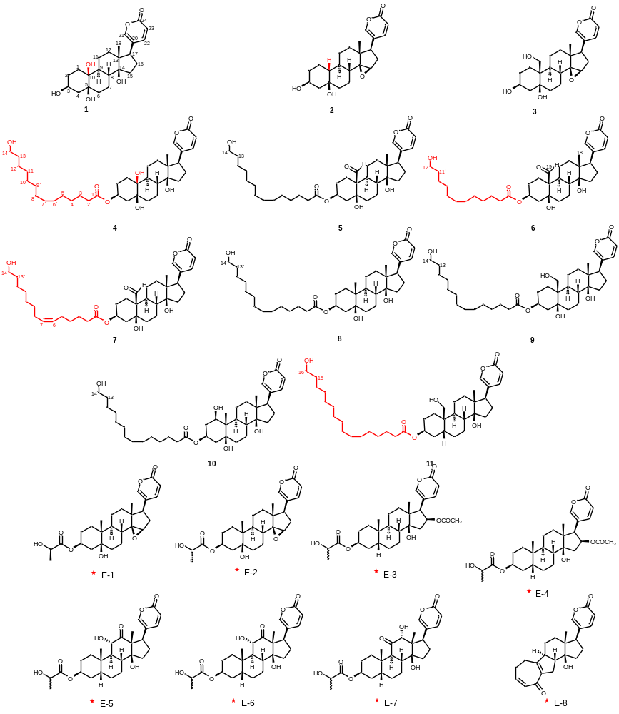
New bufadienolides from toad eggs
Notes:
These are some new bufadienolides from toad eggs. Typically, we get a series conjugated bufadienolides with long aliphatic chains at 3-hydroxyl group.

Slide 19
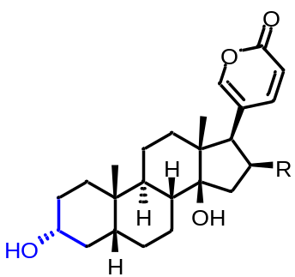
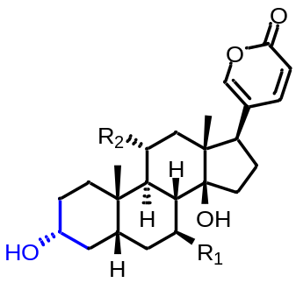
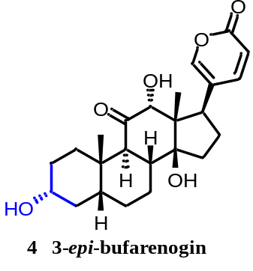
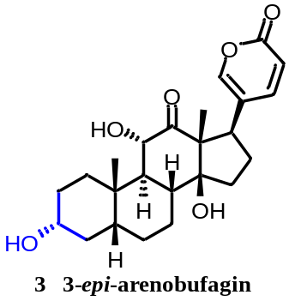






Toad bile
19
♠ new compounds
♠ crystal
♠
5 R= -H 3-epi-bufalin
19 R= -OH 3-epi-desacetylbufotalin
8 R= -OAc 3-epi-bufotalin
♠
7 R1= -OH R3= -H 3-epi-7β-Hydroxybufalin
20 R2= -OH R1=H 3-epi-gamabufotalin
♠
♠
♠
♠
♠
Notes:
We isolated a series of 3-alfa bufadienolides in toad bile.

Slide 20
Recent Progress in Our Group
Chemical investigation on toad venom, toad skin, toad bile and toad eggs.
The anti-cancer effects of bufadienolides
The analgesic effects of bufadienolides
Notes:
Throungh the system investigation of the potent bufadienlides, we have set up a small natural product library. Based on these we further do some research about their anti-cancer and analgesic activities.

Slide 21
The anti-cancer effects of bufadienolides
Cell Lines | CNE-1 | CNE-2 | HepG2 | HepG2/ADM | Cell Lines | CNE-1 | CNE-2 | HepG2 | HepG2/ADM
No. | IC₅₀ (μM) |  |  |  | No. | IC₅₀ (μM)
BBGv-1 | 0.279±0.086 | 0.460±0.173 | 0.589±0.019 | 0.345±0.037 | BBGv-30 | 0.803±0.095 | 1.270±0.028 | >50 | >50
BBGv-2 | 1.450±0.354 | 4.570±0.566 | 1.738±0.077 | 1.272±0.066 | BBGv-31 | 10.507±0.381 | 24.070±5.020 | 10.372±0.920 | 8.439±0.674
BBGv-3 | 1.747±0.129 | 8.860±0.792 | 4.633±0.217 | 2.171±0.578 | BBGv-32 | 1.955±0.064 | 3.760±0.577 | 4.983±0.752 | 3.131±0.432
BBGv-4 | 0.380±0.113 | 1.275±0.043 | 1.566±0.749 | 0.592±0.254 | BBGv-33 | 54.865±4.858 | 92.295±0.120 | 80 | >50
BBGv-5 | 1.720±0.113 | 2.865±0.431 | 3.175±0.439 | 2.375±0.198 | BBGv-34 | 1.653±0.206 | 1.227±0.137 | 21.500±1.972 | 17.417±1.466
BBGv-6 | 4.990±0.042 | 7.375±0.530 | >100 | >100 | BBGv-35 | 0.330±0.028 | 3.053±0.203 | 3.198±0.776 | 2.322±0.516
BBGv-7 | 0.325±0.007 | 0.614±0.200 | >100 | >100 | BBGv-36 | 0.410±0.061 | 0.790±0.184 | 7.842±0.125 | 6.569±0.246
BBGv-8 | 1.300±0.071 | 3.115±0.163 | 0.460±0.194 | 0.354±0.13 | BBGv-37 | 1.450±0.113 | 3.050±0.354 | 60 | >50
BBGv-9 | >100 | >100 | 26.750±23.114 | >100 | BBGv-38 | 64.380±0.877 | >100 | >100 | >100
BBGv-10 | 0.260±0.046 | 0.193±0.012 | 0.470±0.057 | 0.148±0.029 | BBGv-39 | 0.235±0.035 | 0.435±0.049 | 2.645±0.341 | 1.196±0.027
BBGv-11 | >100 | >100 | >100 | >100 | BBGv-40 | 0.400±0.072 | 2.050±0.707 | 0.628±0.086 | 0.213±0.110
BBGv-12 | 4.893±0.762 | 1.765±0.078 | 3.584±0.799 | 2.595±0.339 | BBGv-41 | 89.885±0.643 | >100 | >100 | >100
BBGv-13 | 0.310±0.071 | 0.390±0.127 | 2.355±0.084 | 1.706±0.062 | BBGv-42 | 73.825±0.955 | >100 | >100 | >100
BBGv-14 | 0.355±0.049 | 0.690±0.159 | 0.076±0.019 | 0.015±0.004 | BBGv-43 | >100 | >100 | >50 | >50
BBGv-15 | 0.277±0.038 | 0.817±0.138 | 2.664±0.422 | 1.604±0.340 | BBGv-44 | >100 | >100 | >50 | >50
BBGv-16 | 0.560±0.085 | 0.270±0.042 | 0.556±0.034 | 0.300±0.044 | BBGv-45 | 1.007±0144 | 2.340±0.110 | 4.950±0.080
BBGv-17 | 1.707±0.422 | >50 | 14.630±1.910 | 10.958±0.281 | BBGv-46 | 7.740±0.170 | 9.515±0.686 | 14.770±1.200
BBGv-18 | 10.480±1.457 | 17.863±0.587 | 55 | >50 | BBGv-47 | 11.785±2.143 | 38.000±1.600 | >50 | >50
BBGv-19 | 0.250±0.057 | 0.333±0.107 | 3.677±0.075 | 2.199±0.098 | BBGv-48 | >100 | >100 | >100 | >100
BBGv-20 | 0.160±0.078 | 0.485±0.092 | 0.527±0.009 | 0.232±0.025 | BBGv-49 | 0.517±0.015 | 1.255±0.177 | 3.626±0.522 | 1.797±0.179
BBGv-21 | 0.110±0.028 | 0.140±0.072 | 0.101±0.013 | 0.039±0.005 | BBGv-50 | >100 | >100 | >100 | >100
BBGv-22 | 51.400±3.239 | >100 | >50 | >50 | BBGv-51 | 20.497±1.930 | 24.060±3.973 | 16.760±0.654 | 14.067±1.784
BBGv-23 | 33.485±2.143 | >100 | 120 | >50 | BBGv-52 | >100 | >100 | >100 | >100
BBGv-24 | >100 | >100 | >100 | >100 | BBGv-53 | >100 | >100 | >100 | >100
BBGv-25 | 5.057±0.624 | 17.960±1.385 | 43.340±5.020 | >100 | BBGv-54 | >100 | >100 | >100 | >100
BBGv-26 | 15.225±1.365 | 26.470±1.937 | >100 | >100 | BBGv-55 | 56.190±0.622 | >100 | 26.840±8.310
BBGv-27 | 7.830±0.240 | 24.965±3.472 | >100 | >100 | BBGv-56 | >100 | >100 | 64.770±19.900 | 52.180±3.200
BBGv-28 | 0.563±0.088 | 0.570±0.127 | 5.484±0.104 | 4.515±0.117 | BBGv-57 | >100 | >100 | 68.730±0.010 | 61.440±2.430
BBGv-29 | >100 | >100 | 57.520±2.112 | 46.207±4.195 | BBGv-58 | >100 | >100 | >100 | >100

Slide 22



The structure and activity relationships of Bufadienolides
CoMFA
CoMSIA
Arenobufagin (ABF)

Slide 23




The effects of bufadienolides on ClC-3 chloride channel
A
B
A
B
C
C
Notes:
ClC-3 chloride (Cl−) channel has been shown to be involved in cell proliferation, cell cycle, and cell migration processes. Herein, we found that a series of bufadienolides isolated from toad venom were a novel class of ClC-3 Cl− channel activators with antitumor activities

Slide 24



ABF can activate ClC-3 chloride channel
A
B
C
1 μM Arenobufagin
Arenobufagin
D
1 μM Arenobufagin
E
1 μM Arenobufagin
F
Arenobufagin (μM)
Notes:
24

Slide 25



Inhibition of ClC-3 chloride channel can attenuated the apoptosis induced by ABF
A
Arenobufagon
B
C
Arenobufagin
Arenobufagon
Arenobufagin+NPPB
Arenobufagin + Tamoxifen
Arenobufagin+ClC-3 siRNA
Notes:
The PI3K/Akt/mTOR pathway was attenuated by pretreatment with Cl− channel blockers [tamoxifen and 5-nitro-2-(3-phenylpropylamino)benzoic acid, NPPB] or ClC-3 small interfereing RNA.
25

Slide 26
ABF activates the ClC-3 chloride channel to trigger the apoptosis
J Med Chem, 2013, 56: 5734-43.
Notes:
In summary, we discovered that activation of the ClC-3 Cl− channel, which subsequently induced inhibition of the PI3K/Akt/mTOR signaling pathway, was involved in the antitumor activities of bufadienolides.
26

Slide 27
Recent Progress in Our Group
Chemical investigation on toad venom, toad skin, toad bile and toad eggs.
The anti-cancer effects of bufadienolides
The analgesic effects of bufadienolides
Notes:
Since the toad originated medicines

Slide 28


The analgesic effects of E19 in mouse acetic acid writhing model
The writhing times
Inhibition
E19: 0.5 mg/kg
Aspirin: 50 mg/kg
E19 showed significant analgesic effects on mouse.

Slide 29



Analgesic effects and sodium channel
Mechanism of Sodium Channel Inhibitor
Structure of Sodium Channel Inhibitor

Slide 30




Effects of Bufadienolides on Sodium channel in DRG cells
Unpublished data
Notes:
Whole cell patch clamp. These work is currently ongoing.

Slide 31
Acknowledgement
Prof. Wen-Cai Ye (vice-president)
Prof. Dong-Mei Zhang
Asociatiate Prof. Lei Wang
Peng-Wei Zhang
Bao-Jing Li
Financial Support
NSFC 81102518, 81443336
The Pearl River Science and Technology Program

Slide 32

Thank You!
谢 谢！

