Slide 1

Acute Sinusitis – Treatment and Management with Mucolytic Agents
Armed Forces Hospital Hamburg
ENT Department
Professor Dr. med. habil. Thorsten Zehlicke

Slide 2
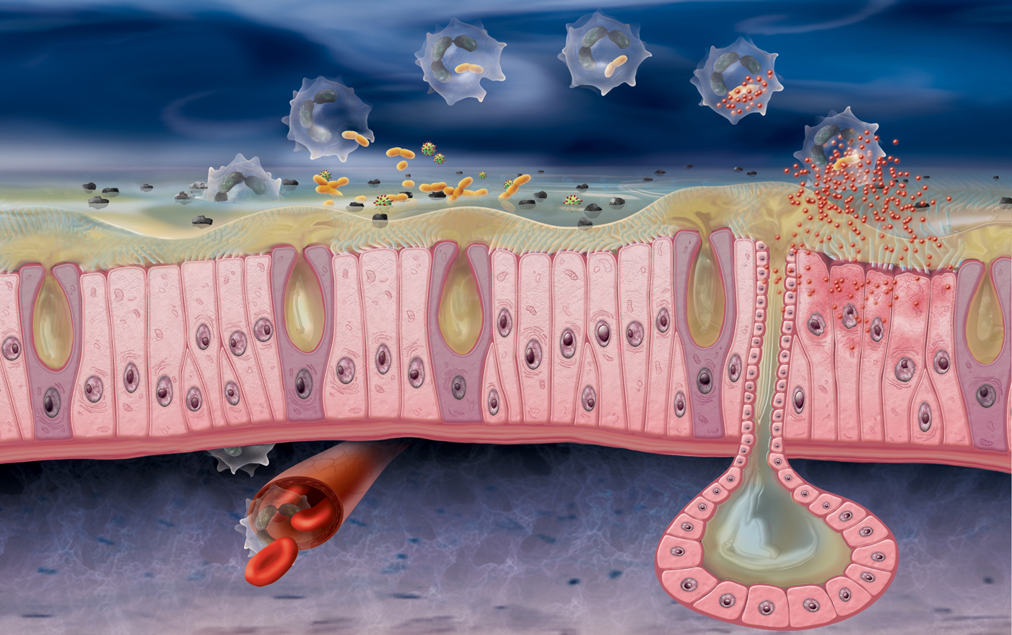
Upper respiratory tract virus infection (URI)
Inflammation of the nasal mucosa
Duration of disease < 14 Tage
Symptoms:
  blocked nose, nasal congestion
  clear or purulent nasal discharge
  post nasal drip
…may lead to an Acute Sinusitis
2
Notes:
2

Slide 3
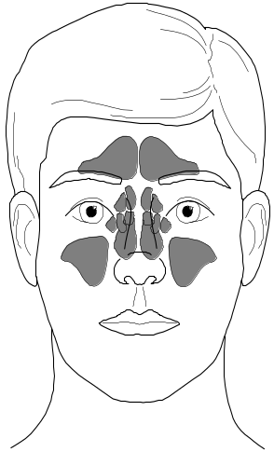
Acute Sinusitis
  Nasal discharge and sinus congestion depends on the infection
  5 – 7 day´s after URI, most viral,
  bacterial (0,5 - 2 %):
  Streptococcus pneumoniae und Haemophilus
  influenzae
3
Notes:
3

Slide 4
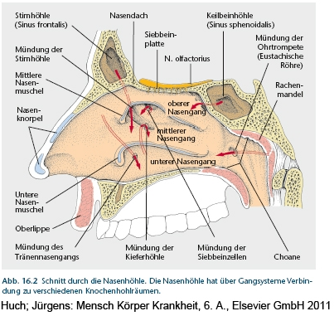
Pathogenesis
  The paranasal sinuses are joined to
  the nasal cavity via small ostia
  Ostia become blocked easily by allergic desease, inflammation, or by swelling in the nasal lining that occurs with a cold. If this happens, normal drainage of mucus within the sinuses is disrupted, and sinusitis may occur.
4
Notes:
4

Slide 5
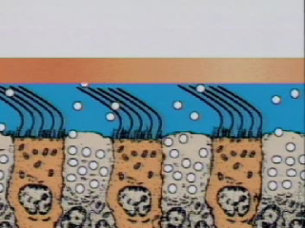
Paranasal sinuses are lined with respiratory epithelium

Slide 6
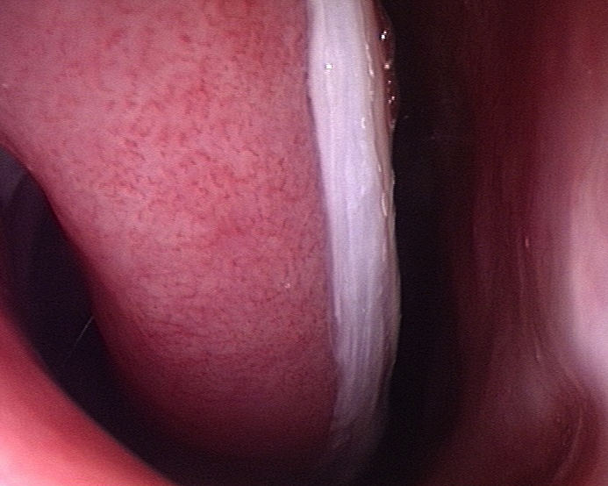
Diagnosis of acute Sinusitis
Diagnosis is usually based on history and examination findings
Only few clinical findings suggest a clear diagnosis (eg endoscopically proven Pus )
Technical methods ( CT, smear , etc. ) are only conclusive

Slide 7
Diagnosis
If no pain in the facial area and no complaints in the area of the nose ( " blocked nose " rhinitis, hyposmia , ) are present , the diagnosis is very unlikely ("Evidenz"level IIc).
One-sided pressure / or percussion tenderness over the sinuses and purulent rhinitis in the examination confirm the suspicion ("Evidenz"level IIc).
Guideline Rhinosinusitis DGHNO

Slide 8
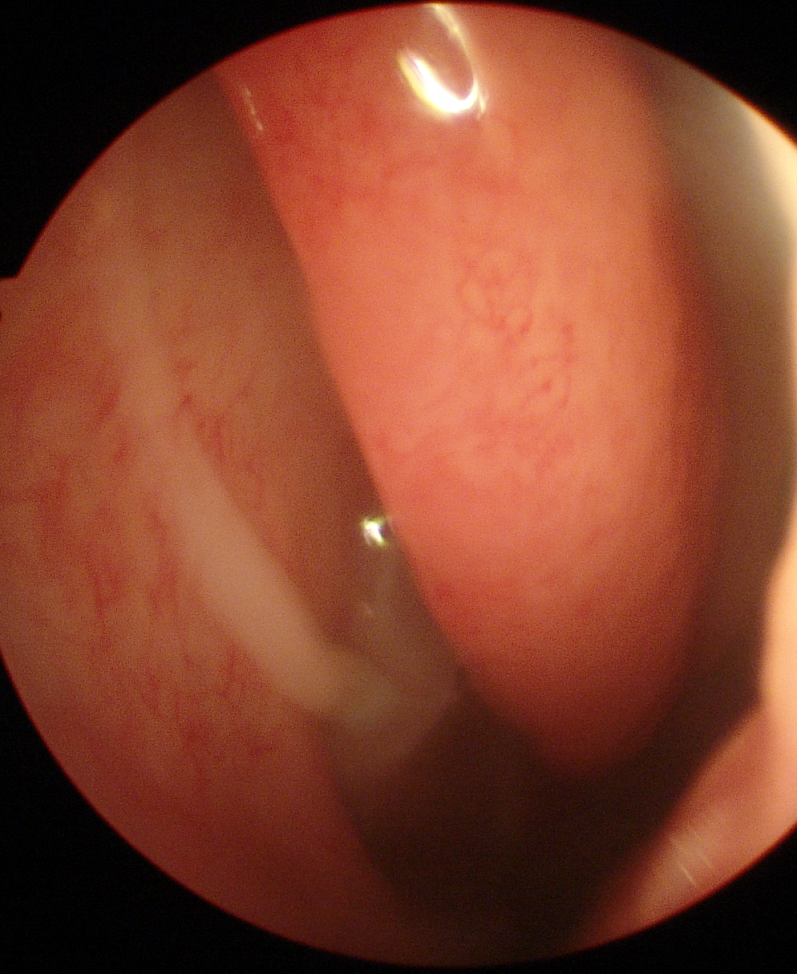
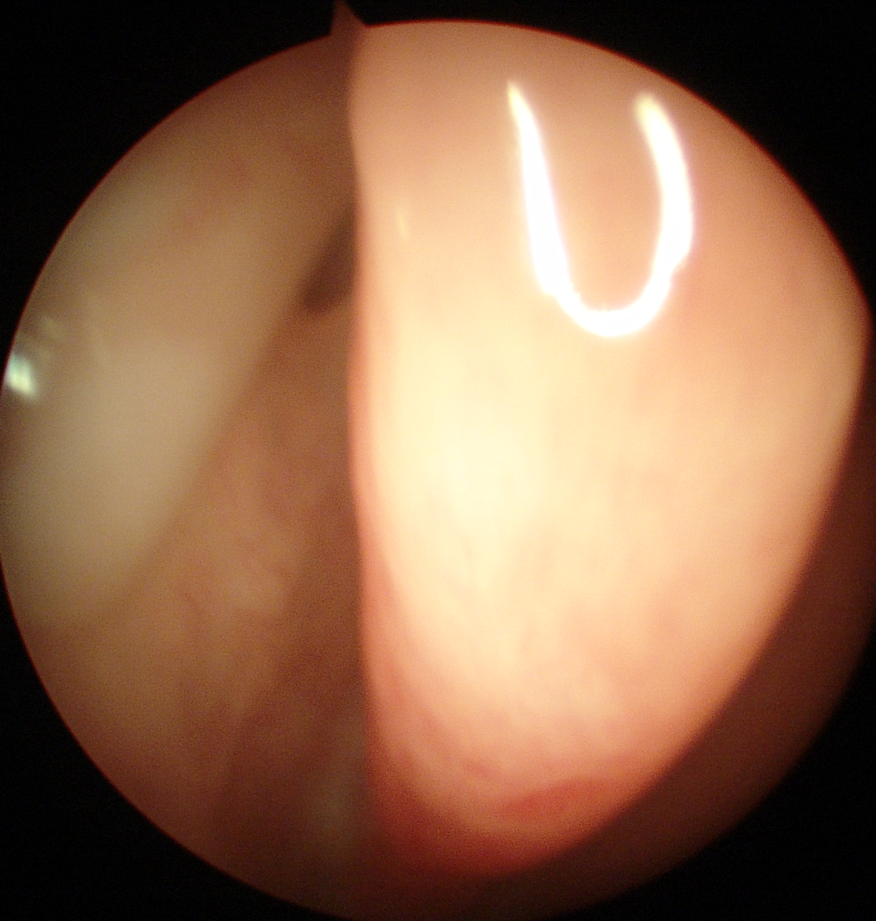
Diagnosis
Some findings are almost conclusive : visible pus in the middle meatus at endoscopy , " purulent postnasal drip" and a premaxillary swelling ("Evidenz"level IIb).
Guideline Rhinosinusitis DGHNO

Slide 9
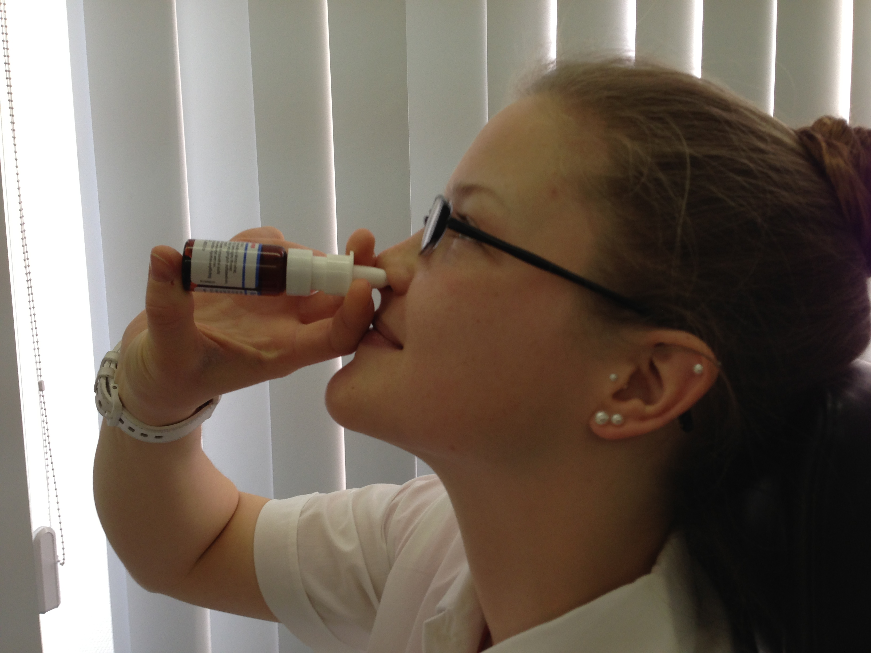
How to avoid the development of acute sinusitis and how do I treat ?
Secretolysis ?
Antibiotics ?
Decongestant nasal therapy ?

Slide 10
Xylometazolin Spray
Frequently prescribed in Germany
Imidazole derivatives , alpha- sympathomimetic effect
Contraction of vascular smooth muscles - narrowing of the vessels – decongestant effect
Many publications on the improvement of nasal breathing during banal infection (PubMed 185 Publ. word search „xylometazoline nasal“)

Slide 11
Xylometazolin Spray
The therapeutic effect of nasal decongestants is scarcely been studied for acute rhinosinusitis , placebo-controlled studies are not available
Giudeline German Society of Oto-Rhino-Laryngology,
Head and Neck Surgery
Rhinosinusitis

Slide 12
Antibiotic Therapy
Indications for antibiotic therapy in acute rhinosinusitis:
severe symptoms
Fever > 38.5 ° C
a gain of complaints over the disease
a threatening complication
Patients with chronic inflammatory lung disease immunodeficient or immunosuppressed patients
Patients with serious underlying diseases or specific risk factors
Guideline Rhinosinusitis DGHNO

Slide 13
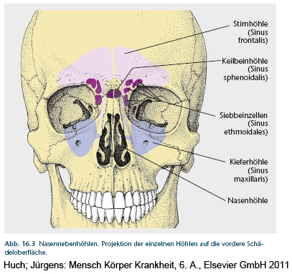
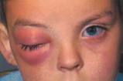
Acute Sinusitis - Complications
Periostitis , orbital cellulitis
Meningitis , Encephalitis , epidural or subdural Empyema and intracranial Abscess
Thrombosis of the sagittal sinus and cavernous sinus
13
Notes:
13

Slide 14
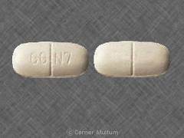
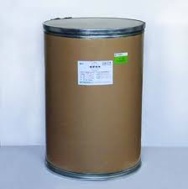
Antibiotics
First choice
Amoxicillin
Aminopenicillin + beta-Lactamase-Inhibitor, Oralcephalosporin 2
Makrolid, Ketolid
Cotrimoxazol
Clindamycin, Doxycyclin
Cephalosporin 3a, Moxifloxacin, Levofloxacin Ciprofloxacin
Guideline Rhinosinusitis DGHNO

Slide 15
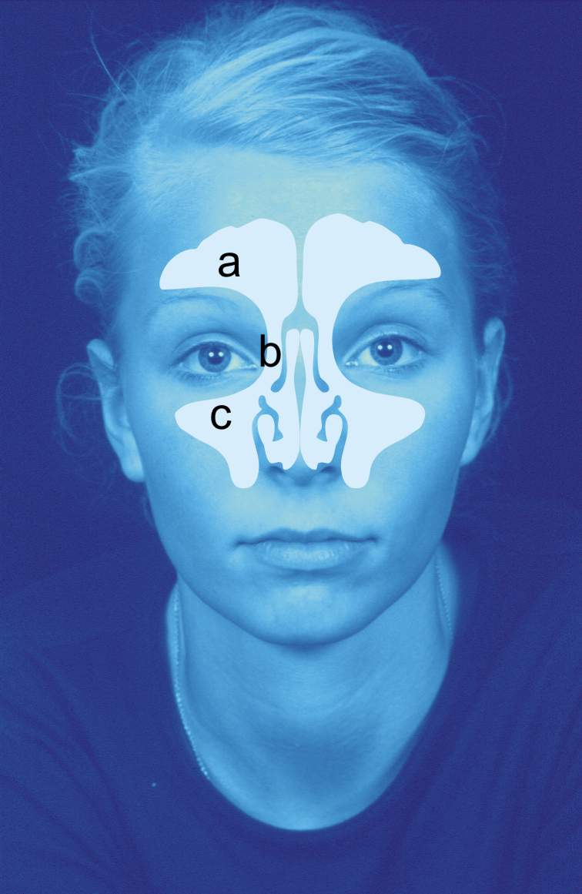
Antibiotics
Few placebo- controlled trials
Several meta- analyzes that compare different antibiotics against each other
Guideline Rhinosinusitis DGHNO

Slide 16
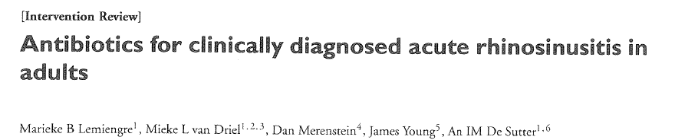
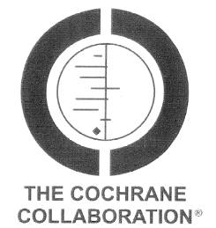
Antibiotics
Analysis of 10 studies with 2450 patients
Shortening time of the disease (not significant)
Antibiotic therapy is not indicated ( resistance and side effects , serious complications of ARS rarely)

Slide 17
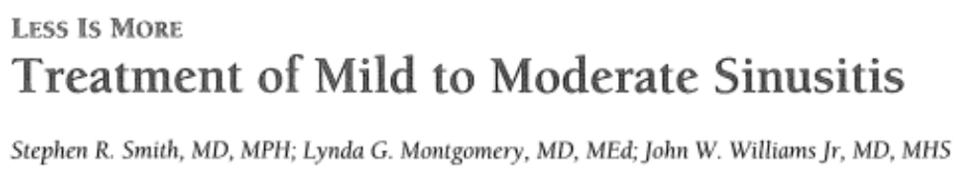

Antibiotics
Investigation of meta analysis of randomized placebo controlled trials of the last 10 years
Only studies antibiotic therapy vs Placebo
Little difference in the treatment time
Significantly more side effects in the antibiotic
group

Slide 18
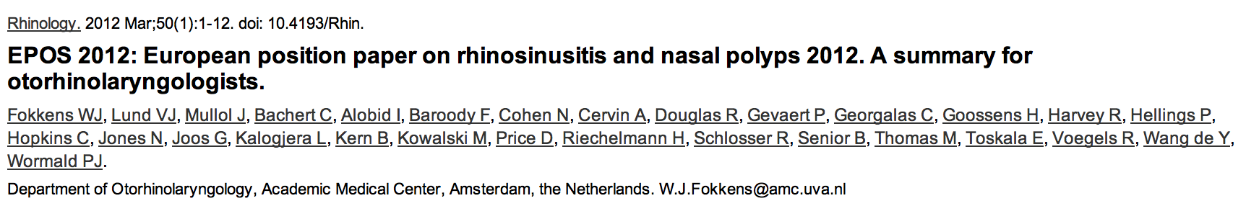
Antibiotics
Antibiotic therapy should be limited to serious disease states
Complications can not be reduced by antibiotic therapy
Rhinology. 2012 Mar;50(1):1-12

Slide 19
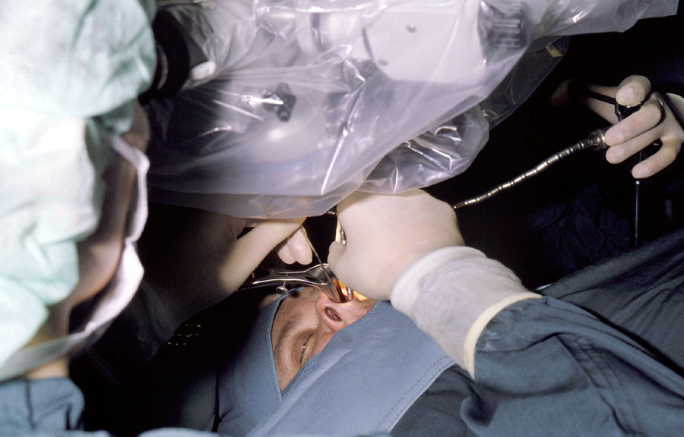
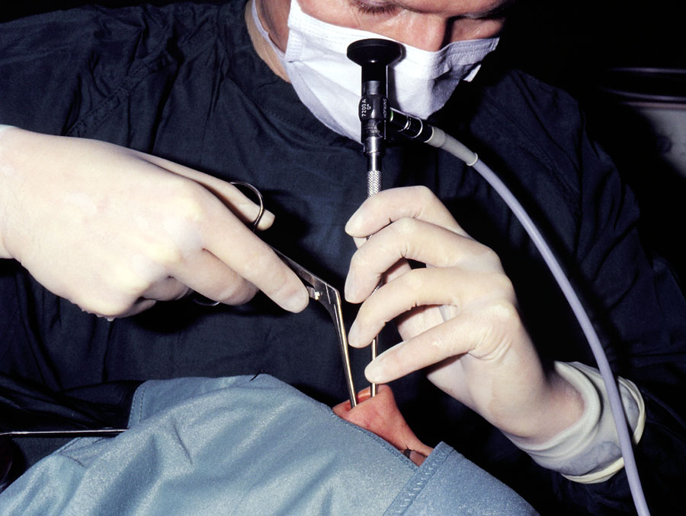
Therapy of Complications

Slide 20
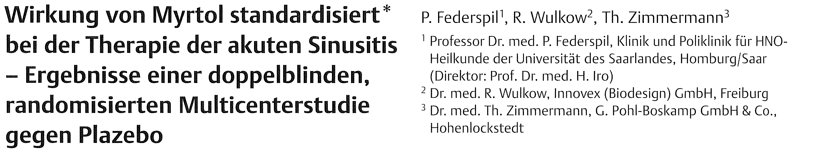
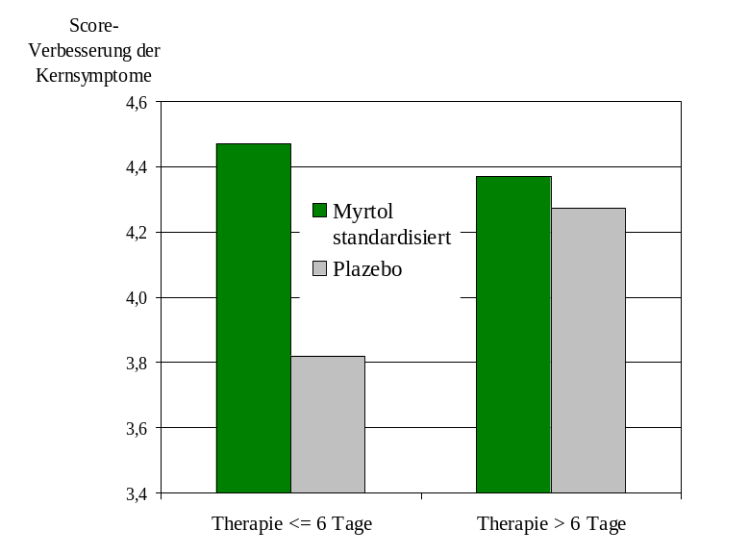
Secretolysis
331 patients with acute sinusitis
Myrtol - Placebo - Essential oil
Survey of symptom scores (SSC)
Significant improvement of the SSC Myrtol over placebo with good tolerability
A significant treatment effect is based on the symptom scores

Slide 21
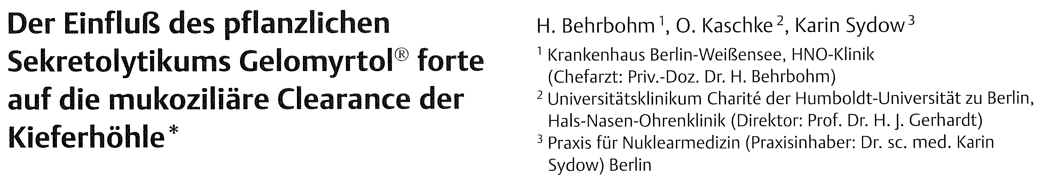
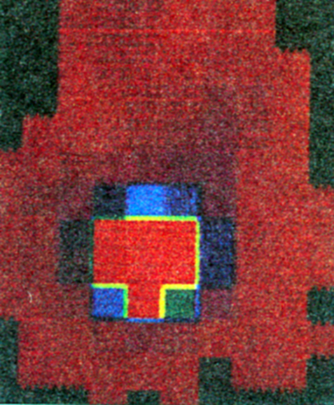
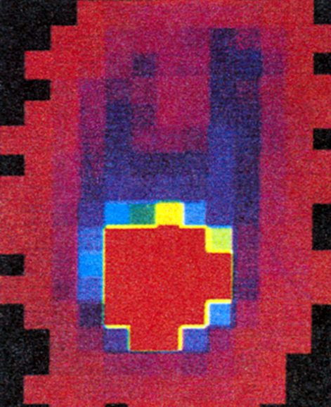
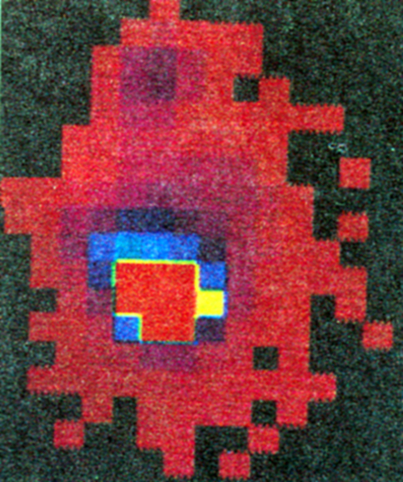
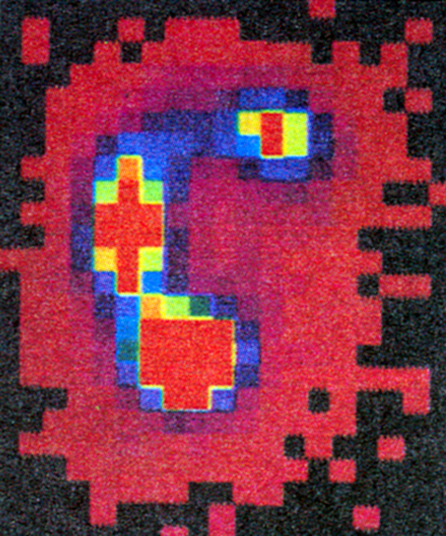
Secretolysis
Sequenzszintigrafic study of four subjects for the detection of mucocilliare clearence equivalent before and after administration of Myrtol
Unique increasing transportation rate after administration of Myrtol

Slide 22
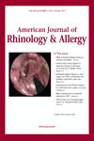
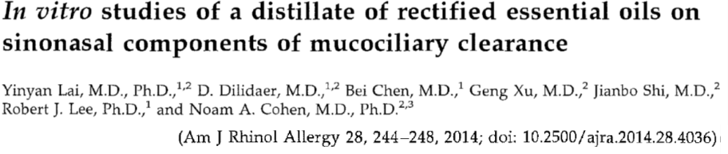
Systematic study of the various factors influencing the MCC
Used cell cultures were obtained from sinus cells from human donors
In vitro studies of air-liquid interface (ALI ) cultures
Notes:
Nachdem Sie nun die Welt der Mukoziliären Clearance in ihren Grundzügen kennengelernt haben, möchte ich Ihnen die aktuelle in vitro Studie von Lai et al. vorstellen.
Bei der Studie handelt es sich um einen systematische Untersuchung der verschiedenen Einflussfaktoren auf die MCC, also den Reinigungsmechanismus unsere Atemwege. Bei der Studie handelt es sich um Laboruntersuchungen.
Das für die Versuche eingesetzte Zellmaterial wurde von menschlichen Spendern gewonnen, die sich aufgrund anderer Erkrankungen ohnehin einer sinonasalen Operation unterziehen mussten. Das gewonnene Zellmaterial wurde weiter aufgearbeitet und als Air Liquid Interface Kulturen gezüchtet.
Bei der eingesetzten Air Liquid Interface Kultur handelt es sich um Zellkulturen die auf der einen Seite einem flüssigen Medium ausgesetzt sind und auf der anderen Seite Luft bzw. Gas.

Slide 23
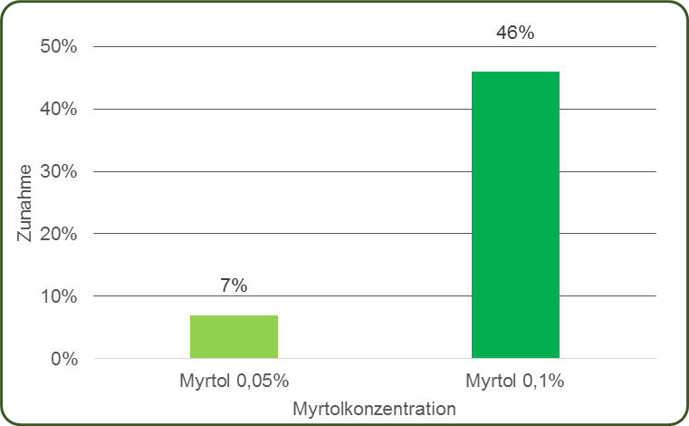
Influence on the transport speed of the mucus (mucociliary clearance)
Dose-dependent increase in the MCC by GeloMyrtol® forte
0,05%
0,1%
Wirkstoffkonzentration
Notes:
Die Untersuchungsergebnisse zeigen, dass es nach der basolateralen Applikation von GeloMyrtol forte zu einer dosisabhängigen Steigerung der MCC kommt.

Slide 24
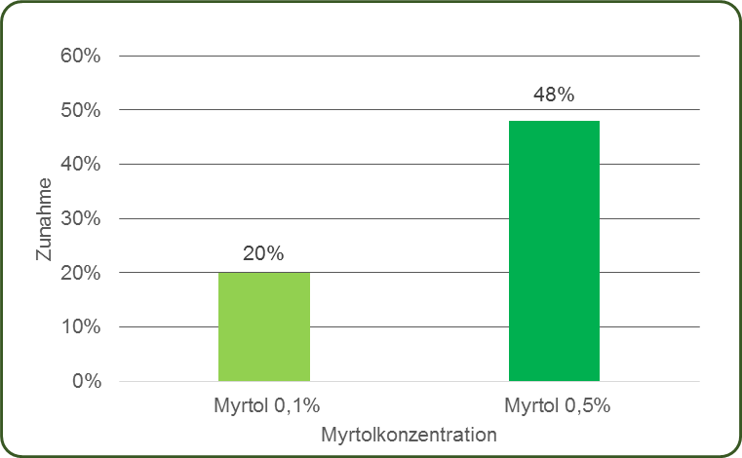
CBF increase 30 min after exposure (ciliary beat frequency)
Dose-dependent increase in CBF by GeloMyrtol® forte after application.
0,05%
0,1%
Wirkstoffkonzentration
Notes:
Die basolaterale Applikation spiegelt hier die natürliche Applikationsrute von Myrtol wieder, die perorale Aufnahme.

Slide 25
Conclusions
To treat a viral illness with antibiotics usually does not make sense
Antibiotic therapy means little effect at relatively frequent adverse events
Antibiotic therapy produces bacterial resistance
Acute sinusitis in otherwise healthy patients is not an indication for antibiotic therapy , even with fever.

Slide 26
Conclusions
There are many references to the good effectiveness of Myrtol for acute sinusitis
Treatment with Myrtol means effect at relatively rare adverse events
Proven secretolysis, higher transport speed of the mucus plus anti-inflammatory and antibacterial effect
Meaningful and effective alternative to antibiotics without the typical side effects and resistance risks.

