Slide 1


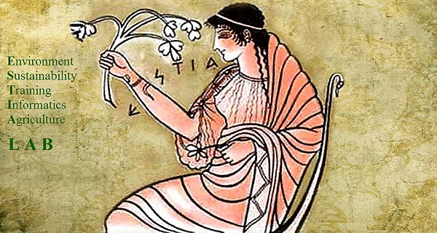
The Application of High Pressure Processing in Dairy Industry
DR. Thomas p. zafiriadis
Dvm – food technologist m.sc.
Professor at State Professional Training Institution Of Katerini
Director ESTIA LAB IKE
President of Scientific Committee,
Pan-Hellenic Association Of Food Technologists

Slide 2
ESTIA LAB ike
Few words about…..
Our company was founded on April, 2015. It’s main aim is to help Greek farmers and Greek food processors. To achieve this target, we provide the following services:
Research and development of new products, targeting Greek farmers and food processors alike.
Consultation on agricultural and food production matters.
Promotion of sustainability in food and feed production.
Promotion of environmental protection.
Collaboration with Greek and foreign universities and institutions in various schemes and projects.
Education and training of Greek farmers and processors in matters, concerning food safety and hygiene, as well as better use of natural resources.
Execution of food and feed analyses to its customers in accredited laboratories. In the near future a greater bulk of these analyses would be executed to our laboratory.

Slide 3

State professional training institution of katerini
Few words about….
The State Professional Training Institution of Katerini is a post-secondary school (post-High School) educational foundation which aims to High School graduates that want to learn a profession outside universities and polytechnics (both of them comprise Higher Education). The trainers, usually, are Hogher Education graduates as well as professionals that have the capability to teach the trainees the aspects of the chosen by them profession. All trainers are or going to be certified as suitable for Adult Education. There are more than 100 different specialties in the State Professional Training Institutions, extending from food preparation (Culinary, Pastry and Bakery Chefs) to medical assistants (nurses, medical labs assistants, etc.).

Slide 4
Pan – Hellenic association of food technologists
Few words about….
Pan – Hellenic Association of Food Technologists (P.E.TE.T.), was founded in Thessaloniki, in 1981. In 1982, the seat was transferred in Athens. It is the professional and scientific union of Food Scientists and Technologists, graduated from both Universities and Polytechnics (food technologists, agronomists, veterinarians, chemists, biologists, chemical engineers), which are employed in food industry. Thessaloniki, is the seat of Union’s Northern Greece’s Branch which covers all areas of Northern Greece (Regions of Thessaly, Epirus, Macedonia, Thrace). During its existence, Pan-Hellenic Association of Food Technologists has organized 2 International Conferences of Food Technology in Athens (2005) and Thessaloniki (2007), numerous scientific meetings in various food expos, held in Athens and Thessaloniki (ARTOZA, MEAT DAYS-DAIRY EXPO-FROZEN FOOD, DETROP), and many seminars for food technologists and other people employed in food industry, such as bakery, pastry and culinary chefs with a great variety of topics (legislation, quality assurance systems, food production).
Finally, since 2007 our Union is a member of International Union of Food Scientists and Technologists (IUFoST) and its European Branch (EFFoST).

Slide 5
INTRODUCTION
The development of milk and dairy industry, has been influenced by numerous factors, such as consumer demands.
High pressure processing =
Non thermal pasteurization and preservation process, leading to the production of food produce that retains most of its organoleptic and nutritional attributes, unlike most conventional methods of heat treatment, such as conventional pasteurization and sterilization.

Slide 6
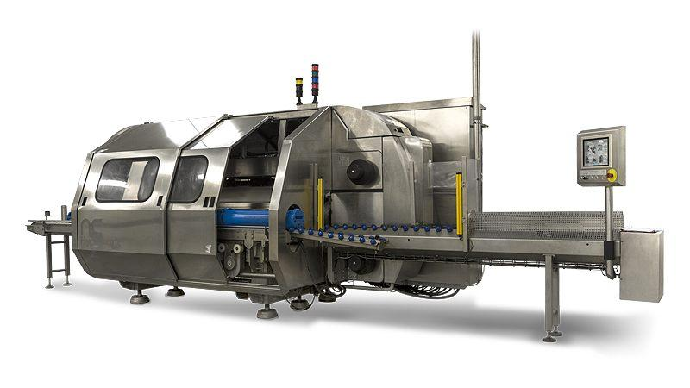
INTRODUCTION
High pressure processing is, also, used for:
Milk homogenization.
Production of emulsions, such as chocolate milk.
Cheese production.
Acidification of milk and yoghurt production.
Management of dairy wastewater (production of whey protein concentrates, used in the production of low calorie products, such as low fat of fatless ice cream).
Recovery of lactose and proteins from dairy wastewater (nutraceuticals, drugs, food additives).

Slide 7
Thermal Processing and the Use of HPP
The main problems, observed during milk pasteurization, sterilization and concentration, using the traditional methods, are:
The loss of desirable organoleptic properties, especially those related to the texture, color and flavor.
The reduction of milk’s nutritional value. Milk sterilization and concentration and in lesser extent milk pasteurization cause significant loss to vitamin B complex, polyunsaturated fatty acids, alteration and degradation of milk proteins, leading to the development of bad odor and flavor due to the production of sulfhydryl compounds (stale egg flavor), and production of Amadori compounds due to Maillard reaction (milk browning).
Under these circumstances, High Pressure Processing (from now on called HPP) plays an important role in the preservation both of the special organoleptic features that characterize milk, and its nutritional value.

Slide 8
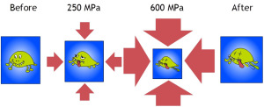
Thermal Processing and the Use of HPP
The main aim of milk pasteurization is the destruction/inactivation of microbes. In the case of HPP, it has been shown that pressures ranging between 300 and 600 MPa can destroy yeasts, molds and most vegetative bacteria, including most infectious food-borne pathogens. On the other hand, pressures ranging around 50-300 MPa can cause bacterial spore germination. Germinated spores can then be killed by applying mild heat treatment. The main benefit through this process is the retention of nutritional compounds and compounds that influence the odor, flavor and texture of the final products. At pressures > 1000 MPa even bacterial spores are killed, however Ultrahigh Pressure Processing (UPP) isn’t used in sterilization processes yet.

Slide 9
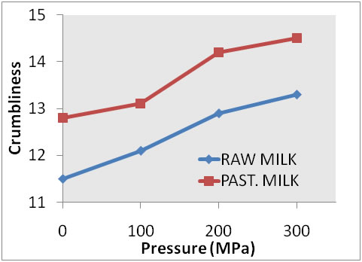
Thermal Processing and the Use of HPP

Slide 10
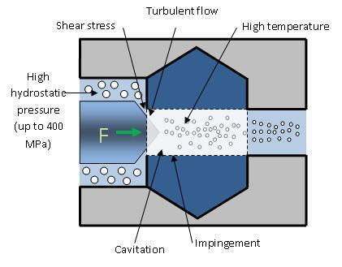
Homogenization and HPP
One of the most significant applications of HPP in dairy products industry is in fresh milk homogenization. Homogenization of milk under high pressure has similar effect with HTST – pasteurization and homogenization, i.e. fat globules in high pressure homogenization (HPH) were half the size of those in conventional pressure homogenization (CPH), β – lactoglobulin was denaturated significantly, and the number of psychrotrofic and mesophilic microbes were reduced significantly, whereas no Staphylococcus aureus nor coliform cells remained. At the same time HPH did not affect the colour of the milk and HPH milk did not cream during refrigerated storage.

Slide 11
Emulsification
Typical example of the HPP use in emulsion production is the chocolate production. Chocolate production is presented in the following flow diagram:
Preparation of cocoa syrup
Heat Treatment, Mixing and Dispersing
Full/ skimmed milk
Addition of cocoa, sugar, stabilizer
Addition of stabilizer
Pasteurization and Packaging
Addition of sugar
radial diffusers
Stabilizers:
Sodium alginate,
carrageenans,
amylum
Typical heat treatment or HPP in lower temperature
counter jet diffusers
axial nozzle

Slide 12
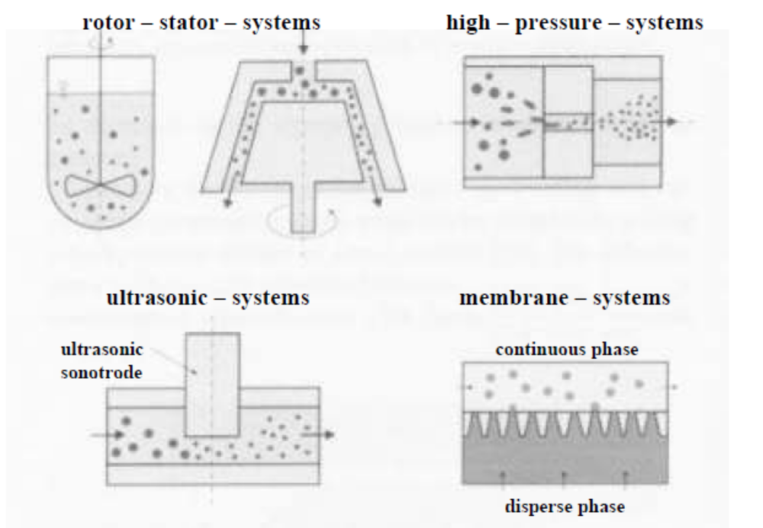
Emulsification
Schematic presentation of the different emulsifying systems

Slide 13
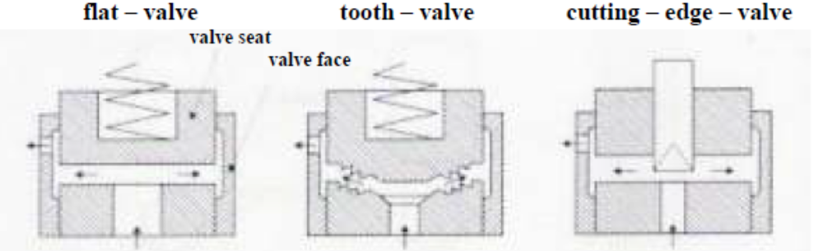
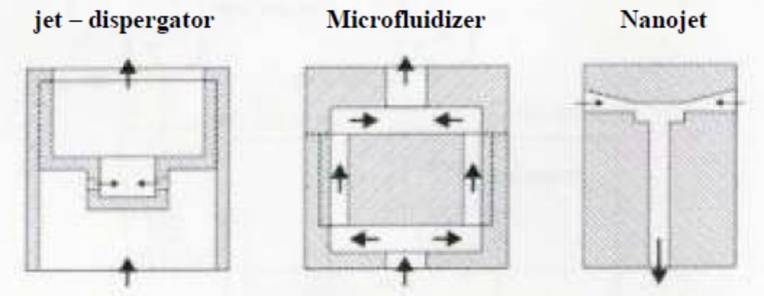
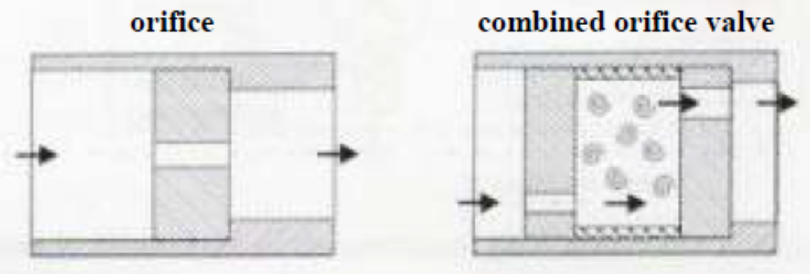
Emulsification
Radial Diffusers
Counter Jet Diffusers
Axial Flow – Nozzle Systems

Slide 14
Emulsification
The high pressure systems that usually are used can be subdivided into radial diffusers, counter jet diffusers and axial nozzle aggregates, depending on the flow guidance. These systems operate continuously. With high pressure systems can be achieved mean droplet diameters of x < 0.2 μm with high product throughputs. However, the stress on the product is very high due to high pressure gradients and flow rates.

Slide 15
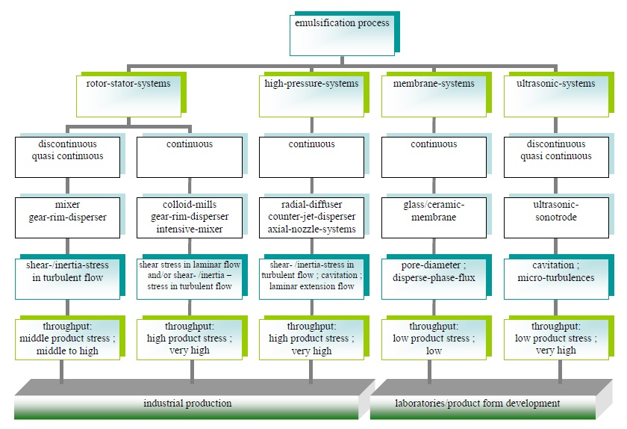
Emulsification

Slide 16
Wastewater Fractonation
Fractionation of dairy wastewater into lactose – enriched and protein – enriched streams by using an ultrafiltration membrane is a novel method for the better use of lactose and proteins present in wastewater of dairy industry. Lactose is used in food, dairy and pharmaceutical products. Dairy industry produces large amounts of lactose, a part of which is only recovered during processing. A lot of lactose, however, is not recovered with the conventional methods and eventually becomes a waste disposal problem. The impose of strict disposal standards for discharging waste solutions means that dairy industry will have to recover enormous amounts of lactose being produced by cheese processing and whey permeate streams. On the other hand, dairy proteins are, also, valuable products and are used as high – value food additives, nutraceuticals and therapeutics. Ultrafiltration is a useful technique, and when operated in multistage could reduce water consumption and increase the concentration of lactose in the product. Nanofiltration and reverse osmosis proved to be more efficient in terms of lactose recovery, but it requires higher operating pressures compared to ultrafiltration. All the above methods (ultrafiltration, nanofiltration and reverse osmosis) require the application of high pressure.

Slide 17
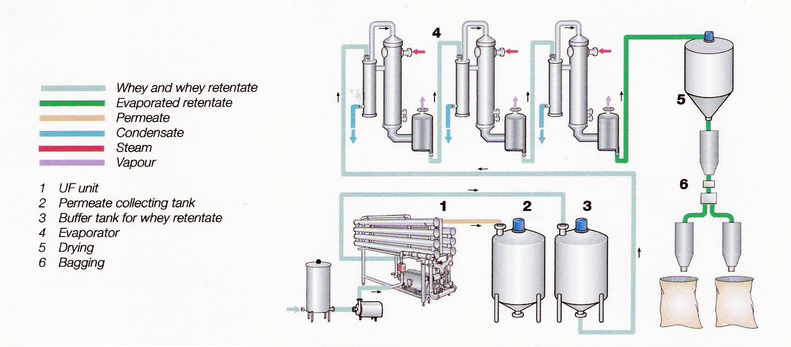
Wastewater Fractionation
Process for recovery of a dried protein concentrate using ultrafiltration (UF) (TetraPak, Dairy Processing Handbook 1995)
Process for recovery of a dried protein concentrate using ultrafiltration (UF) (TetraPak, Dairy Processing Handbook 1995).

Slide 18
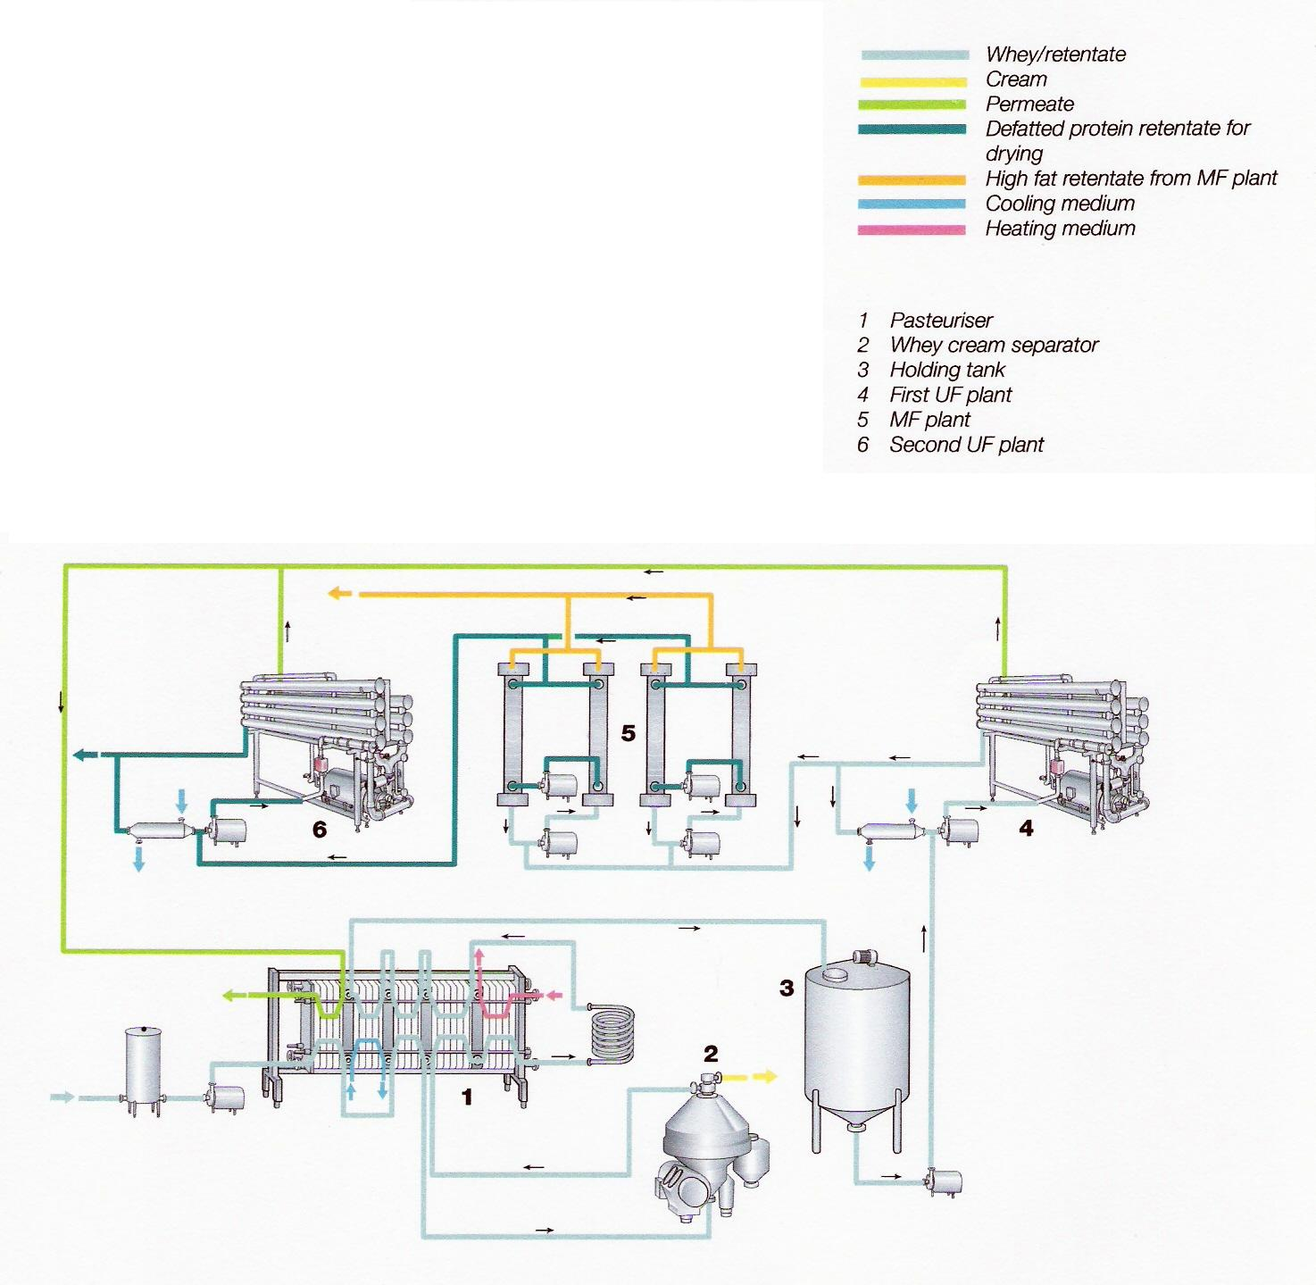
Wastewater Fractionation
Process for deffating of whey protein retentate (TetraPak, Dairy Processing Handbook 1995).

Slide 19
Cheese Making
Ultrafiltration initially used in dairy industry for whey separation from its wastewater, found a new application, as a novel method for cheese making, after 1969. In this case, milk pasteurization, defattening and concentration make use of special ultrafiltration systems. The membranes used are semi-permeable, i.e. allows only water and small molecules, such as lactose and soluble salts, to pass through. Other milk’s constituents, such as proteins, fat, insoluble salts, small amounts of lactose and bacteria are retained at concentrate. Condensation grade varies to:
Kind of milk (bovine, sheep).
Kind of cheese produced.
Ultrafiltration increases milk yield, however the final product differs in organoleptic attributes form those that are made, using traditional methods. The main reason for these differentiation are the whey proteins. Ultrafiltration was successfully used in the production of cheeses, where curd does not require heat treatment.

Slide 20
Cheese Making
Ultrafiltration is used in three ways in cheese making:
Pre-concentration to low concentration to standardize the protein to fat relation, followed by conventional cheesemaking in traditional equipment.
Moderate concentration and subsequent cheesemaking in a modified cheese process including some whey drainage. The equipment used differs significantly from the traditional one.
Concentration to the final dry mater (DM) content of the cheese.
The first two methods can be used for the manufacture of several types of cheese, whereas the third one makes it possible to manufacture completely new types of cheese.

Slide 21
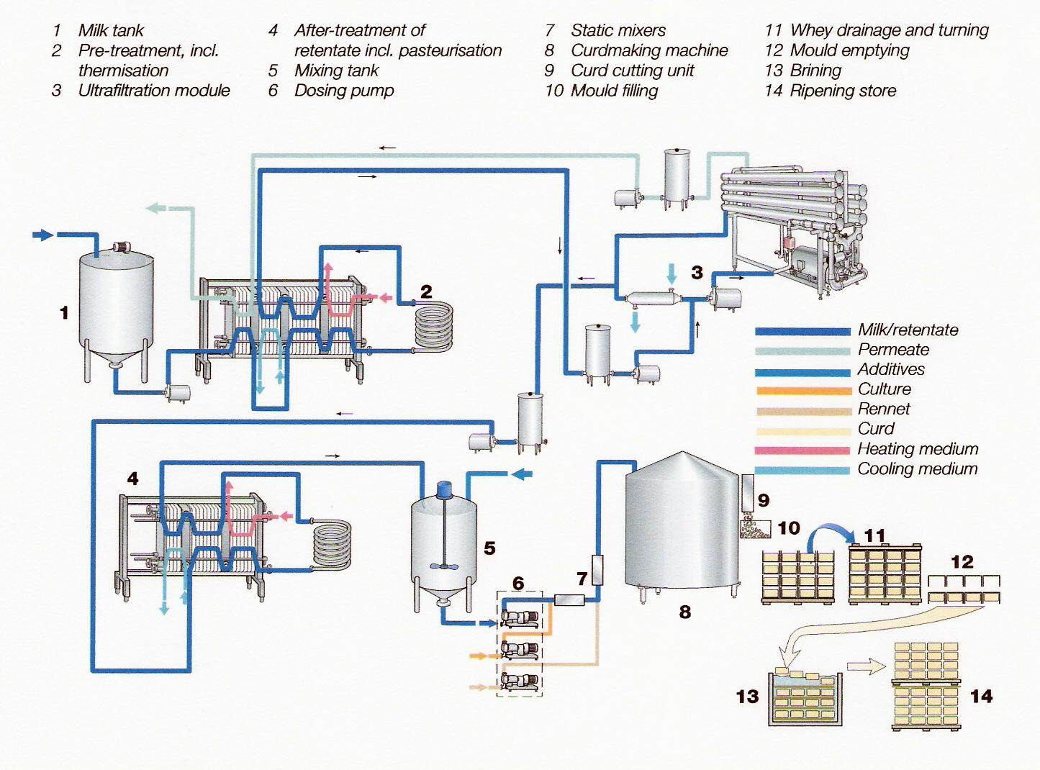
Cheese Making
Flowchart for production of Tilsiter cheese utilising ultrafiltration and a curdmaking machine (TetraPak, Dairy Processing Handbook 1995).

Slide 22
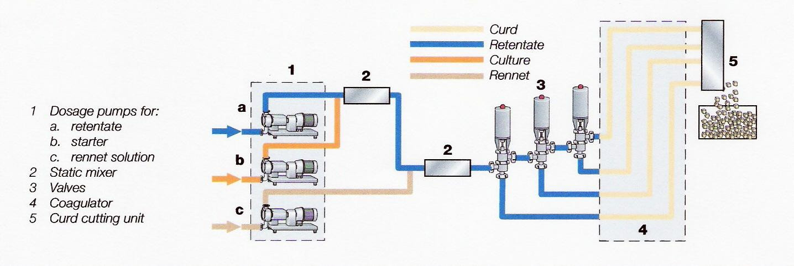
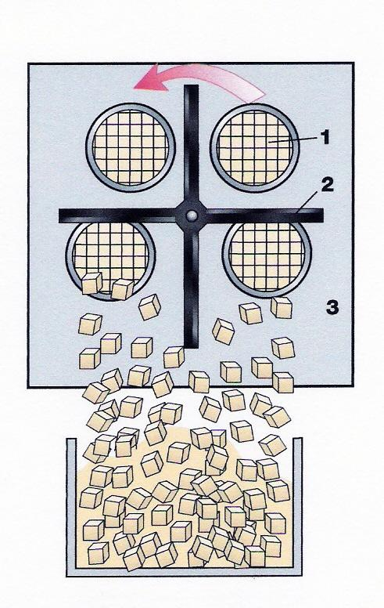
Cheese Making
Principle of curdmaking machine (TetraPak, Dairy Processing Handbook 1995).
Cutting unit on a curdmaking machine:
Ends of pipes with stationary horizontal and vertical knives.
Rotating knife.
Frame.

Slide 23
Other Attributes of HPP
HPP treatment favours acid coagulation. Due to HPP – induced changes in the buffering capacity, when HPP – treated reconstituted milk is acidified, onset of gelation occurs at a higher pH than in the case of unpressurized milk. HPP – milk can be used for the production of yoghurt.
Finally, HPP – treated milk possesses better gelation attributes. The most significant changes concern viscosity, viscoelasticity and texture of gels made of concentrated milk.

Slide 24
CONCLUSIONS
The consumer demand for minimally processed products, which are safe and healthy and the same time retain all the organoleptic and nutritional attributes is raising steadily. High pressure processing offers a solution to this demand. Although the present cost is high enough, the general use of this process in the future to satisfy these demands will lead to the construction of better and cheaper equipment, which would increase the yield and the effectiveness not only in novel but also in conventional dairy products.

Slide 25
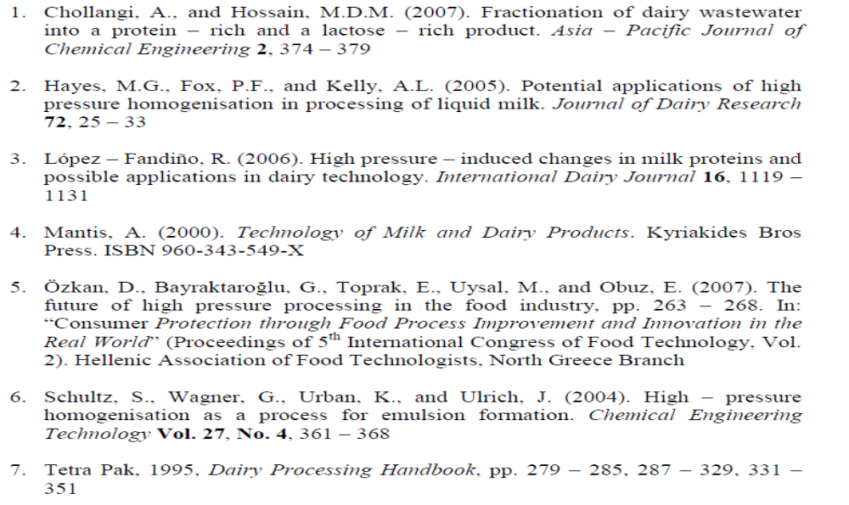
references

Slide 26
E-mails and Websites:
Personal e-mail: thzafiriadis@yahoo.com
ESTIA LAB e-mail and website:
estialaboratory@gmail.com http://estialaboratory.wix.com/estialab?fb_ref=Default
Pan-Hellenic Association of Food Technologists e-mails and websites:
info@petet.org.gr
thes@petet.org.gr
www.petet.org.gr

Slide 27


Next Meeting: 29th EFFOST International Conference, Athens, GREECE

Slide 28

Thank You For Your Attention

Slide 29

QUESTIONS ?

