Slide 1

6th International Conference on
Structural Biology
August 22-23, 2016
New Orleans, USA

Slide 2



Prediction of protein-protein interactions
in the twilight zone of low homology
for the modulation of an ion channel:
An analogy approach
International Conference on Structural Biology, August 22-23, 2016
New Orleans, Louisiana, USA
Thomas Sciorª, Angel Islas^{a,b}
a. Pharmacy Dpt. Facultad de Ciencias Químicas, Universidad Autónoma de Puebla, Puebla, Mexico
b. Biophysics Lab, Instituto de Fisiología, Universidad Autónoma de Puebla, Puebla, Mexico

Slide 3
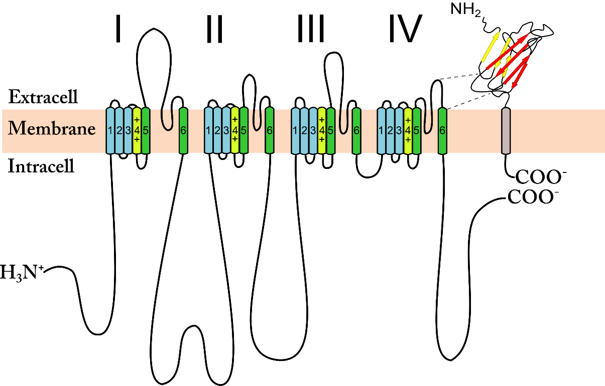
Mammalian Na+ channel topology
Alpha
subunit
Beta1
sub-unit
[adapted from Catterall and Swanson, 2015]
Beta1 subunit:
Extracellular = inmunoglobulin-like protein (IG-like = all beta)
Alpha subunit:
4 homologous domains (DI-IV) each with 6 transmembrane segments (S1-S6), S5-pore-S6
Notes:
Contributes to the AP of every excitable cell: / Selectively transports Na+ into the cell / Voltage-dependence
Alpha Bacterial channel crystals / homo vs hetero tetramer / our templates for alpha…
2) Beta subunit family / previous crystal structures available, rat, human ( % identities) / N- C-term figure
3) Beta1 phylogenetic evolution from an Ig?
3) Voltage and kinetic modulation /previous mutagenesis studies on Beta1 = unknown alpha-beta1 interface

Slide 4
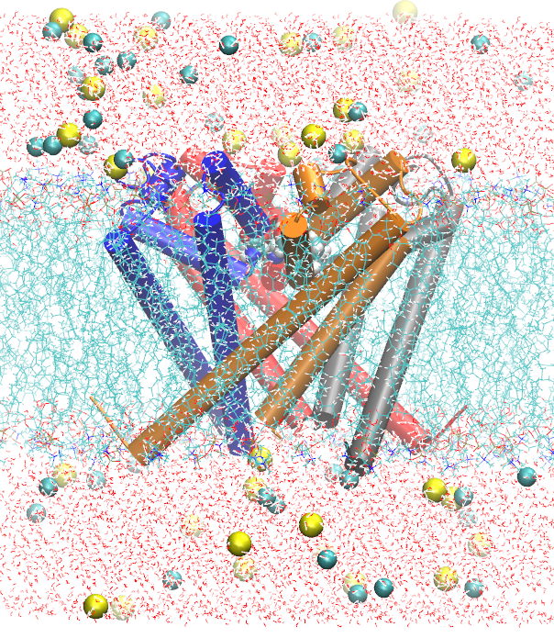
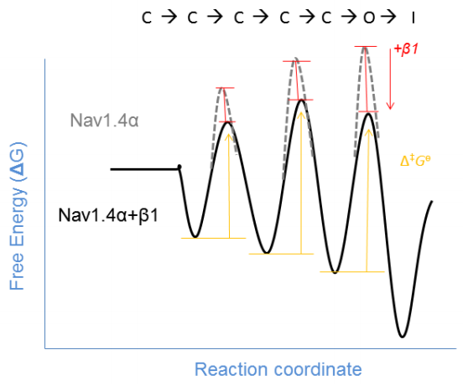
Function: Beta1 allosterically modulates the Na+ current
Beta1 modifies the voltage dependence and accelerates the inactivation and recovery from inactivation of the Na+ channel
Na+
[Adapted
from Benett et al., 1993]

Slide 5
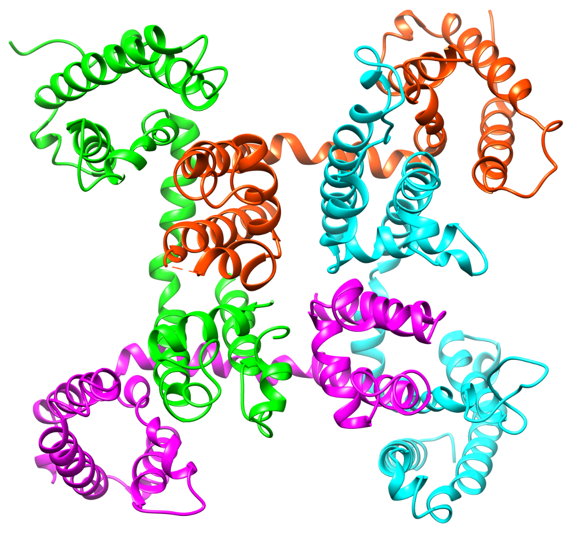
Structures of Bacterial vs. Mammalian Alpha Na+ channel subunits
Crystal structure from Bacteria (3RVY) homotetramer, 4 chains
Unknown Mammalian structures =
4 non-id. domains in 1 chain only
Homology protein modelling is a problem due to low similarity (identity).

Slide 6
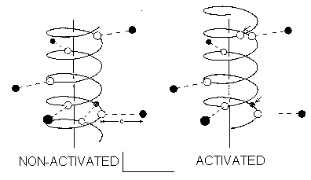
Results obtained despite unknown structures
Postulated reversible protein-protein interface (PPI)
Beta1
Alpha
[Chancey et al., 1996]
Notes:
Contributes to the AP of every excitable cell: / Selectively transports Na+ into the cell / Voltage-dependence
Alpha Bacterial channel crystals / homo vs hetero tetramer / our templates for alpha…
2) Beta subunit family / previous crystal structures available, rat, human ( % identities) / N- C-term figure
3) Beta1 phylogenetic evolution from an Ig?
3) Voltage and kinetic modulation /previous mutagenesis studies on Beta1 = unknown alpha-beta1 interface

Slide 7
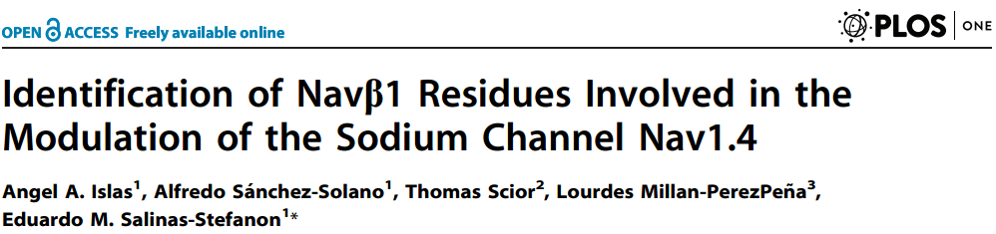
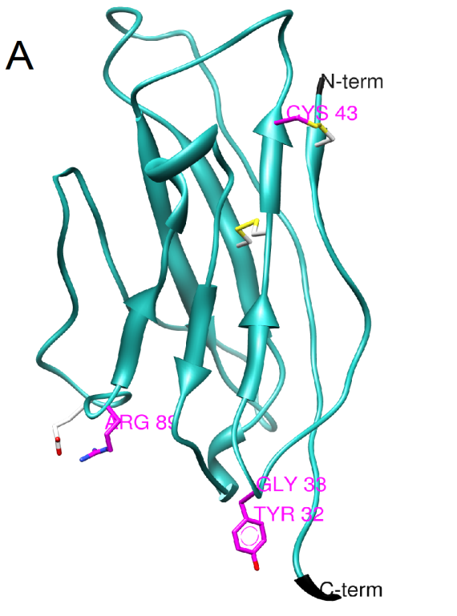
Our first approach was published:
Homology modelling for Nav Beta1
(2013)
Combined structure-based and knowledge-based approach
Arg highest probability (12.7%) to be a hotspots (Ofran and Rost 2007)
Oposite charge of the α subunit

Slide 8
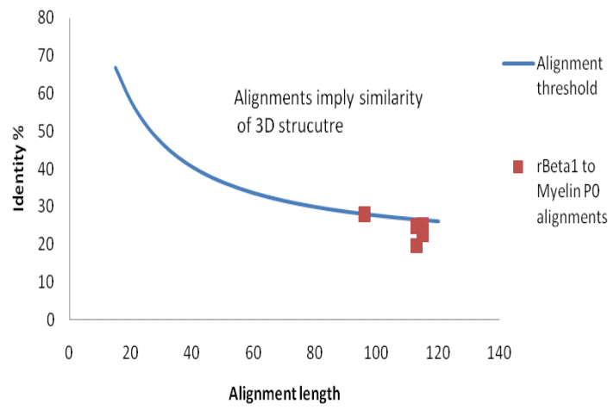
Twilight zone = low sequence homology between target and 3D template
Target model is reliable when using template
1NEU = 3D template
Target model
is unreliable if the sequence ids of target & template fall below threshold
[modified from Sander
and Schneider 1991]

Slide 9
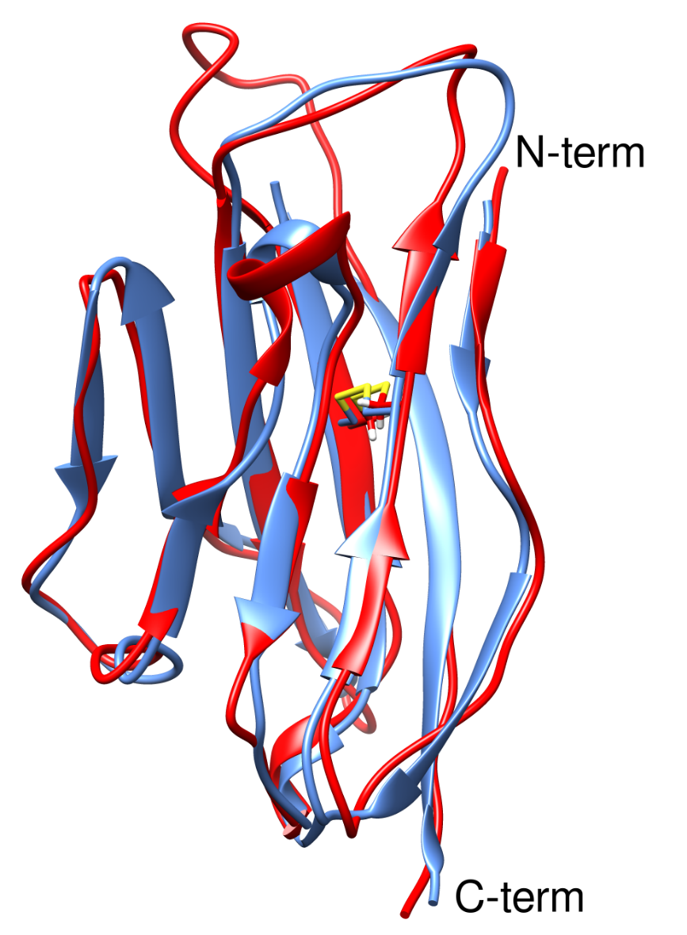
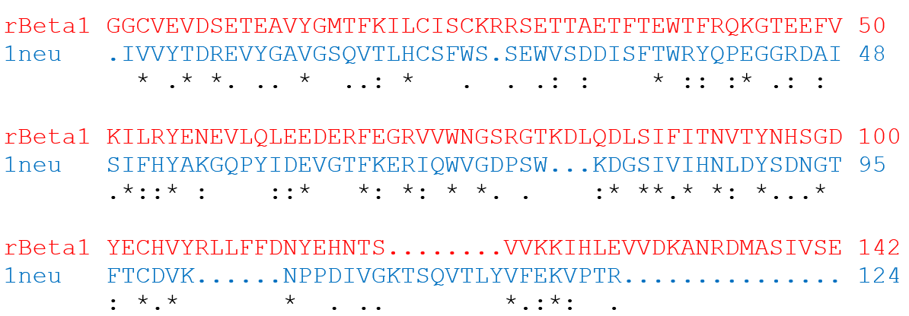
Beta1: Homology protein modelling
Unknown structure (target) 28% id
Crystal structure (3D template 1NEU)
1NEU : all beta protein (Myelin Membrane Adhesion Molecule P0)
Target models based on 3D-templates that are > 30% identical accurately reproduce the correct fold [Joseph & de Brevern, 2014].

Slide 10
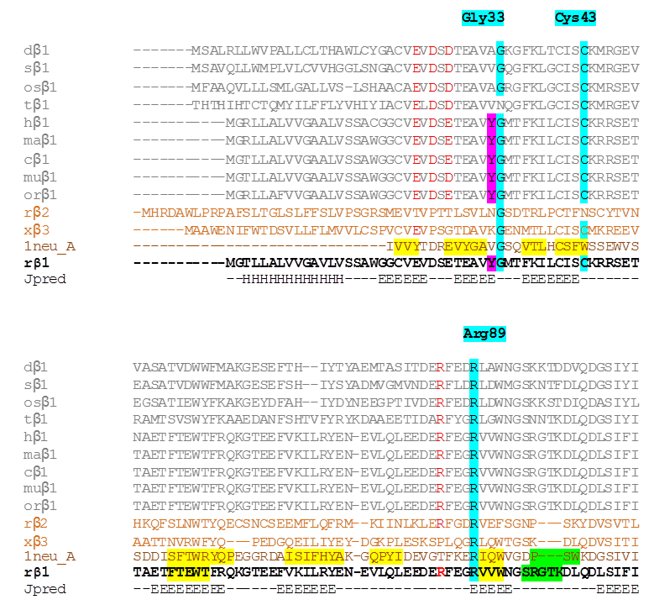
Multiple sequence alignments (MSA)
Species
(vertebrates)
Beta1 modulation is conserved in vertebrates

Slide 11

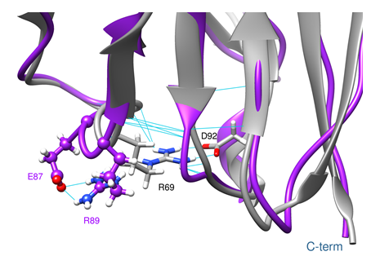
Functionally relevant hypothetical intramolecular bonds in Navβ1
C21
Involved in voltaje modulation sparing kinetics

Slide 12
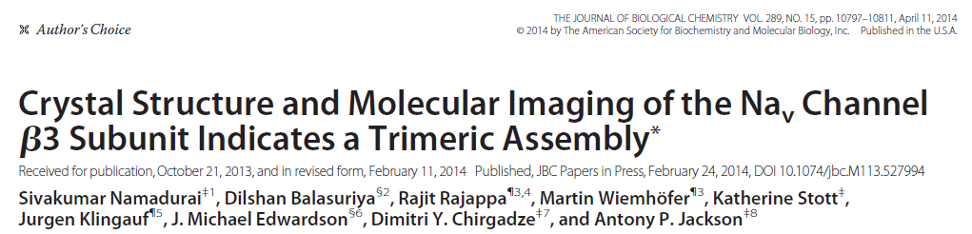
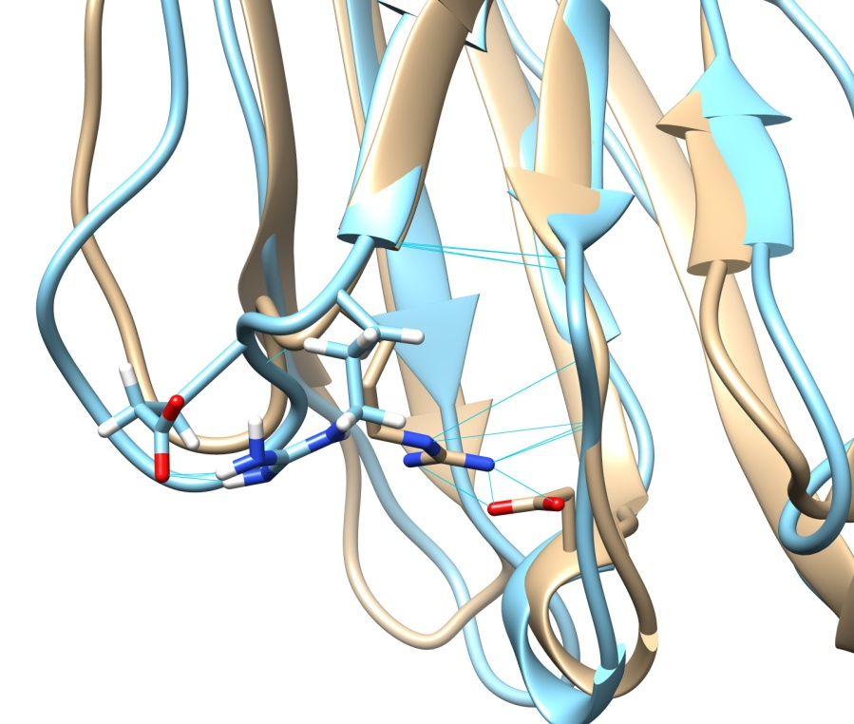
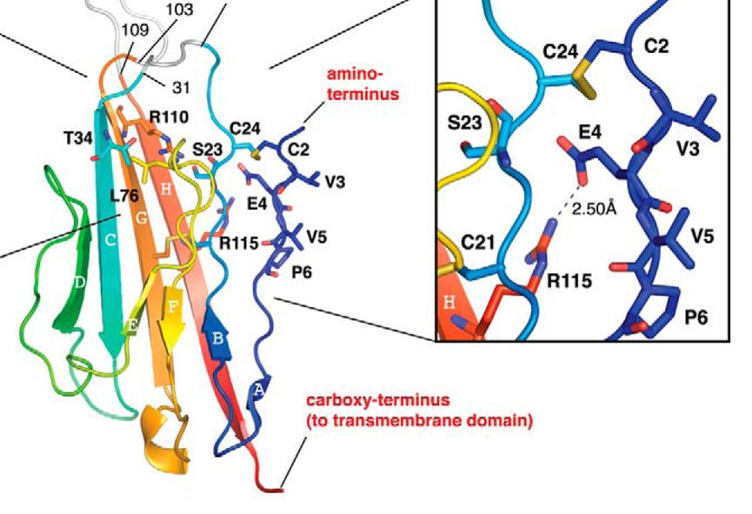
Hypothetical bonds exist in hNavβ3 (48 % id)
Notes:
45%id

Slide 13
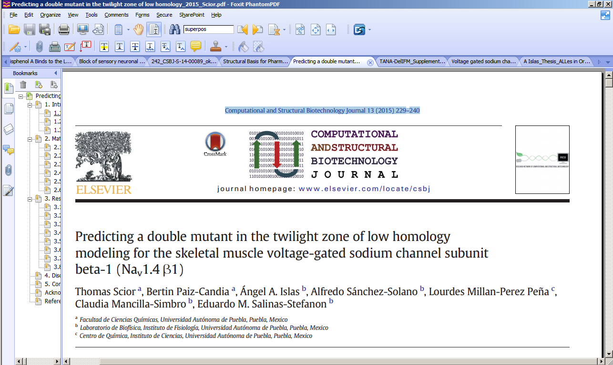
Second approach: Analogy modelling
(2015)

Slide 14
Combined study of i) molecular design ii)molecular biology iii) electrophysiology
Aim: Co-expression of the Alpha subunit of voltage-gated sodium channel Na_{v}1.4 with a Beta1- mutant causes a general and significant loss-of-function.
Results: a double mutant (TANA = T109A + N110A) on Beta1 showed the desired general loss of channel function.

Slide 15
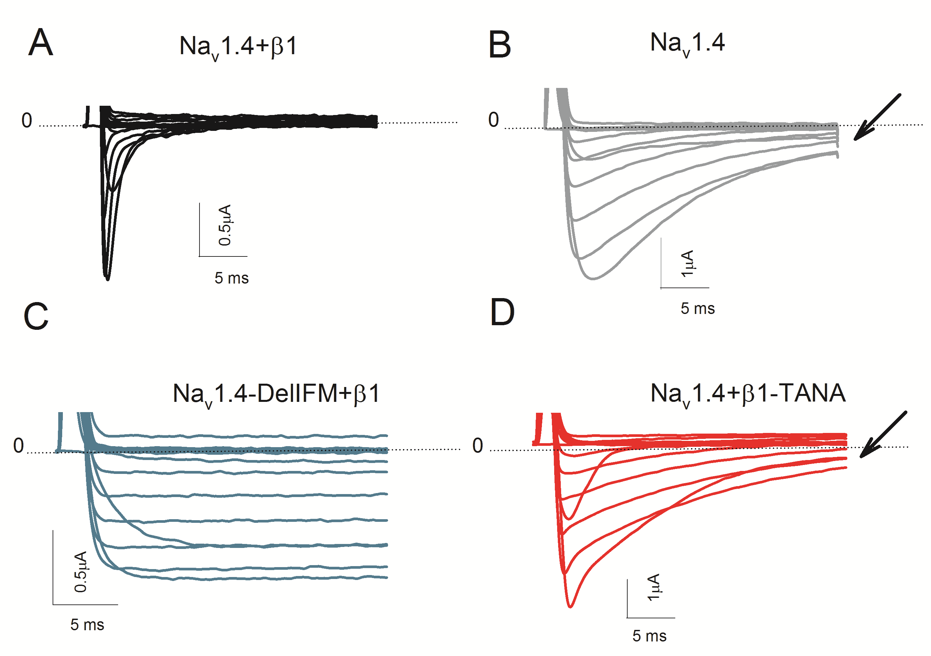
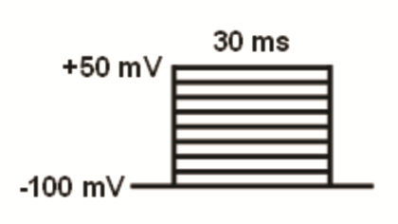
Experimental results: voltage-clamp
( WT)
Beta1 not present
(MT = TANA)
Membrane protein expression on frog oocytes
Inward Na+ currents elicited via cell membrane voltage control

Slide 16
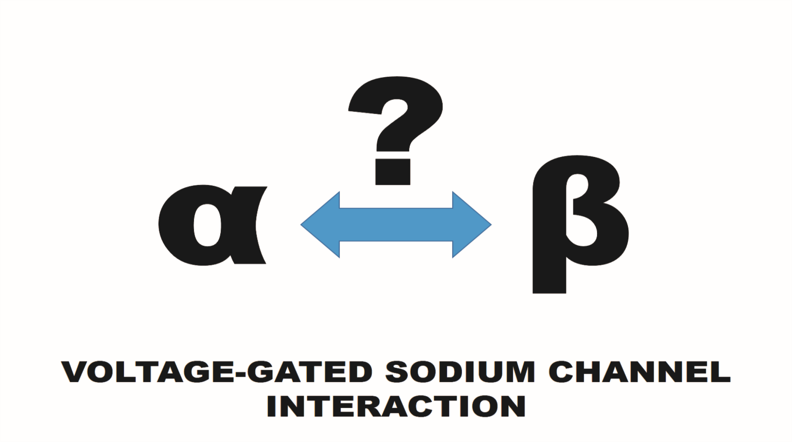
Electrophysiologically elucidated, but still structurally unknown
Dr. Islas stops and Prof. Dr. Scior starts

Slide 17
Homology is a prerequisite for reliable 3D template modeling of target proteins with unknown structure.
At present no crystal structure of a full α subunit for eukaryote Na+ channels has been published.
Currently the best 3D templates to model a mammalian α subunit constitutes the bacterial channel NavAb (PDB codes: 4EKW and 3RVY; Refs11,12) which has a 33% identity (E value of 2 e-13) with respect to rNav1.4 isoform (100%), in addition to NaChBac and NavAb (PDB code: 4DXW and 3RVY; Refs 22,12).
In 2014, at the end of the present study about predicting the interacting residues, the first crystal structure of Na_{v}β3 was published (PDB code: 4L1D; Ref 28) with 48% id against target sequence Beta1.

Slide 18
References for PDBs
11. Payandeh, J.; Gamal El-Din, T. M.; Scheuer, T.; Zheng, N.; Catterall, W. A., Crystal structure of a voltage-gated sodium channel in two potentially inactivated states. Nature 2012, 486 (7401), 135-9.
12. Payandeh, J.; Scheuer, T.; Zheng, N.; Catterall, W. A., The crystal structure of a voltage-gated sodium channel. Nature 2011, 475 (7356), 353-8.
22. Zhang, X.; Ren, W.; DeCaen, P.; Yan, C.; Tao, X.; Tang, L.; Wang, J.; Hasegawa, K.; Kumasaka, T.; He, J.; Wang, J.; Clapham, D. E.; Yan, N., Crystal structure of an orthologue of the NaChBac voltage-gated sodium channel. Nature 2012, 486 (7401), 130-4.
28. Namadurai, S.; Balasuriya, D.; Rajappa, R.; Wiemhofer, M.; Stott, K.; Klingauf, J.; Edwardson, J. M.; Chirgadze, D. Y.; Jackson, A. P., Crystal Structure and Molecular Imaging of the Na_{v} Channel beta3 Subunit Indicates a Trimeric Assembly. The Journal of biological chemistry 2014.

Slide 19
Listing of inspected ion channel structures concerning to α subunit.
PDB code | Observations
1T0J Ref 16 | Chains A and B: voltage-gated calcium channel subunit beta2a which is an intracellular domain and does not correspond to the ectodomain Navβ1. Chain C: voltage-dependent l-type calcium channel alpha-1c. Comparable to 4DEY.
4DEY Ref 49 | Chain A: voltage-dependent l-type calcium channel subunit beta. Chain B: voltage-dependent l-type calcium channel subunit alpha.
1ZSX Ref 50 | Chain A: voltage-gated potassium channel beta-2 subunit. It forms an heteromeric complex, without channel interface, albeit an analogous salt bridge exists (R74---E1114) between two regions with similarities to Navβ1.
3LUT Ref 20 | Chain A: voltage-gated potassium channel subunit beta-2. Chain B: potassium voltage-gated channel alpha subunit. The intracellular beta-2 segment has not a Ig-like fold. It has nothing in common with target Navβ1. The 499 residue-long alpha structure also presents the extra and intracellular loops. The latter have no homology with target loop regions.
2A79 Ref 51 | Chain A: voltage-gated potassium channel beta-2 subunit. Chain B: potassium voltage-gated channel alpha subunit. Compare to new 3LUT.

Slide 20
References for PDBs
16. Van Petegem, F.; Clark, K. A.; Chatelain, F. C.; Minor, D. L., Jr., Structure of a complex between a voltage-gated calcium channel beta-subunit and an alpha-subunit domain. Nature 2004, 429 (6992), 671-5.
Chen, X.; Wang, Q.; Ni, F.; Ma, J., Structure of the full-length Shaker potassium channel Kv1.2 by normal-mode-based X-ray crystallographic refinement. Proceedings of the National Academy of Sciences of the United States of America 2010, 107 (25), 11352-7.
49. Almagor, L.; Chomsky-Hecht, O.; Ben-Mocha, A.; Hendin-Barak, D.; Dascal, N.; Hirsch, J. A., The role of a voltage-dependent Ca2+ channel intracellular linker: a structure-function analysis. The Journal of neuroscience: the official journal of the Society for Neuroscience 2012, 32 (22), 7602-13.
50. Wennerstrand et al., Crystal structure of human potassium channel kv beta-Subunit (kcnab2). to be published.
51. Long, S. B.; Campbell, E. B.; Mackinnon, R., Crystal structure of a mammalian voltage-dependent Shaker family K+ channel. Science 2005, 309 (5736), 897-903.

Slide 21
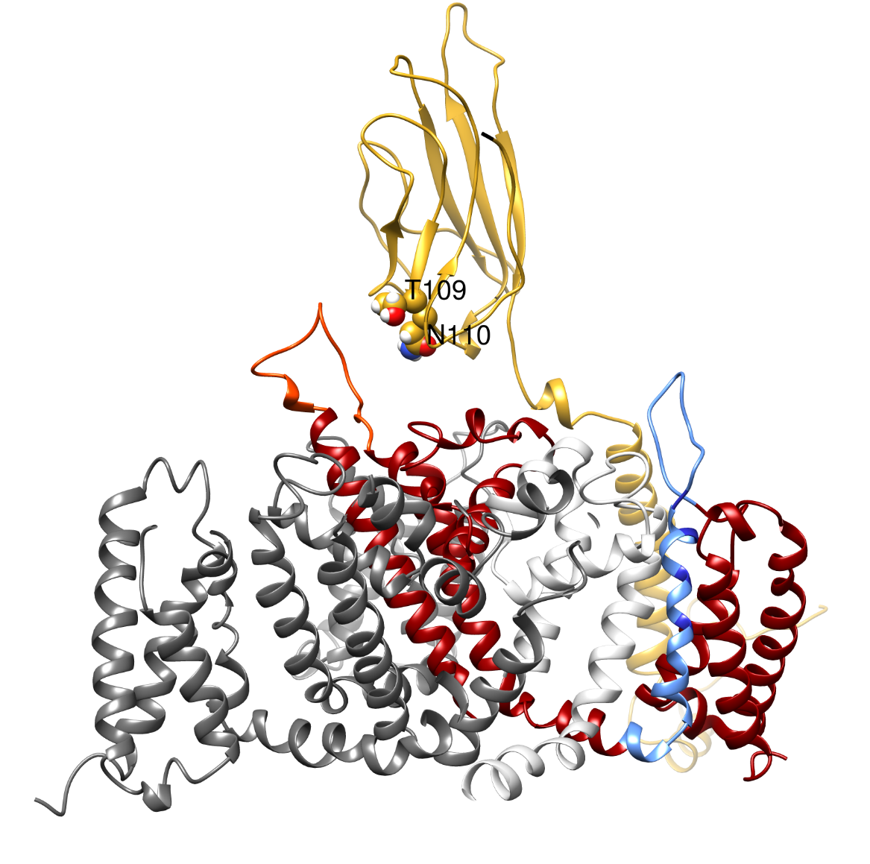
TANA mutation was predicted in one trial:
A single site-directed mutagenesis (SDM) assay was sufficient.
How was this one shot – one hit cycle possible among 200 residues of Beta1?

Slide 22
The answer has been published in CSBJ, 2015:
Predicting a double mutant in the twilight zone of low homology modeling for the skeletal muscle voltage-gated sodium channel subunit beta-1 (Nav1.4 β1).
Scior T, Paiz-Candia B, Islas ÁA, Sánchez-Solano A, Millan-Perez Peña L, Mancilla-Simbro C, Salinas-Stefanon EM.
Comput Struct Biotechnol J. 2015 ;13:229-40. doi: 10.1016/j.csbj.2015.03.005. eCollection 2015. PMID: 25904995 ( free article ).

Slide 23
Second approach: Analogy modeling
(2015)

Slide 24
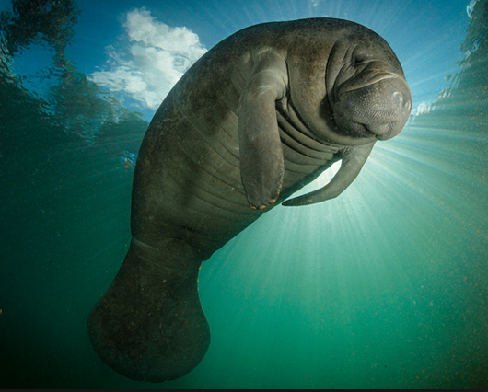
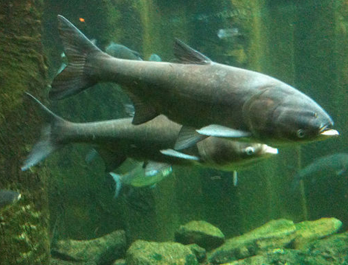
Analogy modeling as a proposed solution in the twilight zone
Manatee tail vs. Fish tail
Shapes (structures) converge in time due to same environmental evolutionary pressure (functions)

Slide 25
Here analogy protein modeling leads to additional insights where 3D data is missing:
Analogy is about epi-homology features which are neither a source of identical or similar structures, nor biol. functions (no homology necessary).
Here epi-homology means the observation of reversibility or irreversibility of PPI (with or w/o homology).

Slide 26
No or low homology:
Sequences, structures and functions of biomolecules vary between and within species. The sequence differences are either relevant (signal) or irrelevant (noise) to account for that variability in all biological material.
Noise comes from either random mutations w/o relation to structure and function during evolution or from experimental and data handling errors.
When homology is very low then not only the differing but also the conserved residues of sequences could be signal or noise upon alignment.
Conserved resid=Signals are compulsory providing the str. or funct. feature (pattern, generalized rule).

Slide 27
We seek to disrupt the sodium channel function by substituting a few amino acids of the Beta1 subunit for alanine by a SDM study.
Inferred from literature and our electro-physiologic studies we postulated that the PPI between Alpha and Beta1 subunits of the Nav1.4 sodium channel is reversible.
Search for known reversible PPI associated to immunoglobulin-like (IG, Ig) proteins (all-beta fold), the same as predicted for target Beta1 subunit.

Slide 28
Reviews for PPIs
[] Xu D, Tsai CJ, Nussinov R. Hydrogen bonds and salt bridges across protein–protein interfaces. Protein Eng 1997;10(9):999–1012.
[] Moreira IS, Fernandes PA, Ramos MJ. Backbone importance for protein–protein binding. J Chem Theory Comput 2007;3(3):885–93.
[] Moreira IS, Fernandes PA, Ramos MJ. Backbone Importance for Protein-Protein Binding. J Chem Theory Comput. 2007 May;3(3):885-93.
[] Gallina AM, Bork P, Bordo D. Structural analysis of protein-ligand interactions: the binding of endogenous compounds and of synthetic drugs. J Mol Recognit. 2014 Feb;27(2):65-72.
[] Didier Rognan. Rational design of protein–protein interaction inhibitors. Med. Chem. Commun., 2015, 6, 51-60.
[] Folador EL, de Oliveira Junior AF, Tiwari S, Jamal SB, Ferreira RS, Barh D, Ghosh P, Silva A, Azevedo V1. In Silico Protein-Protein Interactions: Avoiding Data and Method Biases Over Sensitivity and Specificity. Curr Protein Pept Sci. 2015;16(8):689-700.
[] Peng X, Wang J, Peng W, Wu FX, Pan Y. Protein-protein interactions: detection, reliability assessment and applications. Brief Bioinform. 2016 Jul 21.
[] etc. etc.
.

Slide 29
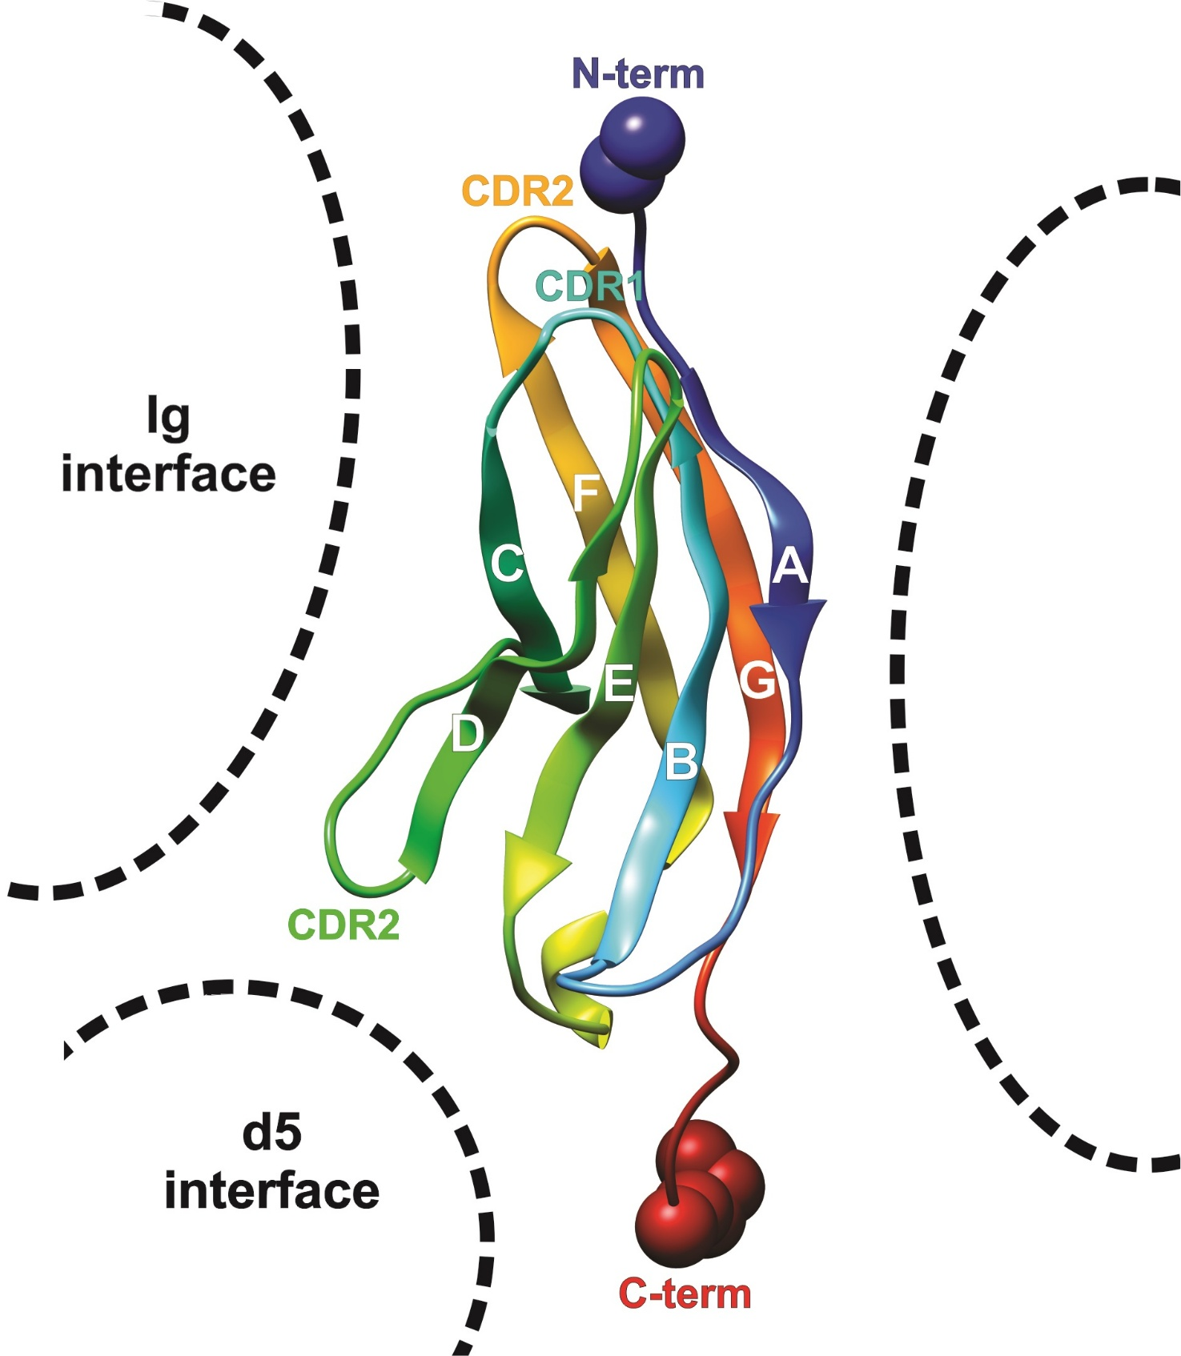
Complementarity determining region on ABs
IG-like homologs :
AB (CDR123) MD-2 Trk
Beta1
irreversible PPI
AG or TLR4
Irrelevant analogs
Explored by SDM studies in literature
and by our SDM on strands A, D or G (1. study)
reversible PPI:
NT or TLR4*
=Alpha analogs
PPI is analogous = not homologous
MEMBRANE

Slide 30
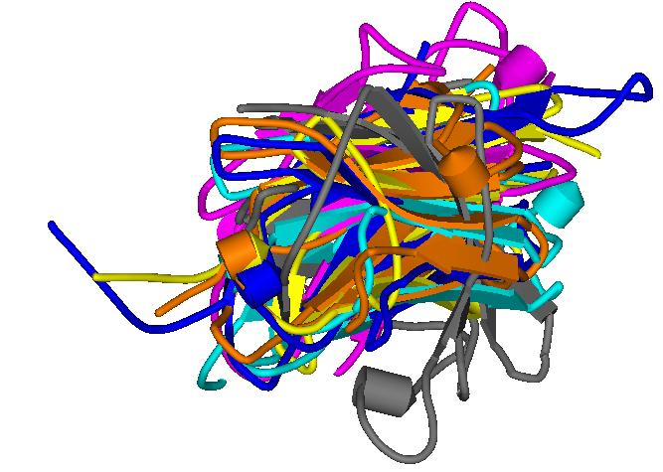
Collecting and aligning of all-beta proteins (= IG-like) with known PPIs regardless of their structures or functions:
TLR4/MD-2(=IG-like)
AG/AB(=IG)
… to find
analogs of
unknown PPI:
Alpha/Beta1(=IG-like)

Slide 31
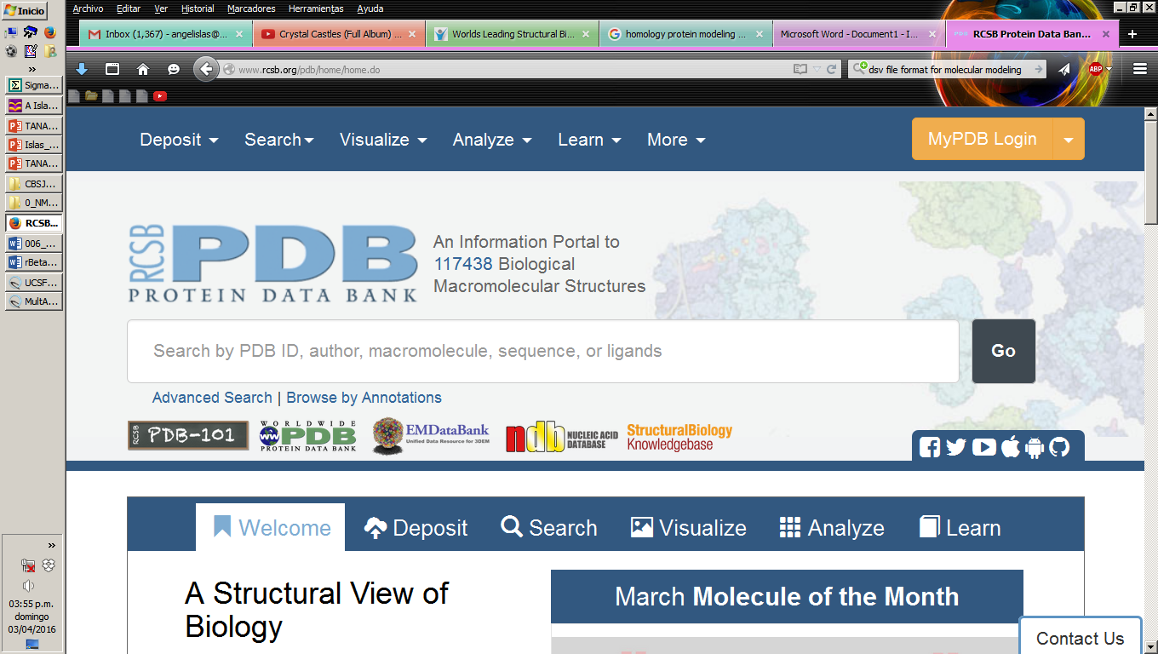
Analogous PPI for Alpha and Beta1 subunits
Alignment of All-beta struct (IG-like) of
AG: antigen
AB: antibody
TLR4: Toll-like receptor 4
MD-2: LPS receptor
NT: neurotrophin
Trk: Tyr kinase receptor
HSP: heat shock protein = chaperone
AG
Literature focused review
EED mutant
(McCormick 1999)
AB
Irreversible PPI
MD-2
TLR4
HSP
Trk
Below twilight:
amino acid id < 17%!
TLR4*
misfolded
substrate
NT
Reversible PPI

Slide 32
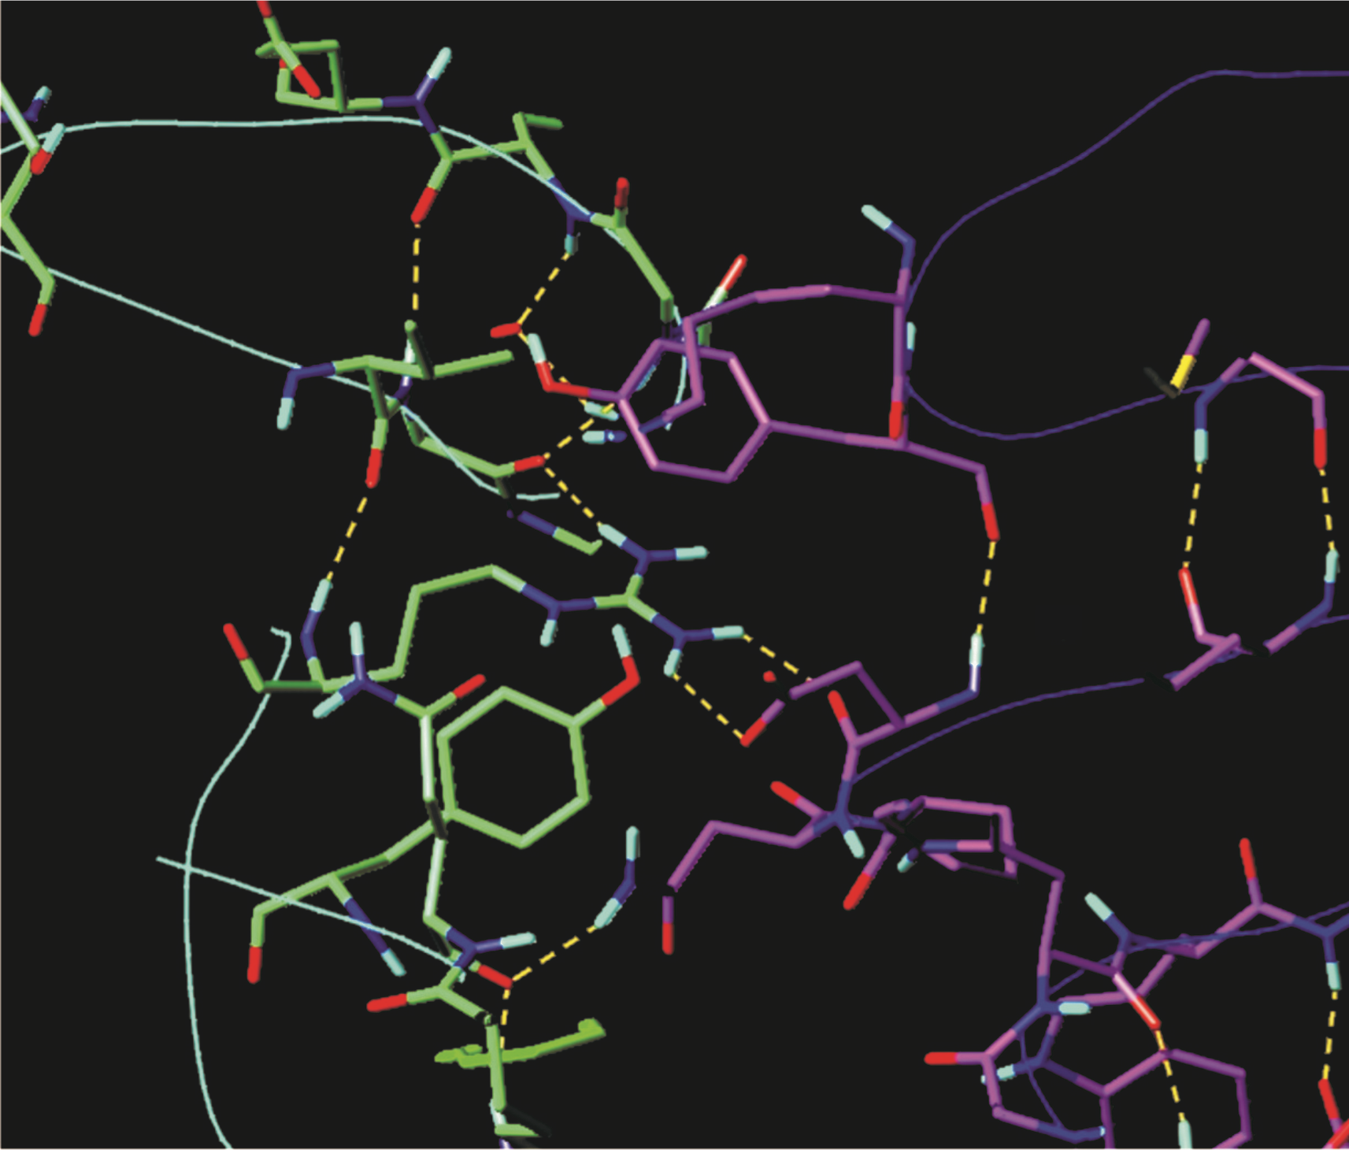
NeuroTrophin / IG-like bind ofTrkB
rev. PPI /
showing D349 + N350
bound to
Arg144 + Gln94 of NT
homolog to Beta1 (13 %id)
analog to Alpha (0 %id)

Slide 33
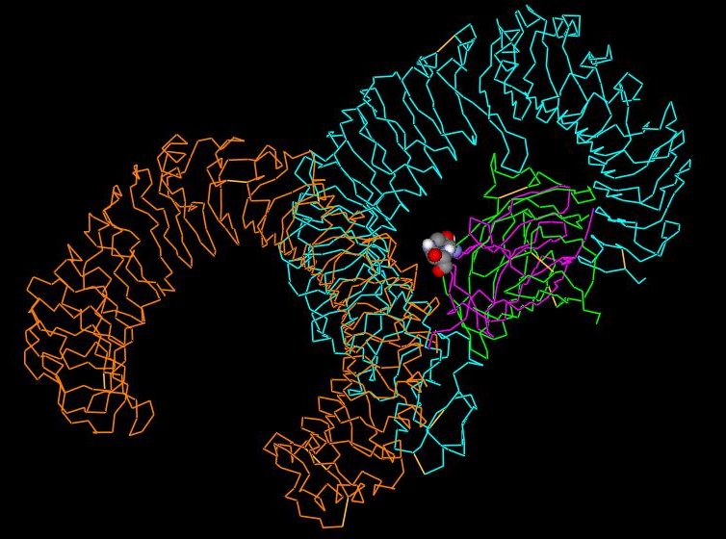
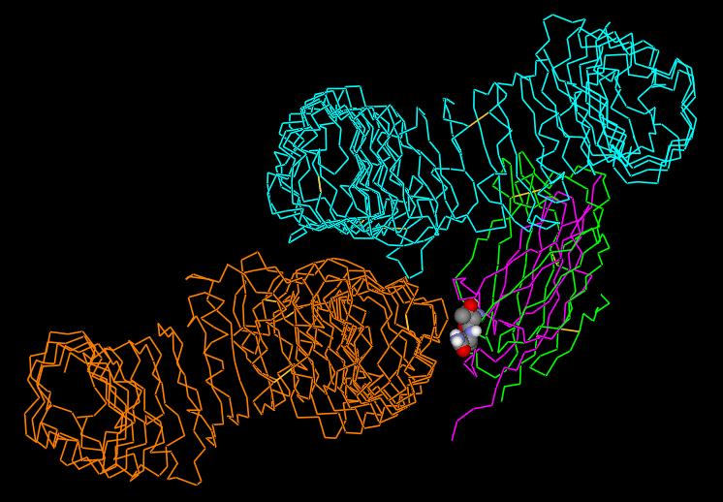
Rosetta stone Irreversible PPI
TLR4/MD-2
TLR4/MD-2
Reversible PPI
TLR4*/TLR4
TLR4*/MD-2
TLR4* analog to Alpha 3D-aligned IG-like str of Trk
2 COMPULSORY aa D349 N350

Slide 34
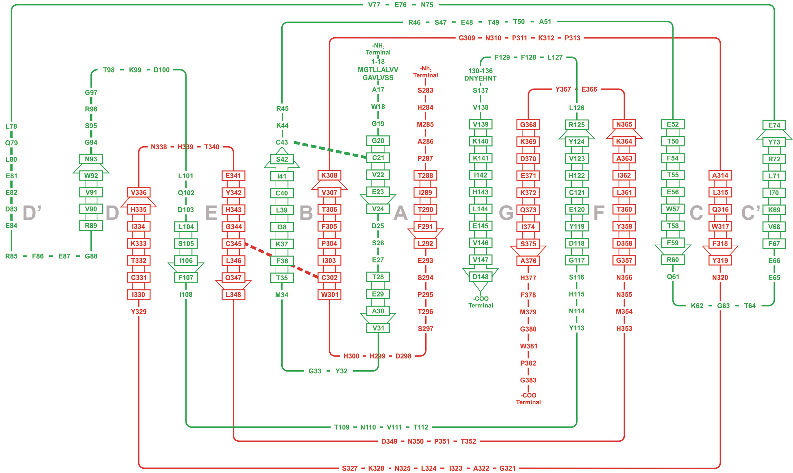
Topology of Beta1 vs. all beta Trk
Compulsory = signal two conserved aa: T N
PhD tesis of
Bertin Paiz
Candia from
our Lab =
= Laboratorio de Simulaciones moleculares computacionales, BUAP, Puebla, Mexico

Slide 35
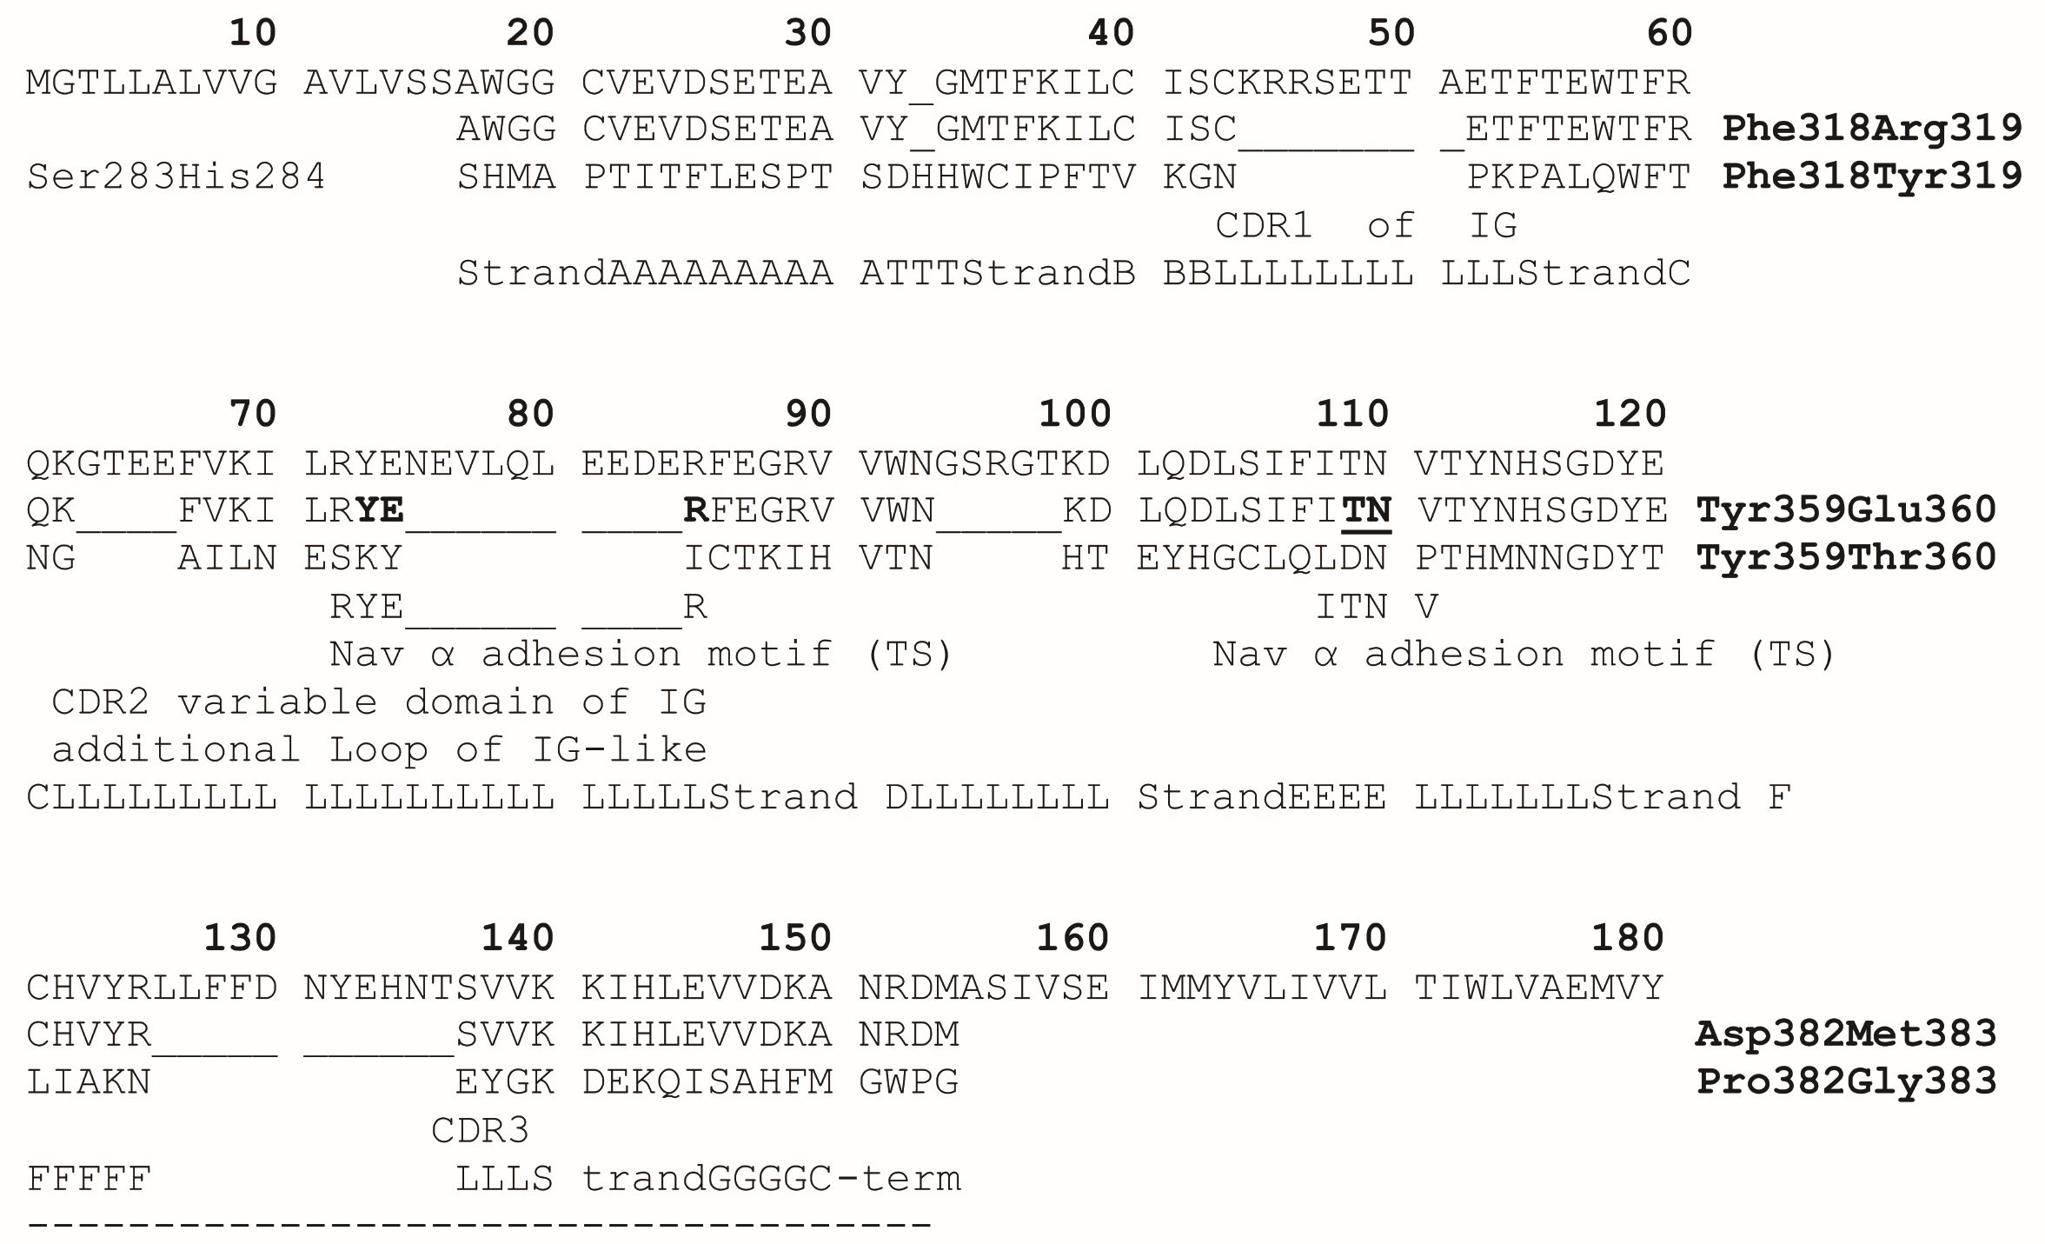
MSA: 1+2 lines: Beta1 target; 3 line:
TrkB = 3D PDB template 1HCF (13% id)

Slide 36
NeuroTrophin / IG-like bind ofTrkB
SDM trial:
compulsory
D349 N350
results in
T109 N110 of Beta1 (= TANA MT)
Arg144 Gln94 of NT=analog to Alpha

Slide 37
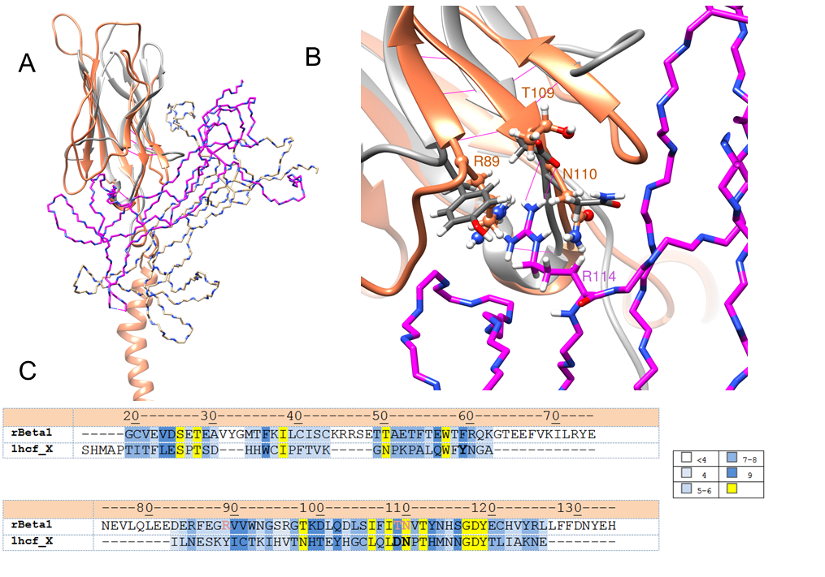
TANA
3D model of PPI with 2 compulsory aa D and N

Slide 38
Analogy modelling: Functional interface
of Nav1.4 channel
Consecutive residues Thr109 and Asn110 in Beta1 are compulsory and contribute to the Na+ channel interface
beta1
Reversible PPI
alpha

Slide 39
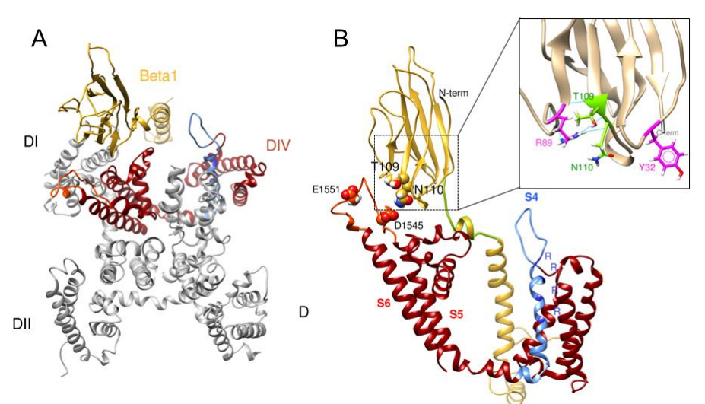
Nav alpha-Beta1 putative interface
DI
DIV
DII
DIII
Islas, et al.,PloS one, 8 (2013) e81995.
Scior, et al., Comput Struct Biotechnol J, 13 (2015) 229-240.

Slide 40
Model type | I-TASSER | Manual work | MODELER
Year of modeling | 2011 / 2012 | 2013 | 2014
History | 1st model for SDM prediction by HOMOLGY | 2nd model for the SDM prediction of general loss of function by ANALOGY | Complementary model for methodological comparison in this study
Template Protein type | 1NEU = Myelin membrane adhesion molecule P0 ⁴⁰ | 1HCF = Receptor tyrosine kinase TrkB with neuro-trophin ⁴¹ | Voltage-gated sodium channel subunit β3 ²⁸
Species | Rat | Human | Human
Function | Component of the myelin sheet of nerve cells on the extracellular membrane face | Neurotrophin cell uptake by ecto-domain d5 of cell surface receptor TrkB | Na_{v} 1.4 Beta3 is a Na+ current modulator; in contact with subunit α ^{6,8,42}

Slide 41
3D template and fold type | NEU_A; Ref 40: with Ig-like β sandwich fold; V set domains (antibody variable domain-like) | 1HCF; Ref 41: Ig-like, 2-layer sandwich; 2 sheets connected by 2 cross-overs; sheet 1 with 4 strands; sheet 2 with 3 strands | 4L1D; Ref 28: Ig-like, 2-layer sandwich, “2 sheets sandwich”; 9 strands and 1 short helical segment Na_{v} Β3 ecto-domain
Molecular interaction type | Cell to cell matrix adhesion, participates in the interaction between Schwan cells and neuronal axons ⁴⁸ (** last row) | Cell surface protein - protein adhesion, Observed reversible interface | Cell-surface protein - protein adhesion, Postulated reversible interface
% identities to target Beta1 | 28 % | 13 % | 48 %

Slide 42
MSA: Clustal W
Percent Identity % score by Clustal W 2.1
against
NavB1 = 100 % target reference sequence:
1NEU_A 1JPS_H 3GRW_A 3KLD_A 1HCF_X
22.95 18.42 14.55 16.00 12.64
Approach 2. Approach
by Homology by Analogy
Published in 2013 in 2015

Slide 43
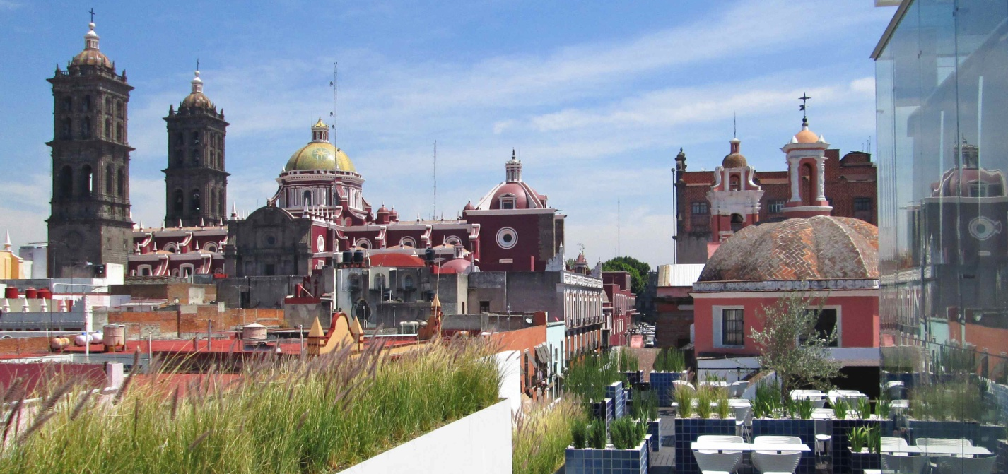
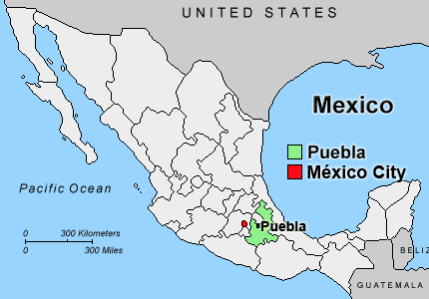
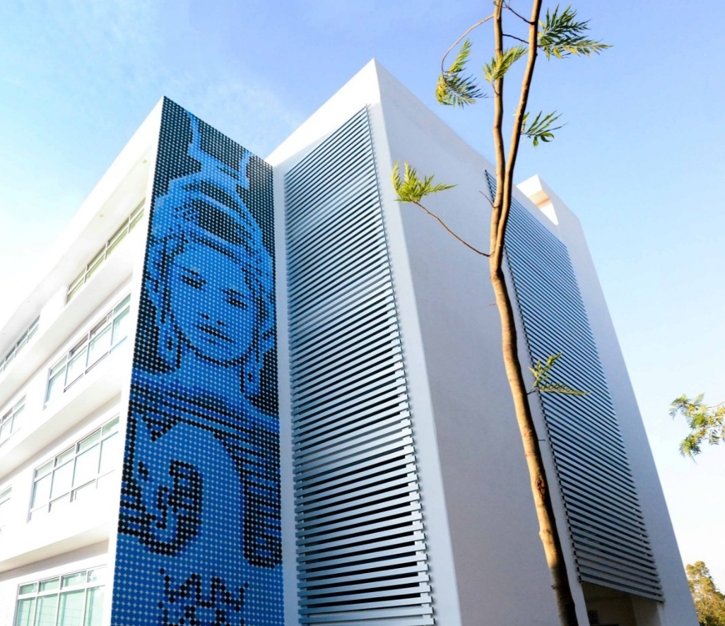


Thank you

Slide 44
Additional slides

Slide 45
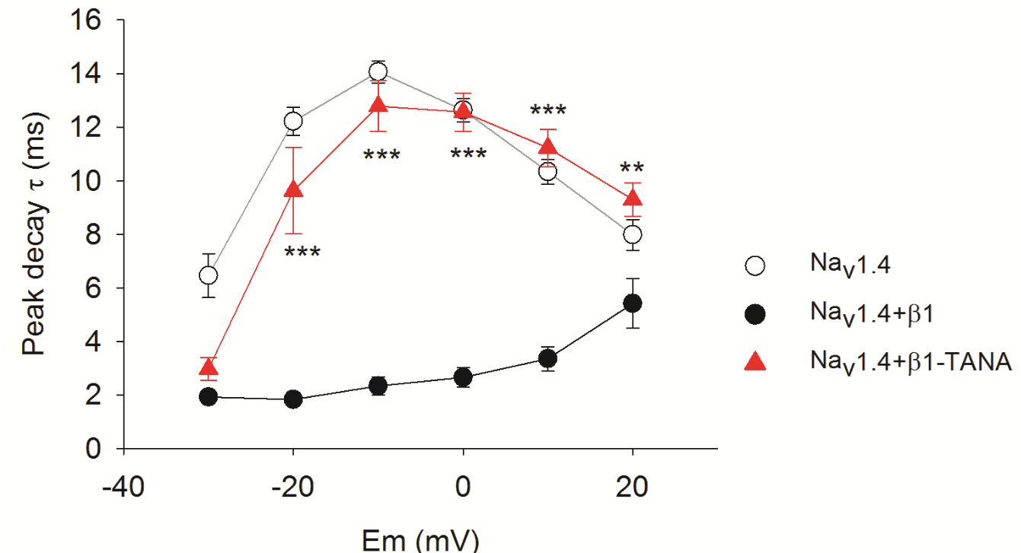

TANA significantly delays Na+ current kinetics
[unpublished data, Salinas-S et al. 2016]
Na+ channels open, inactivate and recover within 1-2ms (Catterall 2012)

Slide 46
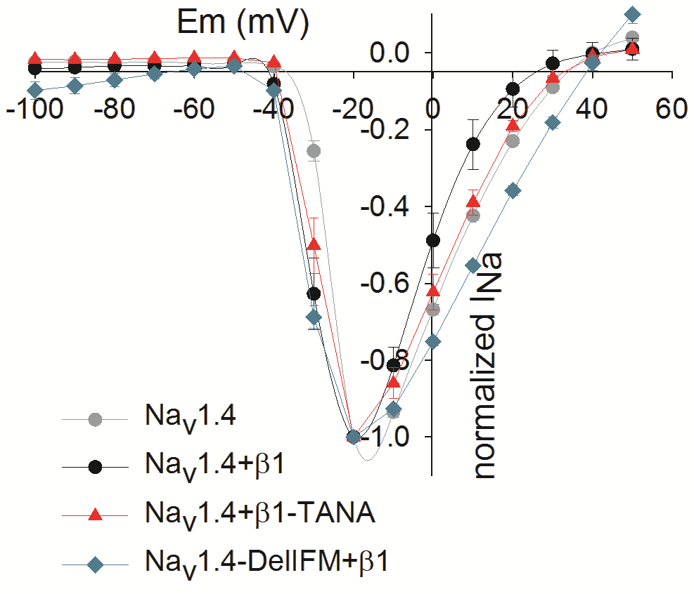
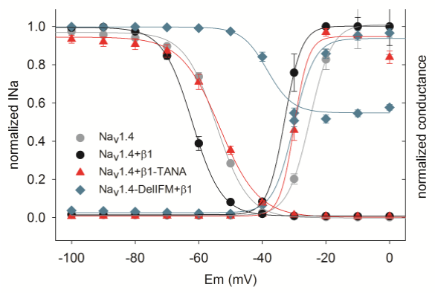
β1 TANA disrrupst the voltage modulation

Slide 47
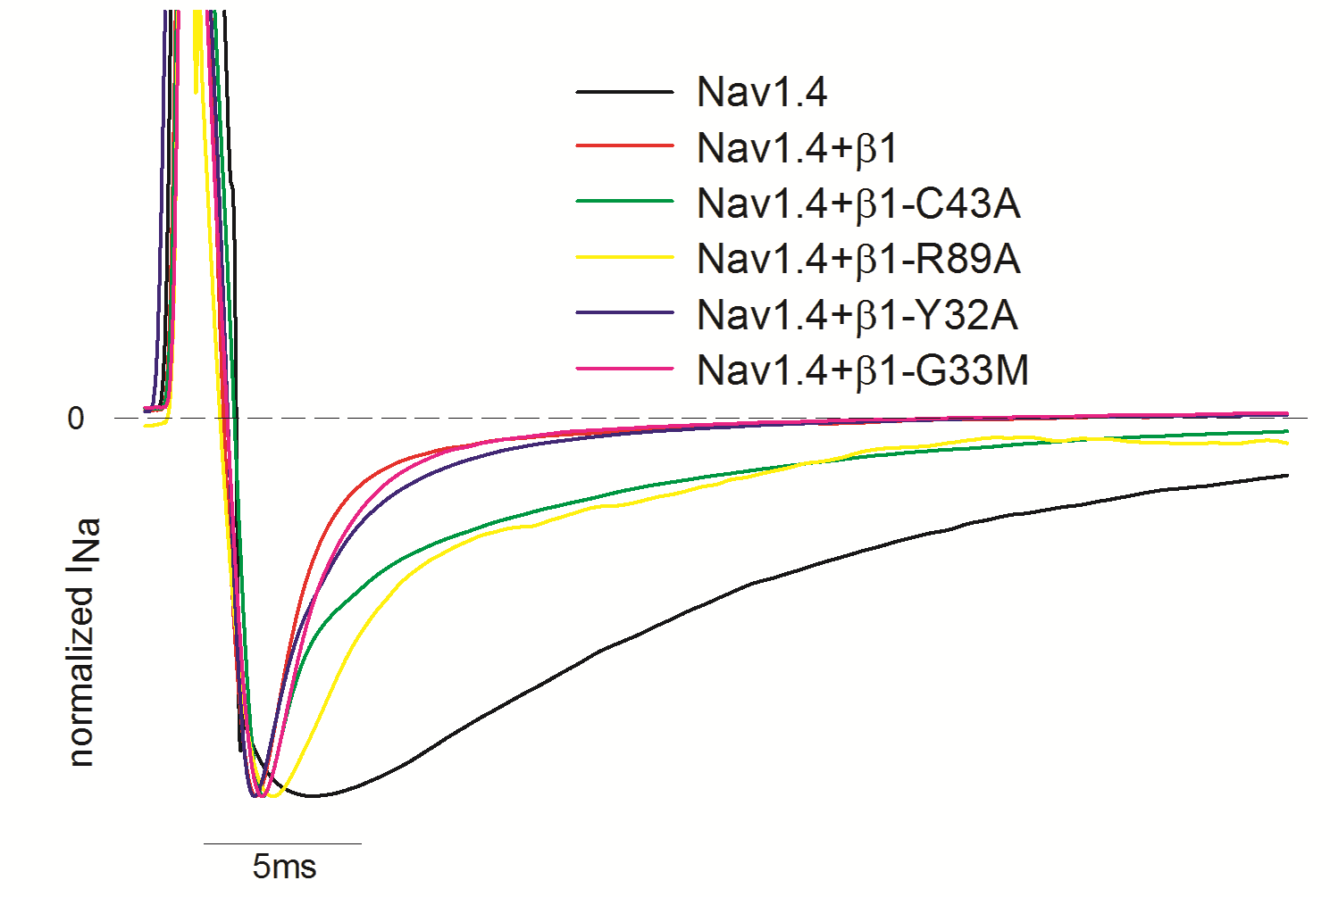
Single point mutations disrupt the modulation that Navβ1 exerts on the Na+ Channel at different degrees

Slide 48
