Slide 1
Etiology-based drug discovery for Amyotrophic Lateral Sclerosis
Thomas J. Lukas, Ph.D.
Department of Pharmacology, Feinberg School of Medicine, Northwestern University, Chicago, IL 60611

Slide 2
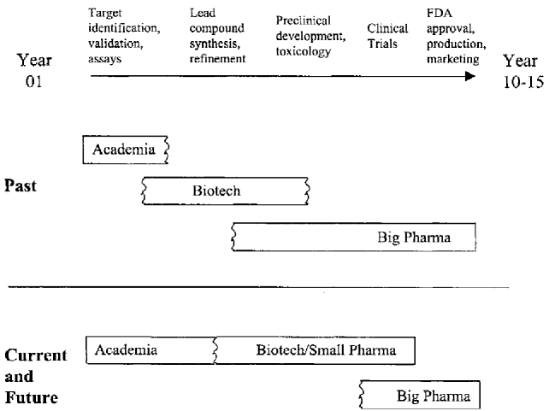
Increasing role of academic drug discovery research in the drug pipeline
Potential Gap

Slide 3
How do you accelerate Drug Discovery in an Academic Environment?
Early target identification– Genetics, DNA microarrays, Proteomics
Validation of relevant assays for compound screening (preferably cell-based). Direct effects on gene expression (Protein and/or mRNA measures)
Focused High-Throughput Screening (Spending constraints).
Screening of Smart Compound Libraries (Harvard, Scripps, etc).
5. Medicinal Chemistry optimization of lead structures (Have backups)
Feedback from assays to develop SAR and validate mechanism of action.
Perform preclinical pharmacokinetics and toxicity testing.
Demonstrate efficacy in preclinical trials (Animal models).

Slide 4



Amyotrophic lateral sclerosis (Lou Gehrig’s Disease)
Stephen Hawking
Chairman Mao

Slide 5
ALS is an age-related, fatal, paralytic neurodegenerative disorder resulting from degeneration of large motor neurons in the brain and spinal cord. Lethality 2-5 years after onset. Riluzole is the only FDA approved drug that is currently used but does not significantly alter mortality.
ALS occurs as sporadic disease (SALS) in 90% of cases, however, 10% of ALS cases are familial (FALS). Mutations in Cu, Zn superoxide dismutase (SOD1) are responsible for 20% while the newly discovered hexanucleotide repeat expansion in the C9ORF72 gene is responsible for at least 60% of FALS cases.
Transgenic mice over-expressing mutant SOD1, such as G93A develop paralysis and pathology reminiscent of SOD1-linked ALS in humans.
Experiments in these model animals indicate that damage to motor neurons occurs due to the acquisition of a toxic function by mutant SOD1 and the onset of symptoms and pathology are dependent on the level of expression of the mutant SOD1.
We reasoned that if the expression of SOD1 could be reduced, onset of disease could be postponed.

Slide 6
Part I. High throughput screening for inhibitors of SOD1 expression.
1. G93A mutant SOD1 (G93A) mouse fibroblasts were quantitatively plated in a 96 well format and incubated overnight.
2. The test compounds were applied in DMSO solution (range 0.1 to 50 µM final concentration) in triplicate wells to fresh media and incubated with the fibroblasts for 48 hr.
3. Aliquots of extracts were used for protein measurements and a specific human SOD1 ELISA assay. ELISA data was normalized to either total protein or to GAPDH activity.
4. Multiple libraries of compounds were screened: FDA-approved drugs,
known protein kinase inhibitors; and natural products. ~2000 compounds
Results:
Hits were curated based upon low toxicity and potential neuroprotective
activity. Many were protein kinase inhibitors with activity against GSK3-Beta and/or members of the cyclin-dependent protein kinase family.
No Robotics used -- only a devoted medical student

Slide 8
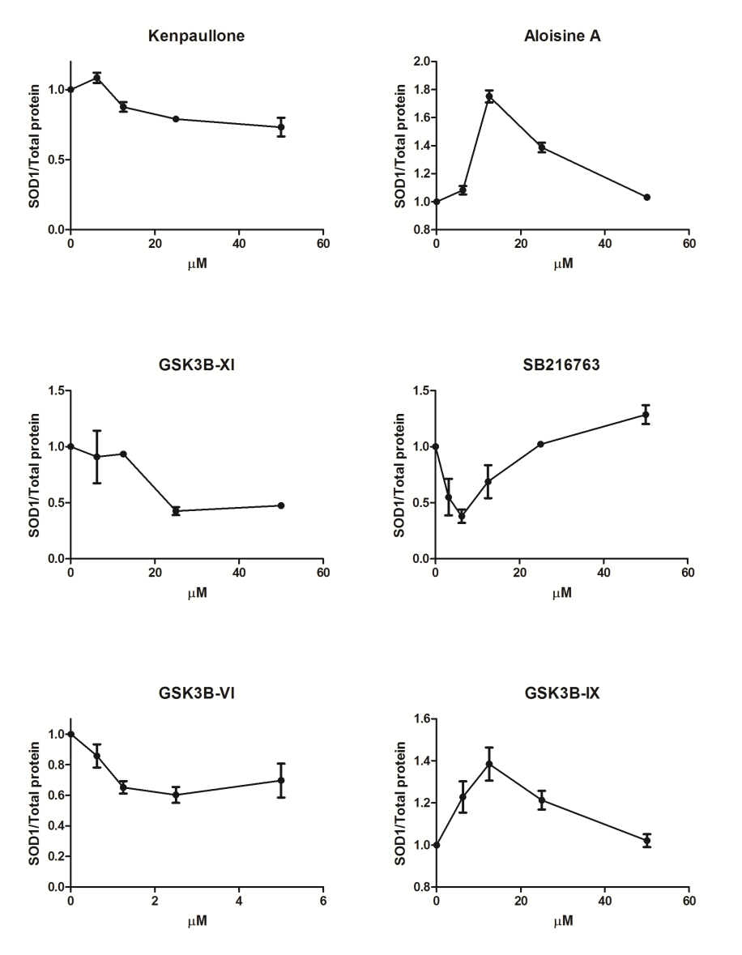
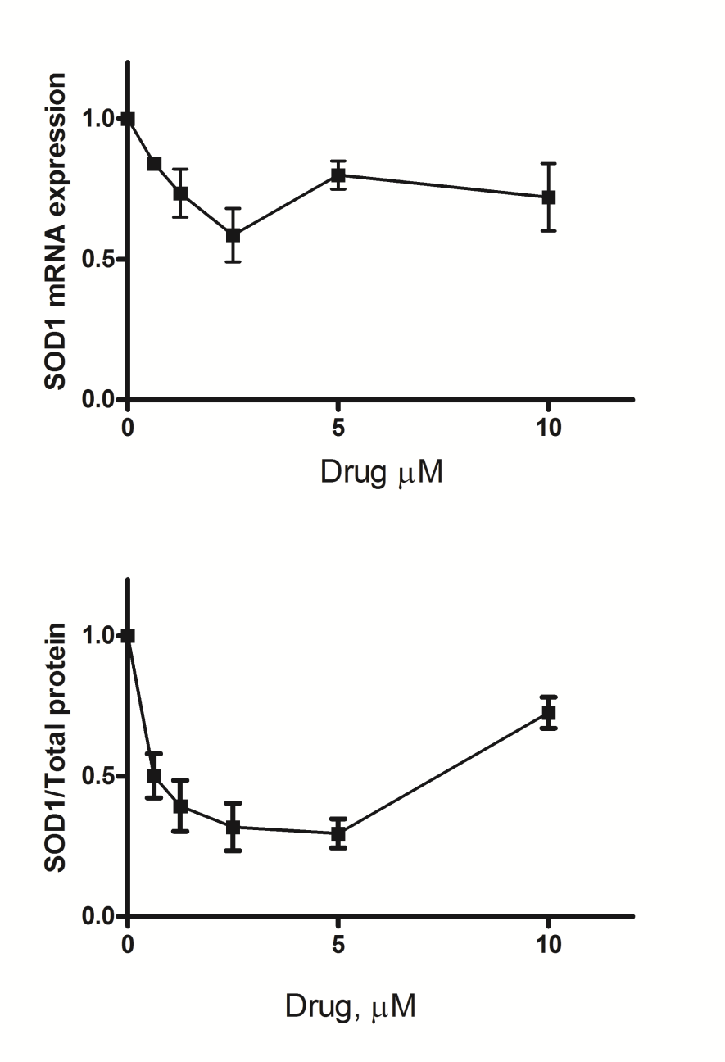
Example inhibition of SOD1 expression curves from the cellular assay.
GSK3B-II
GSK3B-II displays upward
Curvature in inhibiting both SOD1 mRNA
and protein SOD1 expression.
Many compounds exhibit biphasic curves

Slide 9
Table I. GSK3β inhibitors and mutant SOD1 protein expression in mouse fibroblasts
ID | Name | GSK3β IC50 (nM) | SOD1 IC50 (nM) | Comments
1 | GSK3B-II | 390 | 625 | Lead compound
2 | GSK3B-IX | 5 | Activates | Also inhibits CDK5,CDK2, CDK1
3 | GSK3B-XI | 25 | 10000 | Also inhibits CDK4
4 | SB216763 | 32 | 3000 | In vivo imaging of GSK3β
Inhibition of SOD1 expression is not correlated with the IC50 of the tested
compounds towards GSK3β. It is not a class effect.
Assumed mechanism of action is on the regulation of the SOD1
Promoter.

Slide 10
Primary motor neuron response is comparable to fibroblasts

Slide 11
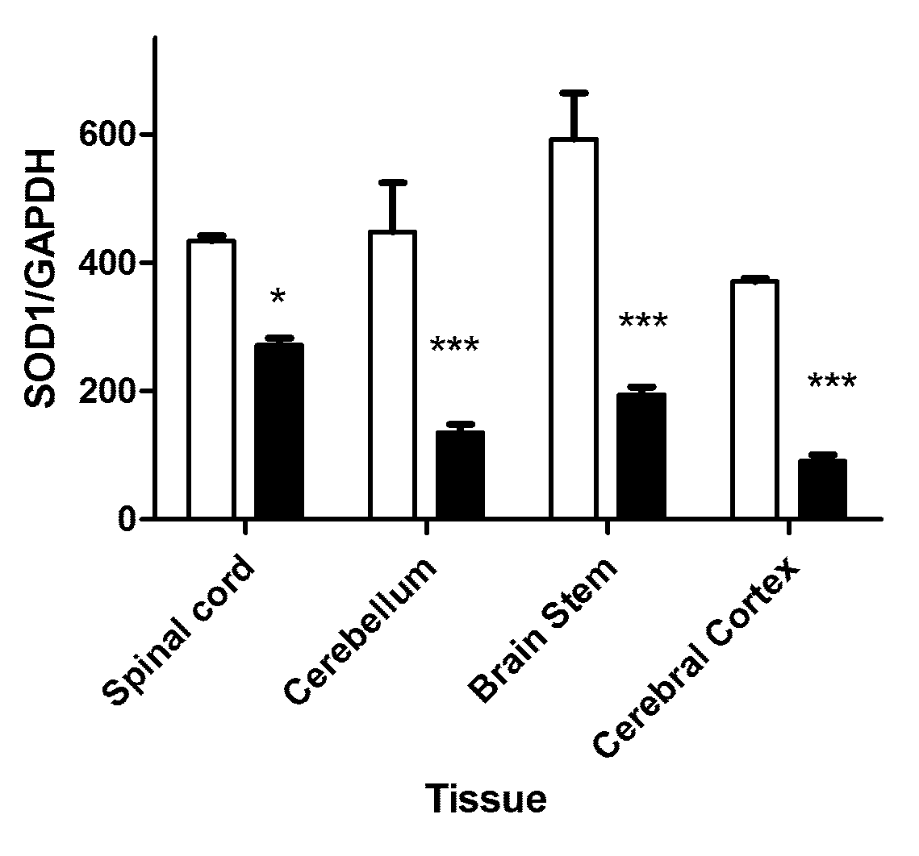
GSK3B-II (20 mg/kg, IP 26 days) decreases mutant SOD1 expression in the G93A-SOD1 mouse
But.... Extended (beyond 1 month) and/or high dosage leads to toxicity

Slide 12
Medicinal Chemistry optimization of the lead compound
ID |  | ClogPª | Relative SOD1 expression 10 µM compound (p-value)^{c}
7 (GSK3B-II) | R= 3-Iodo | 2.91 | 0.73 (0.022)
NUCC-433 | R= 3-Methoxy | 1.71 | 0.50 (0.005)
NUCC-319 | R= 3-Fluoro | 1.93 | 1.43 (0.001)
NUCC-435 | R= 4-Trifluoromethyl | 2.82 | 1.57 (0.003)
NUCC-439 | R= 3-Chloro | 2.51 | 0.96
NUCC-432 | R= 3-Nitro | 1.53 | 1.17
NUCC-318 | R=3-Bromo | 2.65 | 0.91
NUCC-434 | R=4-Methoxy | 1.71 | 0.47 (0.001)
NUCC-440 | R=4-Chloro | 2.51 | 1.23 (0.09)
NUCC-320 | R=4-Bromo | 2.65 | 1.03
NUCC-321 | R=4-Iodo | 2.91 | 0.69 (0.026)
NUCC-324 | R=4-Fluoro | 1.93 | 0.86
NUCC-436 | R=4-Methyl | 2.29 | 1.26
NUCC-431 | R=4-Nitro | 1.53 | 1.02
NUCC-441 | R=H | 2.29 | 1.33 (0.07)
Lukas, T. J., Schiltz, G. E., Arrat, H., Scheidt, K., and Siddique, T. (2014) Bioorg.Med.Chem.Lett. 24, 1532-1537

Slide 13
NUCC-434 (A) and NUCC-433 (B)
Inhibit SOD1 expression with
less upward curvature in their dose
response curves.

Slide 14
Distribution of GSK3B-II in mouse tissues after a 20 mg/kg injection (n=2)
Distribution of CMIDD-434 in mouse tissues after a 10 mg/kg injection (n=2)
Tissue | Time | Concentration (µM)
Brain | 1 hr | 0.944
Spinal Cord | 1 hr | 4.00
Serum | 1hr | 0.672
Brain | 24 hr | 0.077
Spinal cord | 24 hr | 0.855
Serum | 24 hr | 0.073
Time hr | Serum (µM) | Spinal Cord (µM) | Brain (µM)
2 | 0.153 | 0.057 | 0.029
4 | 0.334 | 0.162 | 0.047
24 | 0.123 | 0.113 | ND*
The CMIDD drugs are currently undergoing testing in G93A-SOD1 mice for efficacy
in reducing SOD1 expression and clinical improvements (onset, progression).

Slide 15
Part II. Pilot study for ACTH as a treatment for ALS
in the G93A SOD1 mouse
1. There are reciprocal actions between pituitary neuropeptides and proinflammatory cytokines.
2. An ACTH analog influences neuromuscular function by electrophysiological enhancement of motoneurons and exhibits both neurotrophic and myotrophic properties.
3. ACTHar gel (Questcor) is used to treat infantile spasms and relapsing multiple sclerosis.
Experimental treatment arms for the study.
IM: intramuscular injection, SC: subcutaneous injection U/kg
Male G93A mice |  |  |  |  | Female G93A mice
Control | 120 IM | 120 SC | 60 SC | 60 SC/w | Control | 120 IM | 120 SC | 60 SC | 60 SC/w
8 | 7 | 9 | 6 | 5 | 8 | 7 | 9 | 8 | 5

Slide 16
Clinical statistics of the timing of ALS-like symptoms with corresponding treatment doses.
Animal Group | Onset/Tremor Median Age | Paralysis Median Age | Endstage Median Age
Control | 103 | 122 | 129
IM120 | 109 | 120 | 127
SC120 | 116 | 126 | 130
SC60 | 121 | 127 | 134
SC60W | 115 | 130 | 138
Log-rank significance p= | 0.0001 | 0.0509 | 0.318
Log-rank trend p= | 0.0001 | 0.0023 | 0.355
Rotarod performances are significant for the treated groups (except for IM120) before the age of onset.
Animal Group | Males p-value (wks) | Females p-value (wks)
IM120 | > 0.05 (all) | >0.05 (all)
SC120 | < 0.01 (11-13) | <0.001 (11-14)
SC60 | <0.01 (10-12) | <0.001 (10-16)
SC60W | <0.001 (9-11) | <0.01 (13)

Slide 17
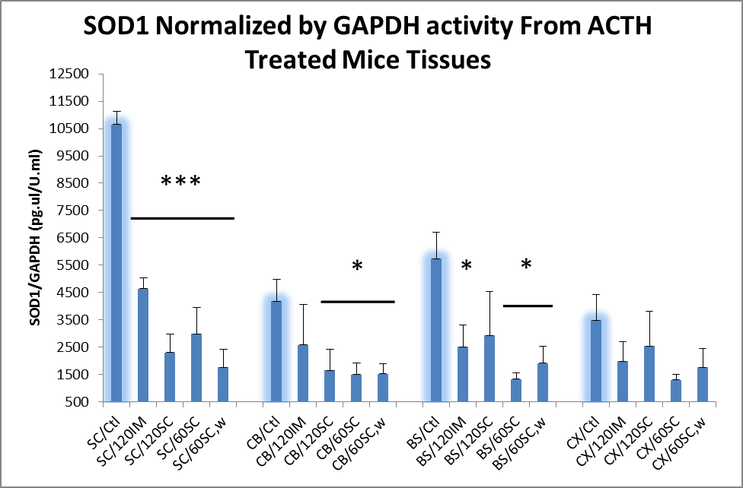
Does ACTH have an effect on SOD1 levels in the SOD1 transgenic mouse?

Slide 18
Summary
Etiology-based treatments for SOD1-linked ALS are feasible with
specific classes of small molecules (1,3,4-oxadiazoles).
ACTHar gel shows promise as a treatment for ALS and may specifically
Benetit patients with SOD1-lunked disease.

Slide 19

Acknowledgements
Faculty Collaborators
Teepu Siddique
H.X. Deng
Post Doctoral Fellows
Hasan Arrat
Edwin Soriano
Animals
Rongen Fu
Erdong Liu
Karl Scheidt Gary Schiltz
Funding- NIH, Questcor, Les Turner ALS Association, CMIDD

Slide 20
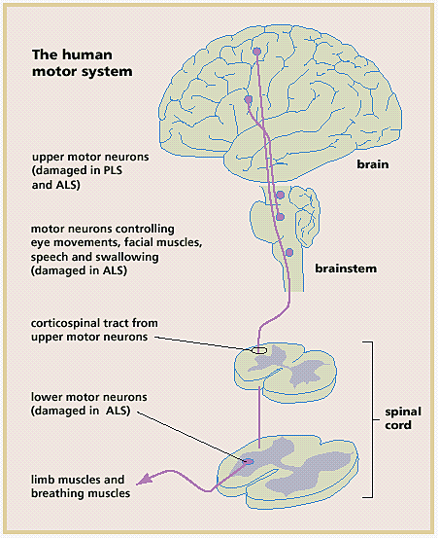
Pathology in ALS
Dysfunction of upper motor neurons in cortex
spastic paralysis
Dysfunction of lower motor neurons in brain stem and spinal cord
→ muscle weakness and atrophy → respiration failure and death in three years (50%) to five years (90%). No effective treatment.

