Slide 1
New Tools to Study and Perturb the Glycocalyx
Glycobiology 2015
10-12 August, 2015
Thomas Boltje
Institute for Molecules and Materials
Radboud University
The Netherlands

Slide 2
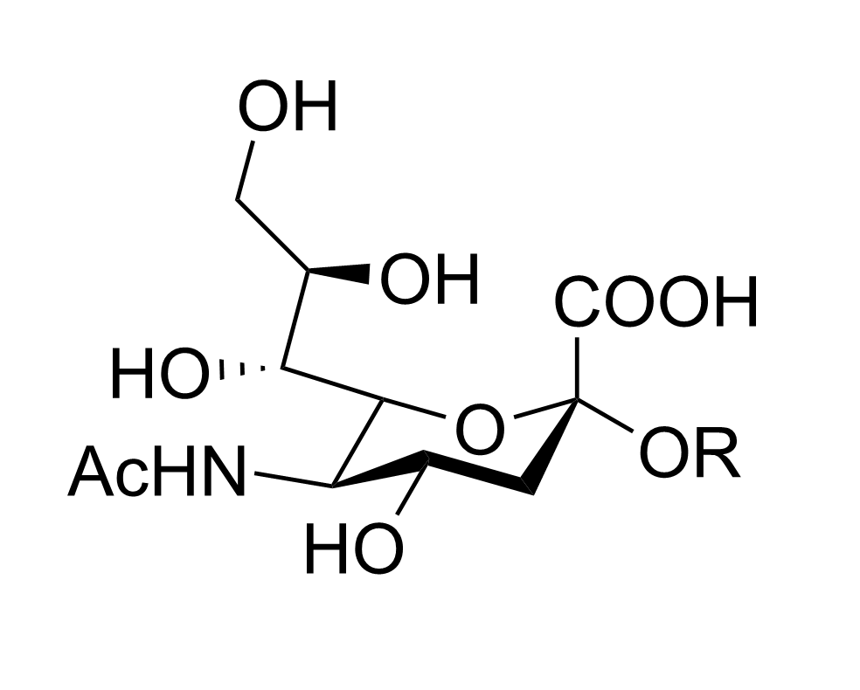
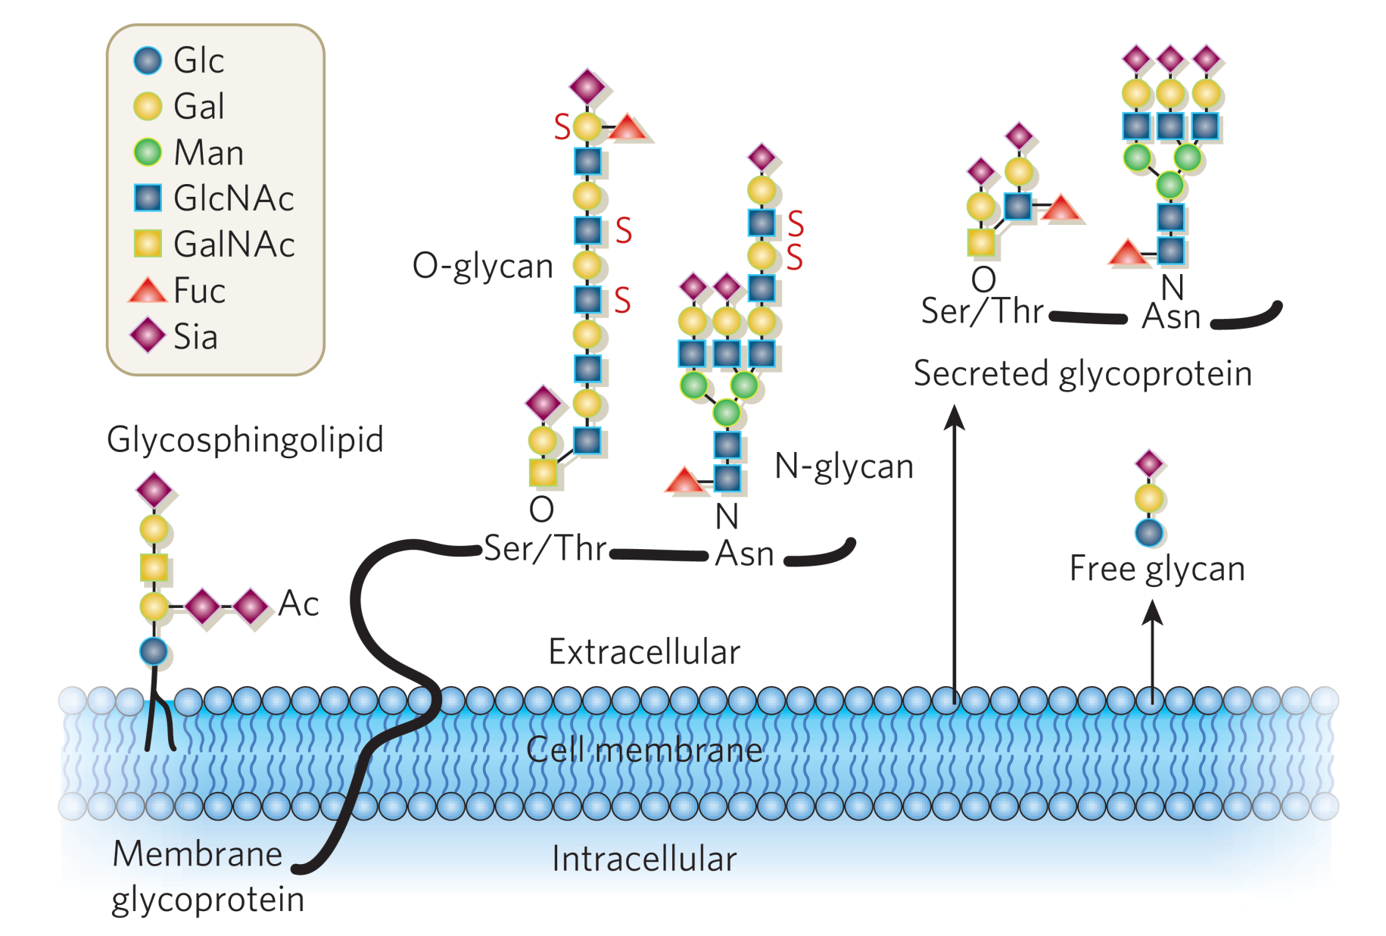
Sialic Acid Structure and Function
Sialic acids: a family of over of >50 2-keto-3-deoxynononic acids
Found on the termini of glycan chains
Play an important role in the immune response
Varki et al, Essentials of glycobiology 2nd edition

Slide 3
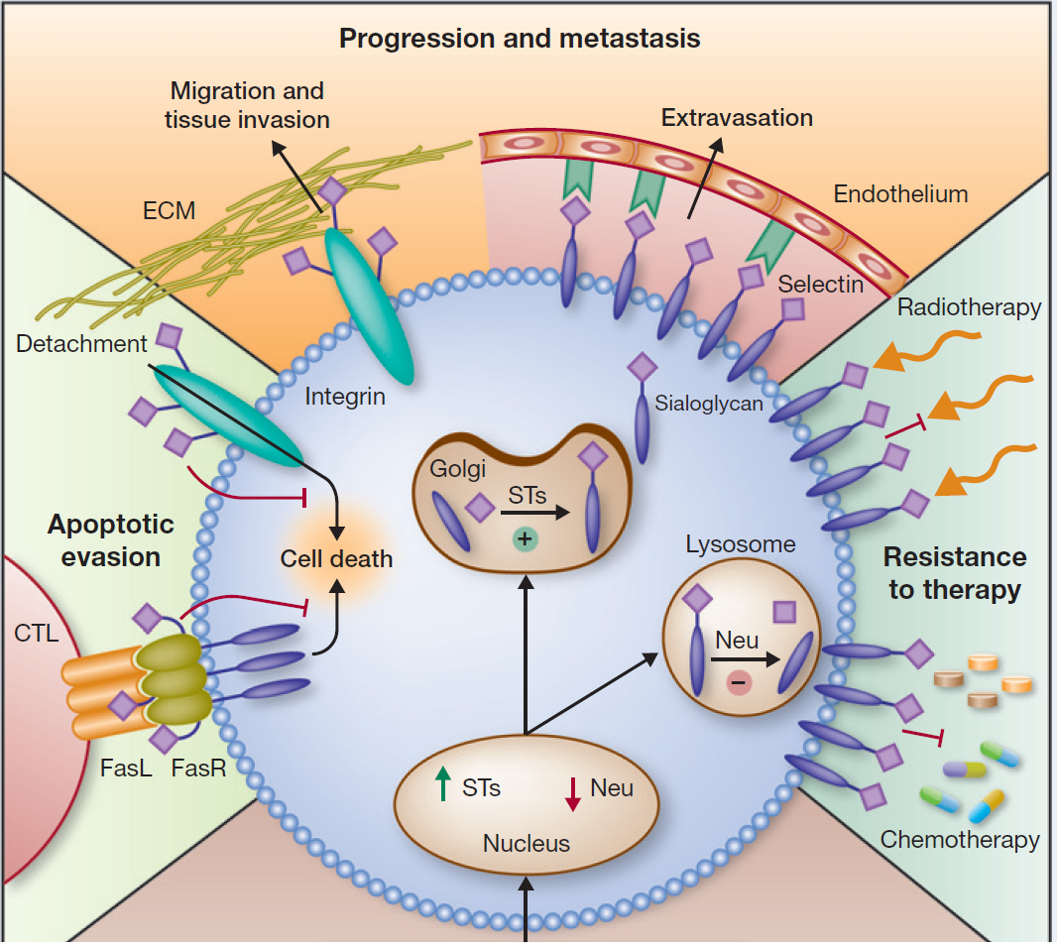
Sialic acid sweetens a tumors life
Cancer cells are oversialylated
Immune Evasion
Resistance to Apoptosis
Migration and Metastasis
Resistance to Therapy
Poor Prognosis
Büll C, Stoel M.A., den Brok M.H, Adema G.J., Cancer. Res, 2014, 74, 3199-3204.
Büll C, den Brok MH, Adema G.J., Biochim. Biophys. Act. Rev. Cancer. 2014, 1846, 238-246.

Slide 4

Reducing Oversialylation in Cancer
Removal
Sialidase treatment:
Promising results
Often contaminated
Short lived effect
Difficult to study effect on immune response
Cancer Cell
Currie G.A., Bagshawe K.D., British Journal of Cancer 1968, 22, 843–853.
Sanford, B.H. Transplantation, 1967.

Slide 5
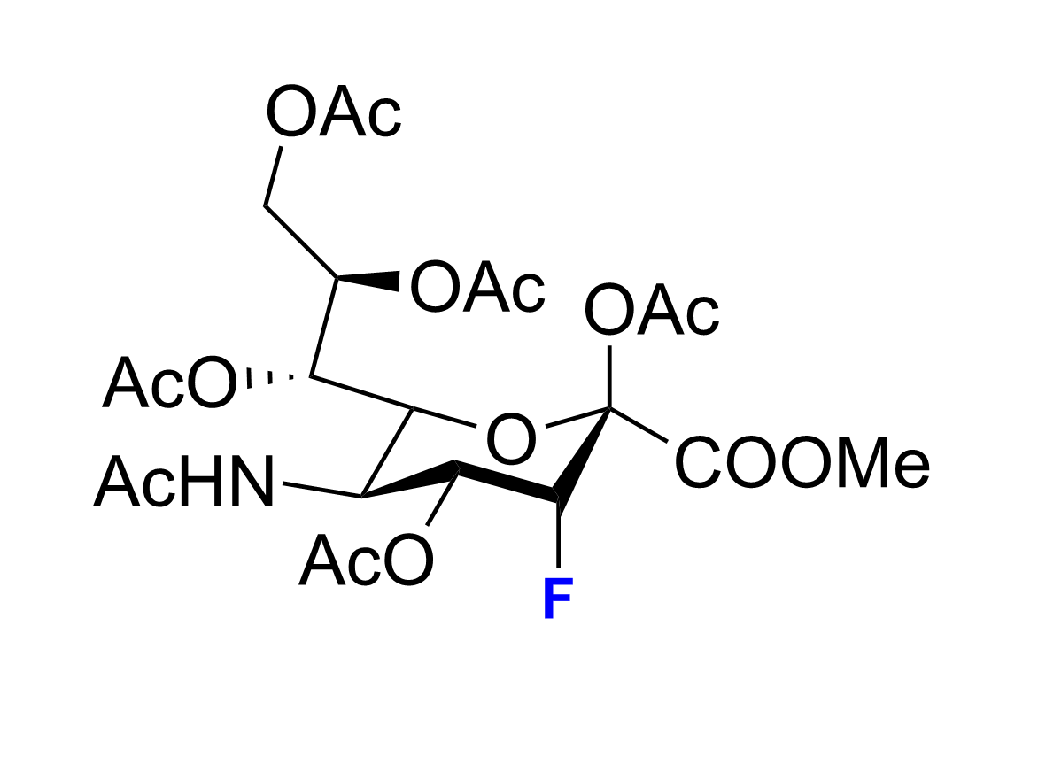
Reducing Oversialylation in Cancer
P-3F_{ax}-Neu5Ac
Cytoplasm
Sialoglycan
Metabolic Flux
Sialic
Acid
Sialyltransferases
Sialic Acid Transporter
Golgi
Rillahan C.D., Paulson J.C., et.al., Nat. Chem.Biol. 2012, 661-668

Slide 6
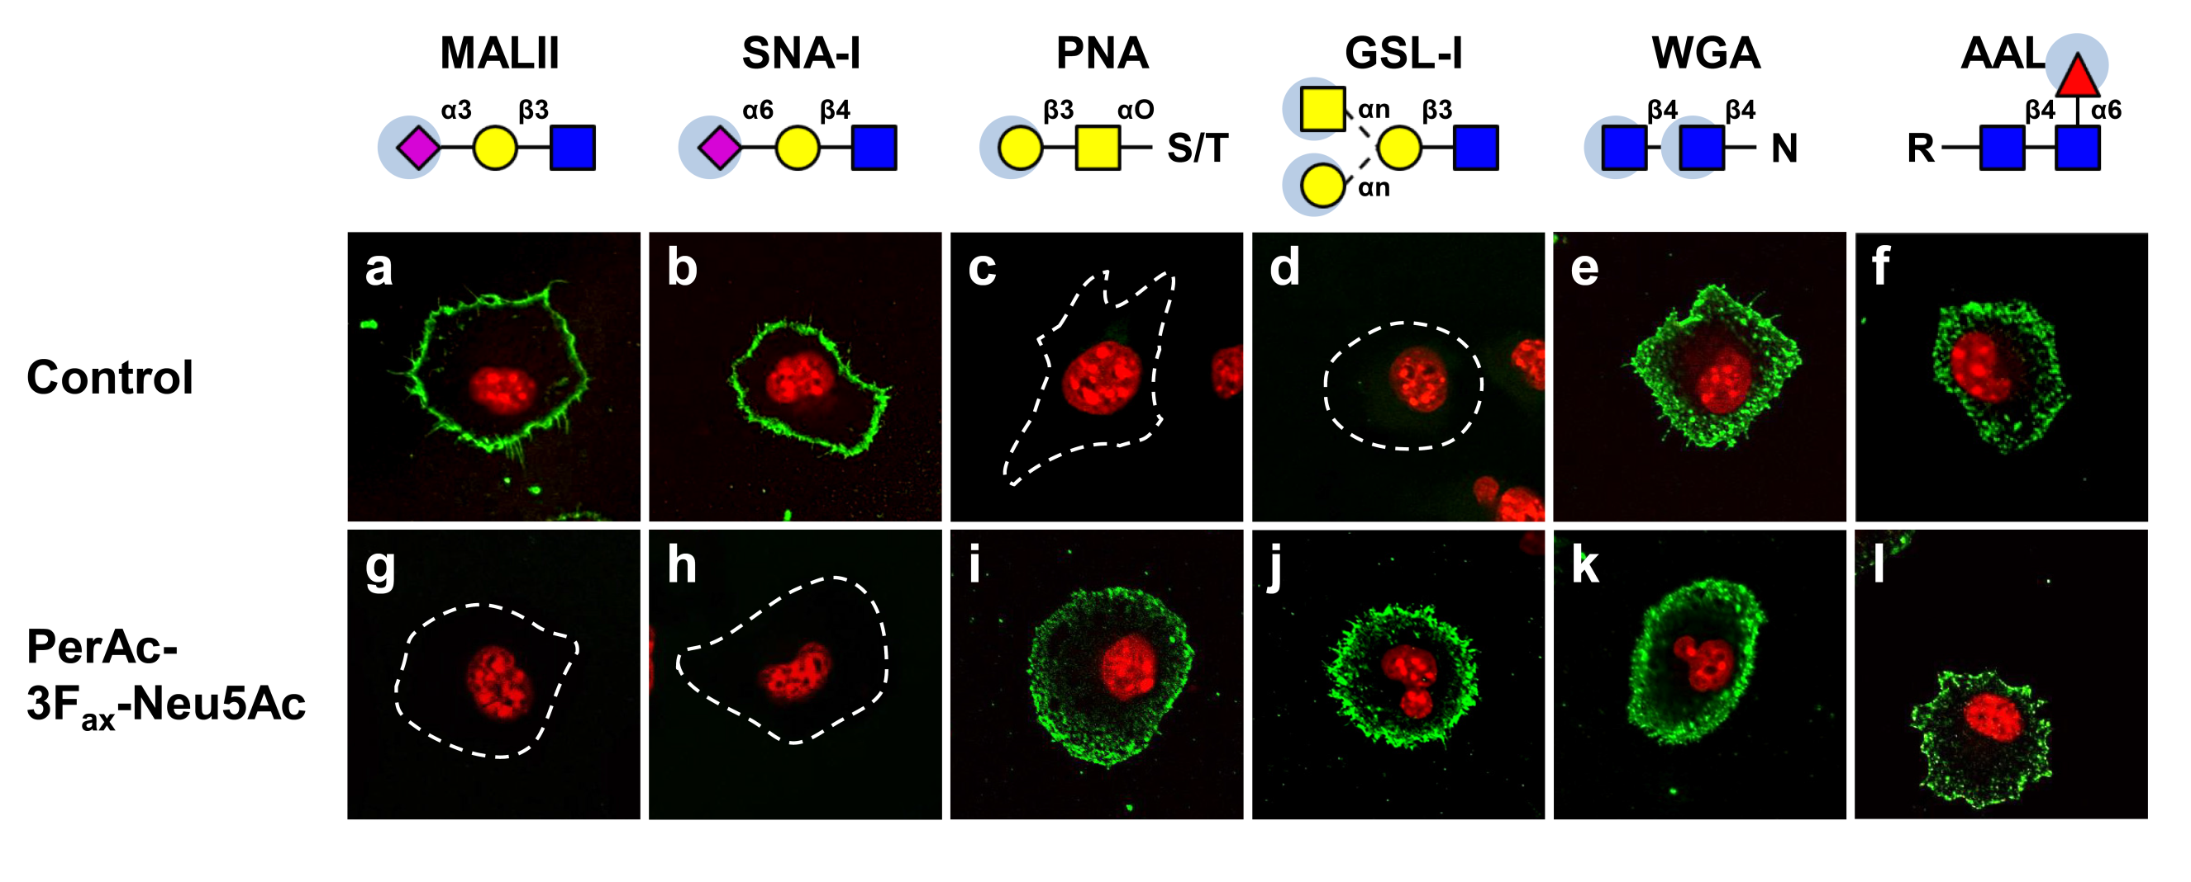
Inhibition of sialylation slows tumor growth and metastasis
Cell culture with 64μM concentration of inhibitor leads to almost complete desialylation
Cell viability is not affected
Büll C, Boltje T.J., Adema G.J. et.al., ACS Nano. 2015, 9, 733-745.
Büll C, Boltje T.J., Adema G.J. et.al., Mol. Cancer Ther. 2013, 12, 1935-1946.

Slide 7
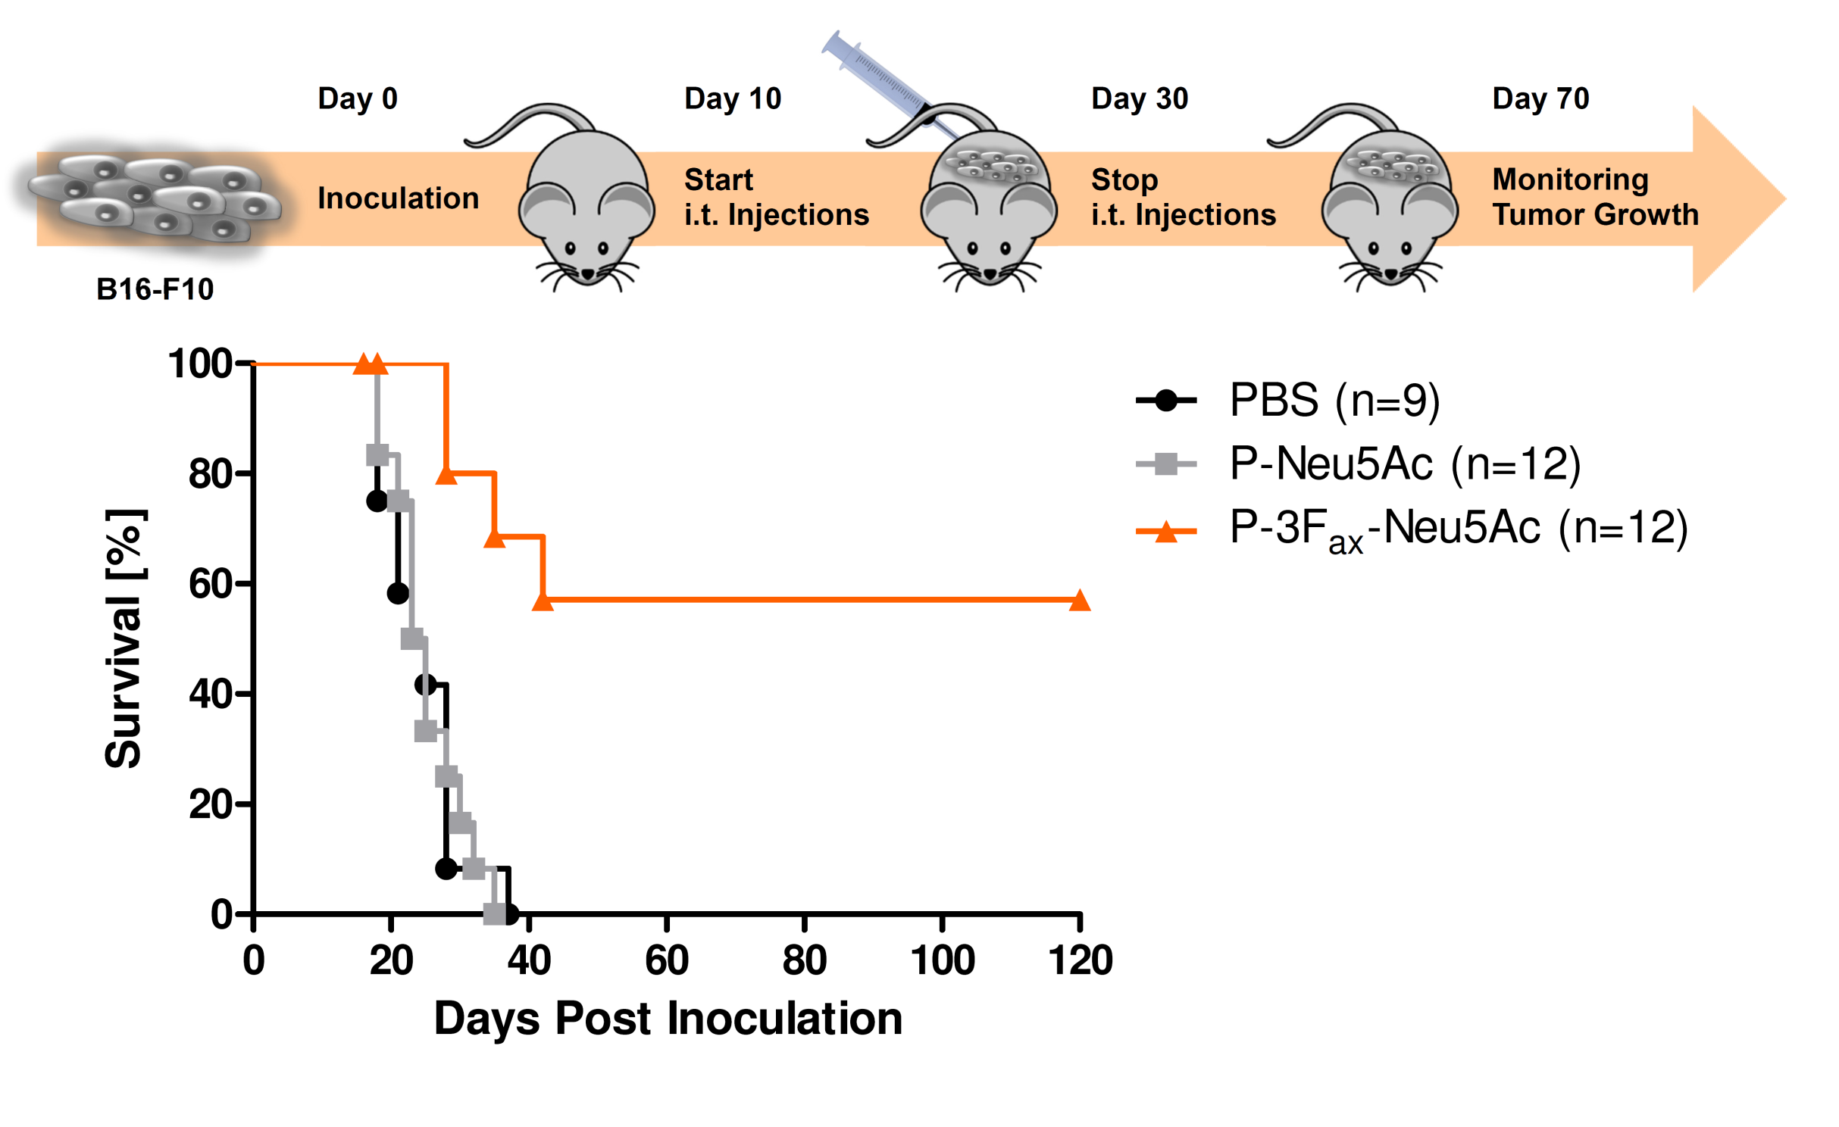
Inhibition of sialylation slows tumor growth and metastasis
Control groups treated with PBS, or sialic acid died after 40 days
60% of the treated group survived
Büll C, Boltje T.J., Adema G.J. et.al., ACS Nano. 2015, 9, 733-745.
Büll C, Boltje T.J., Adema G.J. et.al., Mol. Cancer Ther. 2013, 12, 1935-1946.

Slide 8
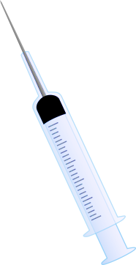


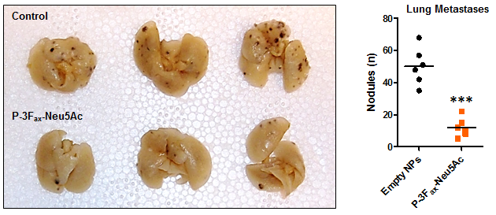
Inhibition of sialylation slows tumor growth and metastasis
Day 0
Day 10
Day 30
Day 70
Inoculation
Start
i.t. Injections
Stop
i.t. Injections
Monitoring
Tumor Growth
B16-F10
Mechanism?
Büll C, Boltje T.J., Adema G.J. et.al., ACS Nano. 2015, 9, 733-745.
Büll C, Boltje T.J., Adema G.J. et.al., Mol. Cancer Ther. 2013, 12, 1935-1946.
p<0.05 *, p<0.01 **, p<0.001 ***

Slide 9
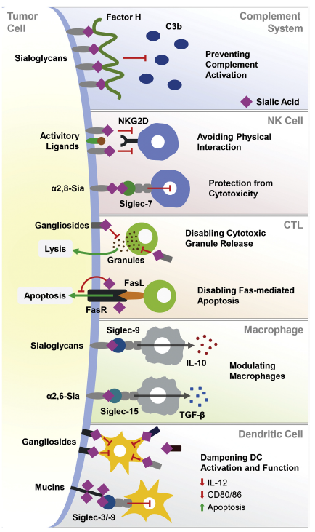
Sialic acid: an important immune response regulator
Biophysical properties: high negative charge, dense highly hydrated layer
Attracts complement inhibiting Factor-H
Actively bound by immunosuppressive SIGLEC receptors on immune cells
Büll C, den Brok MH, Adema G.J., Biochim. Biophys. Act. Rev. Cancer. 2014, 1846, 238-246.

Slide 10
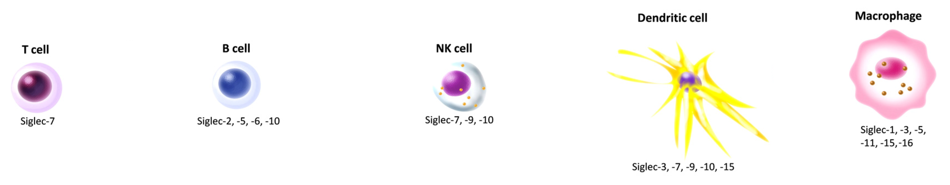
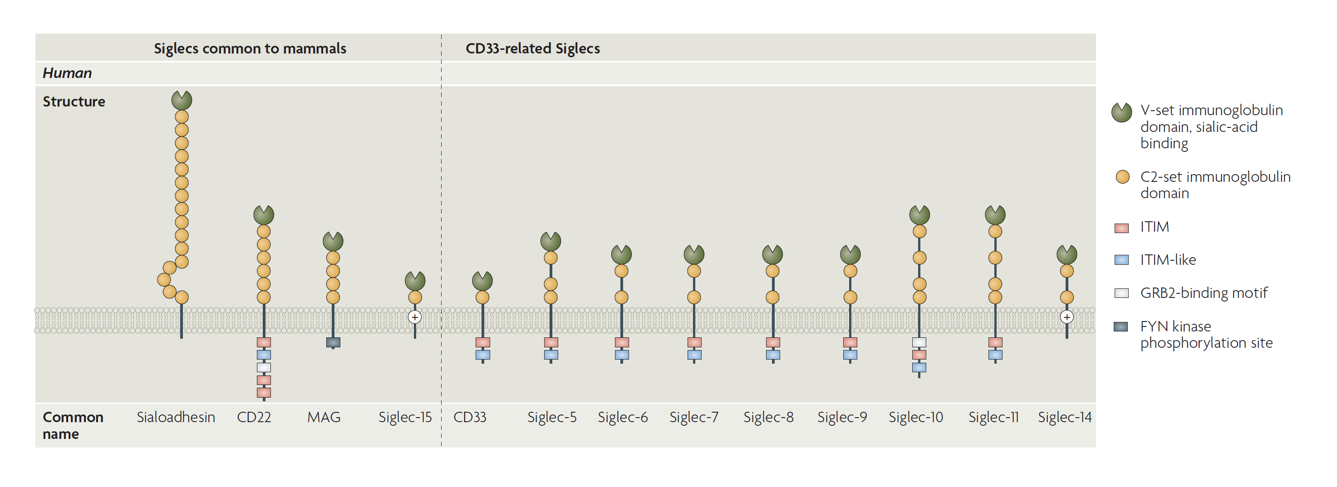
SIGLEC structure and expression
Sialic acids inhibit complement activation
Protective biophysical properties, hydration, negative charge etc.
Bind a dedicated set of immuno suppressive SIGLEC receptors on immune cells
Jandus C., Simon H-U., von Gunten S., Biochem. Pharmacol. 2011, 82, 323-332
Büll C, den Brok MH, Adema G.J., Biochim. Biophys. Act. Rev. Cancer. 2014, 1846, 238-246.
Macauley M.S., Crocker P.R., Paulson J.C., Nat. Rev. Immunol. 2014, 14, 653-666

Slide 11
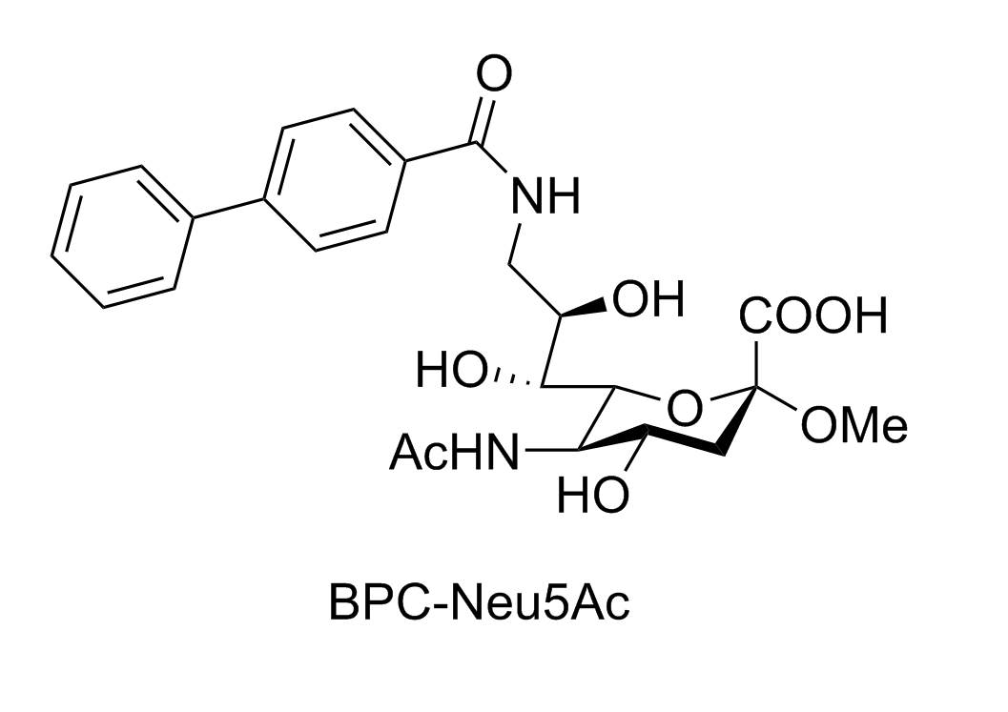
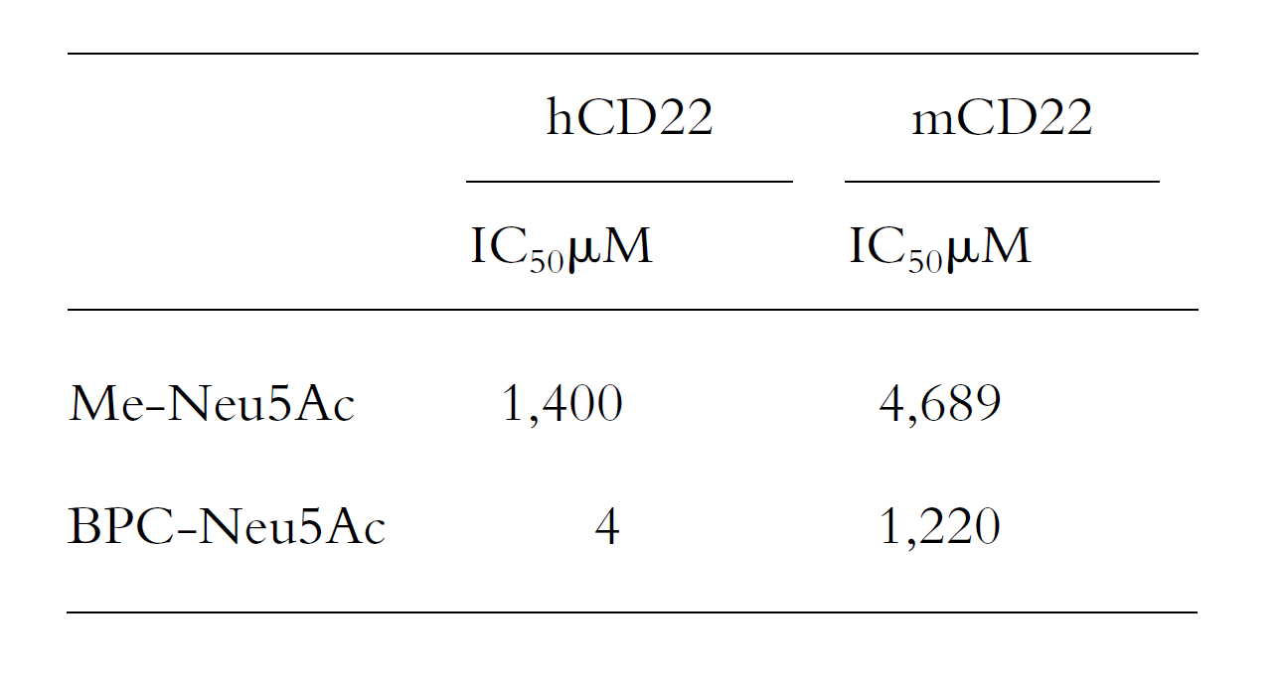
Targeting specific SIGLECs
Kelm, Nitschke and co-workers
Modified sialic acids can bind SIGLECs with high affinity
Modifications can be used to achieve selective binding
Modifications can be attached at various positions (C-5, C-9 etc).
Kelm S., Gerlach J., Brossmer R., Danzer C.P., Nitschke L., J. Exp. Med., 2002, 195, 1207-1213.

Slide 12
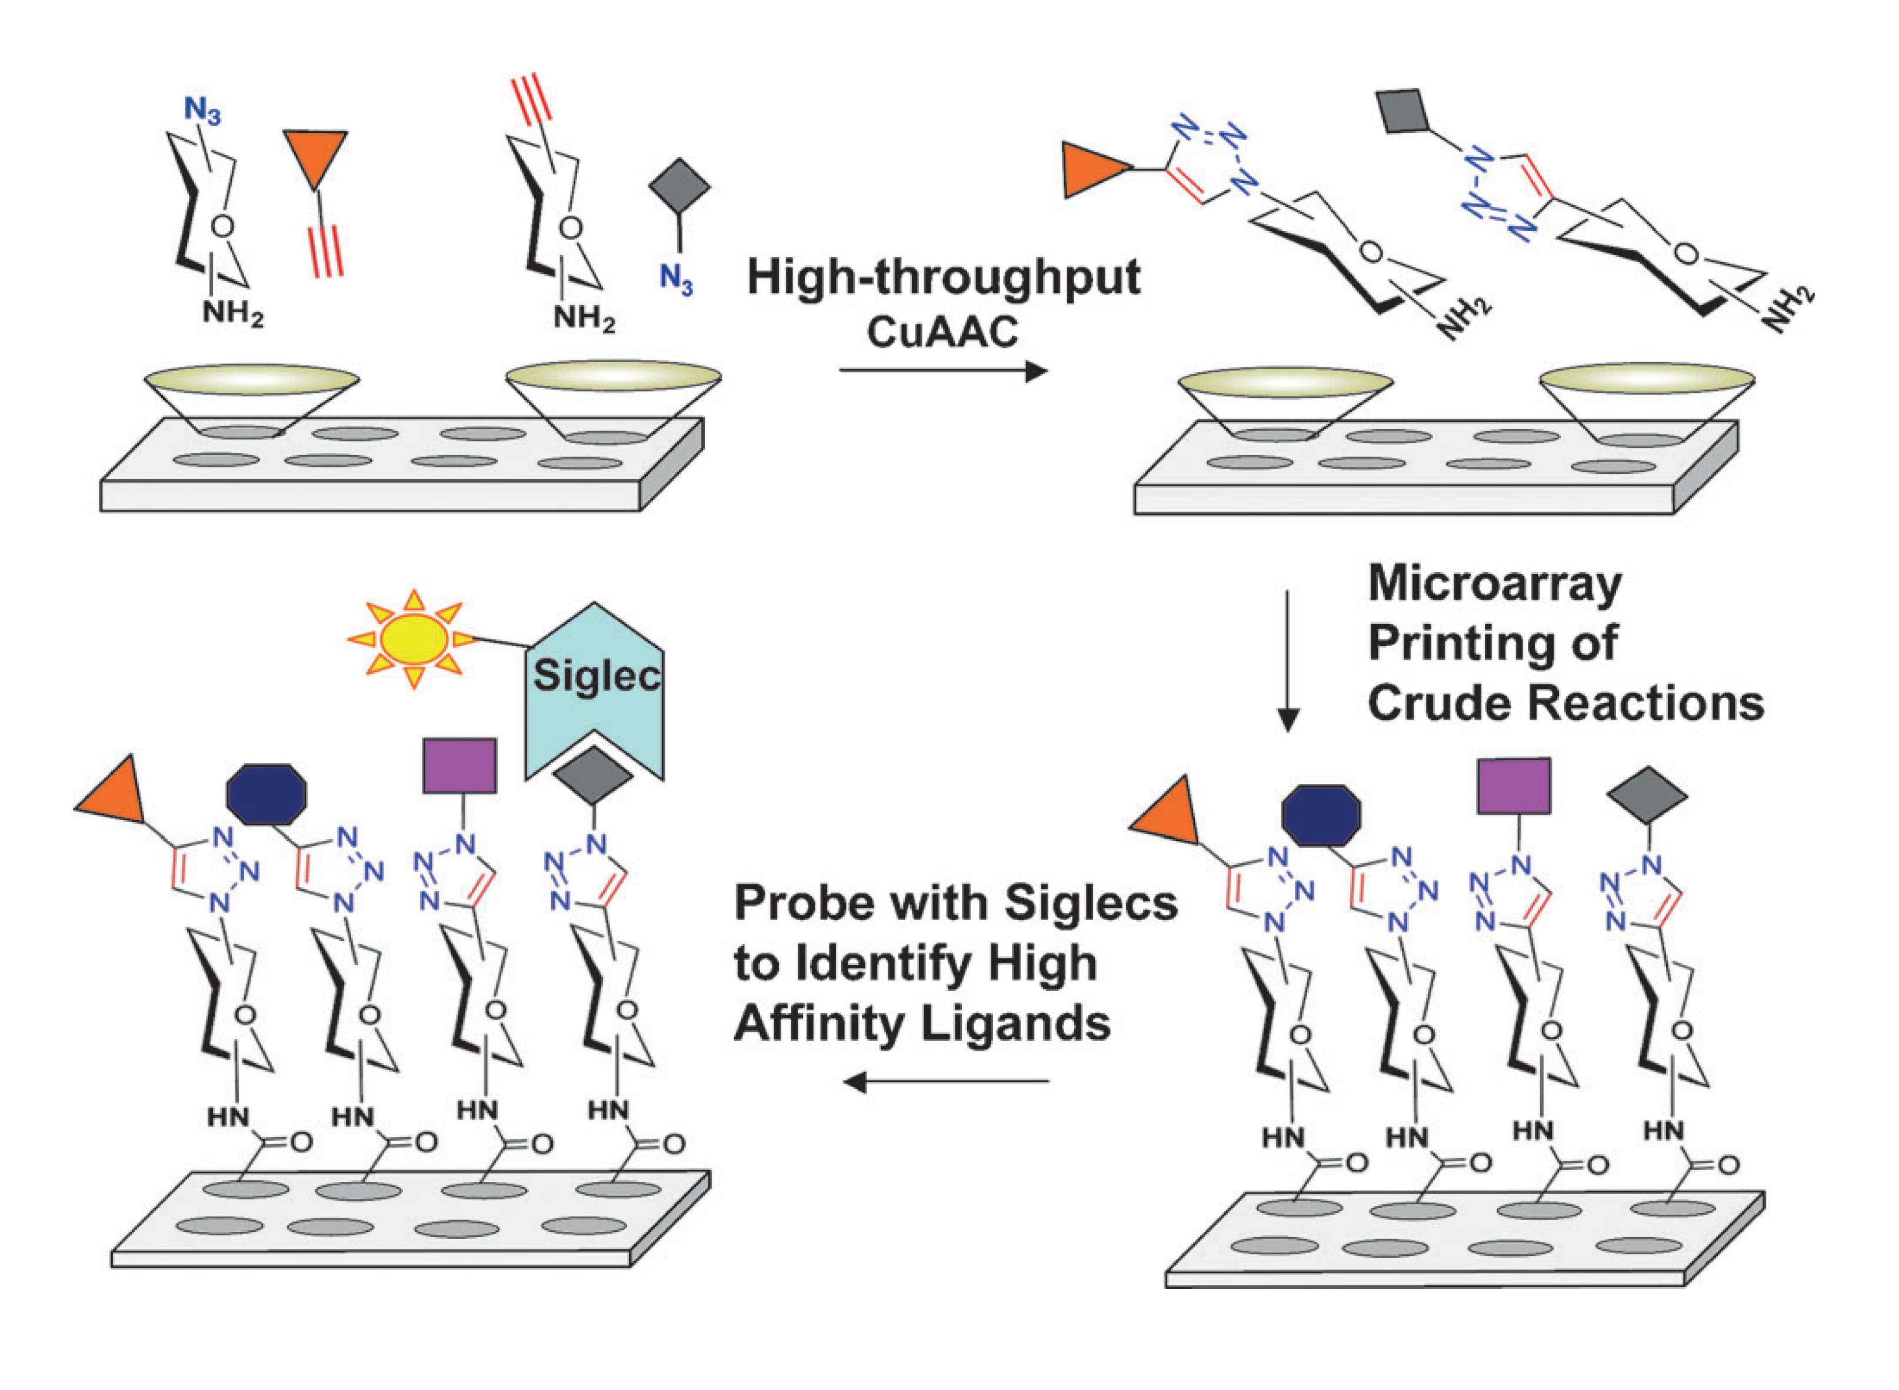
Targeting specific SIGLECs
High throughput modification and screening via click chemistry
Rillahan C.D., Schwartz E., McBride R., Fokin V.V., Paulson J.C., Angew. Chem. Int. Ed., 2012, 51, 11014-11018.

Slide 13
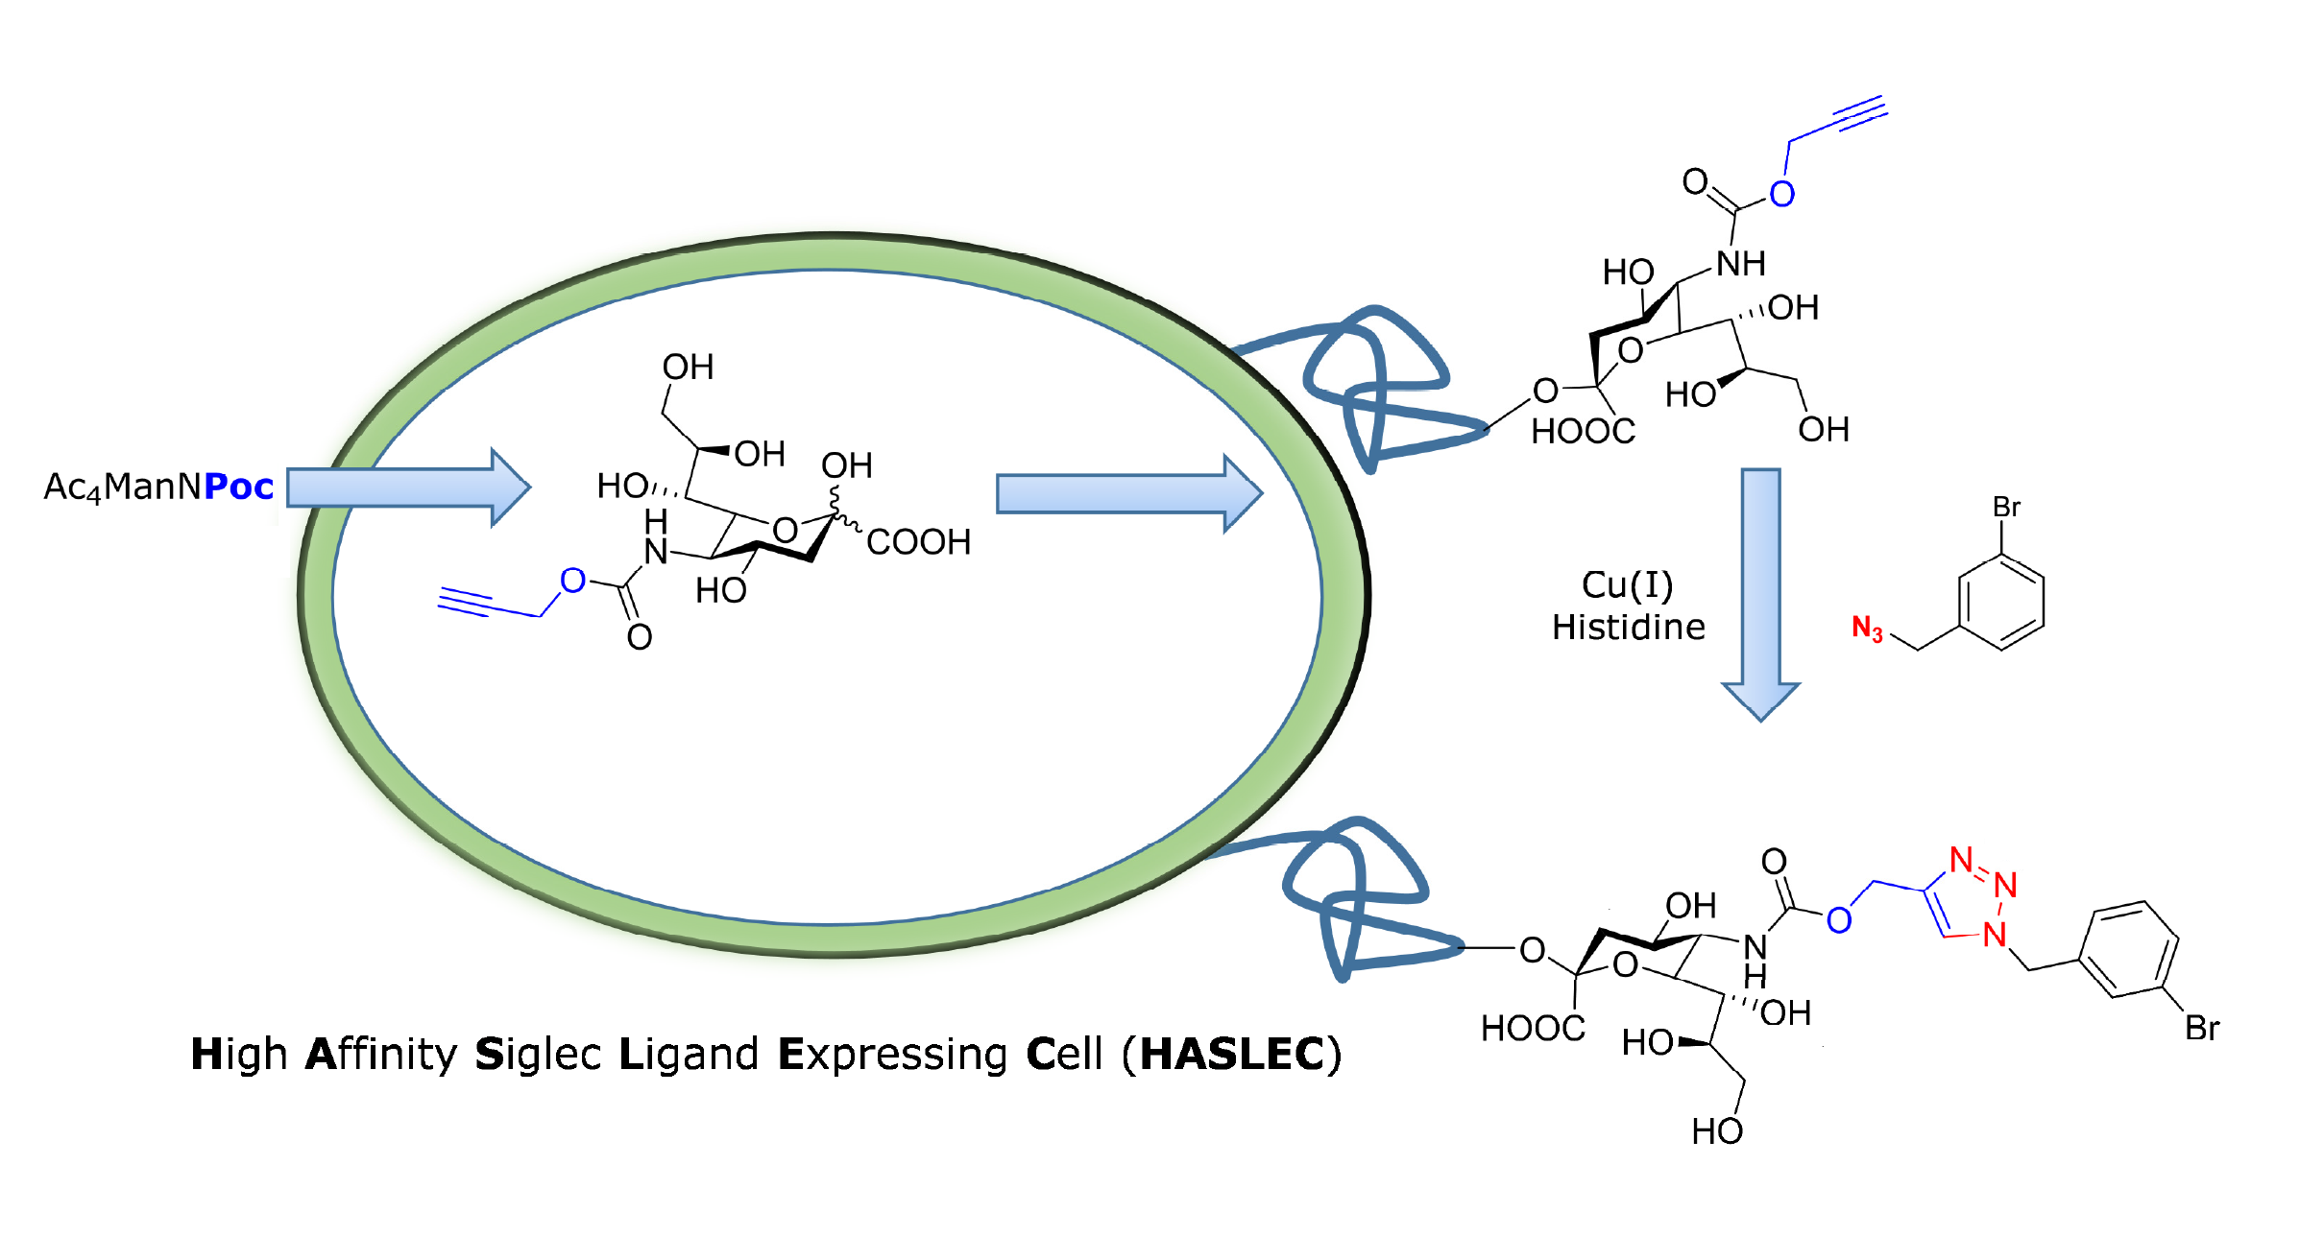
High Affinity SIGLEC Ligand Expressing Cells HASLECs
On cell synthesis to create High Affinity SIGLEC Ligand Expressing Cells HASLECs
Natural context of sialic acid expression
Enables to study the effect of binding on signaling
Heise T., Büll C., Adema G.J., Boltje T.J. et.al. ACS. Chem. Biol. ASAP

Slide 14
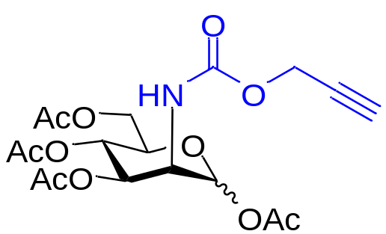
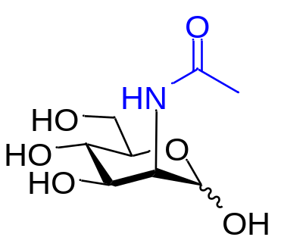
Metabolic labeling of sialic acids and sialoglycans
Cell membrane
Cell
Alkyne
Alkyne
Alkyne
GNE/NANS/NANP
CMAS/ST
1) J.A. Prescher & Carolyn R Bertozzi, Nat. Chem. Biol. 2005
2) Pamela V. Chang, Carolyn R. Bertozzi, Peng Wu et al. Angew. Chem. 2009
3) Wong C.H. et al, PNAS, 2007
= ManNac
= Sialic acid
= Protein

Slide 15
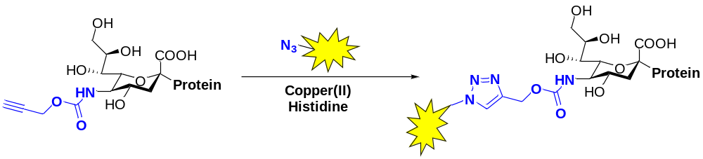
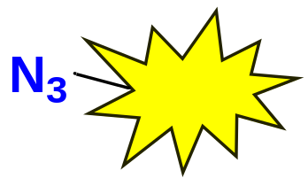

Making the chemical reporter visible
Alkyne
The two reactants are unique in nature
They only react with each other
The rest of the cell remains the same
Cell
Cell membrane
1) Wong C.H. et al, PNAS, 2007
2) Kennedy et al 2011 J. Am. Chem. Soc.

Slide 16
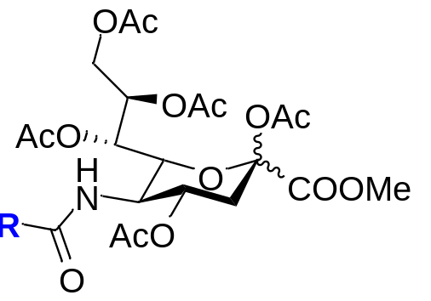
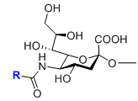
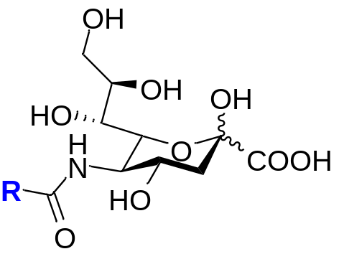

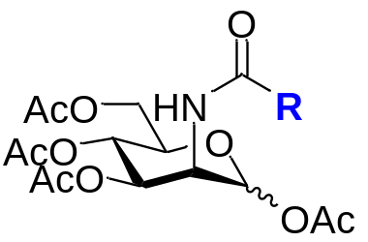
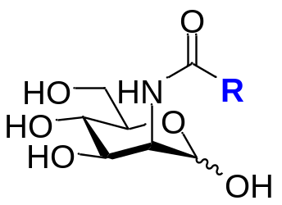
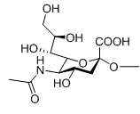

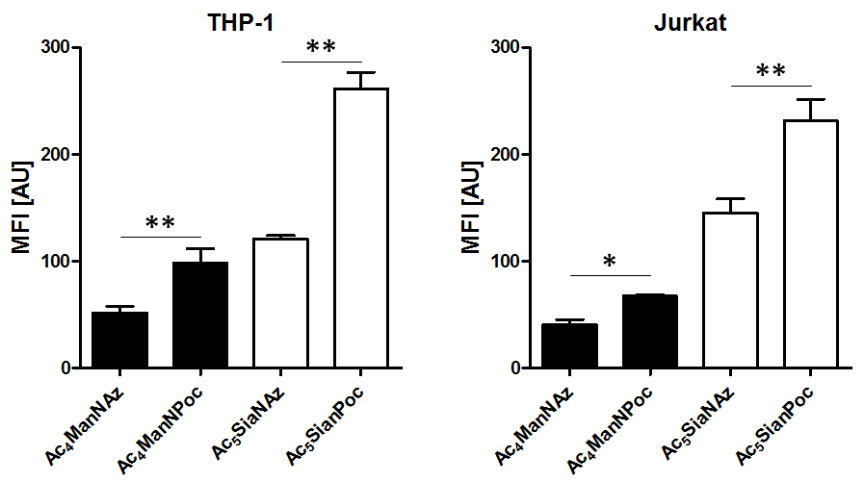
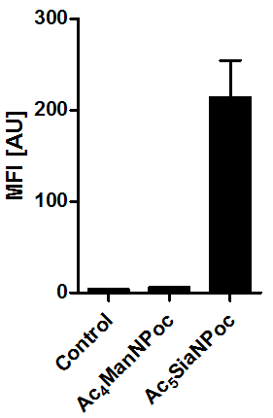
Labeling Sialic Acids
GNE
NANS
NANP
cell
Cu(I)
Histidine
N₃
or
T.-L. Hsu, S. R. Hanson, K. Kishikawa, S.-K. Wang, M. Sawa, C.-H. Wong, Proc. Natl. Acad. Sci. U. S. A. 2007, 104, 2614-2619
P. V. Chang, X. Chen, C. Smyrniotis, A. Xenakis, T. S. Hu, C. R. Bertozzi, P. Wu, Angew. Chem., Int. Ed. 2009, 48, 4030-4033.
Luchansky, S.J., Goon, S. & Bertozzi, C.R., Chembiochem, 2004, 5, 371-4.
Heise T., Büll C., Adema G.J., Boltje T.J. et.al. ACS. Chem. Biol. ASAP

Slide 17
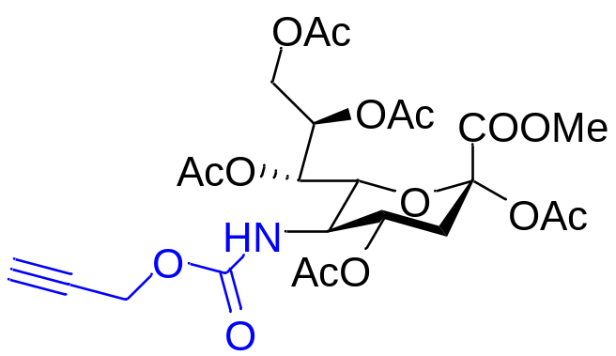


Metabolic labeling of sialic acids and sialoglycans
Cell membrane
Cell
Alkyne
Alkyne
Alkyne
GNE/NANS/NANP
CMAS/ST
Heise T., Büll C., Adema G.J., Boltje T.J. et.al. ACS. Chem. Biol. ASAP
= ManNac
= Sialic acid
= Protein

Slide 18
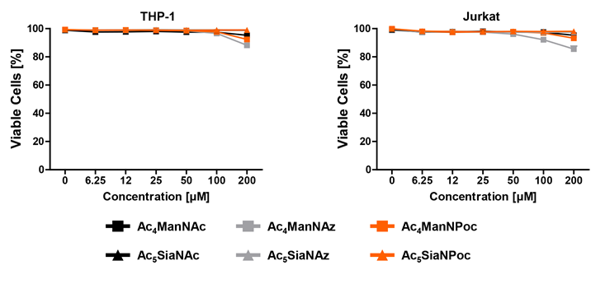
Sialic acid analogues are less toxic

Slide 19
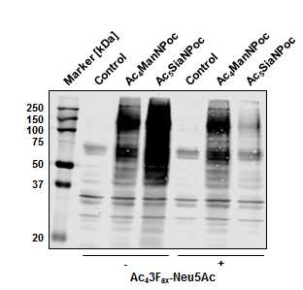
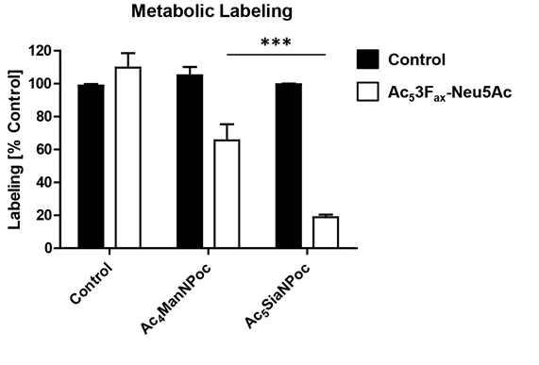
Sialic analogues are more specific

Slide 20
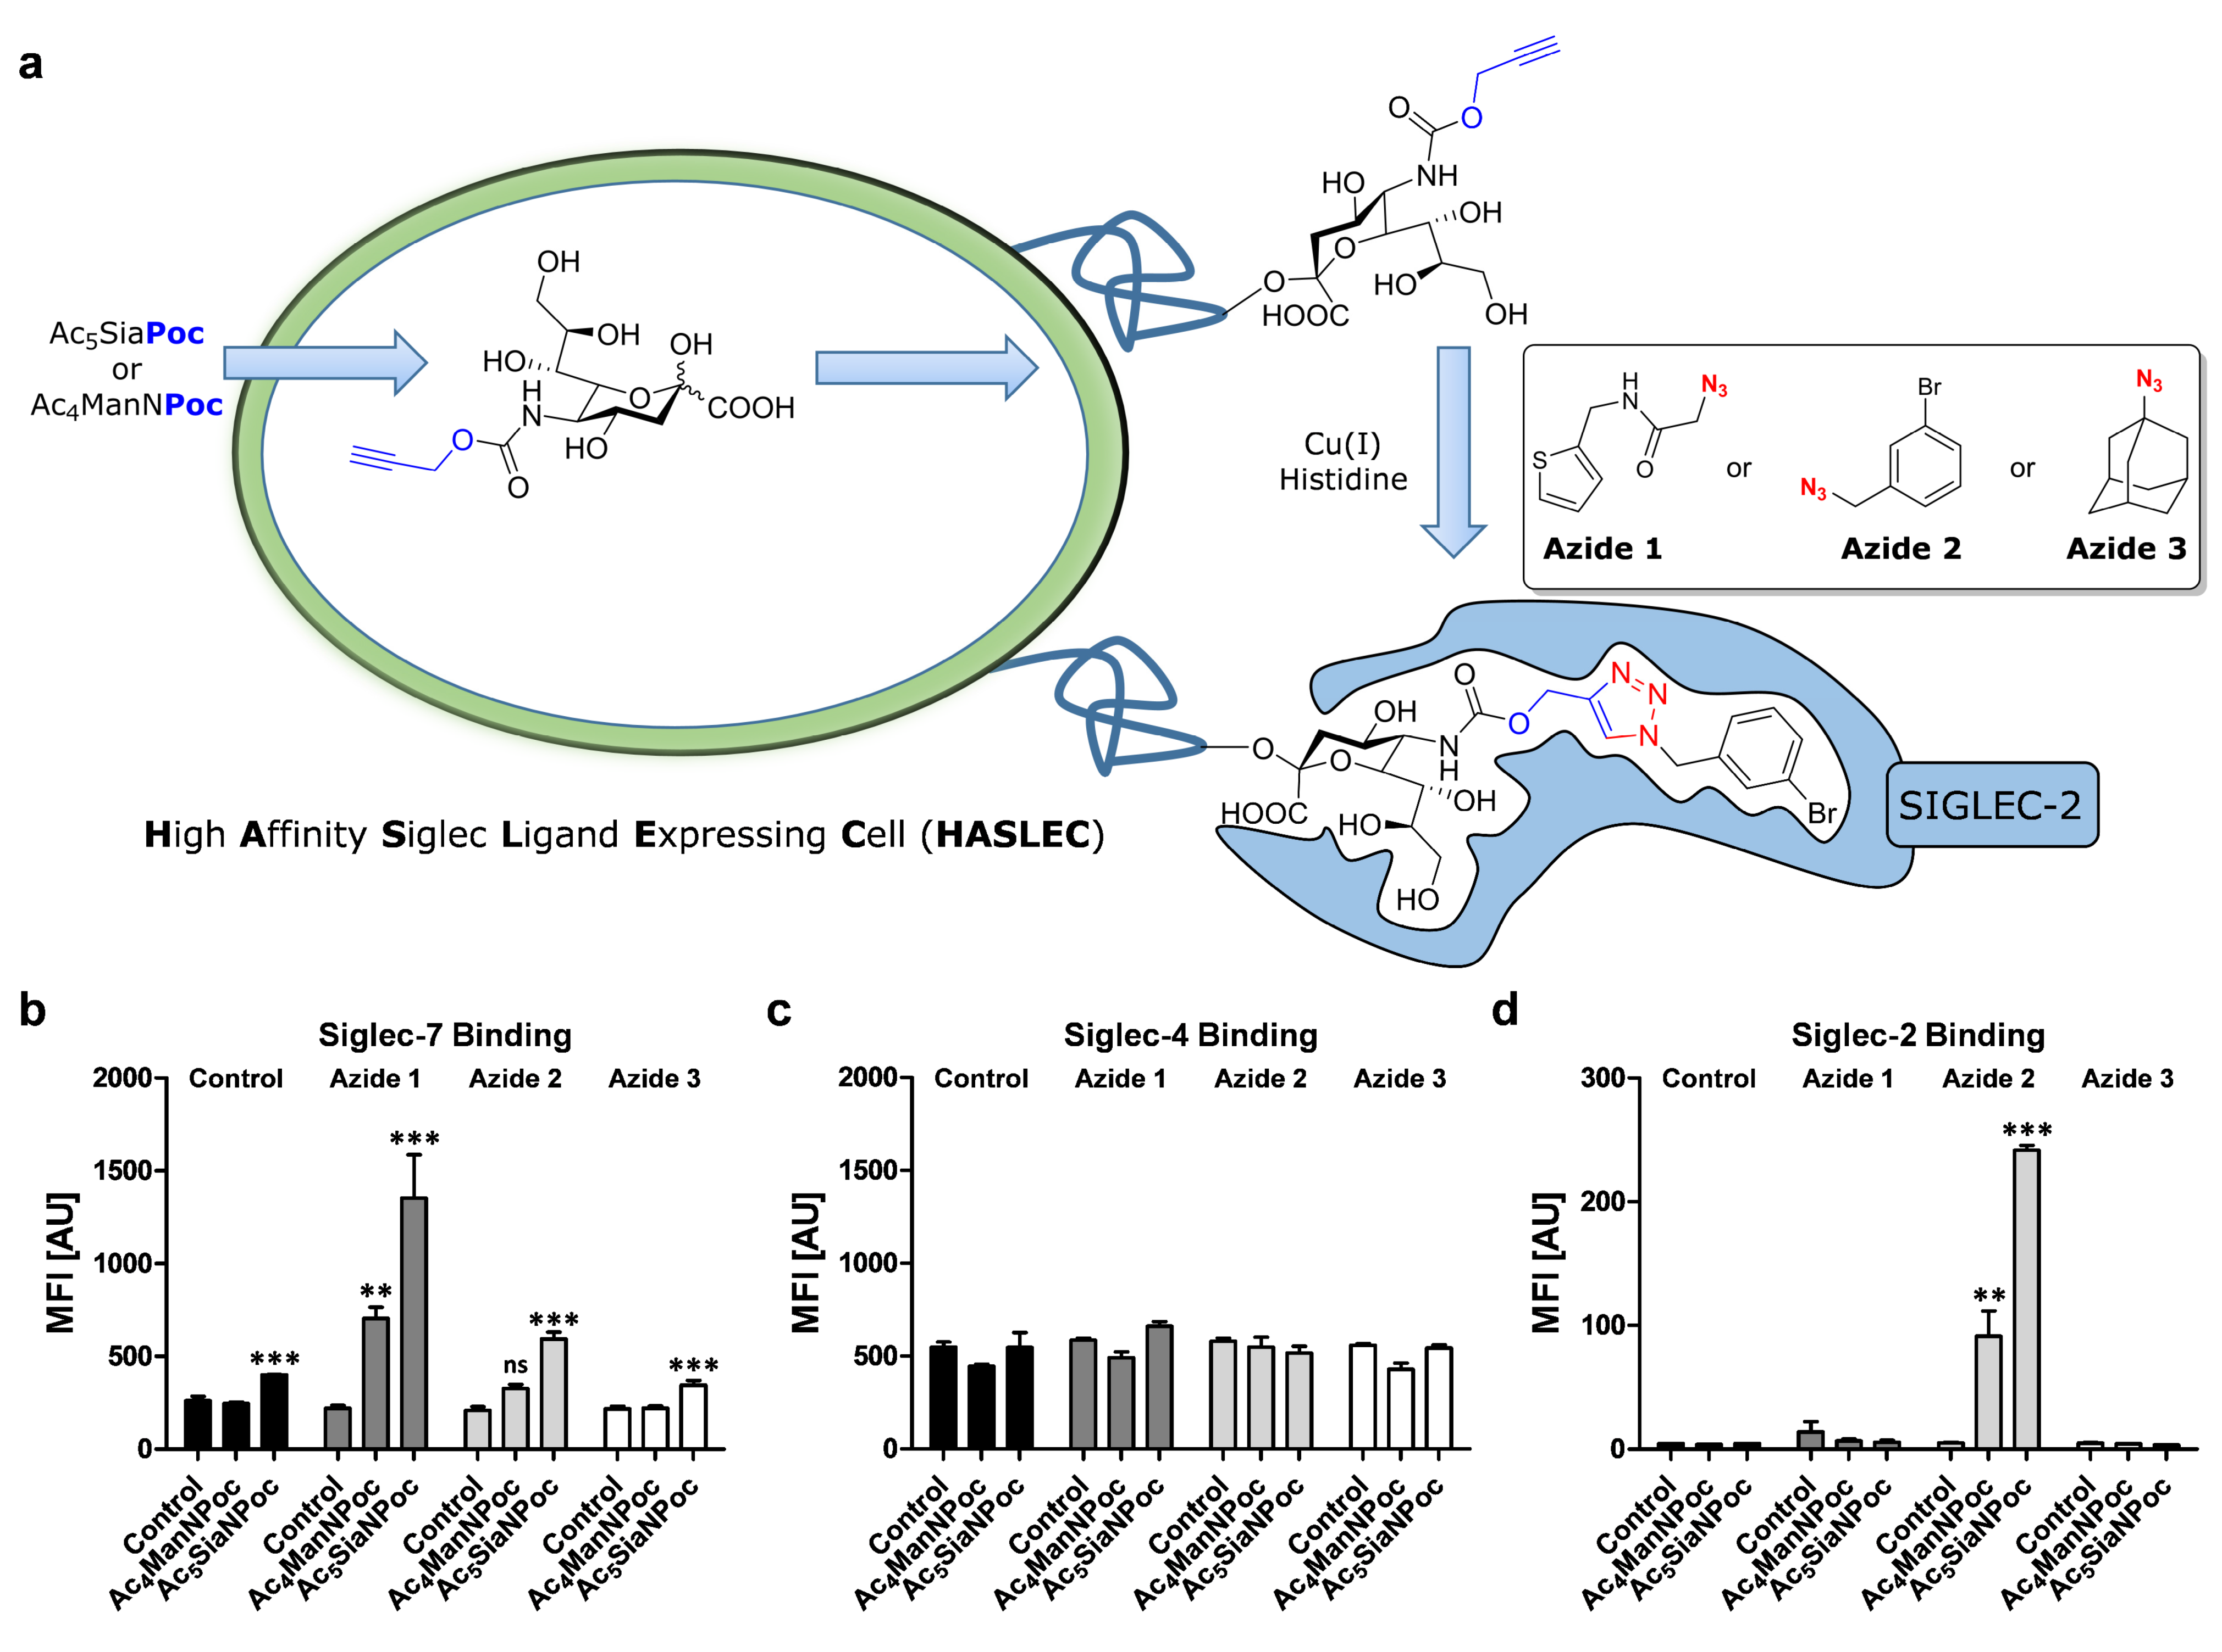
High Affinity Siglec Ligand Expressing Cells (HASLECs)
Heise T., Büll C., Adema G.J., Boltje T.J. et.al. ACS. Chem. Biol. ASAP

Slide 21

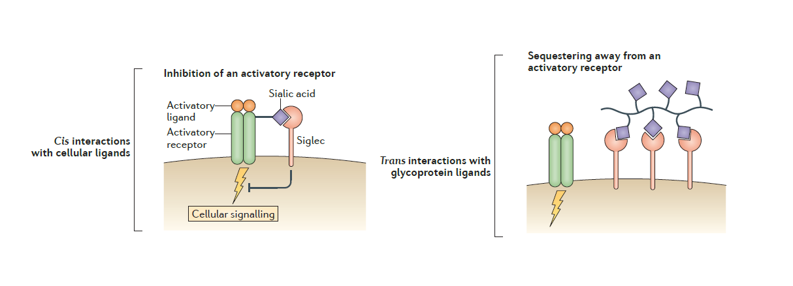
Future work, more design and screening
More screening
More ligands
Different positions on the sialic acid
Functional experiments
HASLEC/SIGLEC containing cell binding
Functional consequences of HASLEC binding: Immune activation/suppression
= Sialic acid
= High Affinity SIGLEC Ligand
HASLEC
Macauley M.S., Crocker P.R., Paulson J.C., Nat. Rev. Immunol. 2014, 14, 653-666
Hudak J.E., Canham S.M., Bertozzi C.R., Nat. Chem. Biol., 2014, 1, 69-75

Slide 22




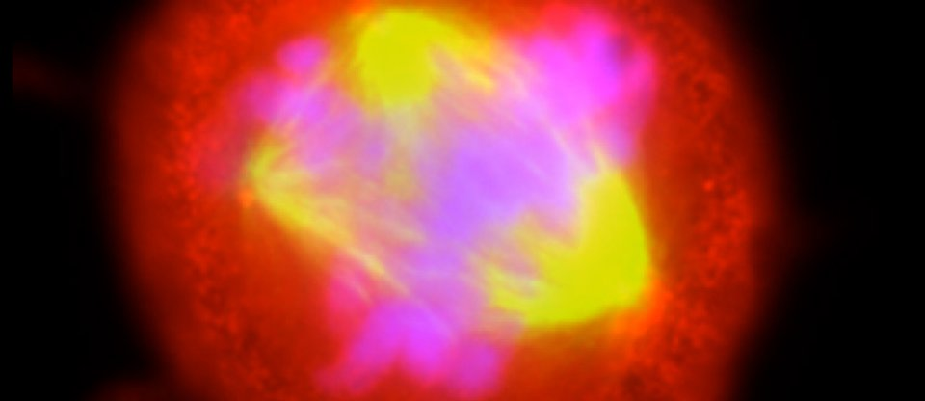
Acknowledgements
Synthetic organic chemistry
Torben Heise
Victor Bloemendal
Funding
Tumor Immunology
Prof. Gosse Adema
Christian Büll
Danielle Beurskens

