Slide 1
About OMICS Group
OMICS Group is an amalgamation of Open Access Publications and worldwide international science conferences and events. Established in the year 2007 with the sole aim of making the information on Sciences and technology ‘Open Access’, OMICS Group publishes 500 online open access scholarly journals in all aspects of Science, Engineering, Management and Technology journals. OMICS Group has been instrumental in taking the knowledge on Science & technology to the doorsteps of ordinary men and women. Research Scholars, Students, Libraries, Educational Institutions, Research centers and the industry are main stakeholders that benefitted greatly from this knowledge dissemination. OMICS Group also organizes 500 International conferences annually across the globe, where knowledge transfer takes place through debates, round table discussions, poster presentations, workshops, symposia and exhibitions.

Slide 2
OMICS International Conferences
OMICS International is a pioneer and leading science event organizer, which publishes around 500 open access journals and conducts over 500 Medical, Clinical, Engineering, Life Sciences, Pharma scientific conferences all over the globe annually with the support of more than 1000 scientific associations and 30,000 editorial board members and 3.5 million followers to its credit.
OMICS Group has organized 500 conferences, workshops and national symposiums across the major cities including San Francisco, Las Vegas, San Antonio, Omaha, Orlando, Raleigh, Santa Clara, Chicago, Philadelphia, Baltimore, United Kingdom, Valencia, Dubai, Beijing, Hyderabad, Bengaluru and Mumbai.

Slide 3

3D Breast liftING without a vertical scar
THOMAS HAFFNER M.D. board certified cosmetic surgeon ibcs/ Cambridge/ Uk
Cologne, Germany
Scientific Programm Day One - 22.June 2015

Slide 4
3D Breast lifting without a vertical scar
I present you now a new method of mastopexy, with wich fullness of the upper pole and the right projection of the nipple can be achieved, while the vertical scar is abandoned.
I show you first briefly, how conventional mastopexxies function and what are the principles of the new 3 D Mastopexy without a vertical scar.
Thomas Haffner M.D. Cologne, Germany www.aesthetic-carre.de

Slide 5
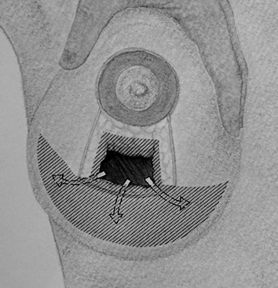
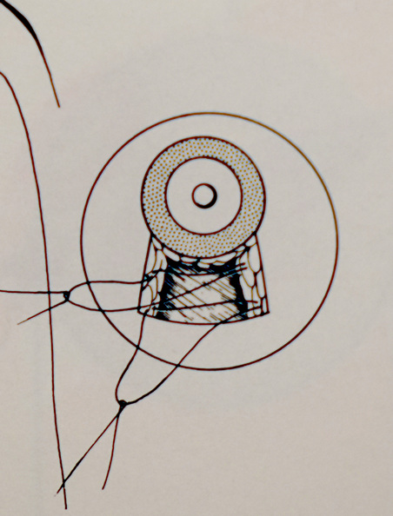
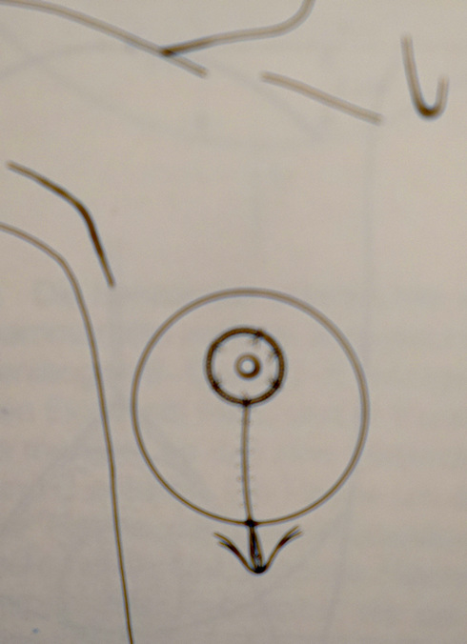
Principles of conventional mastopexies
1 2 3
1/ A conventional mastopexy involves the reducing or tightening the lower pole, which gives a support for the upper pole .
2/ The Nippel –Areola Complex (NAC) is shifted upwards and gets so better position in the middle of the breast.
3/ The End Support for the whole breast done by skin resection and skin tightening which results in an inverted T-scar or in a vertical scar.
Conclusions :
A/ The priciple of conventional mastopexy is supporting, pushing the lower pole
B/ The NAC must be shifted, pushed upwards separately and doesn´t moves with the breast itself
C/ The skin tightening by a vertical scar gives a very important ,elementary support for the whole breast and ensures the good breast shape with longevity of the results

Slide 6
There are doubts about a breast lift without a vertical scar
Reviews by plastic surgeons from around the web
„ 3d breast lift without vertical scar is not possible, It must be only an advertising“
„All breast lifts are performed in 3 dimensions“ (Prof.M. Noah, Germany)
Now here is my answer: All my collegaues have right !
New procedures need also advertising.
In fact all of us work in 3 dimensions and use vertical, T or periarolar scar -
but I show you now, why a better breast form exists using the new 3 d breast lifting without a vertical scar.
“The illusion of a breast lift can only be reliably achieved by resecting lower pole excess tissue and filling the upper pole with an implant.” ^{(E.Swanson, Kansas,USA)}
First I show you, that all of my patients understand the new method of mastopexy without a vertical scar and understand what does a proper 3D form mean >> AS FOLLOWS
Thomas Haffner M.D. Cologne, Germany www.aesthetic-carre.de

Slide 7
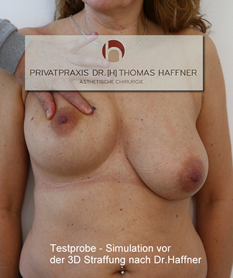
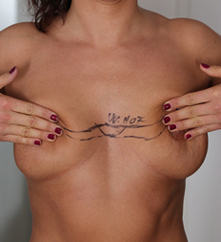
New Principles of the 3D breast lift without vertical scar
1/ The whole breast should be so repositioned and fixed as it showed here
2 / The whole breast get a real reposition and not only supported by a lower pole resection
3/ The NAC moves with the whole breast
4/ The patients understand, what the proper projection and 3D symmetry means and show their breasts in the new wished symmetrical position themselves
Thomas Haffner M.D. Cologne, Germany www.aesthetic-carre.de

Slide 8
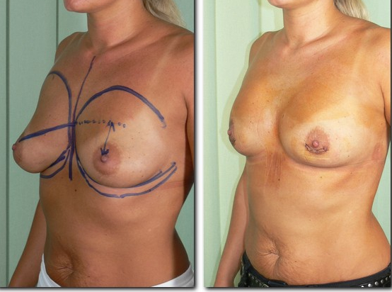
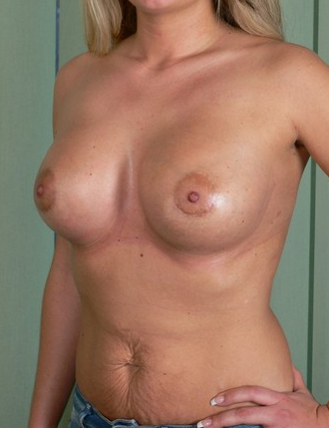
Case: small ptotic breasts + good skin:
3D Reposition Lift without a vertical scar possible
.)
Fact: If a ptotic breast will enlarged, than exists a larger ptotic breast
1/ To achieve a perfect 3D projection in „Miami style“ the ptotic breast should be repositioned and lifted first.
2/ You see the shortened breast, which hasn´t yet the proper projection
3/ In the seond stage we place an implant, whith which the proper 3D symmetry achieved
Implants are fully covered with 4 muscles – longevity of the results by „ own internal bra“
Thomas Haffner M.D. Cologne, Germany www.aesthetic-carre.de

Slide 9
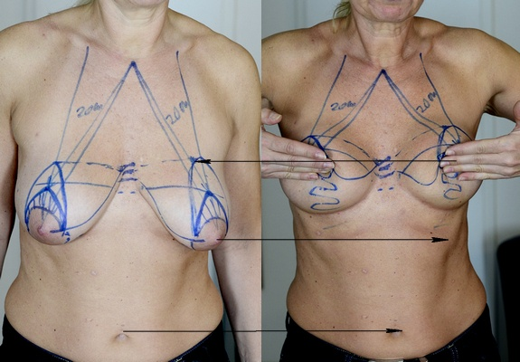
Case: Large ptotic breast with good skin: 3D Reposition-Lift without a vertical scar with implant possible
.)
Testing how we would elevate the breast with the nipple together about 10-12 cm upwards – an overcorrection is necessary
Thomas Haffner M.D. Cologne, Germany www.aesthetic-carre.de

Slide 10
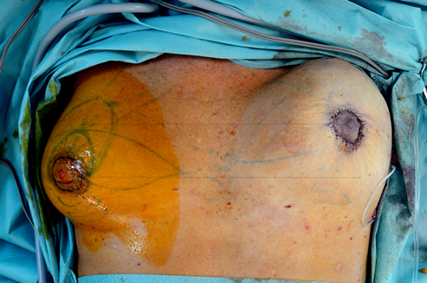
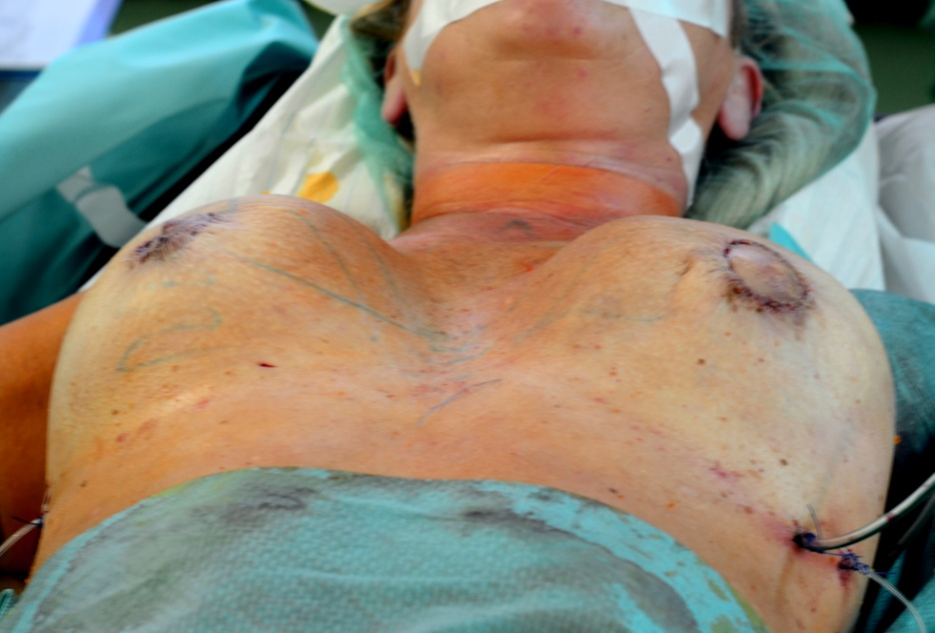
3D Reposition-Lifting Mastopexy without a vertical scar : the result on the table
.)
Note the extremely reposition, elevation of the whole breast on the left side without a vertical scar
At the and of the 3 D lift we performed an overcorrection, with maximal possible shifting of the whole breast upwards.
Thomas Haffner M.D. Cologne, Germany www.aesthetic-carre.de

Slide 11
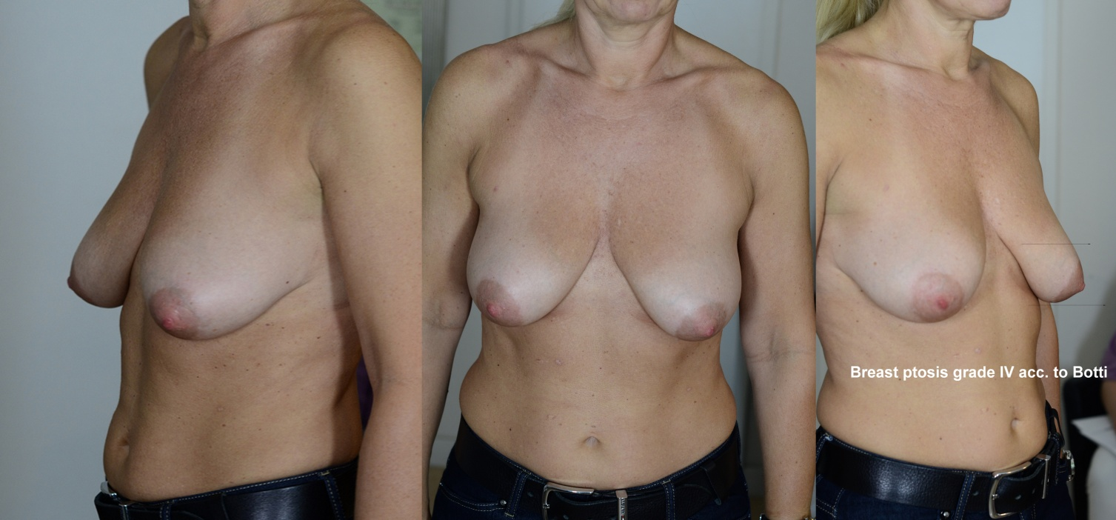
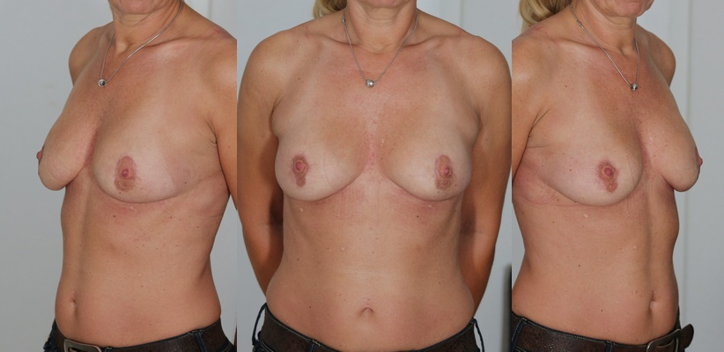
The case: 3D Reposition-Lifting Mastopexy - First step
Ptotic breasts grade 4 after Botti
Lifting, shortening, repositioning of the whole breast is with implant is possible, while she had an elastic skin
Now you see the repositioned and shortened breast without a vertical scar.
The breasts are smaller, therefore they are now suitable for a fully submuscular augmentation in the second stage. After the second stage we get than the proper 3D symmetry without vertical scar
Thomas Haffner M.D. Cologne, Germany www.aesthetic-carre.de
Notes:
The Result: Shortening of the whole breast makes us possible to achieve the projection performing the second stage by implanting a supporting device

Slide 12
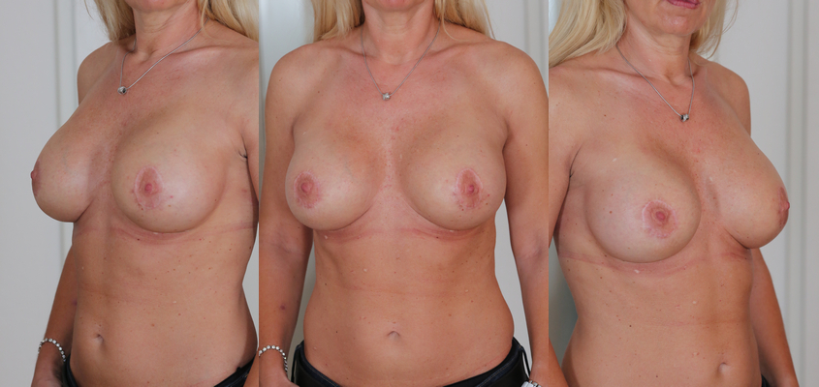
3D Reposition-Lifting: second step the Augmentation
The case: Ptosis grade 4
The result after the second session: 3D symmetry with natural upper pole fullness, which was achieved without a vertical scar.
Note the longevity of result by supporting internal muscular bra
( after 12 months here)
Thomas Haffner M.D. Cologne, Germany www.aesthetic-carre.de
Notes:
The Result: Shortening of the whole breast makes us possible to enlarge the breast with proper projection in the second stage

Slide 13
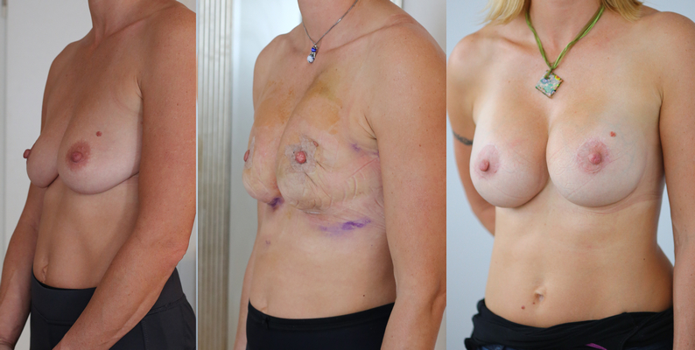
PAR + SKIN compact and elastic : vertical scar can be abandoned if implant used
1/ Ptotic breasts with parenchym atrophy but with an elastic skin can be brought in the proper 3 D symmetry only with additional augmentation in two sessions, as follows:
a, Reposition – lifting according to Haffner as presented here. The breast will repositioned and shortened, the whole breast with the NAC together elevated.
b, An augmentation fully submuscular as a supporting internal, muscular bra results the wished
proper projection and symmetry in all 3 dimensions
Thomas Haffner M.D. Cologne, Germany
Notes:
The Result: Shortening of the whole breast makes us possible to achieve the projection performing the second stage by implanting a supporting device

Slide 14
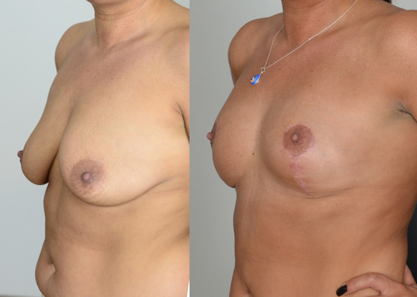
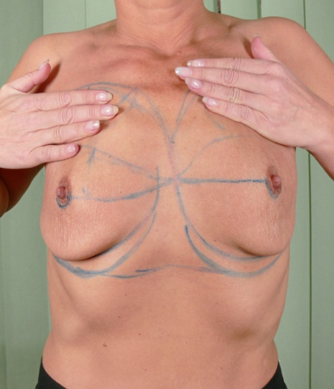
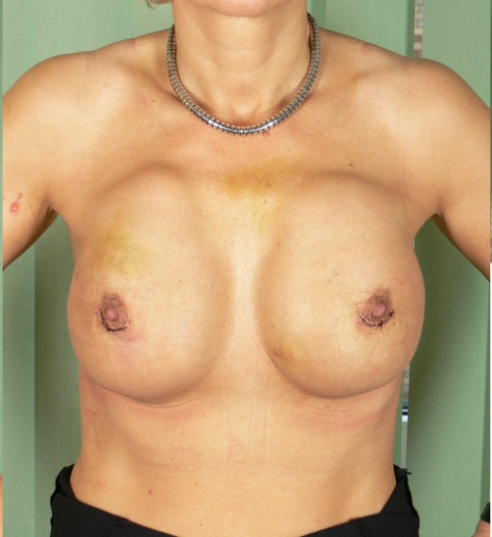
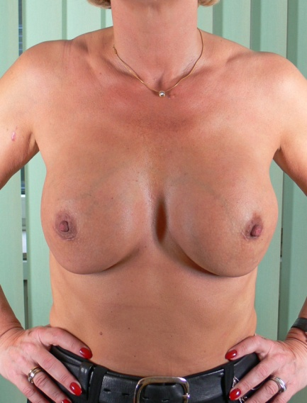

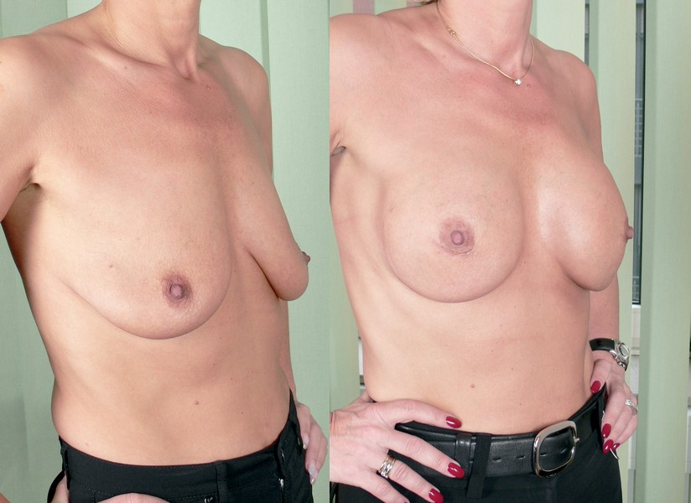
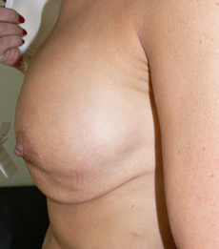
PAR + SKIN thin and atrophic : vertical scar necessary
1/ Ptotic breasts with parenchym atrophy and skin atrophy ( unelastic skin) can be sufficient corrected only by excising and tightening of the skin by means of a vertical or inverted T-scar.
2/ Because of parenchym atrophy a supporting submuscular augmentation also necessary
Notes:
The Result: Shortening of the whole breast makes us possible to achieve the projection performing the second stage by implanting a supporting device

Slide 15
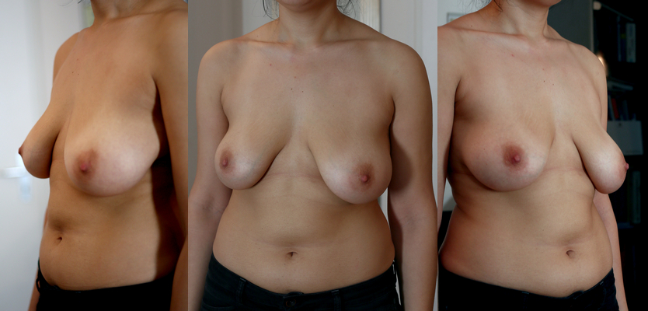
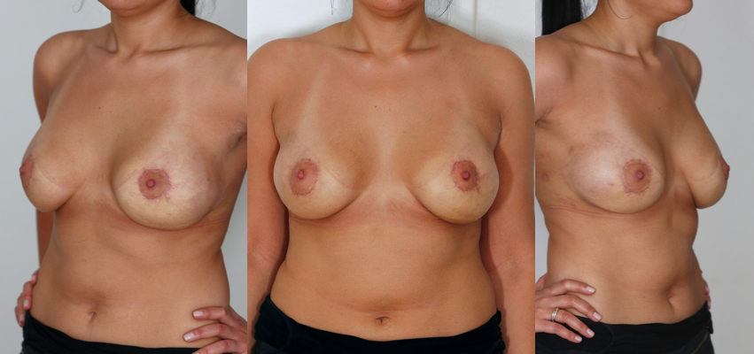
EXPERT LEVEL : 3D mastopexy without a vertical scar & without an implant by large ptotic breast
The case:
Breast ptosis > 4 cm
NAC Ptosis > 2-3 cm
Assymetrie
Flat thorax
After 3 D reposition – lifting mastopexy – 6 months
-Natural look, well shaped breast with pleasant projection, no breast ptosis
-NAC elevated about 4-5 cm
-Upper pole fullness
-Symmetry in all dimensions (3D)
Thomas Haffner M.D. Cologne, Germany
Notes:
The Result: Shortening of the whole breast makes us possible to achieve the projection performing the second stage by implanting a supporting device

Slide 16
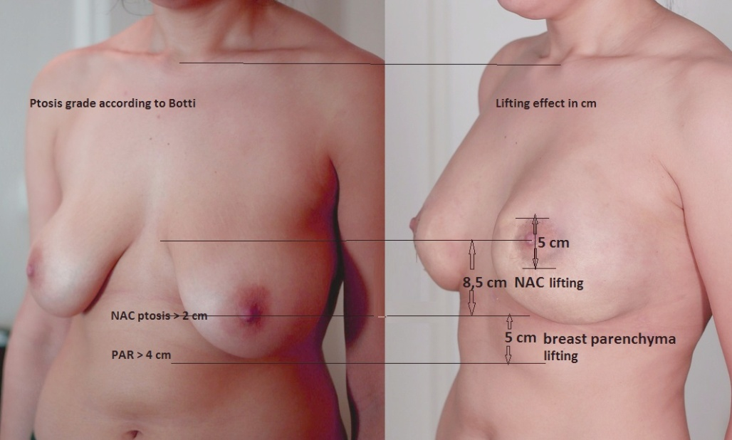
The changes by 3D mastopexy without a vertical scar and without an implant
1/ The Contour: Convex instead of concav
2/ The Form: Fullness instead of Flatness
3/ The Projection: round instead of flat
4/ Whole breast: repositioned instead of supported only
5/ Real NAC Elevation of about 8,5 cm
6/ PAR – Lower Pole Lift = 5 cm
7/ Total Breast Lift = 8,5+5= 13,5 cm
8/ Rounding and Symmetry in
sagittal + frontal +vertical levels :
3 D symmetry
Thomas Haffner M.D. Cologne, Germany
Notes:
The Result: Shortening of the whole breast makes us possible to achieve the projection performing the second stage by implanting a supporting device

Slide 17
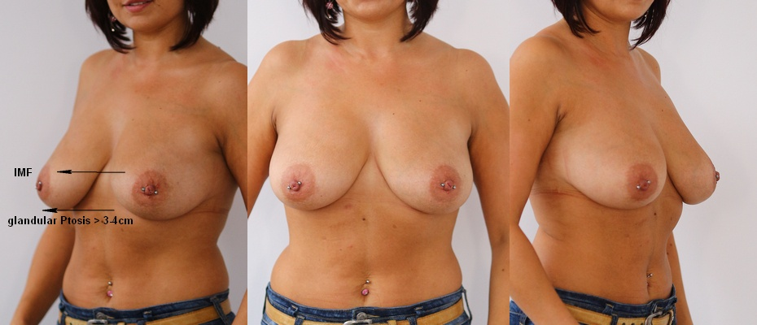
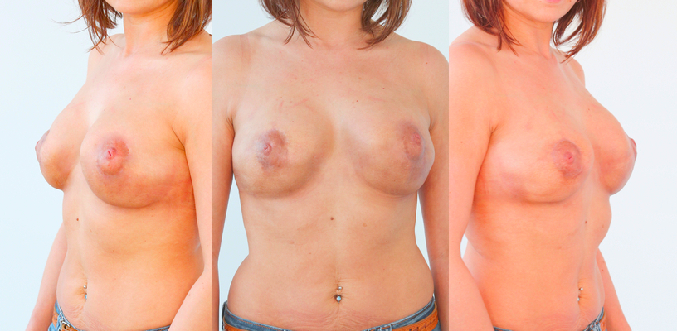
The case: 3D mastopexy without a vertical scar & without an implant by ptosis grade 4
The case:
Glandular ptosis > 3-4 cm
NAC Ptosis > 1-2 cm
Assymetrie
Flat contoures
After 6 months
-Natural look, well shaped round breast
No ptosis
-NAC elevated about 6-8 cm
-Upper pole fullness
-Symmetry in all dimensions (3D)
-Stability and longevity
Thomas Haffner M.D. Cologne, Germany
Notes:
The Result: Shortening of the whole breast makes us possible to achieve the projection performing the second stage by implanting a supporting device

Slide 18
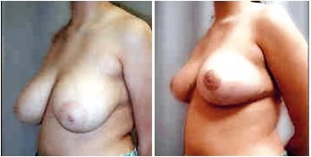
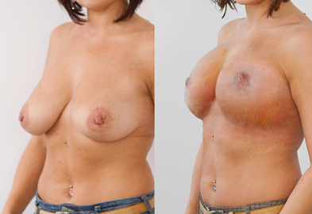
Comparing of the results of mastopexy with or without vertical scar
.)
1/ Average result after Lejour mastopexy:
- upper pole flatness
- ptosis keeps – IMF can´t be seen
2/ Result with the 3D Reposition-Lifting Mastopexy :
fully prominence of the upper pole
perfect symmetry in all 3 dimensions without a vertical scar.
Thomas Haffner M.D. Cologne, Germany www.aesthetic-carre.de

Slide 19
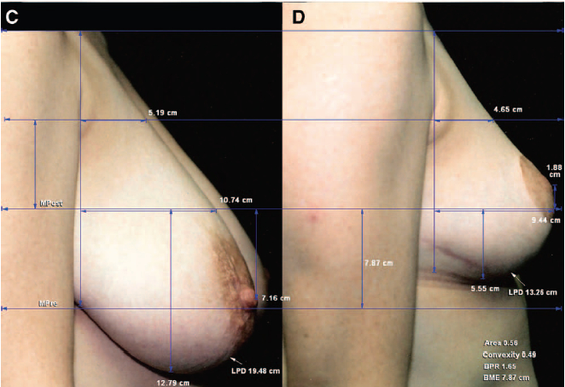
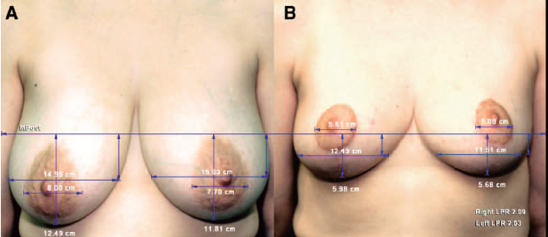
Results of mastopexies with vertical scar or inverted T-technique *
All patient groups demonstrated a significant elevation (P < 0.001) of the breast mound.
Vertical mastopexy, but not inverted-T mastopexy, increased breast projection and upper pole projection
The upper pole contour is linear before and after surgery *
The lower pole is slightly boxy by both conventional mastopexies...
Breast implants boosted breast projection and upper pole projection regardless of technique
* According to Eric Swanson: Comparison of Vertical and Inverted-T Mammaplasties Using Photographic Measurements Plastic Surgery 2008: 77th Annual Scientific Meeting of the American Society of Plastic Surgeons, October 31 to November 5, 2008, Chicago, Ill.)
Thomas Haffner M.D. Cologne, Germany www.aesthetic-carre.de

Slide 20
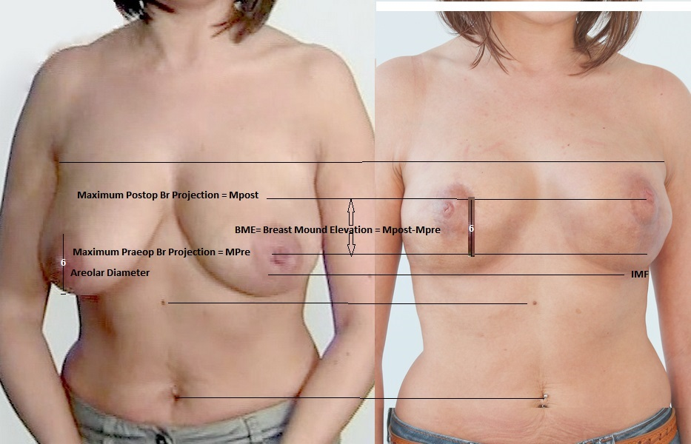
Results 3d mastopexy without a vertical scar
1/ The whole breast is so repositioned and lifted, that no ptosis exist, the IMF is visible again
2/ A breast mound is elevated with the breast together
– here about 6 cm
Thomas Haffner M.D. Cologne, Germany
Notes:
The Result: Shortening of the whole breast makes us possible to achieve the projection performing the second stage by implanting a supporting device

Slide 21
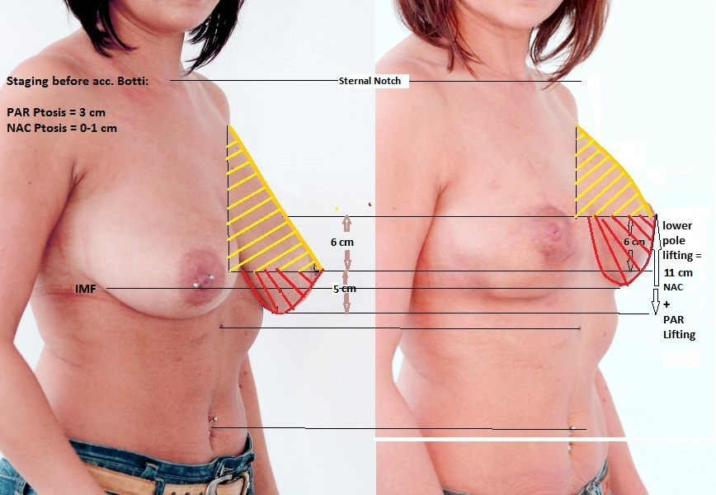
What kind of changes have been made by the 3 D a mastopexy without a vertical scar?
2/ The upper and lower pol have a new, round contour
3/Amount of the lifting of the whole breast =
NAC + PAR Lifting = 11 cm
Thomas Haffner M.D. Cologne, Germany
Notes:
The Result: Shortening of the whole breast makes us possible to achieve the projection performing the second stage by implanting a supporting device

Slide 22
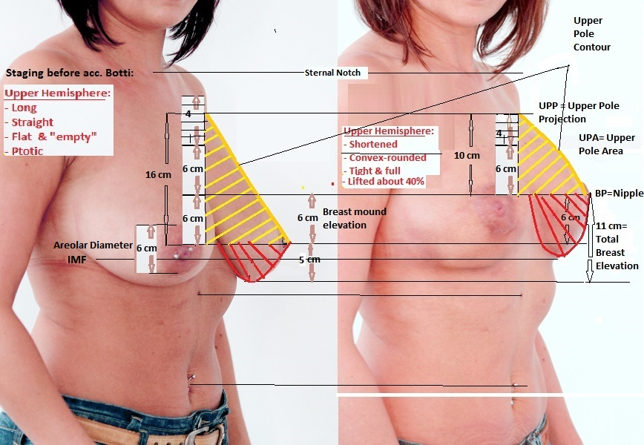
What kind of changes have been made ?
1/ Breast mound elevation : 6 cm
2/ Changing of the upper and
lower pol contour
3/NAC + PAR Lifting = 11 cm
4/The upper pole – and the whole breast - is shortened about 40 %
5/ The shortened, compressed and lifted breast is now suitable for an volumen restoration by means of an supporting, fully submuscular placed implant
- if an implant would be necessary or wished -
Thomas Haffner M.D. Cologne, Germany
Notes:
The Result: Shortening of the whole breast makes us possible to achieve the projection performing the second stage by implanting a supporting device

Slide 23
Summary : 3d Mastopexy without a vertical scar
Ptotic breasts with elastic skin can be lifted and can have a proper 3 D symmetry without a vertical scar using the new reposition-lifting mastopexy
Requirements
a, The Skin : Elastic, not too worn out: in case of too much skin excess and inelastic skin an excision with vertical or T-scar is a better option
c, The Gland and Connective Tissue : should be a bit compact, rather firm.
Fat and lost tissues can´t be anchored.
b, The Volume : „ empty“ breasts need also an implant, to get the proper projection.
But a vertical scar because of moderate volume loss is not necessary.
Thomas Haffner M.D. Cologne, Germany
Notes:
The Result: Shortening of the whole breast makes us possible to achieve the projection performing the second stage by implanting a supporting device

Slide 24
You have seen the first presentation about Haffner´s
3D Reposition-Lifting without a vertical scar
Thank you for your attention !!
Your many questions can be answered by mail :
praxishaffner@gmail.com
Thomas Haffner M.D. Cologne, Germany www.aesthetic-carre.de

Slide 25
Let us meet again..
We welcome you all to our future conferences of OMICS International
5th International Conference and Expo
on
Cosmetology, Trichology & Aesthetic Practices
On
April 25-27, 2016 at Dubai, UAE
http://cosmetology-trichology.conferenceseries.com/

