Slide 2
Waste To Energy Using Anaerobic Digestion
Earth & Science Climate Change
3rd International Conference
July 28-30, 2014
Thomas Sonnleitner
Vice Chancellor for Administrative Services
University of Wisconsin Oshkosh

Slide 3
“The trouble with our time
is that the future
is not what it used to be.”
Paul Valerey (1871 – 1945)

Slide 4
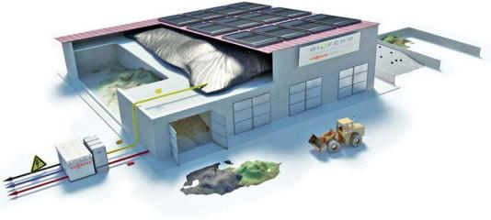
University & Colleges

Slide 5
Representing Sustainability on
Higher Education Campuses
Universities and colleges are, and must continue to be, national leaders in the sustainability and renewable energy movements.
  Waste-to-energy technology offers two sustainability solutions to campuses: organic waste diversion and renewable energy.

Slide 6
University of Wisconsin–Oshkosh
University goal:
Increase the use of energy from renewable sources.

Slide 7
University of Wisconsin–Oshkosh
Background
3rd largest UW school
Founded in 1871
14,000 Students
74 associate, baccalaureate, master's and doctoral degree programs
In October 2012, UW Oshkosh has hosted for the 11th consecutive year one of the world’s largest Earth Charter Community Summits
1st Fair Trade University in United States
Charter Member of Higher Education ACORE Committee

Slide 8
University of Wisconsin–Oshkosh
Sustainability History
President’s Climate Commitment
Carbon footprint inventories
Sustainability councils/directors
Student advocacy groups and research
Environmental studies curriculum
Wind purchases
Performance contracts around energy efficiency
Statewide lighting retrofits

Slide 9
University of Wisconsin–Oshkosh
Sustainability Initiatives
1st university in WI to sign the President’s Climate Commitment and pledge to attain carbon neutrality
Taken and continues to take great steps towards this goal:
  Carbon Footprint Inventory
  Study and implementation of several renewable energy projects (solar, geothermal, biogas) to reduce campus dependence on coal-fueled power

Slide 10
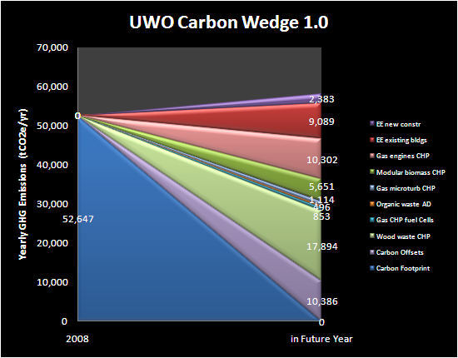
University of Wisconsin–Oshkosh
Developing a Plan
Develop a Structure
Crate a Baseline
Develop a Plan
Progress Reports
Emissions today & forecast into future
Inventory management plan & tools update, track and audit
Strategies for dealing with supply side & demand side for energy

Slide 11
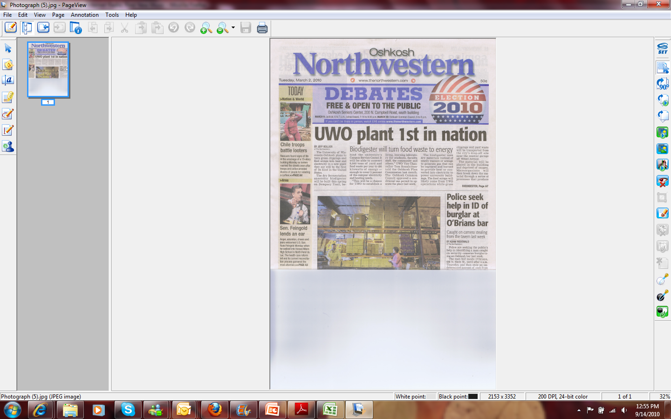
University of Wisconsin–Oshkosh
Case Study: Biodigester 1

Slide 12
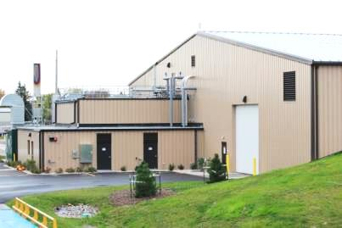
University of Wisconsin–Oshkosh
Case Study: Biodigester 1
Dry Digester
  1st commercial scale dry fermenter in nation
  Processes 8,000 tons of food waste and yard waste annually
  from UWO and the community
  Produces 370 kW of continuous electrical power OR 495 kW of continuous thermal energy
    Private/public collaboration
  between the UWO Foundation,
  BIOFerm™ Energy Systems,
  City of Oshkosh and WPS

Slide 13
University of Wisconsin–Oshkosh
Case Study: Rosendale
Wet digester
  Largest dairy farm in WI
    9,600 cows
  Helps solve environmental issues
  Construction began June 3rd, 2013
  Partnership with Milk Source Dairy
  Partnership with Infinity Lawn and Garden
  Partnership with Alliant Energy

Slide 14
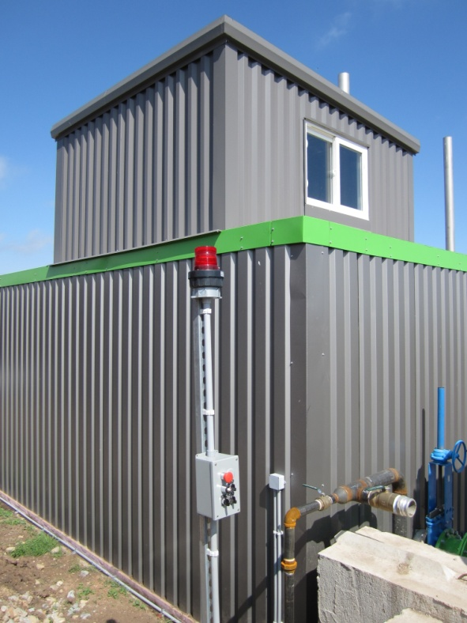
University of Wisconsin–Oshkosh
Case Study: Allen Farms
Small scale, plug-and-play digester
  1st small scale digester installation
  Designed for limited waste steam
  Processes up to 2,000 tons of cattle manure and bedding from 135 cows
  Produces 64 kW continuous electrical power OR 101 kW of continuous thermal energy

Slide 15
University of Wisconsin–Oshkosh
Digesters and Campus Sustainability
Reduces organic waste input to landfills
Produces renewable energy
Creates residual processing economies
Increases focus on sustainability education/curriculum
First commercial scale dry fermentation system in the nation!
Creates unique private/public partnership

Slide 16
University of Wisconsin–Oshkosh
Funding the Project
Write a business plan based on real data
  Business partner
  Financing institution
  A blueprint for operations
  Find a business partner to provide financing and will in turn benefit from the project
  UW Oshkosh Foundation

Slide 17
University of Wisconsin–Oshkosh
The Business Plan
Writing was a journey of discovery
  Resources, consultations, creating a model
The plan
  Resources, consultations
  Marketing
  Operations
  Financials/Cash Flow Projection
  Concluding Statement

Slide 18
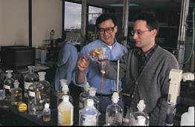
University of Wisconsin–Oshkosh
Identifying a Project for Your Campus
Every campus is different:
Understand sustainability efforts/benefits
Explore the viable options
Identify best options
Build support
Find partners
Write the business plan
Secure funding
Build it!

Slide 19
“The pessimist complains
about the wind.
The optimist expects
it to change.
And the realist
adjusts the sails.”
William Arthur Ward (1921 – 1994)

Slide 20
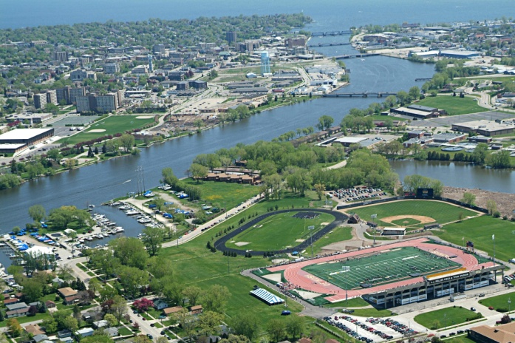
Reasons to Consider Food
Waste Diversion?
  An estimated 25% of fresh water usage in U.S. is used on food that is never eaten. – Food Waste Reduction Alliance
“Americans throw away enough food every day to feed 200 million adults” – Mongabay.com
Our country wastes enough food to fill the 90,000 seat Rose Bowl every day. – Alternet.org

Slide 21

Turning Food Waste from a Burden to a Benefit
Renewable Energy at UW Oshkosh
Notes:
ADD BIOFERM LOGO = UWO LOGO SIZE

Slide 22
UW Oshkosh
Commitments
Earth Charter (signed in 2002)
  Principles
    Primary: Respect and Care for the Community of Life
  Supporting
    (Safeguard) Ecological Integrity
    (Promote) Social and Economic Justice
    (Advance) Democracy, Nonviolence and Peace

Slide 23
UW Oshkosh
Leading by Example:
American College & University Presidents Climate Commitment
  Attain climate neutrality by mid-century or sooner
  Steps to climate neutrality involve:
    Use reductions through:
      Efficiency (performance contracts, green building)
      Behavior change
    Renewable energy credits (~20%)
    Onsite renewable energy (solar = 3% electric)
    Carbon offsets

Slide 24
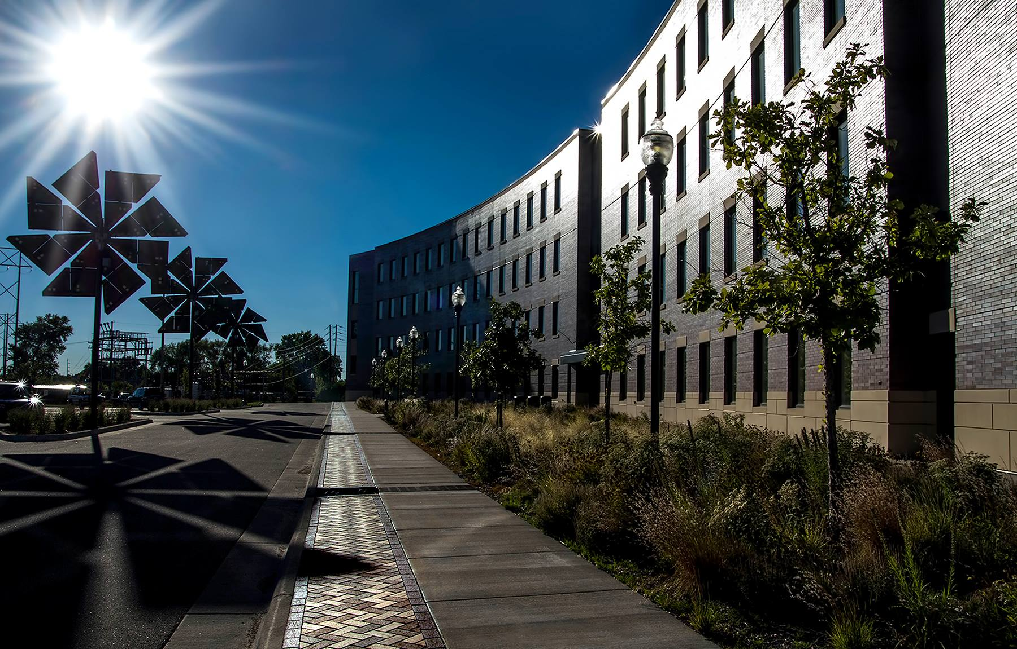
Leadership in
Energy & Environmental Design (LEED)
(At UWO: 3 certified, 1 in review, several in planning)

Slide 25
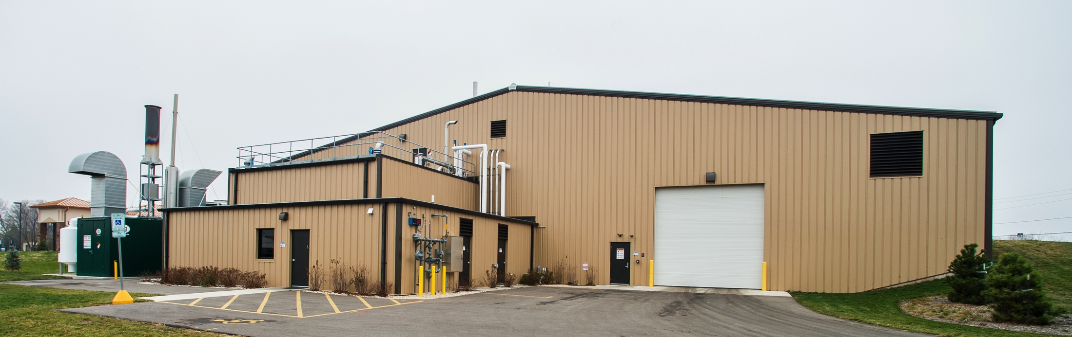
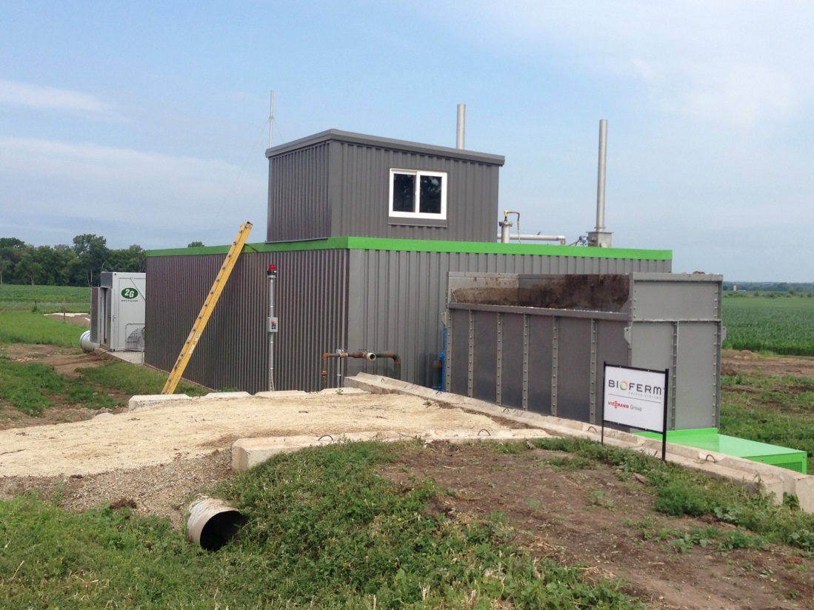
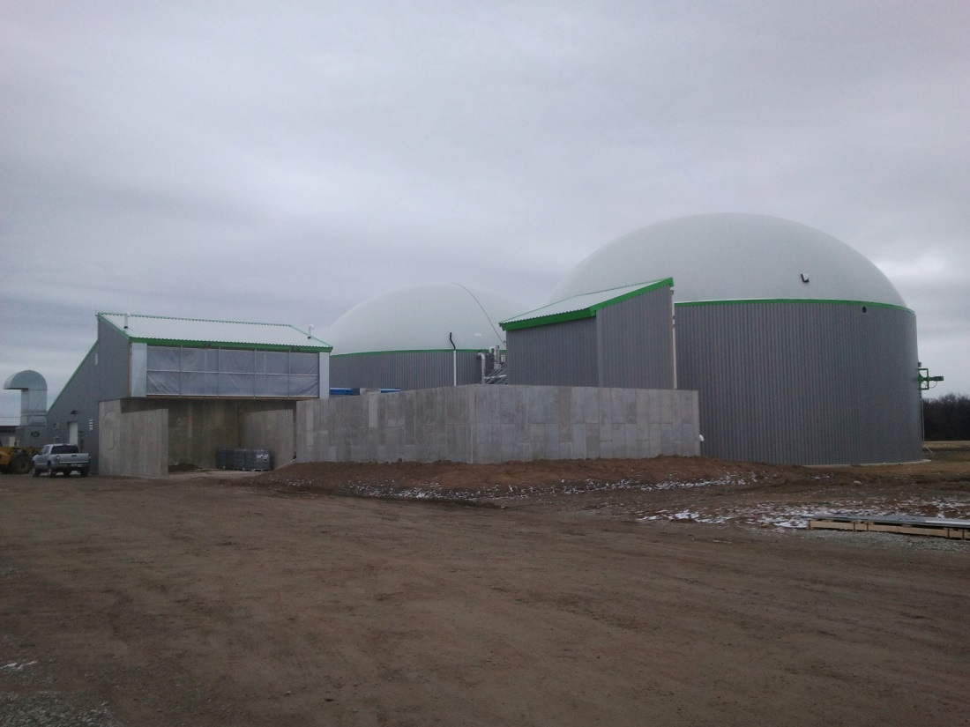
UW Oshkosh Biogas Systems
City – Dry Fermentation
Small Farm – Plug Flow
Large Farm – Complete Mix
Notes:
Ground Breaking – September 2010
Construction Completed July 2011
Commissioning started in August 2011
CHP started October 2011

Slide 26
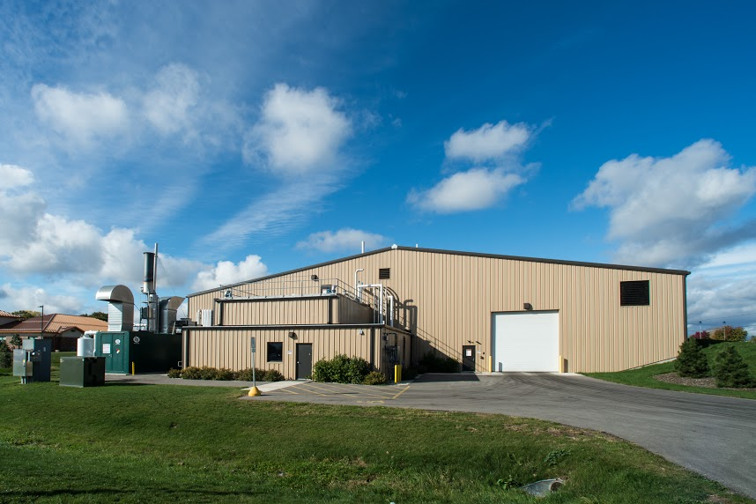
BD1: The First Commercial Scale Dry Fermentation System in the Nation!

Slide 27
University of Wisconsin–Oshkosh
Case Study: Biodigester 1
Dry Digester
  Processes 10,000 tons of food waste and yard waste from the community
  Produces 370 kW of continuous electrical power
  Waste water treatment plant collaboration
  Private/public collaboration

Slide 28
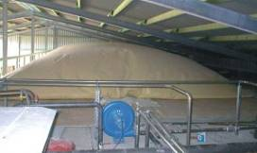
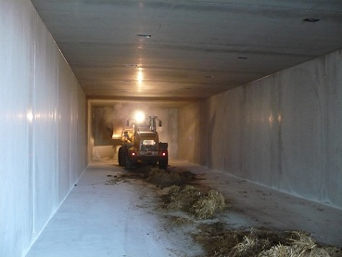
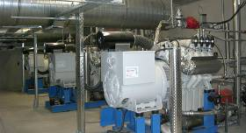
Dry System: 3 Basic Components
GAS STORAGE
GAS
GAS
SEALED CHAMBER
GENERATOR

Slide 29
Electricity and Heat are
generated…
GAS STORAGE
GAS
ELECTRICITY
GAS
GENERATOR
PERCO-
LATE
HEAT
BIOMASS
HEAT
HEAT
Solid “digestate” → aerobic composter site
(can be custom batched – e.g. organic)

Slide 30
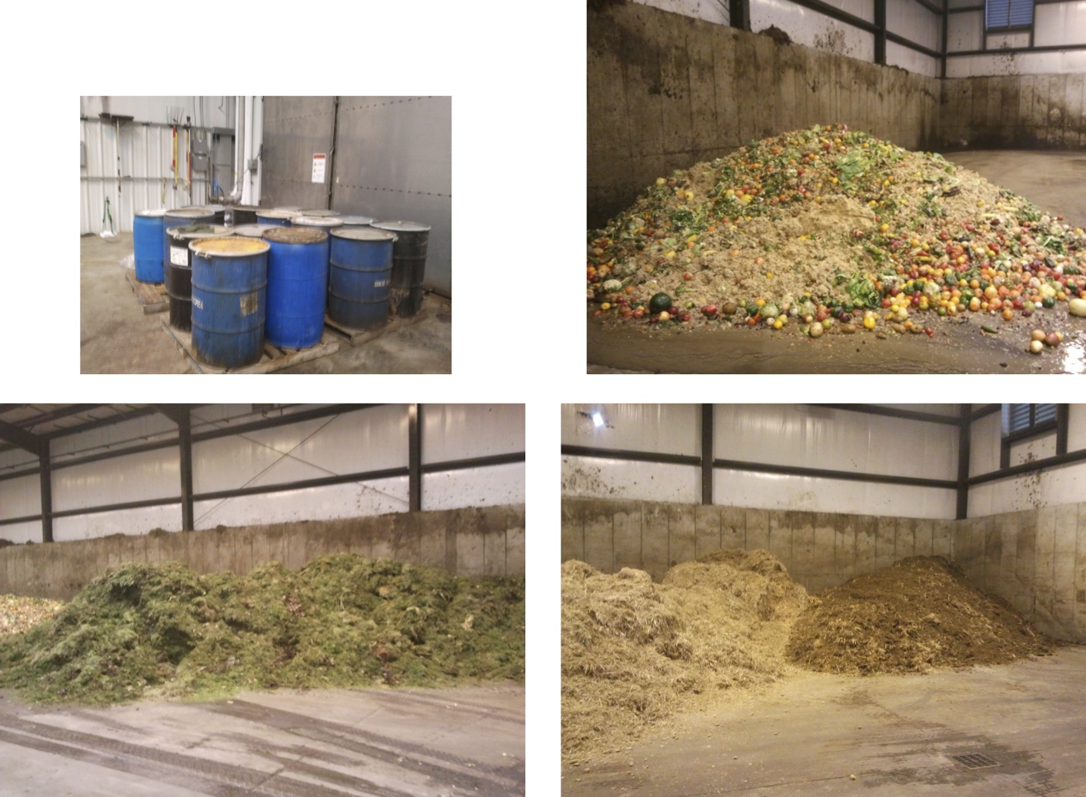
Feedstocks
Notes:
Each week receive betwenn 150 – 200 tons of fresh organics

Slide 31
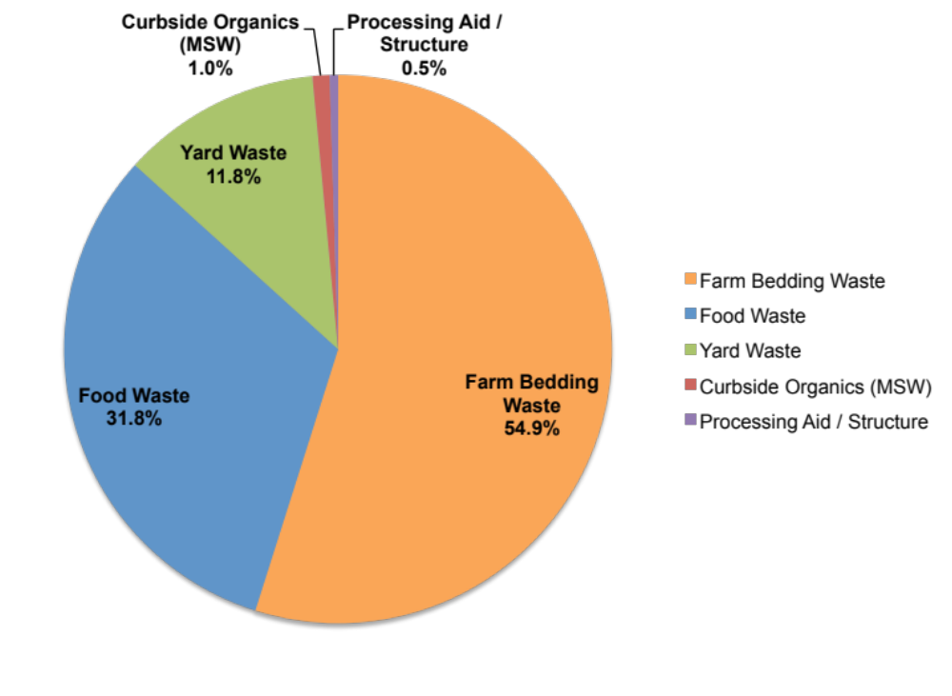
BD1 – Average Feedstock Totals
Annual Organic Material Processed = 10,000 tons per year

Slide 32
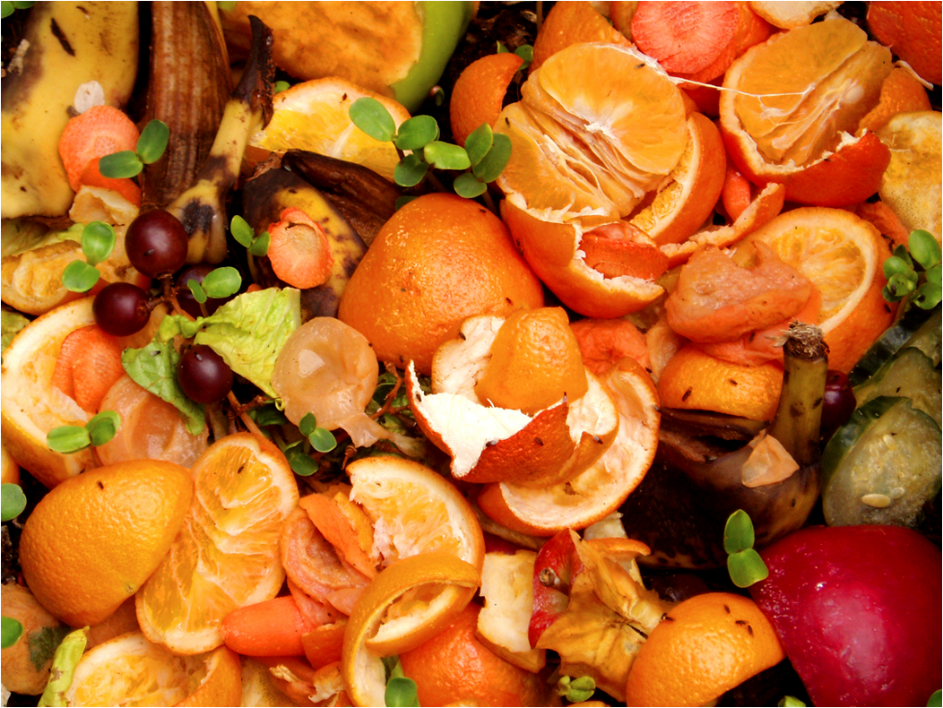
Why Reduce Waste?
Paying to send food waste to the landfill is…… a waste!
  Environmentally sound practice
    Methane is 75-100x more potent as a GHG than CO₂ over 20 years
  Cost
    Potentially cost neutral
  Resource Opportunity
    Use in generating renewable energy and heat
    Creates education and PR opportunities
    Extends landfill life-cycle

Slide 33
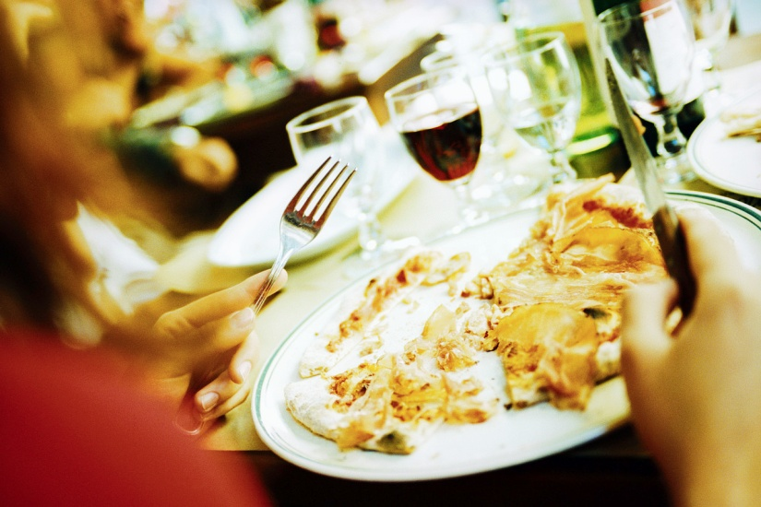
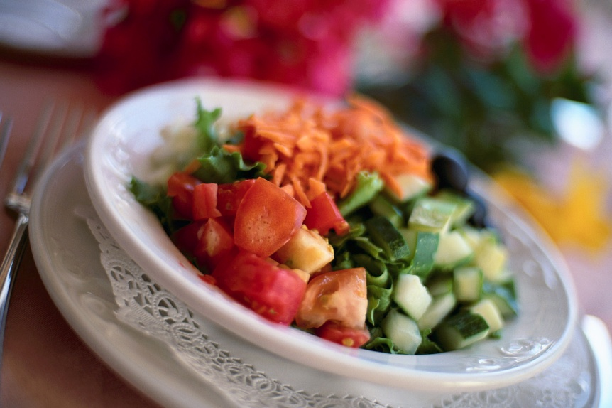
Food waste: what is useable for food stock
MAY CONTAIN:
Leftover food, coffee grounds & tea bags
Lightweight paper products (paper napkins, paper straw wrappers, etc.)
Pizza boxes & other corrugated cardboard
Limited Plastic must be BPI certified to be compostable
MAY NOT CONTAIN:
X – Excessive grease or bone waste
X – Uncooked meat
X – Paper with wax coating
X – Plastic not BPI certified to be compostable

Slide 34
What makes Successful Food
Diversion projects?
Successful projects have:
Leadership & team buy-in
Site specific plan
Site champion(s)
Training & follow-up review of site collections
Simple & consistent collection system to minimize contamination

Slide 35
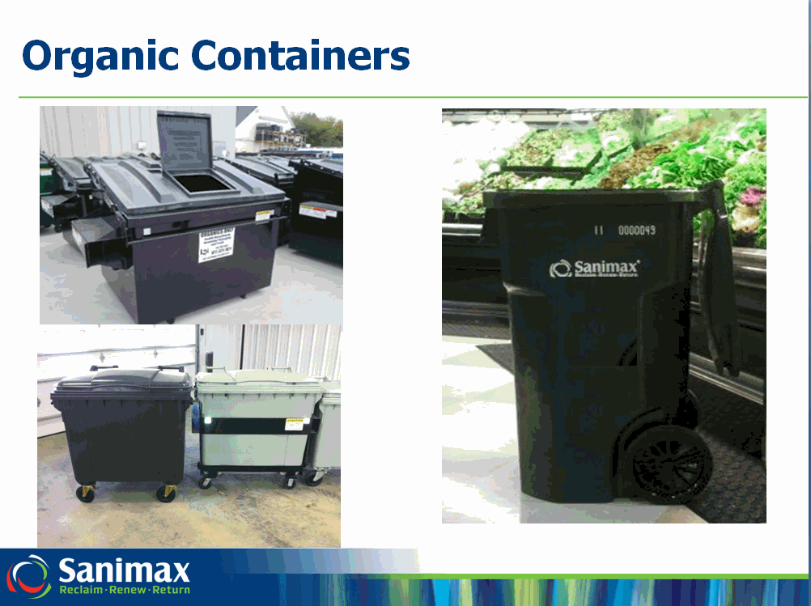

Slide 36
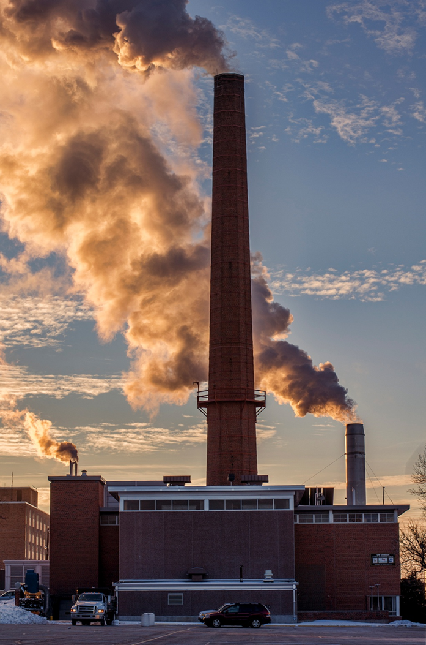
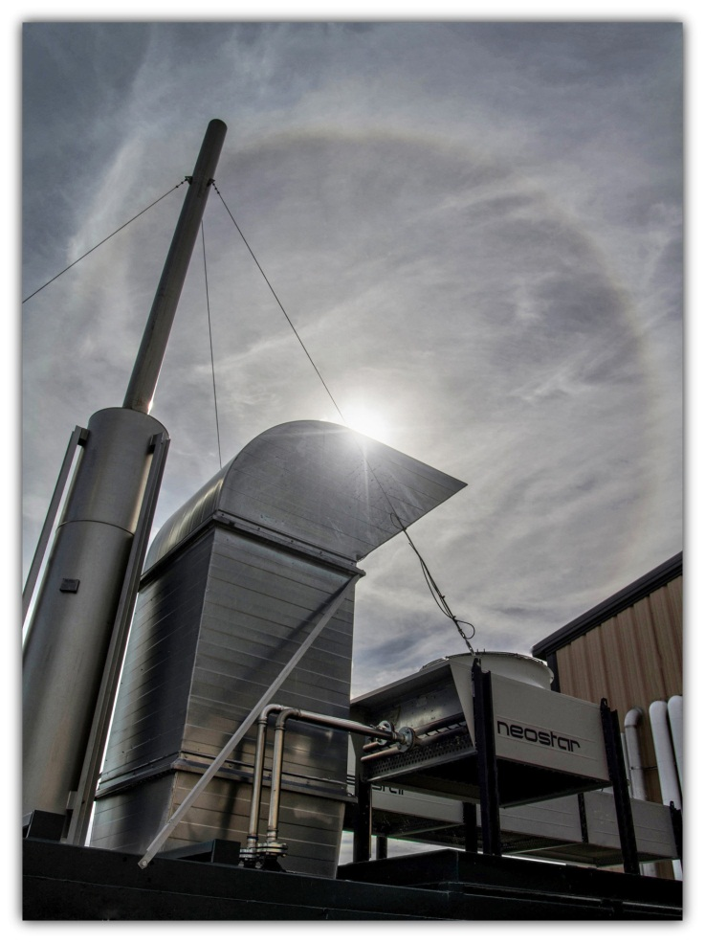
Fossil Fuels or Renewable Energy?
Be part of the transition!

Slide 37
Next Steps
Accurate Site Assessment
  Tonnage
  Current Infrastructure
  Current hauling costs/contracts
Cost Benefit Analysis
  Financial

Slide 38
Area Participants
UW Oshkosh
Walmart
Rocky knoll-Plymouth Nursing home
Piggly Wiggly-Lomira
St Agnes Hospital-Fondulac
Ripon Medical Center
Waupan Memorial Hospital
Xavier High School-Appleton
Secura Insurance Company-Appleton
Humana Insurance Company-Depere
Festival Foods-Neenah
Festival Foods-Oshkosh
Wisconsin Resource Center-Winnebago
UWGB
Schreiber Cheese-Green Bay
Bellin Memorial Hospital
Piggly Wiggly – Beaver Dam
Etc..

Slide 39
Oshkosh Area School District
Opportunities
Proximity to BD1 & UW Oshkosh
Pre-Consumer – two kitchens
Post-Consumer – similar meal waste for H.S.
OASD by the #s
# days # meals # meals/yr
5500 meals -district wide 180 5500 990,000
1430 meals - at high schools 180 1430 257,400
32lbs/student, 1200 h.s.students-38,400 lbs waste/year 19.2 Tons/yr
32lbs/student, 4300 district students-137,600 lbs waste/year 68.8 Tons/yr

Slide 40
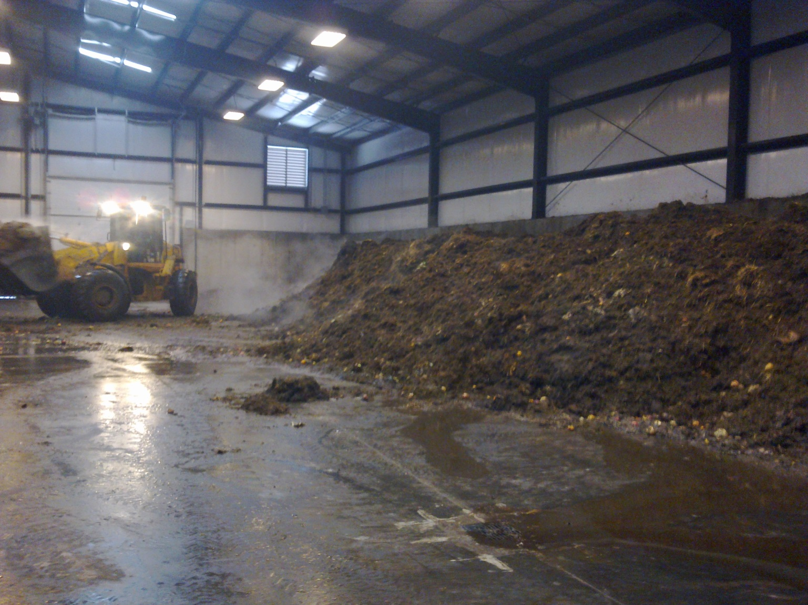
Mix Feedstock with Digestate
Notes:
Add better picture of fresh and final digestate mixed together and loader mixing

Slide 41
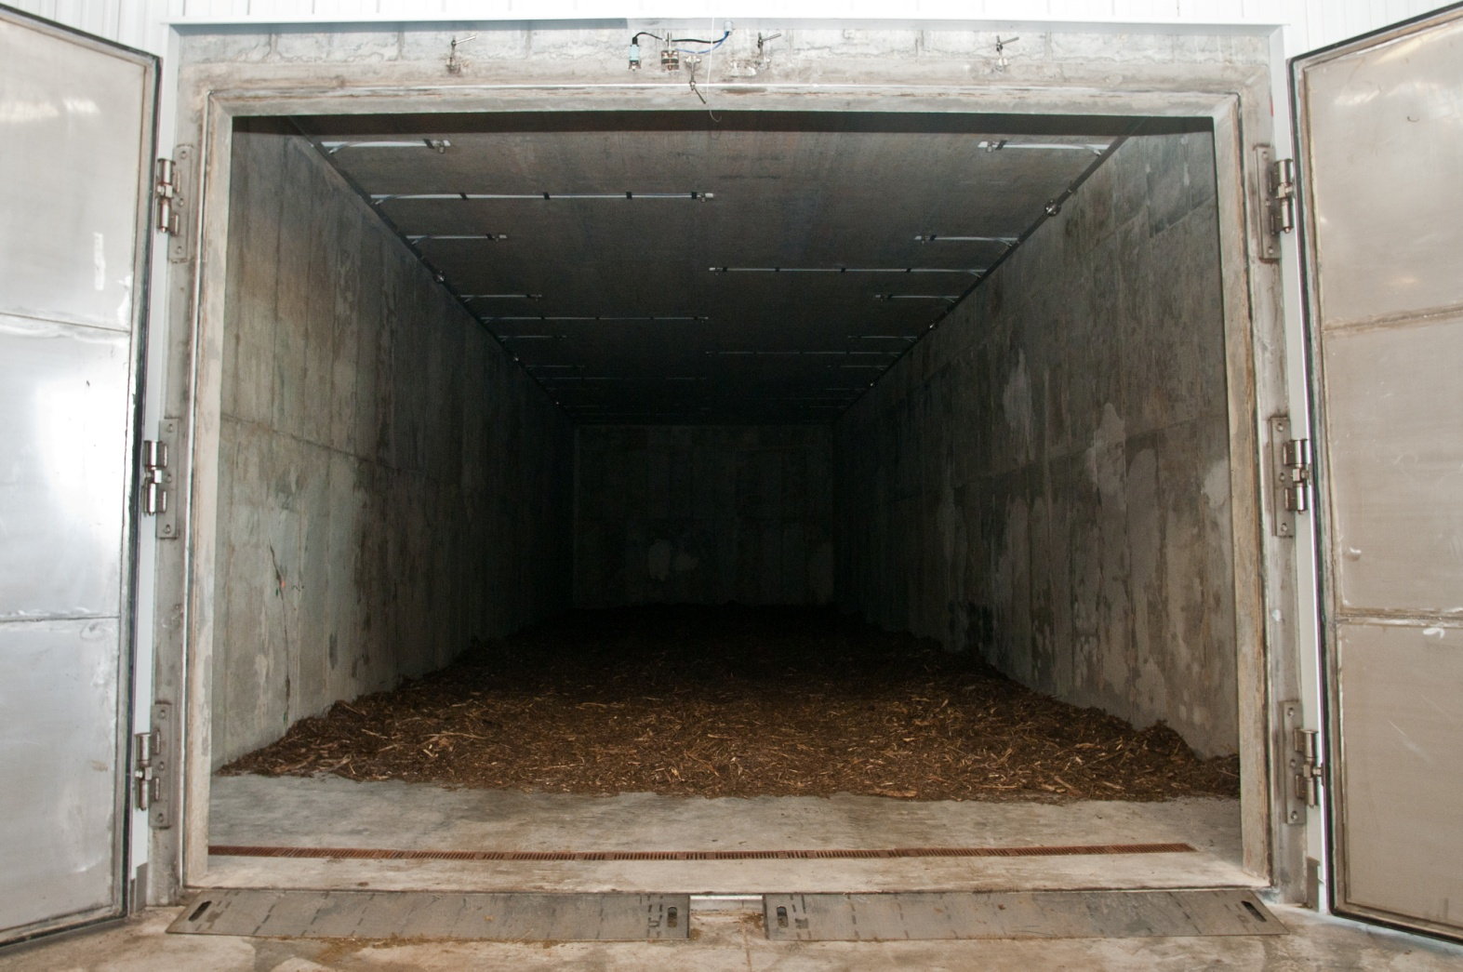
Clean Fermenter Prior to Loading
Notes:
Initially lined floor with wood chips

Slide 42
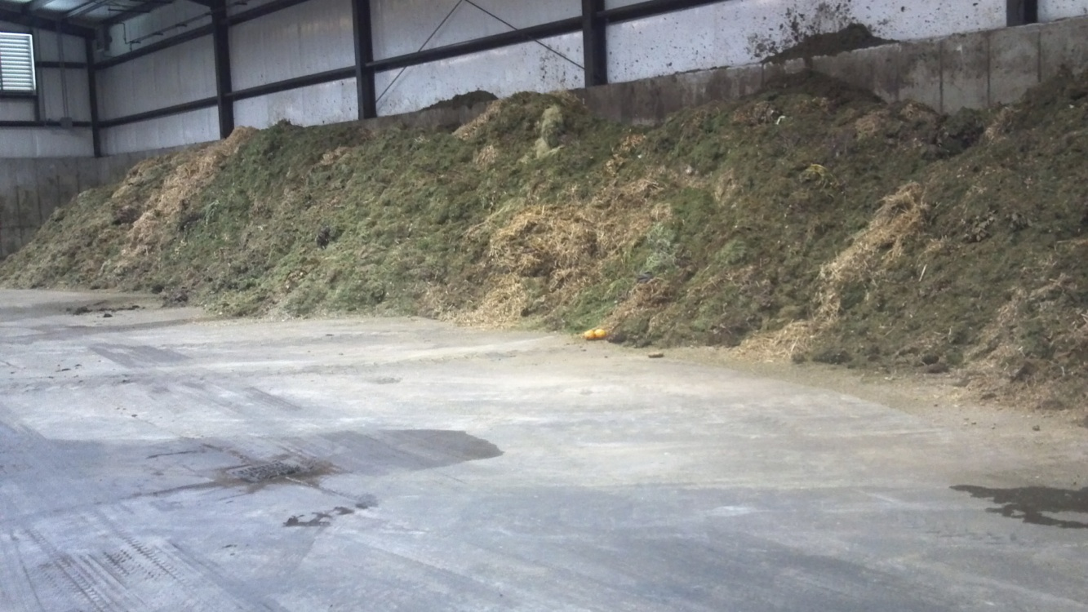
Mixed Feedstock

Slide 43
UW Oshkosh Biogas Systems
City – Dry Fermentation
Small Farm – Plug Flow
Large Farm – Complete Mix
Notes:
Ground Breaking – September 2010
Construction Completed July 2011
Commissioning started in August 2011
CHP started October 2011

Slide 44
Facility Type
 | BD1 | BD2 | BD3
Location | City of Oshkosh | Rosendale Dairy | Allen Farm
Size/animal type | NA | 9000 Cattle Dairy Farm | 130 Cattle Dairy Farm
Feedstock | Manure – 45% Food Waste - 39% Yard Waste – 15% Curbside MSW – 1% | Manure | Solid Manure – 56% Wash Water – 24% Bedding – 13% Co-Substrates – 7%
Pre treatment | Mixing via Front-End Loader | Sand Separation | Mixing via Front-End Loader

Slide 45
Digester System
 | BD1 | BD2 | BD3
Technology | BioFerm - Dry | Schmack - COCCUS | Schmack - EUCOlino
System Type | Dry | Complete Mix | Plug Flow
Target Temp | Mesophilic | Mesophilic | Mesophilic
Target Internal Solids Content | 25 – 35% | 8 – 12% | 10 – 15%
Target HRT | 28 days | 28 days | 21 - 28 days
Tons per Year | 10,000 | 110,000 | 4,000

Slide 46
Biogas Use / Digestate Management
 | BD1 | BD2 | BD3
CHP Size | 370 kW | 1426 kW | 64 kW
Electric Use | Export – PPA (WPS) | Export – PPA (Alliant) | Export – PPA (WPS)
Revenue Blended Rate ($/kWh) | $0.08 | $0.09 | $0.08
Digestate End Use | Composted | Current – Separated Fiber Future – Further processing | Sent to Manure Pit
Digestate Value | Top Soil | Current – Farm Use Future – Bagged Fertilizer | Fertilizer – Farm Use

Slide 47
Why AD for UW-Oshkosh?
Sustainability Goals
Education
Research
Revenue
Scholarships
Organic Diversion
Partnerships

Slide 48
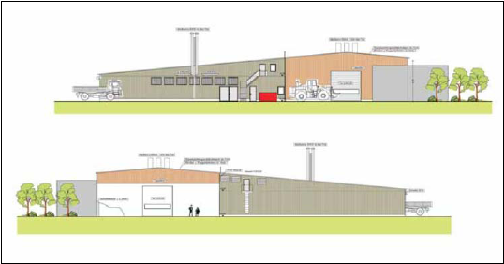
Questions!

