Slide 1
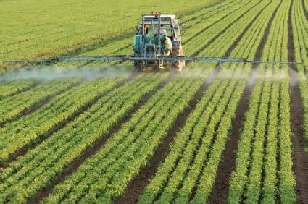
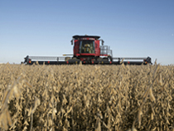
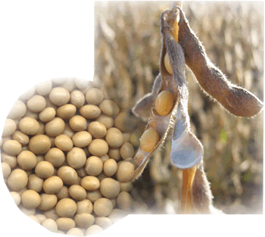
Contamination of soy for food and feed by intended use of herbicides: The case of Roundup Ready GM soy
Thomas Bøhn PhD
Research Professor
GenØk Centre for Biosafety, Tromsø, Norway

Slide 2
Genetically modified organisms (GMOs)
Open use (agriculture)
Contained use (medical)
GM plants
Maize Soybean Cotton Canola
(Major food/feed products globally)
GM traits
Insect resistance
(Bt-toxins)
Herbicide resistance
(Roundup)
~ 85 %
Resistance Evolution
Notes:
GM crops 170 mill hectare
Resistance evolution
increased use of toxins (dose/applications/stacking of traits)
more important to test in practice
Resistance evolution and gene ecology – THEORY
GM Plants and pesticides – REAL LIFE PRODUCTS AS FOOD AND RESIDUES – HEALTH RELEVANT

Slide 3
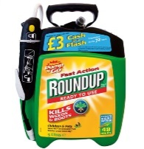
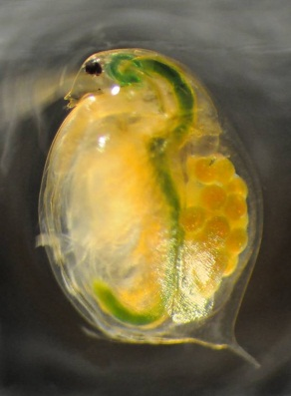
Work done with the Daphnia model, part I
Roundup and glyphosate
  “The environmentally friendly herbicide”
  “Practically non-toxic”
Daphnia magna
Glyphosate in feed (mg/kg)

Slide 4
Acute Toxicity of glyphosate on
Daphnia magna
1000
930 mg/litre
LC₅₀ 48 hour
500
100
10
Early Monsanto
studies for EPA
(McAllister and Forbis 1978)
Notes:
Sjekk skriv fra Marek – historikk i gly tox

Slide 5
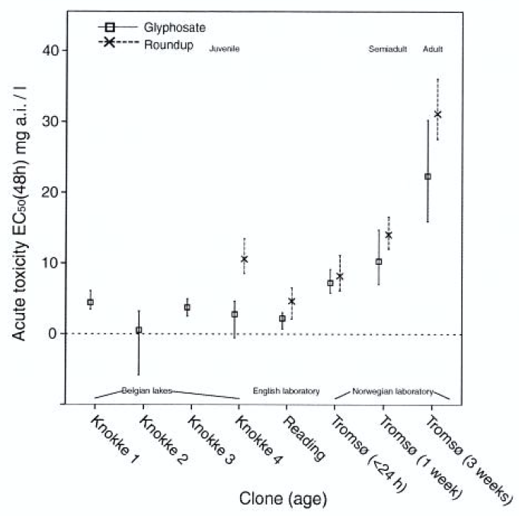
Acute toxicity revised
Glyphosate ~200X more toxic
From Cuhra et al. 2013 Ecotoxicology

Slide 6
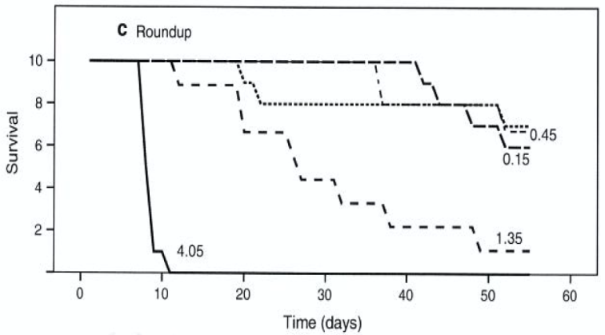

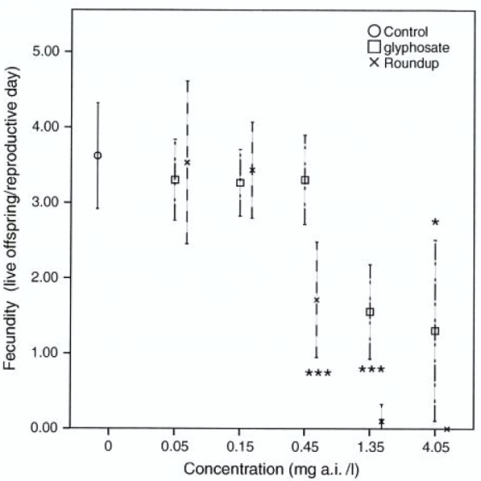
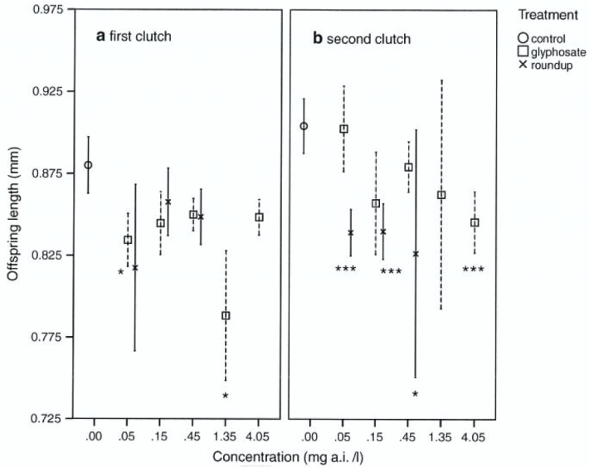
Chronic toxicity
Survival – 1.35 mg/l
Significant effects below environmental concentrations accepted in the US (0.7 mg/l)
Fecundity
0.45 mg/l
Juv body size
0.05 mg/l
From Cuhra et al. 2013 Ecotoxicology

Slide 7

Work done with the Daphnia model, part II
“Roundup Ready”, Herbicide Tolerant GM soy
Glyphosate in feed (mg/kg)

Slide 8
The global number 1 GM trait and plant
RR GM soy is dominating world soy production (81 %)
Sprayed with Roundup/glyphosate herbicides in the growing season
Notes:
Let us have a look at the most important plant and trait for GM plants: RR GM soy and Roundup herbicide

Slide 9
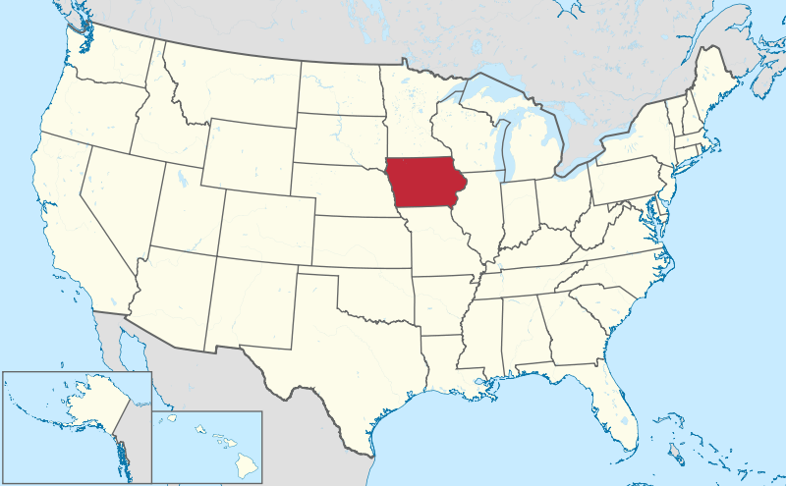
Soy material for testing
Iowa farmers
(n=31)
GM (n=10)
Conv. (n=10)
Organic (n=11)
Notes:
This triplet = 1 sample
7 samples X 3 main categories = 21 varieties for testing

Slide 10
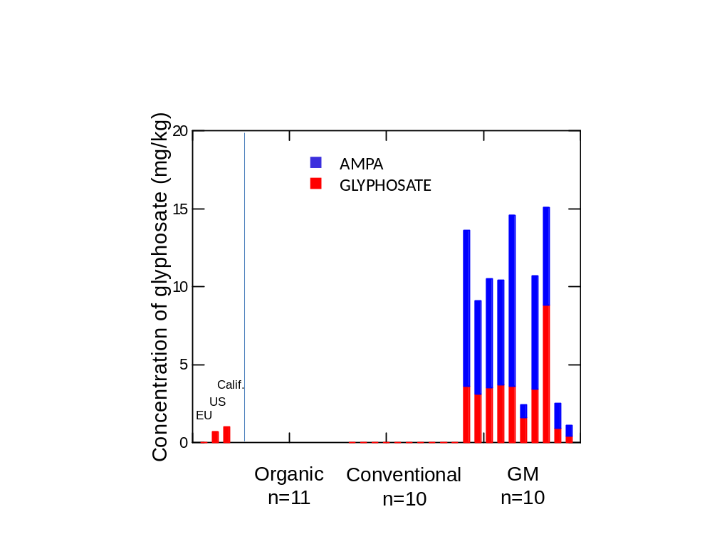


Glyphosate and AMPA in soybeans
“Extreme levels and far higher than those typically found” (Monsanto 2011)
From Bøhn et al. 2014 Food Chemistry

Slide 11

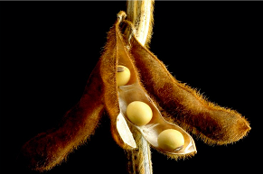
Negative effects in food?
In Daphnia magna model
  0.05 – 1.35 mg/L of glyphosate give negative effects
In food and feed
  9.0 mg/kg of glyphosate residues in GM soybeans on the market

Slide 12
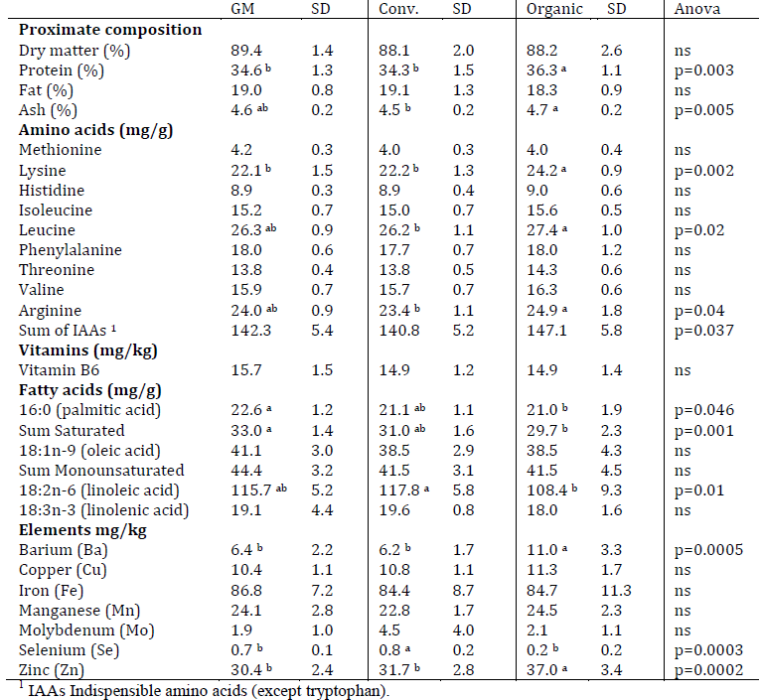
Elemental composition in soy

Slide 13
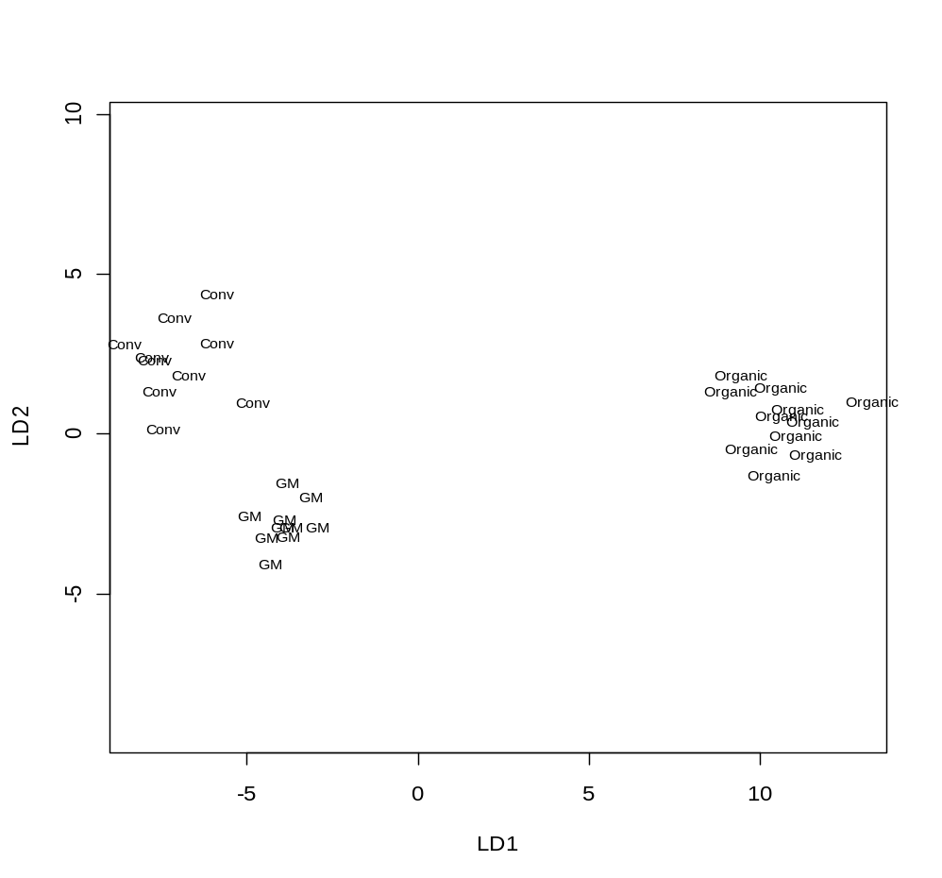
Substantially different!
Discriminant analysis for GM, conventional and organic soy samples based on 35 variables (Glyphosate/AMPA residues are not included)
From Bøhn et al. 2014 Food Chemistry

Slide 14
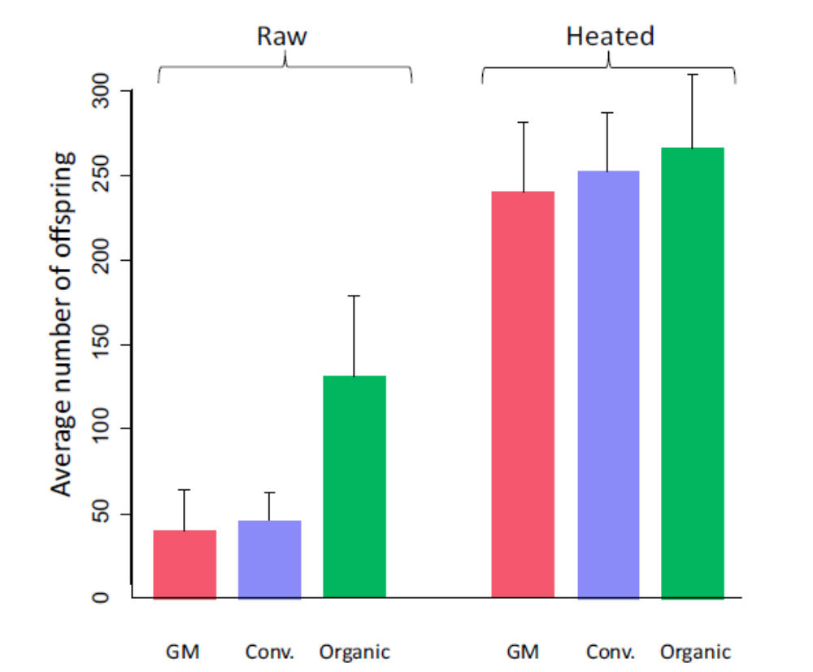

Organic soy superior as feed
From Bøhn et al. 2015 (In press)

Slide 15
Feeding test with GM soybeans

Slide 16
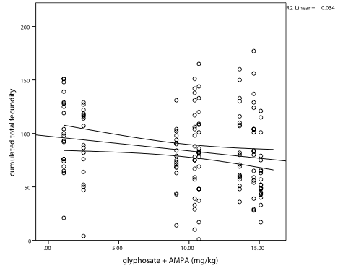
More glyphosate in soybeans
– reduced fecundity
R² = 3.4 %
P = 0.024
Fecundity
Glyphosate in feed (mg/kg)
(Cuhra et al. 2015)

Slide 17
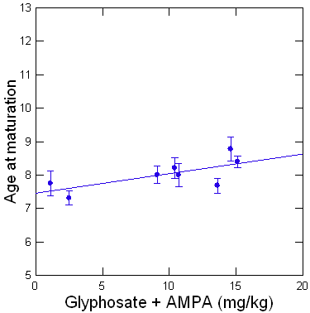
More glyphosate in soybeans
– delayed reproduction
R² = 5.3%
P = 0.005
(Cuhra et al. 2015)

Slide 18
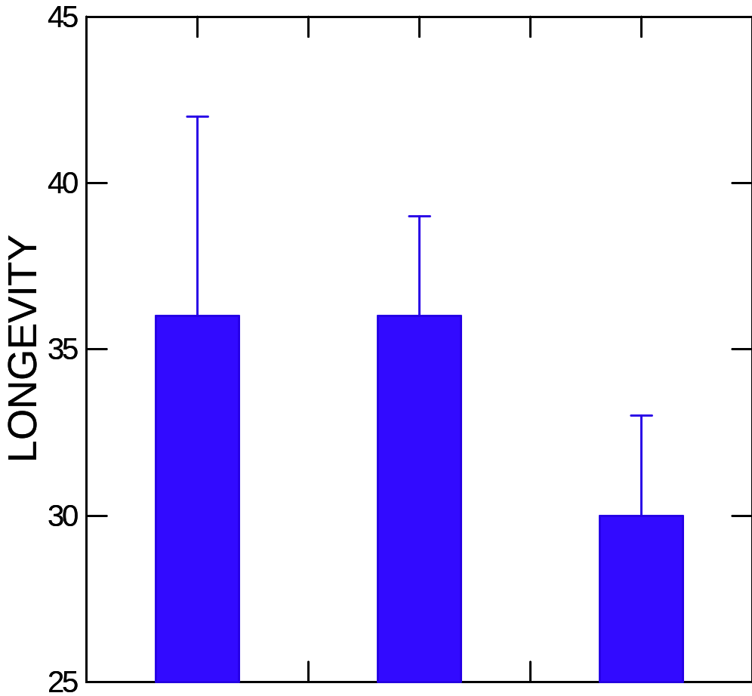
High glyphosate in soybeans
– reduced life span
**
P<0.01
Expected longevity (days)
Low
Medium
High
Gly + Ampa (mg/kg)
(Cuhra et al. 2015)

Slide 19
Conclusions
Glyphosate/Roundup is much more toxic than previously believed
Herbicide tolerant GM soy accumulates glyphosate
Feeding studies in ecotox model organism D. magna support the hypotheses that:
  GM soy has inferior quality compared to conventional and particularly organic soybeans
  Glyphosate residues negatively affect food/feed quality in GM soybeans

Slide 20
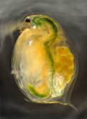
Further research in D. magna
Toxicity
  Roundup
  Dicamba
  2,4-D
  Combinatorial tox
Feeding studies to test GM plant quality
  Soy
  Maize
  Multistack plants
Data on phenotype
  Survival
  Growth
  Fecundity
  Population effects
Data on genotype
  Transcriptomics
  miRNA
  Pathway analysis
  Link to Birmingham (DGC)

Slide 21
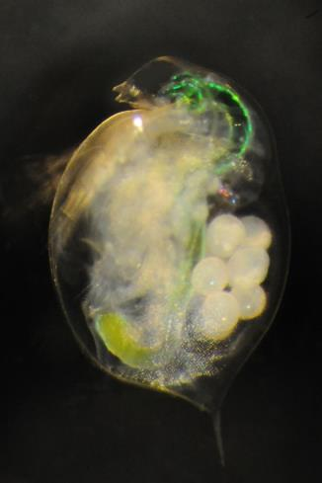
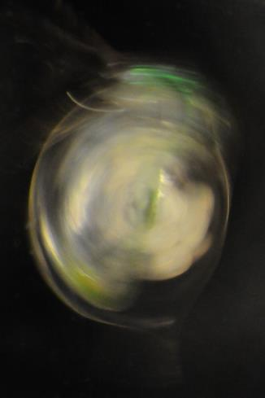

Daphnia magna
“Daphnia borealis”

Slide 22

Discussing GMOs!

Slide 23

Thank you for your attention!

