Slide 1
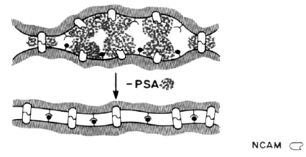

Intrabodies against the Polysialyltransferases ST8SiaII and ST8SiaIV inhibit Polysialylation of NCAM in rhabdomyosarcoma tumor cells
Somplatzki S, Mühlenhoff M, Kröger A, Gerardy-Schahn R, Böldicke T.
BMC Biotechnol. 2017 May 12;17(1):42. doi: 10.1186/s12896-017-0360-7.
8th European Immunology Conference
Madrid, Spain
Dr. Thomas Böldicke
Helmholtz-Centre for Infection Research, Germany
Structure and Function of Proteins

Slide 2
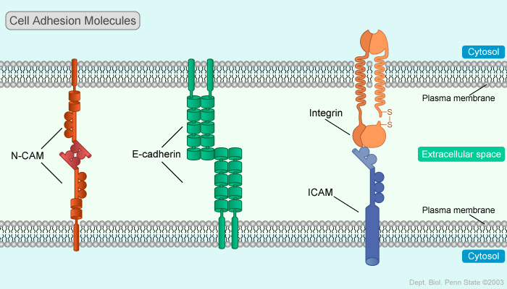
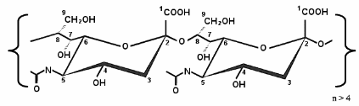
NCAM promotes cell interactions wheras PSA-NCAM inhibits these interactions
a, NCAM-NCAM interaction
b, PSA-NCAM inhibits NCAM-NCAM interaction and interaction of other cell surface molecules

Slide 3
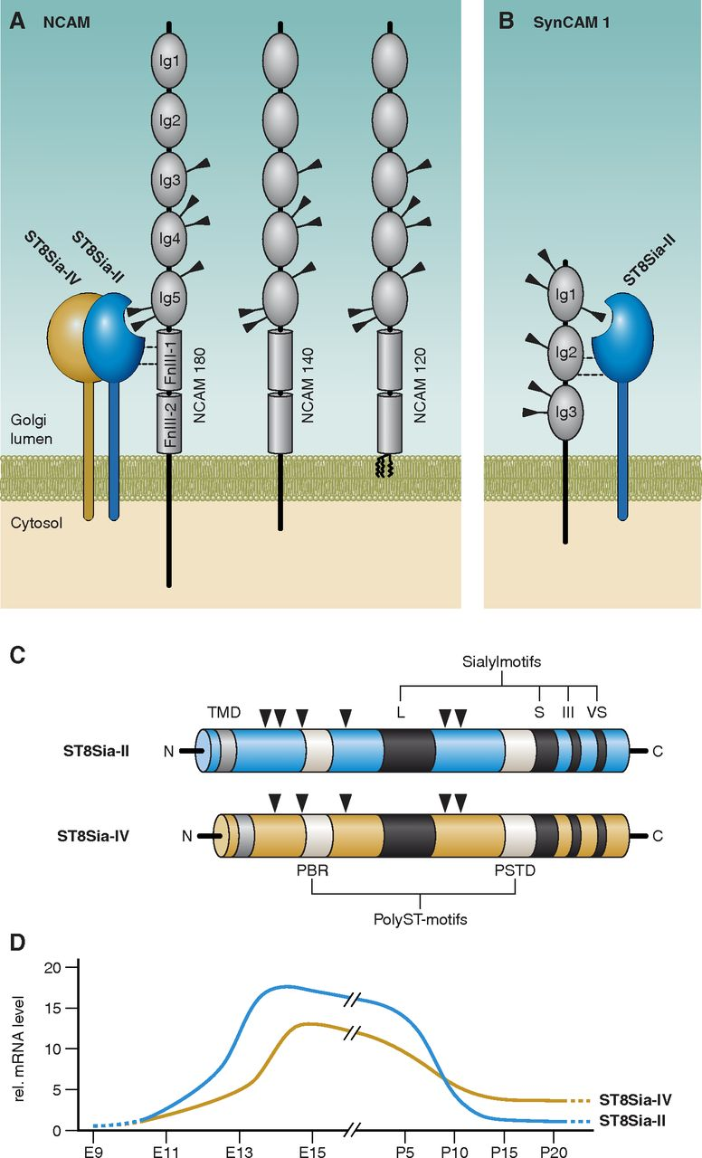
Polysialylation of NCAM is mediated by Golgi-located polysialyltransferases ST8Sia-II and ST8Sia-IV

Slide 4
Function of Polysialated NCAM (PSA-NCAM)
● PSA on NCAM avoids cell interactions due to steric inhibition and/or inhibited interaction with other cell molecules
● involved in cell migration, axon growth, nerve branching, pathfinding, synaptic arrangement
● highest expression during late embryonic and early postnatal stages (development and rearrangement of the nervous system)
● almost no expression in adult organisms, except for some regions connected with repairing issues
● expressed in some tumors

Slide 5
PolySia has an important influence on cell migration of tumor cells
● Tumor cells of neural origin often express NCAM and ST8SiaII and ST8SiaIV.
● Polysialylation of NCAM has been detected in Wilms Tumor,
Nephroblastom, Multiple Myeloma and Rhabdomyosarcoma.
Aim of our project was to answere the following questions:
Is the polysialylation of NCAM in rhabdomyosarcoma tumors mediated by two polysialyltransferases responsible for the metastasis of tumor cells in mice?
Is it possible to inactivate the polysialyltransferases by intrabodies expressed inside the ER?
If the translocation of the two polysialyltransferases from the ER to the Golgi-apparatus is inhibited by two ER intrabodies we can use them to analyse the effect of polysialylation on metastasis.

Slide 6
Intrabodies
● Recombinant antibody fragments, format: scFv or single domain antibody
● Expressed in target cells expressing the corresponding antigen
● Protein Knockdown of the antigen
● Main advantage: Specificity
● Targeting of proteins passing the ER, nuclear and cytosolic proteins.

Slide 7
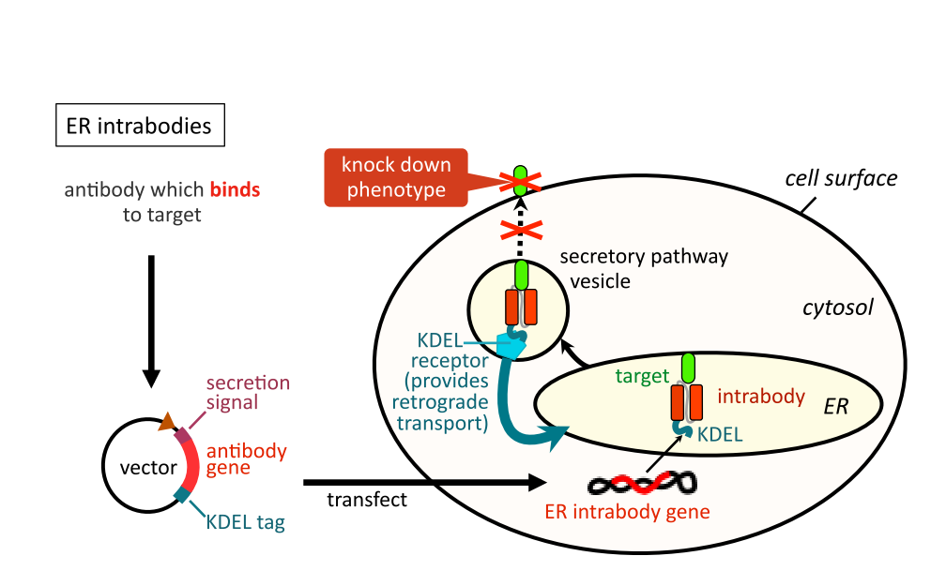
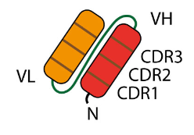
IB format: scFv
IB format scFv
Mechanism of Knockdown of ER intrabodies

Slide 8
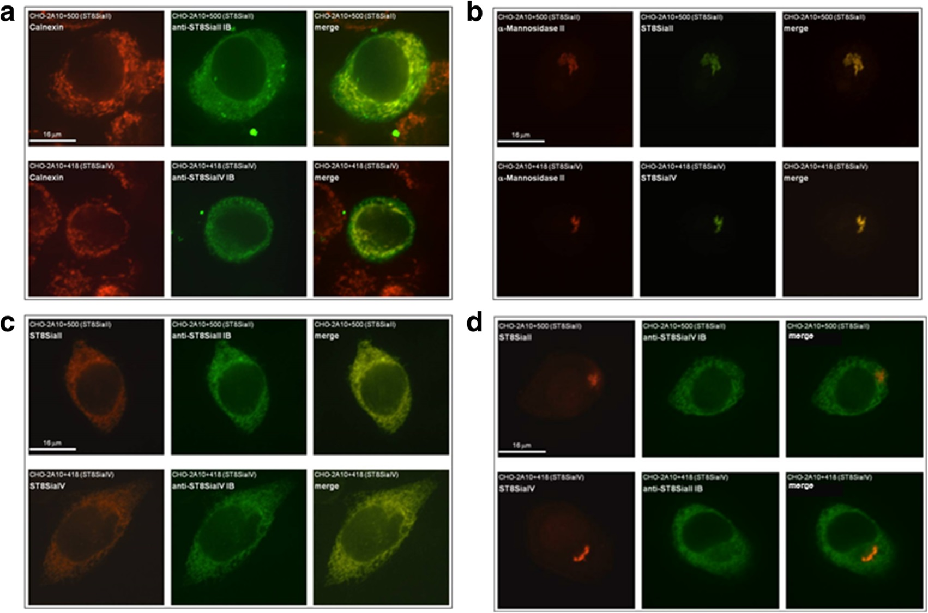
Anti-ST8SiaII-IB and anti-ST8SiaIV-IB mediates retention of ST8SiaII and ST8SiaiV inside the ER
(a) Colocalisation of IBs with ER marker calnexin, (b) colocalisation of ST8SiaII and ST8SiaIV with Golgi marker α-mannose II, (c) staining of ST8SiaII and ST8siaIV and specific intrabodies, (d) negativ control

Slide 9
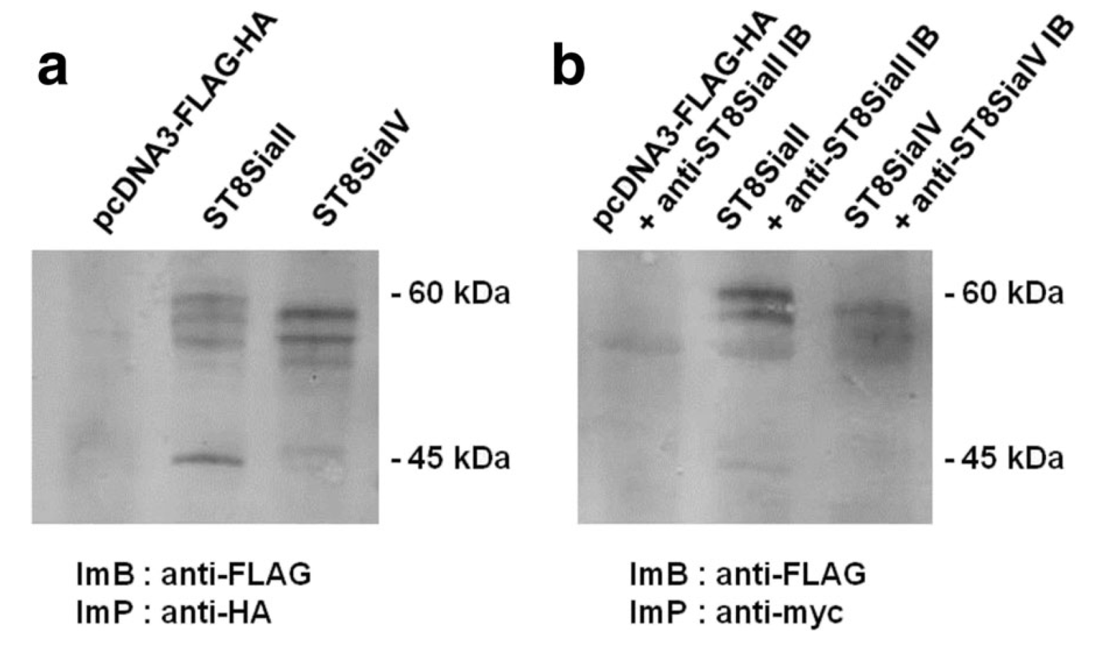
Intracellular Binding of anti-ST8SiaII-IB and anti-ST8SiaVI-IB to their antigens. a, control IP, b, Co-IP.

Slide 10
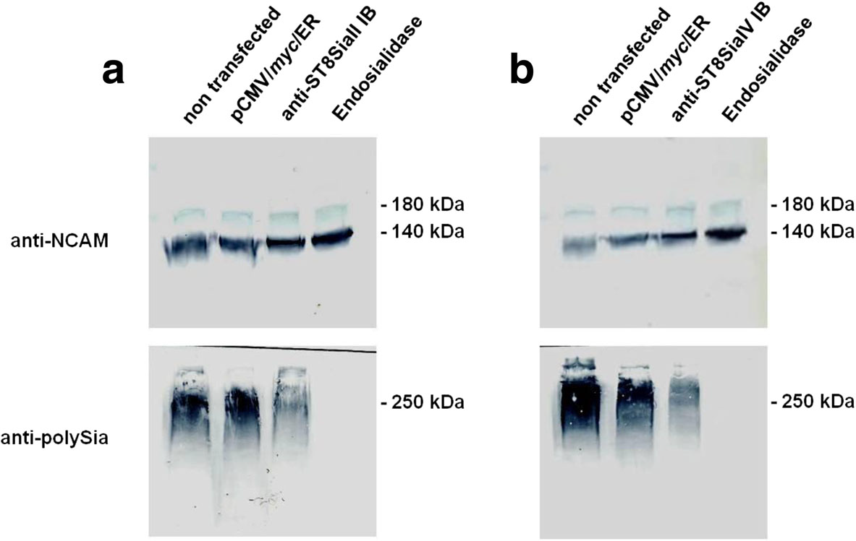
Reduced expression of polySia in recombinant CHO cells mediated by anti-ST8SiaII and anti-ST8SiaIV IBs.
a Immunoblot analysis of expressed NCAM and polySia of NCAM in CHO-2A10 + 500-cells expressing ST8SiaII transfected with ST8SiaII-IB. Negative control: cells non transfected or transfected with pCMV/myc/ER. Positive control: cell lysat treated with endosialidase. b Immunoblot analysis of expressed NCAM and polySia of NCAM in CHO-2A10 + 418-cells expressing ST8SiaIV transfected with ST8SiaIV IB.

Slide 11
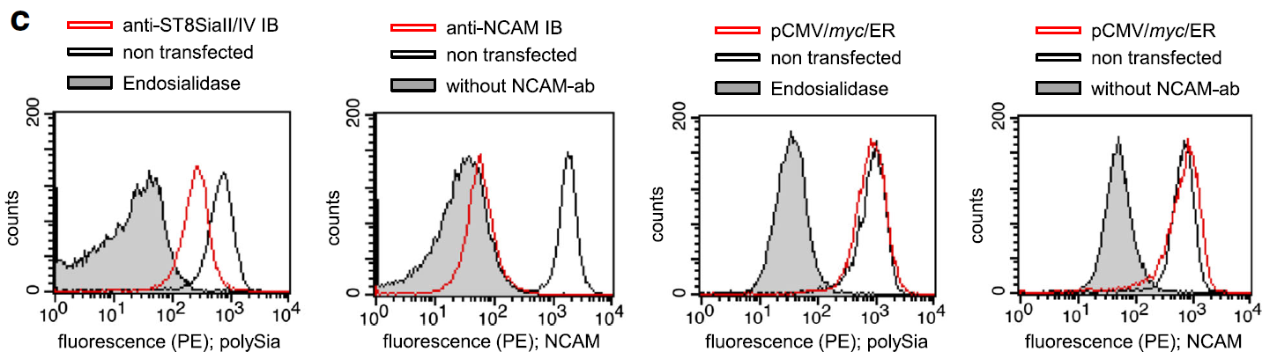
PolySia cell surface expression is inhibited in TE671 rhabdomyosarcoma cells stable expressing αST8SiaII-IB, αST8SiaIV-IB.

Slide 12
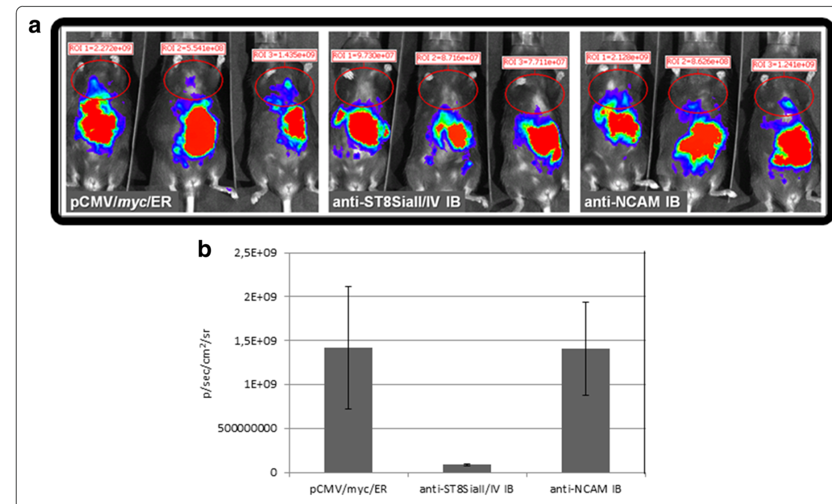
a
Inhibitory effect of anti-ST8SiaII-IB and anti-ST8SiaIV-IB on metastasis of rhabdyomasarcoma cells after 4 weeks of tumor cell injection in mice.
a) Detection of tumor cells by luminescence, b) Mean values of each group of mice with corresponding standard deviation.

Slide 13
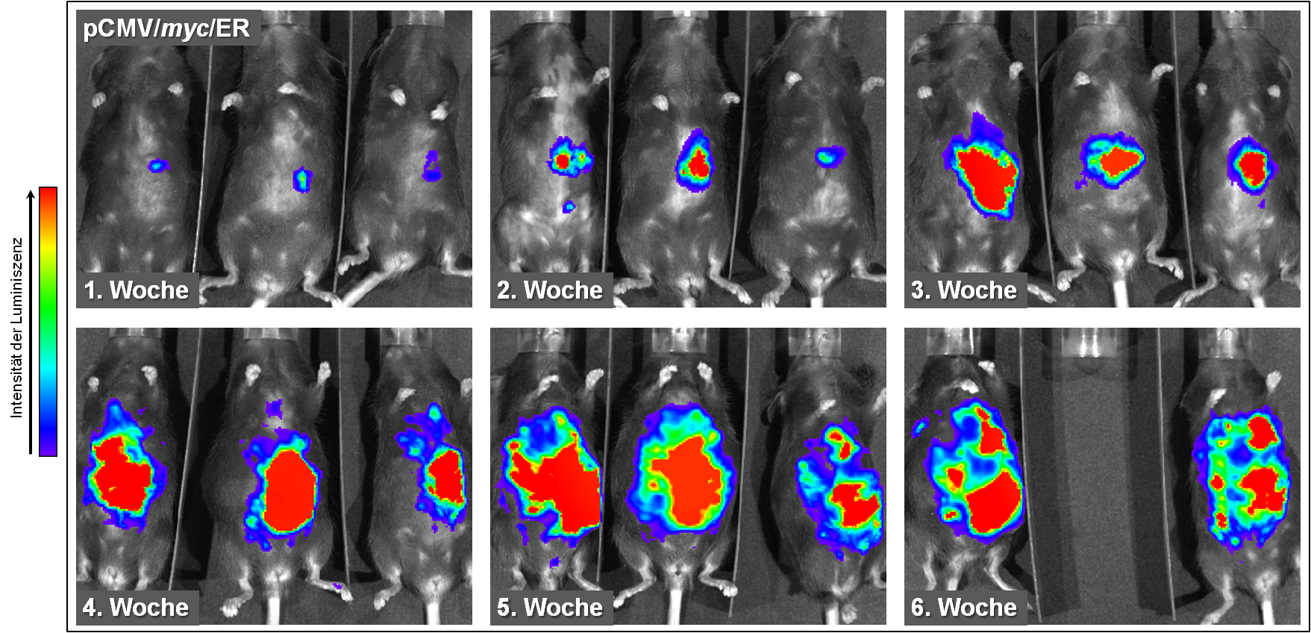
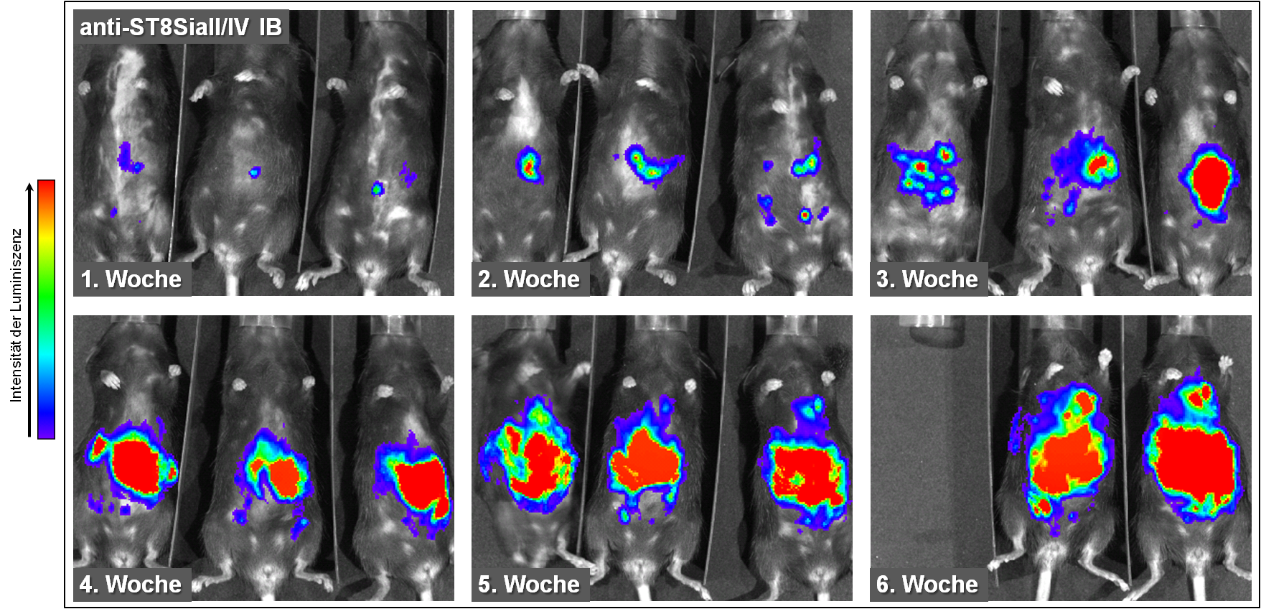
Complete Tumor growth tracking
A
week 1
week 2
week 3
Control mice
week 4
week 5
week 6
B
Intrabody mice
week 1
week 2
week 3
week 4
week 5
week 6

Slide 14
Conclusion
● The new IBs are potent tools to study the individual role of each enzyme in cell migration and tumor progression of different tumors.
● In addition they can be used to get more insight into the role of ST8SiaII and ST8SiaIV on the polysialylation of targets different from NCAM (i.e. SynCAM-1, europilin-2, the chemokine receptor CCR7, and E-selectin ligand-1).

Slide 15
Acknowledgement
Gerardy-Schahn (MHH)
Martina Mühlenhoff (MHH)
Andrea Kröger
Stefan Somplatzki
Hansjörg Hauser

