Slide 1
Surgical Ovarian Ablation in premenopausal , ER positive breast carcinoma patients in rural India
Dr T B Culas
Professor of Surgery
Government Medical College
Palakkad , Kerala

Slide 2
Breast Cancer : Surgery
Surgeons were treating breast cancer since the days of Hippocrates
In 1896 , George Beatson reported six cases of breast cancer treated with surgical ovarian
ablation with a favourable response in two cases
In 1950, Charles Huggins described surgical adrenalectomy as a second line of line therapy
In 1968, Elwood Jenson found the estrogen receptor . Breast cancer cells
were divided into “ER –positive” and “ER negative” depending on their levels of expression
Beatson response riddle seemed to have been solved

Slide 3
Breast Cancer : Tamoxifen
1962 : ICI filed a patent for a birth control pill ,Tamoxifen
Estrogen antagonist
Moya Cole launched a trial at Christie on women with advanced breast cancers . 10 /46 had almost a complete remission
Tamoxifen had come to stay in the management of BC

Slide 4
Breast Cancer: Combination chemotherapy
In 1972 Gianni Bonnadonna and Umberto Veronesi launched the
NCI trial for chemotherapy after surgery in Milan
The regimen was called CMF . In I975 , Bonnadonna reported this
adjuvant chemotherapy had prevented relapses in one in every six
treated women

Slide 5
Breast Cancer : Chemotherapy
How does it work ?
? mediates on the suppression of biochemical pathways involved in
estrogen synthesis
? chemical ovarian ablation
? cell kill - apoptosis /necrosis

Slide 6
Is chemotherapy chemical ovarian ablation ?
Chemotherapy induces amenorrhea in a large proportion of premenopausal women. The younger the women the lesser the castrating effect and lesser the response
Endocrine profile of those exposed to chemotherapy is similar to those who have undergone ovarian ablation
Chemotherapy induced permanent amenorrhea found to have a better prognosis than temporary amenorrhea
Multiple trails show a direct correlation between outcomes after chemotherapy and ovarian ablation

Slide 7
Long-Term Follow-Up of Chemotherapy-Induced Ovarian Failure in Young Breast Cancer Patients: The Role of Vascular Toxicity
The Oncologist : Sept 2015 vol 20
Continuous prospective evaluation of ovarian vasculature and function in a cohort of young patients during and after chemotherapy indicated that ovarian toxicity may derive from acute vascular insult. Age may affect whether patients regain ovarian function, whereas recovery of blood flow and premenopausal FSH levels at later assessment was notable in patients aged <35 years

Slide 8
BC : Side effects of chemotherapy
Common : alopecia anemia
fatigue thrombocytopenia
nausea and vomiting allergic reactions
peripheral neuropathy neutropenia
neutropenic fever
Cardiotoxicity
Secondary hematologic malignancies
Decline in LVEF

Slide 9
Side effects of Tamoxifen
Increased risk of thromboembolic disease
Endometrial cancer
Stroke
Hot flashes , headaches
Weight gain

Slide 10
Side effects of surgical OA
Coronary Heart Disease
Nurses’ Health Study : HR 1.28 ; 95 %CI 1.00 -1.64
Death from all causes
HR 1.12 : 95% CI 1.03 – 1.21
Death from Lung Cancer
HR 1.13; 95% CI 1.02 -1.68
Dementia
76 of 813 ( 9.3 %)
Osteoporosis

Slide 11
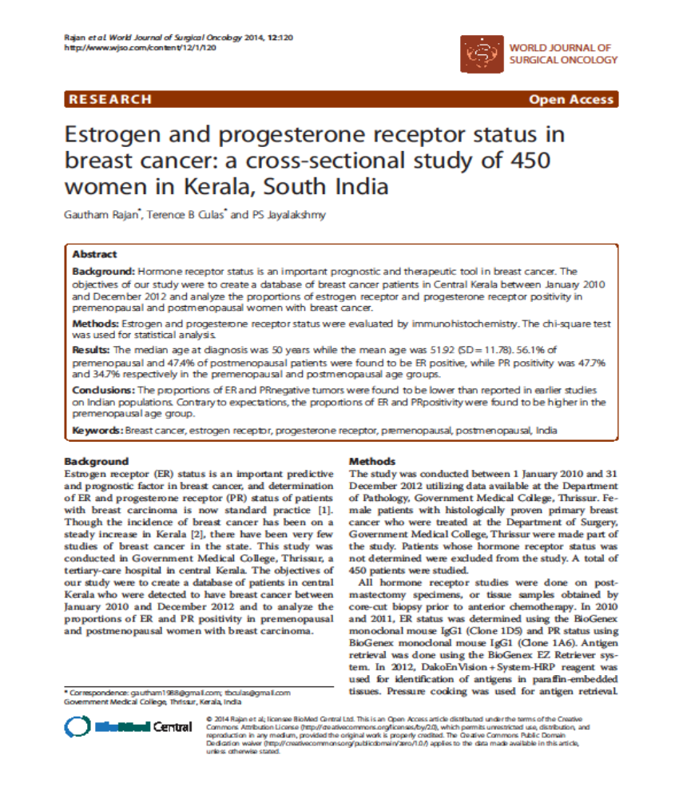

Slide 12
450 cases (Jan 2010-Dec 2012)
WJSO 2014:12 ; 120
Mean age at diagnosis 50
Premenopausal ER +ve 56.1 %
Premenopausal PR +ve 47.7%

Slide 13
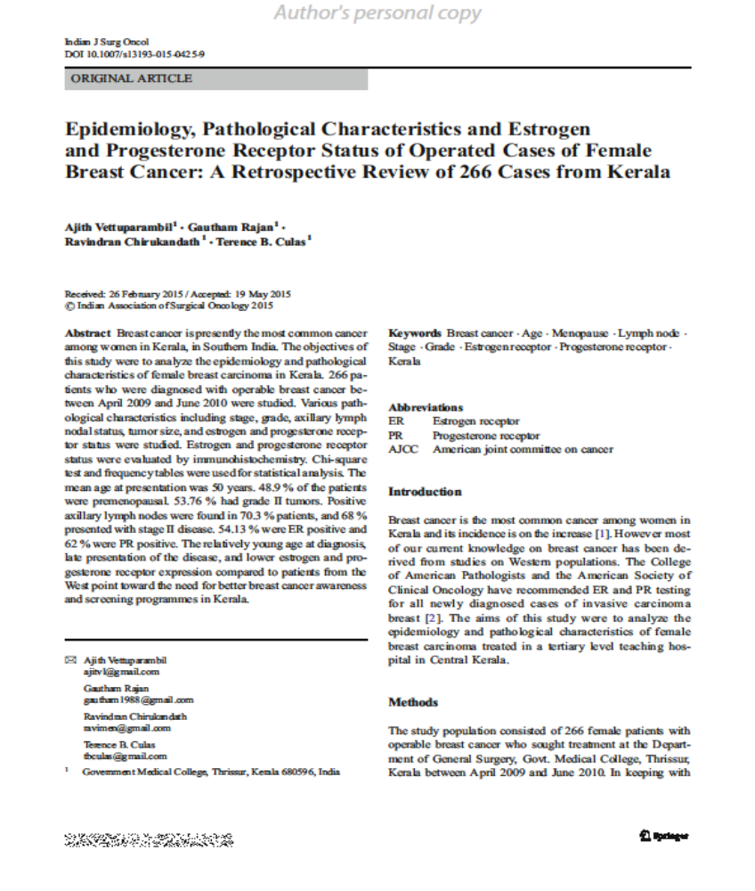

Slide 14
266 cases (Apr 2009 – Jun 2010 )
Ind J surg Oncol 2015
Mean age at presentation 50
Premenopausal 48.9 %
ER +ve patients 53.14 %

Slide 15
Our experience in Kerala (South India)
4 female patients from 2007 to 2010
Age 35 - 44 yrs
Stage LABC
Core Biopsy Infiltrating duct carcinoma
ER receptor positive
Refused Chemotherapy
Completed their families
were offered surgical ovarian ablation (lap /open) with MRM

Slide 16
Follow up
Upto 2015
1 patient lost to follow up
Other three patients doing well
Were put on AI 2 years & Tamoxifen 3 years
Review with CBE ,USG Abd , Estradiol levels , Bone Scan (2-3 yearly )

Slide 17
ASCO Guidelines
OA alone is not recommended as an alternative to any other form of systemic therapy, except in the specific case of patients who are candidates for other forms of systemic therapy but who, for some reason, will not receive any other systemic therapy (eg, patients who cannot tolerate other forms of systemic therapy or patients who choose no other form of systemic therapy);

Slide 18
CCO Guidelines
Cancer Care Ontario. Adjuvant Ovarian Ablation (OA) in the Treatment of Premenopausal Women with Early Stage Invasive Breast Cancer. (Eisen) 2010
There is no available evidence on which to base a recommendation regarding which specific form of OA (surgical oophorectomy, ovarian irradiation, or medical suppression) should be preferred.”

Slide 19
American College of Obstetricians and Gynecologists. Elective and risk-reducing salpingo-oophorectomy. 2008
“Salpingo-oophorectomy may be indicated for breast cancer survivors who have a high risk of ovarian cancer.....Those women with breast cancer who are identified with aBRCA1 or BRCA2 mutation have a 20-50% lifetime risk of ovarian cancer and a 40-60% risk of developing a second breast cancer.”
“ Salpingo-oophorectomy appears to be more effective than tamoxifen alone as adjuvant therapy in premenopausal women with hormone-sensitive breast cancer.

Slide 20
American College of Obstetricians and Gynecologists. Elective and risk-reducing salpingo-oophorectomy. 2008
Premenopausal women taking aromatase inhibitors for breast cancer need concurrent suppression of ovarian function, and salpingo-oophorectomy may be a cost-effective alternative to long-term ovarian suppression using gonadotropin-releasing (GnRH) agonists

Slide 21
National Instititue for Health and Clinical Excellence. (National Collaborating Centre for Cancer). Early and locally advanced breast cancer. 2009
Offer adjuvant ovarian ablation/suppression in addition to tamoxifen to premenopausal women with ER-positive early invasive breast cancer who have been offered chemotherapy but have chosen not to have it.”

Slide 22
Association of Breast Surgery at BASO. Surgical guidelines for the management of breast cancer. 2009
A decision whether or not to use endocrine therapy should be based on an assessment of the absolute benefit and the risks or side effects of treatment. Treatment regimes should be described in local protocols.

Slide 23
Rural India
Access to tertiary centres is difficult
Cost of treatment is may be unaffordable even in state run hospitals
Compliance to treatment is poor
Follow up – a major problem

Slide 24
Conclusion
In rural India , premenopausal women who are ER +ve , have
completed their families and who refuse chemotherapy should be
be offered Surgical Ovarian Ablation.

