Slide 1



Antibiotics sensitivity of microorganism causing nosocomial infections
3rd International Conference on
Clinical Microbiology & Microbial Genomics
Tea Koiava
Batumi Shota Rustaveli State University, Georgia

Slide 2
Internal infections
The most frequent reason for a mortality of hospital patients is internal infections which are associated with general medical manipulations;
2 million people become ill from this infection and 5-10 % of them die annually.

Slide 3
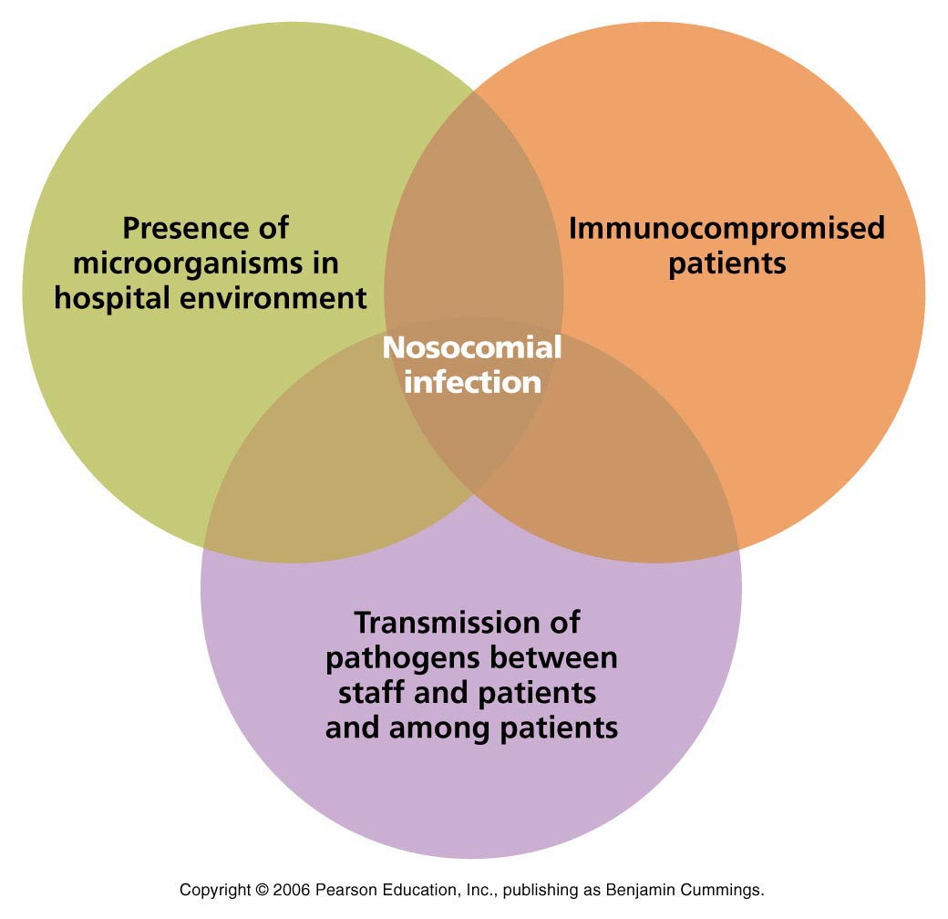
Reasons!!!

Slide 4
Nosocomial infections
….are a major problem today, not only in developing countries but also in the major developed countries;
Antibiotic use is one of the important factor in the development of nosocomial infections;
Notes:
The inappropriate use of antibiotics is a major contributor to the increase in drug-resistant strains of bacteria, and coupled with the natural selection and exchange of genetic resistance elements with microorganisms, drug resistance has emerged as a worldwide problem, with an increasing number of microorganisms becoming resistant to treatment each year.

Slide 5
microorganisms causing nosocomial infection in most cases belong to the ESBL producing bacteria and are resistant to several antibiotics
Notes:
The prolonged and large-scale use of antimicrobial drugs of this class has caused the reduction of their effectiveness, because of emergence such strains that produced a broad spectrum beta- lactamase. They basically belong to the class A . This has made ​​it necessary to use thefourth-generation cephalosporin: group of carbapenem (imipenem, meropenem) and the inhibitor - protected beta- lactams. All this has caused the widely distribution of microorganisms producing the enzyme beta – lactamase, and changed the distribution of different groups in different regions of the world

Slide 6
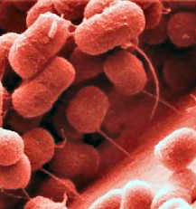
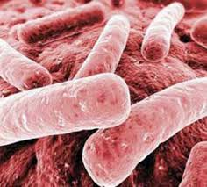
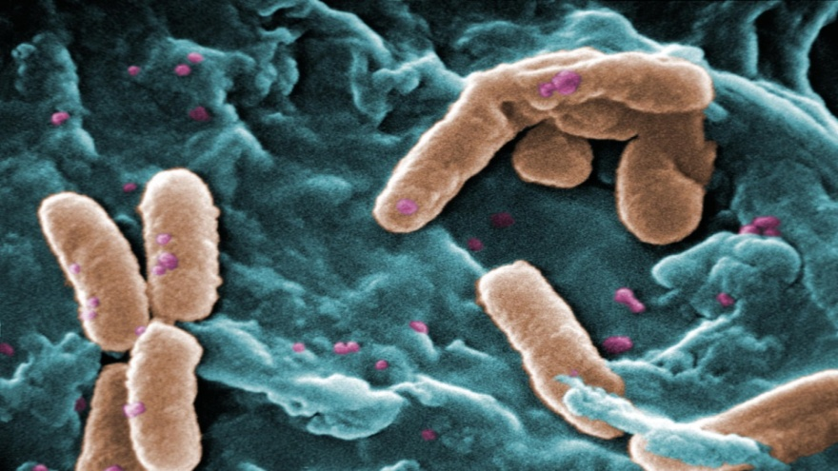
ESBL bacteria vary
according to regions and countries
Pseudomonas aeruginosa
Klebsiella
E. coli
Ascinetobacter
are mostly found among the agents of the infection.
Notes:
It should be noted that the data in the literature on the bacteria that are prevalent among the agents of nosocomial infections vary according to regions and countries. Pseudomonas aeruginosa, Klebsiella, E. coli, Ascinetobacter and others are mostly found among the agents of the infection. But not only bacteria, but also fungi, such as Candida, Aspergillums and viruses as well (respiratory, syncytial and influenza) belong to these agents, but more rarely.
.

Slide 7
The identification of bacterial spectrum of the etiologic agents of these infections is incompletely carried out and the antibiotic therapy has been determined spontaneously
Notes:
The spread of infection rate is very high in the health facilities of Adjara area, which is supported with statistics data of Public Health and the Center for Disease Control, however,

Slide 8
.
The goal of our research was
identify the causative bacteria of nosocomial infection in several hospitals in Adjara
to study the profile of antibiotic –resistance.

Slide 9
Materials
Sputum
Urine
Blood
Biological Fluids

Slide 10
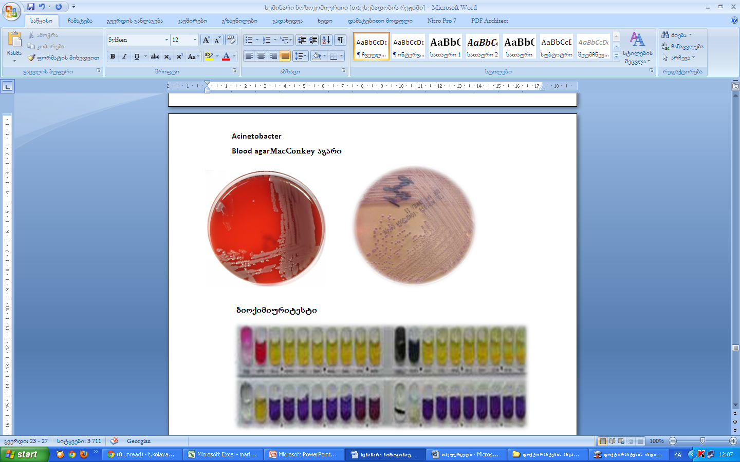
Methods
Culturing of a culture into culture medium;
Obtaining of pure culture;
Identification of cultures by using the API tests;
Antibiotic resistance was determined by Bauer-Kirby Disk Diffusion method.
Notes:
Isolation and identification of bacteria were carried out by using the standard bacteriological methods, such as the culturing of a culture into culture medium, obtaining of pure culture and identification of cultures by using the API tests, the antibiotic resistance was determined by Bauer-Kirby Disk Diffusion method.

Slide 11
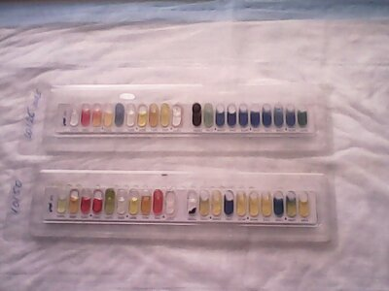
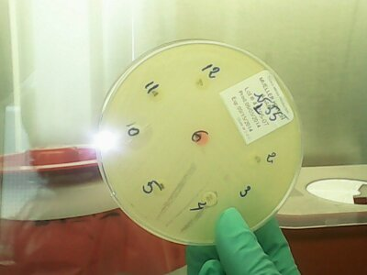
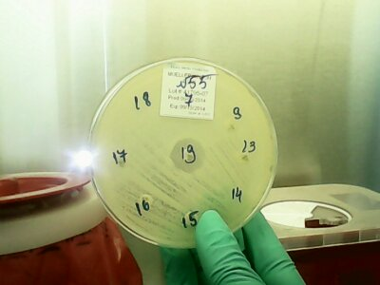
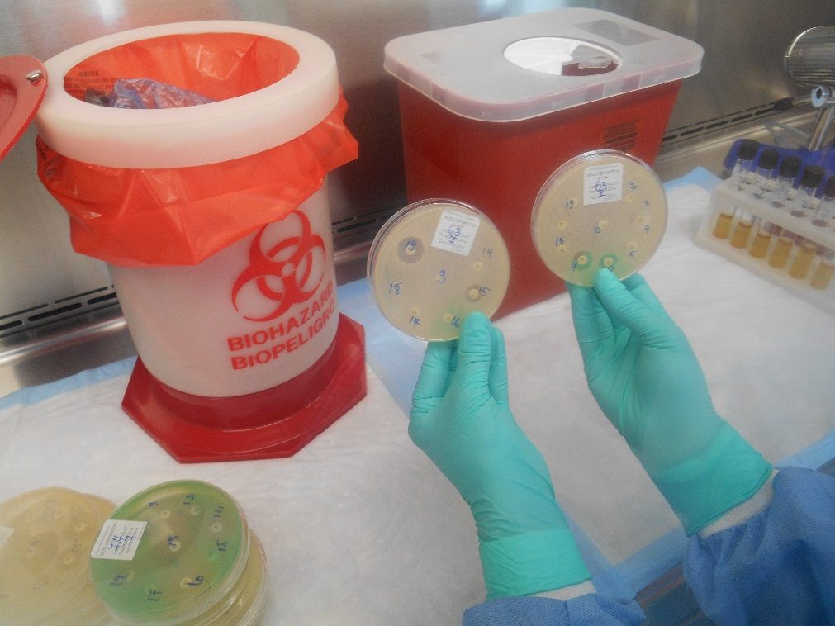

Slide 12
Resultes
100 samples were taken the first 48 hours and totally examined.
81 from that were positive
for bacteria

Slide 13
Most numerous among the agents of nosocomial infection were
Acinetobacter
E. coli
Pseudomonas Aeruginosa
Klebsiella Pneumonia

Slide 14
Urine

Slide 15
Biological fluids

Slide 16
Suptum

Slide 17
Antibiotic Resistance Profile
Cefalosporine Ceftriaxone,
Cefepime,
Piperacillin,
Aztreonam,
Augmentin,
Penicillin,
Oxacillin Ciprofloxacin,
Colistin,
Imipenem,
Meropenem,
Gentamicin,
Amikacin,
Ampicillin / sulbactam,
Co-trimoxazole, Kloramfenikol,
Fosfomycin
Notes:
All isolates were examined for the antibiotic resistance of the following antibiotics: Cefalosporine Ceftriaxone, Cefepime, Piperacillin, Aztreonam, augmentin, Penicillin, Oxacillin Ciprofloxacin, Colistin, imipenem, meropenem, gentamicin, Amikacin, Ampicillin / sulbactam, Co-trimoxazole, Kloramfenikol, Fosfomycin

Slide 18
Antibiotic Resistance Profile
Notes:
All isolates were examined for the antibiotic resistance of the following antibiotics: Cefalosporine Ceftriaxone, Cefepime, Piperacillin, Aztreonam, augmentin, Penicillin, Oxacillin Ciprofloxacin, Colistin, imipenem, meropenem, gentamicin, Amikacin, Ampicillin / sulbactam, Co-trimoxazole, Kloramfenikol, Fosfomycin

Slide 19
Antibiotic Resistance Profile

Slide 20
All isolantes of the gram-negative bacteria were resistant to
Augmentin
Ampicilin
Penicilin

Slide 21
Conclusions
Augmentin, Ampicilin, Penicilin are antibiotics using massively in Georgia;
Supposedly use of these drug as, illegal in most cases without a prescription (these drugs are freely sold in pharmacies) contributes to the formation of antibiotic resistance.
Notes:
Augmentin, Ampicillin and Penicillin belong to antibiotics of β-lactam group, which cause the resistance problem worldwide.

Slide 22
In the future…
We are playing detail genetic screening for:
bla SHV
bla CTX-M
bla TEM

Slide 23


Thank You for Your attention!

