Slide 1

Assessing feasibility of Limestone Aquifer for Managed Aquifer Recharge
Md.Taufique Warsi, Farooq A. Dar, Sarah Sarah, Tanvi Arora and Shakeel Ahmed
CSIR-National Geophysical Research Institute

Slide 2
Managed Aquifer Recharge
Managed aquifer recharge (MAR) includes a wide variety of different techniques with which water (e.g. stormwater, surface water or treated waste water) is intentionally introduced into an aquifer to store, treat the water
India is now a water stressed country, Groundwater touches every aspect of life, and in India uncertainty over access to and the availability of this basic resource may be reaching crisis levels
In India, MAR is an attractive solution to improve water quantity and quality for water stressed

Slide 3
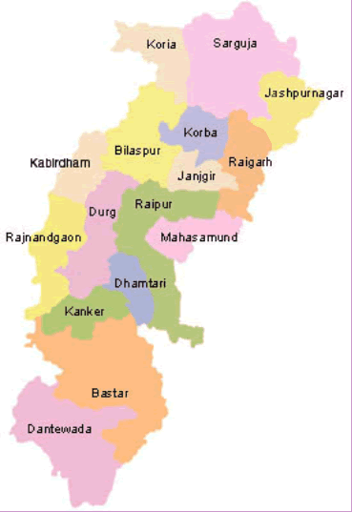
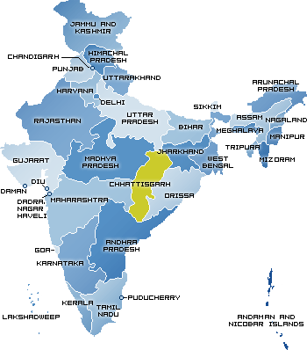
Study Area
65% of the city’s drinking water supply is by pipeline and the rest by groundwater.,
excessive withdrawal and depletion of aquifers,
Unmanaged human activities have destroyed natural talabs
Aquifers under stress

Slide 4
Objective
To develop a conceptual model of the Chandi limestone aquifer which is poorly understood in terms of its hydrogeology and demands detailed research before carrying MAR program in the area
Integrated results from hydrogeology and hydrogeophysical data interpretation
To propose suitable sites for implementation of MAR program

Slide 5
Model development
Geophysics and other methods
Database treatment and documentation
RS/GIS supported mapping
Verification and evaluation of data
Preparing 3D aquifer picture

Slide 6
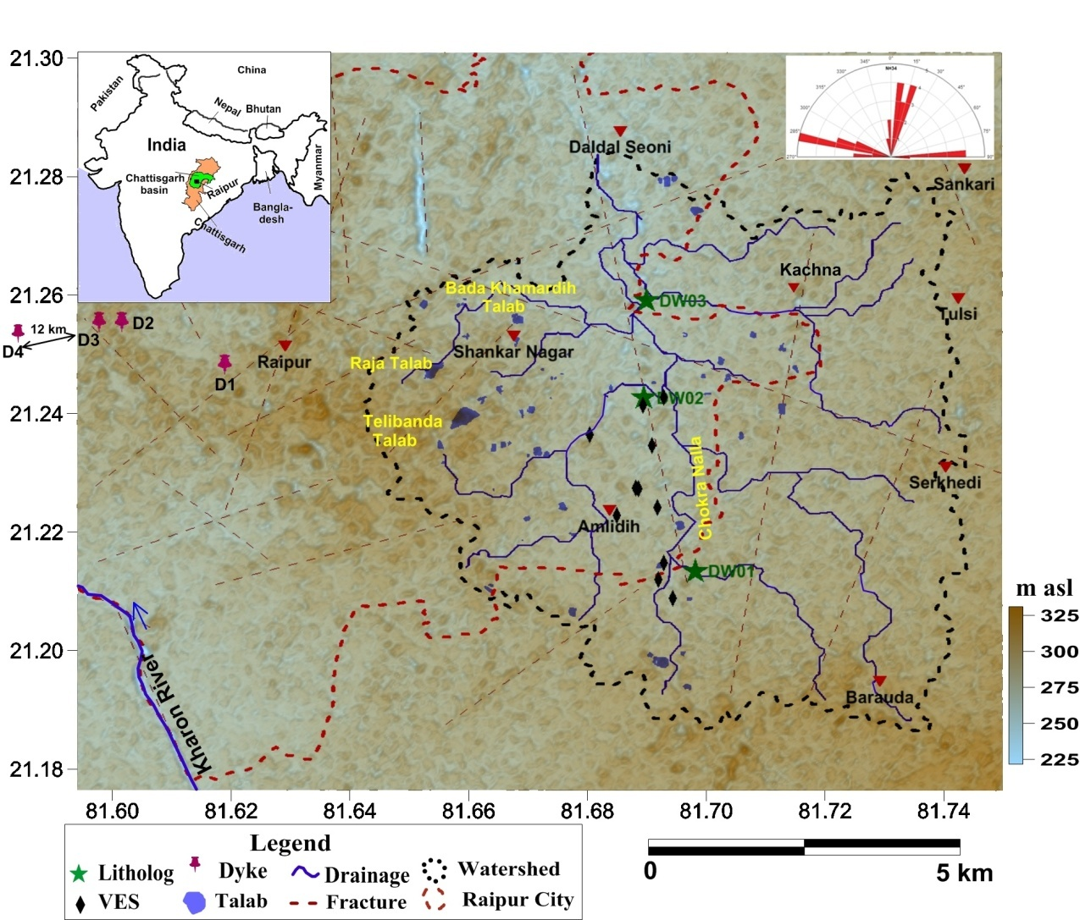
Site characterisation
N

Slide 7
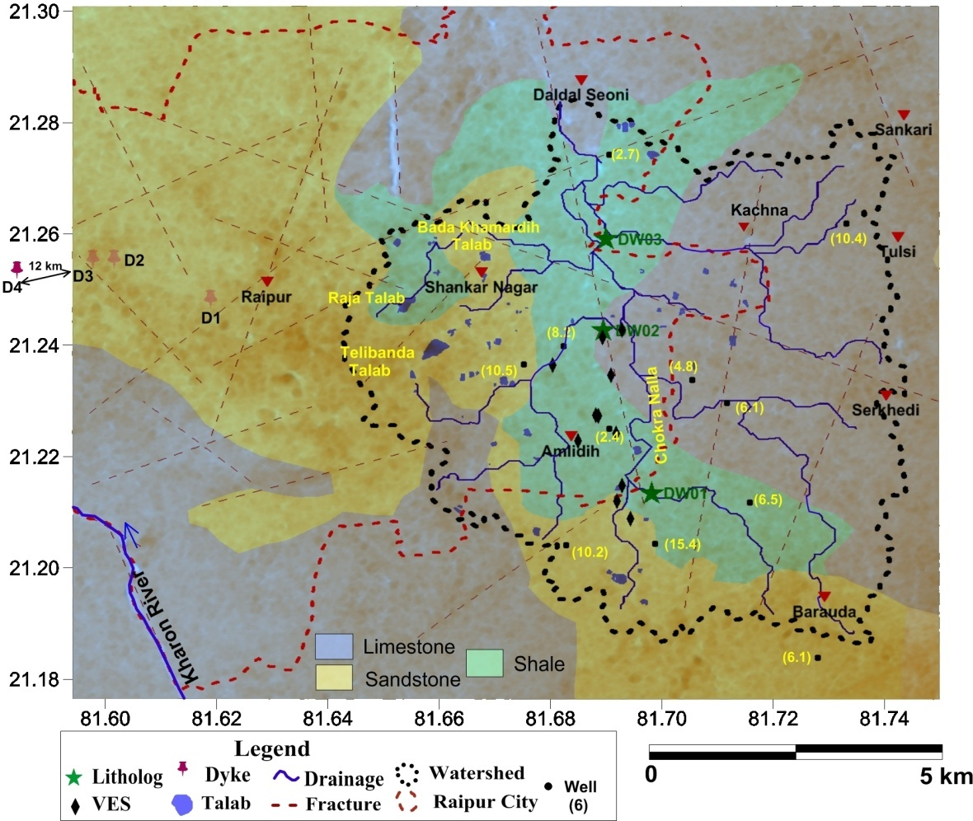
Geology
N

Slide 8
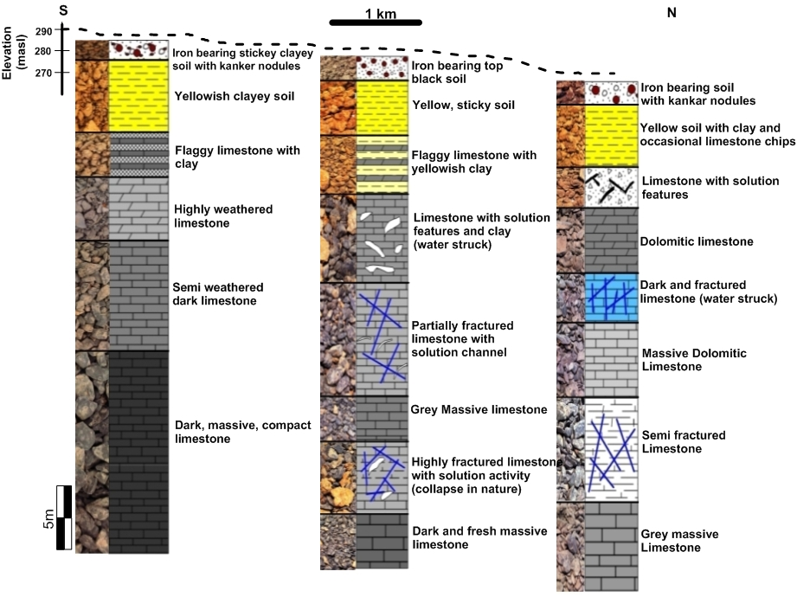
Lithologs
DW1
DW3

Slide 9
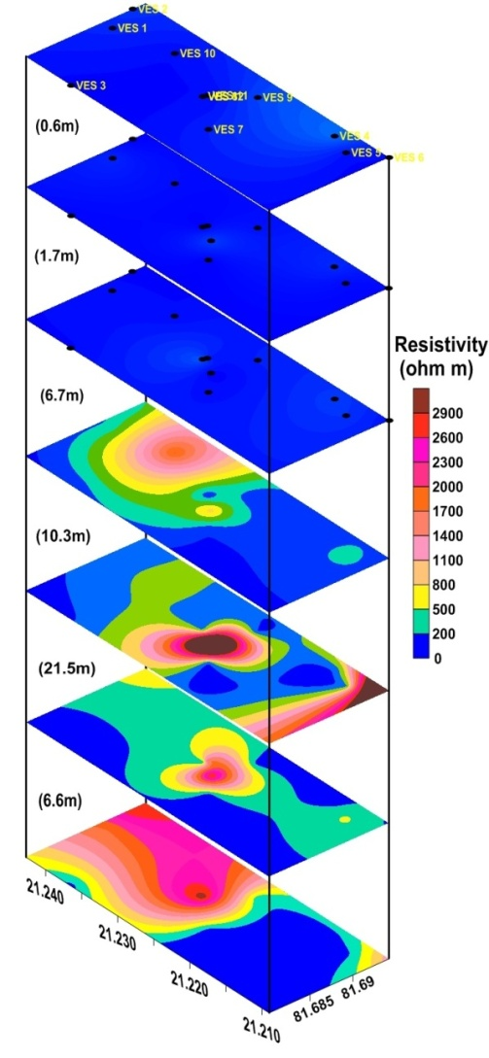
Geophysical Study
Vertical Electrical Sounding
Layer wise section of resistivity layers generated from Vertical electrical soundings carried out at 12 locations.

Slide 10
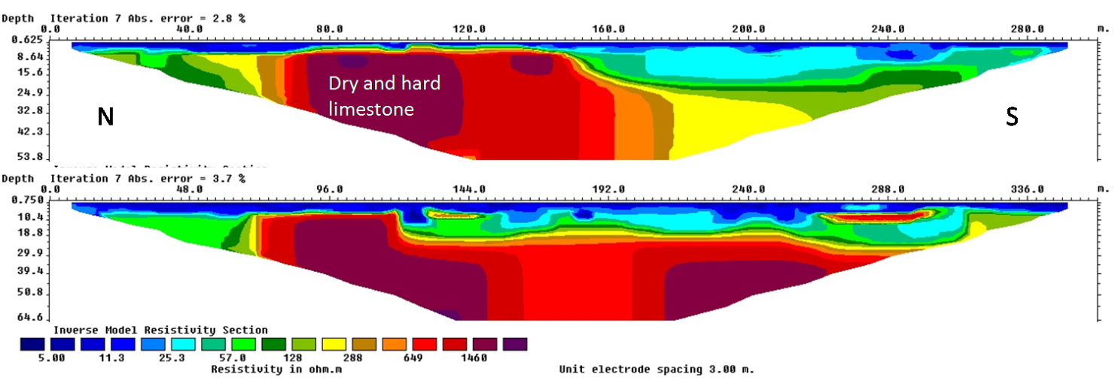
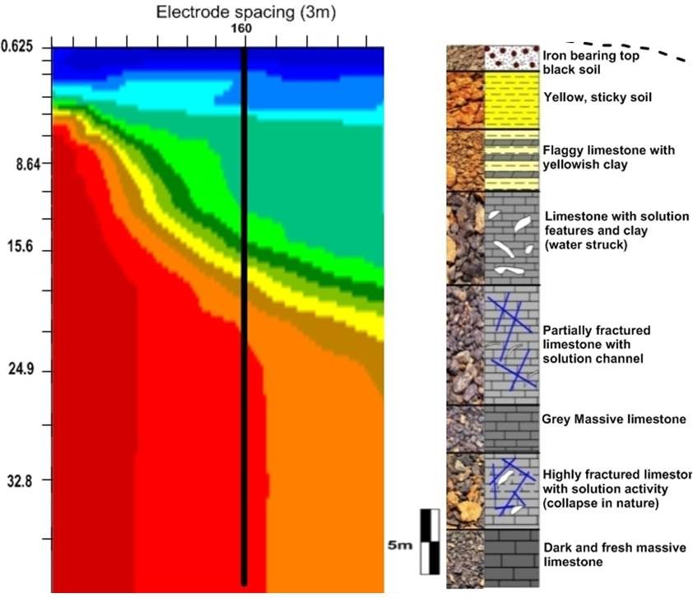
Verification and evaluation of data
2D-ERT along the profile at station E16and E7.
Correlation of 2D ERT drilled information DW02.
Well collapse; no logging possible

Slide 11
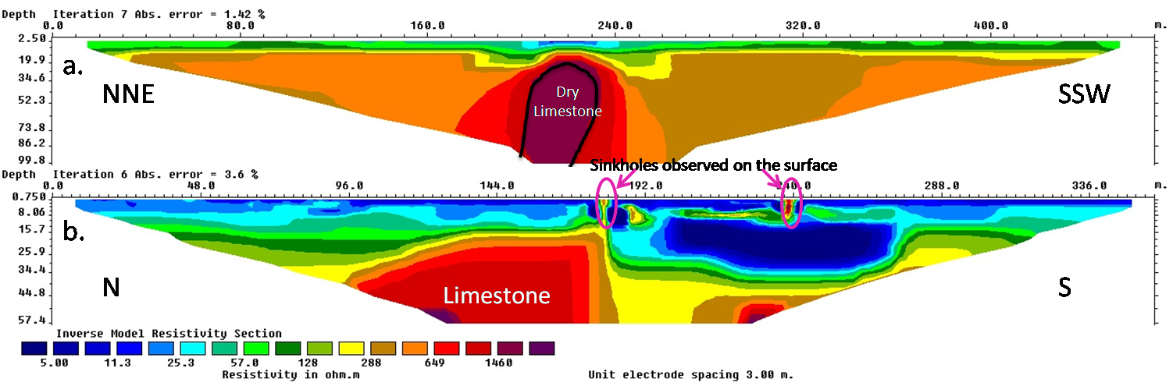
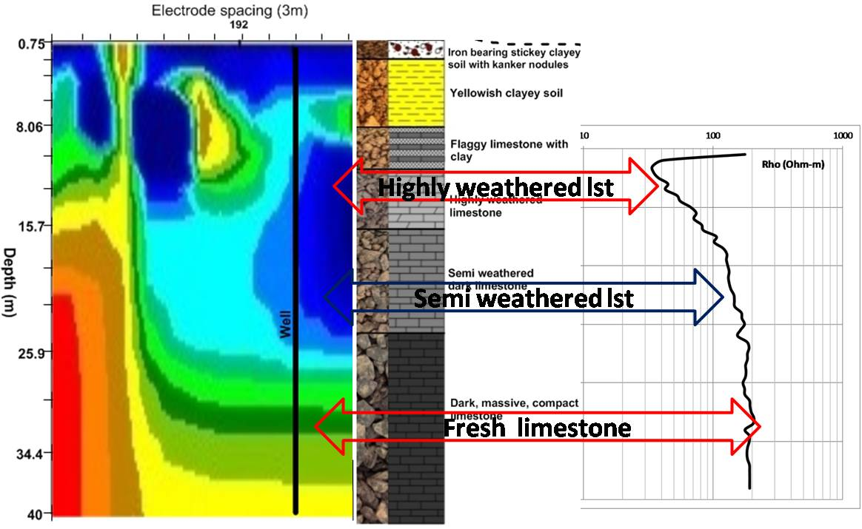
Geophysical Study
2D-ERT along the profile at station E1 and E2.
Correlation of 2D ERT drilled information DW01.

Slide 12
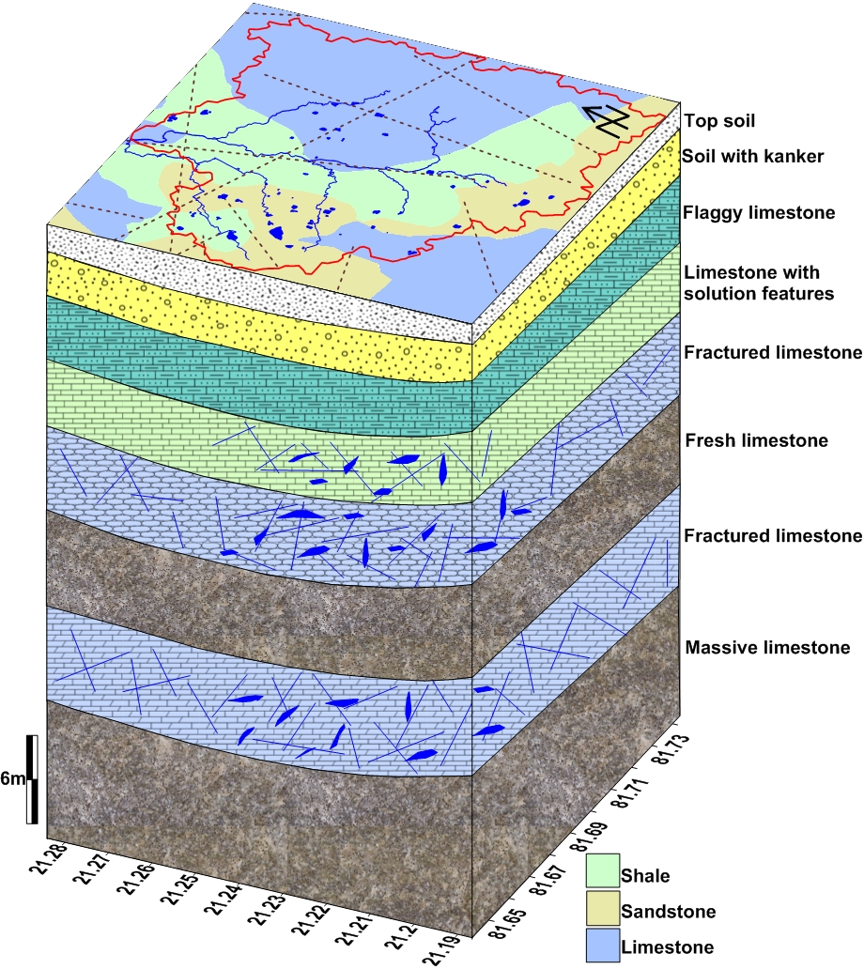
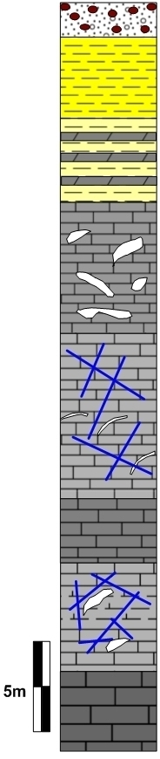
Final 3D subsurface model of the study area

Slide 13
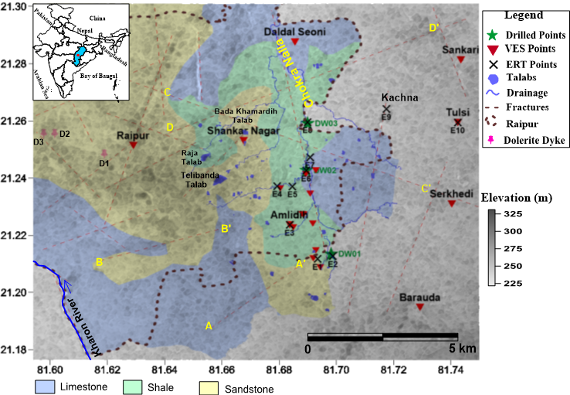
Proposed sites for MAR
Orientation of Dyke
Resistive zone
Conductive zone
Resistive zone
Conductive zone

Slide 14
Conclusion
limestone area is feasible for managed aquifer recharge and the presence of surface features like, less slope (<5⁰), presence of fractures, karst features, etc will increase the rate of groundwater infiltration.
The karst surface dissolution features make it highly conductive to groundwater flow and carry the infiltrating water directly and rapidly to the aquifer.
The results will help to locate the best suitable sites in Chandi limestone for developing managed aquifer recharge structures and to assess their feasibility
Results can be upscale to other carbonate aquifers of India.

Slide 15
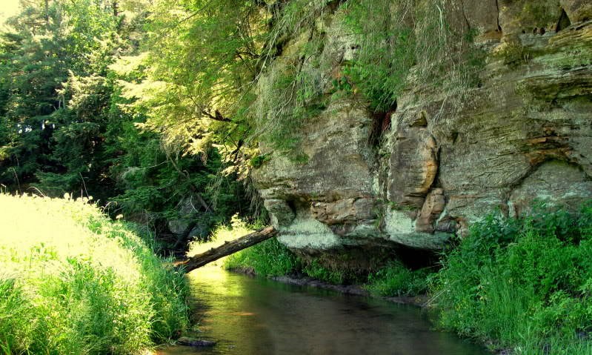
Thank You

