Slide 1
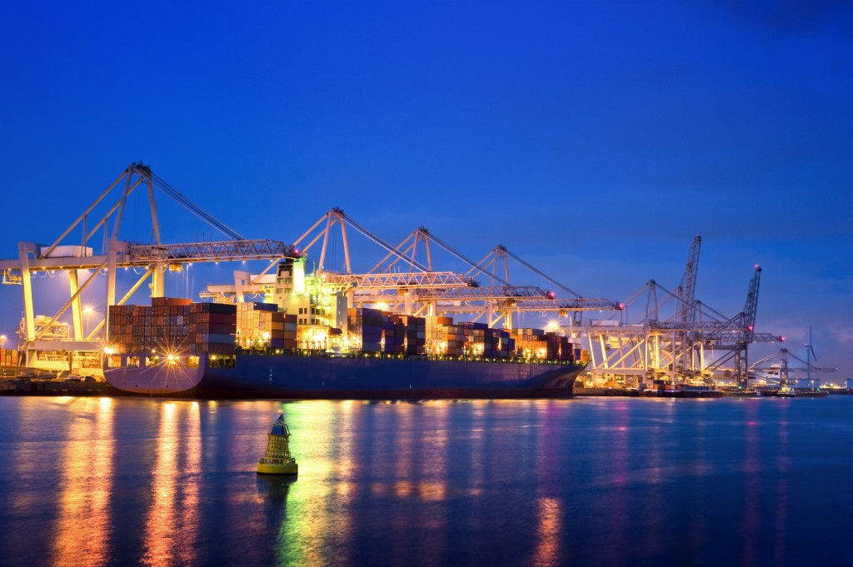
Matheuristic Application to ship routing and scheduling problem in crude oil transportation
2nd World Congress on Petroleum and Refinery
June 1-3, Osaka, Japan
Tatsushi Nishi
Graduate School of Engineering Science, Osaka University (nishi@sys.es.osaka-u.ac.jp)

Slide 2
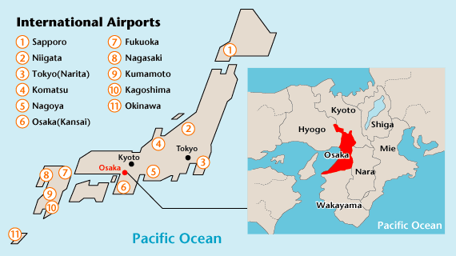
Introduction to Osaka University
Mathematical Science for Social Systems
Department of Systems Innovation
Graduate School of Engineering Science
Osaka University
bachelor students: 15,479
master students : 4,693
doctor students : 3,199
Total students : 23,371
Foreign students: 2,184
Professors : 3,183
Assistants : 3,179
Total staffs : 6,362
3 main campus
Toyonaka campus
Suita campus
Minoo campus

Slide 3
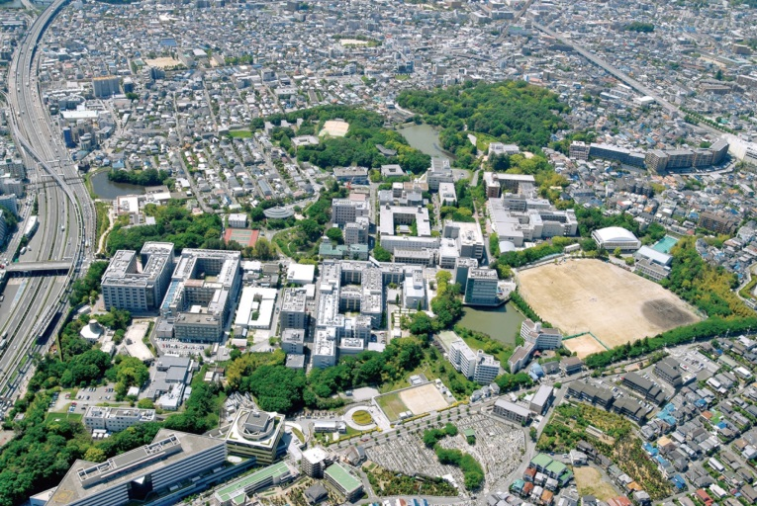
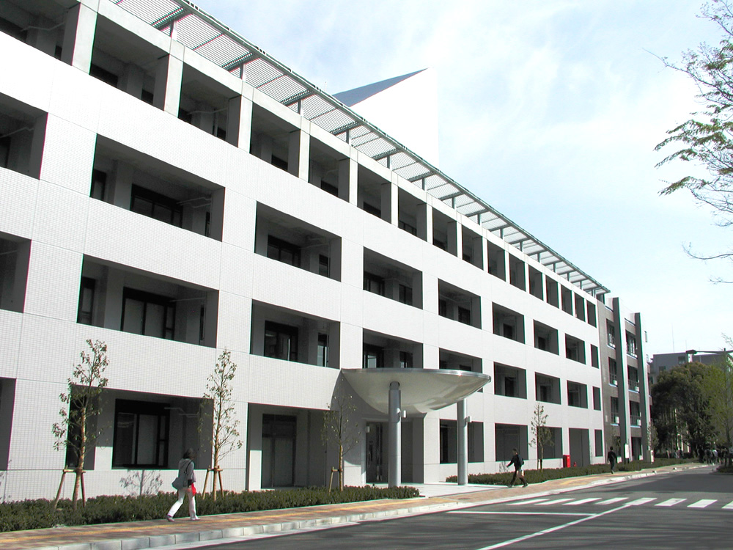
Introduction of Engineering Science
School of Engineering
School of Science
School of Engineering Science
More basic than Engineering
Toyonaka campus (450000m²)
Mathematical Science Department
・Finance and Insurance
・Data Science
・Mathematical Model
System Mathematics Research Group

Slide 4
Brief Introduction: Associate Prof. Tatsushi Nishi
PhD Degree in Kyoto University (Chemical Engineering)
Assistant Professor of Okayama University (Electrical Engineering)
Associate Professor of Osaka University from 2006 (Mathematical Science for
Social Systems)
March 2014-2017, Visiting Professor of Beijing University of Chemical Technology
Research areas: system optimization, automation, supply chain
planning and scheduling, combinatorial optimization,
multi-robot control, public transport, process systems engineering
Courses taught: discrete optimization, graph theory
operations research, intelligent mathematical programming
Associate Editor of IEEE Transactions on Automation Science and Engineering 2012-
(Impact factor: 2.428 (2015), 2.162 (2014), 1.461 (2013))
Conference Editorial Board of IEEE ICRA (top robotics conference)

Slide 5
Our team
・Scheduling
public transport, railway crew scheduling, airline scheduling
transportation, routing, logistics, production scheduling
・Supply chain optimization
production planning, supplier selection, revenue management,
contract decision, quantity discounts or volume discounts
・Discrete event systems
Petri nets, timed automata, modeling, optimization, automated guided vehicles, deadlock avoidance, Petri net decomposition technique
5

Slide 6
Outline of my talk
Japan’s oil production and consumption
Scheduling problem in crude oil transportation
Matheuristics approach
Practical application
Case study
Conclusion and future works

Slide 7
Collaboration with industries
Semiconductor factory automation
Control of automated guided vehicles for transportation
Scheduling of cluster tool for silicon wafer production
Railway scheduling automation
railway crew scheduling in Japan Railway
train-set scheduling with maintenance constraints
shift scheduling
Petroleum chemical industry automation
International ship scheduling for crude oil transportation
Transportation network design
7

Slide 8
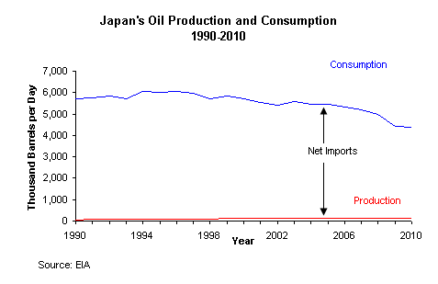
Japan’s Oil Production and Consumption
Japan is the second largest net importer of oil
Japan relied on oil imports to meet 45% of its energy need in 2009

Slide 9
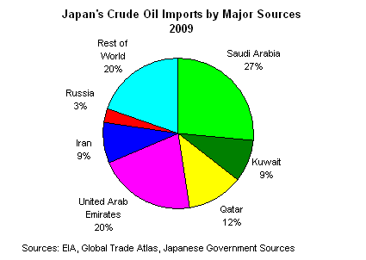
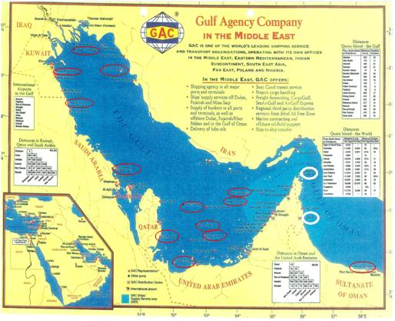
Japan’s Crude Oil Imports
The scheduling of international oil transportation becomes significant !

Slide 10

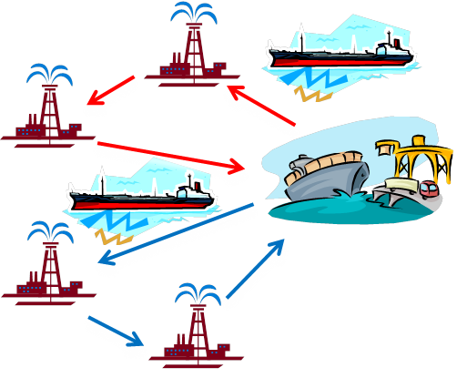


Crude oil transportation problem
Pickup and delivery crude oil transportation scheduling problem.
Request of demands
Efficient schedule
Oil
The objective is to minimize the total cost during pickup and delivery.

Slide 11



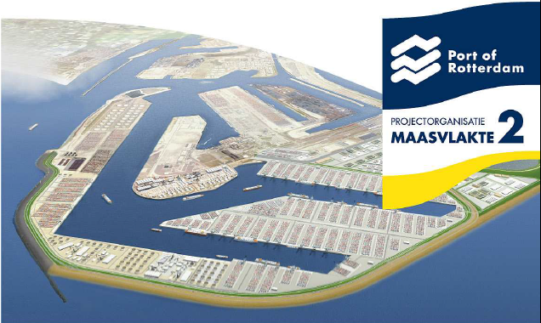
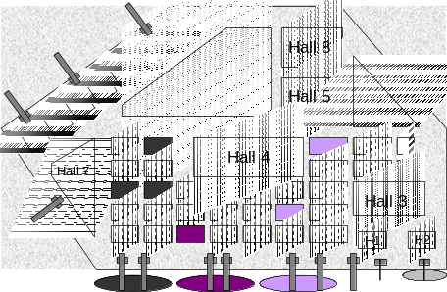
Scheduling problems in crude oil transportation
Inventory routing problem
Pickup and delivery ship routing problem
Berth allocation problem

Slide 12
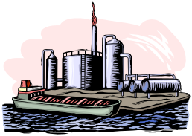
Ship routing and scheduling problem in crude oil transportation
Outbound transportation
Inbound transportation
Total Demand
Demand
Loading places
Start(midpoint)
Base
Unloading places
Demand
Loading planning
Unloading planning

Slide 13
Ship routing and scheduling problem in crude oil transportation
Which crude oil should be transported by a fleet of tankers ?
Each ship can transport two or more items.
The problem is to determine
1. Optimal assignment of crude oil transportation in a tanker
2. Visiting sequence of loading and unloading place
3. Optimal timing of visiting dates
In order to minimize the total cost of fuel, port charge, etc.
one month travel
depot in Arabian countries
Depot in Japan

Slide 14
Crude Oil Transportation Problem
Specific constraints
  Demand for each crude oil
  The number of loading places is at most two.
  Capacity for each tanker
  Minimum and maximum loading volume constraint
  First port constraint
  Split/Merge delivery constraint
5
Notes:
This slide explains the Petri Net decomposition approach.
Near optimal decomposition method using simulated annealing method is proposed by He et al.
Finite automata decomposition technique is proposed by Derabi.
Liao et al proposed a simultaneous task asssignment and routing for OHT vehicle scheduling,
They proposed Lagrangian relaxation method to solve the problem.
The authors studied route planning problem for automated guided vhicles.
However, in conventional works, the task assignment and routing is not
considered simultaneously.
In this paper we propose a Petri Net decomposition approach for the simultaneous optimization for task assignment and routing
For automated guided vehicles.
When the problem is solved by the decomposition approach, the decomposed subnets has no final marking.
We construct a general decomposition algorithm with the subnets with no final marking.
e propose
Conventionally,

Slide 15
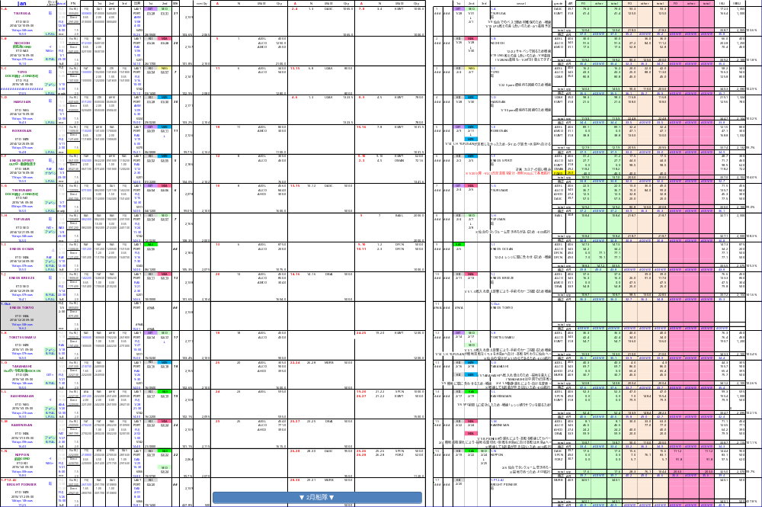
Ship scheduling example

Slide 16
Real-world example
Number of vessels : 28
Number of oil types: 26
Number of loading places: 22
Number of unloading places: 8
Average number of oil types in a vessel: 3-4

Slide 17
Difficulties
Oil prices are subject to change.
Contacting with Arabian countries is also subject
to change according to several circumstances.
Practitioners need to modify their plan immediately
minimizing the effect of disturbances.
Currently human operators make decisions.
It takes several days to create a plan.

Slide 18
Literature Review
  Maritime Transport Logistics
  Multi-ship pickup and delivery is proposed.
  Dynamic programming, heuristic search has been proposed.
  Split Delivery Vehicle Routing Problems
  Mingzhou Jin, Kai Liu, Burak Eksioglu “A column generation approach for the split delivery vehicle routing problem”,
  Operations Research Letters, Vol. 36, pp. 265-270, 2008
  →Single item delivery
  In this paper, we treat multiple items and split delivery.
6
Notes:
This is literature review of routing problems for automated guided vehicles.
There are several approaches for solving routing problems for automated guided vehicles.
Simulation-based method with dispatching rule is usually used for practical application.
Timed event graph approach and Petri net based control methods have been studied.
Deadlock resolution is one of critical issues. There are several control policy with priority rule.
For optimization methods, optimization methods with Petri Nets has been widely studied.
The scheduling with Petri Nets can be reformulated as firing sequence problem for Petri Nets.
The problem is shown to be NP hard even if the simple structure of Petri Nets.
Heuristic search is used to solve the problem.
However, if the size of PN is large, state space explosion problem arises.
To solve the problem, we propose a general optimization method using Petri Net decomposition approach.

Slide 19
Matheuristics approach
Matheuristics are heuristic algorithms made by the
Interoperation of metaheuristics and mathematical programming.
Cross-problem robustness
CPU-time effectiveness
Mathematical programming + Metaheuristics = Matheuristics

Slide 20
Column Generation Heuristic
Dantzing-Wolfe reformulation
Restricted master problem
dual variables
Pricing subproblem
Adding columns
If the reduced cost is positive, a lower bound is derived.
The solution of continuous relaxation is not feasible.
B&B or B&P is often used.
Construction algorithm to create a feasible solution is proposed in this paper
9

Slide 21



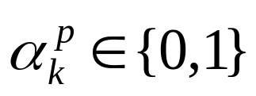
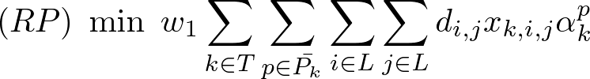
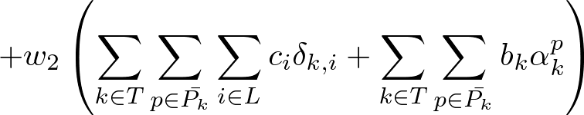
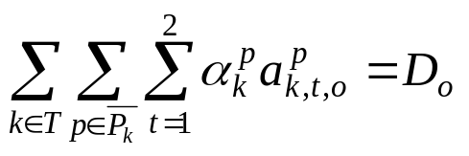
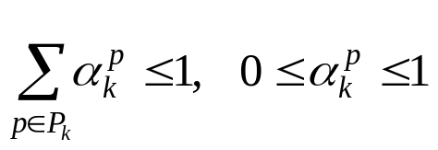
Dantzig-Wolfe Reformlation
{ , , }
A set of columns are given.
: whether column p is adopted or not
charge cost
tanker cost
set partitioning constraints
Linear programming problem (LP)
10
Notes:
This is the layout of AGV transportation system.
The layout consistis 115 nodes and 128 edges.
Each lane is uni-directional.
It is required to derive an optimal task assignment and collision-free routing.

Slide 22
Pricing problem
dual variables obtained by master problem
loading places
depot
Start and end to depot
Loading places is at most two
Capacity of tanker
Min./Max. loading volume
Demand constraints
11
Notes:
This slide explains the modeling of AGV system.
The system consists of several edge or arc, and node.
Velocity is constant. Starting, turning, stopping time is negligible. Traveling time between neighbor nodes is one time unit.
Loading, unloading time is one time unit. Collision, deadlock, blocking are not allowed.
A task has one goal node.Plural tasks can be assigned to an AGV. There can be idle AGVs which has no task.

Slide 23
Construction of feasible solution
Restricted
master problem
Initial columns
generated column
If a column is adopted, the residual demand is calculated.
adopted
Residual column
oil 1
oil 2
oil 3
Column generation is repeatedly executed
Adopted columns
…
If the residual demand becomes zero
A feasible solution to satisfy set partitioning constraint is generated
12
Notes:
We use transition timed Petri Nets where firing duration time is one time period.
The dynamics of transition timed Petri Net is the same as the place/transition net, we use the place/transition net for modeling the problem.
If the system consists of 4 nodes and bidirectional edges, the Petri Net model for the transportation system is represented as follows.

Slide 24
POPMUSIC
Start from an initial solution (greedy algorithm)
Decompose solution into parts
Optimize a portion (several parts) of the solution
via mathematical programming
Repeat until the optimized portions cover the entire solution
part 2
part 1
part 3
part 4

Slide 25
POPMUSIC application
Minimize sum of total cost
Tanker 1
loading & unloading plan
Tanker 2
loading & unloading plan
Tanker 2
loading & unloading plan
1. Create an initial feasible solution
Subject to
Tanker 1
2. Choose some parts of tanker schedules
randomly.
Tanker 2
Tanker 3
Tanker 4
3. Define local subproblem for tanker i and j
4. Solve the local subproblem via
mathematical programming
Constraints of pickup routing
Constraints of delivery routing
5. Steps 2-4 are repeated until the solution is not updated.

Slide 26
Computational experiments
Case study with practical data
  Case 1: 22 loading places, 22 oils, 8 unloading places, 14 tankers
  Case 2: 22 loading places, 25 oils, 8 unloading places, 20 tankers
  Assignments of loading and unloading places for each oil are different.
  The demand and the distance matrix is taken from the real data.
  Coefficients of the objective: w1=1, w2=1
Computational environment
  Intel Core(TM)2 Duo 3.06GHz with 2GB memory is used for the computations.
  RMP and SPk are solved by IBM ILOG CPLEX12.1.
26
Notes:
Now, I would like to show you the results of computational experiments, which are conducted to evaluate the performance of our proposed method.
The input data and computational environment are shown in this slide.
As the data used for problem models, we used the practical data which were addressed in a real problem for one month.

Slide 27
Real Case study data
TABLE I
DEMAND AND LOADING PLACE DATA FOR EACH CRUDE OIL
Oil | Demand | Loading place | Oil | Demand | Loading place
1 | 3720 | 16 | 12 | 4100 | 2
2 | 4309 | 16 | 13 | 1922 | 7
3 | 930 | 16 | 14 | 775 | 13
4 | 465 | 16 | 15 | 310 | 13
5 | 0 | - | 16 | 1550 | 14
6 | 1095 | 10 | 17 | 810 | 19
7 | 0 | - | 18 | 500 | 4
8 | 2205 | 6 | 19 | 1000 | 9
9 | 264 | 6 | 20 | 0 | -
10 | 2492 | 6 | 21 | 500 | 15
11 | 0 | - | 22 | 600 | 3
17

Slide 28

Practical constraints
In order to create a plan with full capacity, the priority of column generation heuristic is set to ×(Loading volume) in the plan.
Some specific oils should be delivered in a specified ratio. We included the constraints in the pricing problem.
The demanded items of oils are given as priority from the database given from expert operator.
28
Notes:
In these experiments, we consider these practical constraints.
In order to create a plan with full capacity, the priority of column generation heuristic is set to alpha^p_k ×(Loading volume) in the plan.
Some specific oils should be delivered in a specified ratio. We included the constraints in the pricing problem.
The demanded items of oils are given as priority from the database given from expert operator.

Slide 29
Computational results (Case 1)
 | Operator (real data) | Branch and bound | Initial solution | Proposed method
Tanker | 14 | - | 14 | 14
distance | 13741 | - | 14438 | 12822
charge cost | 1574500 | - | 1471500 | 1319500
Total cost (Lower bound) | 1588241 | - | 1485938 | 1332322 (1062887.424)
CPU time[s] | - | 20000～ | 0.32 | 382.66
The number of created columns is 823.
The duality gap (UB – LB / UB × 100) is 20.22%
We can obtain a better solution than operator’s planning by using our proposed method.
29
Notes:
Then, next page is the computational result in case 1.
This table shows you the figures representing the results of the experiment.
In case 1, we compared the computational result referred to as “Proposed method” with the result of the actual operating data referred to as “Operator”.
In our proposed method, the total distance and charge cost are less than those of operator.
So we can obtain a better solution than operator’s planning by using our proposed method.

Slide 30
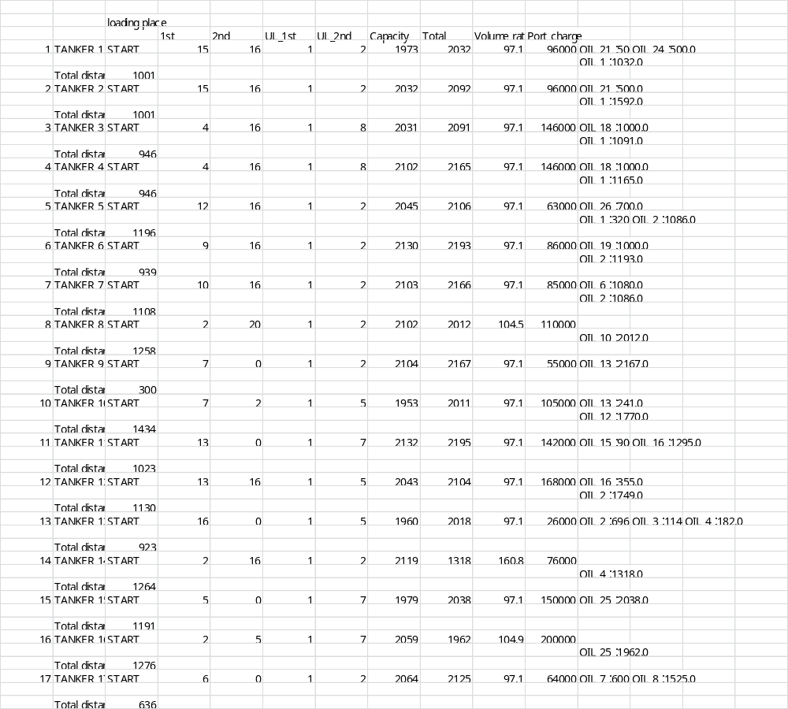
Computational results (Case 2)
Feasible schedule is derived.
 | Proposed method
Tanker | 20
distance | 20188
charge cost | 2132000
Total cost (Lower bound) | 2152188 (1550306.19)
Duality gap | 27.97%
CPU time[s] | 680.25
we can derive a feasible solution in realistic time.
The duality gap is quite large.
The gap has to be reduced.
30
Notes:
In case 2, larger scale problem, the result is as this table.
This is the table of schedule for each tanker. This shows the sequence of visiting ports, capacity, total loading volume, and loading volume of each oil. (Click)
In larger case, we can derive a feasible solution in realistic time. However, the duality gap is quite large. So, it is the problem to reduce the gap.

Slide 31
Computational results
 | Human Operator | Heuristic Algorithm | Proposed Column Generation
Num. tankers | 14 | 14 | 14
Volume ratio [%] | 93.69 | 90.00 | 95.75
Distance [mile] | 13,741 | 12,493 | 12,326
Charge cost [-] | 1,574,500 | 1,596,500 | 1,437,500
Total cost [-] | 1,588,241 | 1,689,993 | 1,449,936 (LB: 1,110,912)
CPU Time [s] | - | 36.7 | 142.4
18
Notes:
The simultaneous task assignment and routing problem is to minimize the sum of task completion time and AGV traveling time.
If the initial location is given to each vehicle, the problem is to find a reachable transition firing sequence to minimize the objective function.

Slide 32
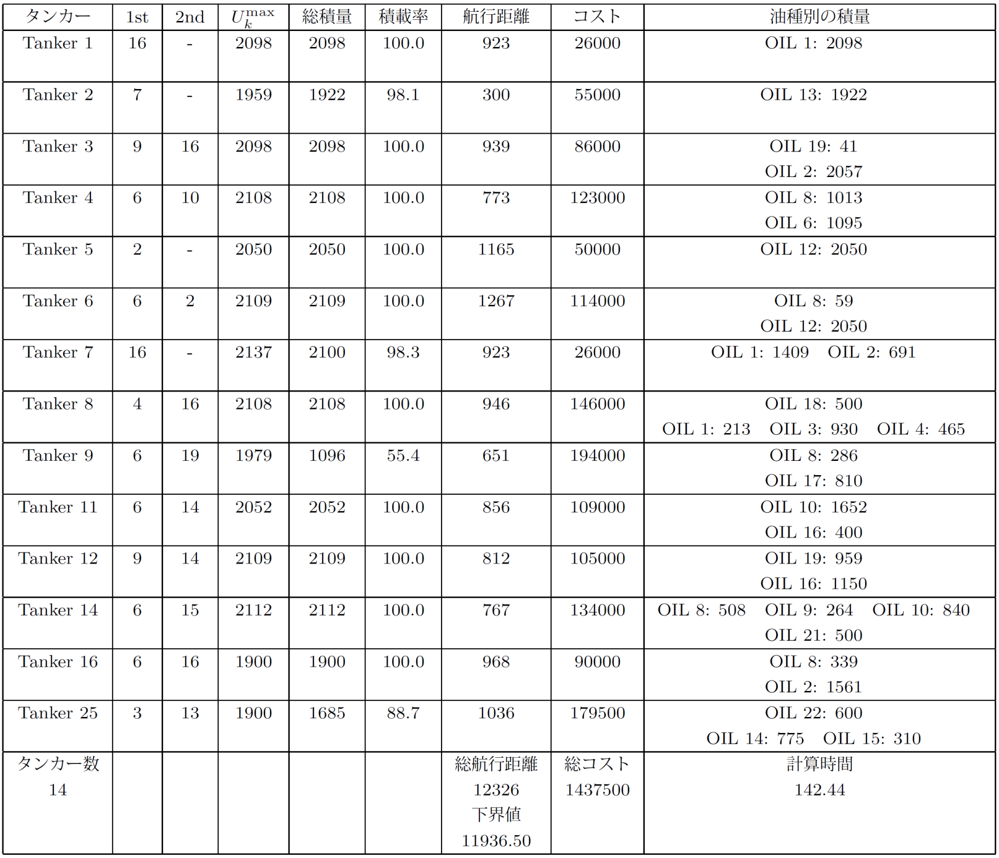
19
Notes:
配船計画の結果は、表の通りに、
各タンカーの泊まる積地や各油種の積量、
航行距離やコストなどが出力されます。
なお、これらの解はすべての制約を満たしています。

Slide 33
Computational results of POPMUSIC
 | Matheuristics | Actual data
Number of vessels | 12 | 12
Total loading miles | 14350 miles | 23133 miles
Total unloading miles | 7622 miles | 6882 miles
Loading port charge | 1079000 | 1139000
Unloading port charge | 1486420 | 1550000
Penalty for supply shortage | 2719000 | 8577428
Penalty for oil type shortage | 19216400 | 27909800
Total costs | 2.80 x 10e7 | 4.39 x 10e7

Slide 34
Computational results of POPMUSIC
Unloading place | Target API | Matheuristic | Actual data
KIIRE |  | 38.5 | 36.1
MURORAN | 36.5 – 37.5 | - | -
SENDAI | 32.0 – 33.0 | 31.2 | 34.0
KASHIMA | 35.0 – 36.0 | 38.2 | 48.0
NEGISHI | 32.5 – 33.5 | 33.3 | 35.4
MIZUSHIMA | 32 – 33 | 36.1 | 35.3
MIZUSHIMA | 31 – 32 | 34.7 | 34.3
OITA | 35 – 36 | 36.4 | 39.1

Slide 35
Conclusion
A column generation and a heuristic algorithm have been proposed to solve the international crude oil transportation problem.
We have developed a construction algorithm to satisfy set partitioning constraints in the column generation.
Computational results demonstrates that the proposed column generation outperforms human operator.
20

