Slide 1





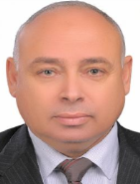
10th Euro-Global Summit on Aquaculture & Fisheries”
October 08-09, 2018, London, UK
Tanta university
Faculty of agriculture
Tanta, Egypt.
WASTE MANAGEMENT FOR SMOKING SALMON BY- PRODUCTS TO EXTRACT OMEGA-3 FISH OIL
Dr. TAREK ZAKI FOUDA
Professor and head of Agricultural Engineering Department Faculty of Agriculture, Tanta University, Egypt.
10th Euro-Global Summit on Aquaculture & Fisheries”
October 08-09, 2018, London, UK

Slide 2
Management and processing of fish by-products and waste
The development and expansion of modern aquaculture began in Egypt leading to a sharp increase in production.
Egypt fish products rise to 1.810 million ton 2018 increased to 2.30 million ton in 2020
fish waste which often represent about 20-50% of the total fish weight.
The fish processing industry generates large quantities of tissue waste and by-products which tend to be either discarded or retailed at low value for fertilizer or animal feed.
10th Euro-Global Summit on Aquaculture & Fisheries”
October 08-09, 2018, London, UK

Slide 3
2020
2017
2016
2015
10th Euro-Global Summit on Aquaculture & Fisheries”
October 08-09, 2018, London, UK

Slide 4
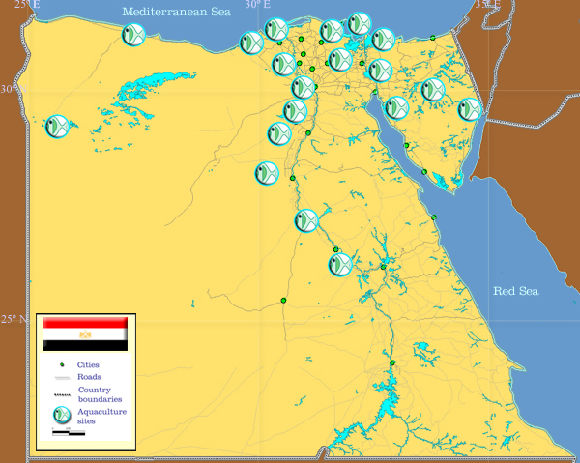
Most aquaculture activities are generally located in the Northern Nile Delta Region, with fish farms usually found clustered in the areas surrounding the four Delta Lakes (Maruit, Edko, Boruls and Manzala). Fish hatcheries are also generally located in the vicinity of the fish farms except for five large Government hatcheries scattered along the course of the Nile in Upper Egypt. The distribution of aquaculture units is shown as blue circles
Fig. Distribution of the main aquaculture production sites (Google Egypt map,)
FAO Fisheries and Aquaculture Department. National Aquaculture Sector Overview Egypt
10th Euro-Global Summit on Aquaculture & Fisheries”
October 08-09, 2018, London, UK

Slide 5

What Is The problem of this Research?
The fish processing industries produce large quantities of fish waste which often represent about 20-50% of the total fish weight.
That it mean we have more than 0.5 million ton from Egypt fish yield (1.810 million ton) in this year 2018 as fish waste
10th Euro-Global Summit on Aquaculture & Fisheries”
October 08-09, 2018, London, UK

Slide 6
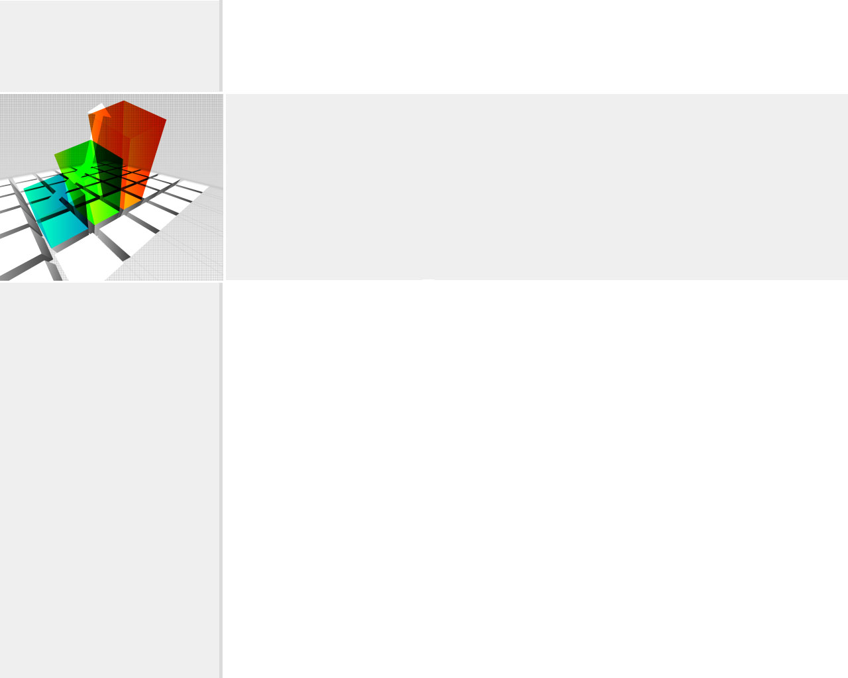
Component of Waste generated from fish
skin 6 %
viscera 7%
off-cuts 10%
head 18%
backbone frames10%).
The fish by product is nearly
10th Euro-Global Summit on Aquaculture & Fisheries”
October 08-09, 2018, London, UK

Slide 7
Component of Waste generated from fish
skin 6 %
head 18%
backbone frames10%
off-cuts 10%
viscera 7%
10th Euro-Global Summit on Aquaculture & Fisheries”
October 08-09, 2018, London, UK

Slide 8
Reprocessing of waste and by-products to fertilizer or animal feed.
Waste and by-products
Fertilizer
Animal feed
Fish Meals
Dried Fish Bone
Fish Skin Leathers
Fish Oil
Fish Oil to Biodiesel
10th Euro-Global Summit on Aquaculture & Fisheries”
October 08-09, 2018, London, UK

Slide 9
Oils extracted from wild salmon by-products are excellent sources of long chain omega-3
Fish oil is a very effective nutrient and contains important omega 3 fatty acids that can be absorbed easily.
Fish Oil Benefits
Protection from Stroke and Heart Attack
Better Brain Function and Higher Intelligence
Less Pain and Inflammation.
Cardiovascular Health.
Lower Incidence of Childhood Disorders
Reduction of Breast, Colon and Prostate Cancer
10th Euro-Global Summit on Aquaculture & Fisheries”
October 08-09, 2018, London, UK

Slide 10
Oil mass in sample
By-products of Salmon smoking waste sample
Samples were collected from Bentleys Egypt company one from Egyptian industrial group, the by-products of Salmon smoking waste (skin, viscera, backbone frames and off cuts), weighted 500 grams and package under vacuum. The raw material of Salmon waste (skin, viscera, backbone frames and off cuts) frozen at -12 °C for one day before it was used in the experiment.
Oil mass in sample determined three times for 100 g. of Salmon by-products by cold pressing and wet rendering methods the oil content ranged between 18.45 and 18.89 g/100 g. Also the oil content obtained through semidried samples and enzymatically treated samples of salmon processing by- products ranged between 16.234 and 18.212 g/100 g. (enzymatic extraction method was considered as the control method)
10th Euro-Global Summit on Aquaculture & Fisheries”
October 08-09, 2018, London, UK

Slide 11
The main objective of this research was to
investigate the possibility of producing fish oil
from smoking salmon waste
by using
cold pressing
wet rendering methods
10th Euro-Global Summit on Aquaculture & Fisheries”
October 08-09, 2018, London, UK

Slide 12
Extract methods
There are many methods to extract fish oil such as wet and dry rendering, solvent extraction, silage production and supercritical fluid extraction.
The wet rendering extraction process
involved first cutting the viscera still frozen into small pieces and putting them in 550 mL boiling water for 20 minutes. Then cooling down for 40 minutes and filtering in a strainer with fast flow rate.
The cold pressing processes
the pressing box have about 10 cm in deep, 30 cm in long, 15 cm in wide and two plate with the same dimensions one of them acting load on the sample's as a small prototype for cold pressing methods. Different compressed times from 10 to 260 min.
10th Euro-Global Summit on Aquaculture & Fisheries”
October 08-09, 2018, London, UK

Slide 13
package under vacuum
The cold pressing processes
Extract fish oil
Samples frozen at -12 °C
Salmon smoking waste, weighted 500g.
The cold pressing processes
10th Euro-Global Summit on Aquaculture & Fisheries”
October 08-09, 2018, London, UK

Slide 14
The wet rendering processes
cool and separate
Extract fish oil
Samples frozen at -12 °C
Salmon smoking waste, weighted 500g.
The wet rendering processes
10th Euro-Global Summit on Aquaculture & Fisheries”
October 08-09, 2018, London, UK

Slide 15
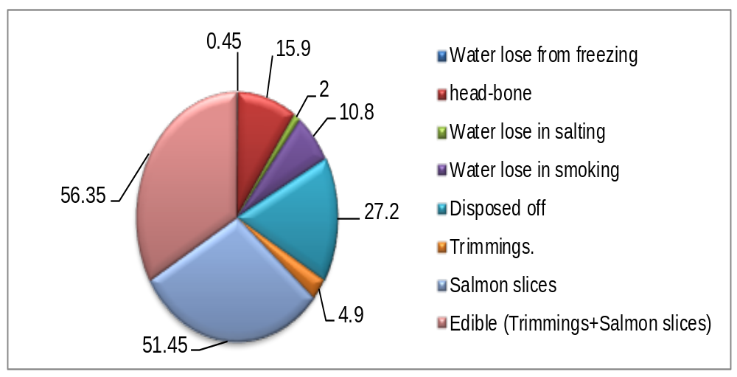
Salmon fish components
Fig. 1. Average distribution of edible portion and by-products percentage in salmon fish
10th Euro-Global Summit on Aquaculture & Fisheries”
October 08-09, 2018, London, UK

Slide 16
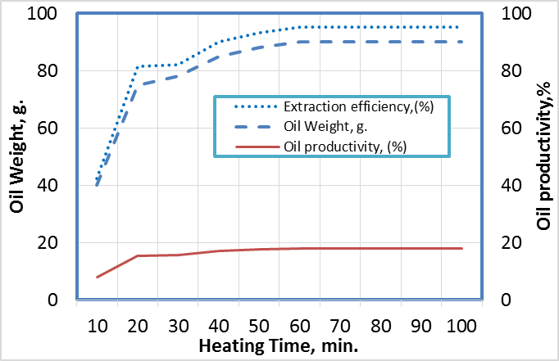
Oil productivity with cold pressing
The results showed that pressing time increased from 10 to 260 min. oil weight increased from 10 to 93 g. oil/500 g.
Salmon by-products, oil productivity increased from 2.00 to 18.60%, and extraction efficiency increased from 10.58to 98.46 % at constant pressure, stress
The results showing steady behaviour after 180 min
Fig. 2 the oil extracted from Salmon by-products with heating time and oil productivity and oil extract efficiency.
10th Euro-Global Summit on Aquaculture & Fisheries”
October 08-09, 2018, London, UK

Slide 17
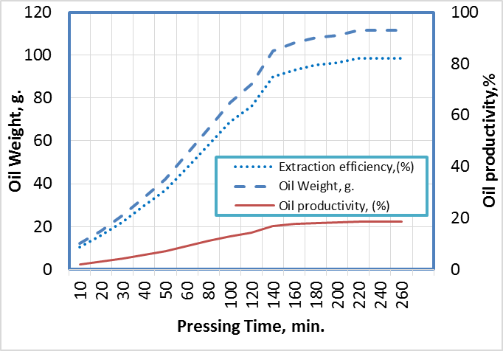
Oil productivity with wet rendering
The results showed that heating time increased from 10 to 60 min. oil weight increased from 40 to 90 g. oil/500 g.
Salmon by-products , oil productivity increased from 8.00 to 18.00%, and extraction efficiency increased from 42.35to 95.23% at constant temperature 100 ºC.
The results showing steady behaviour after 60 min.
Fig. 3 the oil extracted from Salmon by-products with pressing time and oil productivity and oil extract efficiency.
10th Euro-Global Summit on Aquaculture & Fisheries”
October 08-09, 2018, London, UK

Slide 18
conclusions
The important results obtained were summarized in the following:
-The optimum conditions with wet rendering at a constant temperature 100 ºC. and heating time 20 min., oil productivity about 15.40% and extraction efficiency was 81.52%
-The preferred using cold pressing, oil extraction yield increased and characterization of quality. The optimum conditions at pressing time was 180 min., oil productivity was 18.00%, and extraction efficiency were 98.46% at constant pressure.
10th Euro-Global Summit on Aquaculture & Fisheries”
October 08-09, 2018, London, UK

Slide 19
Thanks for your Attention
10th Euro-Global Summit on Aquaculture & Fisheries”
October 08-09, 2018, London, UK

