Slide 1
Safeguarding Adults at Risk of Abuse
Using Person Centred Thinking
Tanya Clover
Notes:
Hello
Thank you for your attention – my sincere apologies for not being here yesterday – and for my departure later today - my child care arrangements have fallen foul!
My name is Tanya – I work as an independent care consultant and trainer.
My background is in the NHS and Social care in the UK –significant roles: consultant trainer for a unified county safeguarding vulnerable adults board – funded by NHS, Social services and the police – and consultant trainer for University of Bradford, School of Heath studies – and associate with Helen Sanderson Associates
I still deliver training for University of Bradford as licensed dementia care mapping and dementia care mapping supported living trainer – have trained extensively across uk and northern Italy.
Have working across adult social care all of my working life – specialising in the support of people living with dementia.
I have just completed a large piece of work – which I will be co presenting at UK dementia conference in November – co delivering with people living with dementia into GP/ front line community health services – changing attitudes, practice and process of how GP surgeries support people living with dementia and their families.

Slide 2
Outline
Adult Abuse: Wide view past and present
Recent legislation and implications (UK)
Personalisation and Balance
Person Centred Thinking and the three Cs
Notes:
My plan today is to talk about Adult Abuse: Wide view past and present, Recent legislation and implications (UK), link this to Personalisation and talk about the importance of Balance before using examples of Person Centred Thinking to illustrate how we can safeguard adults form harm through the three c’s: connection , conversation and community
I hope this is ok for you – there will be time for questions – but ask away if that helps you – and stop me if you have the need!
But before we do - can I ask you to talk to the person next to you – if you don’t know each other introduce yourselves – and then tell them about what you appreciated about one person that you work with, or have come into contact with who has dementia

Slide 3

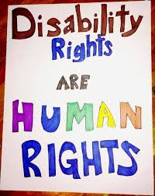
Convictions not just conventions
Notes:
The UK, as I think all/ most countries represented here, are signatories to both the Universal Declaration of Human Rights (proclaimed by the General Assembly of the United Nations on 10th December 1948) and the UNCRPD which came into force on 3rd May 2008
These are, and rightly too, a one size fits all approach to rights
In the UK we have a array of criminal offences (such as the offences against the person’s act 1861) to protect people from people.
We also have the HRA [1998] and The 2014 Care Act to protect people with (and on occasion from) the state or substitute intervention.

Slide 4
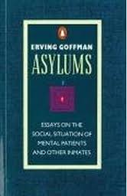
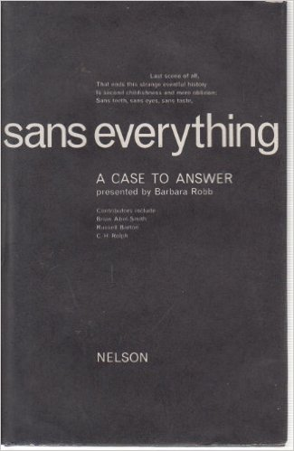
Out of the institutions?
Notes:
If you are interested understanding the why of institutional abuse – you could start with these
In asylums….Goffman descrobes the hiden world of total institutions – check out in the room who works for an institution
Institutions are places where people are brought together under rules – marriage, school, work – being in an institution is often normal – being institutionalised – and governed by and for tat institution shouldn't’t be.
Total institutions- prisons, but also hospitals and care settings. A basic social arrangemtn in modern society is that he individual tends to sleep, work and play in different places, with different co-particpants, under different authorities, or without an over arching plan. The central feature of total institutions, as Goffman tells us, is the breakdown f the barriers ordinarily seperating these three spehers, sleep, work. And play.
Everything happens in the same place
With the same people
Under a tight schedule
For an over arching plan – it may be described as “for thier own good” – but it really meets the needs of the organisations, not the individual
This explored again in the beautiful work by Atul Gawande’s Bieng Mortal – a must read fr all physciians/ practitioners and humanitarians
Shakespeare spoke of "unregarded age in corners thrown…the last scene of all..sans teeth, sans eyes, sans taste, sans everything” (As You Like It)
In 1967 Barbara Robb published a book called Sans Everything: A Case to Answer which explored the marginalisation and mistreatment of the elderly.
You would hope that we have moved on –
But since then we have , in the UK, had investigations into large scale institutional abuses at:
Ely hospital – 1967
Portsmouth Health care NHS trust 1998
Longcare, 1998
Rowan Ward 2002
Cornwall 2006
Sutton and Merton 2007
And not forgetting Mid Staffordshire Hospital 2010 –
And those are just the large, national headlines- there are countless other cases of institutional abuse that do not make the national news
There is a huge amount of positive work underway – but we must never drop our guard – we have moved on from sans everything – but not far enough.
It still pulls at our conscious and holds us to account. I still find people denied basic rights. People are still left without their teeth, their own clothes, their identity, their humanity
in the UK while many care homes offer excellent support, some are not doing enough to provide high-quality, personalised care that helps individuals to live as fulfilling a life as possible. Alzheimer’s Society’s Low expectations report on care in UK care homes found that while 74% of respondents would recommend their loved ones’ homes to others, only 41% said the quality of life of the person with dementia was good (DoH 2013).
So – where do we go

Slide 5
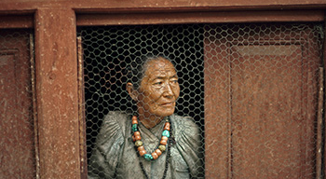
World Elder Abuse Day: June 15th
Notes:
The global population of people aged 60 years and older will more than double, from 542 million in 1995 to about 1.2 billion in 2025. Around 4 to 6% of elderly people have experienced some form of maltreatment at home. Elder maltreatment can lead to serious physical injuries and long-term psychological consequences. The incidence of abuse towards older people is predicted to increase as many countries are experiencing rapidly ageing populations.
Elder abuse is a global social issue which affects the health and human rights of millions of older persons around the world, and an issue which deserves the attention of the international community.
"On this Day, UN Secretary-General Ban Ki-moon calls upon Member States and civil society to strengthen their resolve and redouble their efforts to eliminate all forms of violence and abuse against older people."

Slide 6
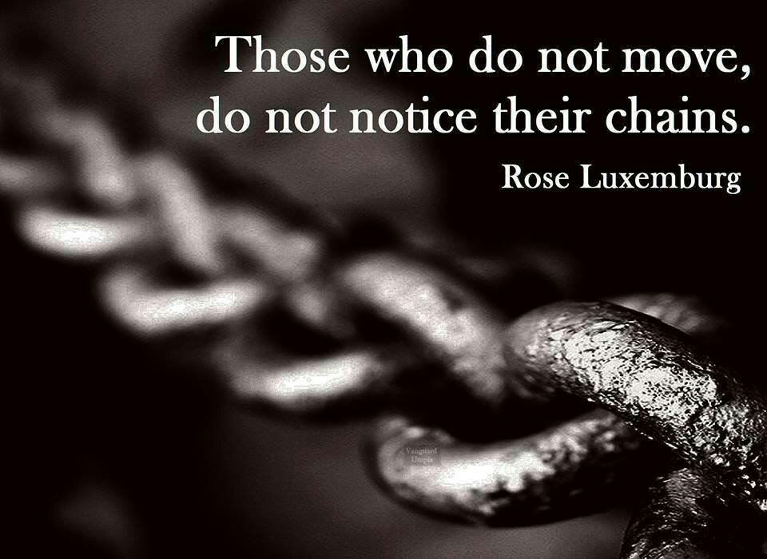
Notes:
Perhaps people are not complaining in care homes because they do not over –and therefore do not notice their chains
Controversial Marxist ideas – but they have relevance

Slide 7

Notes:
The Care Act 2014 in the UK placed a responsibility on local authorities, or those discharged to carry out their role, to promote wellbeing
‘Wellbeing’ is a broad concept relating to
Personal dignity (including treatment of the individual with respect)
Physical and mental health and emotional wellbeing
Protection from abuse and neglect
Control by the individual over day-to-day life (including over care and support provided and the way it is provided)
Participation in work, education, training or recreation
Social and economic wellbeing
Domestic, family and personal
Suitability of living accommodation
The individual’s contribution to society
The Act therefore signifies a shift from existing duties on local authorities to provide particular services, to the concept of ‘meeting needs’

Slide 8
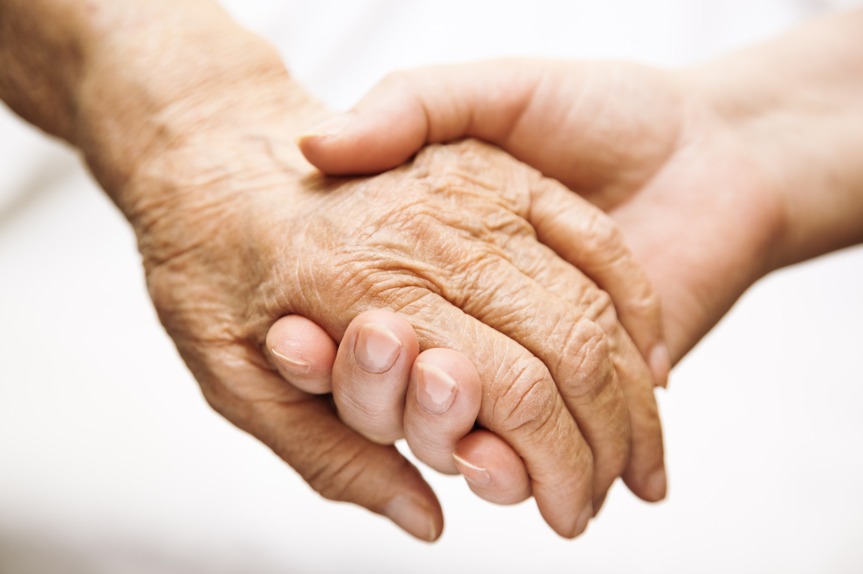
Notes:
The aims of adult safeguarding are to:
Prevent harm and reduce the risk of / stop abuse or neglect to adults with care and support needs
Safeguard adults in a way that supports them in making choices and having control about how they want to live
Promote an approach that concentrates on improving life for the adults concerned
Raise public awareness so that communities as a whole, alongside professionals, play their part in preventing, identifying and responding to abuse and neglect
Address what has caused the abuse or neglect
People have complex lives and being safe is only one of the things they want for themselves. We should work with the person to establish what being safe means to them and how that can be best achieved.
We should not be advocating ‘safety’ measures that do not take account of individual well being.

Slide 9
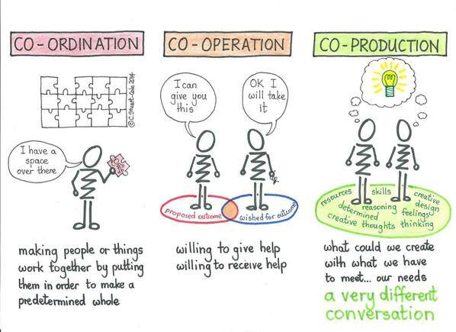
Image: graphics on the go Art Work Stuart Cole
Notes:
In order to achieve these aims, it is necessary to:
Ensure that everyone, both individuals and organisations, are clear about their roles and responsibilities
Create strong multi-agency partnerships that provide timely and effective prevention of and responses to abuse or neglect
Support the development of a positive learning environment across these partnerships and at all levels within them to help break down cultures that are risk-averse and seek to scapegoat or blame practitioners
Enable access to mainstream community resources such as accessible leisure facilities, safe town centres and community groups that can reduce the social and physical isolation which in itself may increase the risk of abuse or neglect
Six key principles underpin all adult safeguarding work
Empowerment, Prevention, Proportionality, Protection, Partnership, Accountability

Slide 10
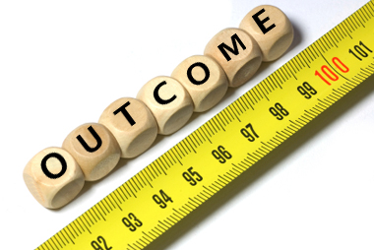
Notes:
The core purpose of adult care and support is to help people to achieve the outcomes that matter to them in their life. The provisions of the Care Act are intended to promote and secure wellbeing and it is clear that protection from abuse and neglect is a fundamental part of that. Safeguarding should be person-led and outcome-focused.

Slide 11
“Personalisation is only recognising something essential in human life – which is that everyone is an individual, like it or lump it”
(Stephen, a person receiving support)
Notes:
Personalisation is only recognising something essential in human life – which is that everyone is an individual, like it or lump it (Stephen, a person receiving support - SCIE 2010)
Personalised services are coproduced - meeting a person’s needs and ensuring they maintain choice and control over not only how those needs will be met, but also fundamentally which needs
To be able to deliver we need to know what is important to a person, how best to offer support, how they communicate and make decisions –and what is working and not working
Peron centred thinking refers to a range of tools and skills – in your hand and in your head – that carers/ supporters can use on a day to day basis to deliver more personalised services.

Slide 12
“For many people with a disability the status quo is [that of] isolation, invisibility and dependence. Their identity is defined by others, they live to other people’s clocks, and their life is restricted by the absence of their own power or by the misuse of other people’s power”
(Pete Ritchie (2002)
Notes:
Person centred planning refers to planning that centers on the person’s hopes and dreams for the future. It has a strong focus on the strengthening of a persons’ presence and contribution to their community, and of asset based community development (ABCD)
Person centred planning is designed to overcome inertia – the tendency for things to continue in a straight line. For many people with a disability the status quo is often isolation, invisibility and dependence. Their identity is defined by others, they live to other people’s clocks, and their life is restricted by the absence of their own power or by the misuse of other people’s power” (Pete Ritchie (2002)
People with disabilities have, for years, been fighting for independent living and full citizenship (image - stuffing round peg into blue hole – not even the right colour let alone right shape) PC thinking and planning is a way to connect fundamental beliefs about what people want with practical ways of making things happen for individuals.
The shift in control- choice and control - away from professionals and organisations back to the person is the social model. The social model helps us to se that the disability is not a condition of the person. The experience of disability is affected by the restrictions imposed (overt and covert) by the social psychology that surrounds them. Here care and support should not seek to fix the person –but to adjust/ diminish and remove the obstructions.

Slide 13
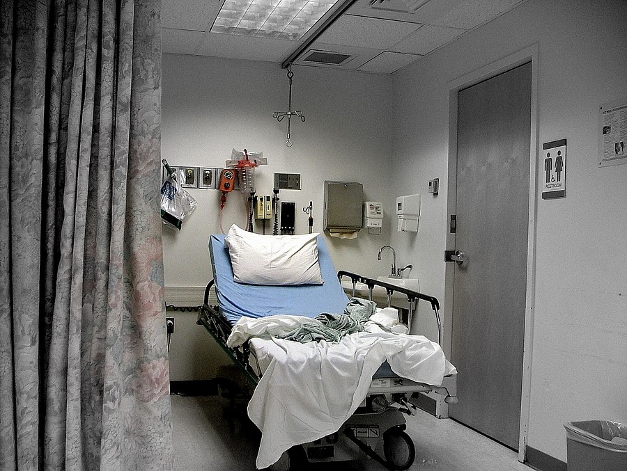
Framework for Accomplishment (O’Brien and Lyle 1987)
Sharing ordinary places
Making decisions
Developing abilities
Being treated with respect & having a valued social role
Growing in relationships
Notes:
Principles of normalization developed from thinking by Bengt Nirje and Wolf Wolfensberger in the late 60’s and early 70’s – argument that peple with a disability should have a position in society, which is equal to - and valued by – people without disability.
The framework for accomplishment was developed out of Wolfensberger collaboration with John Obrien and subsequently his collaboration with Connie Lyle. The framework proposed 5 domains, which are widely agreed to be important in shaping people’s quality of life – interestingly mirrored as domains where people living with disabilities are likely to be disadvantaged by society.
Those domains:
Sharing ordinary places
Making decisions
Developing abilities
Being treated with respect and having a valued social role
Growing in relationships
It is hard, I would say impossible, to do that in clinical, barrier rich and power based settings
PC thinking and planning ahs been part of UK policy since the turn of the century – not a fad – a natural development over 30 years – evidence based
All PC practice share a common set of values:
Independence and rights
Co-production, choice and control
Inclusive and competent communities.
Co production – cannot happen without appreciation of the person’s existing gifts, skills and qualities – gifts describes the person’s difference- difference and diversity create opportunities –for conversation, interaction, connection, respect, growth

Slide 14
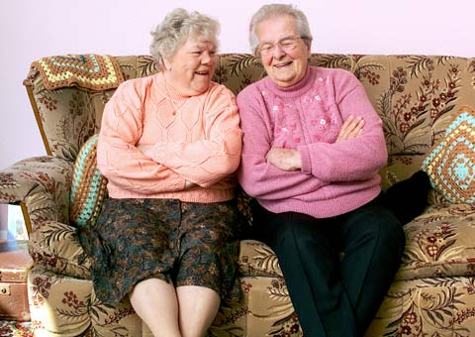
Notes:
Research, a multitude of reports and my own practice experience tells me that when people become increasingly isolated and cut off from families, friends and community, they become vulnerable to abuse and neglect.
So – to reduce the risks for people living with dementia, no matter where they live, we need to reverse this – we need people to Share ordinary places, to Make decisions, to maintain and Developing abilities, to grow in relationships – and by these - people living with dementia are more likely to be treated with respect and have a valued social role
How?
I would like to take the social model -specifically its adaption for those living with dementia which we refer to as the enriched model – take it further and link to PC thinking to show how the model helps us to be aware of the potential presence of abuse – and how it can support change to minimise risk/ reduce opportunity for abuse to occur
..

Slide 15
D = NI + H + P + B + SP
Notes:
Talk trough- include abuse / risk of abuse in SP

Slide 16
D = NI + H + P + B + SP

Slide 17
D = NI + H + P + B + SP

Slide 18
D = NI + H + P + B + SP

Slide 19
D = NI + H + P + B + SP

Slide 20
D = NI + H + P + B + SP

Slide 21
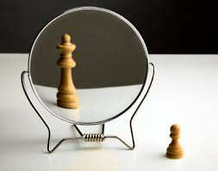
Notes:
Progressive services – embracing PC thinking – are shifting the paradigm – holding up the mirror to society/ social psychology – and demanding that SP change and adapt – that we walk alongside – be guided by – and learn from people.
Fundamental to that progression has to be the acceptance of people living with dementia by care and support services as having a disability, and in our coproducing care and support services with them that are predicated on the social model.
People may need medical intervention- but they live in a social world.
Too often in health and social care I see the person living with dementia described/ labeled – again overtly and covertly - as the problem. And services are geared towards fixing them. We need to see the person for who they are, know what is important to them and how best to support them, know what makes a good day, a bad day, what works and does’t work - and along with their hopes and dreams – we can help to create the communities we would want to live in .

Slide 22
The quality of our lives
depends on the presence or absence of things
that are important to us
Notes:
Read

Slide 23
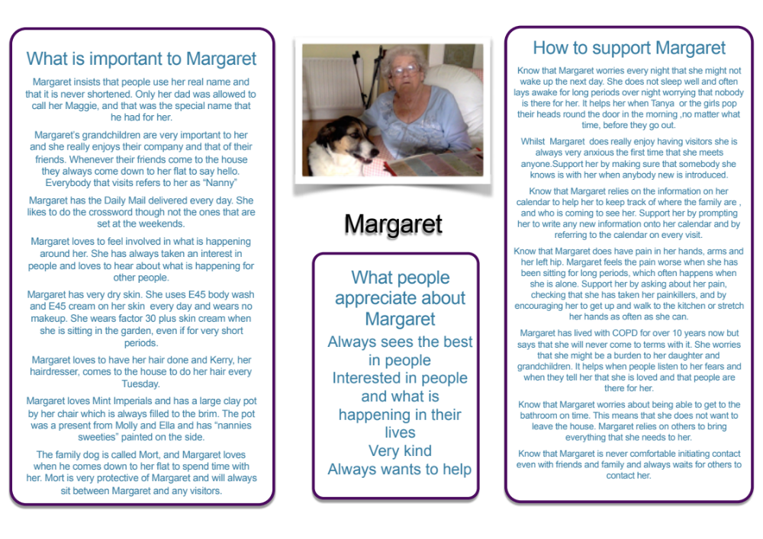
Notes:
One page profiles are a key person centred thinking tool. Profiles explore the balance between what is important to the person to be happy and fulfilled and what is important for the person to be healthy and well.
Meet Margaret
This profile was developed when Margaret lived at home – Margaret lived with her daughter ad granddaughters – but the were out at work/school in the day – and Margaret needed support from carers
This profile helped any new cares to get to know Margaret as an person – beyond her obvious physical health care needs
The 1PP is definitely a shiny outcome – put the power – the power comes from the conversations that you when you build and then review the profile.

Slide 24
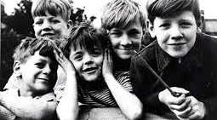
Important to
Notes:
Dot loves to be surrounded by children, has had three daughters of her own and has been a foster mother to over 20 children. Her daughter, Jayne, laughs that her mother would always take in “waifs and strays” from the street, and that you would never know who you would be sat next to at the dinner table when you got home from school. Jayne says that they never had much money, but there were always fresh baked flapjacks on the table, and dinner enough for everyone. “Strangers or kin” Dot says, “ are welcome at my table”.
Knowing this – we knew that it was important to Dot to be with people – combining this with her love to cook and give –Dot now helps staff to make cakes and hand round the cakes – is always center stage at any party – and we know that she prefers this to going out to a café or cake shop – she dis trust shop bought cake!

Slide 25
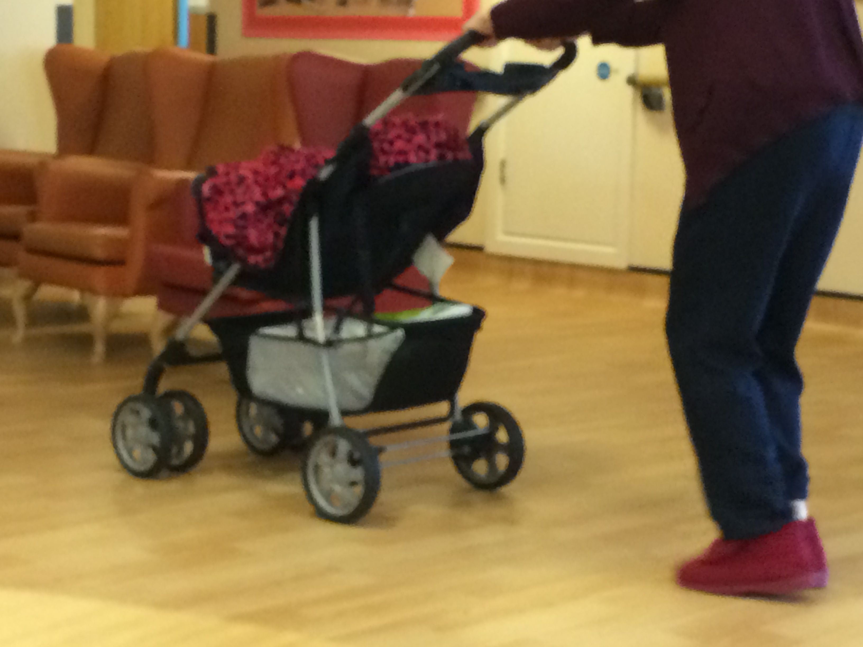
Best support
Notes:
Meet Jenny…this is always the view you will get –
It is has always been importantt to her to walk
But she doesnt recognise a walking frame or what it is for – as she became frailer she found it harder and harder to walk alone –eventually without a walking frame or assistance she stopped being abel to moev around- sitting all day in her chair she bacme even frailer, and cross! She stopped eating as well, withdrwew form support, lost who she was
In conversation we found out that she had 6 children – and (the words of one of her daughters ) “umpty flumpty grandchildren and great grandchildren”
Jenny does’t recognise a walking frame- but she recognises a pram. The staff brought one for her – they put heavy weights in the base to stop it tipping – they wrapped the weights in a children’s nappy bag.
Jenny walks all day – she enjoys this – she is eating more – she stops to talk – she will run into you if you dont stop and talk to her! – reducing isolation, returning her role has given her a renewed sense of self esteem –she is more acceptant of care and support – the inceased moevemnt is strengthening her quads’ imprvoving her balance - increasing her health

Slide 26
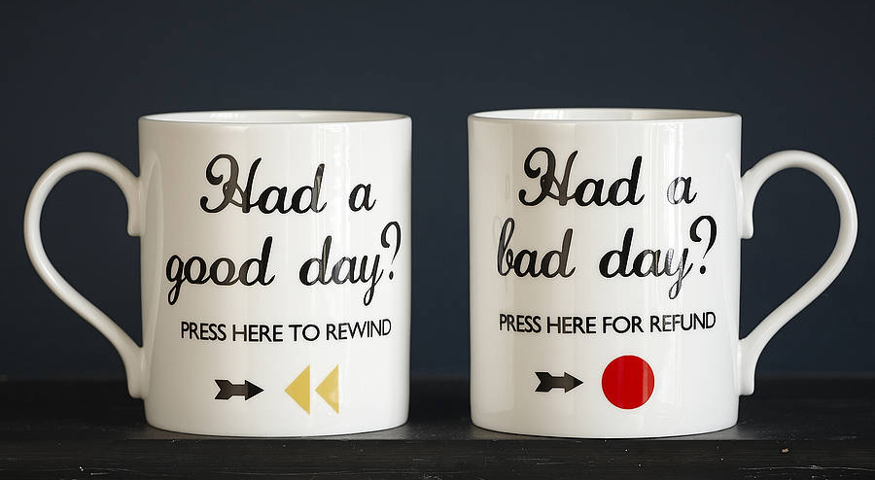
Good day/ bad day
Notes:
We ask people about what makes a good day – what would they eat, do, wear, see, who would be there, what would they talk about – just think- what could make your best ever day
Obviously – we try to create as many good days as possible
But we also ask about bad days – what would be the worst day possible – we would never create this! But it helps us to know what to avoid in our planning – but also explain, on review, actions and reactions in situations - especially if the person was unable to use words fully to explain.
Dolly is described by all that know her as a warm, loving and funny lady who will give her last penny if it would help another or make them happy. She loves to talk to people, and says that the only thing better than talking to an old friend is meeting a new one.
Part of a very large family, she was sent out to work in the “big houses” when she was 14 as a cleaning maid. She stayed in domestic service for the rest of her working life, moving between large houses and smaller private homes as a cleaner.
She has always been a busy and everyone says she has always been a great one for lists, making a list first thing in the morning to tick off, and last thing at night so that she knew what she needed to do the next day.
Dolly hates the thought that others might see her as lazy or slovenly, so she never rises later than 7 am and always goes to bed at 9pm.
A bad day for Dolly is when her morning tea is late – she starts to panic that she is going to be late – that she will be in trouble –or worse left alone. If her day starts late it makes Dolly feel anxious and distressed all day – her distress at times can be so great she does’t eat well, feeling to distress to be in the dining room with others.
A good day – starts well – of course- but it is also important to Dolly to end her day well –and for her that means planning the next day – and letting otters know! She will write out post it notes to give to staff a every evening to remind them that she needs a cup of tea at 7 am. She starts to write these about 5pm, and will give them to people as they pass her. She will be distressed if people say they already know, or that they do not need her note to remind them.

Slide 27
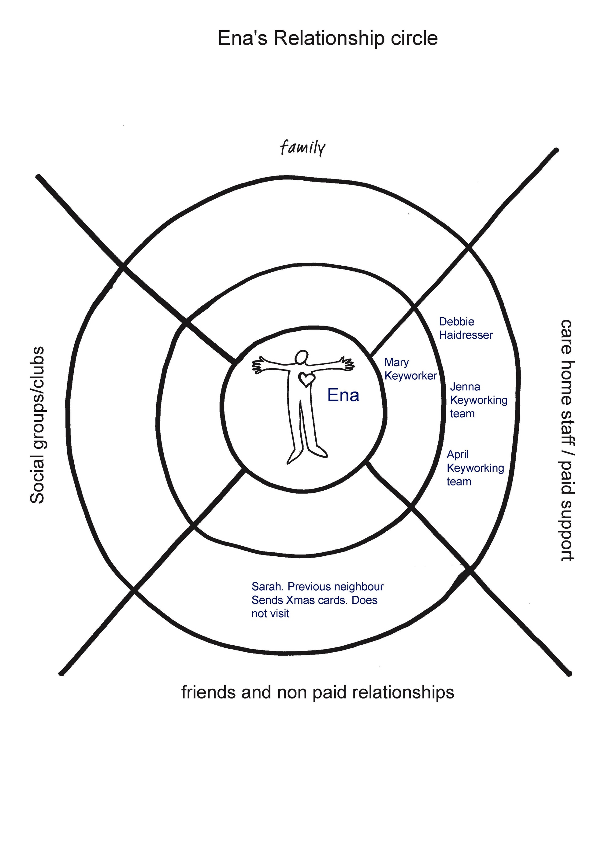
Notes:
Edna tended to spend the majority of her day in bed. She often made loud sounds clearly indicating distress. In developing her one page profile I sat and spoke with her and her keyworker. Her relationship circle identified in a starkly visual way that she had no contacts in her life apart from paid care staff. A relationship circle is a very powerful way of showing the connections and opportunities for relationships that the person has. In conversation she said she did not always recall why she might call out, but thought that it might be because she gets lonely at times and just wants reassurance that people are nearby and haven’t forgotten her.
I was able to share this information with staff, creating a greater understanding of the best support for her. During the meeting we also found out that this lady loves to have a glass of red wine with her meals. Staff asked her if she would like a glass that day. Her eyes lit up and she said very clearly “yes please” and staff now ensure this happens every day.
The act of entering her room, saying hello, even just bringing and taking away the glass all offer opportunity for contact that reduces isolation and raises self-esteem, together reducing the risk of abuse.

Slide 28
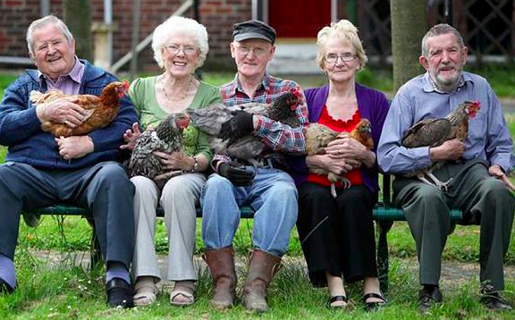
Notes:
- meet – Ruth and her friends - Ruth is taking part in a scheme where isolated older people have been given hens to look after as part of a new project to tackle social isolation! The project, known as Hen Power, has launched in London for the first time following a successful pilot in the North East. It is designed to help tackle social isolation, reduce depression and improve people’s wellbeing. There are 700 older people currently looking after hens in 20 care homes in the North East and the charity behind the scheme, Equal Arts, has been given Lottery funding to roll it out country-wide.
If we are to support communication We need more hens!
click

Slide 29
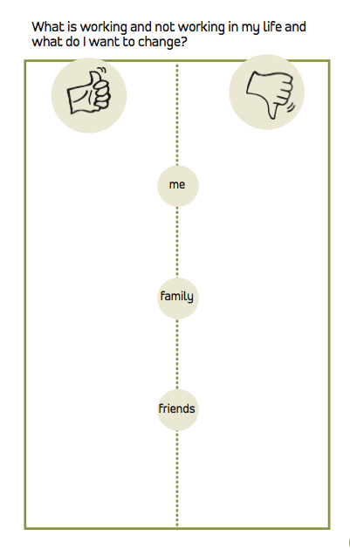
Notes:
I met Raymond and his daughter Val when I facilitated the meeting to create Raymond’s one page profile
Raymond had been living at the setting for a few months, but for all of that time staff had been unable to support him to have a bath. It was only Val who could persuade him to do so when she visited. This placed a strain on their relationship , as Val explained, because she felt that she could not enjoy time their precious time together as she felt obliged on every visit to help him to wash and change his clothes
She felt able to talk about this during the 1pp meeting when I asked her what did’t work. Similarly, the staff member who attended also said that bathing Raymond was something that did’t work for staff.
Val said that maybe it was because the staff were singing the wrong songs. It was that simple! Raymond would love to sing as he washed and changed. Val had discovered this and always sang and danced along with him. Staff now sing and dance. Raymond relishes the sing along in the bath, and Val’s visit now consist of time spent chatting and laughing. After the meeting she shared that the tress of having to deliver care was becoming so overwhelming that she had considered not visiting at all. But that it was only her concern about his care that kept her visiting.
Like Val, many family carers may feel overwhelmed about the role and responsibility of caring. Open and honest discussion, using the tools working, not working and also good day and bad can help to both uncover concerns and share solutions

Slide 30
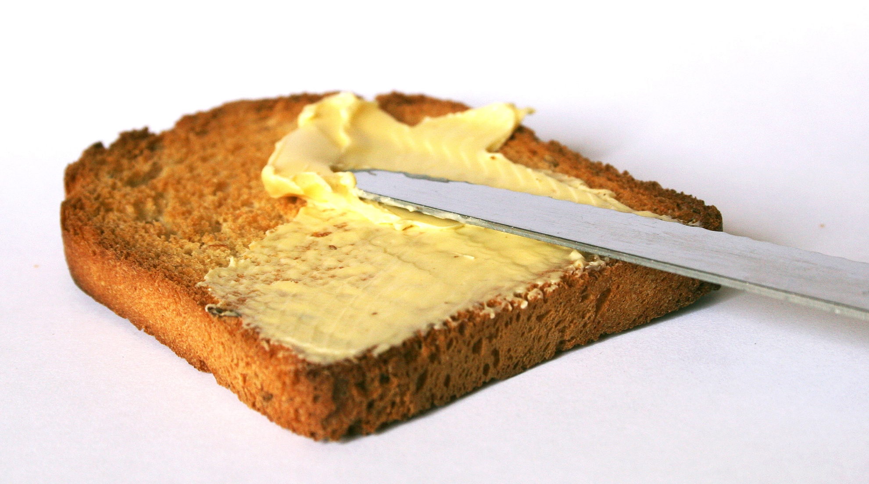
Notes:
One thing we often ask when building a person’s one page profile is about routines- not time routines, but personal patterns that sustain our self esteem
The simplest questions often generated the most passionate conversation.
So- How do you have your toast?
Hot, or cold? Squares or triangles? Butter or margarine?
Reflections and very powerful conversations tell us how much we know, and what we may not know about the people we support.
One page profiles share so much in a clear and simple way. It is the conversations that we have to develop them that have power
It is important for me to have a health breakfast – it is important to me that my toast is cut from home made bread, thick, and cold before being buttered and with honey.
If you want to make change – start small.
It is often the smallest of details that make biggest of differences to our day. So, next time you have the chance, spend the time and find out how people have their toast.

Slide 31
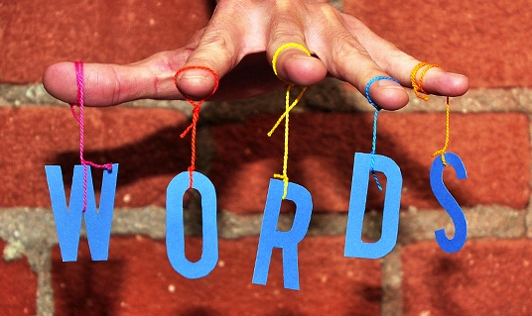
Notes:
This is about creating good conversations- but not about more paperwork –its about being mindful of what we write –its about good paperwork!
Words are very important - how we use them, how we constrain them can change their value and impact
The way that care is described in care reports can give an insight into the deep, often subconsciously held beliefs about people living with dementia held by professional care staff. Labels such as ‘wanderer’, ‘feeder’, and ‘double hander’ are endemic throughout traditional paperwork. A carer would never say ‘good morning feeder’, yet traditional paperwork, constructed as it is out of sight and without the input of the person, allows for such depersonalised language to exist unchallenged. It could not be sustained within a dialogue that holds the person as present, even within the written word. Personhood is sustained through the depth of relationship around the person.
Protection will not come about simply from telling people what is right or wrong, or from right down what we should do - If it were, society would enact laws and all abuse would cease. With the existing raft of legislation and human rights declarations worldwide we can see that this has not happened.
we must be the person we want to meet- create the community we want to live in

Slide 32
5:1
Notes:
And finally- and of course – every one page profile, every 1PP meting, starts with appreciation - with the staff in the room addressing the person and telling them what they appreciate about them – no “but". Or “however” – a list or even a word of honest appreciation- Research tells us that a 5:1 ratio of appreciation to criticism helps us to be more positive and productive.
How often does that happen for people in many mainstream services? Staff as well as people we support? – we know that low self esteem creates a risk of vulnerability to abuse – a person with low esteem may not feel they are worthy/ may feel they deserve what is happening to them. But a person with high esteem – is more likely to speak out/ to be assertive –to be safe
How do you appreciate the people you support? – but wait –before we get there how are you, and your staff appreciated? In all that we do we start with staff – we appreciate people – at the beginning of my presentation I ask you to share what you appreciated about one person that you work with, or have come into contact with who has dementia– at this event when you are back at work - I ask that you go and tell them what you appreciate about them – if you haven't already!

Slide 33

Thank you
Tanya Clover
tanya@clovercareconsultants.com
+44 7592 048 395
@Tandealkent
www.clovercareconsultants.com

