Slide 1

Sexual Partners and Condom Use Attitude: Qualitative Findings among Injecting Drug Users in Hai Phong, Vietnam
2nd International Conference on HIV/AIDS, STDs & STIs
Las Vegas, 2014
Tanvir Ahmed, PhD Candidate
Public Health & Health Promotion, School of Medicine
Population & Social Health Research Program, Griffith Health Institute
Notes:
This is Tanvir Ahmed. I am a PhD candidate in Griffith University, Australia.
I welcome you all to the presentation titled “sexual partners and condom use attitude: Qualitative findings among injecting drug users in Hai Phong, Vietnam:” which is a part of my PhD research.

Slide 2
CONTENTS
Project background
Introduction
Methods
Findings
Limitations
Conclusion
Notes:
During my presentation I will cover these topics. I will start by a briefing on my PhD research, then introduction, methods, findings, limitation and conclusion

Slide 3
RESEARCH BACKGROUND
Research project
HIV Infection and Behavioral Risk Factors among Injecting Drug Users (IDUs) in Hai Phong, Vietnam
  A multiphase research
  Phase 1 (Quantitative) and Phase 2 (Qualitative)
Quantitative
  HIV prevalence and Risk Factors
  Correlates of Sharing Practices
  Correlates of Condom Use
  Qualitative
  Drug injecting and HIV Risk
  Sexual Behaviours, Partners and Condom Attitude
Notes:
The title of my PhD research is “HIV infection and behavioral risk factors among injecting drug users in Hai Phong, Vietnam” which is a multi phase research project.
Phase1 is quantitative and phase2 is qualitative
Quantitative part deals with epidemiological aspects and investigates HIV prevalence and different correlates of sharing and condom use
Qualitative part provides detailed understanding of drug injecting and sexual practices

Slide 4
INTRODUCTION
HIV epidemic in Vietnam
HIV testing started: 1988
First HIV case detected (southern): 1990
First ‘epidemic boom’ among IDUs (southern): 1993
Epidemic well-established among IDUs: 1995
Other groups affected (e.g. FSWs): 1995
Epidemic shifted (southern to northern region): 2000
Initially older people in southern part
Later younger people in northern part

Slide 5
Introduction (1)
Key Features of HIV Epidemic among IDUs
Majority male (sampled 80-90%) & unemployed,
Single (60-70%), young age (20-29 years),
Short transition from non-injecting to injecting (8-14 months),
Injecting heroine currently,
Injecting in ‘public places’ (rail lines, street, park),
Involve in ‘social injecting’ ‘resource pool’ ‘shared drug use’
High rates of sharing practices
Being injected by others (dealer, friend)
Majority sexually active (last 6 months) with multiple partners

Slide 6
Introduction (2)
HIV epidemic in Hai Phong
Location: East of Hanoi (102 km), close to sea
Also close to heroine shipment route linking heroine producing ‘Golden Triangle’
HIV Situation: First HIV case 1994. Reached 1% (1997) to 32.8% (1998); 60-70% till 2005 and dropped to 48% in 2009.
Young IDUs, sexual mixing with FSWs and sharing
Early diffusion and crossover between IDU & FSW

Slide 7
SIGNIFICANCE, AIMS & OBJECTIVES
Significance
Lack of a qualitative understanding on recent sexual transmission risk among IDUs. Because
Previous research mainly quantitative,
Younger IDUs, PLHIV or young People,
Focus on ART, risk behavior, MMT program,

Slide 8
Significance, Aims & Objectives (1)
Aim
To highlight the drug injecting and sexual behaviors having transmission risk and allow an improved understanding of the potential factors that contribute to the high level of HIV prevalence.
Objective
To focus on the experiences and views of IDUs relating safe-sex practices, and
To identify protective and non-protective condom use attitude with different partners

Slide 9
METHODS
Design, Recruitment & Data Collection
Qualitative (follow-up interviews) research design
Fifteen IDUs (13 male & 2 female) participated
Semi-structured (face-to-face) interview conducted
Purposively selected by snowballing technique
Convenient location used for interviews/discussion
Each interview took 45 minutes (approximately)
Two interviewers conducted the interviews (Vietnamese)
One supervisor engaged in supervising & recruiting
Topic guide with necessary probes and points used

Slide 10
Methods (1)
Data Analysis
Scripts reviewed to remove any personal identifier
Transcribed from paper to file (verbatim)
Translated (double checking, randomly back translation)
Key themes, sub-themes identified (topic guide, objectives)
Thematic analysis conducted manually (TA framework used)
Presentation
Direct quotes with recurring sub-themes presented in tables
Relational diagram drawn by ‘partners types’ with ‘attitudes’

Slide 11
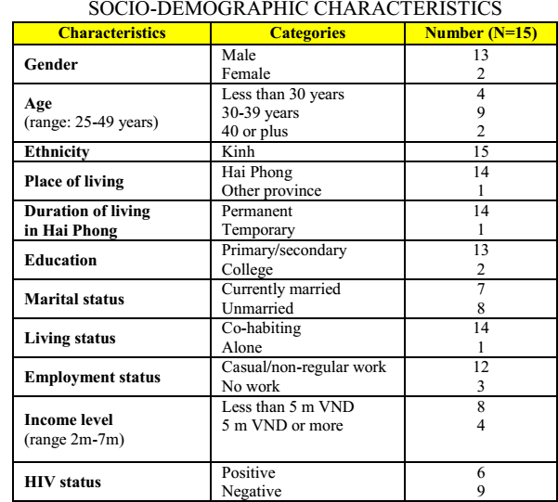
RESULTS
Profile of Respondents
Access different social networks
Mixed groups (young, old, HIV infected, FSWs)
Notes:
We have accessed different social networks of IDUs and a mixed group of participants participated in the interview
As presented, we had age differences young, adult, older, married and unmarried, status of HIV

Slide 12
Results (1)
Sexual Behaviour
All had sexual debut in the early twenties.
First experience majority with FSWs or girl friends
Engage in relationship other than wives or regular partners
Having sex with FSWs is common
Contexts of Involving Sex with FSWs
Marital status
Younger or older
Special event celebration (birthday, cultural program)
Having extra money

Slide 13
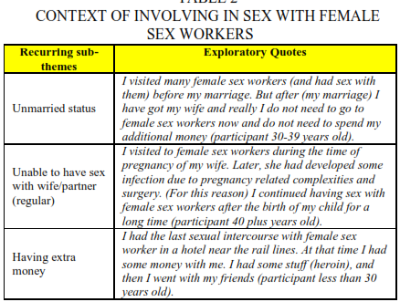
Results (2)

Slide 14
Results (3)
Views on Condom Use
Young & new injectors frequently engaged in sexual behaviours than older
They have interesting views on not using condoms
Contexts of Not-using Condoms
Not considered as important | Not considered as necessary
Negotiate with FSWs | Lack of awareness
Clients do not like | Exchange drug or extra money
Partner does not want | Wrong self-assessment

Slide 15
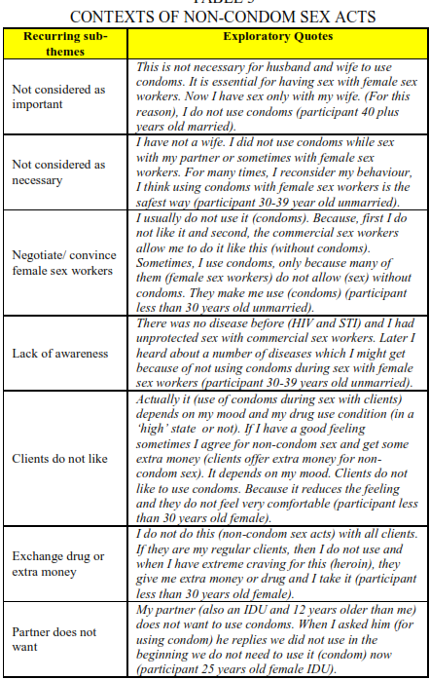
Results (4)

Slide 16
Results (5)

Slide 17
Results (6)
Contexts of Condom Use
HIV infected and older IDUs mainly engaged in safe-sex.
The contexts include:
Suspicious about STIs
Family consciousness
Client negotiation (empowerment of FSWs)
Protection against pregnancy
Scare about HIV infection

Slide 18
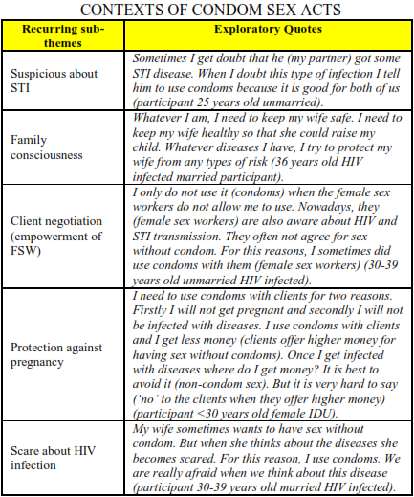
Results (7)

Slide 19
Results (8)

Slide 20
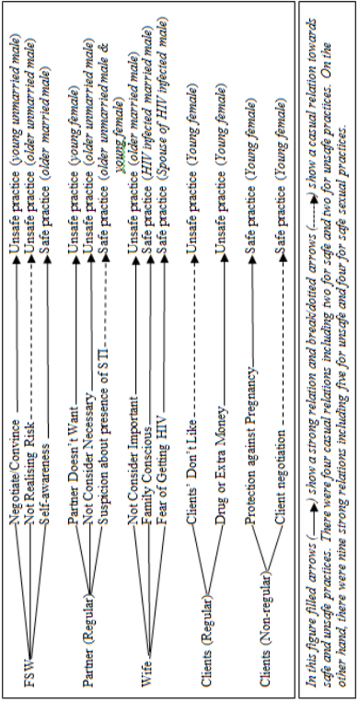
Results (9)
Relational Diagram
Transmission risk by partner types and condom use attitudes
Notes:
This is a relational diagram showing condom attitude by partner types. The transmission risk associated with unsafe sexual practices among young male, female is clearly visible

Slide 21
LIMITATIONS
Limitation
Not representative (participants from a broader research)
However our mixed group includes multiple social network
Focus only sexual behaviours and condom use attitudes not presented accessibility to HIV prevention services
    Getting free condoms did not appear as protective attitude
Few participants with con-current multiple partner relationship However we highlighted their previous experiences

Slide 22
RESEARCH IMPLICATION & CONCLUSION
Risk of sexual transmission exists among IDUs
Young male and female
Protective attitudes should be encouraged to sustain safe practices
HIV infected IDUs and older male
Non-protective attitudes should be addressed to convert into safe practice
Young male and female (unmarried)
Safe-sex education should be strengthened with a focus on partner relation (types of partners)
Knowledge on HIV transmission and prevention should be strengthened

Slide 23


