Slide 1
Early Life Intervention Diminishes Manifestations of Sjögren's Syndrome in NOD.H-2^{h4} mice
Tamer Mahmoud
Postdoctoral Fellow
Rachel Ettinger
Senior Scientist

Slide 2
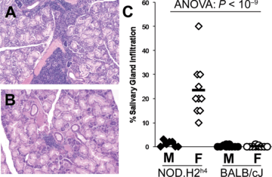
Clinical Manifestations of Sjögren’s Syndrome in Humans and Mice
Sjögren's Syndrome is the 2nd most common autoimmune rheumatic disease characterized by:
↑ Autoantibodies
Ectopic lymphoid follicles in the salivary and lacrimal gland
↓ salivary and tear flow
↑ Female predisposition (9:1)
NOD.H-2^{h4} mice recapitulate many of the human clinical presentations
Salivary Gland
F
M
60 weeks of age
Cihakova, D. et al. Contemporary Challenges in Autoimmunity. 1173:378-383 (2009).

Slide 3
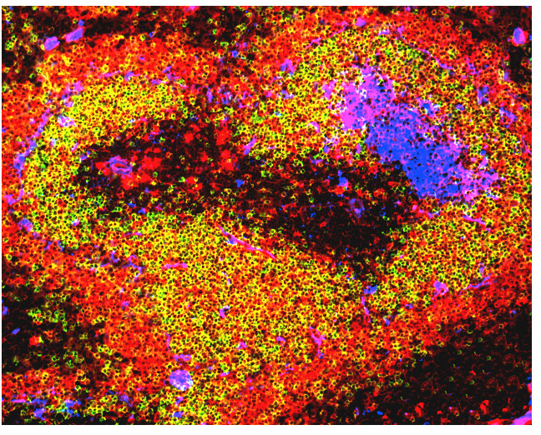
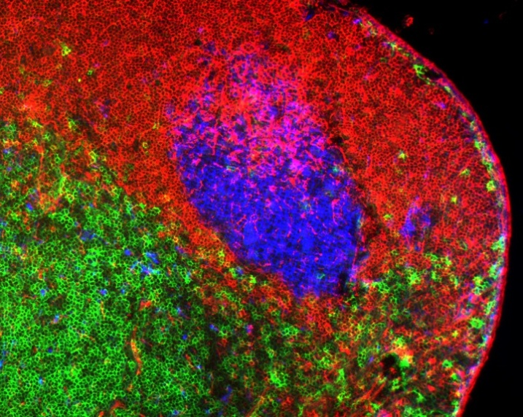
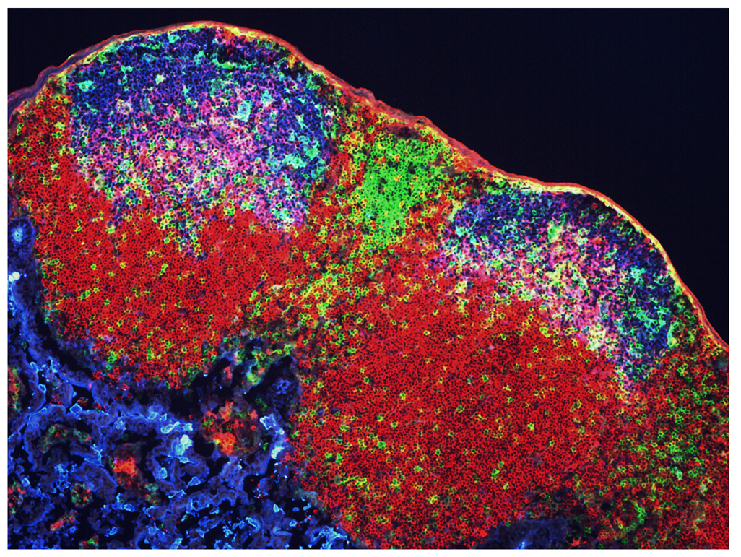
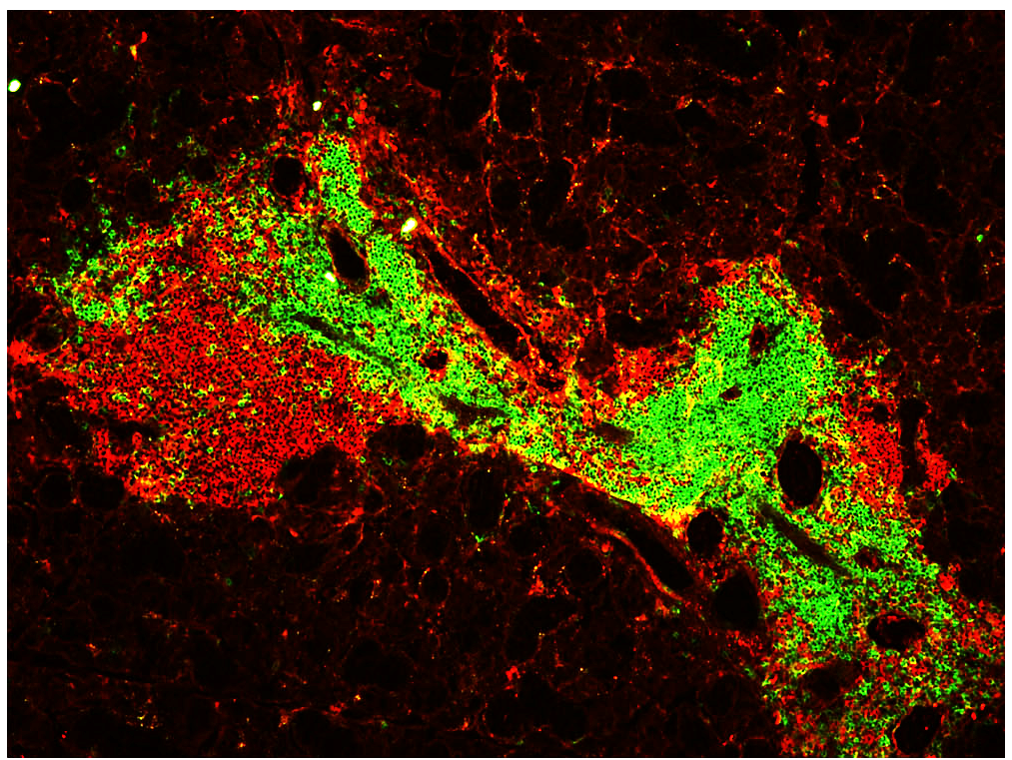
Ectopic Follicles are Organized Lymphocyte Clusters that Develop in Chronically Inflamed Tissue
Spleen Lymph Node
Peyer’s Patch Ectopic Follicle
IgM
CD4
PNA
IgM
IgD
PNA
IgM
CD4
PNA
B220
CD4

Slide 4
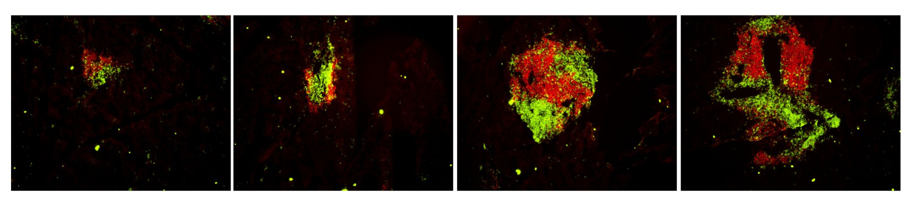
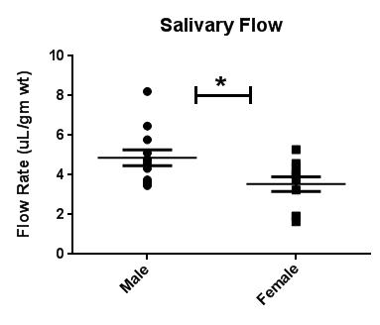
Ectopic Lymphoid Follicles in Salivary Glands Fully Develop at 20 Weeks of Age
B220 / CD3
Salivary Gland
100X
8 wks
12 wks
16 wks
20 wks
24 wks
No EFs
No lymphocytes detected
% of mice with EFs:
0%
67%
50%
100%
100%
60 wks
Karnell et. al, Mol. Imm. 2014

Slide 5
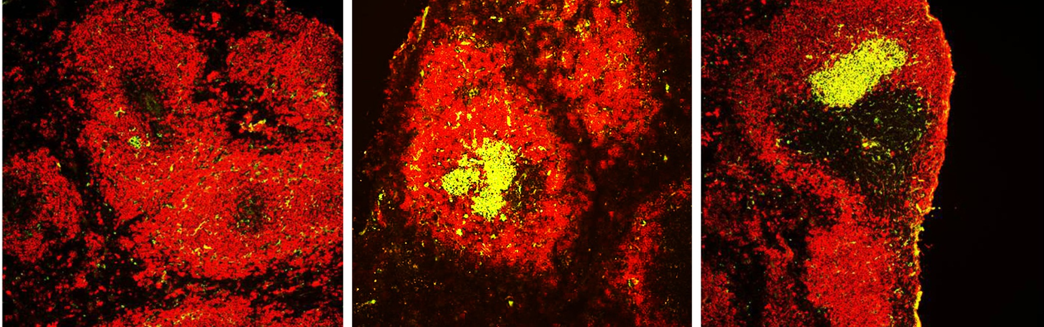
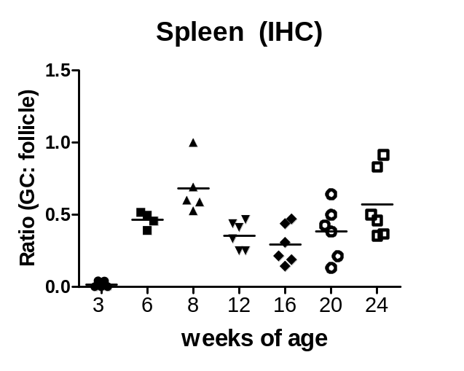
Spontaneous Germinal Centers Develop in the Spleens of Female but not Male Mice Early in Life
Age
3 weeks
3.5 weeks
6 weeks
IgM PNA
100X
Karnell et. al, Mol. Imm. 2014

Slide 6
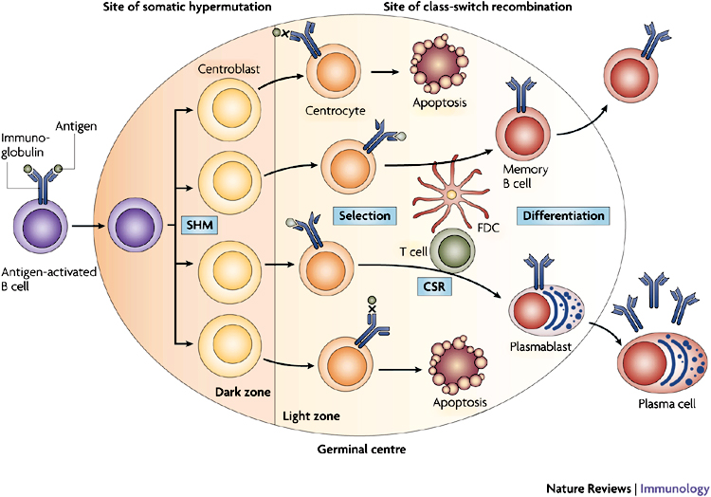
Activated B Cells undergo Affinity Maturation and Class Switch Recombination in Germinal Centers
Klein et al. 2008
GC in autoimmune mice are likely to be the sites where mutated, self-reactive autoantibodies are generated

Slide 7
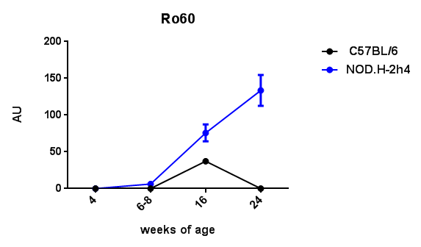
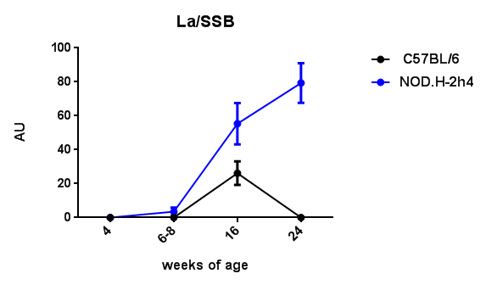
Detection of α Ro/La Autoantibodies Following the Emergence of Spontaneous Germinal Centers

Slide 8
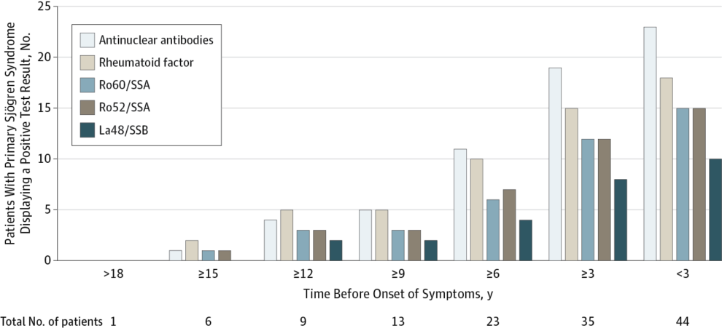
Autoantibodies Present Before Symptom Onset in Primary Sjögren Syndrome
JAMA. 2013;310(17):1854-1855. doi:10.1001/jama.2013.278448

Slide 9
Timeline of Clinical Manifestations
Spontaneous germinal centers arise
Salivary gland ectopic follicles fully develop
Salivary flow rates decline
1
2
6
15
Age (months)
Autoantibodies detected

Slide 10
Approach: Investigate the Long-Term Effect of Germinal Center Disruption in Early Life
Single early life αCD40L treatment
4
24
weeks of age
Treatment
Examine Ectopic Follicles
in Salivary Gland
Age at which spontaneous
GCs emerge
Age at which SG ectopic follicles fully develop

Slide 11
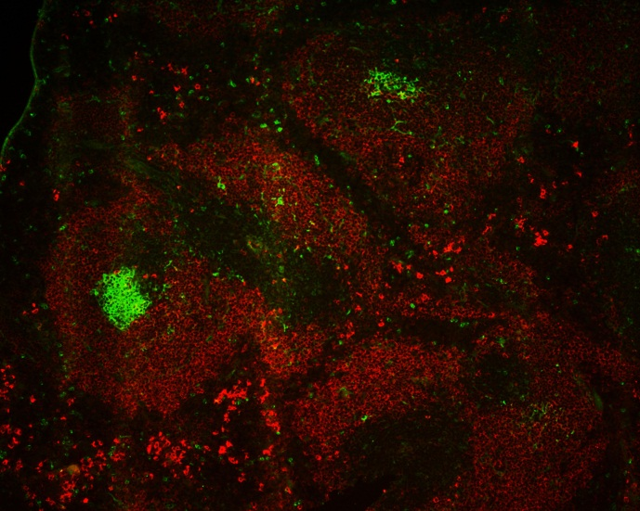
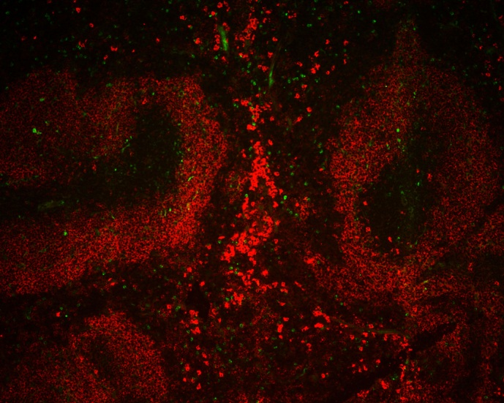
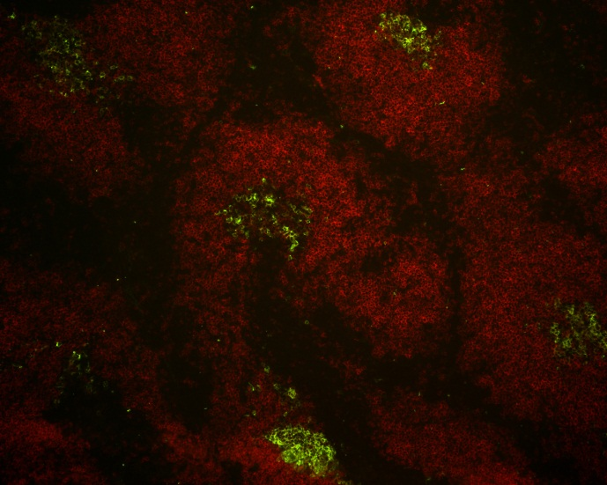
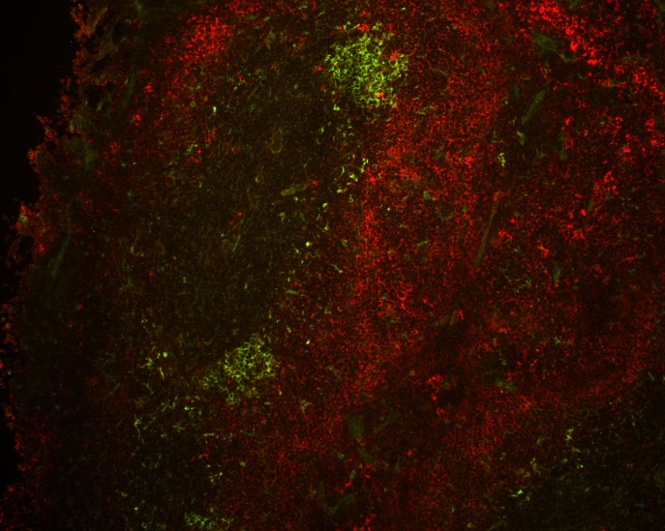
Transient Disruption of Splenic Germinal Centers Post αCD40L Treatment
Control
αCD40L
Treatment
4
IgM
PNA
Sacrifice
12
GCs
reemerge
16
Sacrifice
24
B220
PNA
Age
(weeks)
Spleen (100X)

Slide 12
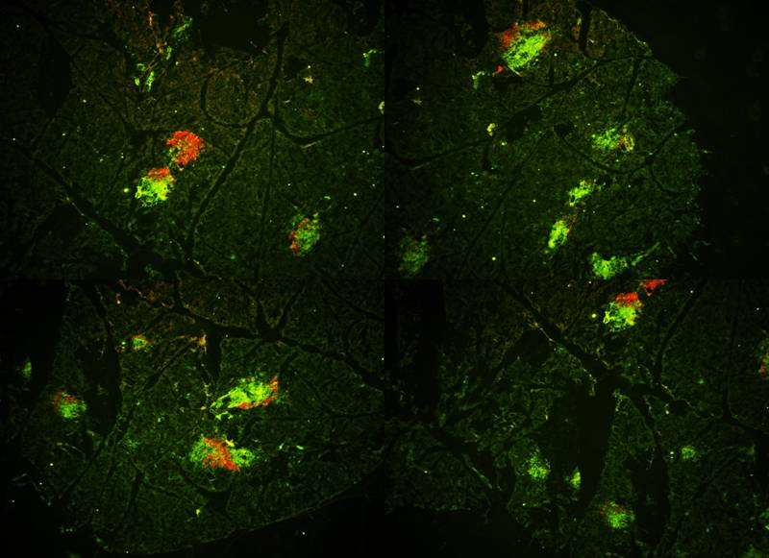
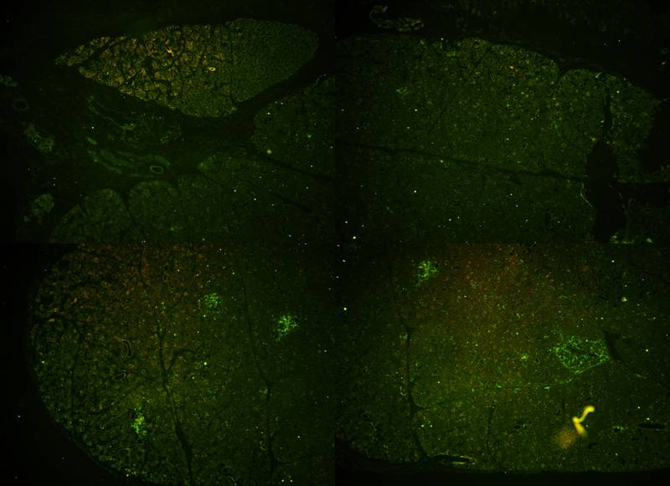
Single Early Life Treatment with αCD40L Abolished Salivary Gland Ectopic Follicles in Aged Mice
4
24
Age (weeks)
Treatment
Sacrifice
Control
αCD40L
Salivary gland 40X
CD3 B220

Slide 13
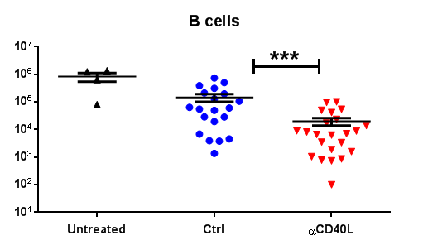
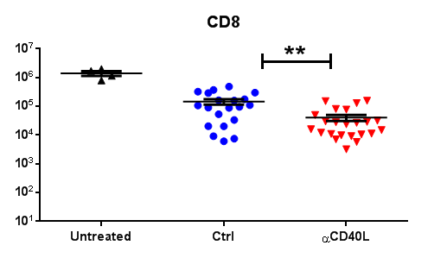
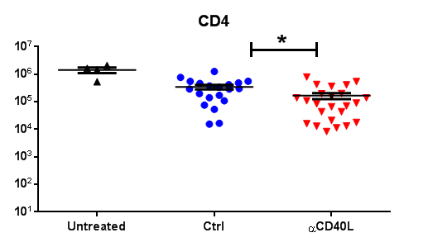
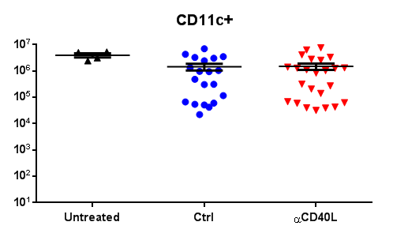
Single Early Life Treatment with αCD40L Decreased Salivary Gland B and T cells in Aged Mice
4
24
Age (weeks)
Treatment
Sacrifice
FACS Analysis
Notes:
Show the 4 week FACS analysis and show more populations

Slide 14
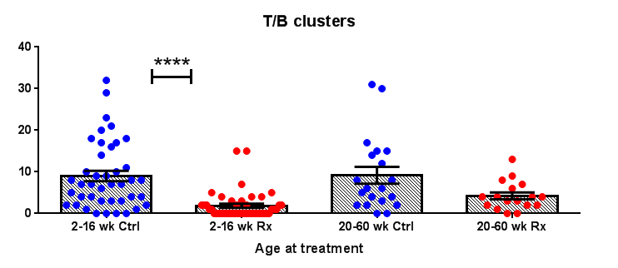
αCD40L Significantly Reduced T/B Clusters in the Salivary Gland
H & E paraffin sections

Slide 15
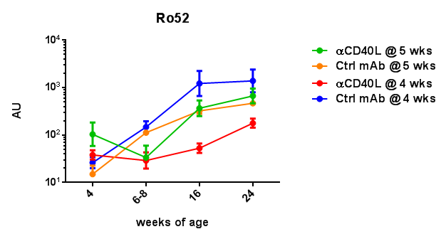
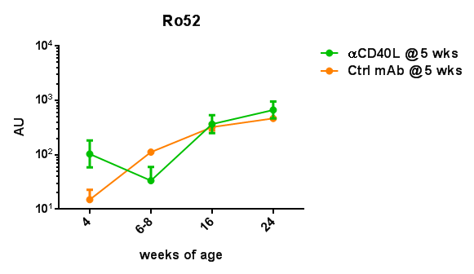
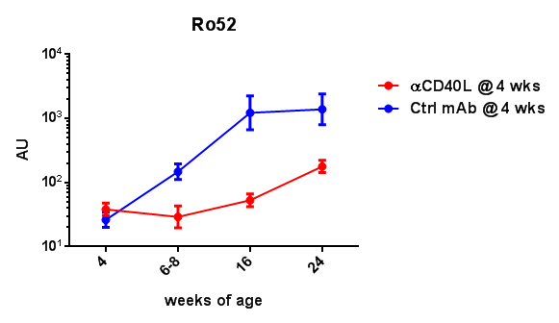
αCD40L Decreases αRo52 Autoantibodies

Slide 16
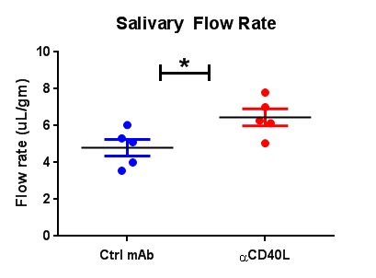
Early Life Treatment with αCD40L Improves Salivary Flow
32 week old mice

Slide 17
Conclusions
NOD.H2h4 mice develop spontaneous germinal centers at 3.5 weeks of age, followed by the emergence of salivary gland lymphoid follicles starting at 12 weeks of age
Early life blockade of CD40-CD40L interactions in mice:
  Inhibits splenic GC reactions for at least 8 weeks
  Significantly reduces SG lymphoid follicles in aged mice
  Significantly reduces B cells and CD8 T cells in SG infiltrates
  Lowers serum levels of SS-associated autoantibodies in an age-specific manner in this mouse model
  Improves salivary flow in aged mice

Slide 18
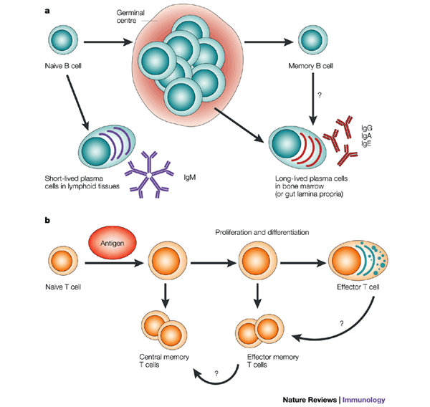

Model
αCD40L
Early Life
Autoreactive
Salivary Gland Infiltration
LTβ
Ectopic Follicle Neogenesis
Elevated Autoantibodies
Reduced Salivary Flow

Slide 19

Acknowledgements
  Rachel Ettinger
  Ronald Herbst
  Laura Carter
  Jodi Karnell
  Shu Wang
  Naemeh Poushafie
  Isharat Yusuf
  Yue Wang
  Nanette Mittereder
  Ellen Kuta
  Devon Taylor
  Diana Pao
  Julie Bakken

