Slide 1
Analytical strategy to unravel novel candidates from Alzheimer's disease gene regulatory networks using public transcriptomic studies
Tamara Raschka, Sep 2016
Supervisors: Shweta Bagewadi Kawalia
  Dr. Philipp Senger
Prof. Dr. Martin Hofmann-Apitius

Slide 2
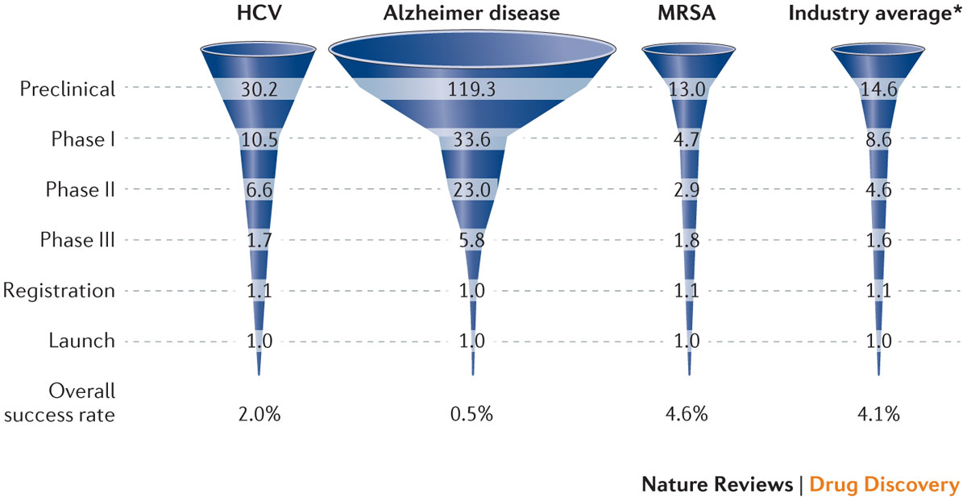
Alzheimer’s Disease
Main focus in research: β-amyloid peptide and tau accumulations
High drug attrition rates questions our knowledge of its etiology
Calcoen et al. Nature Reviews (2015)
Notes:
The funnels illustrate the average number of compounds needed at each development stage to result in one launched drug
destroys cognitive abilities in the aging population: memory, thinking, reasoning, etc.
progress in understanding its mechanisms
high drug attrition rates questioned our knowledge of its etiology

Slide 3
Alzheimer’s Disease
Need for identification of potential biomarkers and new therapeutic targets
Revaluation of past studies, accordingly to complex biological structures
Priori knowledge
AND
Context specificity
AND
Overall network
Past studies
Priori knowledge
New
Past
GSE…
OR
GSE…
DE genes
…
WITHOUT
GSE…
Context specificity
Candidate genes
Notes:
Past: - most of them do not elaborate on context specificity and completeness of the generated networks.
set of genes that participate in the core regulatory (patho-)mechanism is currently limited towards differentially expressed or a priori knowledge
missing out on lesser known candidates.
New: - use priori knowledge in a context specific way to build an overall network
Limited gene expression data in field of neurodegeneration
Compelling evidences may remain buried in existing data
Co-expression analysis to get mechanistic insight into the disease mechanism
Implementation of a robust computational method for identifying common functional patterns across all publicly available AD gene expression datasets
Use prior knowledge for gene selection (seed genes)
Iterative approach to enrich seed genes
First attempt to integrate prior knowledge for analyzing co-expression networks

Slide 4
Motivation
Limited gene expression data in field of neurodegeneration
Compelling evidences may remain buried in existing data
Network based approaches play a critical role in identifying new candidates
Ability to add functional context to the analysis through pathway knowledge
Co-expression analysis to get mechanistic insight into the disease mechanism
Implementation of a robust computational method for identifying common functional patterns across all publicly available AD gene expression datasets
Use prior knowledge for gene selection (seed genes)
Iterative approach to enrich seed genes
First attempt to integrate context specific prior knowledge for analyzing co-expression networks
Notes:
- Why there is limited data in NDD: nobody wants to give a part of their brain for research unless they are dead
- why play a critical role in identifying new candidates: capability to determine subtle expression shifts between correlated gene pairs that are linked to the dysregulation events
- Why need an iterative approach: traditional approach identifies the functional context for a given set of genes but what happens if we artificially populate the set of genes for the determined functional context.

Slide 5

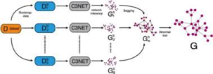



Our Strategy
Selection and Pre-processing Datasets
Leveraging Stable Gene Regulatory Networks
Genetic Variant Analysis
NeuroTransDB
Filter pre-processed data for seed gene list
Optimized GRN construction (BC3Net10)
Studies > 50 samples
GWAS Studies
Seed gene list enrichment
i=0
Subnetwork selection
Quality control
i=1
(i=0) +
i=2
(i=0) + (i=1) +
…..
Manual Mechanistic Interpretation
i=n
………..
Uniform Normalization
Background correction
Quantile normalization
Log2 transformation
Averaged duplicate probes
Yes
Functional enrichment analysis
Any new candidate genes?
Pre-processed diseased datasets
No
Identification of enriched candidates
GSE….
Merge all subnetworks
(i=0) + (i=2) + …. + (i=n)
Figure 1: Workflow diagram
Notes:
SCAIView
Knowledge discovery tool
Combines semantic annotations for biomedical entities
Possibility to rank documents and significant players in AD context
AlzGene
Publicly available database containing genetic association studies in context of AD
Provide a list of genes that appeared in at least three studies
Consensus Path Database (CPDB)
Database system that integrates different databases of human functional interactions

Slide 6
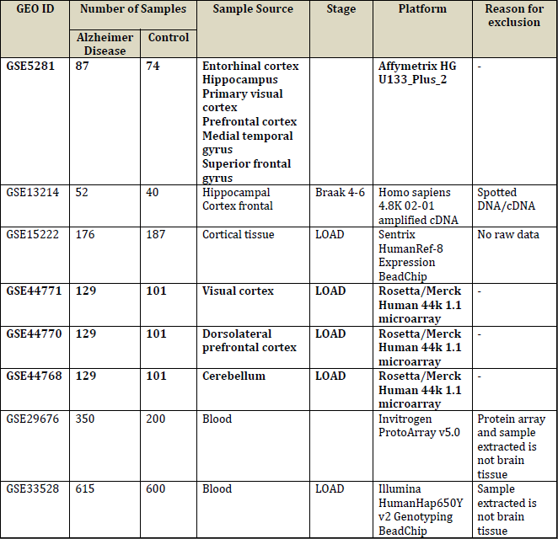
Selection and Pre-processing of Alzheimer's Gene Expression Datasets
Selection and Pre-processing Datasets
Query of GEO and ArrayExpress
Only datasets with more than 50 samples
NeuroTransDB
Studies > 50 samples
Quality control
Uniform Normalization
Background correction
Quantile normalization
Log2 transformation
Averaged duplicate probes
Pre-processed diseased datasets
GSE….
Table 1: Datasets fitting the criteria
Notes:
Retrieved 45 AD related datasets
8 datasets
Focus on brain samples
Some do not provide raw data
4 datasets remained

Slide 7
Selection and Pre-processing of Alzheimer's Gene Expression Datasets
Selection and Pre-processing Datasets
Normalization and Probe Annotation
    R-functions: rma (package affy), backgroundCorrect and normalizeBetweenArrays (package limma)
    Averaged duplicated probes
Outlier Detection
    R-package: arrayQualityMetrics
    between array comparison
    Comparison of array intensity distribution
    MA-plots for individual array quality
Splitting data based on phenotype
NeuroTransDB
Studies > 50 samples
Quality control
Uniform Normalization
Background correction
Quantile normalization
Log2 transformation
Averaged duplicate probes
Pre-processed diseased datasets
GSE….
Notes:
different platforms but same normalization methods
it is not sure that seed genes are complete -> iterative approach for adding more genes to the list
no log₂-transformation for Rosetta/Merck platform
gene information directly included in data for Rosetta/Merck
GSE5281: 9 outliers; GSE44768: 12 outliers; GSE44770: 27 outliers; GSE44771: 19 outliers

Slide 8
Construction of Co-expression Networks
Leveraging Stable Gene Regulatory Networks
Seed Genes Selection
    TOP500 genes
Optimized BC3Net
    10 iterations of BC3Net
    Union of 10 iterations
    final edge weight: mean of the computed edge scores
Subnetwork selection
    edge weight > 0.5
Iterative approach
    Enrich seed genes selection
Filter pre-processed data for seed gene list
Optimized GRN construction (BC3Net10)
Seed gene list enrichment
i=0
Subnetwork selection
i=1
(i=0) +
i=2
(i=0) + (i=1) +
…..
………..
i=n
Yes
Functional enrichment analysis
Any new candidate genes?
No
Identification of enriched candidates
Merge all subnetworks
(i=0) + (i=2) + …. + (i=n)
Notes:
BC3Net: Correlation-based networks
random sampling -> true and most prominent correlations are selected more often than non-correlated ones
2 independently generated networks of same data -> not totally overlapping
edge interactions that only appear less can also be potentially promising candidates
for each dataset and each phenotype

Slide 9
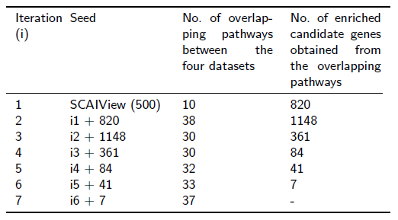
Iterative Functional Enrichment of Co-Expression Networks Derived from Diseased Samples
Table 2: Statistics of the iterative functional enrichment

Slide 10
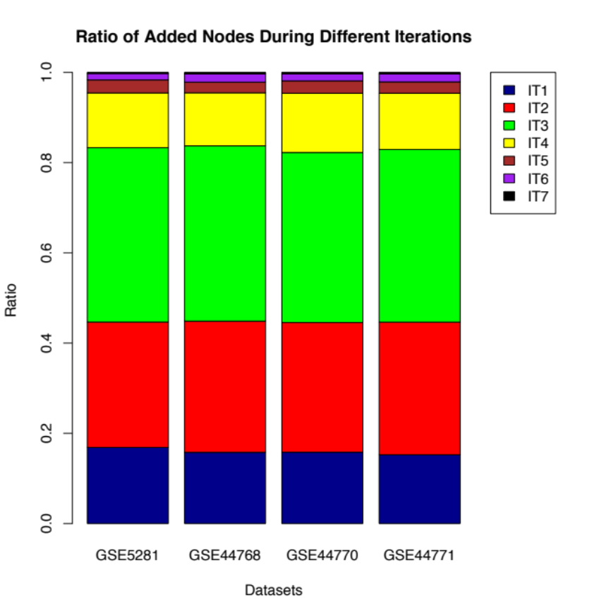
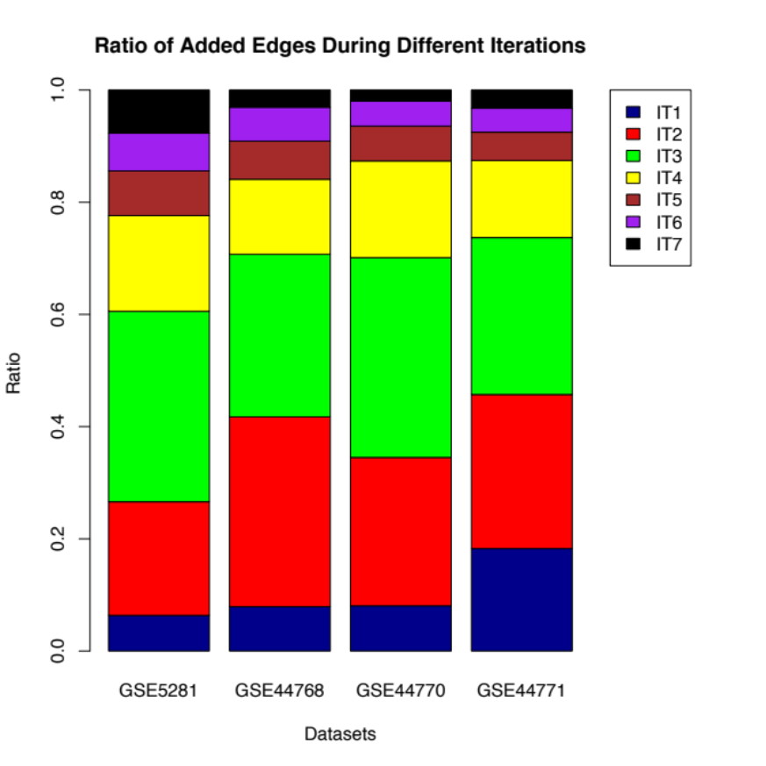
Iterative Functional Enrichment of Co-Expression Networks Derived from Diseased Samples
Figure 2: Ratio of added nodes in different iterations
Figure 3: Ratio of added edges in different iterations

Slide 11
Functional Enrichment Analysis
Leveraging Stable Gene Regulatory Networks
KEGG pathways in CPDB
    p-value <0.05
    Select common pathways across all datasets
Identification of enriched
candidates
    Add genes of common pathways to seed genes
Start new iteration
    Till no genes are added back
Merge all subnetworks
Filter pre-processed data for seed gene list
Optimized GRN construction (BC3Net10)
Seed gene list enrichment
i=0
Subnetwork selection
i=1
(i=0) +
i=2
(i=0) + (i=1) +
…..
………..
i=n
Yes
Functional enrichment analysis
Any new candidate genes?
No
Identification of enriched candidates
Merge all subnetworks
(i=0) + (i=2) + …. + (i=n)
Notes:
Determine functional context of modules of the generated co-expression networks

Slide 12
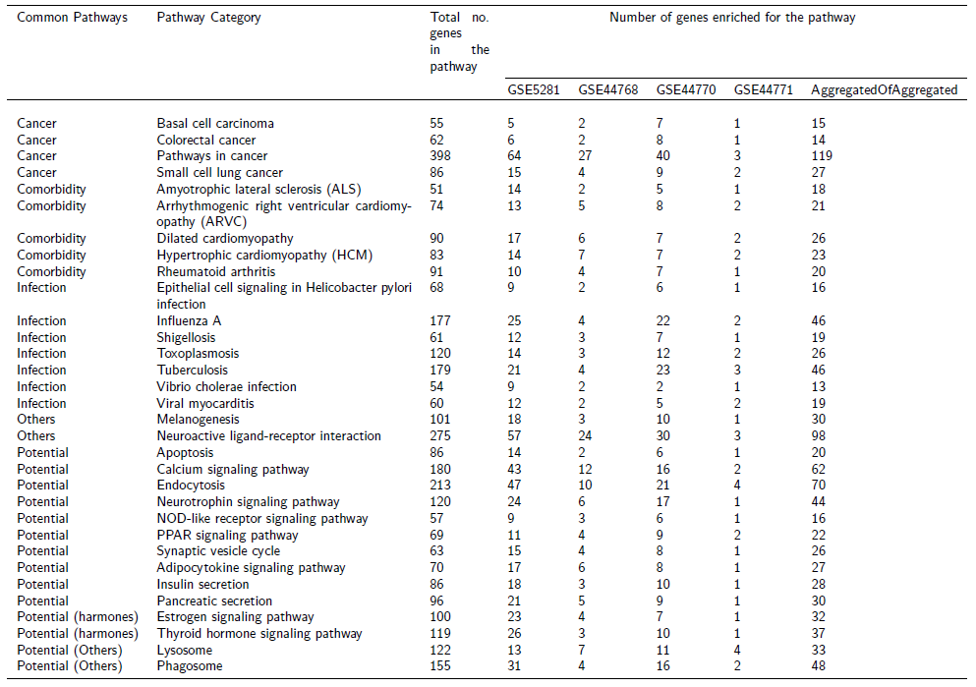
Functional Analysis of Co-expression Networks
Table 3: Landscape of significant pathways (p<0.05) determined across datasets
Notes:
Overlap of four aggregated networks: 32 pathways
Categorized them based on pertinence to AD
Focus only on potential -> neurotransmission pathways (calcium, endocytosis, neurotrophin, estrogen)

Slide 13
Functional Analysis of Co-expression Networks
Figure 6: Landscape of p-value for the final list of significant pathways
Notes:
Consensus network (aggregation of aggregated networks)
Pvalue increased for the potential pathways

Slide 14
Genetic Variant Analysis
Genetic Variant Analysis
Prioritization of candidate genes
  extracted AD evidences for Single-nucleotide polymorphisms (SNPs) from GWAS catalog, GWAS Central and gwasDB
  linkage disequilibrium analysis
  filtered based on the ENSEMBL SNP's functional consequences
  ranked using a cumulative score
GWAS Studies
Manual Mechanistic Interpretation

Slide 15
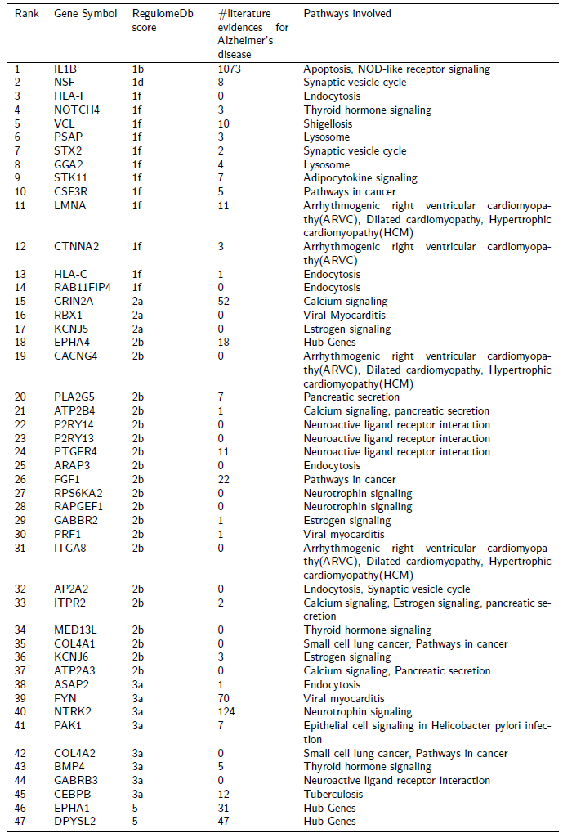
Genetic Variant Analysis
Table 4: List of genes prioritized by genetic variant analysis
Notes:
608 genes from significant pathways across datasets and hub genes
Mapped genes to 4831 SNPs
167 mapped genes
Ranked them
44 high ranked genes + 3 genes from Lambert et al.
14 genes validated by eQTL studies or evident SNPs are linked with active promotor region of gene

Slide 16
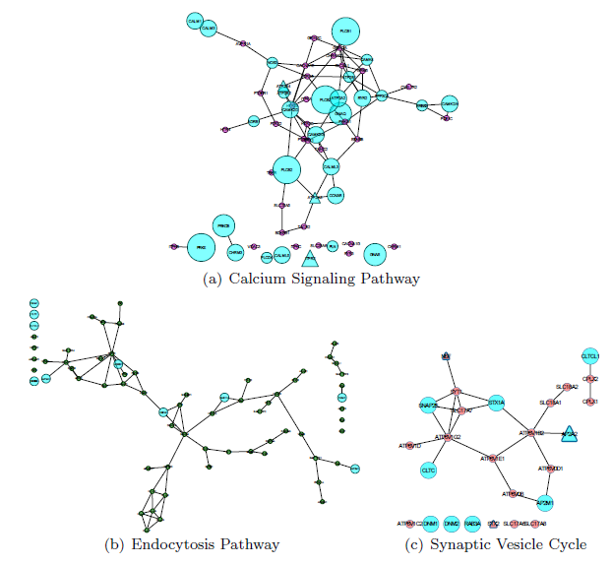
Newly prioritized candidate genes
Figure 7: Subnetworks of shortlisted pathways extracted from consensus network

Slide 17
Well known prioritized candidate genes
  IL1B
    expression significantly increases with increase of AD-related neurofibrillary pathology
  NTRK2
    AD patients have been accounted with reduced levels of BDNF (mediates neuronal survival and plasticity through NTRK2), crucial for learning and memory
  GRIN2A
    Reduced expression increase vulnerability of neurons to excitotoxicity, reduced plasticity
  FYN
    has enhanced cascade effect on NMDA and regulates activity of hyperphosphorylated tau, mediates synaptic deficits induced in amyloid beta
  DPYSL2
    Mediates synaptic signaling through regulation of calcium channels, hyperphosphorylation is causally related to amyloid beta neurotoxicity
  Synaptic transmission is critical for regulating amyloid beta production

Slide 18
Newly prioritized candidate genes
  STX2
    Binds to SNARE which mediates neurotransmitter release, reduced formation of SNARE complex assembly was observed in post-mortem brains of AD patients
  HLA-F and HLA-C
    Involved in amyloid beta trafficking, pro-inflammatory response due to extracellular amyloid beta deposits are involved in worsening the cognitive decline in AD patients
  RAB11FIP4
    Modulator of neurotransmission, dysregulation could inhibit vesicle tethering with SNARE proteins
  ARAP3
    Regulates actin cytoskeleton stability, which plays a key role in synaptic activity
  AP2A2
    Internalizes APP and BACE1 proteins
  ATP2B4, ATP2A3 and ITPR2
    Maintains calcium homeostasis in neuron, PMCAs is the only calcium pump in the brain and is inhibited by the presence of amyloid beta peptides
Notes:
PMCAs is the only calcium pump in the
brain, which is inhibited by the presence of A peptides

Slide 19
Conclusion
First computable method to find common functional patterns across different datasets
Adaptive version of BC3Net is now capable of expanding knowledge space and functional context
First time using prior knowledge to get a seed list and to filter genes
Overcome biasness of traditional approaches like DE genes etc.
Applicable to other diseases

Slide 20
Acknowledgement
I want to acknowledge
Ricardo de Matos Simoes (Dana-Farber Cancer Institute) for helping us with BC3Net algorithm
Mufassra Naz (Fraunhofer SCAI) for performing the genetic variant analysis

Slide 21
Thank you for your attention!
Notes:
Sources:
What does it take to produce a breakthrough drug?

