Slide 1

6th International Conference on
Structural Biology
August 22-23, 2016
New Orleans, USA

Slide 2
Decoding amino acid sequences of proteins to predict location of folding nucleation sites
Takeshi Kikuchi,
Department of Bioinformatics
College of Life Sciences
Ritsumeikan University

Slide 3
Elucidation how a protein folds to its native :
Significant problem in molecular biophysics and molecular
bioinformatics
Folding Initiation Site (Folding Nucleus):
Element in protein sequence which leads to further folding
pathway
Its 3D structure → protein architecture element for evolution?
Question: How is it encoded on the protein sequence?
Purpose of the present study:
Seek a possible way to decode the amino acid sequence of a protein to extract the information on its folding initiation site;

Slide 4
Methods

Slide 5
Evolutionary analysis with phylogenetic tree
(Dr. Yosuke Kawai)
Identifying conserved (hydrophobic) residues of the
homologues of the sequence
(1) Collection of homologues
BLAST
    Database: Non-redundant set of UniProt
    (http://www.uniprot.org/)
    e-value< 0.01
*Altschul SF, Gish W, Miller W, Myers EW, Lipman DJ, J Mol Biol(1990)215:403.
**Suzek BE, Huang H, McGarvey P, Mazumder R, Wu CH, Bioinformatics(2007) 23:1282.
Notes:
0’25”

Slide 6
(2) Multiple Sequence Alignment and Phylogenetic Tree
Fast Fourier Transformation (MAFFT)* with
Neighbor-Joining method
Phylogenetic Analysis by Maximum Likelihood
software package (PAML4.0^{)**}
Substitution Matrix: JTT matirices*** (SeaView)
with Poisson distribution for the substitution model
→ Investigate Conservation of Hydrophobic
residues: A, M, W, L, F, V, I, and Y
* Katoh K, Misawa K, Kuma K and Miyata T,
Nucleic Acid Res., 2002 Nucleic Acids Res. 30, 3059-3066, 2002.
**Saitou N, Nei M, Mol Biol Evol, 4, 406–425, 1987.
Yang Z: PAML 4, Mol Biol Evol, 24, 1586–1591, 2007.
***Jones DT, Taylor WR, Thornton JM, Comput Appl Biosci, 8, 275–282, 1992.

Slide 7
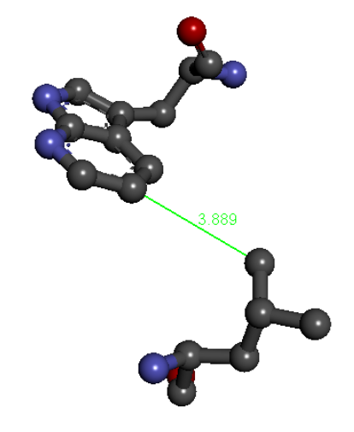
(3) Analysis of Inter-residue Contacts In Native
Structure
Definition of inter-residue contacts:
Two residues are forming a contact when a heavy
atom in a residue closes to a heavy atom in another
residue within 5Å.
≦ 5Å

Slide 8
Analyses based on the inter-residue average distance statistics
Prediction technique to locate compact regions in
a protein sequence with a contact map based on
the inter-residue average distance statistics
T. Kikuchi, G. Némethy, H. A. Scheraga, J. Protein Chem., 7, 427 – 471, 1988.
Takeshi Kikuchi In “Protein Folding”, Eric C. Walters (Ed.), Nova Science Publishers Inc., New York 2010.

Slide 9
Calculations of Inter-residue Average Distances
Average distances for every residue pairs in each range are calculated using the proteins with known 3D structures.
Definition of Ranges
Range: k = |i-j|
Range: M = 1 if 1≤k≤8
M = 2 if 9≤k≤20
M = 3 if 21≤k≤30
M = 4 if 31≤k≤40
･･････
i
j
amino acid sequence
Average Distance of Amino Acid Types A and B in the Range M: d(A, B, M)

Slide 10
Construction of a Predicted Contact Map based on Average Distances : Average Distance Map (ADM)
d(A, B, M): Average Distance between Residue
types A and B in the Range M
d_{c}(M) :Cutoff Distance of the Range M
Contact when d(A, B, M) ≤ d_{c}(M)
d_{c}(M) determines the # of residue pairs with the short average distances in the range M to be plotted on a map .
d_{c}(M) is adjusted in order that the predicted map gives a predicted contact density.
i
×
j

Slide 11
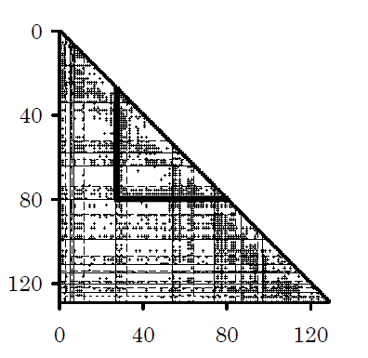
Average Distance Map (ADM)

Slide 12
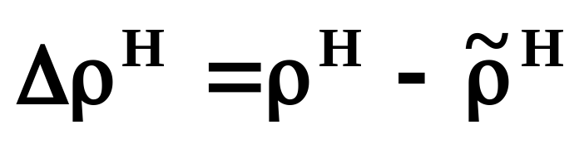


ρ: density of plot within a specific region
$$\tilde{ρ^{H}}$$
$$ρ^{H}$$

Slide 13
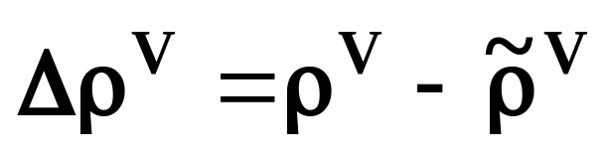


$$\tilde{ρ^{V}}$$
$$ρ^{V}$$
Notes:
0’15”
We divide an ADM into two parts a horizontal line like this way and calculate the density of plots to the whole trapezoidal area, rhoH wave, and triangle area, rhoH, and calculate deltarhoH.

Slide 14

$$η=Δρ^{H}+Δρ^{V}$$
predicted compact region
η：index of compactness of the predicted area

Slide 15
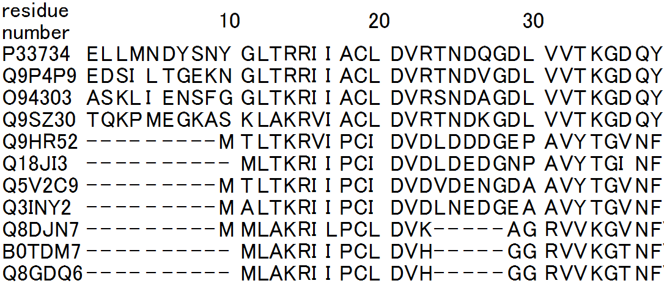
ADM Analysis for Homologues
  Multiple Sequence Alignment
Notes:
0’20”
As already mentioned, we make the search of homologues or orthologues by BLAST and make the multiple sequence alignment.

Slide 16
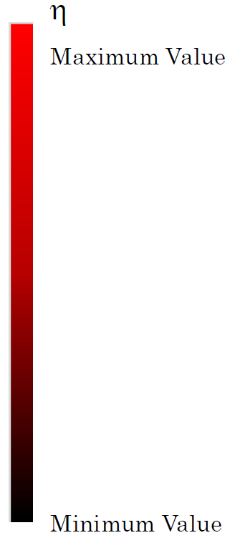
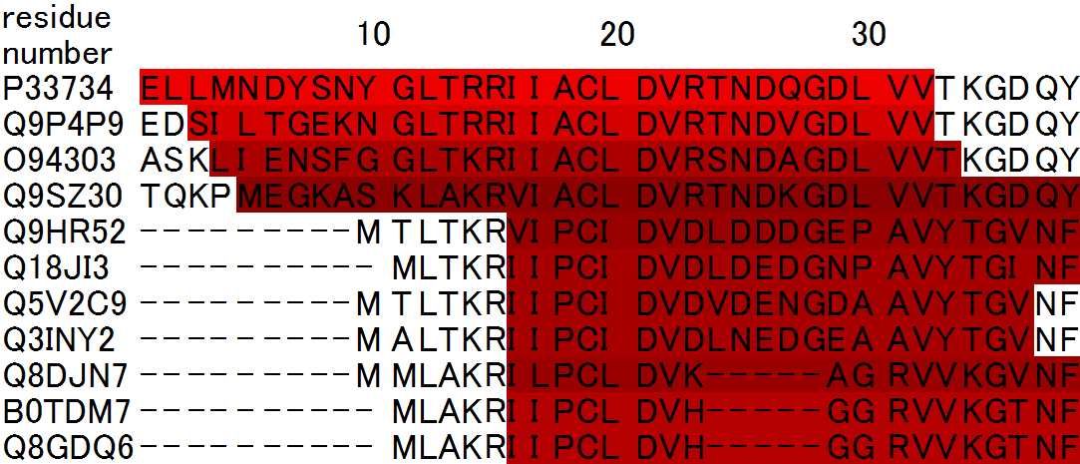
ADM Analysis for Homologues
  Multiple Sequence Alignment
  ADM prediction
  predicted folding units are marked in red.
Notes:
0’10”
Then, we predict compact regions within each searched protein sequence by ADM.

Slide 17
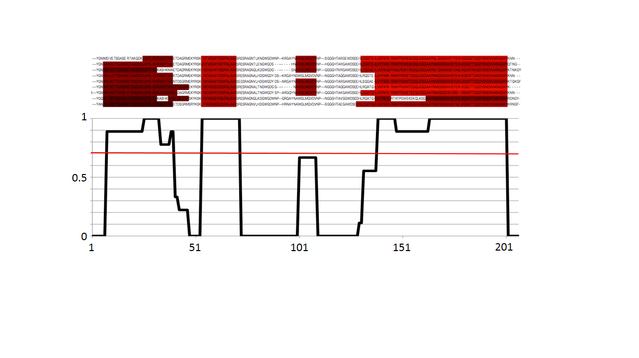
Common folding unit
To represent the common folding segments, we calculate the percentage of residues that are members of the predicted folding segments for each site. The figure below is a histogram of the percentage of each site of the multiple alignment.
We regard the regions with high percentage (>70% denoted by a orange bar) as “robust (common)” folding units.

Slide 18
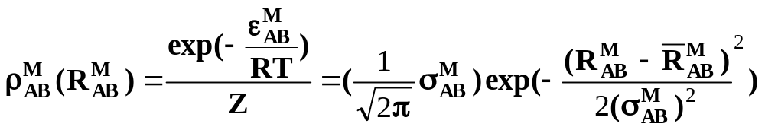




Inter Cα Atomic Potential Derived from the Interresidue Average Distance Statistics
Harmonic Potential Which Reproduces the Average Distances and Their Standard Deviations
Z: Partition Function
: Distance between Residues A and B in the Range M
: Average Distance between Residues A and B in the
Range M
: Standard Deviation of the Distance Statistices
between Residues A and B in the Range M
: Inter Cα Atomic Potential between Residues A and B
in the Range M

Slide 19
Conformation Sampling of Random Comformation with the Present Potential
Protein Model -Beads Model-
Kikuchi T, Amino Acids, 35, 541–549, 2008.
3.8Å
φ
φ
θ
Cα atom
2. Simulation
Metropolis Monte Carlo
60000 iterations with variation of θ and φ angles

Slide 20
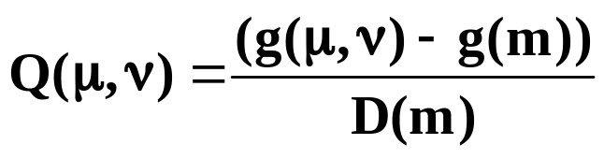
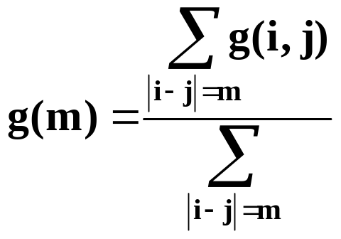
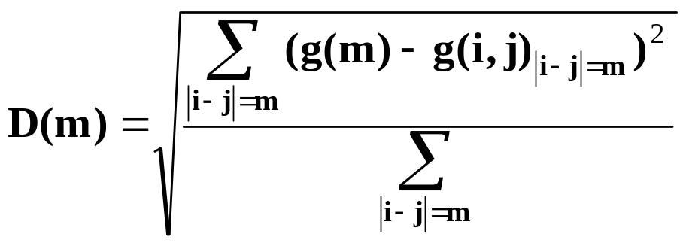
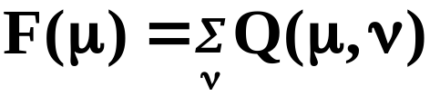
3. Contact Frequency g(i, j)
g(i, j): frequency of R_{ij} ≦ Rcut
R_{ij}: Distance between Residues i and j
Rcut: Cutoff Distance(= 10Å)
4. p(μ) value: Residues with High Contact Frequency
corresponds to φ value

Slide 21
Results

Slide 22
Decoding a protein sequence to extract the information of folding mechanisms of proteins with partially common 3D structures
Globin-like Fold
Ferredoxin-like Fold
Lysozyme-like Fold
β-Trefoil Fold
Immunoglobulin-like Sandwich Fold
IgG Binding Proteins
Notes:
0’10”
We are applying the present techniques to various protein families, and today I focus on the lysozyme-like fold proteins.

Slide 23
Application to lysozyme-like fold family proteins
M. Kabata, T. Nakajima and T. Kikchi, in preparation

Slide 24
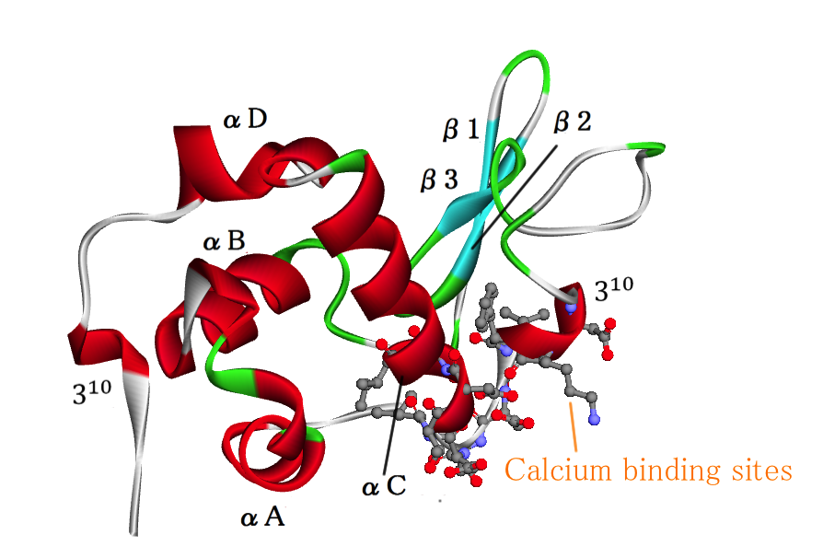
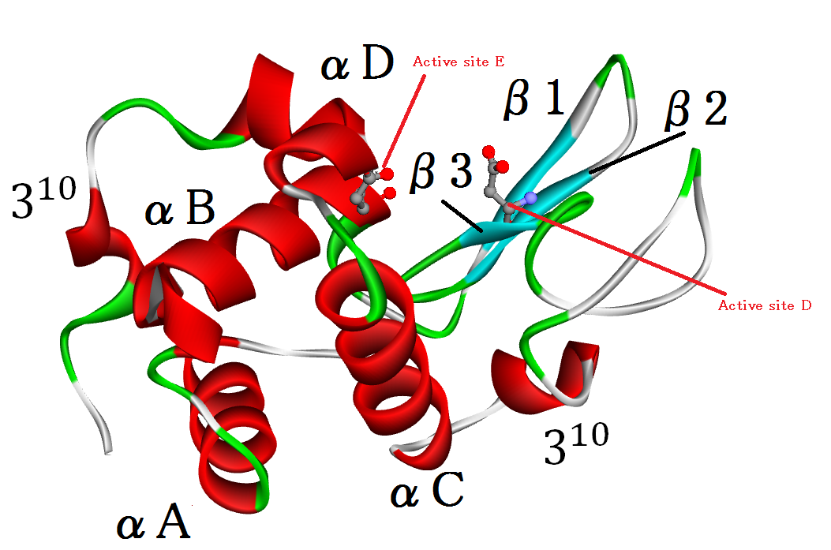
C-type lysozyme
Active site
Active site
Hen egg wite lysozyme
α-lactalbumin
Sequence Identity: 30%
Conserved 3D structure
Different folding mechanisms

Slide 25
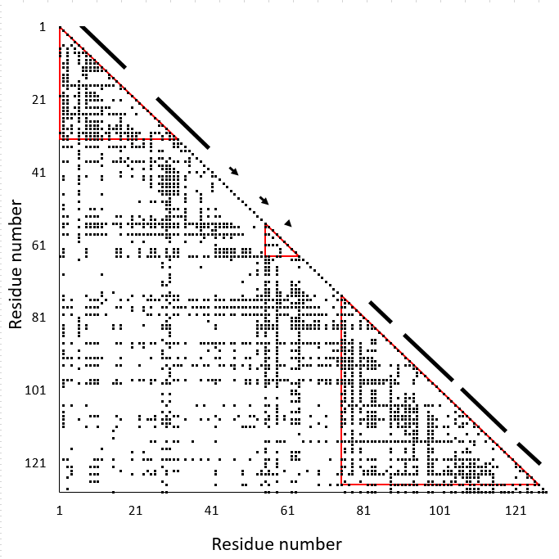
ADM for
Hen egg white lysozyme (PDBID:2vb1)
1 – 32 (η = 0.354)
(55 – 64 (η = 0.201))
75 – 127 (η = 0.235)

Slide 26
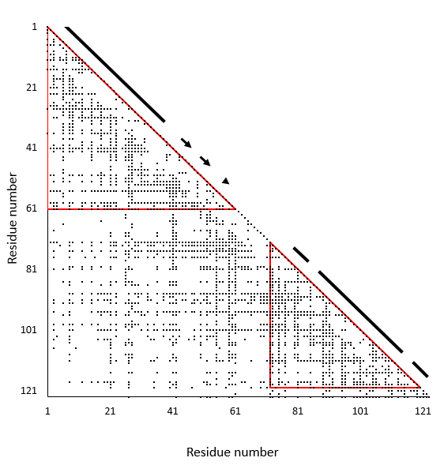
ADM for
Bovine alpha lactalbumin(PDBID:1f6s)
8 - 61 (η = 0.192)
1 – 120 (η = 0.395)
72 – 120 (η = 0.275)

Slide 27
F value plots and NMR H/D Exchange Protection Factor*
(A)
(B)
F-value
Log (Protection factor)
(η = 0.354)
(η = 0.235)
(η = 0.225)
(η = 0.275)
Residue number
Residue number
Hen egg white lysozyme(PDBID:2vb1)
Bovine alpha lactalbumin(PDBID:1f6s)
Predicted compact region by ADM
Nakamura T, Makabe K, Tomoyori K, Maki K, Mukaiyama A and Kuwajima K. “Different folding pathways taken by highly homologous proteins, goat a-lactalbumin and canine milk lysozyme.” J. Mol. Biol. (2010) 396; 1361-1378

Slide 28
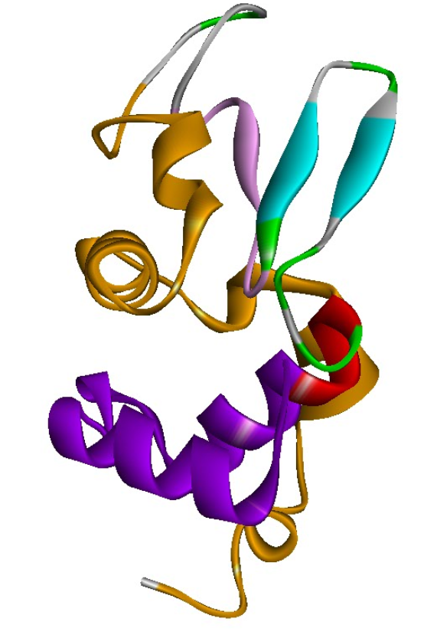
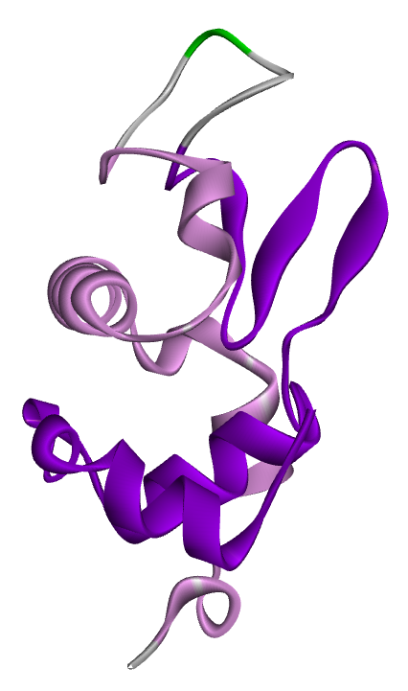
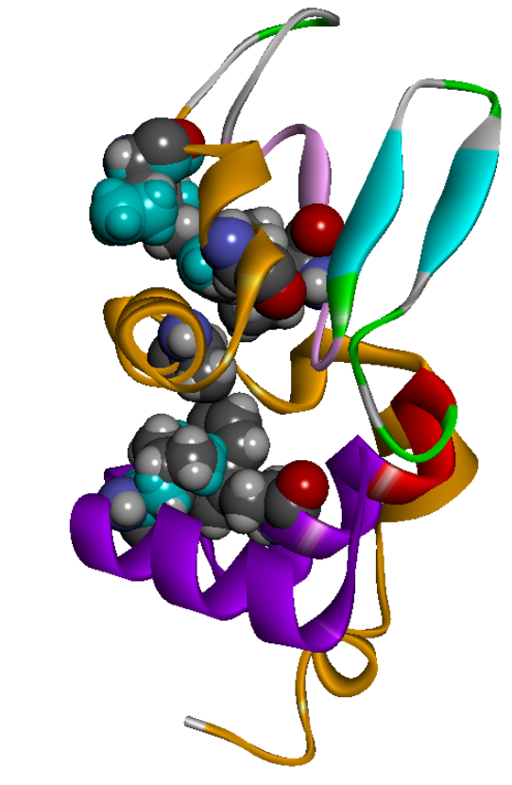
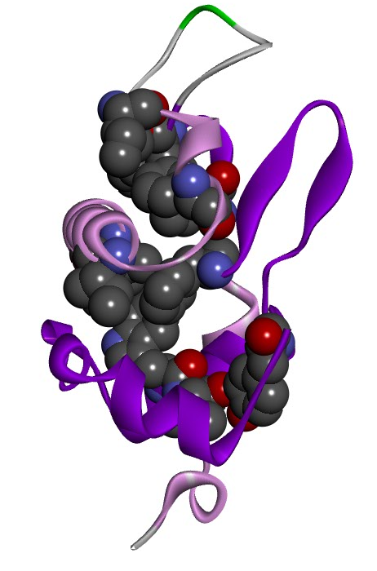
Predicted Compact Region
Hen egg white lysozyme(PDBID:2vb1)
Bovine alpha lactalbumin(PDBID:1f6s)

Slide 29
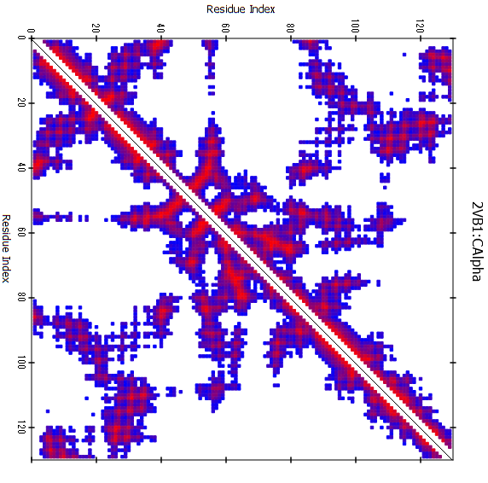
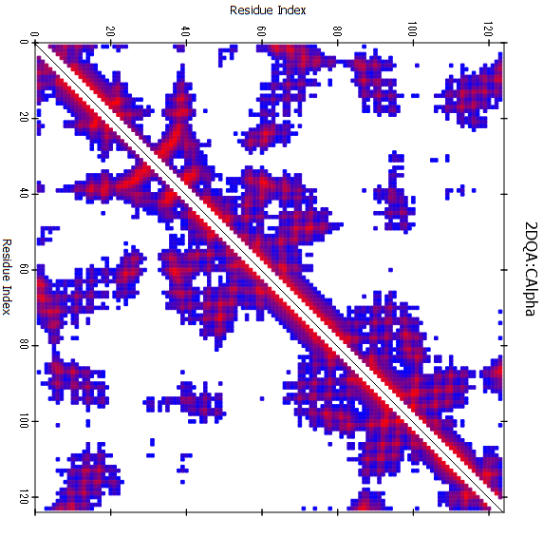
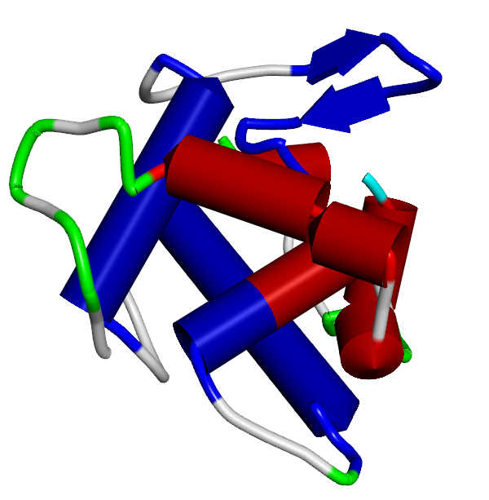
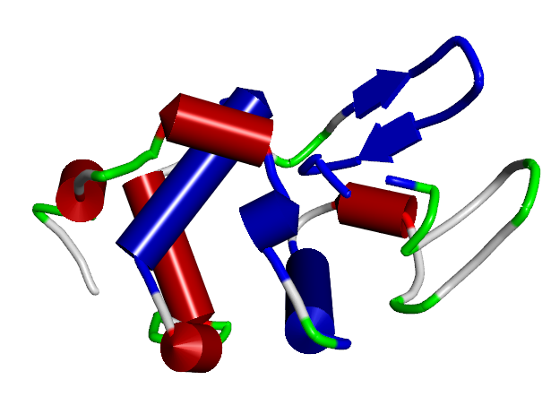
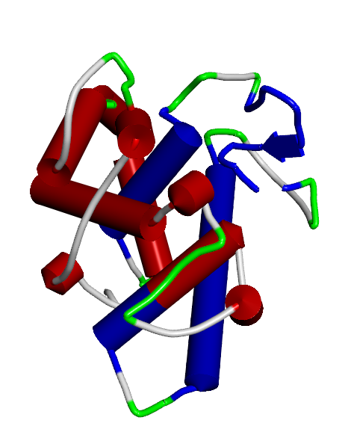
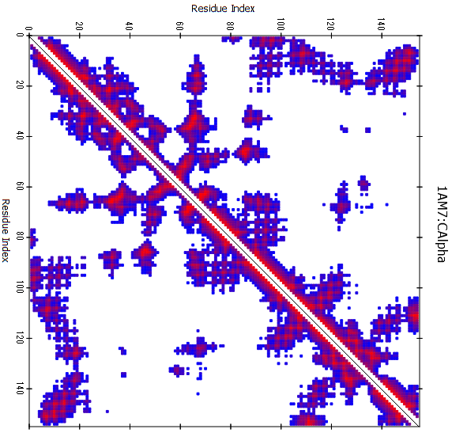
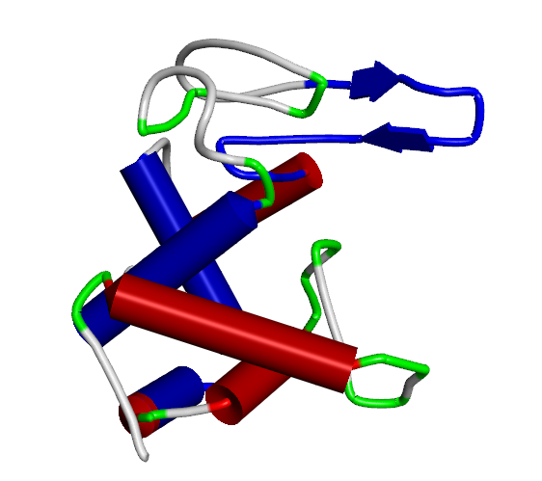
β
β
αA
αA
αC
αC
αB
αB
C-type: Hen lysozyme
(PDBID:2VB1)
I-type: Tapes lysozyme
(PDBID:2DQA)
β
β
αA
αB
αA
αC
αB
αC
G-type: Goose lysozyme
(PDBID:153L)
λ-type: λ phage lysozyme
(PDBID:1AM7)

Slide 30
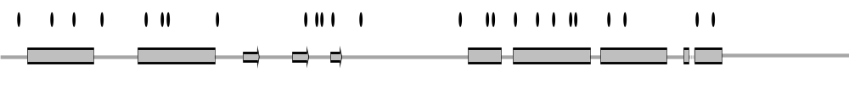
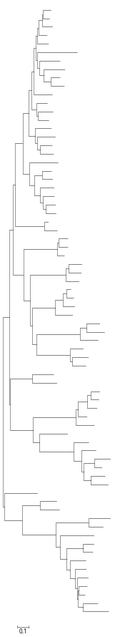
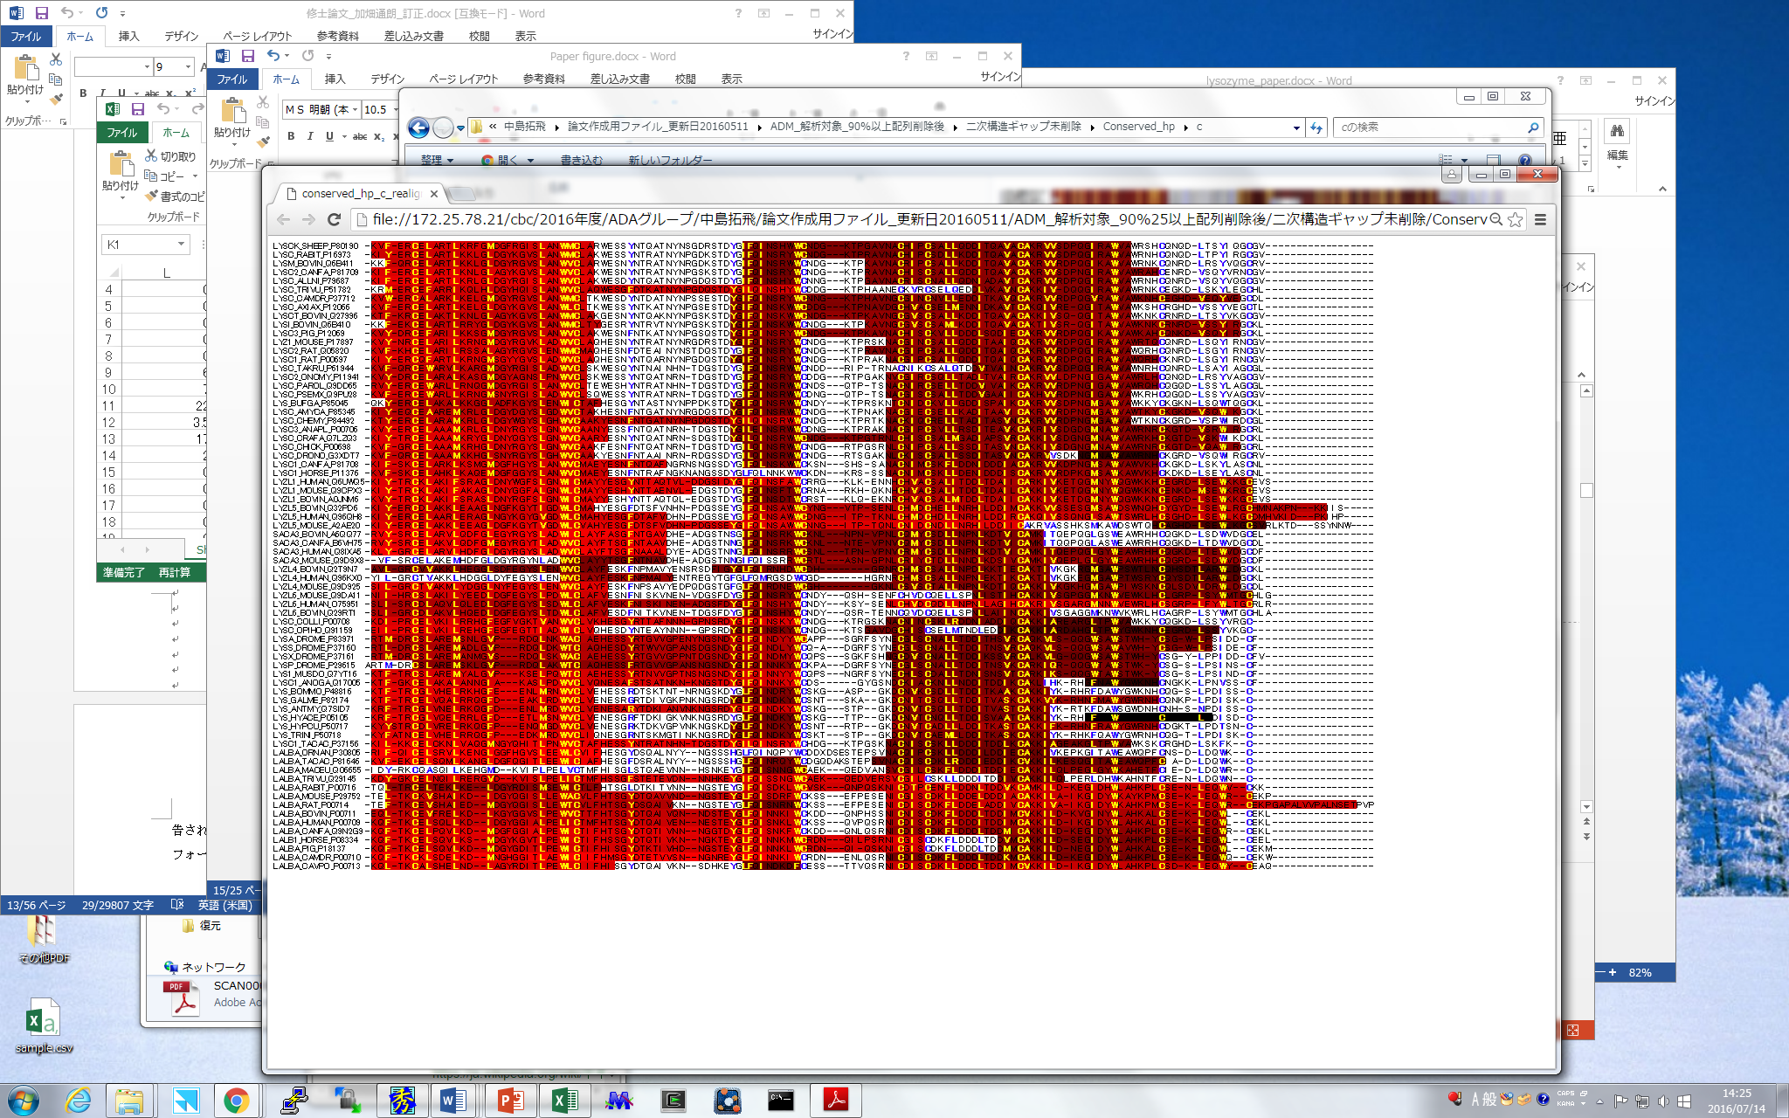
αA
β
αB
αC
C-type
β
αA
αC
αB
Α-lactalbumin

Slide 31
Summary of BLAST searches and ADM analyses for c-type
Query: Hen egg white lysozyme(UniprotID: P00698, PDBID: 2VB1)
The number of sequences: 132
Average sequence identity: 48.5%
Conserved hydrophobic residue: 29
Conserved hydrophobic residue included in compact region: 26 (89.7%)
(total number of residues in compact regions/total residues
= 73.6%)
Robust unit:
Lys1-Ala32, Ile55-Cys64,
Leu75-Cys115
Average ADM identity: 0.78
r = 0.54

Slide 32
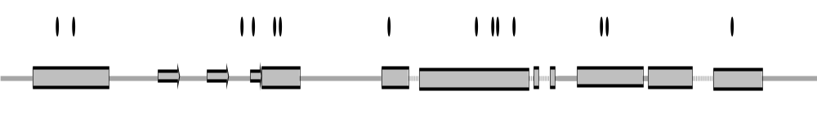
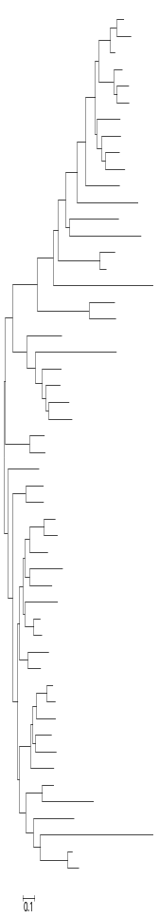
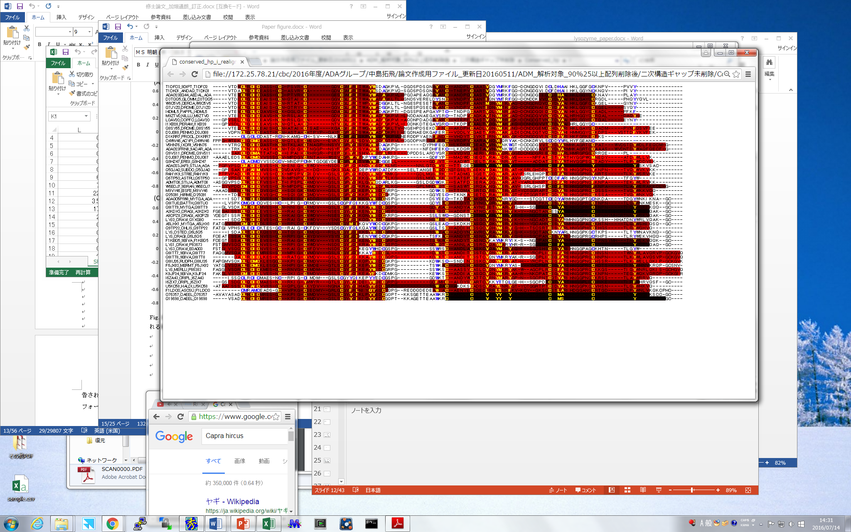
αA
β
αB
αC
i-type
β
αA
αC
αB

Slide 33
Summary of BLAST searches and ADM analyses for i-type
    Query: Tapes japonica lysozyme(UniprotID: Q8IU26, PDBID: 2DQA)
The number of sequences: 43
Average sequence identity: 45.0%
Conserved hydrophobic residue: 22
Conserved hydrophobic residue included in compact region: 19(86.4%)
(total number of residues in compact regions/total residues
= 81.3%)
Robust unit:
Cys10-Ile47,Cys60-His80,
Cys84-Cys102
Average ADM identity: 0.69
r = 0.095

Slide 34
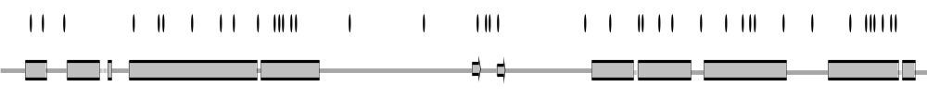
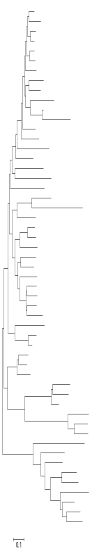
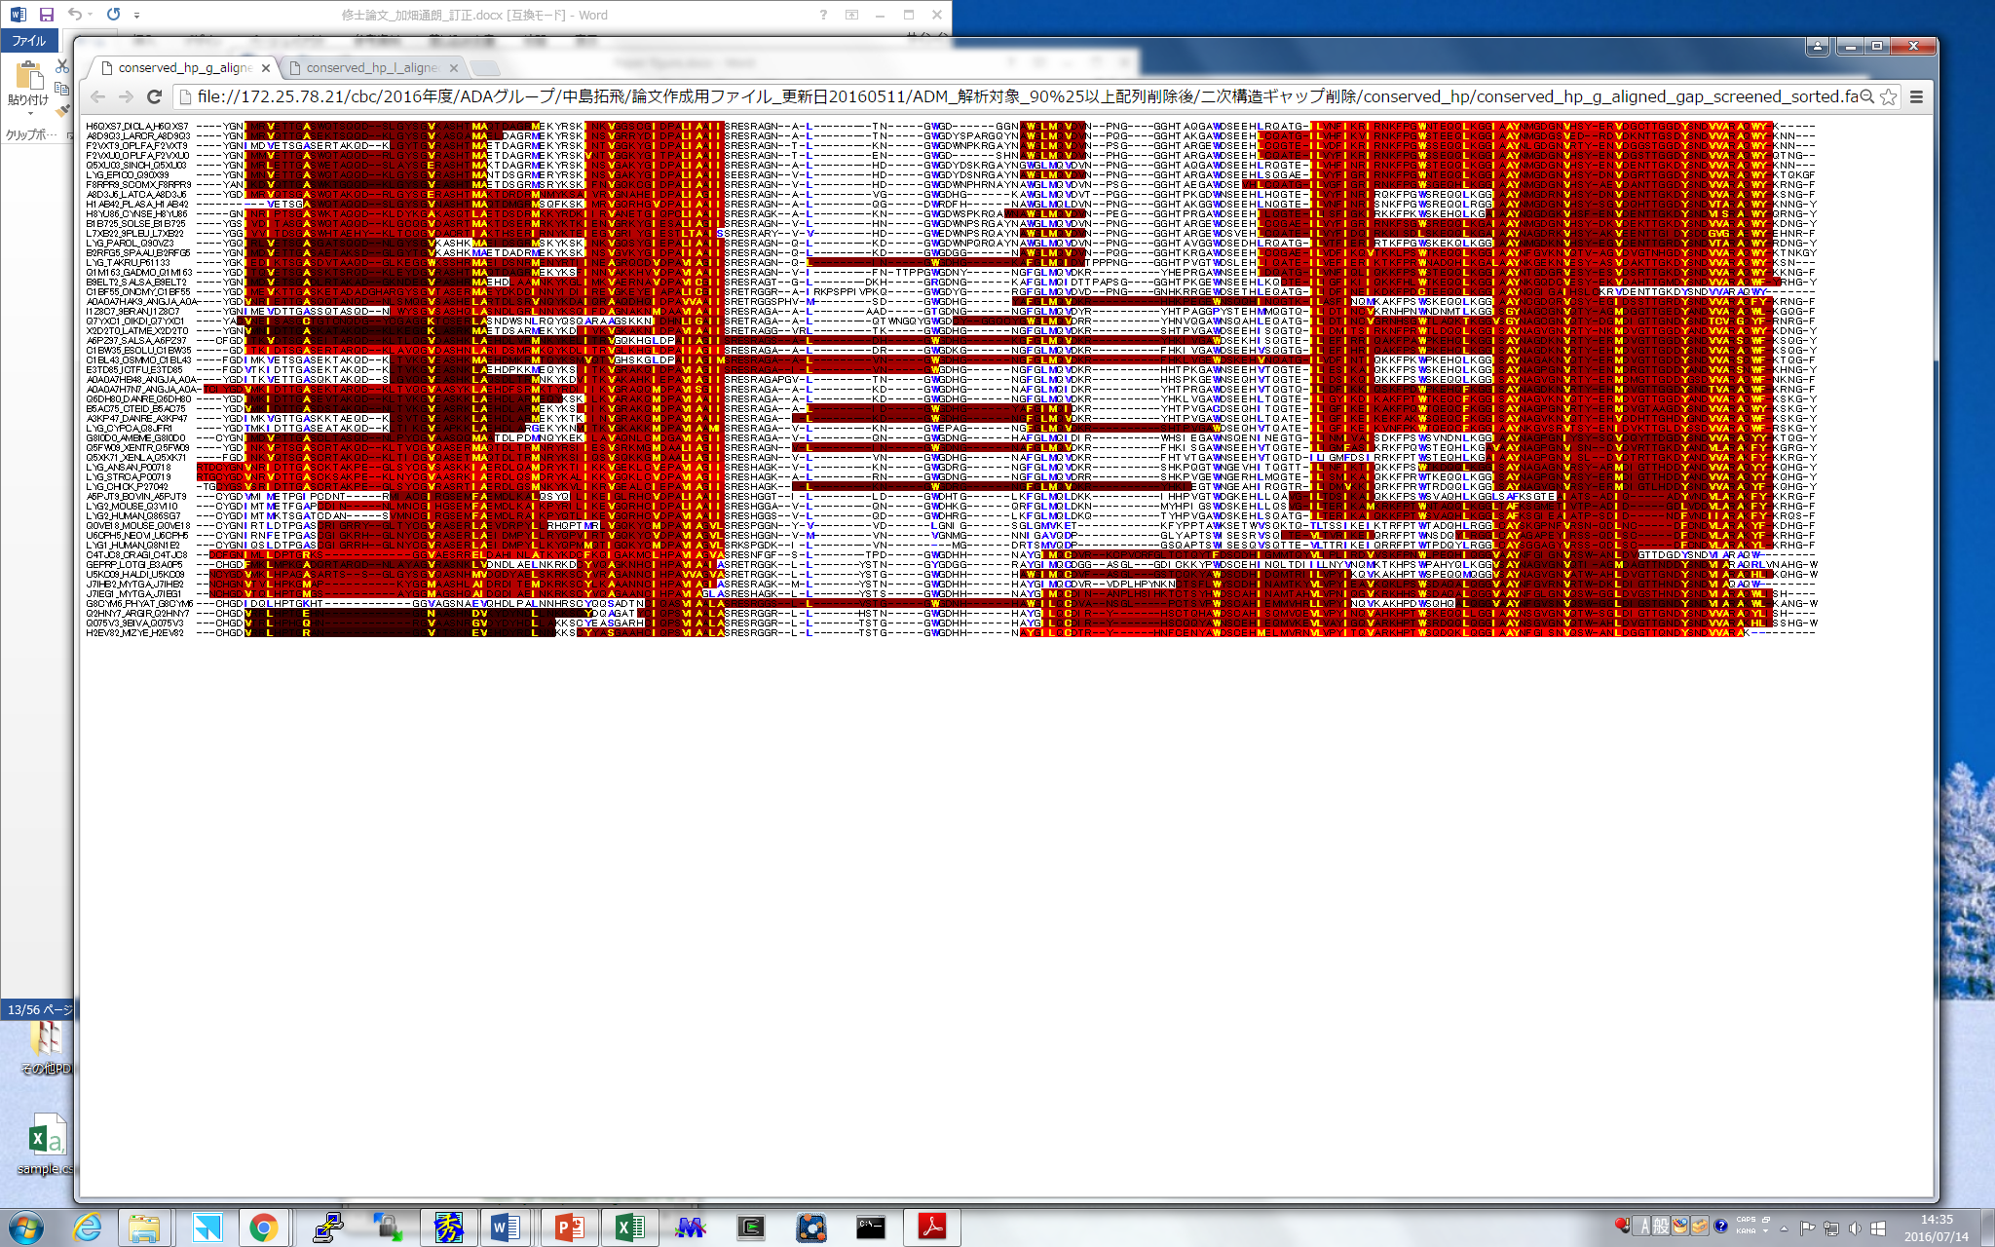
G-type
αA
β
αB
αC
β
αA
αC
αB

Slide 35
Summary of BLAST searches and ADM analyses for g-type
  Query: Goose lysozyme(UniprotID: P00718, PDBID: 153L)
The number of sequences: 62
Average sequence identity: 51.2%
Conserved hydrophobic residue: 33
Conserved hydrophobic residue included in compact region: 25(75.8%)
(total number of residues in compact regions/total residues
= 64.8%)
Robust unit:
Val8-Met45, Ile52-Ile70,
Ile119-Ile127, Gly143-Tyr180
Average ADM identity: 0.77
r = 0.37

Slide 36
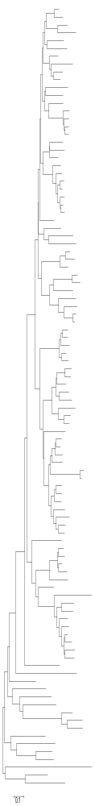
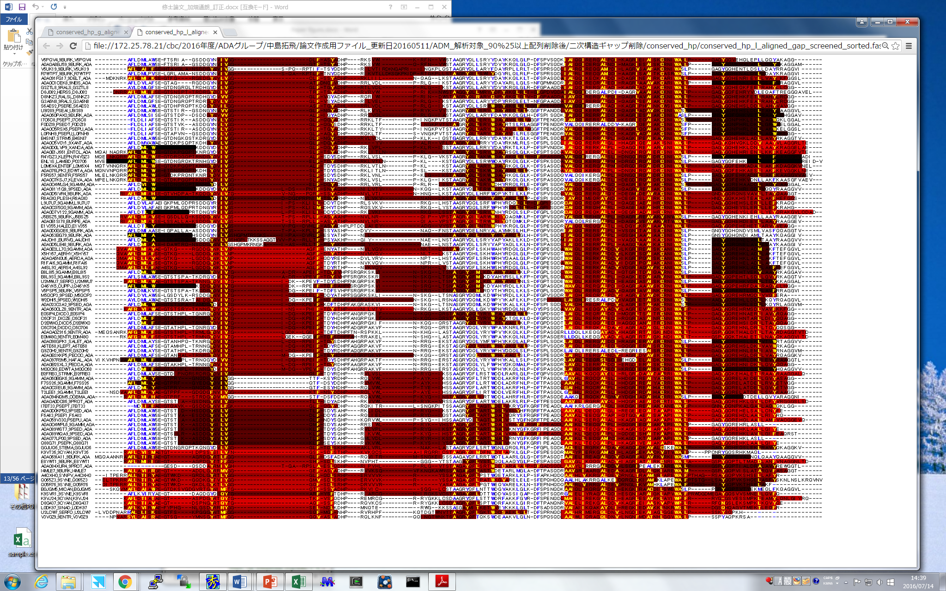
αA
β
αB
αC
λ-type
β
αB
αA
αC
Notes:
0’35”
This slide shows the results of ADMs for rambda-type lysozyme, rambda-phage lysozyme and its homologs in the multiple alignment. This protein is somewhat exceptional. That is, evolutionary conserved region are here and here and these region indicate the common folding units but these regions do not include the common topology units. Thus, the folding units in this protein may different from others but still we can find the common feature with others.

Slide 37
Summary of BLAST searches and ADM analyses for λ-type
  Query: Lambda-phage lysozyme(UniprotID: P03706, PDBID: 1AM7)
  The number of sequences: 150
Average sequence identity: 52.9%
Conserved hydrophobic residue: 55
Conserved hydrophobic residue included in compact region: 27(49.1%)
(total number of residues in compact regions/total residues
= 44.8%)
Robust unit:
Val35-Phe42,Val94-Leu127,
Gly129-Phe146
Average ADM identity: 0.70
r = 0.18
Notes:
0’25“
In goose lysozyme, the ratio of the number of conserved hydrophobic residues within the predicted compact regions to all of them is 49.1% and on the other hand, the ratio of the sequence length of total compact regions to the whole sequence is 44.8%. Again, that means that the conserved hydrophobic residues tend to exist in the compact regions.

Slide 38
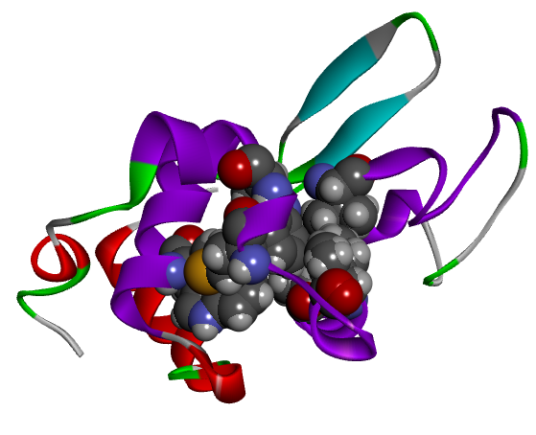
c-type Hen lysozyme (2VB1)
β
58-I
αA
108-M
αC
28-W
95-A
98-A
αB
F-value
α helix
105-M
β sheet
Conserved hydrophobic residue
(η = 0.354)
(η = 0.201)
(η = 0.235)
Predicted Compact region by ADM
αA
β
αB
αC
Residue number
Formed Contact by Conserved Residues
αA-αB:28W-95A
β-αΒ: 58I-98I
αA-αC: 28W-105M
αB-αC: 98I-108W

Slide 39
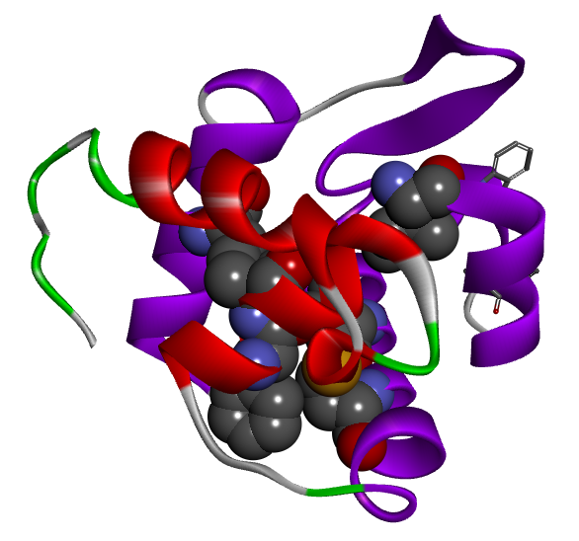
i-type Tapes lysozyme (2DQA)
β
41-I
70-V
74-M
αA
αB
14-M
90-A
F-value
91-F
αC
(η = 0.256)
(η = 0.330)
αA
β
αB
αC
Residue number
Formed Contact by Conserved Residues
α helix
αA-αB:14M-70V
β-αΒ: 41I-70V
αA-αC: :14M-(91A)
αB-αC: 74M-(90F)
β sheet
Conserved hydrophobic residue
Predicted Compact region by ADM

Slide 40
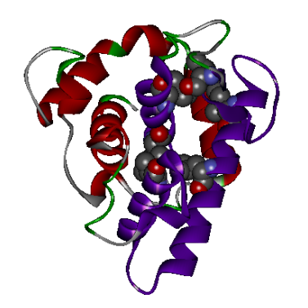
G-type Goose lysozyme (153L)
65-V
β
αA
70-I
113-I
91-F
120-L
F-value
144-I
αB
αC
93-L
(η = 0.284)
(η = 0.208)
(η = 0.202)
αA
β
αB
αC
Residue number
α helix
β sheet
Formed Contact by Conserved Residues
αA-αB: 70I-113I
β-αΒ: 93L-113I
αA-αC: 65V-144I
αB-αC: 120L-144I
Conserved hydrophobic residue
Predicted Compact region by ADM

Slide 41
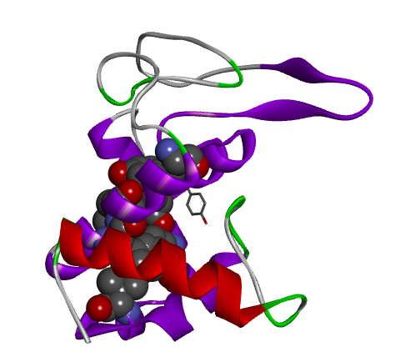
λ-type λ phage lysozyme (1AM7)
β
αC
67-Y
95-A
96-L
αA
F-value
108-I
αB
99-I
12-L
(η = 0.205)
(η = 0.219)
αA
β
αB
αC
Residue number
α helix
Formed Contact by Conserved Residues
β sheet
αA-αB: (12L)-96L
β-αΒ: 67Y-95A
αA-αC: (11F)-99I
αB-αC: 99I-108I
Conserved hydrophobic residue
Predicted Compact region by ADM

Slide 42
Commonly Observed Contacts of Conserved Hydrophobic Residues around peaks of the F value plots
αA-αB
2VB1: 28W-95A
2DQA: 14M-70V
153L: 70I-113I
1AM7: (12L)-96L
β-αΒ
2VB1: 58I-98I
2DQA: 41I-70V
153L: 93L-113I
1AM7: 67Y-95A
αA-αC
2VB1: 28W-105M
2DQA: 14M-(91A)
153L: 65V-144I
1AM7: (11F)-99I
αB-αC
2VB1: 98I-108W
2DQA: 74M-(90F)
153L: 120L-144I
1AM7: 99I-108I

Slide 43
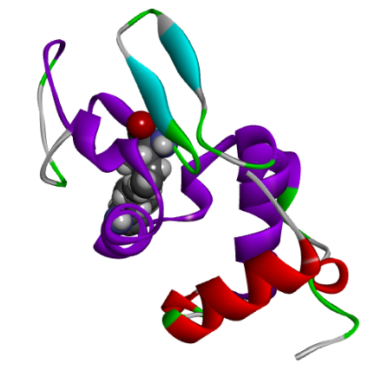
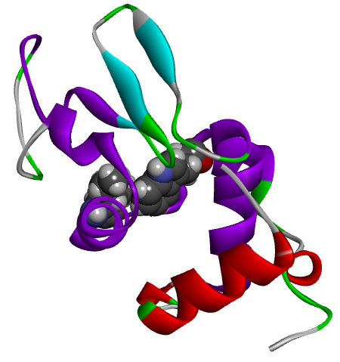
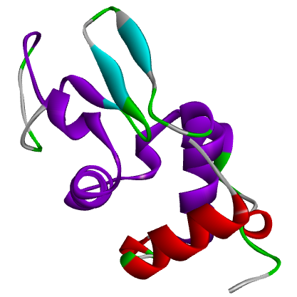
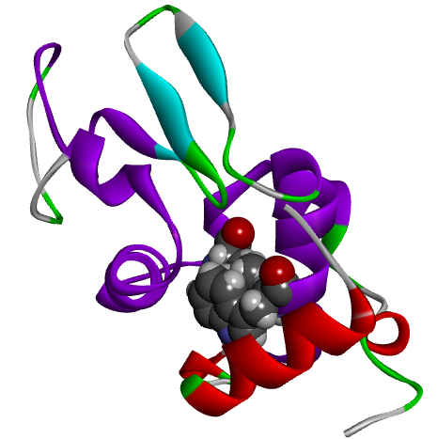
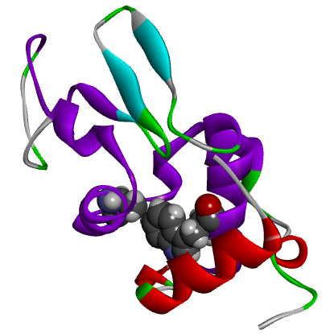
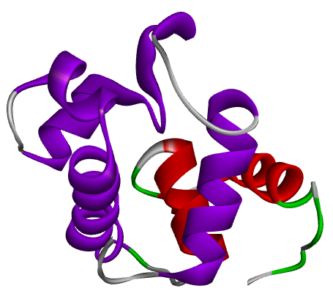
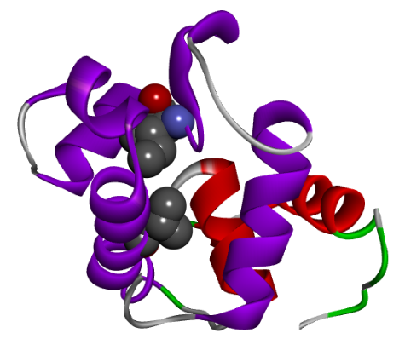













c-type Hen lysozyme
(2VB1)
αA-αB
2VB1: 28W-95A
2DQA: 14M-70V
153L: 70I-113I
1AM7: 12L-96L
i-type Tapes lysozyme (2DQA)
αA-αB
2VB1: 28W-95A
2DQA: 14M-70V
153L: 70I-113I
1AM7: 12L-96L
β-αB
2VB1: 58I-98I
2DQA: 41I-70V
153L: 93I-113I
1AM7: 67Y-95AH
β-αB
2VB1: 58I-98I
2DQA: 41I-70V
153L: 93I-113I
1AM7: 67Y-95A
αA-αC
2VB1: 28W-105M
2DQA: 14M-(91A)
153L: 65V-144I
1AM7: 11F-99I
αA-αC
2VB1: 28W-105M
2DQA: 14M-(91A)
153L: 65V-144I
1AM7: 11F-99I
λ-type λ phage lysozyme (1AM7)
G-type Goose
lysozyme (153L)
αC-αC
2VB1: 98I-108W
2DQA: 74M-(90F)
153L: 120L-144I
1AM7: 99I-108I
αB-αC
2VB1: 98I-108W
2DQA: 74M-(90F)
153L: 120L-144I
1AM7: 99I-108I

Slide 44
Conclusion
The same topology of lysozyme family proteins are formed by specific contacts of conserved hydrophobic residues within secondary structures forming the common topology.

Slide 45


Perspective
We are applying the present techniques to the proteins with highly identical sequences but different 3D structures.

Slide 46







Acknowledgement
Evolutionary Analysis
Dr. Yosuke Kawai (Tohoku Univ.)
Hemoglobin
Prof. Raul Arredondo-Peter
(Universidad Autónoma
del Estado de Morelos, Mexico)
Mr. Takehiro Ihcimaru
Mr. Shunsuke Nakajima
(Kurashiki University of Science and the Arts)
Ferredoxin-type proteins
Dr. Masanari Matsuoka
Lysozyme family proteins
Mr. Michirou Kabata
Mr. Takuto Nakashima
β-Trefoil protein
Mr. Takuya Kirioka
New Go Model
Dr. Masatake Sugita

