Slide 1
About OMICS Group
OMICS Group International is an amalgamation of Open Access publications and worldwide international science conferences and events. Established in the year 2007 with the sole aim of making the information on Sciences and technology ‘Open Access’, OMICS Group publishes 400 online open access scholarly journals in all aspects of Science, Engineering, Management and Technology journals. OMICS Group has been instrumental in taking the knowledge on Science & technology to the doorsteps of ordinary men and women. Research Scholars, Students, Libraries, Educational Institutions, Research centers and the industry are main stakeholders that benefitted greatly from this knowledge dissemination. OMICS Group also organizes 300 International conferences annually across the globe, where knowledge transfer takes place through debates, round table discussions, poster presentations, workshops, symposia and exhibitions.

Slide 2
About OMICS Group Conferences
OMICS Group International is a pioneer and leading science event organizer, which publishes around 400 open access journals and conducts over 300 Medical, Clinical, Engineering, Life Sciences, Phrama scientific conferences all over the globe annually with the support of more than 1000 scientific associations and 30,000 editorial board members and 3.5 million followers to its credit.
OMICS Group has organized 500 conferences, workshops and national symposiums across the major cities including San Francisco, Las Vegas, San Antonio, Omaha, Orlando, Raleigh, Santa Clara, Chicago, Philadelphia, Baltimore, United Kingdom, Valencia, Dubai, Beijing, Hyderabad, Bengaluru and Mumbai.

Slide 3
Application of High Performance Computing for Numerical Simulation of Fracture of Fiber Reinforced Composite Materials
Takeaki Nadabe
University of Tokyo

Slide 4


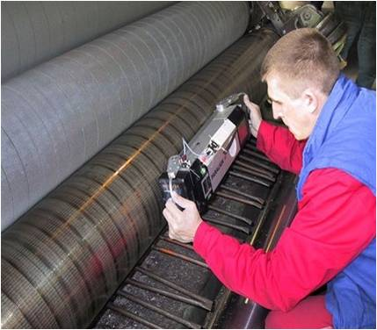
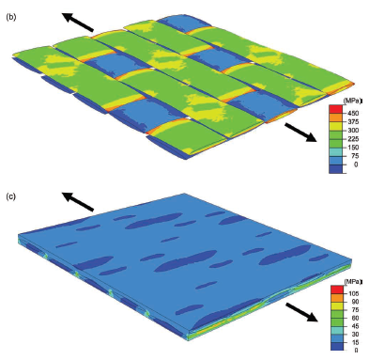
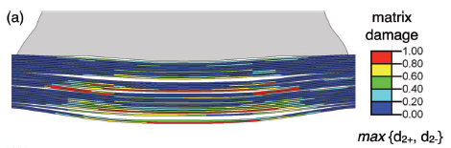
Background
1/11
Application of composite materials in several industrial fields.
Necessity of analysis for mechanical response of materials increases.
Improvement of computational capability.
By applying computational analysis, manufacturing and operation process are expected to be understood more deeply.
J. LLorca, C. González, J. M. Molina-Aldareguía, J. Segurado, R. Seltzer, F. Sket, M. Rodríguez, S. Sádaba, R. Muñoz and L. P. Canal, 2011, “Multiscale Modeling of Composite Materials: a Roadmap Towards Virtual Testing” Adv. Mater., vol. 23, no. 44, pp. 5130-5147.

Slide 5
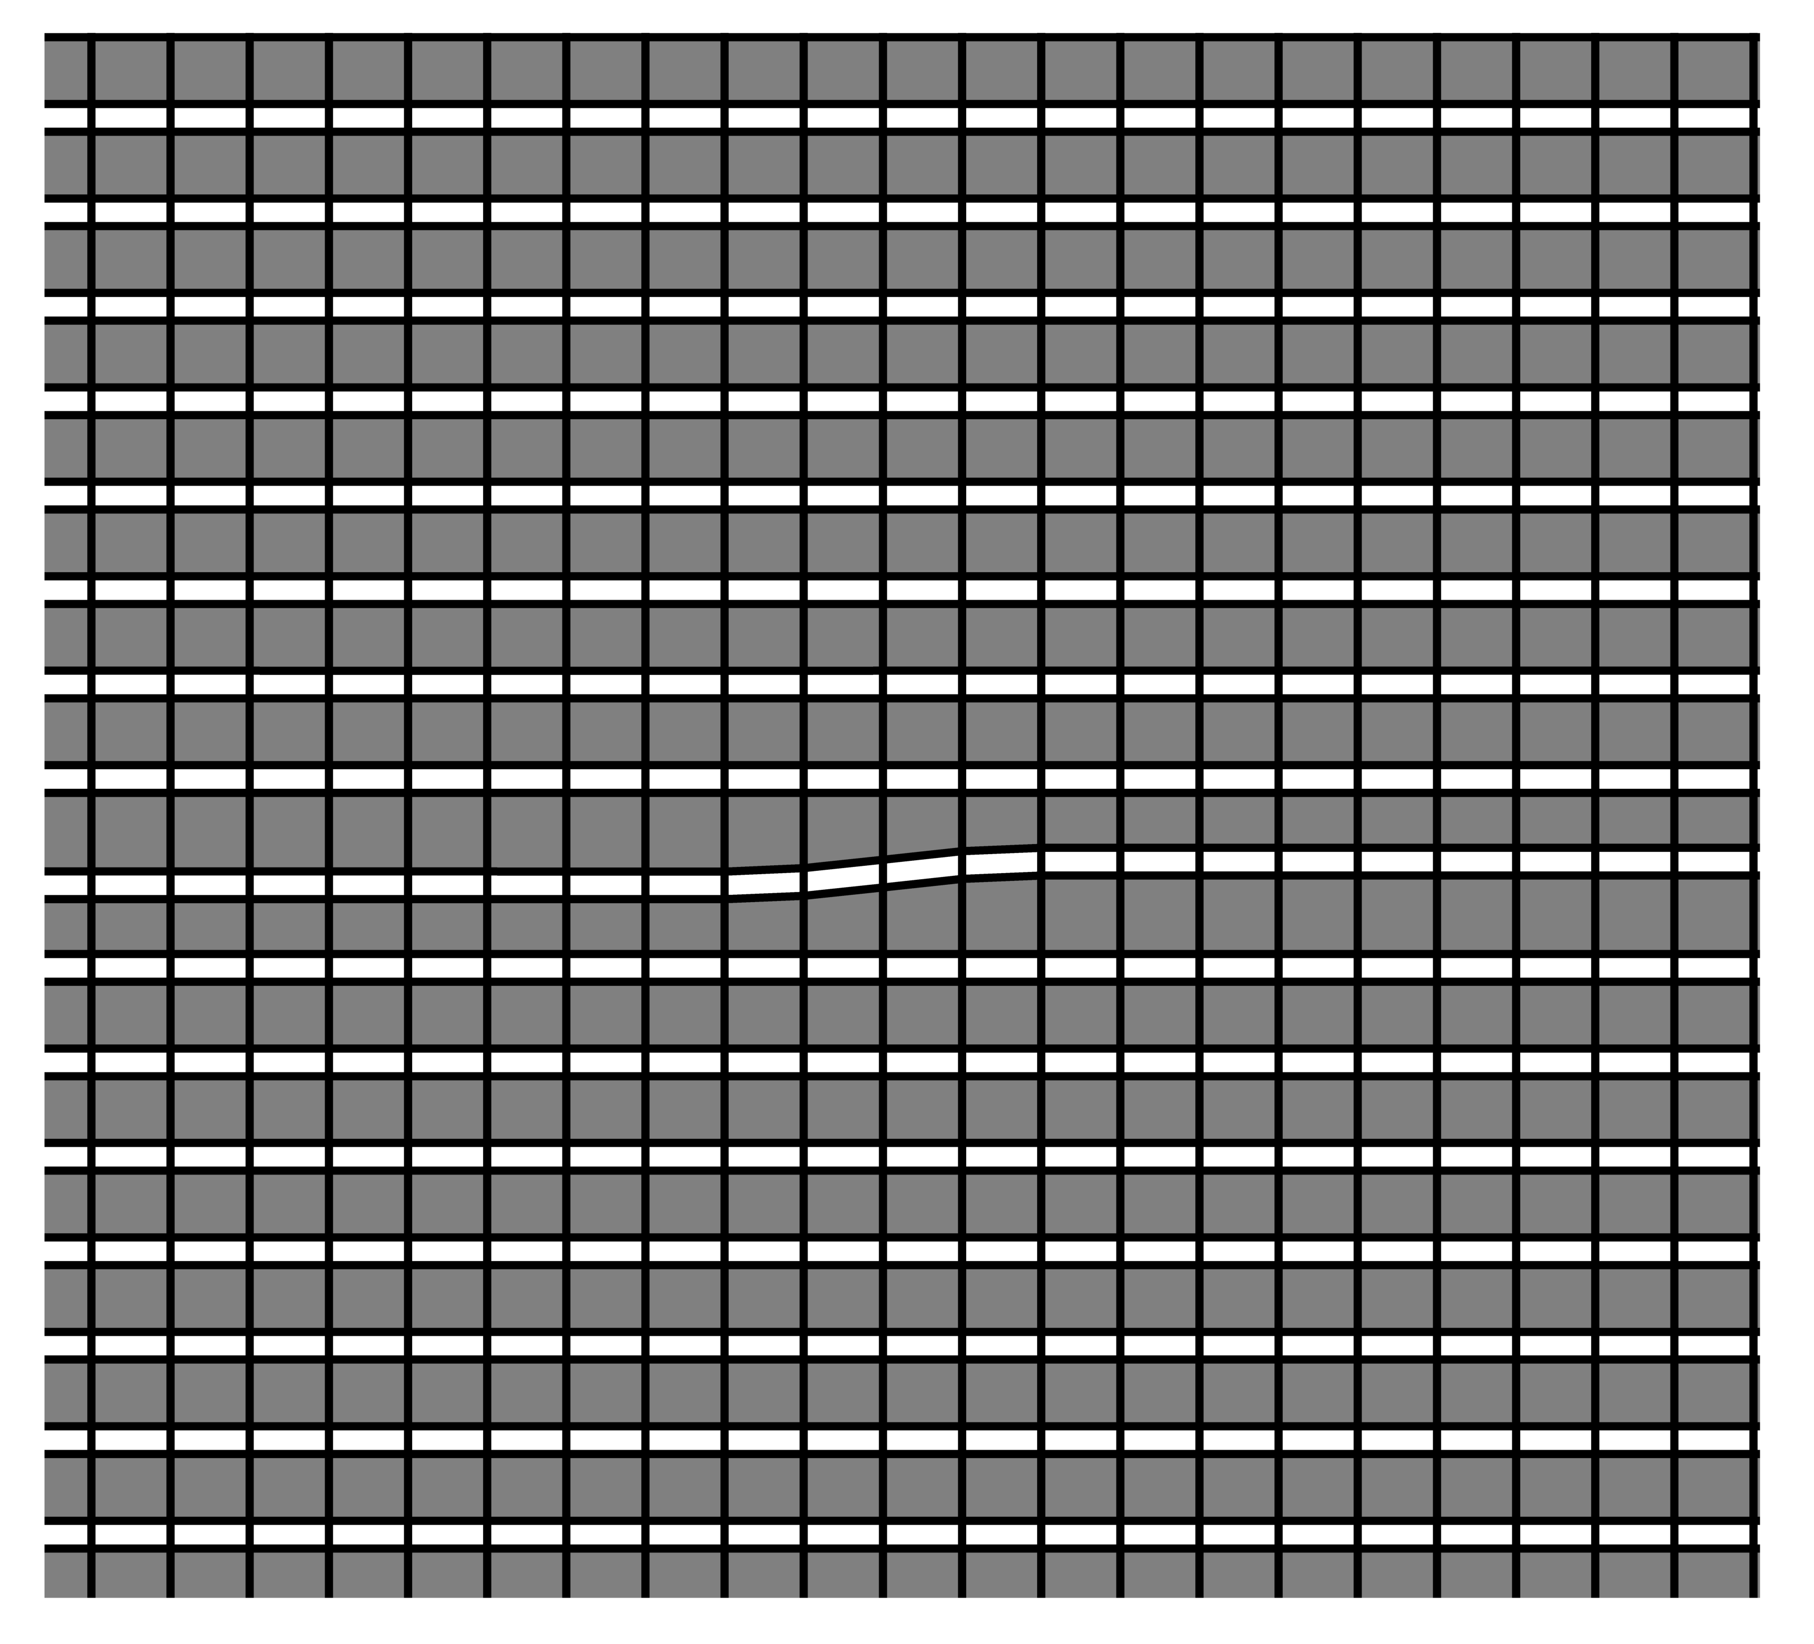

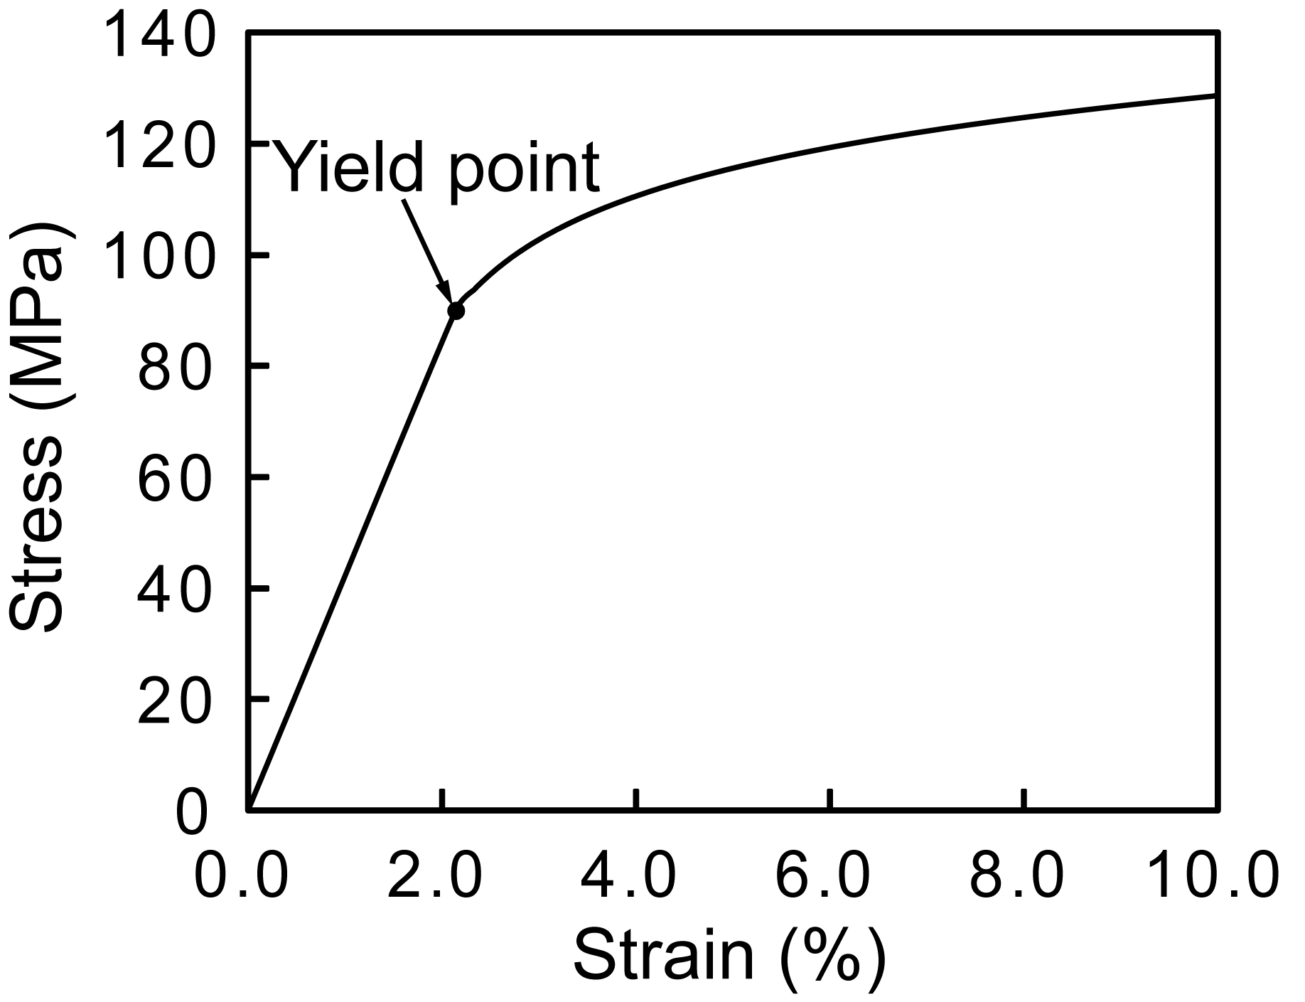
Numerical Simulation of Longitudinal Compressive Failure
2/11
1000 μm
y
x
Initial misalignment of fiber
600 μm
Fixed
Loading
Fiber Matrix
Material property of fiber Material property of matrix Matrix stress-strain curve
Elastic modulus in x- direction | 225 | GPa
Elastic modulus in y- direction | 15 | GPa
In-plane Poisson’s ratio | 0.2
In-plane shear modulus | 15 | GPa
Transverse shear modulus | 7 | GPa
Elastic modulus | 4.2 | GPa
Poisson’s ratio | 0.34
Yield stress | 90 | MPa
Carbon fiber/Epoxy resin AS4/3501-6 is assumed as the material.

Slide 6
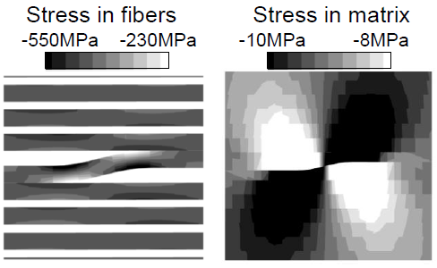
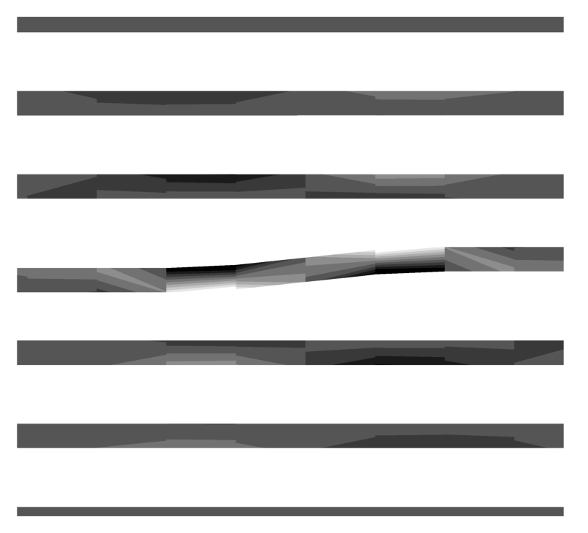
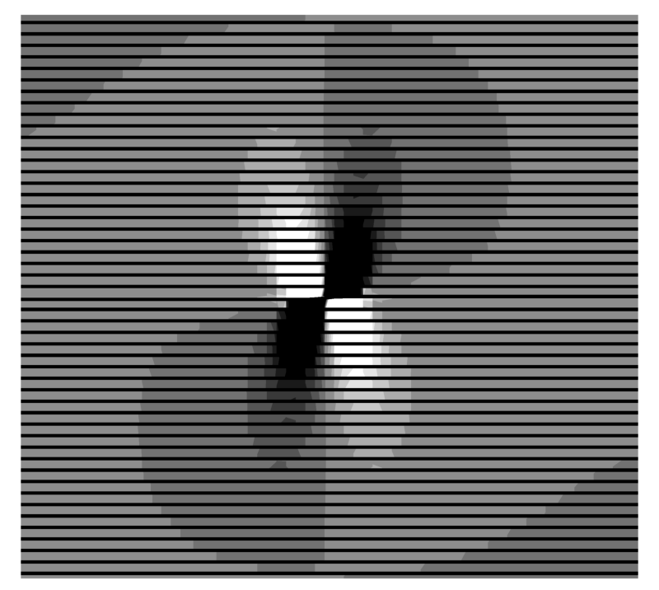
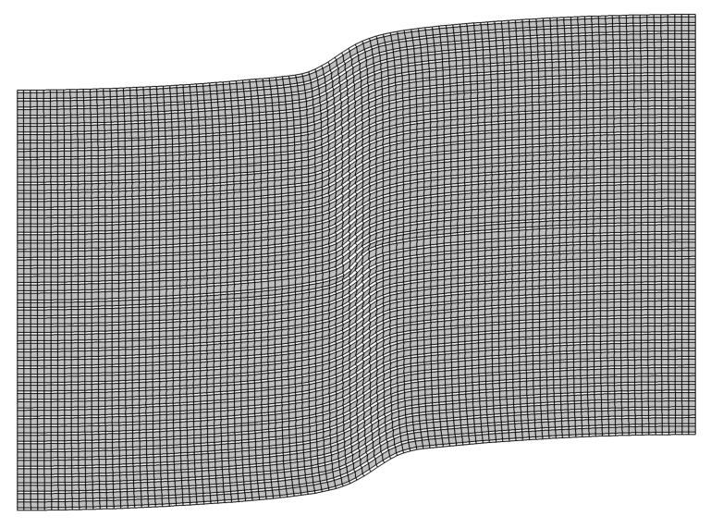
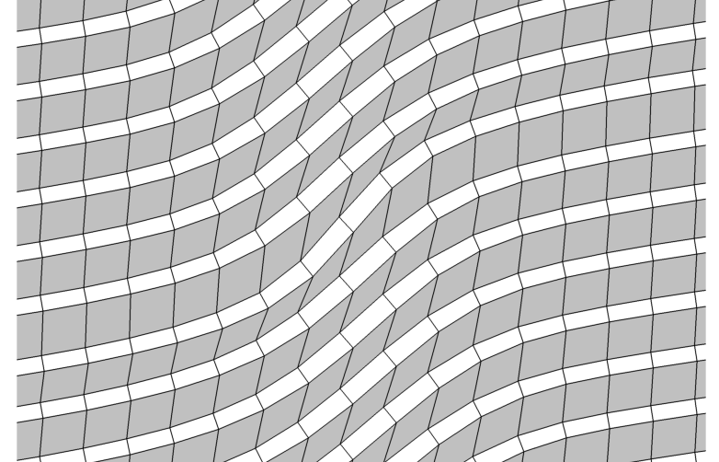
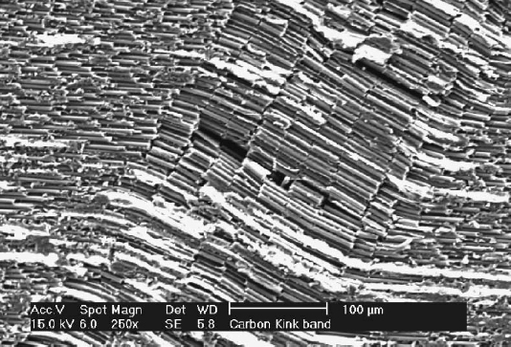
Numerical Simulation of Longitudinal Compressive Failure
3/11
Stress in fiber Stress in matrix
-235MPa -205MPa -4.40MPa -4.25MPa
Strain 0.10%
Bending stress occurs. Stress concentration occurs.
Strain 1.20%
Rhombus shape (shear)
C. S. Yerramalli and A. M. Waas, “A failure criterion for fiber reinforced polymer composites under combined compression–torsion loading,” International Journal of Solids and Structures, vol. 40, no. 5, pp. 1139–1164, 2003.
Localized deformation
Rectangle shape (compressive)

Slide 7
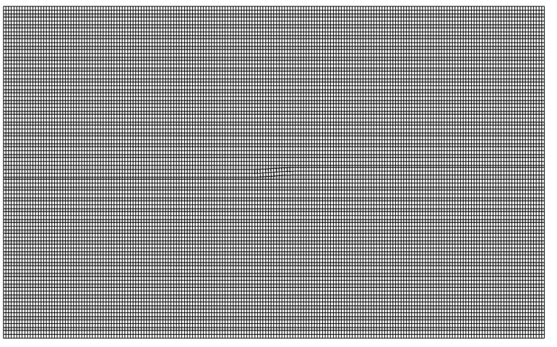
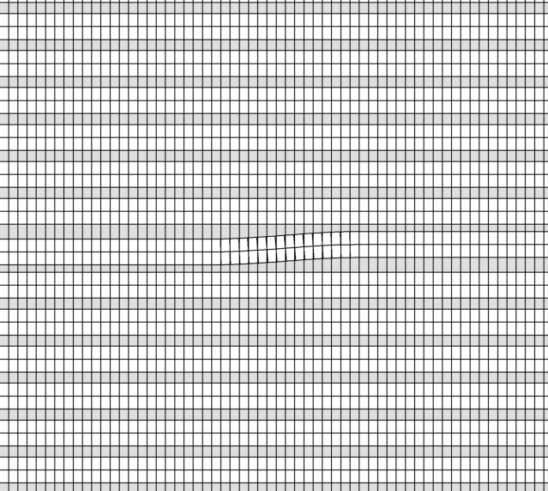
In Case of Fiber Breaking
4/11
1000 μm
y
x
Initial misalignment of fiber
600 μm
Fixed
Loading
Fiber Matrix
Material property of fiber Material property of matrix Matrix stress-strain curve
Elastic modulus in x- direction | 225 | GPa
Elastic modulus in y- direction | 15 | GPa
In-plane Poisson’s ratio | 0.2
In-plane shear modulus | 15 | GPa
Transverse shear modulus | 7 | GPa
Elastic modulus | 4.2 | GPa
Poisson’s ratio | 0.34
Yield stress | 90 | MPa
Carbon fiber/Epoxy resin AS4/3501-6 is assumed as the material.

Slide 8
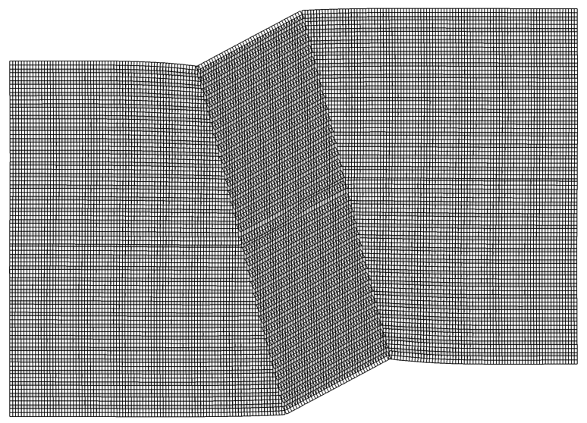
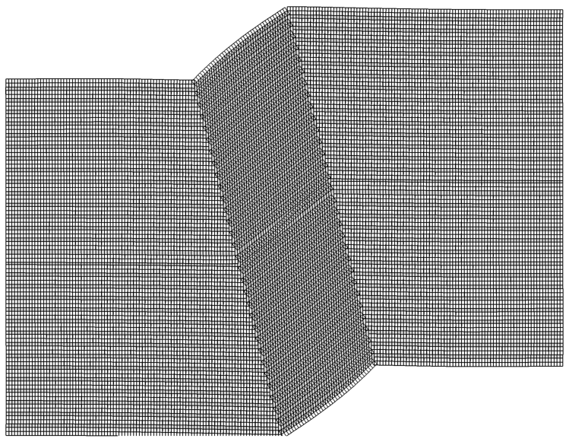
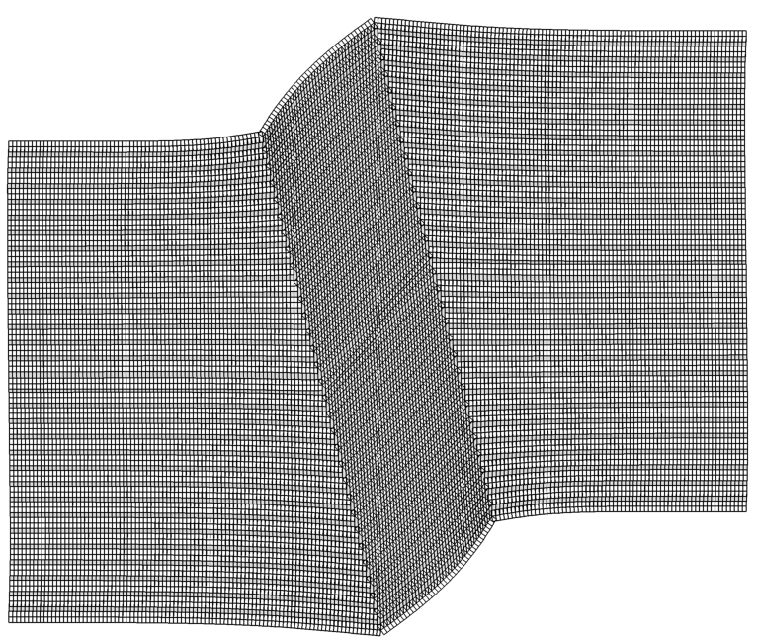
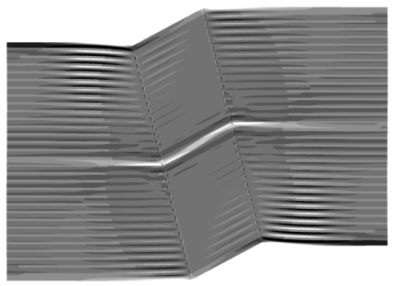
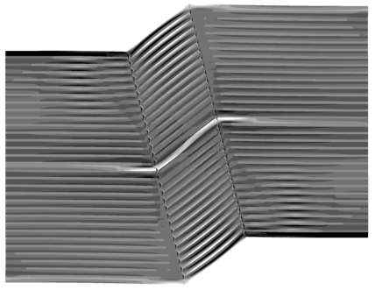
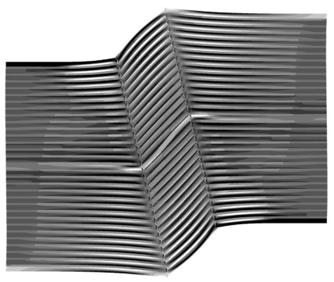
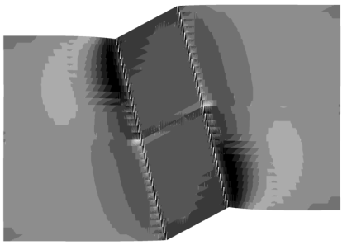
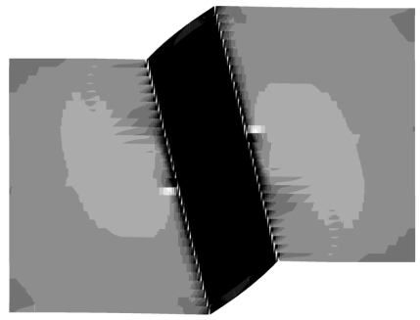
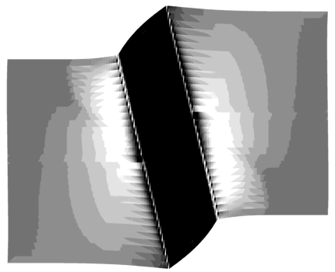
In Case of Fiber Breaking
5/11
At strain 2.0% 4.0% 6.0%
Deformation
2000MPa
Stress in fibers
-2000MPa
140MPa
Stress in matrix
-140MPa

Slide 9
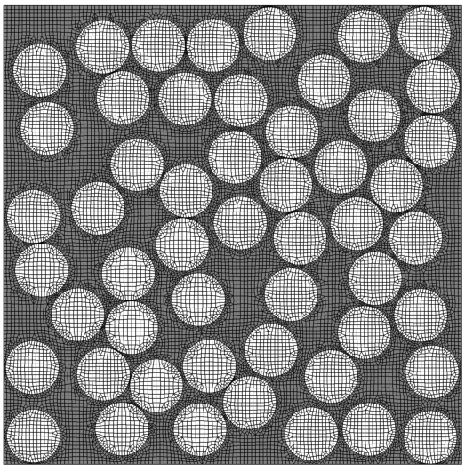
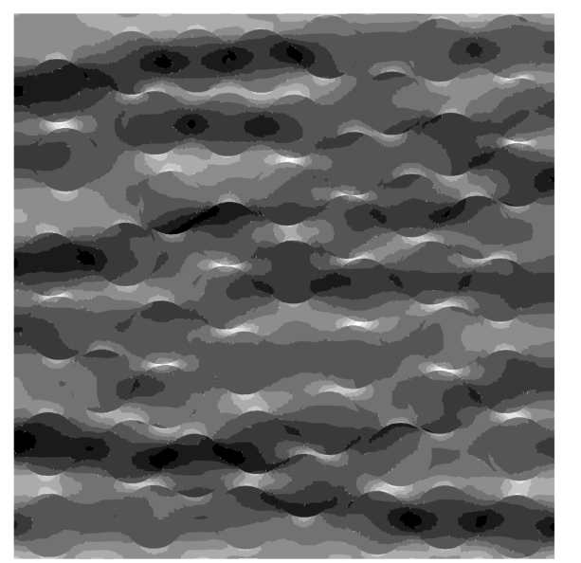
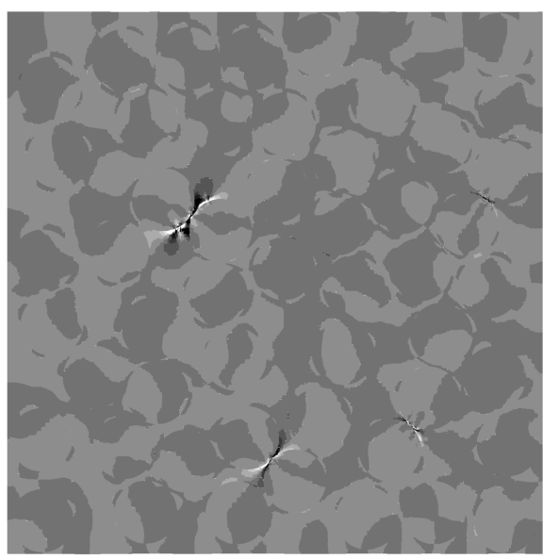

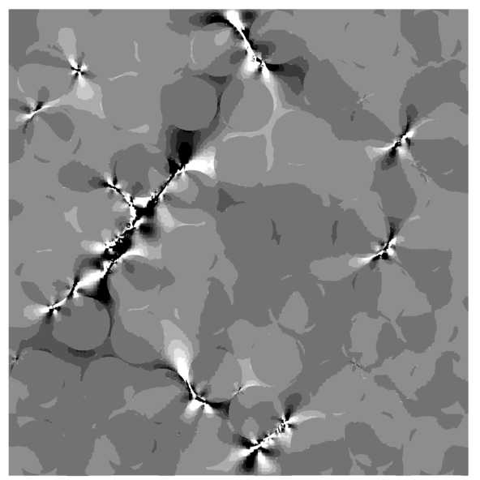
Numerical Simulation of Transverse Compressive Failure
6/11
60 μm
Stress distribution Shear strain rate
y
-80MPa 0MPa -0.001 0.001
x
60 μm
Maximum stress concentration point
Initiating shear band
Fixed
-80MPa 0MPa -0.001 0.001
Loading
Matrix stress-strain curve
Progressing shear band
Fibers come close

Slide 10
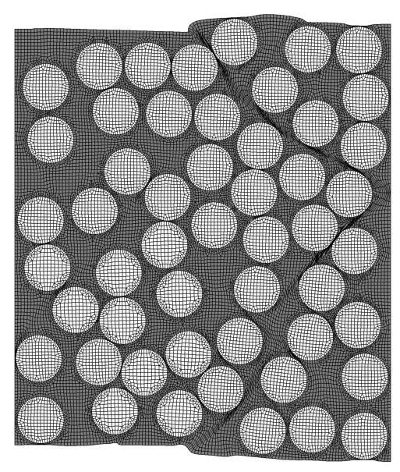
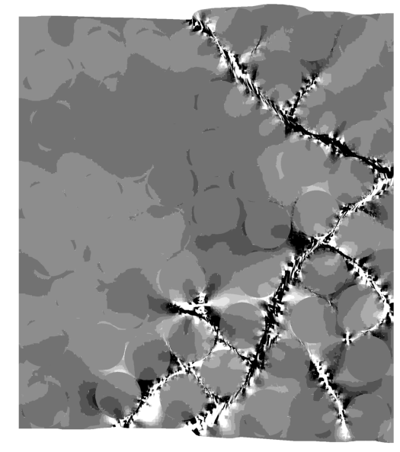
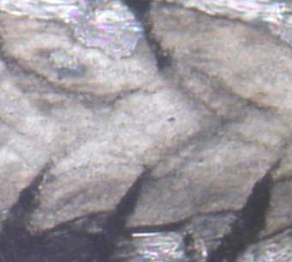
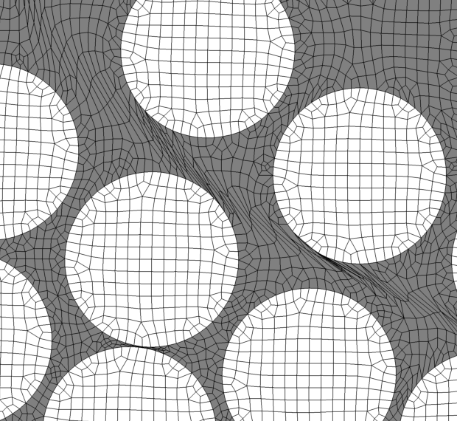
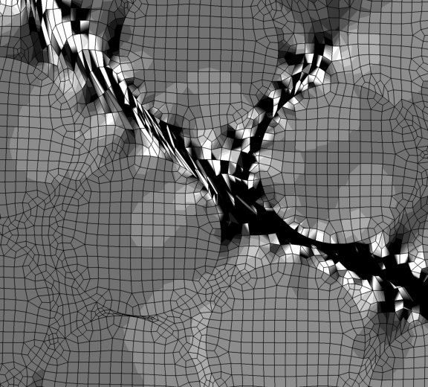
Numerical Simulation of Transverse Compressive Failure
7/11
Deformation Shear strain rate
Simulated deformation
-0.001 0.001
Strain 6.0%
shear band
-0.001 0.001
Microscope photograph

Slide 11
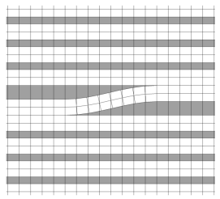
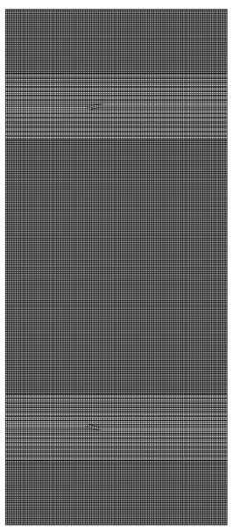
Numerical Simulation of Compressive Failure in Laminated Plate
8/11
y
500 μm
Fiber
45-degree ply
x
0-degree ply
Matrix
-45-degree ply
Misalignment
90-degree ply
1160 μm
90-degree ply
-45-degree ply
Matrix stress-strain curve
0-degree ply
45-degree ply
Periodic boundary condition

Slide 12
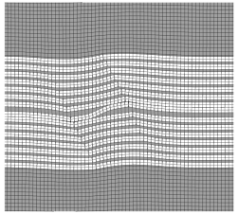
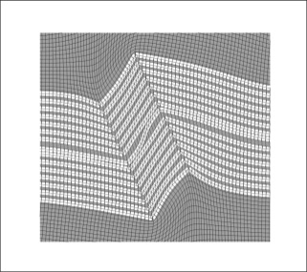
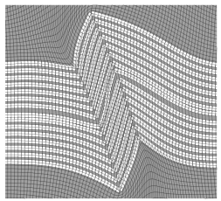
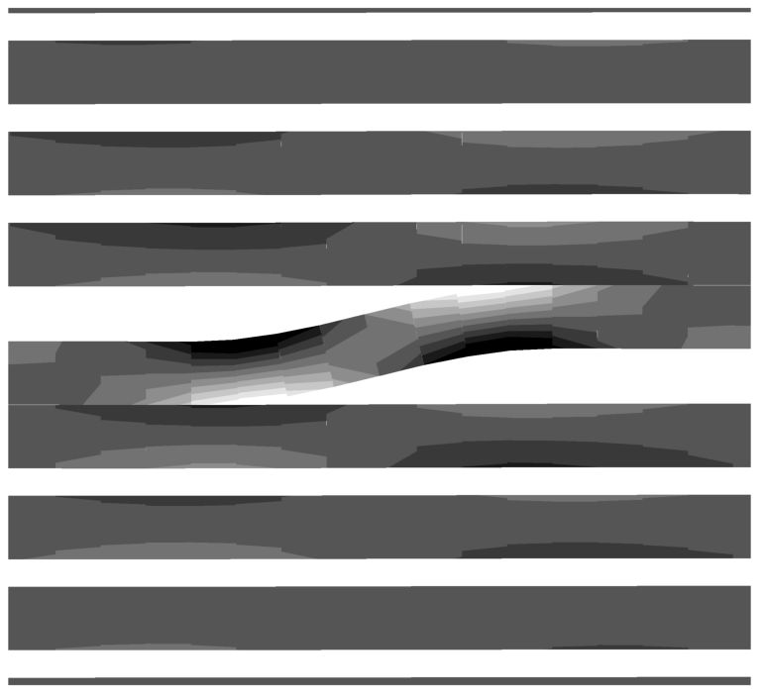
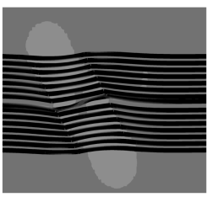
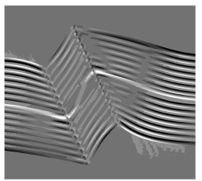
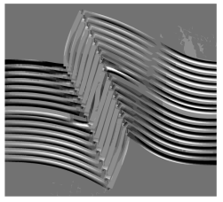
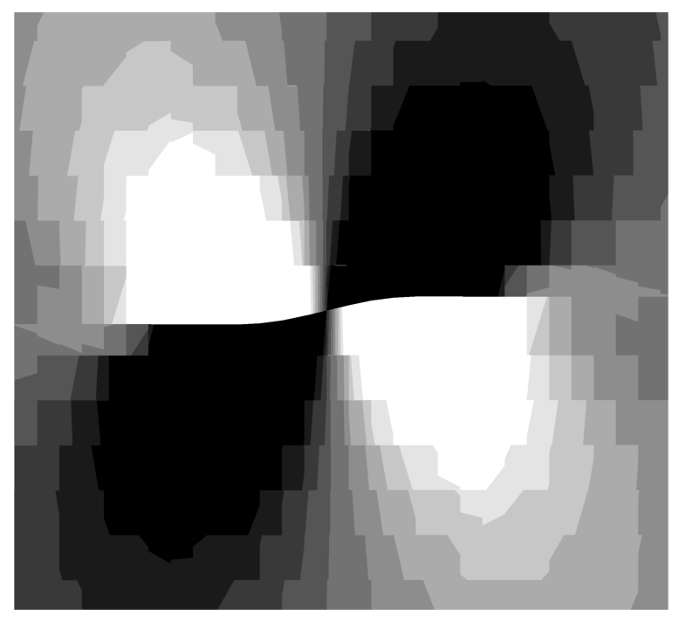
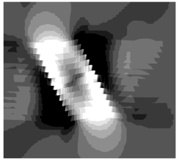
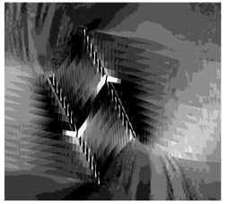
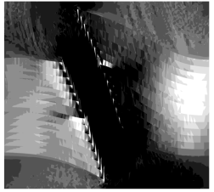
Numerical Simulation of Compressive Failure in Laminated Plate
9/11
At strain 0.20%
At strain 1.45% 8.5% 15.0%
Stress in fibers
-550MPa -230MPa
Deformation
2000MPa
Bending stress
Stress in fibers
Stress in matrix
-10.0MPa -8.0MPa
-2000MPa
140MPa
Stress in matrix
Stress concentration
-140MPa

Slide 13
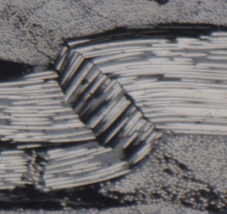
Numerical Simulation of Compressive Failure in Laminated Plate
10/11
Simulated deformation
Microscope photograph

Slide 14
Conclusions
11/11
This study investigates numerical simulation of fracture process of composite materials using computational analysis.
In numerical simulation of longitudinal compressive failure, stress concentration occurs in the initial state of loading around initial misalignment of fiber, and at one moment of the loading, localized deformation appears in the material with originating from the initial misalignment part.
In case of transverse compressive failure, stress concentration occurs in the material due to random placement of fibers, and after increase of applied strain, microscopic shear band appears from the maximum stress concentration point.
Taking into account the fiber bending breaking, fiber kinking which appears in both unidirectional material and laminated plate is simulated in numerical simulation.

Slide 15
Let Us Meet Again
We welcome you all to our future conferences of OMICS Group International
Please Visit:
http://materialsscience.conferenceseries.com/
Contact us at
materialsscience.conference@omicsgroup.us
materialsscience@omicsgroup.com

