Slide 1



Title
Institute of Fluid Science
12/08/2015
Nanotechnology-2015
Large Scale Molecular Simulations for Transport Phenomena in Polymer Electrolyte Fuel Cell
Quantum Nanoscale Flow Systems Laboratory, Nanoscale Flow Division
Novel Battery Nanoscale Flow Laboratory, Innovative Eenrgy Research Center
Institute of Fluid Science, TOHOKU UNIVERSITY
Takashi Tokumasu

Slide 2
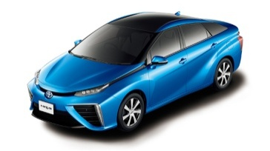

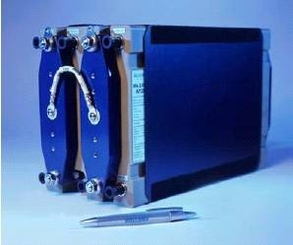
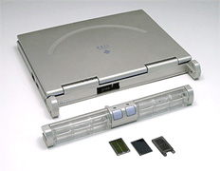
Background
Fuel Cell : Next Generation Power Supply System
High efficiency of energy exchange
Low environment damage (without generating NOx, SOx, .etc)
Low vibration, low noise (without explosion and combustion)
How to
use
Mobile
Home
Car
Office
Factory
Power
1kW 10kW 100kW 1MW 10MW 100MW
MCFC
Kind
PAFC
SOFC
PEFC
Polymer Electrolyte Fuel Cell (PEFC)
Low driving temperature
No scatter of electrolyte
High power density
Firstly commercialize among all fuel cells

Slide 3
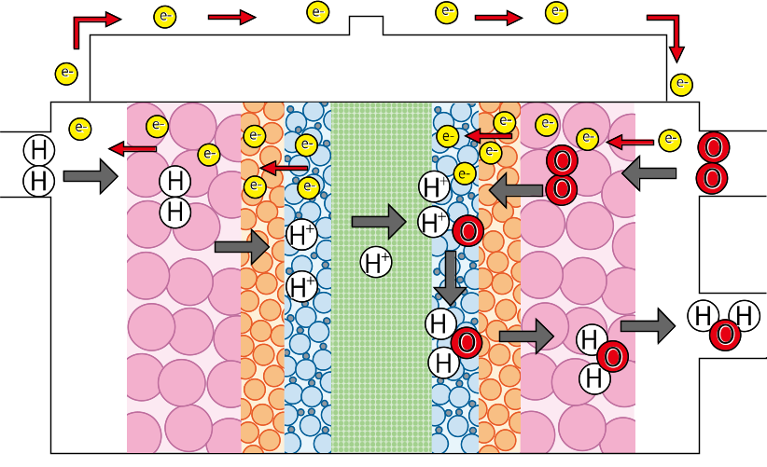
Importance of material transport
Trasfer loss : reactant materials (proton, oxygen) and
product material (water) cannot move faster in PEFC
enough to generate such high currency
Catalytic
Loss
Ohmic
Loss
Transfer
Loss
Ideal(1.23V)
Voltage
Decrease of transfer loss is important to improve the efficiency of a PEFC
POWER
POWER
It is very important to analyze the transport phenomena of materials (proton, water and oxygen) in PEFC.
Currency
Transport phenomena of materials in PEFC
・Gas Diffusion Layer: GDL
・Micro Porous Layer: MPL
・Catalyst Layer: CL
・Polymer Electrolyte Membrane: PEM
construct the flow fields whose characteristic length is from micro to nano meter.
The characteristics cannot be analyzed by continuum theory
GDL
PEM
GDL
MPL
CL
CL
MPL
The analyses of transport phenomena of materials in nanoscale to mezoscale greatly contribute to the development of next generation of fuel cell

Slide 4

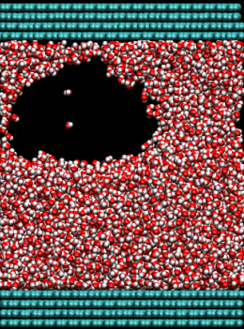
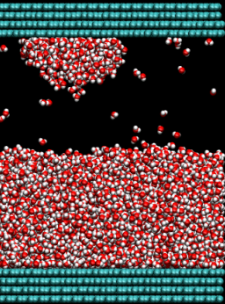
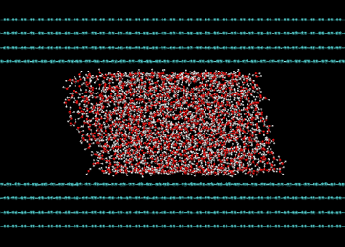
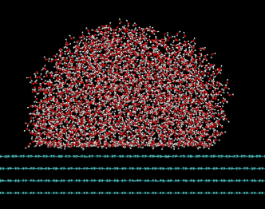
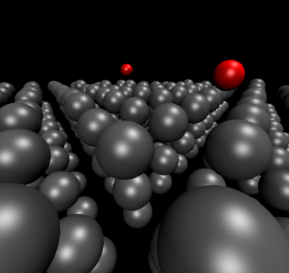
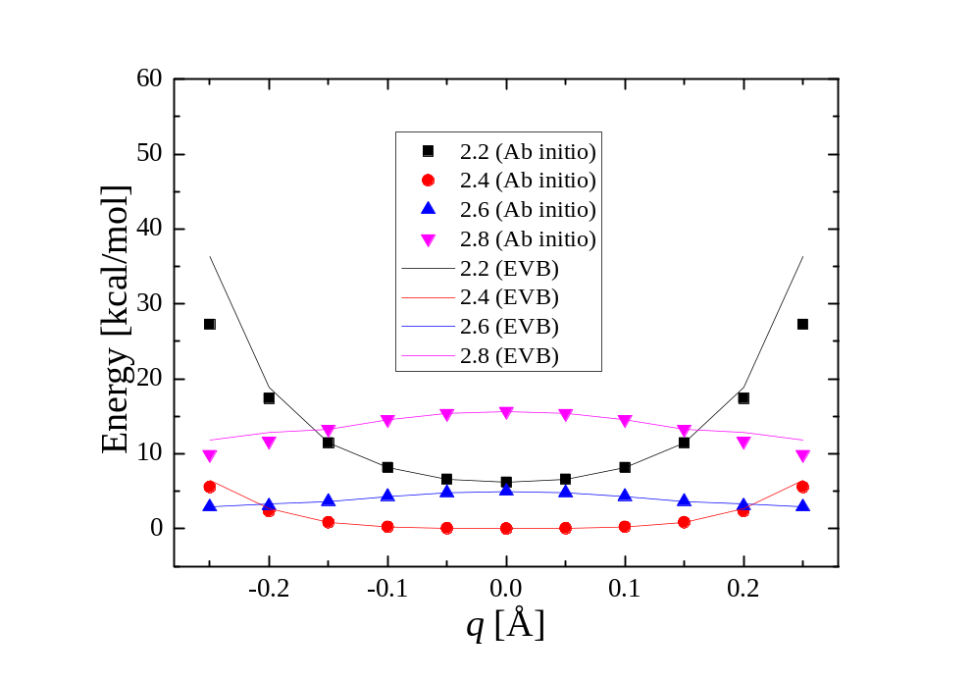
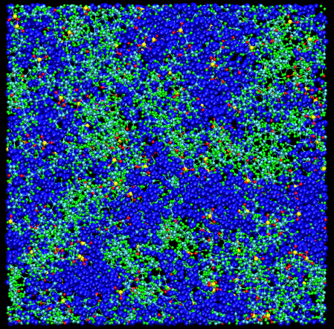
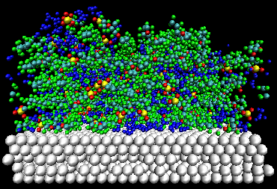
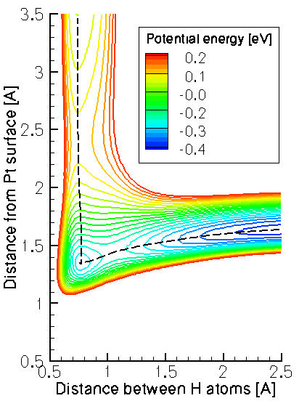
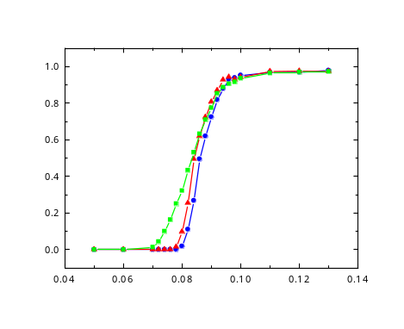
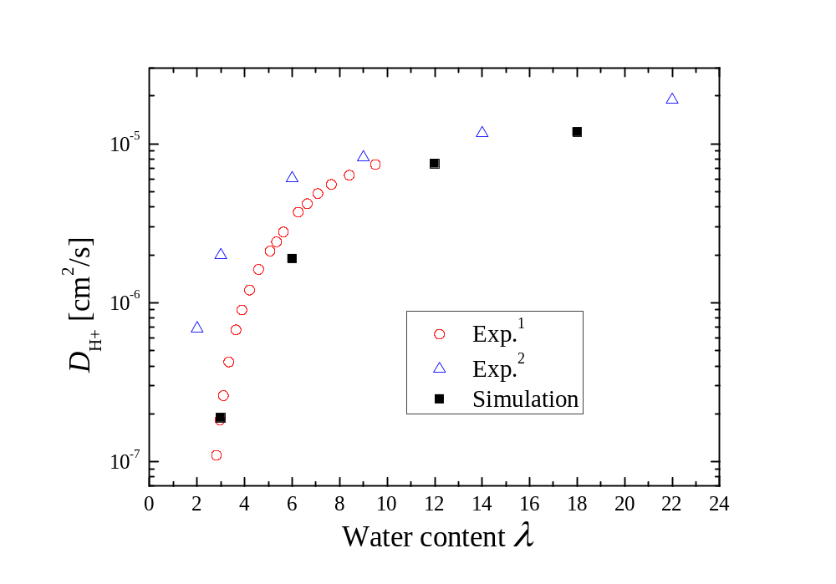
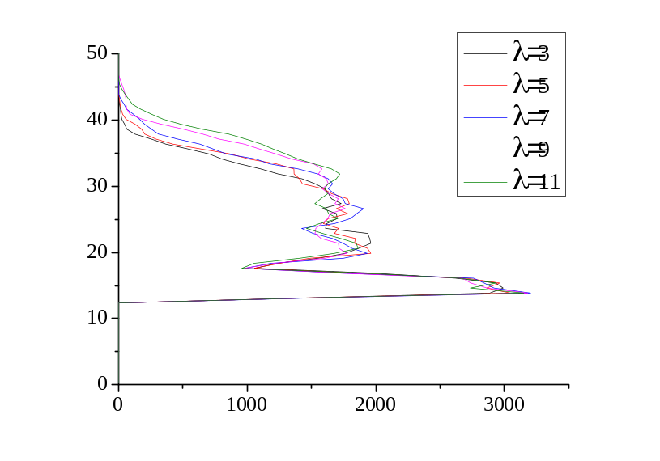
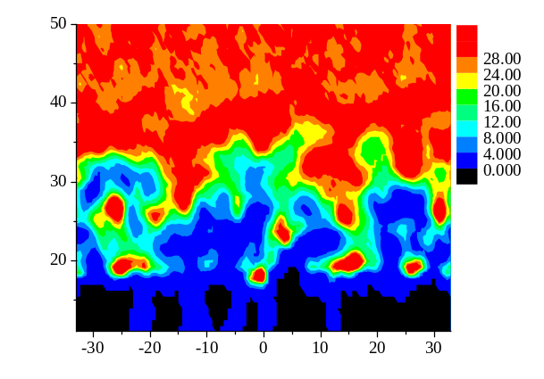

Research Theme about Fuel Cells
Phase diagram of water in a nano pore of MPL
(with the University of Tokyo)
Transport properties of nanoscale water droplet in MPL
Dissociation Probability [-]
: Pt-Fix
: T=0 K
: T=300 K
Initial Translational Energy
Oxygen permeability of ionomer
in Catalyst Layer
Dissociation phenomena of H₂ on Pt catalyst
Proton diffusivity in PEM

Slide 5


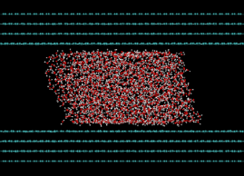
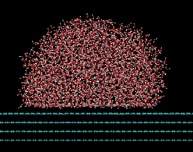

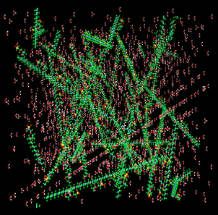
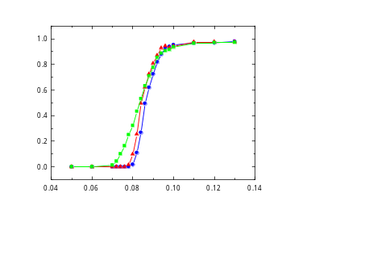

1st Topic
Analysis of transport phenomena of proton and water in polymer electrolyte membrane
Phase diagram of water in a nano pore of MPL
(with the University of Tokyo)
Transport properties of nanoscale water droplet in MPL
Initial Translational Energy
Oxygen permeability of ionomer
in Catalyst Layer
Dissociation phenomena of H₂ on Pt catalyst
Proton diffusivity in PEM

Slide 6
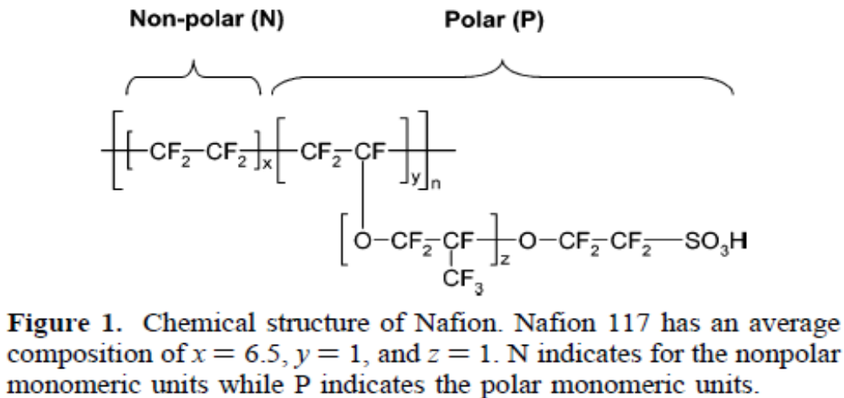
Mechanism of Proton Transfer
Proton (H⁺): has high chemical reactivity.
exists as an Oxonium ion (H₃O⁺) by connecting with a water molecule (H₂O).
Mechanism of Proton Transfer
Structure of water in PEM
・Vehicle Mechanism (slow)
(H₃O⁺ ion moves directly)
PerFluoroSulfonic Acid Membrane (PFSA)
Side Chain
Main Chain
-
・Grotthus Mechanism (fast)
(H₃O⁺ is seen to move by hopping
in network of hydrogen bonding)
Main Chain
Side Chain
Network of hydrogen bonding is formed in the membrane
Water Cluster
Transport
Strong relation
Structure
Information of the relation between transport phenomena and structure of water is needed.

Slide 7
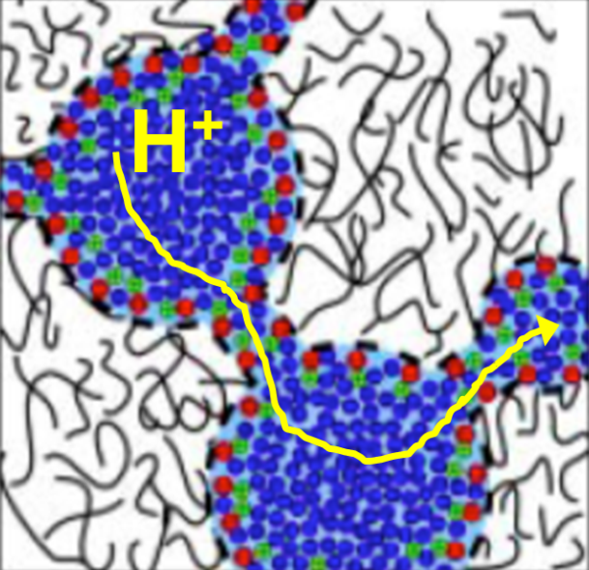
Objectives of This Research
Institute of Fluid Science
To obtain knowledge about the relation between proton and water transport and water structure by using Molecular Dynamics (MD) simulation.
Water culster
Vehicle Mechanism
Grotthus Mechanism
What is the characteristics to determine the proton conductivity of membrane?

Slide 8
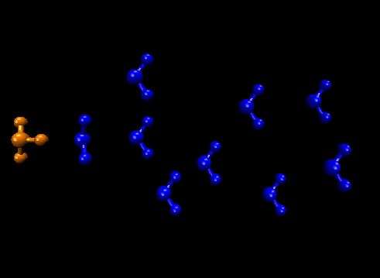
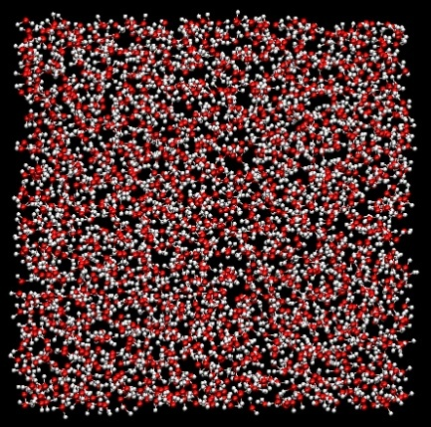
EVB Model
Zundel cation（H₅O₂⁺）
R=2.2～2.8Å
q
Diffusivity of H₃O⁺ and H₂O in water
255 H₂O & 1 H₃O⁺
T = 298.15 [K]
P = 1 [atm]
 | D_{H3O+} [10⁻⁵ cm²/s] | D_{H2O} [10⁻⁵ cm²/s]
w/o hopping | 0.75 | 2.37
w/ hopping | 5.23 | 2.38
Experiment | 9.4 | 2.3
*Park, K. J. Phys. Chem. 2012, 116, 343.

Slide 9
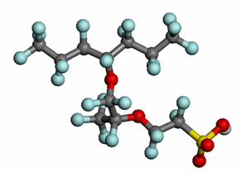
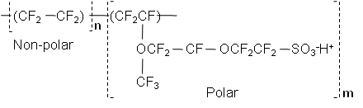
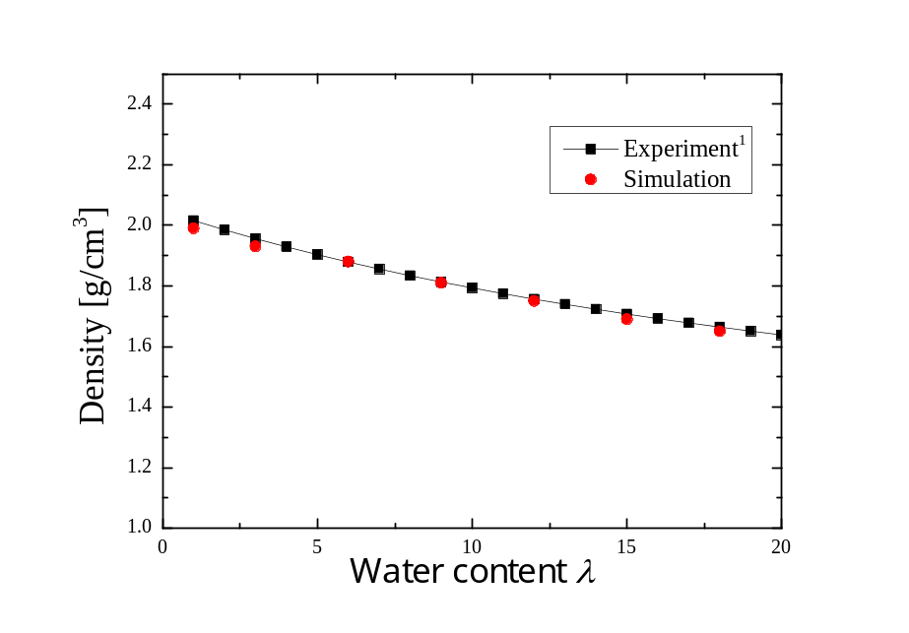

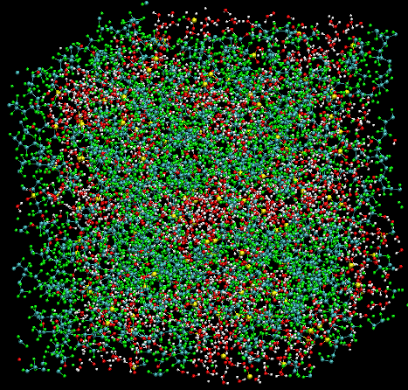
Simulation Method
Chemical structural formula of Nafion
Nafion chain
・(N₇P)₁₃
・25 chains
N
P
Solvent molecules (liq=H₃O⁺+H₂O)
・ N_{H3O+}=N_{SO3-}=325
・Water contents λ=(N_{H3O+}+N_{H2O})/N_{SO3-}
=1, 3, 6, 9, 12, 15, 18
Structural analysis
RDF & Cluster analysis
Dynamical analysis
MRT & MSD
Annealing
The agreement with experiment is within 1.3 %.
1. Morris, D. R. J. Appl. Polym. Sci. 1993, 50, 1445.
Annealing
Samping with NVE (300 K)
0
1.2
t (ns)
Notes:
9

Slide 10
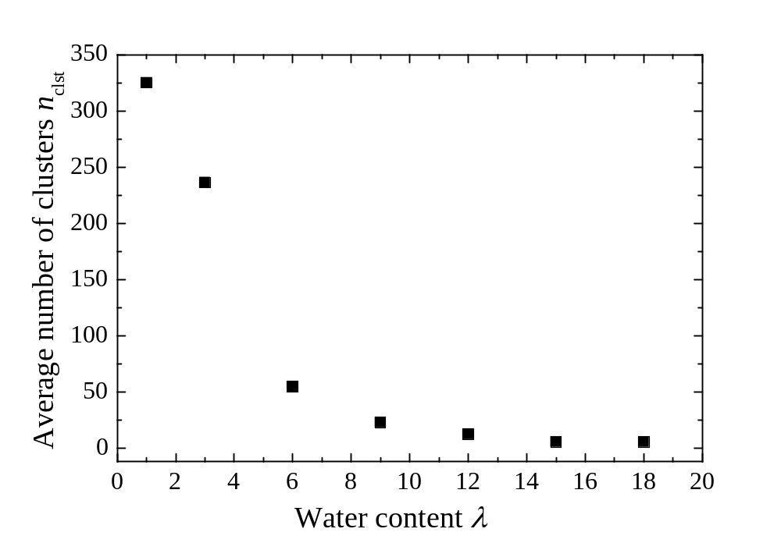
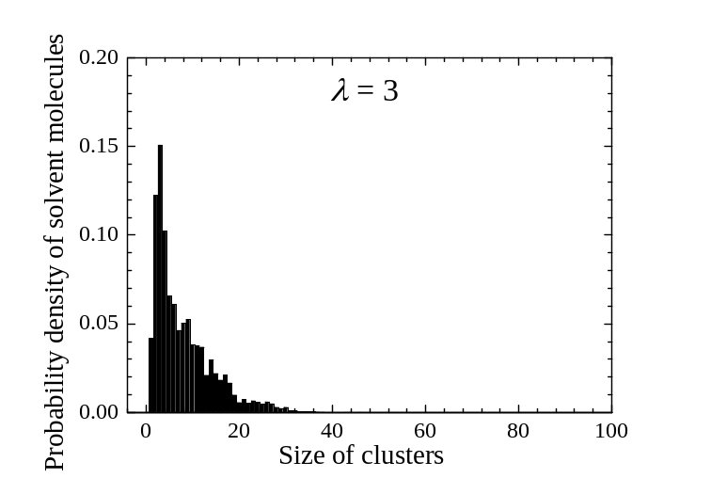
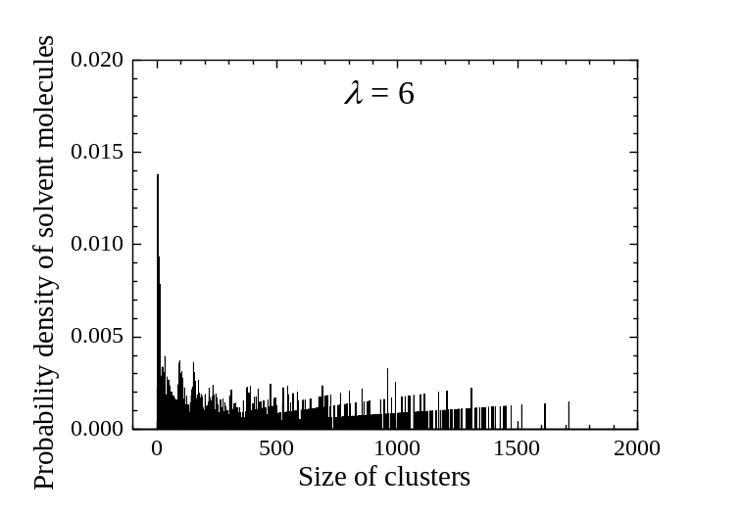
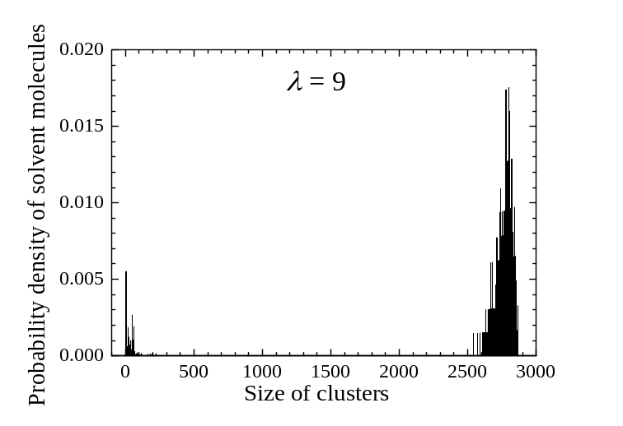
Cluster Analysis
The number of water cluster and their size is analyzed.
Polymer
Abrupt decrease
= Network formation
SO₃⁻
H₂O
H₃O⁺
Small clusters
Wide range of
cluster size
Large clusters
The transport channels for oxonium ions are widely formed at λ = 6.

Slide 11
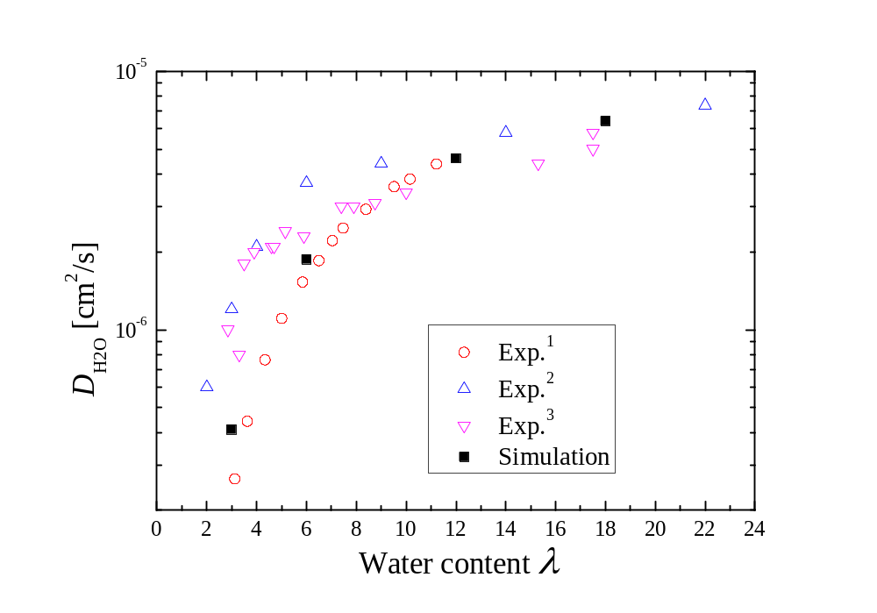
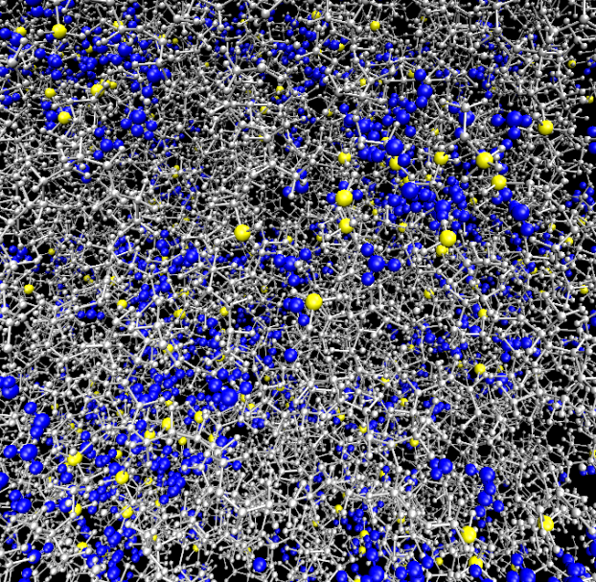
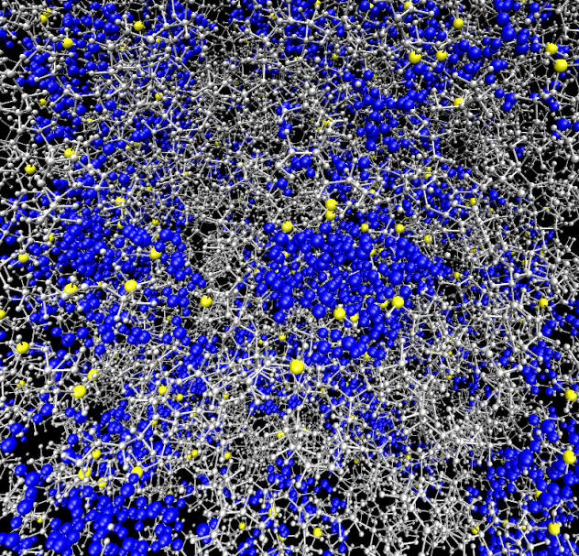
Diffusion Coefficient of H₃O⁺ and H₂O
From this research we can obtain the relation between proton conductivity and nanoscale structure of water cluster in PEM
The information is useful to develop a membrane which has high proton conductivity
The results are qualitatively consistent with the experimental results.
Water content : low (λ=3)
Network of hydrogen bond is short
Grotthus contribution is small
Proton diffusivity is small
λ=3
λ=6
Water content : high (λ>6)
Water cluster becomes continuous
Grotthus contribution is large
Proton diffusivity is large

Slide 12
2nd Topic
Analysis of Oxygen Permeation of Ionomer in Catalyst Layer
Phase diagram of water in a nano pore of MPL
(with the University of Tokyo)
Transport properties of nanoscale water droplet in MPL
Initial Translational Energy
Oxygen permeability of ionomer
in Catalyst Layer
Dissociation phenomena of H₂ on Pt catalyst
Proton diffusivity in PEM

Slide 13
Cathode Catalyst Layer in PEFC
O₂
Structure of cathode catalyst layer
Ionomer
(Ionized thin film : 3nm)
PEM
CL
GDL
H⁺
O₂
4H⁺+4e⁻+O₂ → 2H₂O
1nm
H⁺
e⁻
Ionomer = polymer + water molecule
Proton transport in ionomer (proton conductivity)
larger as the ionomer is thicker
Oxygen permeate through ionomer (oxygen permeability)
larger as the ionomer is thinner
H₂O
Polymer electrolyte
membrane
Catalyst (Platinum)
A good ionomer makes proton and oxygen reach to Pt surface in the proper ratio (H⁺:O₂=4:1)
Supported carbon
Transport phenomena of materials(H⁺, O₂) in/through ionomer is very important!
Now we focus on the oxygen permeability of ionomer.

Slide 14


Objective of This Research
To analyze the oxygen permeability of ionomer on Pt surface by molecular dynamics method.
Parameters : water content
Simulation
Model
：Polymer
Real
System
：
：
：Pt
Details of this research
To make an ionomer which consists of fluorocarbon and water
To characterize the structure of ionomer on Pt surface
To investigate the oxygen permeability of the ionomers against water content

Slide 15
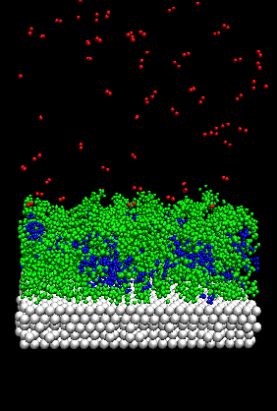
Simulation Method
- Periodic boundary condition (x,y)
- Mirror boundary condition (z)
- Time Integration: velocity verlet + rRESPA
- Water content (λ=(N_{oxo}+N_{wat})/N_{so3-}) : 3,5,7,9,11
- Temperature：350K (operation temperature of PEFC)
- Simulation domain：66.5×57.6×100.0 Å
- Temperature control：velocity scaling
10 MPa
PFSA : 15 chains (5205 atoms)
H₃O⁺ : 75 molecules(300 atoms), Pt : 5layers (2880 atoms)
H₂O : changes according to water content
150, 300, 450, 600, 750 molecules
(450, 900, 1350, 1800, 2250 atoms)
0MPa
Simulation process
To put the ionomer
on a Pt surface
Oxygen is added
To make
an ionomer
0ns
0.8ns
1.5ns
To sample the properties
21.6ns
1.6ns
Annealing Process
Sampling Process

Slide 16
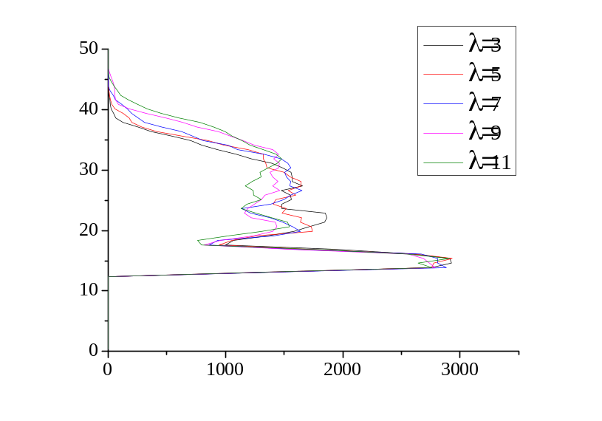
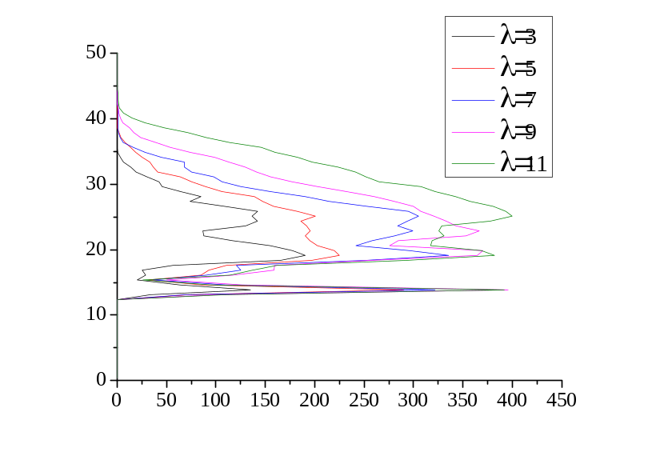

Material Distribution
Ionomer
PFSA
Water
z [Å]
Density [kg/m³]
Characteristics of Ionomer of PFSA
Ionomer swells according to water content
A higher peak is observed near Pt surface (z=15Å)
↓
Polymer adsorbs on a Pt surface
A higher peak is observed in the peak of PFSA
↓
More water distributes in the peak of PFSA
z
11Å

Slide 17
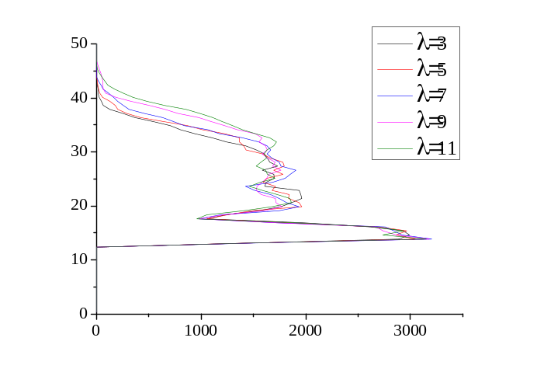

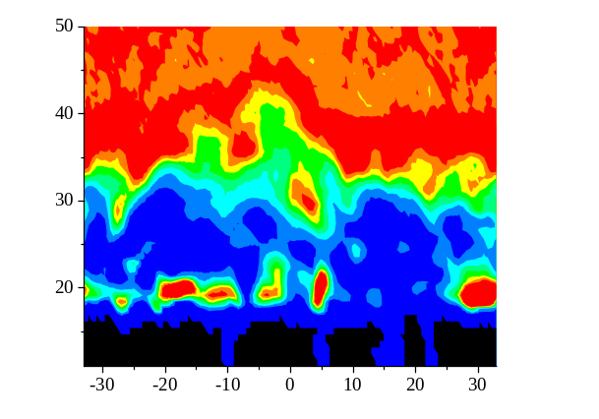
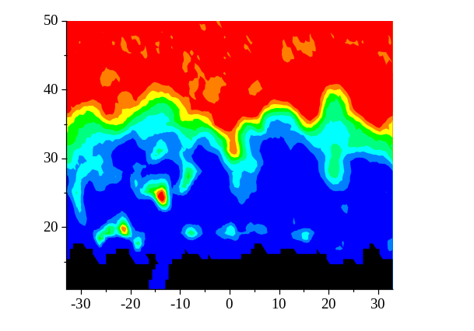
Oxygen Permeability
Water content λ | 3 | 5 | 7 | 9 | 11
No. of permeated O2 | 67 | 21 | 19 | 13 | 11
Density distribution of O₂
λ=3
Oxygen permeability decreases against water content
From this research we can obtain the relation between oxygen permeability and nanoscale structure of ionomer in CL
The information is useful to develop a CL which perform efficient chemical reaction
Ionomer
Water
ionomer-gas
interface
z [Å]
Bulk region
λ=7
ionomer-Pt
interface
z [Å]
Pt
Density [kg/m³]
O₂ is more difficult to permeate through both ionomer-gas interface and bulk region with the increase in water content
The number of O₂ permeation path is large in ionomer-Pt interface at λ=3
The number of path decrease at λ=11
→ Water molecules put in the O₂ permeation path at ionomer-Pt interface with the increase in the water content
λ=11
x [Å]

Slide 18
Summary
Transport phenomena in Fuel Cell
Various flow fields which size is from nanometer to micrometer is formed
Flow (transport) phenomena is different from that obtained by
conventional macroscopic theory
The nano/mezo scale mechanism of transport phenomena in MEA is analyzed by large scale quantum/molecular dynamics simulation.
(1) Transport phenomena in polymer electrolyte membrane
(2) Transport phenomena in catalyst layer
From the results, design concept of MEA (GDL, CL, PEM) which have the most efficient transport characteristics is obtained.
(Accuracy of numerical estimation of efficiency of fuel cell is dramatically increased.)
Contribution of Green Innovation is very large!
The period and cost of development by experiment is largely cut.

Slide 19
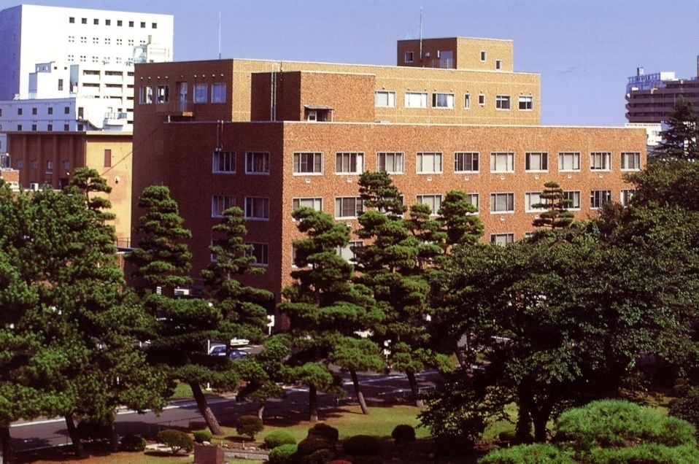
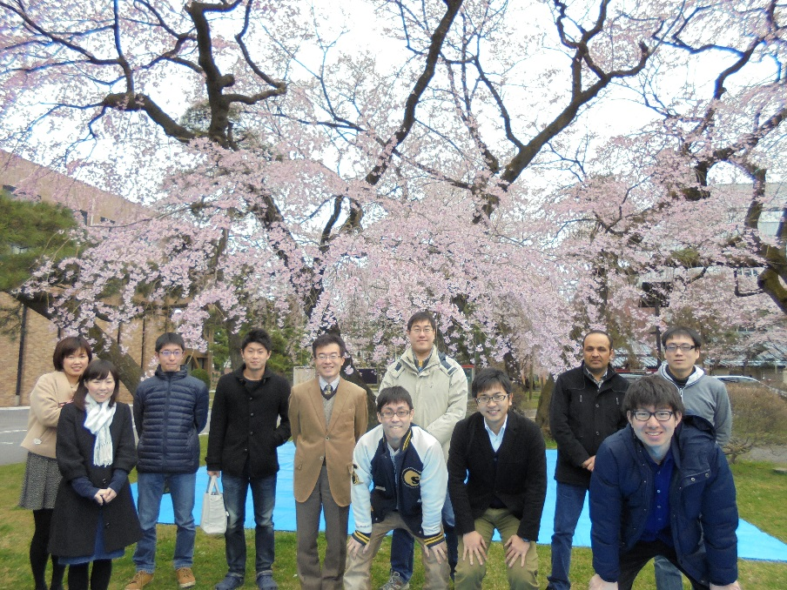
Acknowledgment
Institute of Fluid Science
Thank you for
the kind attention!
A part of this study was financially supported by Research and Development of Polymer Electrolyte Fuel Cells from New Energy and Industrial Technology Development Organization (NEDO) of Japan.
Almost all simulations were performed by a supercomputer system of Advanced Fluid Information in Institute of Fluid Science, Tohoku University.
Special Thanks:
Hironori Sakai Shengfong Huang Takuya Mabuchi Kiyoto Kawai Yuya Kurihara Masataka Nakauchi Joji Aochi Chiemi Kokubun Kayoko Konda

