Slide 1

Development of Businesses Using Smart Grid Technologies in Japan
Takashi Iwamoto
Project Professor, Graduate School of Business Administration, Keio University
September 11, 2017

Slide 2
My profile
2012 - present: Project Professor, Graduate School of Business Administration, Keio University (Keio Business School)
2002 - present: Dream Incubator
  2012 – present: Senior Advisor
  2006 - 2012: Operating Officer
  2002 - 2006: Senior Manager
2001 - 2002: Research Manager, Nokia Research Center, Nokia
1998 - 1999: Senior Engineer, Optical Access R&D Center (Bell Laboratories),
Lucent Technologies
1995 - 1998: Staff Engineer, Semiconductor Sector, Motorola
Ph.D. and MS in Materials Science and Engineering from the University of California, Los Angeles (UCLA)
BE (Bachelor of Engineering) in Metallurgy from the University of Tokyo

Slide 3
Overview of Keio Business School (KBS)
KBS is Japan’s oldest business school founded in 1962.
KBS provides programs which offers MBA, EMBA and Ph.D. degrees.
KBS is the only business school in Japan accredited by two major international accreditation organizations, AACSB International and EFMD EQUIS.

Slide 4
History of the smart city project in Japan
Jan., 2009:
My collegue and I proposed the smart city concept to METI (Ministry of Economy, Trade and Industry) when I was working for Dream Incubator (DI) Inc.
DI developed public policies for the smart city project with METI.
DI worked on planning for the projects with Mitsubishi Estate and Toyota Motor.
The smart city projects were executed in City of Yokohama, Toyota City, Keihanna (Kyoto) and City of Kitakyushu.
Mar.~Aug., 2009:
Apr., 2009 ~Mar., 2010:
Apr., 2010 ~Mar., 2015:
- 3 -

Slide 5
Overview of Dream Incubator (DI)
DI was founded in 2000 by the head of Boston Consulting Group Japan, Seoul and Tokyo.
DI went public in 2002 and is now listed on the 1st section of Tokyo Stock Exchange.
DI has offices in Japan, Vietnam, China and India.
DI’s current main businesses are strategic consulting for big companies and investment and management support for startup companies.
DI is #1 in the new business development consulting segment in Japan and making various public policies regarding new industries.

Slide 6
Issues in Japan in 2009
Japan has various good element technologies in the energy and environment field but it was difficult to make business models with only element technologies because most element technologies were higher cost technologies.
Thus, the following points seemed to be important.
  To consider business models by combining various element technologies
  To collaborate with public policies
Also, to export Japanese technologies to foreign countries, it is important to lead international standardization.
- 5 -

Slide 7
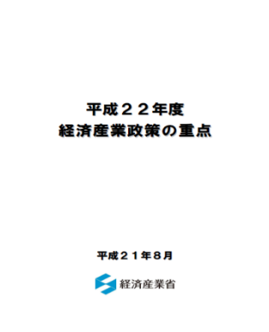
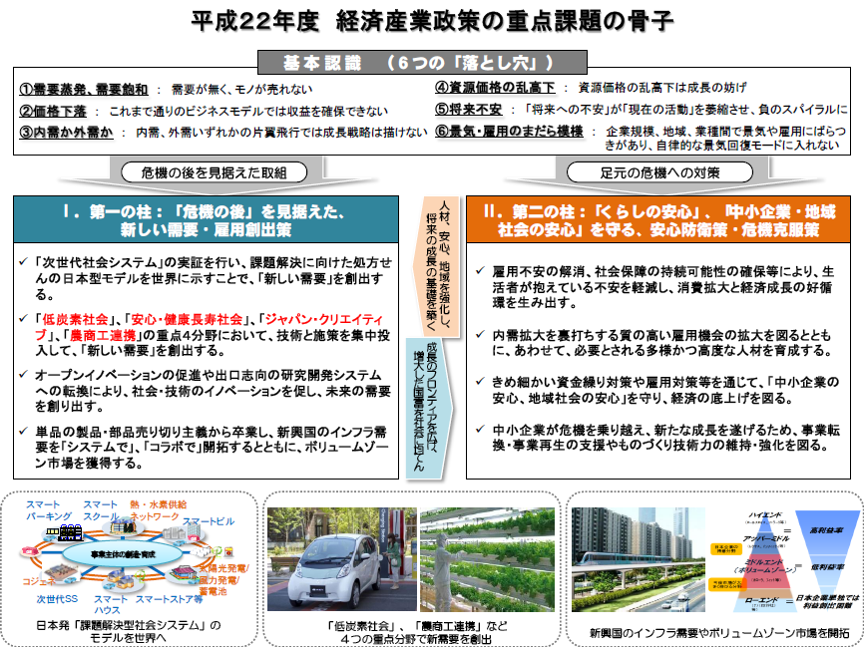
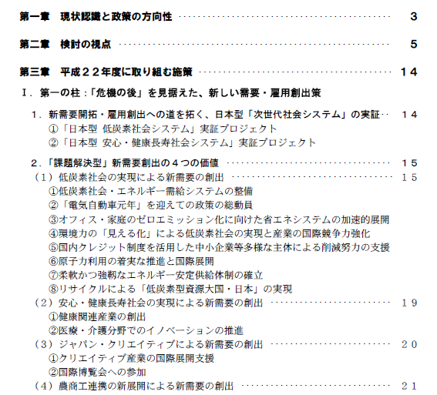
Policies for smart cities in Japan
The top priority policy in METI in 2010
150 BJPY was invested in 4 areas to develop smart city business models.
Source: METI

Slide 8
Key points of the policies for the smart city projects
1. Vision
  “Smart city concept”
2. To grow promising technology modules
  (1) To collect
  (2) To select
  (3) To grow intensively
3. Smart city management
  System to grow Japanese strengths largely and continuously

Slide 9
Essences of the smart city concept
Smart city concept
Until 2009: Support of local cities
From now on: Industry producing
Selection of
technologies
Various technologies with small amounts of budget
  Government selects some from bottom-up items.
Experiments with single technology
  Connection with the other technologies not considered
None
  Activity discontinued as a result
Only technologies with which Japan can win businesses in the world
  Government selects technologies proactively.
Experiments with combined technologies
  Create a model city
Have smart city management function
  Based on the future business models
Scale of
experiments
Continuation
- 8 -
Notes:
の

Slide 10
Promising technology modules based on the future business models
Industry
Business
Home
Transportation
Energy management
Zero emission building
Smart house
EV
Management system/service
Management system/service
Management system
(Controller)
EV
Charging infrastructure
Energy saving devices
New lighting
Energy saving home appliances
Back-up batteries
Batteries
Distributed power generation (PV)
Electrical system controller
Batteries for electrical system
Smart grid
- 9 -

Slide 11
4 areas among 19 areas were selected
Sapporo City
Aomori Prefecture
Tsukuba City
Kashiwanoha
Koto Ward
Otemchi/Marunouchi/Yurakucho
Yokohama City
Toyota City
Gifu Prefecture
Nanto City
Sapporo City
Kyoto City
Keihanna
Osaka Prefecture
Kobe City
Kitakyushu City
Fukuoka City
Goto City
Minamata City
Source: METI
- 10 -

Slide 12
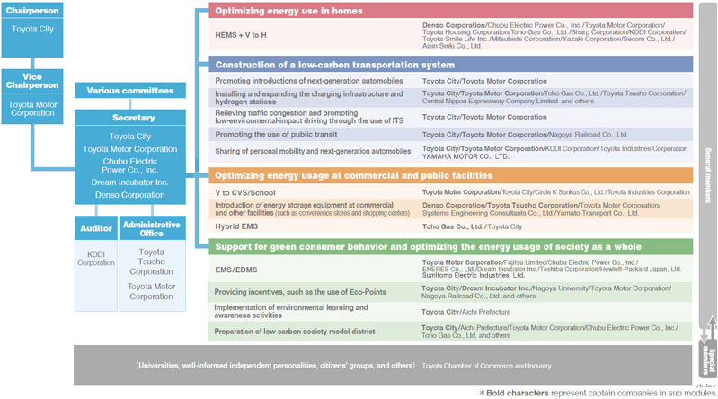
Organization of the smart city development project in Toyota City
- 11 -

Slide 13
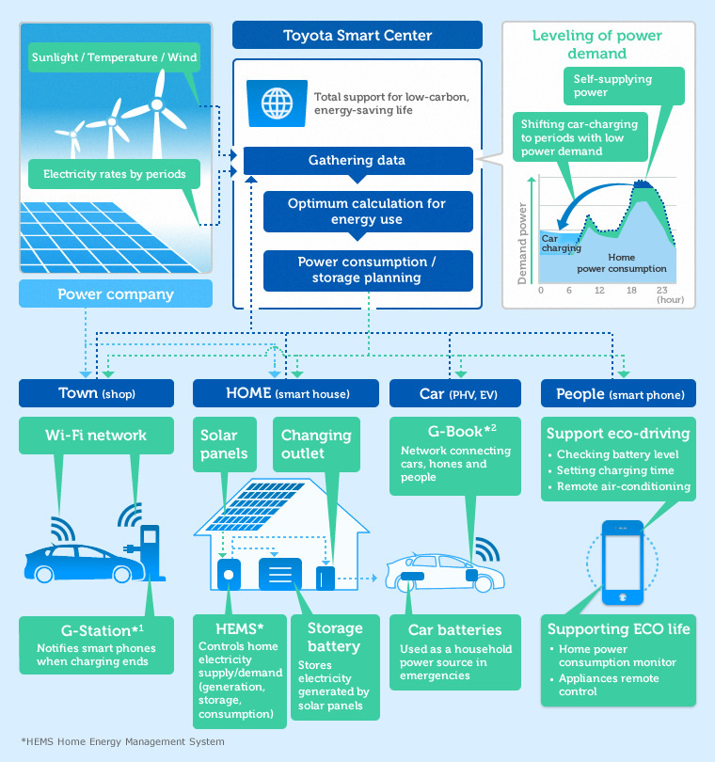
Outcome of the project: Toyota’s smart grid
Source: Toyota Motor
Notes:
の

Slide 14
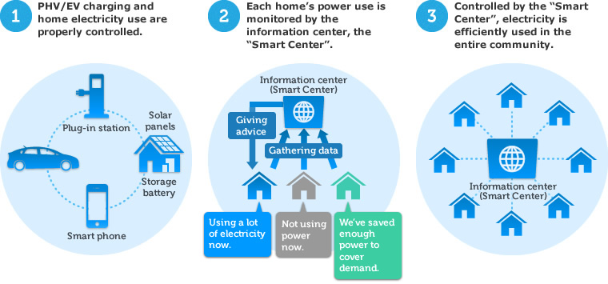
Toyota Smart Center
Source: Toyota Motor
- 13 -
Notes:
の

Slide 15
Japan Smart Community Alliance (JSCA)
In order to support the future growth of Japan’s leading energy-saving and new energy technologies, an organization composed of domestic companies needed to be formed that addresses common issues. For this purpose, the Japan Smart Community Alliance (JSCA) was established in April 2010 to accumulate knowledge and promote collaboration between the public and private sectors.
JSCA aims to contribute to the domestic and international dissemination of smart communities, which are based on the integration of innovative energy and social infrastructures, including smart grids. JSCA is working to facilitate the development of smart communities through collaborative efforts of the public and private sectors in Japan by planning and implementing activities that contribute to Japan’s economy. Such activities include fulfilling local government needs, overcoming potential barriers and issues as well as sharing information on public financing for smart grid technology development.
Source: JSCA

Slide 16
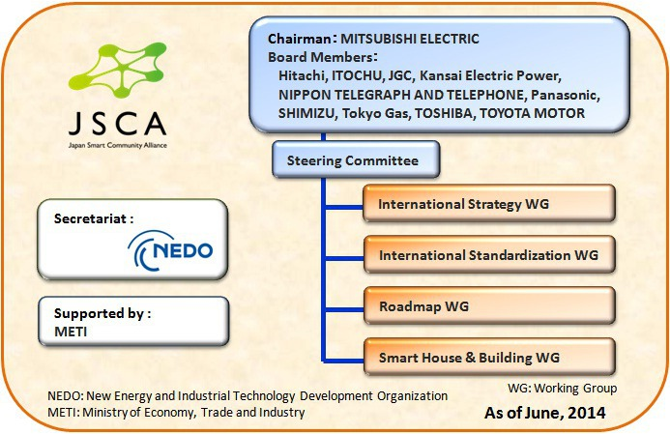
Organization of JSCA
Source: JSCA

Slide 17
JSCA’s international alliances
April 2010: Joined Global Smart Grid Federation (GSGF) as a founding member
April 2010: Concluded MOU with GridWise Alliance and held a joint workshop
September 2011: Concluded MOU with Korea Smart Grid Association (KSGA)
February 2012: Concluded MOU with SmartGrid GB (SGGB) and held a joint workshop
March 2012: Concluded MOU with Smart Grid Interoperability Panel (SGIP)
Source: JSCA

Slide 18
Activities for standardization
February 2012:
Japan (Mr. Yoshiaki Ichikawa of Hitachi) took a position of the chairperson of ISO/TC 268/SC 1 Smart Community Infrastructures.
ISO/TR 37150 (Smart community infrastructure – Review of existing activities relevant to metrics) was published.
ISO/TS 37151 (Smart community infrastructures – Principles and requirements for performance metrics) was published.
ISO/TR 37152 (Smart community infrastructures – Common framework for development and operation) was published.
April 2014:
May 2015:
August 2016:
Source: ISO

Slide 19
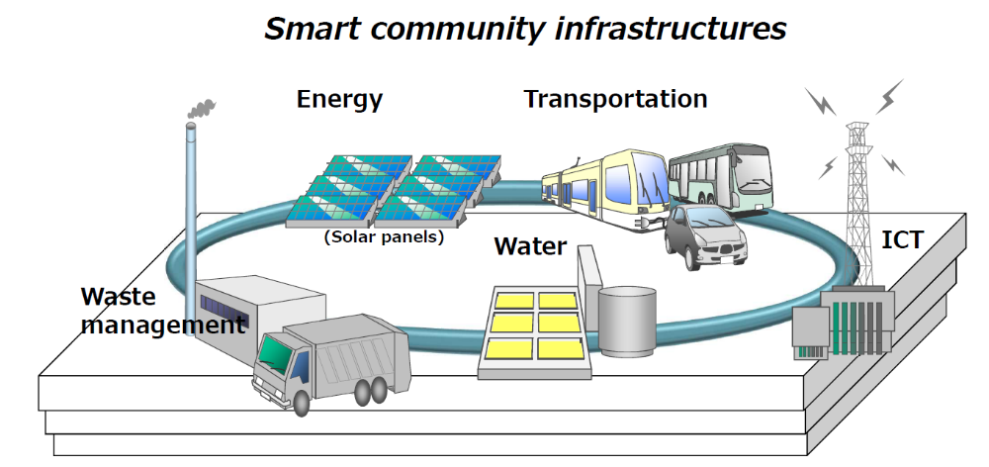
What is smart community infrastructures
Source: ISO

Slide 20
Activities of ISO/TC 268/SC 1
TG 1: Roadmap
TG 2: Smart community infrastructure – Pilot Testing
WG 1: Infrastructure metrics
WG 2: Integration and interaction framework for smart community infrastructures
WG 3: Smart transportation
WG 4: Data exchange and sharing for smart
Source: ISO

Slide 21
Members of ISO/TC 268/SC 1
Participating members (21)
Observing members (12)
Austria
Canada
Chile
China
Denmark
France
Germany
India
Japan
Korea, Republic of
Mexico
Netherlands
Norway
Russian Federation
South Africa
Spain
Sri Lanka
Sweden
Ukraine
United Kingdom
United States
Argentina
Brazil
Czech Republic
Egypt
Finland
Iran, Islamic Republic of
Malaysia
Poland
Singapore
Switzerland
Turkey
United Arab Emirates
Source: ISO

Slide 22
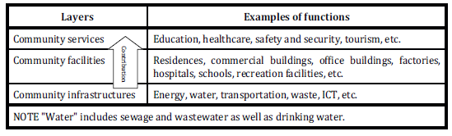
Layers of a community
Community infrastructures support the other 2 upper layers.
Source: ISO

Slide 23
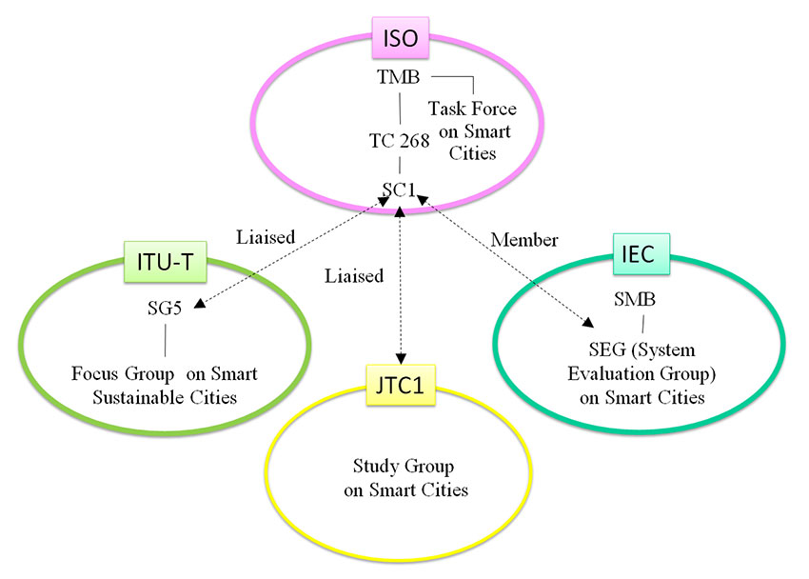
Current situation of standardization for smart cities
ISO: International Organization for Standardization
TMB: Technical Management Board
TC: Technical Committee
SC: Subcommittee
IEC: International Electrotechnical Commission
SMB: Standardization Management Board
ITU-T:International Telecommunication Union Telecommunication Standardization Sector
SG: Study Group
JTC: Joint Technical Committee

Slide 24
Conclusions
Business models should be considered based on future business models to develop businesses using smart grid technologies.
If business using smart grid technologies are considered based on smart cities, it would be possible to make business models.
International standardization is now lead by Japan and we hope Japan’s smart city models can be imported to various foreign countries.

