Slide 1
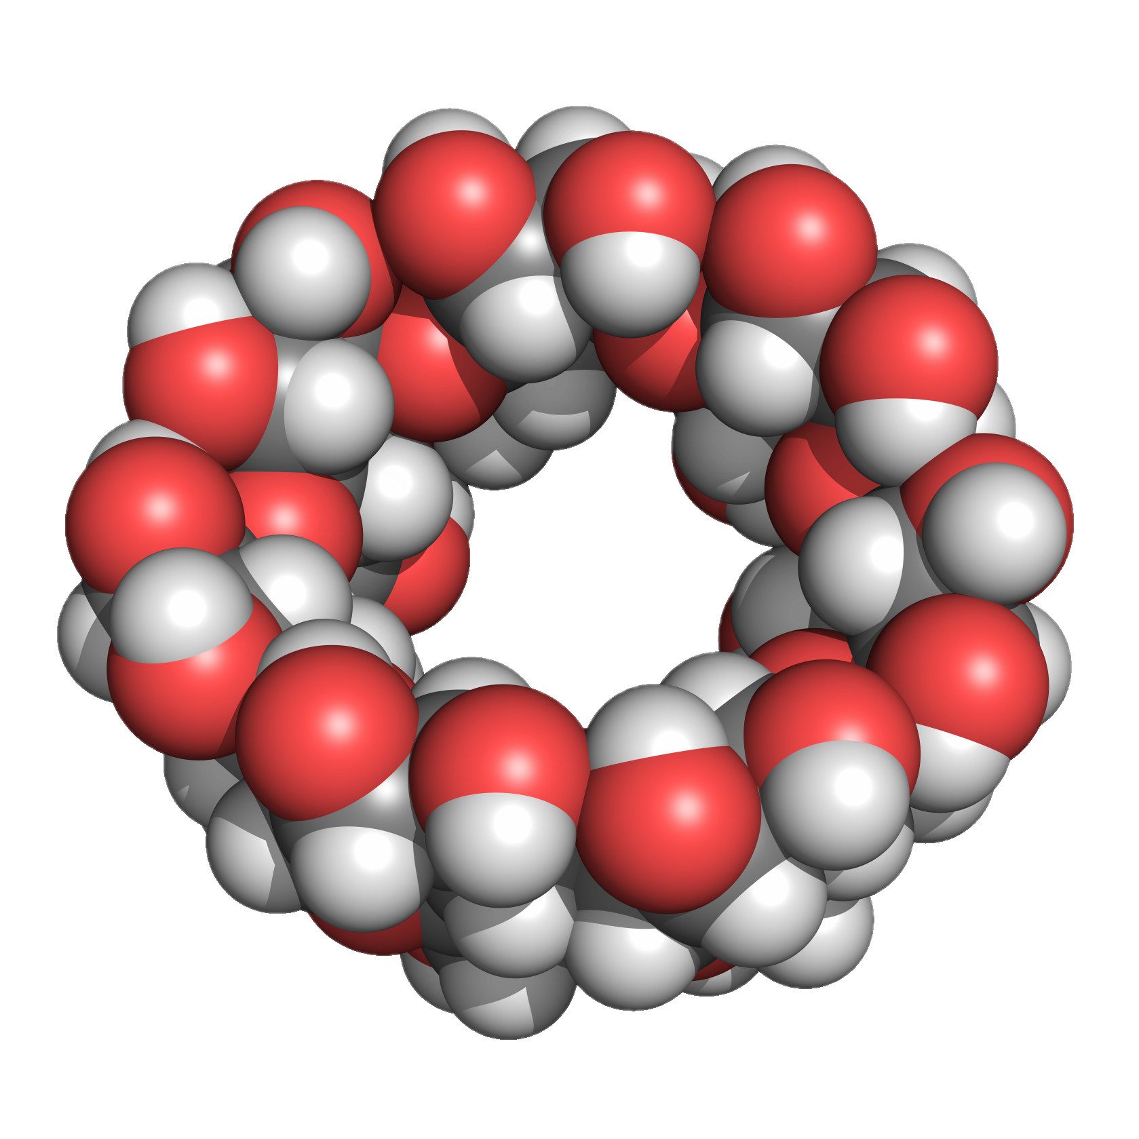
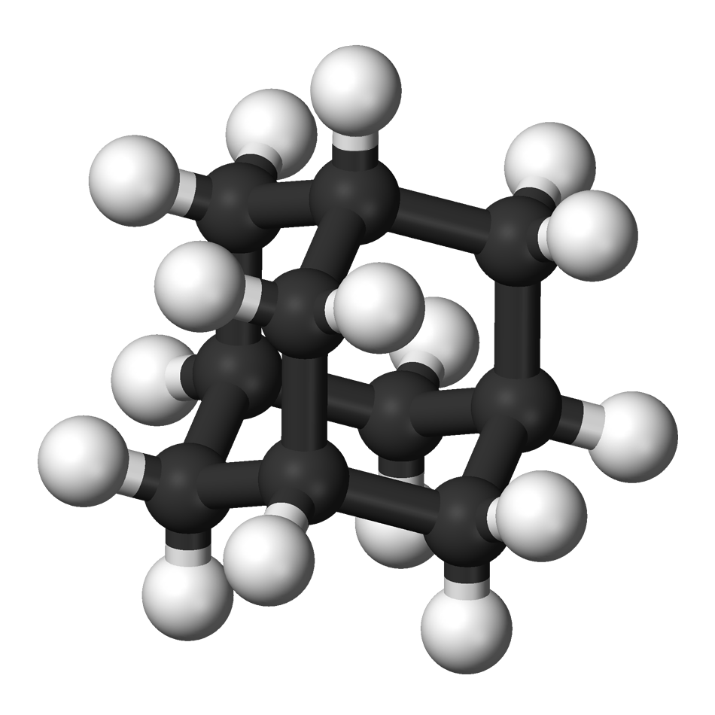
15th Annual European Pharma Congress
7-9 May 2018, Frankfurt
Self-Assembly PEGylation Retaining Activity (SPRA) Technology via an Interaction between Cyclodextrin and Adamantane:
Application for Insulin, Lysozyme and Bromelain
Taishi Higashi¹, Keiichi Motoyama¹, Hidetoshi Arima^{1,2}
¹Graduate School of Pharmaceutical Sciences, Kumamoto University, Japan
²Program for Leading Graduate Schools “HIGO
(Health life science: Interdisciplinary and Glocal Oriented) Program”, Kumamoto University, Japan
Notes:
Thank you Mr. Chairman.
Today, I would like to talk about
“Self-Assembly PEGylation Retaining Activity (SPRA) Technology via an Interaction between Cyclodextrin and Adamantane:
Application for Insulin, Lysozyme and Bromelain”

Slide 2

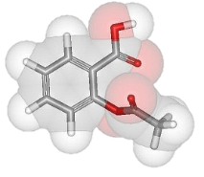
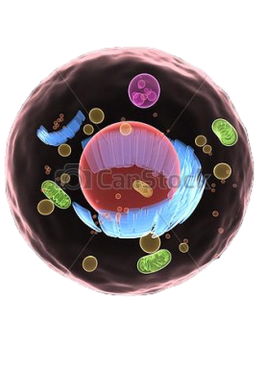
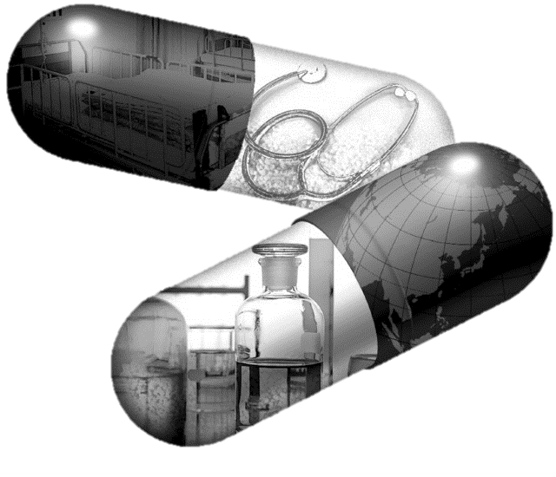

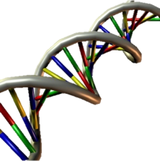
Active pharmaceutical ingredient (API)
1
Machine
Future
Past
Active pharmaceutical ingredient
Low molecular weight
Cell
Near future
Present
Protein
Nucleic acid
・・・
Protein drugs are recent trend in the pharmaceutical field.
Notes:
Recently, active pharmaceutical ingredients (APIs) have been extended from low molecular weight compounds to proteins, nucleic acids, cell and machine.
Of these APIs, protein drugs are recent trend in the pharmaceutical field.

Slide 3
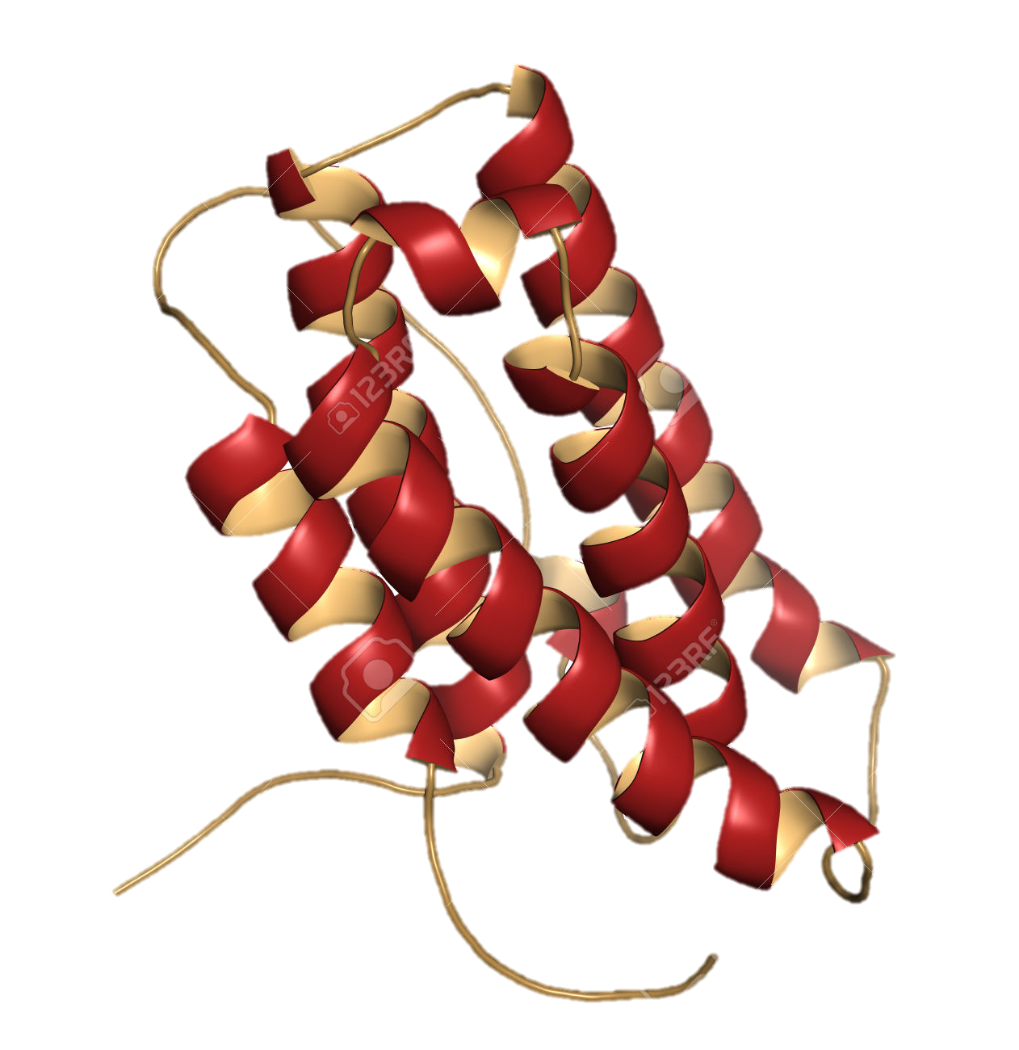
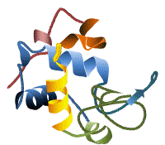
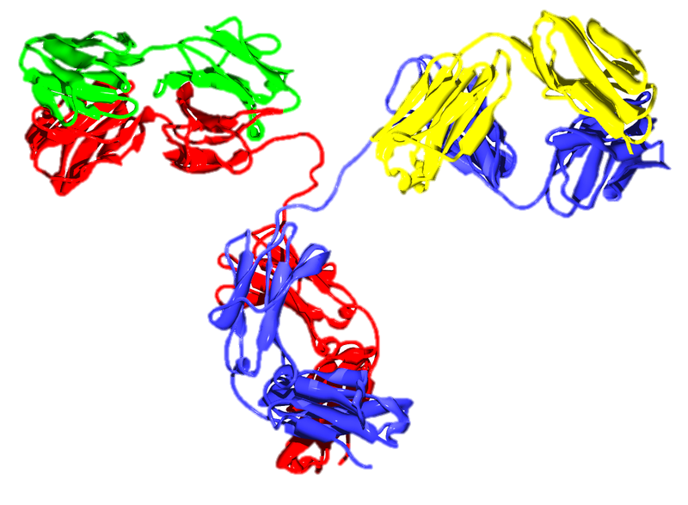
Drawbacks of proteins and their improvements
2
Drawbacks of proteins
Low physicochemical stability
Low enzymatic stability
Short blood half-life
Need for controlled release
Immunogenicity
High cost etc.
S. Frokjaer et al., Nat. Rev. Drug Discov. (2005).
Improvement
Excipient
Bioconjugation
Drug carrier
Amino acid
Sugar
Polyethylene glycol (PEG)
Polysaccharide
PLGA
Liposome
○ Facility
× Low efficiency
○ High efficiency
× Loss of activity
○ High efficiency
× High cost
× Low encapsulation efficiency
・・・
Development of efficient and facile improvement methods is required.
Notes:
However, protein drugs often show these drawbacks, such as
・Low physicochemical stability
・Low enzymatic stability
・Short blood half-life
・Need for controlled release
・Immunogenicity
・High cost
In this context,
Excipient such as Amino acid Sugar,
Bioconjugation such as Polyethylene glycol (PEG) and Polysaccharide
and
Drug carrier such as PLGA and Liposome
are often used to improve the pharmaceutical properties of protein drugs.
However, these methods often show Low efficiency, Loss of activity, High cost and Low encapsulation efficiency.
Therefore, Development of efficient and facile improvement methods is required. .

Slide 4
PEGylation¹⁾ for protein drugs
3
Problems of protein
1) Polyethylene glycol (PEG) modification
Low stability
Immunogenicity
Short circulating half-life
PEGylation¹⁾
Stability
Immunogenicity
Circulating
half-life
Examples of Approved PEGylated Protein Drugs
PEG conjugate
Type of PEGylation
Year to market
Disease
PEG-adenosine deaminase (Adagen®)
Random, linear PEG
1990
Severe combined immunodeficiency
PEG-asparaginase (Oncaspar®)
Random, linear PEG
1994
Acute lymphoblastic leukemia
PEG-G-CSF
(Neulasta®)
Selective, linear PEG 20 kDa
2002
Neutropenia during cancer chemotherapy
PEG-interferon α-2a (Pegasys®)
Random, branched PEG 40 kDa
2002
Hepatitis C
G. Pasut et al., J. Control. Release (2012).
・・・
A number of PEGylated proteins have been commercially available.
Notes:
On the other hand, Polyethylene glycol modification, PEGylation, dramatically improves properties of proteins, such as Stability, Immunogenicity, Circulating
half-life.
Therefore, as shown in this table, A number of PEGylated proteins have been commercially available.

Slide 5
Problems of PEGylated proteins : Loss of the activity
4
Image
PEGylation
Properties
Improve
Properties
Disimprove
Properties
Activity
Activity
Activity
M.W. of PEG
Examples of PEGylated Protein Drugs
PEGylated interferon (Pegasys®)
PEGylated insulin (LY2605541, Phase III)
Discontinue development
M.W. of PEG : 40 kDa (branched)
Circulating half-life : 73 fold
Activity : 7%
M.W. of PEG : 20 kDa (linear)
Circulating half-life : 10 fold
Activity : 6%
C.S. Fishburn, J. Pharm. Sci. (2008).
T.M. Caparrotta et al., Diabetes Obes. Metab. (2014).
・・・
Loss of the activity of proteins by PEGylation is serious problem.
Notes:
However, PEGylation markedly decrease the activity of protein drugs.
Especially, high molecular weight PEG can improve the pharmaceutical properties of proteins,
but it markedly decrease the activity of protein drugs.
For example, commercially available PEGylated interferon show only 7% activity.
In addition, in case of insulin, 94% of the activity was lost by PEGylation.
Thus, Loss of the activity of proteins by PEGylation is serious problem.

Slide 6

5
Self-assembly PEGylation Retaining Activity (SPRA) technology
Self-assembly PEGylation Retaining Activity (SPRA)
Strategy
β-CyD
(Host molecule)
Host-guest interaction
PEGylation of proteins through host-guest interaction between β-cyclodextrin (β-CyD) and adamantane (Ad)
Ad
(Guest molecule)
PEG
Ad-appended protein
(Ad-protein)
Reversible PEGylation
PEGylated β-CyD
(PEG-β-CyD)
Improvement of pharmaceutical properties of protein drugs without loss of the bioactivity
T. Hirotsu and T. Higashi et al., Mol. Pharm. (2017).
Receptor or substrate
SPRA-protein
Notes:
Based on these background, in the present study, we developed Self-assembly PEGylation Retaining Activity (SPRA) technology.
This technology is PEGylation of proteins through host-guest interaction between b-cyclodextrin (b-CyD) and adamantane (Ad), Namely, Reversible PEGylation.
We firstly prepare PEGylated b-CyD and Ad-appended protein.
These compounds form the complex, namely SPRA-protein.
This technology can Improve pharmaceutical properties of protein drugs without loss of the bioactivity, because PEGylated b-CyD dissociates near the receptor and/or substrate.

Slide 7
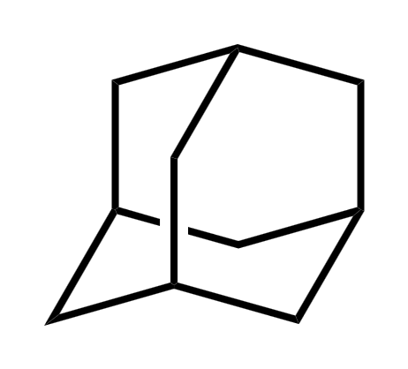

Purpose
6
T. Hirotsu and T. Higashi et al., Mol. Pharm. (2017).
Design and evaluation of “SPRA technology¹⁾” for protein drugs
1) Self-assembly PEGylation retaining the activity (SPRA) technology
Materials and methods
Proteins
Guest molecule
Bovine insulin
Hen egg lysozyme
Adamantane (Ad)
M.W. = 5734 Da
pI = 5.3
M.W. = 14306 Da
pI = 11.0
Host molecule
M.W. of PEG
Outline
β-CyD
20 kDa
1) Preparation of SPRA proteins
2) Thermal and enzymatic stability
3) In vitro enzymatic activity (lysozyme)
4) In vivo hypoglycemic effect (insulin)
Notes:
Therefore, we designed and evaluated “SPRA technology” for protein drugs.
Firstly, we used insulin and lysozyme as model proteins.
Molecular weight of PEG is 20 kDa.
4：00

Slide 8
Preparation of PEG-β-CyD (host molecules)
7
Mono-PEG-β-CyD
O
(OH)₆
=
-CH₃
(OH)₆
N₃
p-Toluenesulfonyl chloride
O-S-
=
NaN₃
O
CH₂OH
H₂O
O
O
O
NaOH a.q.
HOH₂C
OH
HO
HO
O
CH₂OH
=
(OH)₇
Tosylated β-CyD
Azido β-CyD
O
OH
HO
HO
O
O
OH
O
Ph₃P
NH₃ a.q.
HOH₂C
OH
HO
CH₂OH
O
OH
HO
O
β-CyD
Activated PEG
O
OH
OH
O
O
(OH)₆
NH₂
CH₂OH
O
HO
CH₂OH
COON
O
O
M.W. of PEG = 20 kDa
DMSO
Mono-PEG-β-CyD
Amino β-CyD
Multi-PEG-β-CyD
(Cl)₇
NaN₃
(N₃)₇
CH₃SO₂Cl
CH₂OH
DMAc/H₂O
O
O
O
DMF
HOH₂C
OH
HO
HO
O
CH₂OH
=
(OH)₇
per-Chloro β-CyD
per-Azido β-CyD
O
OH
HO
HO
O
O
OH
O
Ph₃P
NH₃ a.q.
HOH₂C
OH
HO
CH₂OH
O
OH
OH
HO
O
β-CyD
Activated PEG
O
HO
OH
O
O
(NH₂)₇
CH₂OH
O
CH₂OH
COON
O
O
PEG chains/β-CyD = 1~4
(ave. 2.8)
DMSO
Multi-PEG-β-CyD
per-Amino β-CyD
Preparation of Mono-PEG-β-CyD and Multi-PEG-β-CyD
Notes:
Firstly, we prepared PEGylated b-CyD as a host molecule.
In this study, we prepared two kinds of PEGylated proteins,
namely mono substituted PEGylated b-CyD and multi-substituted PEGylated b-CyD.

Slide 9
Preparation of SPRA-proteins (insulin, lysozyme)
8
O
: mono-SPRA-insulin
COON
mono-PEG-β-CyD
O
mono-PEG-β-CyD/Ad-insulin
K_{a} : 4.77 × 10⁵ (M⁻¹)
Insulin
Ad-insulin
multi-PEG-β-CyD
: multi-SPRA-insulin
O
COON
K_{a} : 1.14 × 10⁴ (M⁻¹)
O
(PEG : ave. 2.8)
multi-PEG-β-CyD/Ad-insulin
PEG-insulin
O
: mono-SPRA-lysozyme
COON
mono-PEG-β-CyD
O
mono-PEG-β-CyD/Ad-lysozyme
K_{a} : 2.10 × 10⁵ (M⁻¹)
Lysozyme
Ad-lysozyme
multi-PEG-β-CyD
: multi-SPRA-lysozyme
O
COON
O
K_{a} : 1.07 × 10⁴ (M⁻¹)
(PEG : ave. 2.8)
multi-PEG-β-CyD/Ad-lysozyme
PEG-lysozyme
K_{a} values were determined by ITC.
Notes:
Next, we prepared SPRA-proteins.
Ad was modified with insulin, and then mixed with mono- or multi-PEGylated b-CyD.
Stability constants of SPRA-insulins were more than 10,000, suggesting stable complex formation.
As a control, we also prepared covalently PEGylated insulin.
Moreover, mono-SPRA-lysozyme and multi-SPRA-lysozyme were also prepared.

Slide 10
Thermal stability of SPRA-proteins (insulin, lysozyme)
9
Insulin (37ºC)
Lysozyme (70ºC)
: Multi-SPRA-insulin
: PEG-insulin
: Mono-SPRA-insulin
: Ad-insulin
: Insulin
: Multi-SPRA-lysozyme
: PEG-lysozyme
: Mono-SPRA-lysozyme
: Ad-lysozyme
: Lysozyme
120
*
*
*
120
*
*
*
*
*
100
*
*
*
100
*
80
*
*
80
*
Insulin remaining (%)
Lysozyme remaining (%)
*
*
*
60
60
*
40
40
*
*
*
20
20
0
2
4
6
0
2
4
6
Time (day)
Time (h)
Thermal Stability of SPRA-insulin and SPRA-lysozyme in Phosphate Buffer
Samples were incubated in phosphate buffer (pH 7.4) at 37˚C or 70˚C. After centrifugation, supernatant was measured by a spectrophotometer. Each point represents the mean ± S.E. of 4-7 experiments. *p<0.05 versus Insulin or Lysozyme.
・・・
Thermal stability of SPRA-proteins was higher than that of protein alone.
Notes:
Next, we evaluated Thermal stability of SPRA-proteins.
Mono- and multi-SPRA-insulins showed high stability, when compared with insulin alone.
Almost the same results were observed in the lysozyme system, suggesting that Thermal stability of SPRA-proteins was higher than that of protein alone.

Slide 11
Enzymatic stability of SPRA-proteins (insulin, lysozyme)
10
Insulin (Trypsin, 6 h)
Lysozyme (Trypsin, 6 h)
*
*
*
*
Insulin undegradaded (%)
*
Lysozyme undegradaded (%)
Insulin
Ad-insulin
Lysozyme
Ad-lysozyme
PEG-insulin
PEG-lysozyme
Multi-SPRA-insulin
Mono-SPRA-insulin
Mono-SPRA-lysozyme
Multi-SPRA-lysozyme
Enzymatic Stability of SPRA-insulin and SPRA-lysozyme against Trypsin
Samples were incubated with trypsin solution at 37˚C for 6 h, and then the intact protein was measured by a HPLC. Each value represents the mean±S.E. of 3-6 experiments. *p<0.05 versus Insulin or Lysozyme.
・・・
Enzymatic stability of SPRA-proteins was higher than that of protein alone.
Notes:
Next, we evaluated Enzymatic stability of SPRA-proteins.
SPRA-insulin, especially, multi-SPRA-insulin showed high stability, when compared with insulin alone.
Almost the same results were observed in the lysozyme system, suggesting that Enzymatic stability of SPRA-proteins was higher than that of protein alone.

Slide 12
In vitro enzymatic activity (Lytic activity of lysozyme)
11
Why?
K_{c} ≈ 10⁴ M⁻¹
120
100%
98%
90%
100%
100
80
Relative activity (%)
Substrate
60
40
23%
20
*
0
Lysozyme
Ad-lysozyme
Mono-SPRA-lysozyme
Multi-SPRA-lysozyme
PEG-lysozyme
Lytic Activities of SPRA-lysozyme to M. Lysodeikticus Cells in Phosphate Buffer (pH 6.5, I=0.03)
Each value represents the mean±S.E. of 5-13 experiments. *p<0.05 versus Lysozyme.
Substrate
K_{c} ≈ 10⁶ M⁻¹
・・・
SPRA-lysozyme completely retained lytic activity of lysozyme.
Notes:
Next, to evaluate In vitro enzymatic activity of SPRA-proteins, we examined Lytic activity of lysozyme.
Both mono- and multi-SPRA-lysozyme showed almost 100% of the activity.
In contrast, Covalently PEGylated lysozyme showed only 23% of the activity.
These results suggest that SPRA-lysozyme completely retained lytic activity of lysozyme.

Slide 13
In vivo hypoglycemic effect (insulin)
12
Insulin
s.c. (2 U/kg)
Collection of blood
Measurement of serum glucose
Wistar rat
120
Pharmacodynamic Parameters of SPRA-insulin
100
Symbol
T_{nadir} (h)¹⁾
AUC_{G} (%・h)²⁾
MRT_{G} (h)³⁾
80
1.3 ± 0.3
1.4 ± 0.3
1.6 ± 0.2
2.8 ± 0.6
26 ± 9.40
290 ± 48.0
260 ± 12.4
652 ± 90.0
1.2 ± 0.1
4.5 ± 0.7
3.2 ± 0.5
5.6 ± 0.4
Serum glucose level (%)
*
60
*
40
: PEG-insulin
: Ad-insulin
: Insulin
: Multi-SPRA-insulin
20
*
*
0
2
4
6
8
10
12
24
1) Time to nadir serum glucose levels, 2) The cumulative percentage of change in serum glucose levels up to 24 h post-administration, 3) Mean residence time of serum glucose levels. Each value represents the mean±S.E. of 3-10 experiments. *p<0.05 versus Insulin.
Time (h)
Serum Glucose Levels after Subcutaneous Administration of SPRA-insulin to Rats
Each point represents the mean±S.E. of 5-13 experiments. *p<0.05 versus Insulin.
AUC_{G} : In vivo bioactivity
MRT_{G} : Duration of hypoglycemic effect
・・・
Multi-SPRA-insulin showed prolonged hypoglycemic effect without loss of the bioactivity.
Notes:
Next, we evaluated In vivo hypoglycemic effect of SPRA-insulin.
In this study, we used multi-SPRA-insulin because of its high molecular weight.
Importantly, Multi-SPRA-insulin showed prolonged hypoglycemic effect without loss of the bioactivity.
In contrast, covalently PEGylated insulin showed negligible hypoglycemic effect.

Slide 14
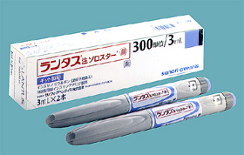
Comparison with insulin glargine
13
Point
Flat blood glucose level is required for treatment of diabetes.
Insulin glargine
A long-acting insulin analogue with “peakless" profile
The most utilized long-acting insulin.
120
(A) Serum glucose level
(B) AUC_{G}
(C) MRT_{G}
100
*
80
*
Serum glucose level (%)
60
*
AUC_{G} (%・h)
MRT_{G} (h)
40
: Insulin glargine
: Multi-SPRA-insulin
20
Insulin glargine
Multi-SPRA-insulin
Insulin glargine
Multi-SPRA-insulin
0
2
4
6
8
10
12
24
Time (h)
Serum Glucose Levels, AUC_{G} and MRT_{G} after Subcutaneous Administration of Multi-SPRA-insulin (2 U/kg) and Insulin Glargine (2 U/kg) to Rats
Each point represents the mean±S.E. of 5-13 experiments. *p<0.05 versus Insulin glargine.
・・・
Multi-SPRA-insulin showed prolonged and peakless hypoglycemic effect, although insulin glargine showed the peak under the experimental conditions.
Notes:
Here, Flat blood glucose level is required for treatment of diabetes.,
And Insulin glargine is the most utilized as long-acting insulin.
Therefore, hypoglycemic effect of SPRA-insulin was compare with insulin glargine.
Multi-SPRA-insulin showed prolonged and peakless hypoglycemic effect, although insulin glargine showed the peak under the experimental conditions.

Slide 15
Blood chemistry values
14
Insulin
s.c. (2 U/kg)
Collection of blood
Blood chemistry data
Wistar rat
24 h
Blood Chemistry Values 24 h after Subcutaneous Administration of Multi-SPRA-insulin to Rats
System
CRE (mg/dL)¹⁾
BUN (mg/dL)²⁾
AST (U/L)³⁾
ALT (U/L)⁴⁾
LDH (U/L)⁵⁾
Saline
Insulin
Ad-insulin
Multi-SPRA-insulin
0.37 ± 0.01
0.35 ± 0.01
0.31 ± 0.02
0.33 ± 0.01
23.1 ± 0.9
19.5 ± 0.8
15.5 ± 1.3
20.3 ± 1.1
73 ± 11
77 ± 21
69 ± 12
81 ± 23
44 ± 3
62 ± 5
42 ± 3
36 ± 6
65 ± 23
62 ± 31
128 ± 26
140 ± 42
1) Creatinine, 2) Blood urea nitrogen, 3) Aspartate aminotransferase, 4) Alanine aminotransferase, 5) Lactate dehydrogenase. Each value represents the mean±S.E. of 3 experiments.
・・・
Negligible changes of blood chemistry values were observed after the administration of multi-SPRA-insulin.
Notes:
Finally, to estimate the safety profile of SPRA-insulin, we measured Blood chemistry values.
Negligible changes of blood chemistry values were observed after the administration of multi-SPRA-insulin.

Slide 16
Conclusion
15
SPRA-proteins were prepared through host-guest interaction between β-CyD and Ad.
Thermal and enzymatic stability of SPRA-proteins was higher than those of protein alone.
SPRA-lysozyme completely retained lytic activity of lysozyme.
Multi-SPRA-insulin showed prolonged and peakless hypoglycemic effect without loss of the bioactivity.
SPRA technology is useful as a novel PEGylation technique for protein drugs.
・・・
Notes:
In conclusion,
・
・
・
・
Therefore, SPRA technology is useful as a novel PEGylation technique for protein drugs.
8：53

Slide 17
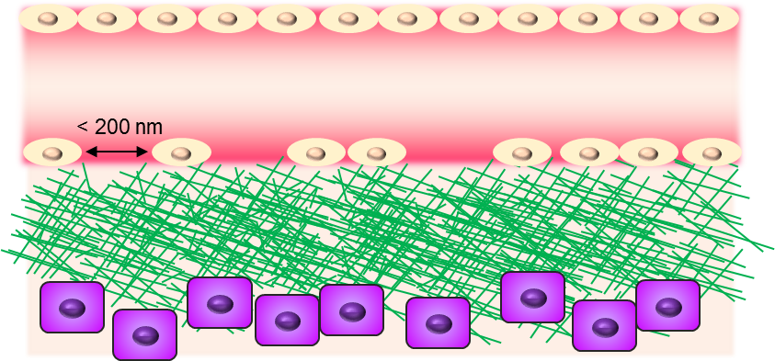
16
Pancreatic cancer
“Cancer” is the first common cause of death and
incidences of cancer increase year by year.
Prostate
(%)
Breast
Drug contribution
Breast
Prostate
Uterus
Uterus
Stomach
Colon
Lung
Colon
Stomach
Liver
Liver
5-year survival rate (%)
Lung
Pancreatic
Pancreatic
7.7%
「National Cancer Center, Center for Cancer Control and Information Services」
Satisfaction of treatment (%)
Pancreatic cancer is one of the refractory cancers.
From「Japan Health Sciences Foundation」
Problem
Dense extracellular matrix (ECM) is present around pancreatic cancer cells.
ECM inhibits diffusion of anticancer drugs into cancer tissues.
Anticancer drug
K.J. Rakesh et al., Nat. Rev. Clin. Oncol., 7, 653-664 (2010).
Extracellular matrix (ECM)
Efficient anticancer drug delivery for pancreatic cancer is required.
interstitial
Cancer cells
Notes:
We talk about next topic.
“Cancer” is the first common cause of death and incidences of cancer increase year by year.
Of various cancers, Pancreatic cancer is one of the refractory cancers.
This is due to the presence of Dense extracellular matrix (ECM) around pancreatic cancer cells.
Because, ECM inhibits diffusion of anticancer drugs into cancer tissues.
Therefore, Efficient anticancer drug delivery for pancreatic cancer is required.

Slide 18
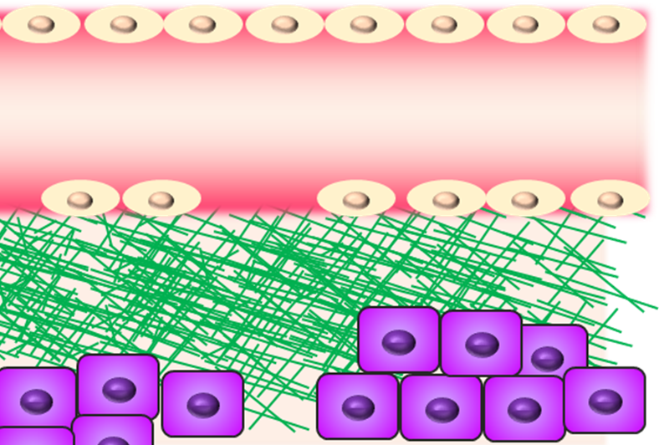
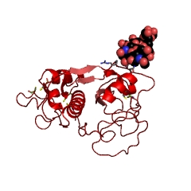
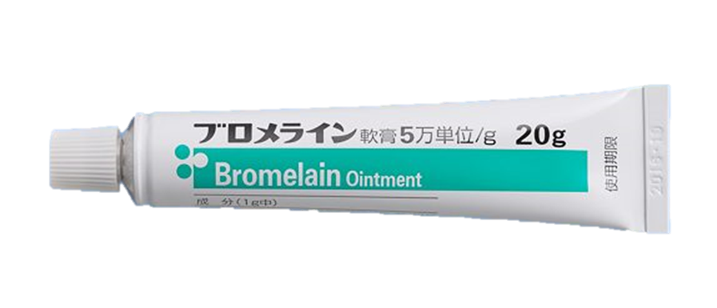
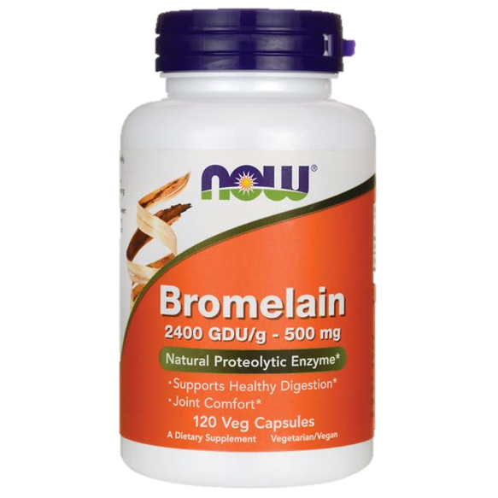
17
Bromelain
Cancer tissue
ECM degrading enzyme
Hyaluronidase
Collagenase
Bromelain
ECM
・Hyaluronan
・Aggrecan
・Collagen
・Laminin
・Fibronectin
Blood vessel
ECM
Bromelain can degrade a number of proteins such as collagen and laminin.
Cancer cells
Bromelain
・Molecular weight (M.W.) : 24 kDa
・Available as food and drug
(Debriding agent)
Hypothesis
Anticancer drugs can be delivered to cancer tissues efficiently by pre-administration with bromelain???
Problem
Bromelain is not able to accumulate in the cancer tissues efficiently because of its short blood half-life.
J.V. Castell et al., Am. J. Physiol., 273, 139-146 (1997).
Y. Anraku et al., Chem. Commun., 47, 6054-6056 (2011).
Notes:
ECM is consisting of ・Hyaluronan・Aggrecan・Collagen・Laminin・Fibronectin.
On the other hand, Hyaluronidase, Collagenase and Bromelain can degrade ECM.
Especially, Bromelain can degrade a number of proteins such as collagen and laminin.
Therefore, we expect that Anticancer drugs can be delivered to cancer tissues efficiently by pre-administration with bromelain???
However, Bromelain is not able to accumulate in the cancer tissues efficiently because of its short blood half-life.

Slide 19
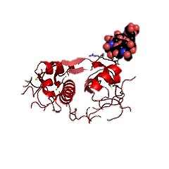
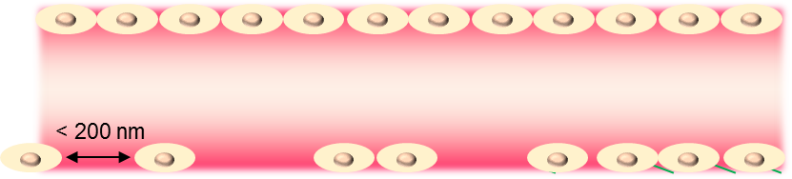
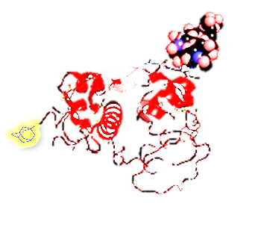
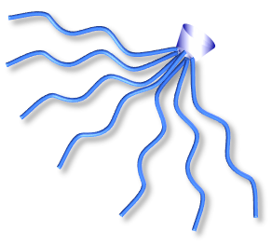
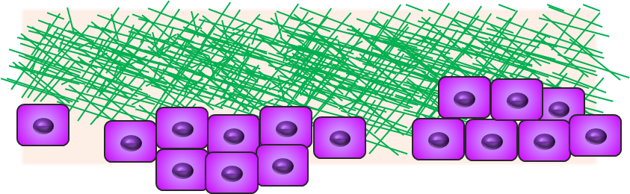
18
SPRA-bromelain
Ad-bromelain + PEG-β-CyD = SPRA-bromelain
Ad-bromelain
SPRA-bromelain can improve blood retention, resulting in accumulation in cancer tissues by EPR effect.
After dissociation, Ad-bromelain degrades ECM, leading to efficient drug delivery.
SPRA-bromelain
PEG-β-CyD
SPRA-bromelain
Anticancer drug
ECM
Ad-bromelain
interstitial
Cancer cells
Notes:
Therefore, in this study, we prepare SPRA-bromelain.
SPRA-bromelain can improve blood retention, resulting in accumulation in cancer tissues by EPR effect.
After dissociation, Ad-bromelain degrades ECM, leading to efficient drug delivery.

Slide 20
19
Purpose
Design and evaluation of the efficient drug delivery system for pancreatic cancer utilizing SPRA-bromelain
Outline
PCT/JP2017/017591
Preparation of SPRA-bromelain
In vitro activity of SPRA-bromelain
(Gelatin-degrading activity, Permeability of FITC-dextran (2 MDa) into gelatin gel)
Accumulation of FITC-dextran (2 MDa) in tumor of tumor-bearing mice
Effects of pre-administration of SPRA-bromelain on antitumor activity of anticancer drugs
In vivo safety profile of SPRA-bromelain
Notes:
Therefore, in this study, we designed and evaluated the efficient drug delivery system for pancreatic cancer utilizing SPRA-bromelain.
This is outline of this study.

Slide 21

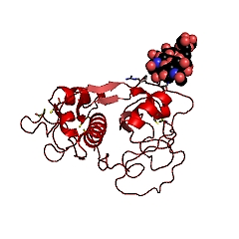
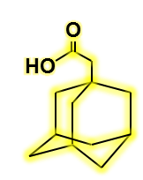
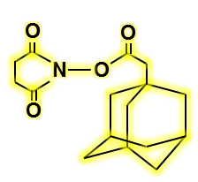
20
Preparation of PEG-β-CyD and Ad-bromelain
Preparation of PEG-β-CyD (Host molecule)
(OH)₇
(Cl)₇
(N₃)₇
(NH₂)₇
CH₃SO₂Cl
NaN₃
Ph₃P
DMF
DMAc/H₂O
25% NH₃ a.q.
β-CyD
per-Cl-β-CyD
per-N₃-β-CyD
per-NH₂-β-CyD
PEG
(M.W. 20 kDa)
In DMF/water
r.t., 24 h
Degrees of substitution of PEG : 1~4
(ave. 2.1)
PEG-β-CyD
Preparation of Ad-bromelain (Guest molecule)
NHS¹⁾, DCC²⁾
Bromelain
Ad-bromelain
In DMSO
r.t., 24 h
In DMF/water
4ºC, 24 h
1-Adamantane
acetic acid (Ad)
1) N-Hydroxysuccinimide
2) N, N’-Dicyclohexylcarbodiimide
Degrees of substitution of Ad : 5
Notes:
We first prepared PEGylated b-CyDs with 20,000 Da PEG chains.
The average degrees of substitution of PEG was 2.1.
Next, Ad-bromelain was prepared from 1-Adamantane acetic acid and Bromelain.
Degrees of substitution of Ad was 5.

Slide 22
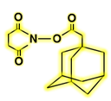
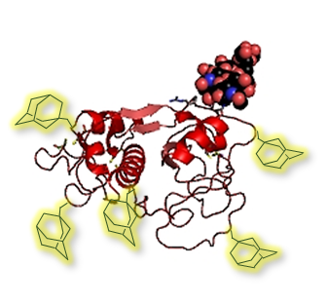
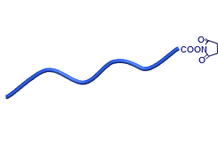
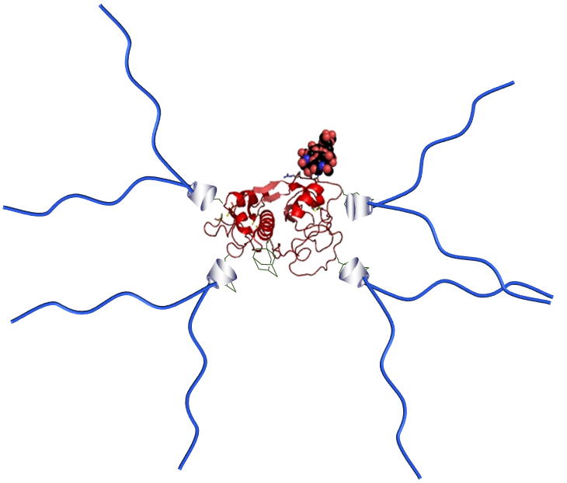
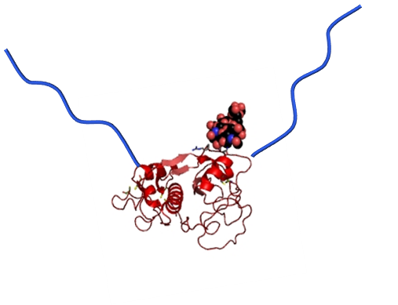
21
Preparation of SPRA-bromelain
Particle size : 10.9 nm
ζ-Potential : 1.07±0.37 mV
PEG-β-CyD
Bromelain
Ad-bromelain
Particle size : 2.35 nm
ζ-Potential : 1.11±0.34 mV
Complex formation
PEG
β-CyD
SPRA-bromelain
Ad
Covalent bond
Particle size : 152 nm
ζ-Potential : 1.33±0.37 mV
K_{a}¹⁾ : 8.4 x 10⁴ (M⁻¹)
PEG-bromelain
Particle size : 32.5 nm
ζ-Potential : -0.28±0.25 mV
Stability constant of Ad-bromelain complex with PEG-β-CyD
Notes:
Next, we prepared SPRA-bromelain by mixing Ad-bromelain and PEGylated b-CyD.
The particle size and stability constant of SPRA-bromelain were 152 nm and 84,000, respectively.
Moreover, we also prepared covalently PEGylated bromelain as a control.

Slide 23
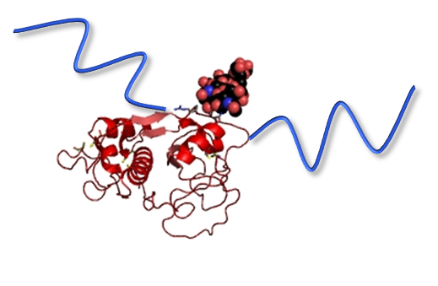
22
In vitro activity of SPRA-bromelain (Gelatin-degrading activity)
Protocol
Bromelain
PEG-bromelain
Ad-bromelain
SPRA-bromelain
5% Gelatin in PBS
300 μL
Collection of supernatant
in PBS 300 μL
Gelatin assay
Gelatin gel
4ºC, 12 h
Gelatin gel
4ºC, 8 h
Gelatin gel
Gelatin gel
24-well plate
24-well plate
24-well plate
*
*
Gelatin released (mg)
*
Bromelain
PEG-
bromelain
Ad-bromelain
SPRA-bromelain
Gelatin-Degrading Activity of Bromelains
Gelatin (5% w/v) was incubated in PBS at 4ºC overnight. After incubation of bromelain (20 μg) for 8 h at 4ºC, protein content in the supernatant was measured by protein assay. The molar ratio of PEG-β-CyD/Ad-bromelain was 10/1. Each value represents the mean ± S.E. of 3-4 experiments. *p < 0.05, versus PEG-bromelain.
SPRA-bromelain completely retained in vitro activity of bromelain.
Notes:
Next, we examined In vitro activity of SPRA-bromelain, namely Gelatin-degrading activity.
Covalently PEGylated bromelain showed negligible Gelatin-degrading activity.
In contrast, SPRA-bromelain showed markedly high activity, indicating that
SPRA-bromelain completely retained in vitro activity of bromelain.

Slide 24
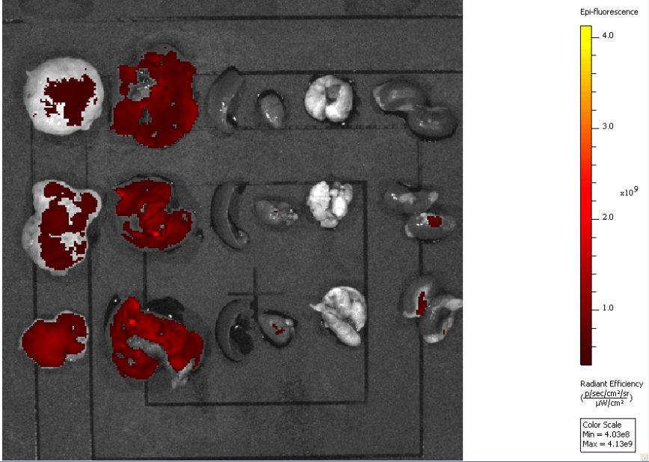
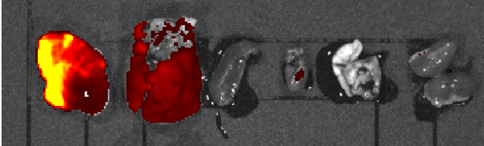
23
Accumulation of FITC-dextran (2 MDa) in tumor-bearing mice
Protocol
5% mannitol
SPRA-bromelain
(bromelain 1 mg/kg)
MIA PaCa-2 cells
(Human pancreatic cancer cells)
＋
Matrigel®
FITC-dextran (2 MDa)
24 h
6 h
In vivo
imaging
(IVIS)
i.v.
i.v.
Tumor
Once a week
(4 times)
BALB/c nu/nu mouse
Once a week (4 times)
(A) 5% mannitol
Tumor
Liver
Spleen
Heart
Lung
Kidney
(B) SPRA-bromelain
FITC-dextran Level in Various Organs after Intravenous Pre-administration SPRA-bromelain in BALB/c nu/nu Mice Bearing MIA PaCa-2 Cells
SPRA-bromelain solution (1 mg bromelain/kg, 250 μL) was intravenously administered to mice bearing MIA PaCa-2 cells. After 24 h, FITC-dextran (2 MDa) solution (1 mg/mL, 250 μL) was intravenously administered to mice. This procedure was repeated 4 times. After 6 h, organs were collected, and then fluorescence was measured by IVIS.
Pre-administration of SPRA-bromelain efficiently delivered FITC-dextran (2 MDa) into tumor tissue compared to the other tissues.
Notes:
Next, we examined Accumulation of FITC-dextran (2 MDa) in tumor-bearing mice after Co-administration of SPRA-bromelain.
Firstly,
SPRA-bromelain solution (1 mg bromelain/kg, 250 mL) was intravenously administered to mice bearing MIA PaCa-2 cells.
After 24 h, FITC-dextran (2 MDa) solution (1 mg/mL, 250 mL) was intravenously administered to mice.
This procedure was repeated 4 times. After 6 h, organs were collected, and then fluorescence was measured by IVIS.
As a result, pre-administration of SPRA-bromelain efficiently delivered FITC-dextran (2 MDa) into tumor tissue compared to the other tissues.

Slide 25
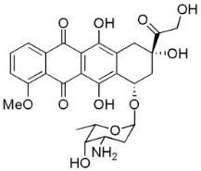
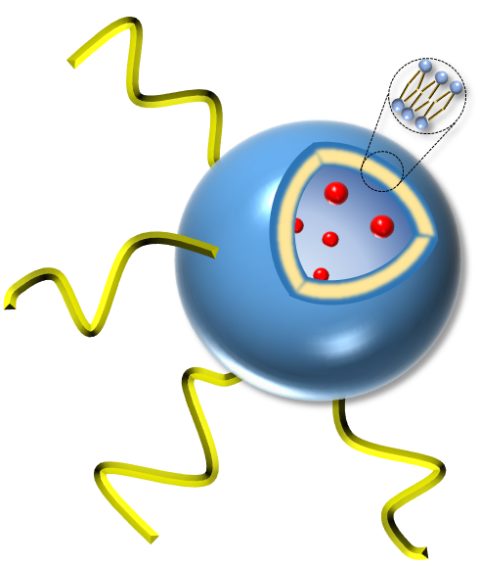


24
Effects of pre-administration of SPRA-bromelain on antitumor activity of anticancer drugs
Protocol
5% mannitol or
SPRA-bromelain
(bromelain 1 mg/kg)
Doxorubicin (3 mg/kg)
or Doxil ® (2 mg/kg)
Doxorubicin
MIA PaCa-2 cells＋Matrigel®
Tumor
Anticancer drug
Doxorubicin
encapsulated
liposome
i.v.
24 h
i.v.
BALB/c nu/nu mouse
Once a week (4 times)
Once a week (4 times)
Doxil®
(A) Doxorubicin
: Sample
(B) Doxil®
: Sample
3
: 5% mannitol
: Doxorubicin
: SPRA-bromelain
＋ Doxorubicin
: Doxorubicin
: 5% mannitol
: Doxil®
: SPRA-bromelain
＋ Doxil®
: SPRA-bromelain
: Doxil®
5
4
2
Tumor volume (cm³)
Tumor volume (cm³)
3
1
*
2
*
†
*
*
1
*
†
*
*
*
0
7
14
21
28
0
7
14
21
28
Time (day)
Time (day)
Tumor Volume after Intravenous Administration of Doxorubicin (A) or Doxil® (B) with SPRA-bromelain in BALB/c nu/nu Mice Bearing MIA PaCa-2 Cells
Bromelain solutions (1 mg/kg) were intravenously administered to mice bearing MIA PaCa-2 cells. After 24 h, Doxorubicin (3 mg/kg) or Doxil® (2 mg/kg) was intravenously administered to mice. This procedure was repeated 4 times. Each point represents the mean ± S.E. of 3 mice. *p < 0.05, versus 5% mannitol. †p<0.05, versus doxorubicin or Doxil®.
SPRA-bromelain enhanced the antitumor activity of both doxorubicin and DOXIL® in pancreatic cancer model mice.
Notes:
Next, we examined Effects of pre-administration of SPRA-bromelain on antitumor activity of anticancer drugs.
Bromelain solutions (1 mg/kg) were intravenously administered to mice bearing MIA PaCa-2 cells.
After 24 h, Doxorubicin (3 mg/kg) or Doxil (2 mg/kg) was intravenously administered to mice.
This procedure was repeated 4 times.
Importantly, SPRA-bromelain enhanced the antitumor activity of both doxorubicin and DOXIL® in pancreatic cancer model mice.

Slide 26
25
In vivo safety profile of SPRA-bromelain
(Repeated administration, healthy mouse)
Blood Chemistry Values after 4 Times Intravenous Administrations of 5% Mannitol, Bromelain and SPRA-bromelain to C57BL/6J Mice for 4 Weeks
System | CRE ^{a)} (mg/dL) | BUN ^{b)} (mg/dL) | AST ^{c)} (U/L) | ALT ^{d)} (U/L) | LDH ^{e)} (U/L)
5% mannitol | 0.20 ± 0.00 | 26 ± 0.5 | 55 ± 0.7 | 26 ± 0.3 | 253 ± 16
Bromelain | 0.20 ± 0.00 | 31 ± 1.9 | 68 ± 8.3 | 24 ± 1.3 | 263 ± 30
SPRA-bromelain | 0.20 ± 0.00 | 34 ± 1.5 | 54 ± 1.9 | 24 ± 0.4 | 284 ± 35
a) Creatinine, b) Blood urea nitrogen, c) Aspartate aminotransferase, d) Alanine aminotransferase, e) Lactate dehydrogenase.
Twenty four h after intravenous administration of bromelains solutions (1 mg bromelain/kg, 250 μL), serum was collected. Each value represents the mean ± S.E. of 3-5 mice.
SPRA-bromelain negligibly changed the blood chemistry values after intravenous administrations.
Notes:
Finally, to estimate In vivo safety profile of SPRA-bromelain, Blood Chemistry Values after 4 Times Intravenous Administrations of SPRA-bromelain were measured.
As a result, SPRA-bromelain negligibly changed the blood chemistry values after intravenous administrations.

Slide 27
26
Conclusion
PEG-β-CyD formed a stable supramolecular complex (SPRA-bromelain) with Ad-bromelain.
SPRA-bromelain completely retained in vitro activity of bromelain.
SPRA-bromelain improved accumulation of FITC-dextran (2 MDa) in cancer tissue.
SPRA-bromelain enhanced the antitumor activity of both doxorubicin and Doxil® in pancreatic cancer model mice.
SPRA-bromelain negligibly changed the blood chemistry values after intravenous administrations.
SPRA-bromelain could be useful as an efficient anticancer drug delivery system for pancreatic cancer.
Notes:
In conclusion,
・
・
・
・
These results suggest that SPRA-bromelain could be useful as an efficient anticancer drug
Delivery system for pancreatic cancer.
16:00

Slide 28

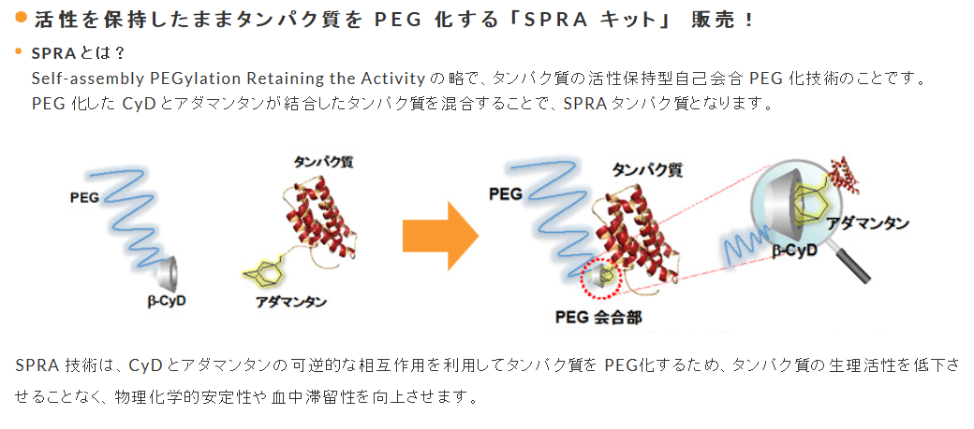

Kit of SPRA technology is commercially available !!
27
Notes:
As an important news, Kit of SPRA technology is commercially available !!

Slide 29
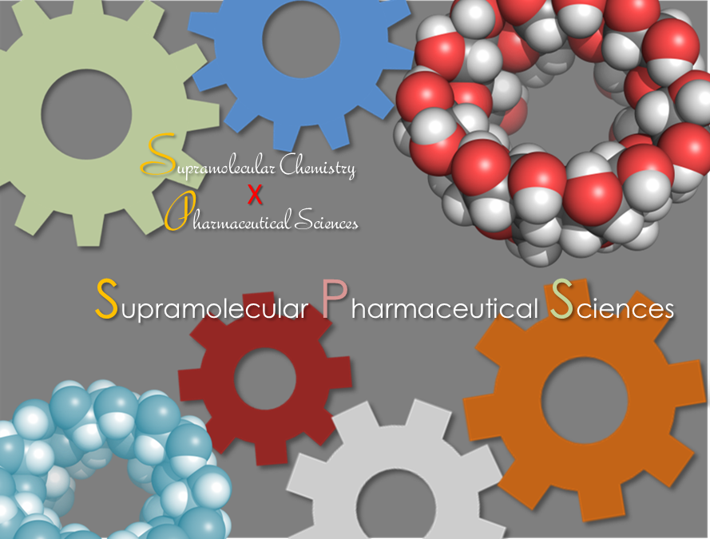
Supramolecular Pharmaceutical Sciences
A new concept which combines pharmaceutical sciences and supramolecular chemistry.
This concept could be useful for developing new ideas, methods, hypotheses, strategies, materials, and mechanisms in pharmaceutical sciences.
Notes:
SPRA technology is based on supramolecular chemistry.
Recently, we propose the importance of supramolecular chemistry in pharmaceutical sciences.
And create a new concept “Supramolecular Pharmaceutical Sciences”
This concept is combination of pharmaceutical sciences and supramolecular chemistry, and could be useful for developing new ideas, methods, hypotheses, strategies, materials, and mechanisms in pharmaceutical sciences.

Slide 30
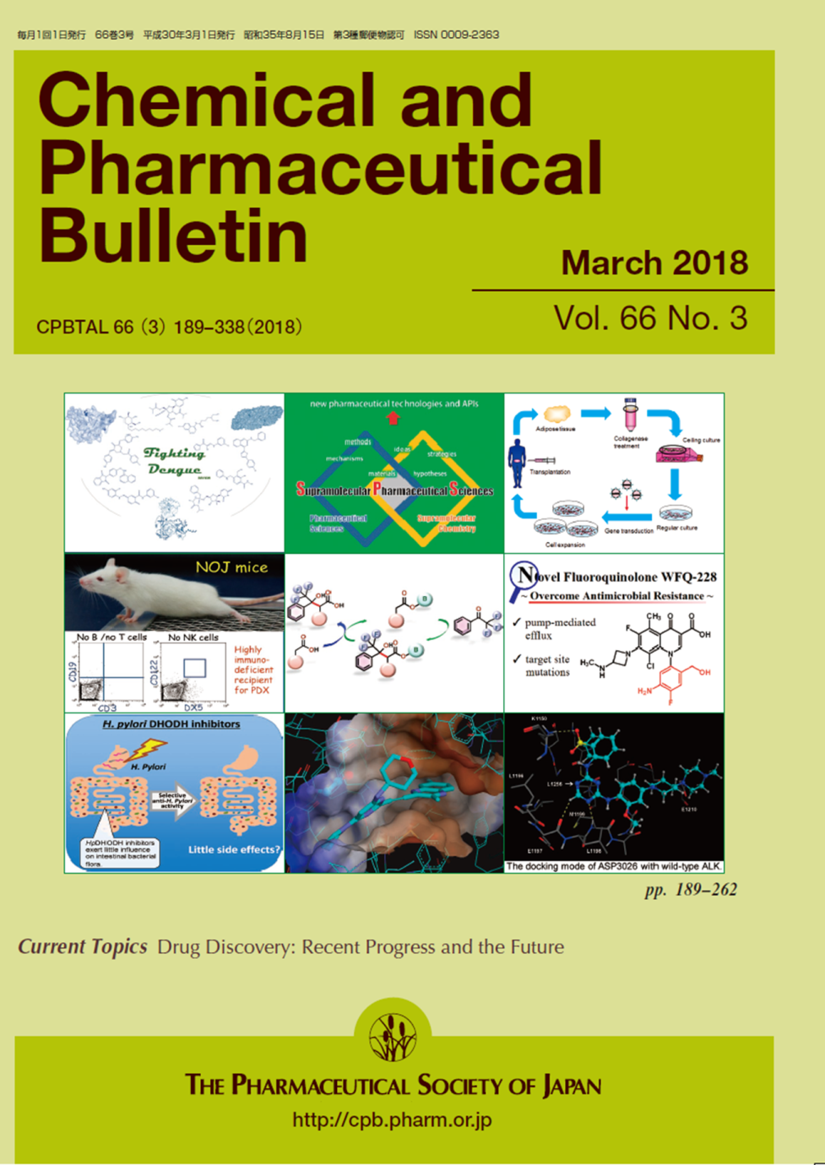
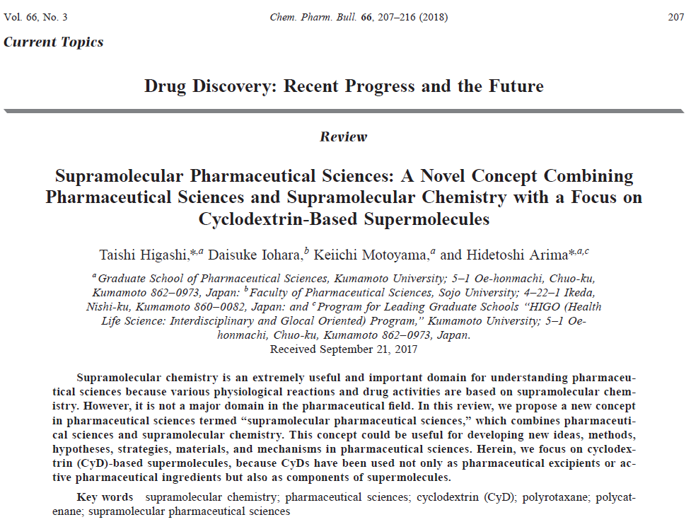
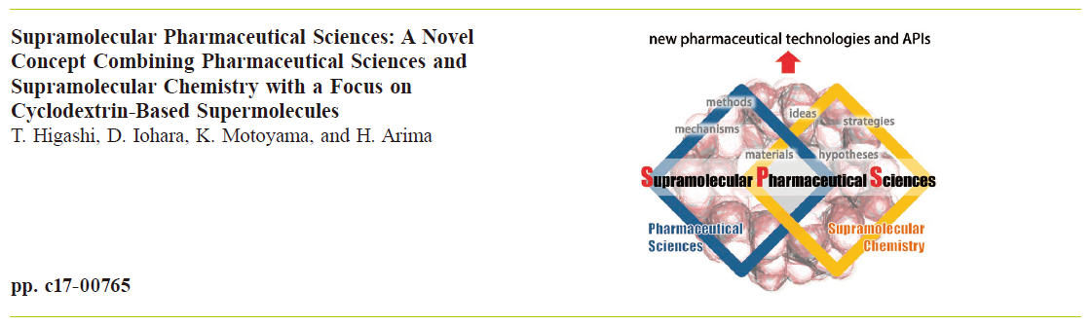
For detail, please see our review article!!
29
Notes:
For detail, please see our review article!!

Slide 31









Acknowledgement
30
Graduate School of Pharmaceutical Sciences,
Kumamoto University
Department of Physical Pharmaceutics
Dr. T. Hirotsu
Ms. N. Sato
Mr. T. Kogo
Dr. S. Misumi
Dr. H. Nakamura
Grant
Technical support
Notes:
Thank you for your kind attention.

Slide 33
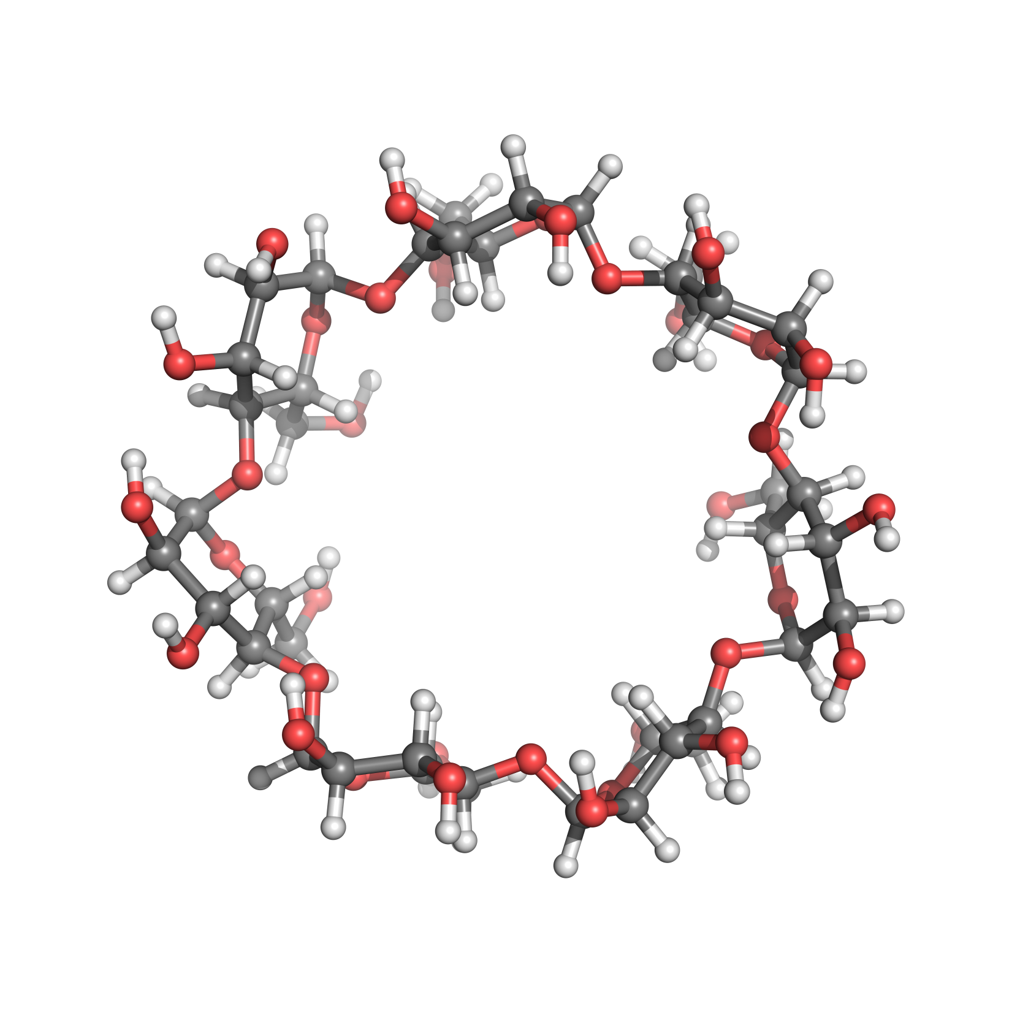
Cyclodextrins (CyDs)
4
OR₆
OR₆
OR₆
O
O
O
R₃O
O
OR₂
R₂O
OR₃
O
O
OR₂
R₃O
OR₆
R₆O
OR₃
R₂O
O
(
O
OR₂
R₃O
OR₃
O
OR₂
O
O
R₂O
)
O
OR₃
R₆O
n
OR₆
Glucose unit :
α-CyD = 6, β-CyD = 7, γ-CyD = 8.
Chemical and Schematic Structures of Cyclodextrins (CyDs)
Host-guest interaction
Guest molecule
Hydrophilic exterior
Hydrophobic cavity
CyD
Inclusion complex
・・・
CyDs form inclusion complexes with hydrophobic guest molecules.
Notes:
Cyclodextrins (CyDs) are cyclic oligosaccharides composed of six, seven and eight glucopyranose units,
And they are called a-, b- and g-cyclodexterin, respectively.
CyDs have Hydrophilic exterior and Hydrophobic cavity,
And CyDs form inclusion complexes with hydrophobic guest molecules.

Slide 34
Preparation of SPRA insulin (Preliminary study)
7
O
COON
O
Activated β-CyD
Ad-PEG
Insulin
β-CyD-insulin
conjugate
SPRA insulin
β-CyD-insulin
conjugate
100
AUC_{G} : In vivo bioactivity
AUC_{G}
Serum glucose level (%)
AUC_{G}¹⁾ (%・h)
50
Insulin
11%
*
0
2
4
6
8
Insulin
β-CyD-insulin
conjugate
Time (h)
Serum Glucose Levels and AUC_{G} after Subcutaneous Administration of Insulin and β-CyD-insulin Conjugate to Rats
Each point or value represents the mean±S.E. of 5-6 experiments. *p<0.05 versus Insulin.
1) Area upper the blood glucose level-time curve
・・・
β-CyD-insulin conjugate showed the negligible hypoglycemic effect.

Slide 35

8
Preparation of SPRA insulin (Preliminary study)
O
COON
O
Activated Ad
PEG-β-CyD
Insulin
Ad-insulin
conjugate
SPRA insulin
100
Ad-insulin
conjugate
Serum glucose level (%)
AUC_{G} (%・h)
50
Insulin
T. Hirotsu
(D2)
0
2
4
6
8
10
12
Insulin
Ad-insulin
conjugate
Time (h)
Serum Glucose Levels and AUC_{G} after Subcutaneous Administration of Insulin and Ad-insulin Conjugate to Rats
Each point or value represents the mean±S.E. of 5-6 experiments.
・・・
Ad-insulin conjugate retained hypoglycemic effect of insulin.

Slide 36
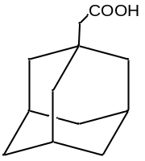
Formation of SPRA-insulin (¹H-NMR, ITC)
11
Multi-PEG-β-CyD
: Multi-SPRA-insulin
Ad-insulin
Multi-PEG-β-CyD/Ad-insulin
¹H-NMR
ITC
Insulin
1
1
Time (s)
1
3
0
500
1000
1500
2000
2500
4
4
3
4
2
3
2
2
2
Corrected
heat rate
1
0
Δδ (ppm)
kJ/mol of
injectant
-10
-20
K_{a} :1.14 × 10⁴ (M⁻¹)
1
2
3
4
4
8
12
16
20
Injection
Chemical Shifts of ¹H-NMR Spectrum of Ad Moiety of Ad-insulin in the Presence of Multi-PEG-β-CyD
Typical Isothermal Titration Calorimetry (ITC) Data Obtained for the Interaction of Multi-PEG-β-CyD with Ad-insulin in PBS

Slide 37
Comparison with other long-acting insulins
18
SPRA-insulin
(Multi-SPRA-insulin)
Insulin glargine
PEG-insulin
Conformation
Recombinant insulin analog
PEGylated insulin via covalent bond
PEGylated insulin via host-guest interaction
The number of PEG chain
―
1
(20 kDa)
1~4
(20 kDa)
In vivo activity (AUC_{G})
160%
10%
250%
(vs insulin)
Duration of hypoglycemic effect (MRT_{G})
110%
40%
180%
(vs insulin)
・・・
SPRA-insulin could be a promising long-acting insulin product.

Slide 38
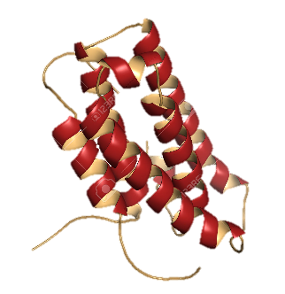
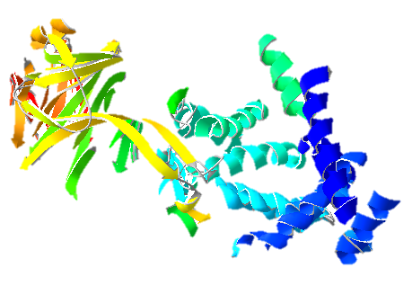
PEG¹⁾ylated protein
3
Benefit of PEGylated protein
1) Polyethylene glycol
Low blood retention
Immunogenicity
Low stability
PEGylation
High blood retention
Reduced immunogenicity
High stability
Disadvantage of PEGylation
PEGylated interferon (Pegasys®)
PEGylated hyaluronidase (Phase Ⅲ)
M.W. of PEG : 40 kDa (branch)
Blood half-life : 73-fold
Activity : < 7%
M.W. of PEG : 30 kDa (linear chain)
Blood half-life : 200-fold
Activity : < 25%
C.S. Fishburn, J. Pharm. Sci., 97, 4167-4183 (2008).
C.B. Thompson et al., Mol. Cancer Ther., 9, 3052-3064 (2010).
G. Manji et al., Clin. Cancer Res., 7, 1670-1678 (2017).
PEGylation markedly reduces the activities of proteins.
Notes:
In general, there is pegylation as a method to improve blood retention of proteins.
These show examples of the disadvantage of pegylation.
Pegylated interferon PEGASYS or PEGylated hyaluronidase
is reported that its blood retention remarkably improved compared to non-PEGylated form, but its activity significantly decreased in both cases.

Slide 39
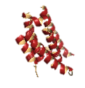
Self-assembly PEGylation Retaining Activity (SPRA)
4
Design
Self-assembly PEGylation Retaining Activity (SPRA) technology
Protein
Protein
PEG
PEG
Adamantane (Ad)
β-Cyclodextrin
(β-CyD)
PEGylated β-CyD
(PEG-β-CyD)
Ad-appended protein
(Ad-protein)
PEG-β-CyD/Ad-protein complex
(SPRA-protein)
PEGylation via a host-guest interaction between β-CyD and Ad
β-CyD
Protein
PEG
Reversible supramolecular PEGylation
Ad
Improvement of blood retention without loss of the activity of protein
Binding site of PEG
T. Hirotsu et al., Mol. Pharm., 14, 368-376 (2017).
T. Hirotsu et al., Carbohyd. Polym., 164, 42-48 (2017).
Notes:
In the previous study, we reported. Self-assembly PEGylation Retaining Activity (SPRA) technology via a host-guest interaction between b-cyclodextrin (b-CyD) and adamantane (Ad).
And SPRA technology succeeded in improvement of blood retention without loss of the bioactivity of protein.

Slide 40
Permeability of FITC-dextran (2 MDa) into gelatin gel
10
Protocol
Bromelain
PEG-bromelain
Ad-bromelain
SPRA-bromelain
Collection of PBS
(Receiver)
in PBS (100 μL)
+ FITC-dextran (2 MDa)
Measurement of
fluorescence
Gelatin gel
4ºC
48 h
Gelatin gel
PBS
PBS
Receiver
Transwell®
*
Effect of Bromelain, PEG-bromelain, Ad-bromelain and SPRA-bromelain on Gelatin Gel Permeation of FITC-dextran (2 MDa)
Gelatin (5% w/v) was incubated in PBS at 4ºC overnight. After incubation of bromelain for 48 h at 4ºC, FITC-dextran (2 MDa) concentration in the receiver was measured by a fluorescence microplate reader. The molar ratio of PEG-β-CyD/Ad-bromelain was 10/1. Each value represents the mean ± S.E. of 3-4 experiments. *p < 0.05, versus PBS.
Fluorescence
intensity (%)
*
*
6%
*
without
gelatin
PBS
Bromelain
SPRA-
bromelain
Ad-bromelain
PEG-
bromelain
with gelatin
SPRA-bromelain retained the activity of bromelain and improved the gelatin gel permeability of FITC-dextran (2 MDa).
Notes:
Next, we examined the permeability of FITC-dextran into Gelatin Gel.
This result suggested that SPRA-bromelain retained the activity of bromelain and improved geratin gel permeability of FITC-dextran.
PEGylated bromelain transmitted only 6% of FITC-dextran compared to bromelain alone,
On the other hand SPRA-Bromelain showed FITC-dextran as well as control.

Slide 41

Proposed mechanism for enhanced antitumor effect of anticancer drugs by SPRA-bromelain
14
Anticancer drug alone
SPRA-bromelain＋anticancer drug
Anticancer drug (Doxorubicin, Doxil®)
SPRA-bromelain
After 24 h
Anticancer drug (Doxorubicin, Doxil®)
ECM
ECM
MIA PaCa-2 cells
MIA PaCa-2 cells
Patent application : PCT/JP2017/017591
Notes:
This figure shows the proposed mechanism for enhanced antitumor effect of anticancer drugs by SPRA-bromelain.
After intravenous administration, SPRA-bromelain accumulates in tumor tissues and degrade the ECM.
After injection of anticancer drugs, these drugs can be delivered deep into the tumor tissue, and shows more potent
Antitumor activity than drug alone.

