Slide 1
About OMICS Group
OMICS Group International is an amalgamation of Open Access publications and worldwide international science conferences and events. Established in the year 2007 with the sole aim of making the information on Sciences and technology ‘Open Access’, OMICS Group publishes 400 online open access scholarly journals in all aspects of Science, Engineering, Management and Technology journals. OMICS Group has been instrumental in taking the knowledge on Science & technology to the doorsteps of ordinary men and women. Research Scholars, Students, Libraries, Educational Institutions, Research centers and the industry are main stakeholders that benefitted greatly from this knowledge dissemination. OMICS Group also organizes 300 International conferences annually across the globe, where knowledge transfer takes place through debates, round table discussions, poster presentations, workshops, symposia and exhibitions.

Slide 2
About OMICS Group Conferences
OMICS Group International is a pioneer and leading science event organizer, which publishes around 400 open access journals and conducts over 300 Medical, Clinical, Engineering, Life Sciences, Phrama scientific conferences all over the globe annually with the support of more than 1000 scientific associations and 30,000 editorial board members and 3.5 million followers to its credit.
OMICS Group has organized 500 conferences, workshops and national symposiums across the major cities including San Francisco, Las Vegas, San Antonio, Omaha, Orlando, Raleigh, Santa Clara, Chicago, Philadelphia, Baltimore, United Kingdom, Valencia, Dubai, Beijing, Hyderabad, Bengaluru and Mumbai.

Slide 3


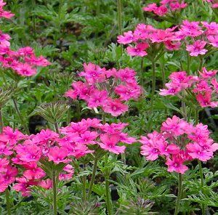

Phytochemical and biological investigation of Verbena tenara Spring cultivated in Egypt
Taghreed A. Ibrahim
Professor of Pharmacognosy- King Saud University- KSA
Professor of Pharmacognosy– Cairo University- Egypt
tshehata@ksu.edu.sa

Slide 4
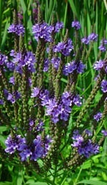
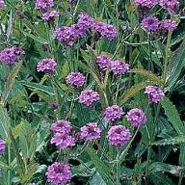
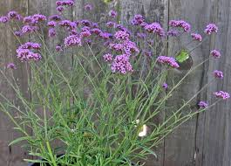
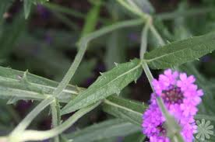
Introduction
The genus Verbena family Verbeneaceae comprises about 250 species of an annual, perennial herbaceous or semi-woody plants.
Previous chemical investigations of several Verbena species revealed the presence of many classes of chemical constituents:
Flavonoids Iridoids Phenolic acids Phenylethanoids Verbenachalcones Essential Oils Triterpenes
V. venosa
V. rejida
V. bonariensis
V. officinalis

Slide 5
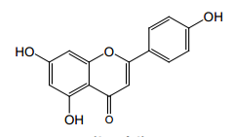
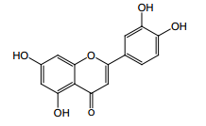
Introduction (Cont.)
1- Flavonoids (El- Hela et al, 2010 and Siddiqui et al, 2011):
Apigenin Luteolin
Vitexin Isovitexin
Orientin Isoorientin
Chrysoeriol
Apigenin
Luteolin

Slide 6
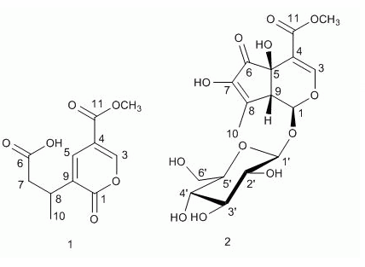
Introduction (Cont.)
2- Iridoids: (Shu et al, 2014)
New iridoids were isolated:
1- verbeofflin
2- 7- hydroxydehydro- hastatoside
From V. officinalis

Slide 7
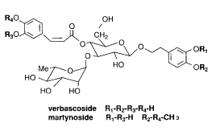
Introduction (Cont.)
3-Phenylethanoids:
(El-Hela et al, 2000)
Verbascoside and martynoside were isolated from V. bipinnatifida

Slide 8
Introduction (Cont.)
4- Verbenachalcone (Li et al, 2001)
A novel dimeric dihydrochalcone, verbenachalcone (1), was isolated from the aerial parts of Verbena littoralis.
5- Essential oil Shams Ardakani et al, 2003)
3-hexen-1-ol (7.28%), 1-octen-3-ol (32.76%), linalool (4.66%), verbenone (20.49%) and geranial (7.22%).
Isolated from V. officinalis

Slide 9
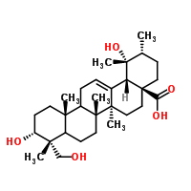
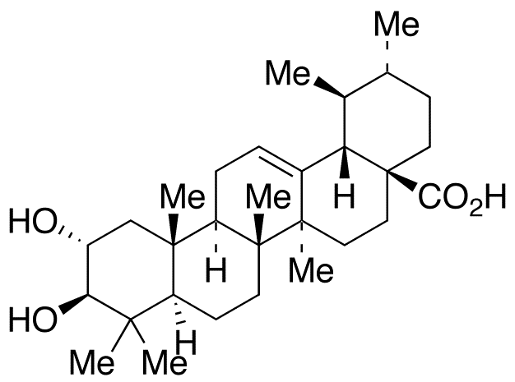
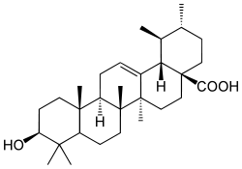
Introduction (Cont.)
6- Triterpenes: (Shu et al, 2013)
3α,19,23-trihydroxyurs-12-en-28-oic acid, namely, 4-epi-barbinervic acid.
2α,3β-dihydroxyurs-12-en-28-oic acid.
3α,24-dihydroxyurs-12-en- 28-oic acid.
3α,24-dihydroxy-olean-12-en-28-oic acid
ursolic acid
Isolated from Verbena officinalis

Slide 10
Introduction (Cont.)
Uses in folk medicine (Toki et al., 1995 and Ganaboa & Castro 2004):
Medicinal plants belonging to genus Verbena are reported to be used traditionally as:
Tonic diaphoretic sedative diuretic antidiarrheal expectorant and anti-inflammatory topical applications.

Slide 11
Introduction (Cont.)
Previous pharmacological studies proved that Verbena species have:
Antioxidant antifungal antibacterial parasiticide immunostimulant antidepressant hypotensive hepato-protective neuro-protective and hypoglycemic effects
(Lai et al, 2006, Ismail et al, 2006, Toki et al, 1995 and Carnat et al, 1995).

Slide 12
Introduction (Cont.)
Based on the available literature there is no data concerning either the chemical composition and /or the pharmacological activities of Verbena tenara Spreng except iridoids (El-Domiaty et al, 1999), so the chemical and biological investigation of Verbena tenara Spring appears to be very interesting.

Slide 13
Aim of Work
1- Qualitative and quantitative investigation of chemical constituents of V. tenara including:
a- Investigation of essential oil constituents.
b- Investigation of pet. ether extract.
c- Investigation of methanolic extract constituents:
phenolics, flavonoids, phenylethanoids and iridoids.

Slide 14
Aim of Work (Cont.)
2- Evaluation of biological activity of essential oil (EO), pet. ether extract (PEE) and methanol extract (ME):
Anti-inflammatory, antimicrobial and antioxidant effects.

Slide 15
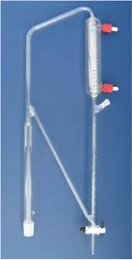
Essential oil
Isolation of essential oil from the fresh aerial part of V. tenara by hydrodistillation using Clavenger apparatus.
Table (1) Physical characters of essential oil of Verbena tenara
Item | Result
Colour | Yellowish
Odour | Aromatic characteristic
Percentage | 0.21%
refractive index | 1.46277
specific gravity | 0.87322

Slide 16
Essential oil (Cont.)
Table (2) GC/ MS analysis of the essential oil of Verbena tenara
Results of GC/MS of essential oil revealed that:
1- 10 compounds were identified in the oil.
2- the identified components constitute 82.54% of the total oil composition.
3- Citronellyl acetate (33.2%) is the major constituent followed by menthol (15.64%) and eugenol (13.0%).
No | Rt | % | Identified compounds
1 | 4.13 | 2.5 | α - Pinene
2 | 4.3 | 5.5 | β-Pinene
3 | 6.39 | 2.85 | Cineol
4 | 6.44 | 15.64 | Menthol
5 | 7.8 | 1.42 | Terpinol
6 | 8.5 | 1.19 | Borneol
7 | 9.1 | 4.8 | Camphene
8 | 11.11 | 13.0 | Eugenol
9 | 13.55 | 2.44 | β- Caryophyllene
10 | 14.03 | 33.2 | Citronellyl acetate
Total |  | 82.54

Slide 17
Methodology
Defatted Powder
Pet. Ether extract (0.5%)
Powdered aerial part of the plant
Methanol extract (6%)
Saponification
Unsap.
Sap.
Flavonoid
phenylethanoid
Iridoid
Acidification
Methylation
Phenolic
GC/MS
GC/MS
Folin-Ciocalteu
AlCl₃
Arnow's reagent
Trim & Hill

Slide 18
Results of Quantitative Analysis
Table (3) Results of quantitative analysis of ME of Verbena tenara
Class | Total phenol µ g % | Flavonoids µ g (%) | Phenyl ethanoids µ g % | Iridoids µ g %
Percentage | 46 ± 0.6 | 19.1±0.04 | 165 ± 1.87 | 32.77± 1
Calculated as | Gallic acid | Quercetin | Verbascoside | Herbagoside

Slide 19
Table (4) GC/ MS analysis of the fatty acid methyl esters of V. tenara
Peak No. | GC analysis |  | Compound name
 | Rt | %
1 | 2.89 | 1.7 | Capric acid
1 | 3.36 | 1.2 | Lauric acid
2 | 5.96 | 1.8 | 11.Amino myrstic acid
3 | 7.15 | 9.8 | Myristic acid
4 | 7.19 | 1.65 | Hydrastininic acid
5 | 10.73 | 13.6 | Palmitic acid
6 | 12.9 | 2.8 | Pentadecanoic acid
7 | 13.4 | 8.3 | α-Linolenic acid
8 | 14.3 | 3.85 | Stearic acid
9 | 19.2 | 12.85 | Arachidic acid
10 | 19.8 | 2.7 | Behenic acid
11 | 21.7 | 16.85 | Erucic acid
12 | 23.7 | 2.55 | Heneicosanoic acid
13 | 25.3 | 2.66 | Nonadecanoic acid
14 | 25.5 | 8.33 | Tricosanoic acid
15 | 27.4 | 2.91 | lignoceric acid
16 | 29.2 | 0.95 | Pentacosanoic acid
17 | 30.7 | 2.6 | Cerotic acid
18 | 32.3 | 2.9 | Carboceric acid
18 fatty acid were identified.
Erucic acid is the major fatty acid (16.85% followed by palmitic acid (13.6%) and arachidic acid (12.85%).

Slide 20
Table (5) GC/ MS analysis of the unsap. matter of V. tenara
GC/MS of unsap. Matter revealed the identification of 18 compounds, representing 81.56% of total unsap.
2 steroidal compounds were identified: β-sitosterol and stigmasterol.
2 triterpenes were detected: lupeol and ursolic acid.
Stigmasterol represents the major component in unsap. Matter (25.03%) followed by octacosne (11.01%) and hexacosane (10.1%).
No | Rt | % of identified compound | Compound name
1 | 18.99 | 0.37 | Ionon
2 | 20.12 | 0.30 | dodecane
3 | 23.83 | 4.31 | Phytol
4 | 26.7 | 1.4 | Nonadecane
5 | 27.32 | 1.1 | Eicosane C20
6 | 28.9 | 1.13 | Heneicosane
7 | 30.7 | 7.7 | Phytane
8 | 32.1 | 2.5 | Methyicosane
9 | 33.7 | 2.1 | Tricosane
10 | 35.04 | 0.7 | Squalene
11 | 36.2 | 10.1 | Hexacosane
12 | 37.27 | 3.2 | Heptacosane
13 | 38.8 | 11.01 | Octacosane
14 | 39.8 | 0.7 | Chlostenol
15 | 40.3 | 25.03 | Stigmasterol
16 | 41.04 | 3.2 | β - Sitosterol
17 | 41.5 | 4.4 | Lupeol
18 | 43.2 | 2.4 | Ursolic acid

Slide 21
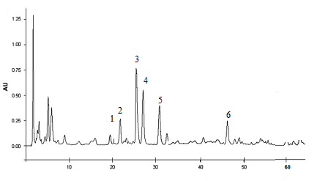
Flavonoid content
HPLC/MS analysis of flavonoid content proved the presence of 6 main components.
Identification by comparison with standard authentic samples and comparing the data with published one.

Slide 22
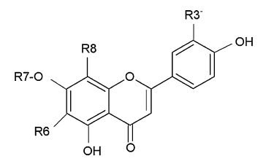
Table 6. Flavonoid content of the methanolic extract from aerial parts of V. tenara
Peak | R_{t} (min.) | Concentration (mg/100 g dry sample) | Compound name
1 | 19.20 | 1.53 ± 0.35 | Orientin
2 | 22.32 | 3.53 ± 0.18 | Vitexin
3 | 25.95 | 14.39 ± 0.97 | Isovitexin
4 | 26.82 | 13.39 ± 0.56 | Luteolin-7-O-glucoside
5 | 31.30 | 10.53 ± 0.32 | Apigenin-7-O-glucoside
6 | 47.32 | 4.74 ± 0.62 | Chrysoeriol
Figure 1. Structure of V. tenara flavonoids
No. | Compound | R_{3'} | R₆ | R₇ | R₈
1 | Orientin | OH | H | H | Glucose
2 | Vitexin | H | H | H | Glucose
3 | Isovitexin | H | Glucose | H | H
4 | Luteolin 7-O-glucoside | OH | H | Glucose | H
5 | Apigenen 7-O-glucoside | H | H | Glucose | H
6 | Chrysoeriol | OCH3 | H | H | H

Slide 23
Biological Study
Anti-inflammatory
Antimicrobial
Antioxidant

Slide 24
Anti-inflammatory
Using rat paw edema method, using carrageenan for induction of edema and indomethacin as standard anti-inflammatory drug.
Table 7. Anti-inflammatory effect of EO, PEE and ME of V. tenara on carrageenan-induced rat paw edema
Group | After 1h |  | After 2h |  | After 3h |  | Afer 4h
 | Edema (mm) | % Inhibition | Edema (mm) | % Inhibition | Edema (mm) | % Inhibition | Edema (mm) | % Inhibition
Control (saline) | 78.2 ± 0.5 | -- | 95 ±0.6 | ---- | 110 ± 0.6 | --- | 113 ± 0. 7 | ---
EO (50 µL/kg b.wt. | 78.0 ± 0.7 | 0.26 ± 0.8 | 90.3 ± 0.4 | 4.95 ± 0.4 | 100 ± 0.7 | 9.1 ± 0.2 | 100 ± 0.5 | 11.82 ± 0.5
PEE 50 mg/kg b. wt. | 75.5 ± 1.3 | 3.45 ± 0.63 | 74.8±0.2 | 21.26 ± 0.30 | 72.5 ±0.7 | 34.1 ± 0.42 | 70.3± 0.7 | 37.79 ± 0.5
ME 50 mg/kg b. wt. | 70.2± 0.2 | 10.23 ± 0.47 | 72.8± 0.2 | 23.37 ± 0.65 | 70.65 ±0.7 | 35.77 ± 0.74 | 68 ± 0.6 | 39.82 ± 0.45
Indomethacin 10 mg/kg | 70.1 ± 1.5 | 10.36 ± 0.2 | 72.0 ± 0.5 | 24.2 ± 0.5 | 67 ± 1.6 | 39.1 ± 0.8 | 65 ± 0.6 | 42.48 ± 1.2

Slide 25
Anti-inflammatory (Cont.)
PEE and ME showed significant anti-inflammatory effects while EO showed no effect.
ME showed higher activity than PEE.
The effect is time dependant reached its maxima after 4 hours.
Figure 2. Anti-inflammatory effect of EO, PEE and ME of V. tenara on carrageenan-induced rat paw edema

Slide 26
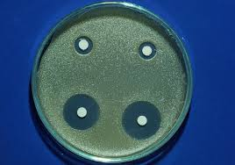
Antimicrobial Activity
The disc agar diffusion method (Lee, et al 1998 and Mohamad, et al 2004 )
Discs of Whatmann No. 3 filter paper (4 mm) were impregnated with tested extract and placed on the surface of nutrient agar seeded with tested microorganisms.
The plates were incubated at 37 ⁰C for 24 hours and at 25 ⁰C for 72 hours for bacteria and fungi, respectively.
The diameters of the inhibitory zones were measured in millimeters.

Slide 27
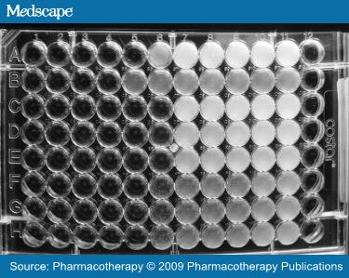
Antimicrobial Activity
Gentamycin and Amphotericin B were used as a standard antibacterial and antifungal agents, respectively.
MIC’s were determined using microdilution broth susceptibility assay.
Mueller Hinton Broth supplemented with Tween 80 detergent at a final concentration of 0.5% (v/v), and Sabouraud dextrose broth with Tween 80 were used for bacteria and fungi, respectively.

Slide 28
Table 8. Antimicrobial effect of EO, PEE and ME of Verbena tenara
Microorganism | EO |  | PEE |  | ME |  | MICs of the standards
 | DDª M ± S.D. | MIC^{b} | DDª M ± S.D. | MIC^{b} | DDª M ± S.D. | MIC^{b} | Gentamycin | Amphotericin B
Staphylococcus aureus | 15.4 ± 0.27 | 400 | 13.2 ± 0.44 | 550 | 18.3 ± 0.92 | 200 | 8 x 10⁻³ | NT
Staphylococcus epidermidis | 14.2 ± 0.65 | 650 | 14.6 ± 1.17 | 650 | 16.8 ± 1.27 | 350 | 1 x 10⁻² | NT
Streptococcus pyogens | 9.3 ± 0.34 | ˃ 1000 | 10.7 ± 0.56 | ˃ 1000 | 14.3 ± 0.64 | 350 | 8 x 10⁻³ | NT
Escherichia coli | 10.4 ± 0.63 | 900 | 9.1 ± 0.24 | ˃ 1000 | 12.7 ± 1.84 | 400 | 8 x 10⁻³ | NT
Klebsiella pneumonia | 7.2 ± 0.75 | ˃ 1000 | 7.2 ± 1.76 | ˃ 1000 | 9.58 ± 1.26 | ˃ 1000 | 1 x 10⁻² | NT
Proteus vulgaris | 8.8 ± 0.72 | ˃ 1000 | 8.8 ± 0.77 | ˃ 1000 | 9.3 ± 0.60 | ˃ 1000 | 1 x 10⁻² | NT
Pseudomonas aeruginosa | 11.8 ± 0.68 | 400 | 11.4 ± 0.54 | 900 | 11.4 ± 0.70 | 400 | 1 x 10⁻² | NT
Shigella boydii | 11.2 ± 0.61 | 750 | 10.2 ± 1.28 | ˃ 1000 | 13.6 ± 0.62 | 400 | 1 x 10⁻² | NT
Candida albicans | 14.2 ± 0.63 | 400 | 13.2 ± 0.43 | 400 | 16.4 ± 1.30 | 350 | NT | 1 x 10⁻³
Candida glabrata | 11.6 ± 0.23 | 900 | 7.2 ± 0.76 | ˃ 1000 | 7.3± 1.40 | ˃ 1000 | NT | 1 x 10⁻³
Candida krusei | 12.6 ± 0.58 | 600 | 8.2 ± 0.93 | ˃ 1000 | 8.5 ± 1.87 | ˃ 1000 | NT | 1 x 10⁻³
Candida parapsilosis | 10.8 ± 0.28 | 900 | 8.5 ± 0.36 | ˃ 1000 | 8.5 ± 0.85 | ˃ 1000 | NT | 1 x 10⁻³

Slide 29
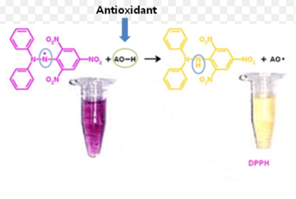
Antioxidant Activity
The antioxidant activity of the EO, PPE and ME was determined on the basis of the scavenging activity of the stable DPPH free radical, (Braca et al, 2001).
About 3mL of 0.001M DPPH in methanol was added to 1mL EO and extracts at different concentrations (250, 500, 1000, 1500, 2000 and 2500 mgmL1). Absorbance at 517nm was determined after 30 min
The percent inhibition of activity was calculated as:
[(Ao–Ae)/Ao]100
(Ao is absorbance without extract; Ae is absorbance with extract).
IC50 values were calculated by linear regression of plots.

Slide 30
Table 9. DPPH radical-scavenging activities of the EO, PEE and ME from V. tenara aerial parts
Extract | Concentration (µg/ml) | (%) Inhibition M ± SD | Regression equation (r²) | IC₅₀ (µg/ml)
EO (µL/ml) | 250 500 1000 1500 2500 | 40.25 ± 0.46 52.46 ± 0.72 66.85 ± 1.79 70.32 ± 0.91 75.43 ± 1.53 | y= 0.014 x + 44.498 r²= 0.893 | 393.00
PEE | 250 500 1000 1500 2500 | 10.30 ± 0.34 15.33 ± 0.62 17.73 ± 0.87 20.55 ± 0.75 25.26 ± 0.37 | y= 0.006x + 10.86 r² = 0.936 | 6523.33
ME | 250 500 1000 1500 2500 | 42.78 ± 0.74 56.22 ± 0.65 64.56 ± 1.86 75.79± 1.86 86.16 ± 1.54 | y= 0.018 x + 44.217 r² = 0.964 | 321.28
ME showed the highest free radical scavenging effect followed by EO.
PEE showed no free radical scavenging activity.

Slide 31

Discussion
EO showed antimicrobial activity, which might be due to presence of high percentage of citonyllyl acetate (33.20%) which was proved to possess antimicrobial activity against S. aureus, S. epidermidis and C. albicans. (Singh et al, 2012).
Cineol (2.85%) and menthol (15.64%), were proved to exhibit antimicrobial activity against a wide range of bacteria and fungi (Pattnaik et al, 1997).
Eugenol (13.00%) exhibited antimicrobial activity against several bacterial and fungal strains (Devi et al, 2010 and Mahaboob et al, 2005).

Slide 32
Discussion (Cont.)
The antioxidant activity of the essential oil might be due the monoterpene hydrocarbons and also to the overall chemical constituents contained is this oil (Derwich et al, 2011).

Slide 33
Discussion (Cont.)
PEE showed antimicrobial activity which might be due to presence of Stigmasterol (25.03%) and lupeol (4.40%) which were proved to have a moderate antimicrobial activity (Woldeyes et al, 2012) and (Margareth et al, 2009).

Slide 34
Discussion (Cont.)
The significant anti-inflammatory effect of the PEE might be attributed to the high percentages of stigmasterol (25.03%) which has proved to possess a potent anti-inflammatory activity (Gabay et al, 2010).
as well as the presence of lupeol (4.40%) which has proved to have anti-inflammatory, analgesic and antipyretic effects (Al-Rehaily et al, 2001).

Slide 35
Discussion (Cont.)
The high DPPH free radical scavenging effect of ME may be attributed to its content of flavonoids (19.10 µg%) and phenolics (46.00 µg%).
Anti-inflammatory activity of ME might be due to the presence of flavonoids (González-Gallego et al, 2007) and phenolic compounds (Kroes et al, 1992).
ME exhibited antimicrobial activity which might be attributed to the presence of flavonoids (19.10 µg%) (Cushnie & Lamb 2005), phenolics (46.00 µg%), iridoids (32.77 µg%) and phenylethanoids (165.00 µg%) (Zajdel et al, 2013).

Slide 36

Conclusion
In conclusion, essential oil, petroleum ether and methanol extracts from the aerial parts of V. tenara exhibited anti-inflammatory, antioxidant and antimicrobial activities.
These effects might be attributed to the detected compounds in the essential oil, unsaturated fatty acids, sterols and triterpenes in the petroleum ether extract and phenolic acids, iridoids, phenylethanoids and flavonoids in the methanol extract.

Slide 37
Conclusion
These results showed that V. tenara could be considered as natural antioxidant and antimicrobial agents and to represent a good anti-inflammatory remedy.

Slide 38
Atef A. El-Hela
Areej M. Al-Taweel
Associate Professor of Pharmacognosy- Deputy Chair of Pharmacognosy Department- College of Pharmacy- King Saud University- Riyadh- Saudi Arabia.
Professor of Pharmacognosy and Head of Pharmacognosy Department- Faculty of Pharmacy- Al-Azhar University- Cairo- Egypt.
Associate Professor of Pharmacognosy- Pharmacognosy Department- Faculty of Pharmacy- Cairo University- Cairo- Egypt.
Hala M. El-Hefnawy

Slide 39


Slide 40
Lets Meet again at Pharmacognosy-2015
3rd International Conference and Exhibition on Pharmacognosy, Phytochemistry and Natural Products
October 26-28, 2015 Hyderabad, India
Theme: Advanced trends for the future of Herbal Drugs and Products
Website: http://pharmacognosy-phytochemistry-natural-products.pharmaceuticalconferences.com/

