Slide 1

Hydrodeoxygenation of bio-oil model compounds over supported Nickel Catalysts
T.M. Sankaranarayanan¹, A. Berenguer¹,P. Jana¹, I.Moreno^{1,2},J.M.Coronado¹,P.Pizarro^{1,2},
D.P. Serrano^{1,2}
¹IMDEA Energy Institute, Avda. Ramón de la Sagra 3, Móstoles, Madrid, Spain
²Department of Energy and Chemical Technology, ESCET, Universidad Rey Juan Carlos, Móstoles, Madrid, Spain

Slide 2
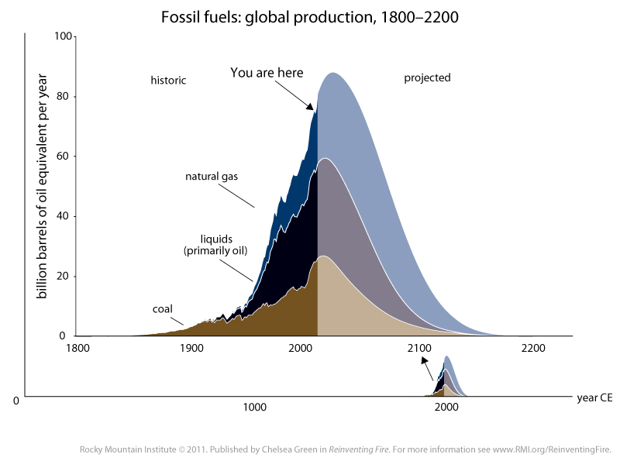
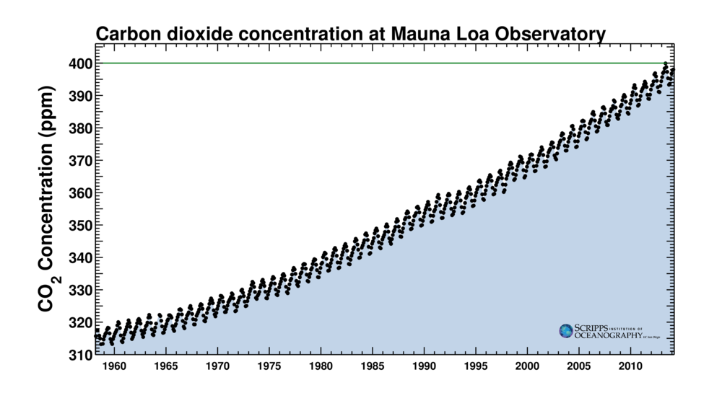
The use of fossil fuels at the present rate is not sustainable due to:
1. Rapid depletion of resources
2. Carbon emission – global warming due to greenhouse gases (GHG)
How long will Fossil
Hydrocarbon fuels last ?
FUEL Reserve/Production
Oil 13978 days (~38 years)
Gas 59404 days
Coal 150,573 days

Slide 3
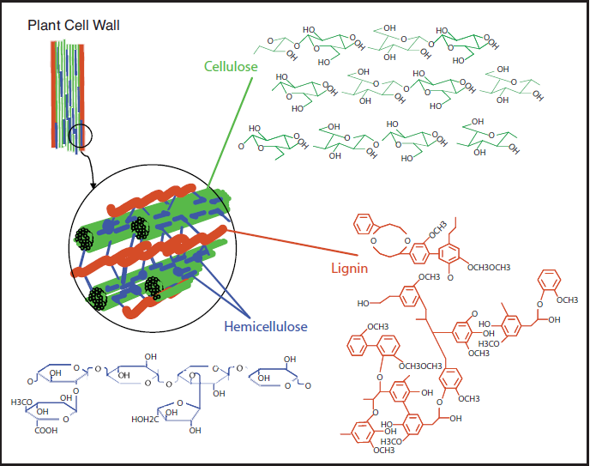

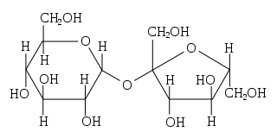
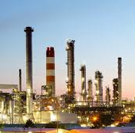
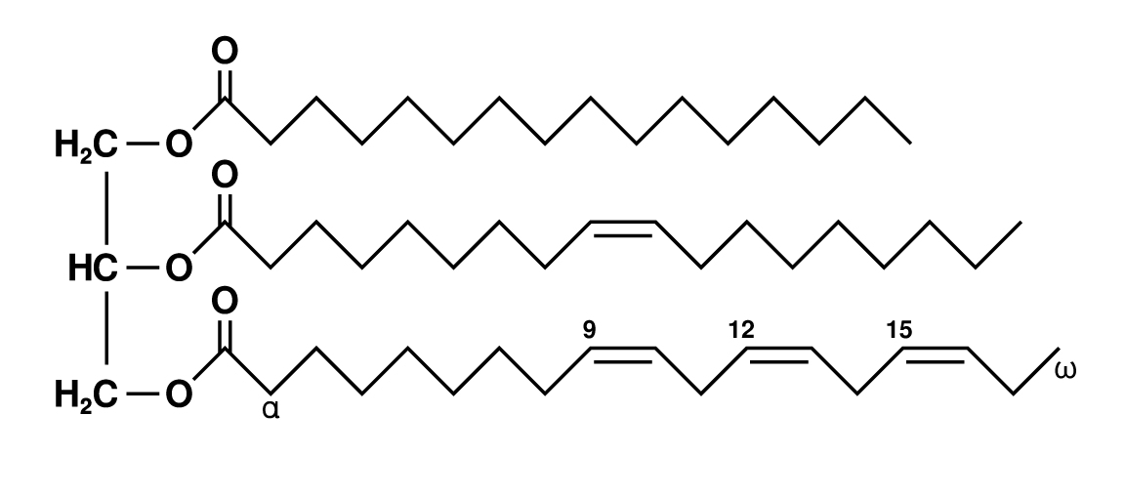
USE RENEWABLE
AND
CARBON NEUTRAL BIO-MASS BASED FUELS
Biomass Sources For Biofuels
Lignocellulose (cellulose, Hemicellulose, Lignin)
Starch
Sugars
Lipid glycerides ( Vegetable Oils & Animal Fats)

Slide 4
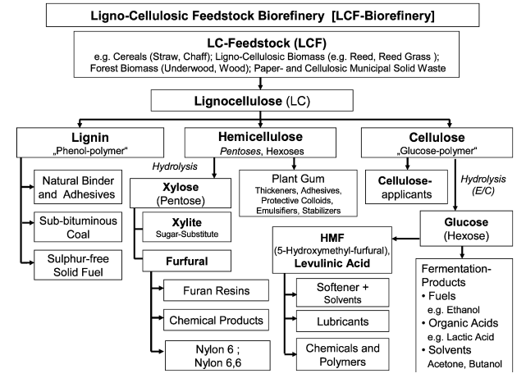
B.Kamm and M.Kamm, Appl Microbiol Biotechnol 64 (2004) 137-145

Slide 5
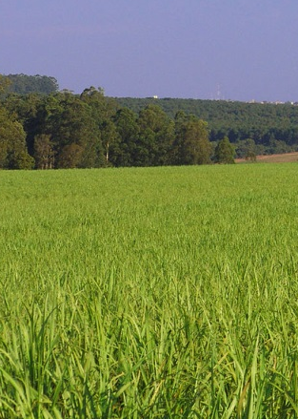

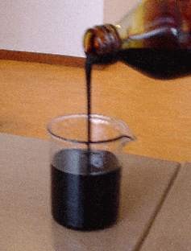

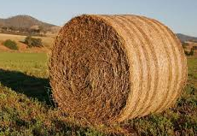
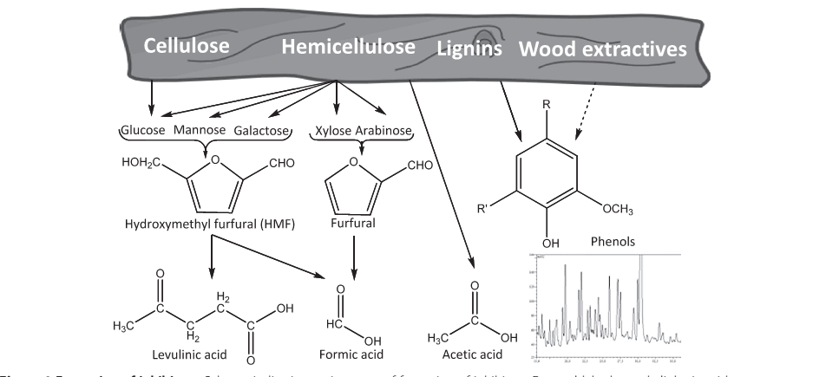
Pyrolysis
500 ºC
Inert atmosphere
Bio-Oil yield: 60-70 wt.%
Energy yield:~ 60-70 %
Ligno-cellulosic
Biomass
1 Ton
~0.6-0.7 Ton
Bio-oil
~ 50 wt.% oxygen
~28-35 wt.% water
Wt, % | Composition
20-30 | Water
15-30 | Lignin compounds
10-20 | Aldehydes
10-15 | Carboxylic acids
5-10 | Carbohydrates
2-5 | Phenols
1-4 | Furfurals
2-5 | Alcohols
1-5 | Ketones
Ref: http://www.btgworld.com/en/news

Slide 6
Objective
The HDO of bio-oil model compounds.
Experimental
Results and discussion
Conclusion

Slide 7
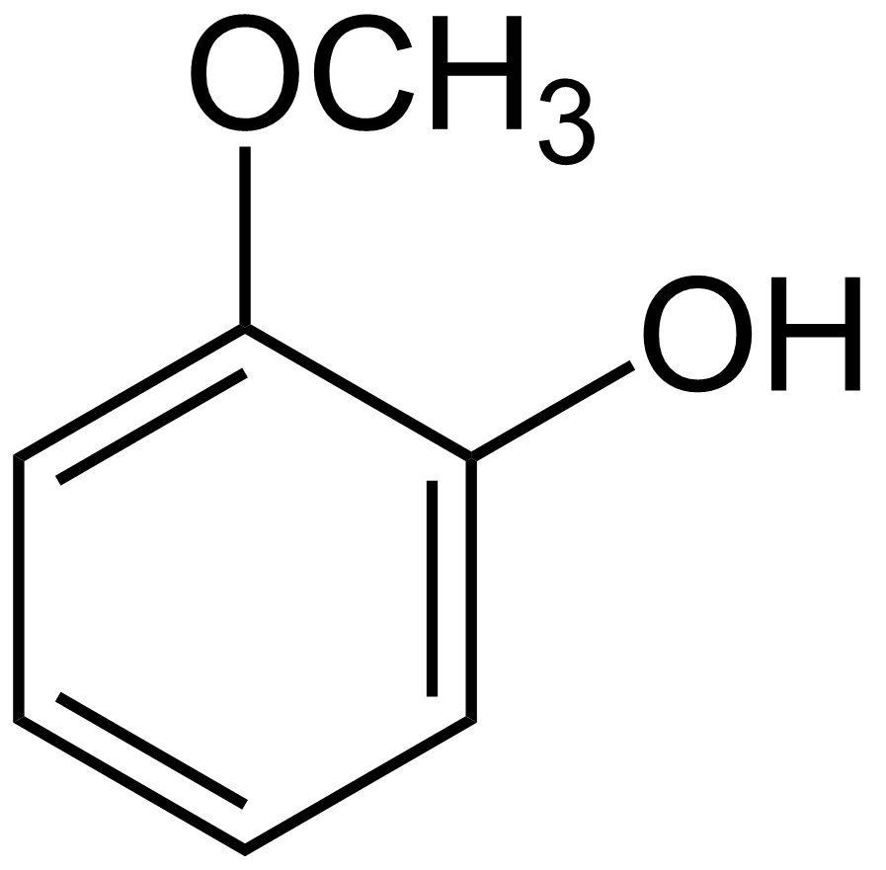
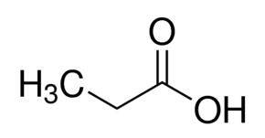
Feed:
Guaiacol [GUA]
Propionic acid [PA]
Feed 1: GUA (3%) in decalin
Feed 2: GUA(2%)+PA(1%) decalin
Catalysts:
5% of Ni on
H-ZSM-5 Comm
hierarchical-ZSM-5 [Seed Silanization]
Mesostructured Al-SBA-15
Mesostructured SBA-15
Ref: Catalysis Today, Volume 243, 163-172, 2015

Slide 8
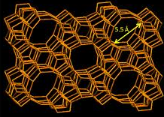
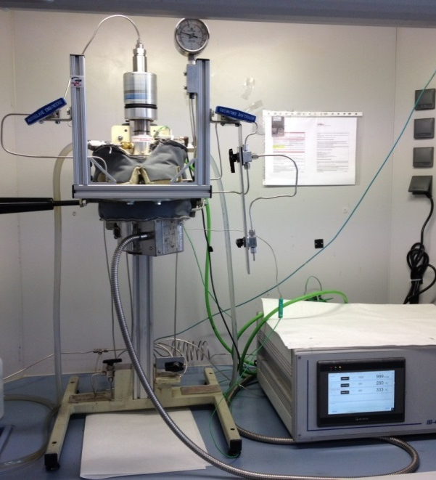
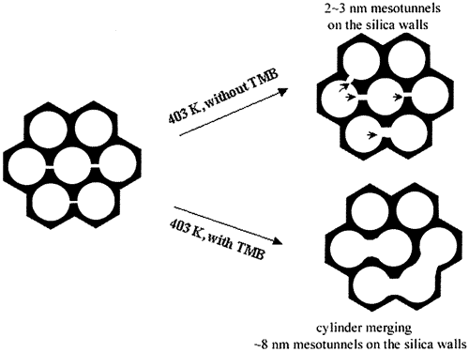
Experimental and Catalytic activity
Incipient Wetness impregnation method
5% of Ni loaded on the supports
Calcined at 550 ^{ᵒ}C/5h (static air)
Reduced at 500 ^{ᵒ}C/3h (∼80 ml of H₂)
h-ZSM-5
Reactant : | 3% of Feed in decalin
Catalysts : | 0.15 g
Reactor volume and speed: | 100 ml, 1000 rpm
Temperature : | 260 ^{ᵒ}C
H₂Pressure(Initial): | 40 bar
Reaction Time : | 2 h
Product Analysis : | GC, GC-MS
Al-SBA-15
SBA-15

Slide 9
Physicochemical characteristics of the catalyst

Slide 10
Surface area, Surface acidity and H₂-Chemisorption
micro
hierarchical
Mesostructure
Sample Name | Actual Metal Content [%] [ICP]ª | S_{BET} [m²/g]^{b} (S_{ext})* | Vpore [cc/g]^{c} | D[%]^{d} | Metallic surface area, S [m²/g-M] ^{d} | Metal Crystallite size, dp [nm] ^{d} | Acidity [mmol/g]^{e}
H-ZSM-5 Comm | 30 (Si/Al) | 437(93)* | 0.42 | - | - | - | 0.331
Ni/H-ZSM-5 Comm | 4.53 | 381(45)* | 0.27 | 4.4 | 28 | 24 | --
h-ZSM-5 | 47(Si/Al) | 563(302)* | 0.601 | - | - | - | 0.353
Ni/h-ZSM-5 | 4.41 | 469(210)* | 0.545 | 12 | 80 | 8.5 | --
Al-SBA-15 | 70(Si/Al) | 922 | 1.25 | - | - | - | 0.123
Ni/Al-SBA-15 | 4.55 | 697 | 0.82 | 7.6 | 50 | 13.3 | --
SBA-15 | - | 772 | 1.38 | - | - | - | 0.049
Ni/SBA-15 | 4.37 | 544 | 1.10 | 2 | 14 | 48 | --
ªSi/Al ratio and actual metal content from ICP; ^{b}Surface area determined by BET method; ^{c}Total pore volume measured at P/Po- 0.98; ^{d}Metal dispersion, Metallic surface area and Metal crystallite size from H2-chemisorption method; ^{e}Acidity data measured by TPD analysis using Ammonia as a probe molecule [mmols of NH3 desorbed /g of sample in the range, 100-600 ˚C

Slide 11
X-Ray Diffraction
h-ZSM-5
Al-SBA-15
The low angle diffraction reveals the presence of orderded Meso structure before and after metal impregnation.
The well-defined peaks corresponding to (1 0 0), (1 1 0) and (2 0 0) reflections, which are characteristics of a 2D hexagonal mesostructure p6mm, are clearly observed for SBA-15.
Additional phases were not observed in the case of MFI based samples, where as Ni-phases were observed in mesoporous supported samples
SBA-15

Slide 12
Temperature Programmed Reduction (TPR)
Transmission electron microscopy (TEM)
metal-support interaction and Dispersion:
h-ZSM-5 > Al-SBA-15 >H-ZSM-5 comm> SBA-15

Slide 13
RESULTS AND DISCUSSIONS
Ni/H-ZSM-5 Ni/h-ZSM-5 Ni/Al-SBA-15 Ni/SBA-15
Comm
The Conversion of Guaiacol was in the order :
Ni/h-ZSM-5~Ni/Al-SBA-15>Ni/SBA-15>Ni/H-ZSM-5 Comm
3% of Guaiacol; Temp,260˚C; Pres, 40 bar; Time, 2h

Slide 14
Product distributions

Slide 15
Conversion of GUA+PA
75%
78%
2% of GUA +1% of PA; Temp,260˚C; Pres, 40 bar; Time, 2h
Conversion of GUA
Ni/H-ZSM-5 Ni/h-ZSM-5 Ni/Al-SBA-15 Ni/SBA-15
Comm
Ni/H-ZSM-5 Ni/h-ZSM-5 Ni/Al-SBA-15 Ni/SBA-15
Comm
The Conversion of Guaiacol was in the order :
Ni/h-ZSM-5>Ni/Al-SBA-15>Ni/SBA-15>Ni/H-ZSM-5 Comm
The Conversion of Propionic acid was in the order :
Ni/Al-SBA-15>Ni/h-ZSM-5>Ni/SBA-15>Ni/H-ZSM-5 Comm

Slide 16
Product distributions with respect to Guaiacol

Slide 17
Product distributions with respect to Propionic acid

Slide 18

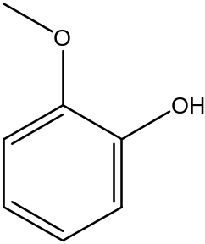
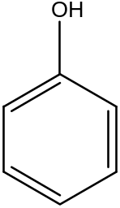



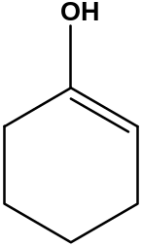

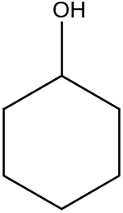


Reaction pathway
Ni/h-ZSM-5
Ni/Al-SBA-15
Feed 1
DDO
HYD
DMO
ISO
HYD
CRK
DMO
HYD
+
CH₃OH
CRK
DH
DMO - Demethoxylation
DDO - direct deoxygenation
HYD - Hydrogenation
DH - dehydration
ISO - isomerization
CRK - craking
ISO
DH
CH₃—O—CH₃

Slide 19
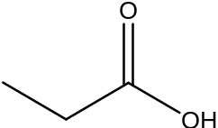



Reaction pathway
Ni/h-ZSM-5
Ni/Al-SBA-15
Feed 2
DDO
HYD
DMO
ISO
HYD
CRK
DMO
HYD
+
CH₃OH
CRK
DH
ISO
DH
CH₃—O—CH₃
HYD
DH
HYD

Slide 20
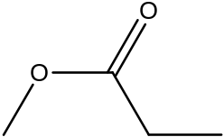
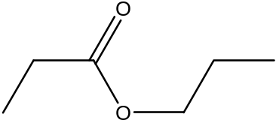
Reaction pathway
Ni/h-ZSM-5
Ni/Al-SBA-15
Feed 2
DDO
HYD
DMO
ISO
HYD
CRK
DMO
HYD
+
CH₃OH
CRK
DH
ISO
DH
CH₃—O—CH₃
+
CH₃OH
PA

Slide 21
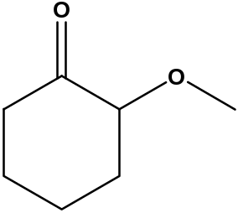
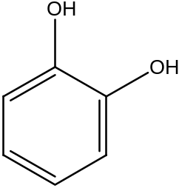
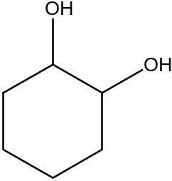
Reaction pathway
Ni/SBA-15
Feed 1
HYD
DM
HYD

Slide 22
Reaction pathway
Ni/SBA-15
Feed 2
DMO
HYD
DM
HYD
CH₃OH

Slide 23
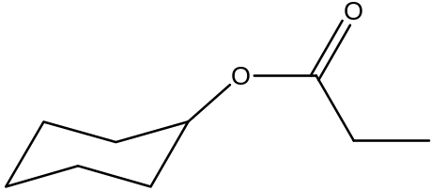
Reaction pathway
Ni/SBA-15
Feed 2
DMO
HYD
DM
HYD
CH₃OH
C₆H₁₁OH

Slide 24
Ni/h-ZSM-5 > Ni/Al-SBA-15 > Ni/SBA-15 > Ni/H-ZSM-5 Comm
Best Activity

Slide 25
Conclusions
Ni/h-ZSM-5 supported catalysts show the highest guaiacol conversion compared to supports.
  The acidity of the supports associated with the metals strongly favors the HDO conversion of Guaiacol. DMO favours the propionic acid esterification.
Hydrodeoxygenation, hydrodearomatization and isomerization reactions take place in high extension over the Ni/h-ZSM-5 sample, revealing it is a suitable catalyst for bio-oil processing in order to attain high quality fuels

Slide 26
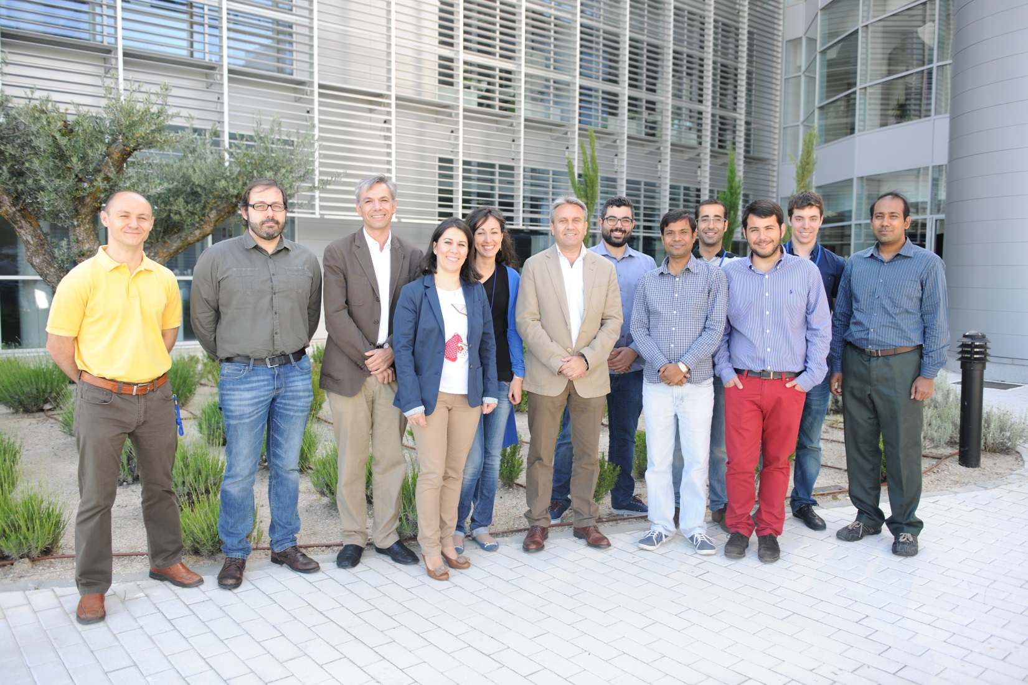

Sincere Thanks to all my group members, Technicians, Administrative Staffs!!
Thank you all for your kind attention !!!

