Slide 1

Purification and Characterization of Amidase from Paracoccus sp. SKG: Utilization of amidase inhibited whole cells for bioconversion of acrylonitrile to acrylamide
By
Prof. T. B. Karegoudar
Department of Post Graduate Studies and Research in Biochemistry
Gulbarga University, Gulbarga
Karnataka, India-585106

Slide 2
I. Introduction
Nitriles (organo-cyanide, RC≡N) are cyanide-substituted
carboxylic acids produced naturally and synthetically.
Naturally occurring nitriles are found in plants, bone oils, insects
and microorganisms in low concentration complexed with
other biomolecules.
Synthetic nitriles have been extensively used as solvents,
extractants, in the manufacture of pharmaceuticals and drug
intermediates etc.
Important for synthesis of amines, amides, carboxylic acids,
esters, aldehydes, ketones and heterocyclic compounds.

Slide 3
Acetonitrile
Acetonitrile with mol formula CH₃CN, colourless liquid is
the simplest organic nitrile.
Widely used in the chemical industry as a starting material
for the synthesis of chemicals, pharmaceuticals, pesticides
and rubber products.
The most common use of this chemical as eluting medium in
HPLC.
The industrial production of acetonitrile was estimated to be
more than 40,000 tons per annum.
Industrially, it is used as a solvent for the manufacture
of pharmaceuticals and photographic film.

Slide 4
Other
Japan
China
India
Europe
The Americas
Fig 1. Worldwide consumption of acetonitrile in 2010

Slide 5
Toxicity of Nitriles
The direct discharge of wastewater containing nitriles poses severe
health hazards.
Most nitriles are highly toxic and some are mutagenic and
carcinogenic in nature.
Release of nitriles into water bodies results in letting cyanide,
which persists in the soil or surface water causing severe
environmental pollution.
Therefore this study was undertaken for isolation,
of bacteria degrading nitriles, purification and characterization of key enzyme. Further whole cells were used as biocatalyst for the production of amides and acids.

Slide 6
II. Isolation of bacteria capable of degrading aliphatic nitriles
A bacterium capable of utilizing aliphatic nitrile as the sole carbon and nitrogen source was isolated from chemical waste samples.
Employed selective enrichment culture technique.
Culture was grown in MS medium devoid of carbon and nitrogen sources for nitrile degradation studies.
Enrichment was carried out by transferring 5% inoculum to fresh minimal medium during which nitrile concentration was gradually increased.
The purity of the culture was checked periodically by plating on LB agar plates.

Slide 7
Table 1: Morphological and cultural characteristics of strain SKG
Characteristics | Observation
Morphological characteristics
Form | Small rods
Size | 2.1µm x 0.51 µm
Gram stain | Gram negative
Motility | Motile
Flagella | Present
Endospore | Absent
Cultural characteristics
Agar culture | Small and round colonies on acetonitrile plate
Agar slants | Smooth
Mc Conkey’s agar | Colour less colonies
Pigmentation | Absent

Slide 8
Table 2: Physiological characteristics of strain SKG
Characteristic | Result
Growth on nutrient or L.B Broth | +++
Growth temperature
5 ^{ο}C | −
30 ^{ο}C | +++
37 ^{ο}C | ++
45 ^{ο}C | +
pH range for growth | 6.5-9.0
Relation to oxygen | Aerobic

Slide 9
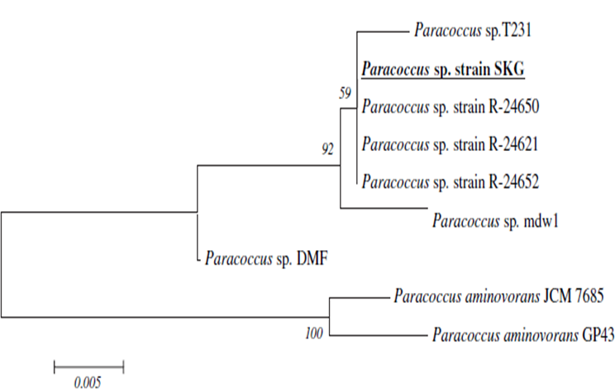
Fig 2. Phylogenetic tree of the strain SKG and related organisms based on 16S rDNA
sequences.
Fig 3. Scanning electron microscopic
observation

Slide 10
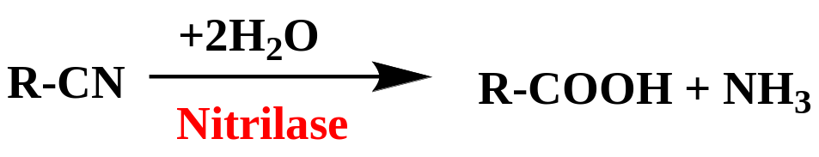
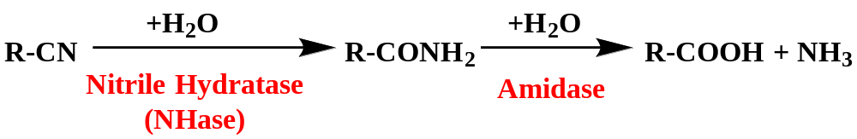
III. Catabolic pathways for the degradation of
nitriles
In the first pathway, nitriles undergo direct hydrolysis to their
carboxylic acids and ammonia by nitrilase (EC 3.5.5.1)
In the second, nitrile hydratase (EC 4.2.1.84) catalyzes nitriles to amides which are then hydrolyzed to their respective carboxylic acids and ammonia by amidase (EC 3.5.1.4)

Slide 11
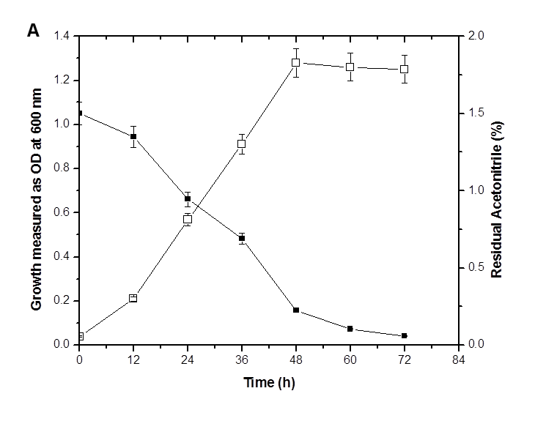
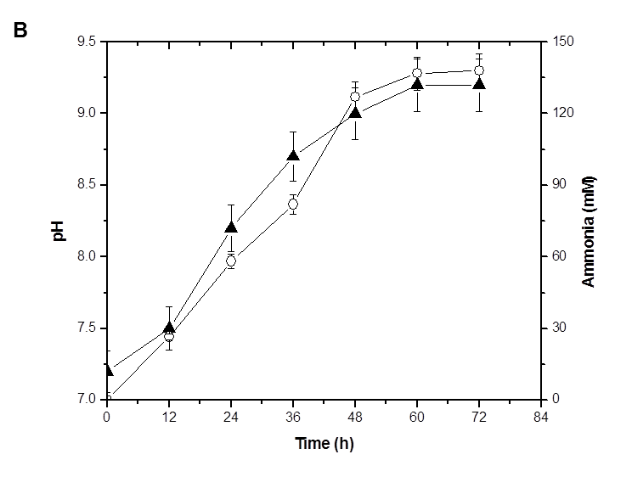
Growth and utilization of acetonitrile by Paracoccus sp. SKG
Fig 4. (A) Growth of SKG (□) and utilization of acetonitrile (■).
(B) pH of the medium (▲) and concentration of ammonia (○) released from acetonitrile
degradation.

Slide 12
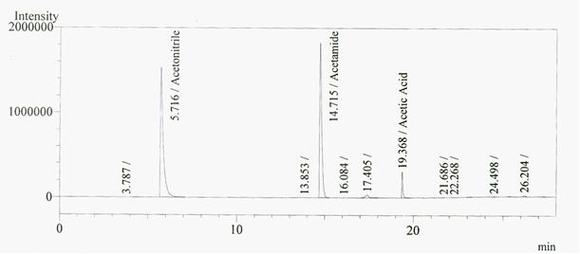
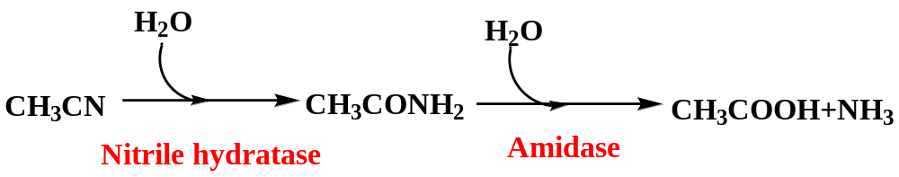
Fig 5. GC elution profile of metabolites of acetonitrile from spent medium after 48 h
of incubation. (Retention time of acetonitrile: 5.71 min, acetamide: 14.71 min and
acetic acid: 19.36 min).
Enzyme assays
Nitrilase (ND)
Nitrile hydratase (96 units)
Amidase (274 units)
Fig 6. Degradation pathway of acetonitrile by Paracoccus
sp. SKG.

Slide 13
IV. Purification and characterization of amidase
Amidases or amidohydrolases (EC 3.5.1.4) are ubiquitous enzymes in the living world.
Hydrolyze amides to the corresponding carboxylic acids and ammonia.
Significant step in biotechnological applications in the production of enantiomerically pure intermediates.
Amidases have extensive demand for industrial applications, such as production of optically pure compounds and waste water treatment.
Purification and characterization of amidases will help to solve the problem of acrylic acid accumulation during acrylonitrile hydration to acrylamide.

Slide 14
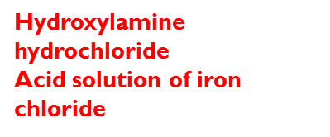
Flow chart for purification of amidase
Cell lysate
Ammonium sulphate
fractionation (60-70%)
Applied
to DEAE sepharose
(Anion exchange)
Gel Permeation
Chromatography
Native PAGE
Red-brown band
Zymogram
SDS-PAGE
Amidase
(Acyltransfer activity)

Slide 15
Table 3: Steps involved in the purification of amidase from Paracoccus sp. SKG.
Purification step | Total protein (mg) | Total activity (U∗) | Specific activity (U/mg) | Fold purification | Yield (%)
Crude enzyme Ammonium sulphate precipitation (40-60) DEAE fractionation Gel permeation fractionation | 240 64 15 1.2 | 5160 4290 3705 2400 | 21.5 67 247 960 | 1 3.11 11.4 44.6 | 100 83.1 71.8 46.5
∗One unit of enzyme activity was defined as the amount of enzyme which catalyses the formation of 1 μmol of product per min. Specific activity was expressed as units per mg of protein.

Slide 16
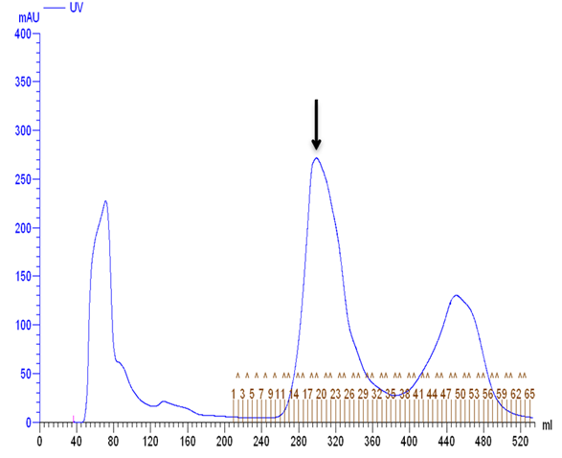
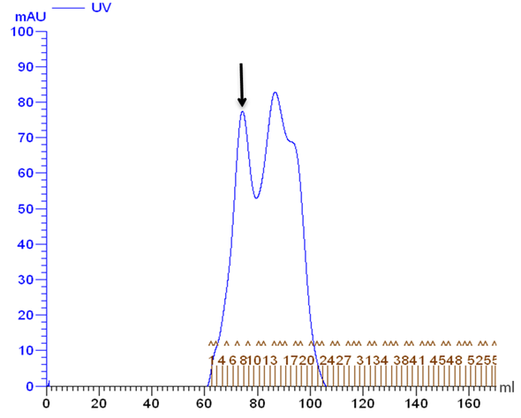
Fig 7. Elution profile of amidase from DEAE-
Sepharose column chromatography. Arrow
mark indicates the activity fraction.
Fig 8. Elution profile of amidase from Sephacryl S-
200 column chromatography. Arrow mark
indicates the activity fraction.

Slide 17
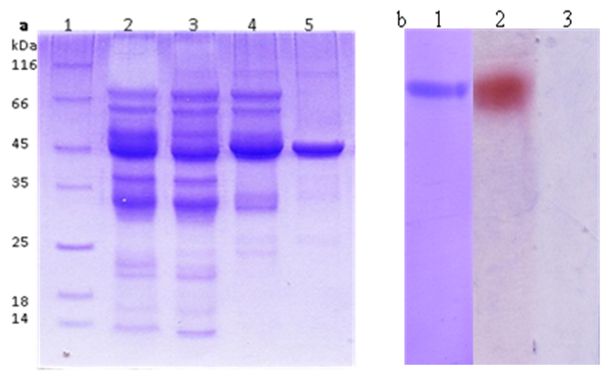
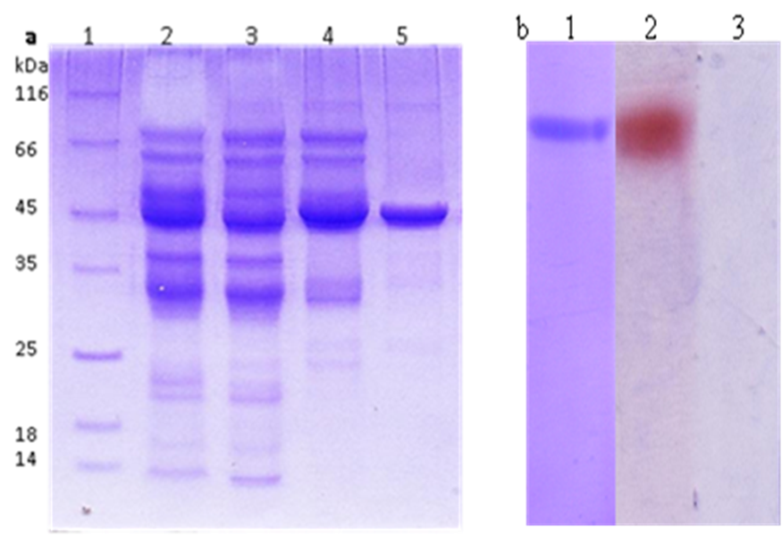
Fig. 9. (A) SDS-PAGE analysis of samples
containing amidase activity from different
purification steps.
(B) Native-PAGE and zymogram activity
of purified amidase (10 μg).
A
B
Lane 1. Protein molecular mass markers,
2. Crude extract,
3. Ammonium sulphate fraction,
4. DEAE Sepahrose fraction
5. Gel permeation fraction.
Lane 1. Purified amidase stained with
coomassie brilliant blue
2. Amidase activity
3. Control for amidase activity (without
substrate).
Notes:
a b c

Slide 18
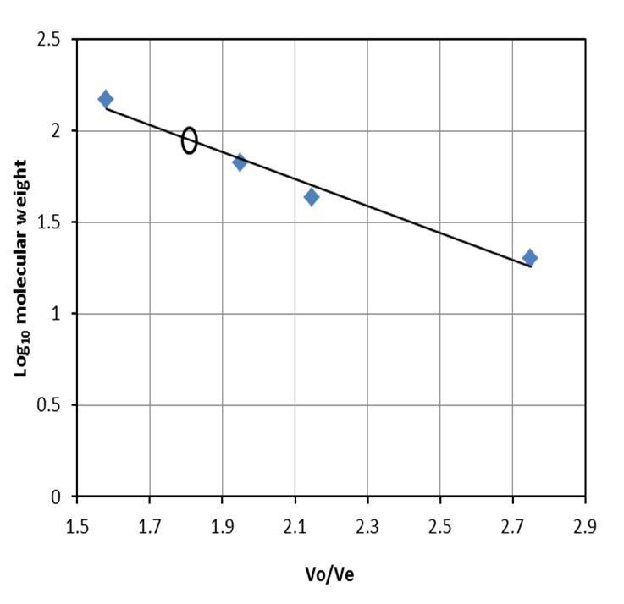
Fig 10. Molecular weight determination using gel filtration. Symbol (ο) amidase and standard proteins are
alcohol dehydrogenase, albumin, ovalbumin and chymotrypsin.
The amidase was purified to about 44.6 fold, with a recovery of 46.5%.
The purified enzyme migrated as a single band in SDS-PAGE with a molecular mass of 45 kDa.
Using gel filtration on a Sephacryl S-200 column, the molecular mass of the native protein was estimated to be 90 kDa.
Native enzyme consists of two identical subunits of 45kDa each.

Slide 19
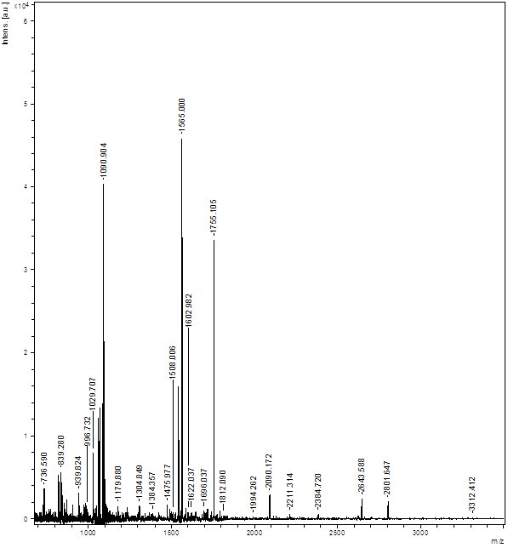
Fig. 11: MALDI-TOF mass spectrum of amidase from Paracoccus sp. SKG.
The 45 kDa band excised from the gel was subjected to trypsin digestion.
The peptide mass fragments (PMF) of purified amidase obtained from the MALDI-TOF were analyzed using a Mascot database search.
Ten tryptic peptide fragments showed the highest identity with tryptic fragments of Paracoccus denitrificans PD1222 amidase.
The identified PMF showed significant score and sequence coverage with Paracoccus denitrificans PD1222 amidase.

Slide 20
Table 4: Substrate spectrum of the amidase from Paracoccus sp. SKG. Amidase activity with acetamide as the substrate is considered as 100 %.
Substrate | Relative activity (%)
Acetamide | 100.0
Propionamide | 88.7
Acrylamide | 61.8
Valeramide | 52.3
Thiourea | 18.0
Nicotinamide | 11.4
Urea | 03.6
Benzamide | 00.0

Slide 21
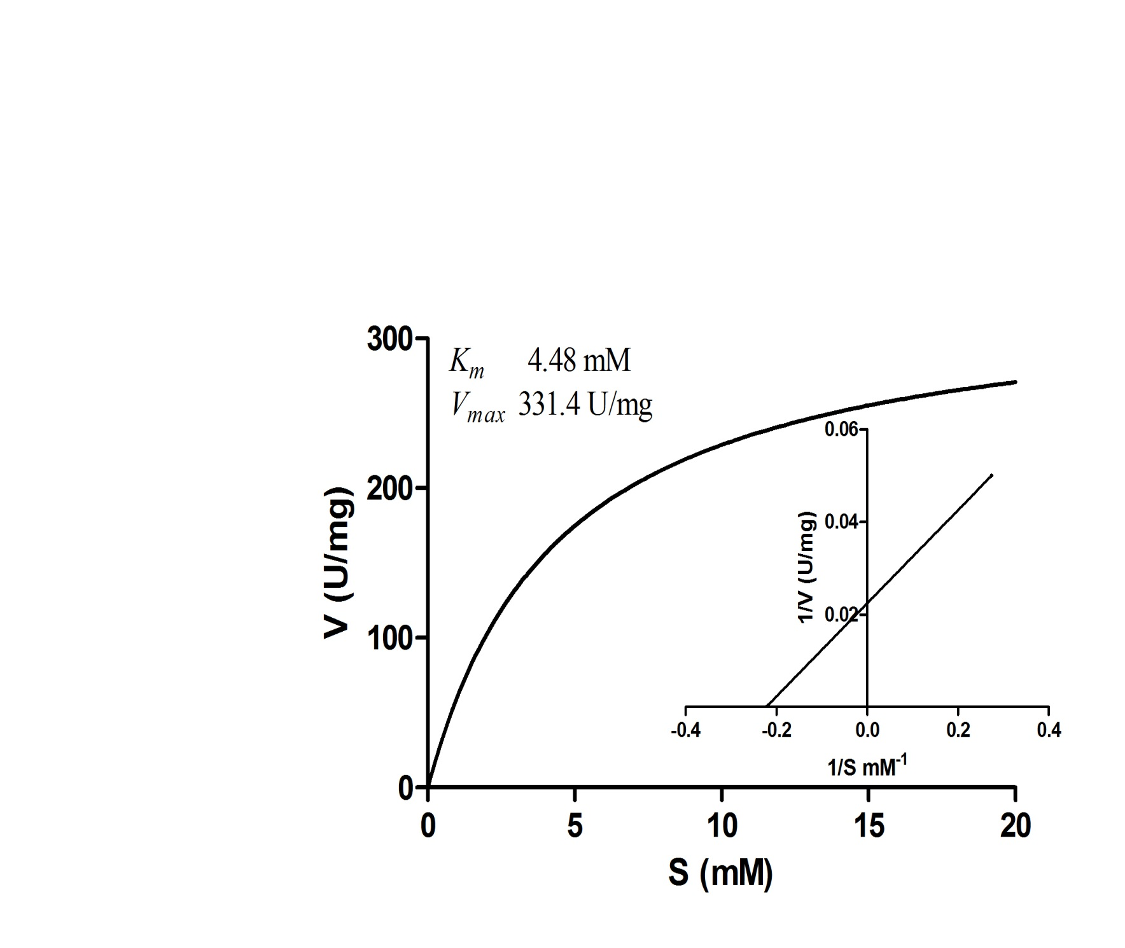
Fig 12. A plot of initial velocity [V] of Michaelis-Menten reaction versus the substrate concentration
[S] with purified amidase showing hyperbolic curve with an acetamide substrate. The K_{m} and
V_{max} for amidase are 4.48 mM and 331.4 U/mg of protein respectively. Inset: Lineweaver-Burk
showing the K_{m} and V_{max} for amidase 4.4 mM and 331.40 U/mg of protein respectively.

Slide 22
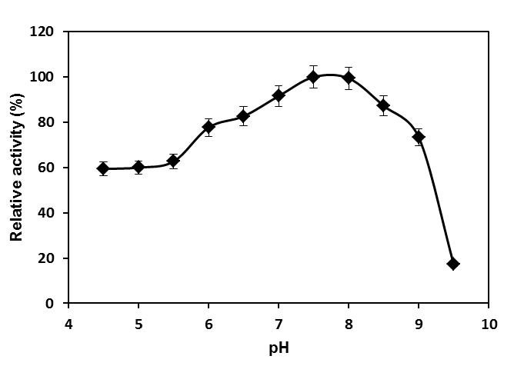
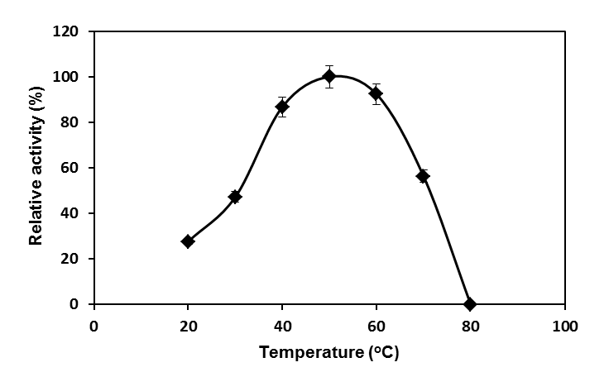
Fig 13. Effect of pH on amidase activity of Paracoccus
sp. SKG. The amidase activity at pH 7.5 was
considered as 100%.
Fig 14. Effect of temperature on amidase activity of
Paracoccus sp. SKG. The amidase activity at
50 ^{ο}C was considered as 100%.

Slide 23
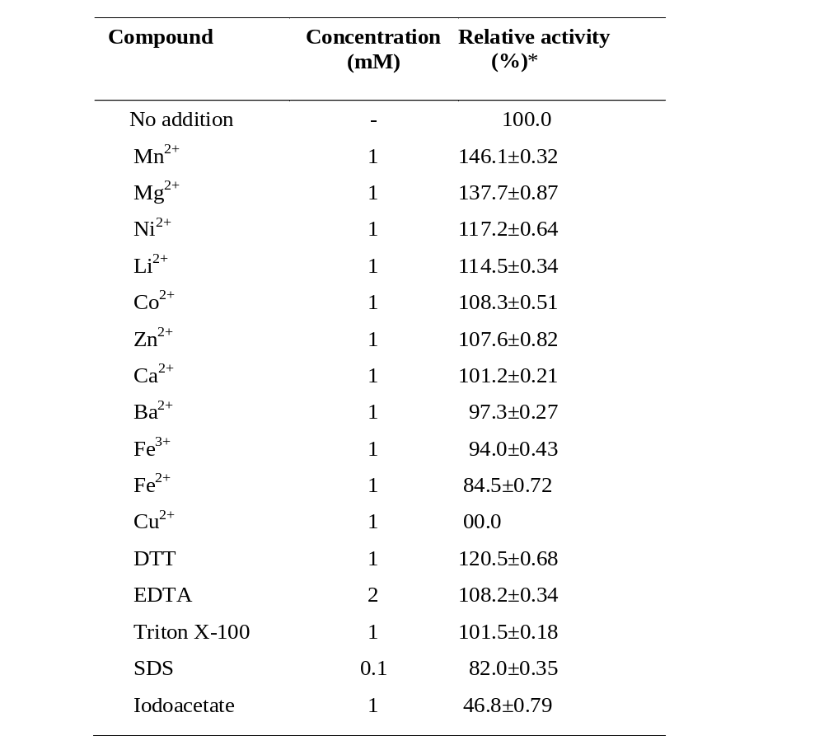
Table 5: Effect of various compounds on amidase activity.
* Amidase assay without compounds is considered as 100% and data represent the mean ± SD, n = 3.

Slide 24
V. Bioconversion
The conversion of one substance to another of higher industrial value by biological means.
Bioconversion is becoming essential to the fine chemical industry in that their customers demand single isomer intermediates.
In many cases, biocatalysis has replaced chemical catalysis because of
Higher enantioselectivity and higher regioselectivity in aqueous solution
Does not require protection and deprotection of functional groups
Better stability
Operates under milder conditions
Greater efficiency
Higher product yields

Slide 25
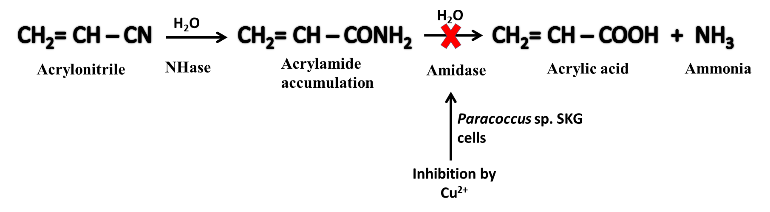
Biotransformation of Nitriles and Amides
Paracoccus sp. strain SKG: A potential biocatalyst for acrylamide
production
Amidases are considered to be -SH proteins because they are inhibited by heavy metals such as mercury, copper and lead.
The possible mechanism of the Cu²⁺ inhibition is due to heavy metals such as copper usually binds to the sulfhydryl group of cysteine in the active site of the enzyme leading to inactivation of the enzyme.

Slide 26
Acrylamide
Acrylamide an important chemical used as coagulator, soil conditioner and stock additive for treatment in leather and textile industry.
Acrylamide can be synthesized both chemically and enzymatically.
Chemical method has some disadvantages, such as the rate of formation of by-product, acrylic acid in larger quantity than acrylamide
and requiring high-energy input.
Microbial bioconversion of acrylonitrile using whole cells having NHase has received much attention because of environment-friendly features.
Acrylamide further transforms into acrylic acid through amidase catalysis , which is an undesirable feature.
Amidase-inhibited whole cells of Paracoccus sp. SKG as biocatalyst for the production of acrylamide in a batch reaction.

Slide 27
Preparation of Cu⁺² treated resting cells of Paracoccus sp. SKG for use in bioconversion
Cells were grown in MM1 medium with 1.5% acetonitrile
Log phase cells were harvested and washed with 50 mM PPB pH 7.2.
Cells were pre-incubated with 1mM CuSo₄
10 min at room temperature
Washed cells used for biotransformation
Notes:
a

Slide 28
Table 6: Optimization of reaction conditions for bioconversion of acrylonitrile to acrylamide by using preincubated whole cells of Paracoccus sp. SKG.
Sl No. | Reaction condition | Tested range | Optimum conditions
1 2 | CuSO₄ (mM) 50 mM potassium phosphate buffer (pH 6.0 – 8.5) | 1 - 10 6.0 - 8.5 | 1.0 7.5
3 | Temperature (^{ο}C) | 20-40 | 30
4 | Cells concentration (mg dcw/ml) | 0.5-10 | 2.0
5 | Acrylonitrile (% v/v) | 1 - 6 | 4.0
One unit of NHase activity was defined as the amount of enzyme converting 1 μmol of acrylonitrile to acrylamide per min/mg of dcw.

Slide 29
Bioconversion of Acrylonitrile : Reaction Mixture
Buffer | Potassium phosphate buffer (50 mM)
pH | 7.5
Substrate | Acrylonitrile , 4% (760 mM)
Biocatalyst | Preincubted cells of Paracoccus sp. SKG (2 mg dcm/ml)
Total reaction volume | 100 ml

Slide 30
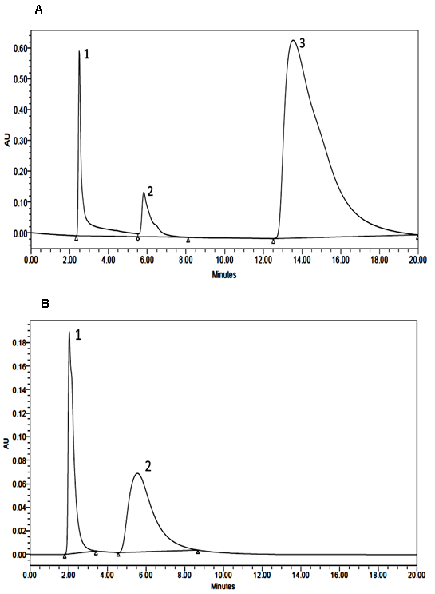
Fig.15. HPLC analysis of bioconversion
of acrylonitrile to acrylamide by
using whole cells of Paracoccus
sp. SKG.
(A) Whole cells without preincubation
with Cu²⁺.
(B) Whole cells preincubated with
Cu²⁺.
Retention time of
acrylamide: 2.3 min,
acrylonitrile: 5.7 min,
acrylic acid: 13.5 min.
A
B

Slide 31
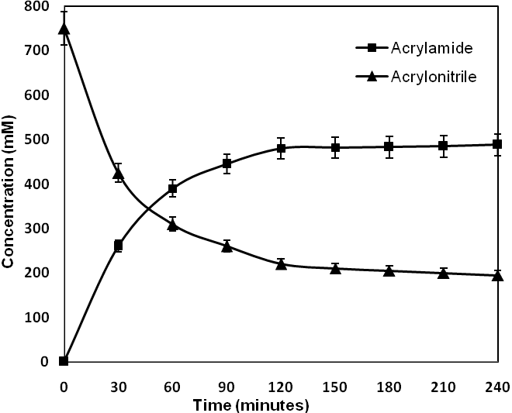
Fig 16. Time course conversion of acrylonitrile to acrylamide using preincubated whole cells of Paracoccus sp. SKG.
Acrylamide recovered kept overnight at 0–4 °C for crystallization and dried at room temperature and weighed.
The accumulation of acrylamide reached 2.7 g for 100 ml with 65%, i.e., 480 mM conversion.

Slide 32
Conclusions
The isolated bacterial strain Paracoccus sp. SKG is able to degrade aliphatic nitriles.
This strain has successfully removed 94 % of 1.5 % acetonitrile.
Amidase from nitrile degrading Paracoccus sp. SKG was purified to homogenity and characterized.
Further, the use of amidase-inhibited whole cells of Paracoccus sp. SKG was exploited as a biocatalyst for the production of acrylamide.
The accumulation of acrylamide reached 27 g/L with 65% conversion of acrylonitrile in 2 h.

Slide 33
Acknowledgements
Research collaborators
1. Dr. Dayananda Siddavattam
Department of Animal
Sciences,University of
Hyderabad,
Hyderabad, 500 046, India
Dr. Yogesh S. Shouche
National Centre for Cell Science
Pune University,
Pune-411 007, India
Funding agencies:
    DST
    DBT, Govt of India

Slide 34
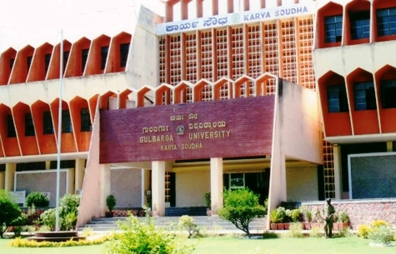
thank you…

