Slide 1
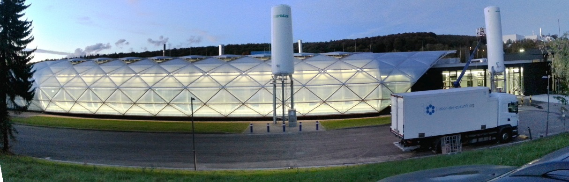
New routes in treating brain disorders
Dr. Sylvia Wagner
Preclinical Nanobiotechnology Group
Department of Bioprocessing and Bioanalytics
Fraunhofer IBMT
Sulzbach / Germany
Notes:
Thank you for the introduction and for the opportunity to present our results.
Hello everybody. Welcome you to my talk.
As said before the topic of my talk is “New routes in treating brain disorders”.

Slide 2
The shortage of drugs for the central nervous system
Causal interventions still lacking
  Current therapies only aim at easing symptoms
Substances may often show promising in vitro results, but fail in vivo.
Reason:
  > 98 % of all small molecule drugs cannot enter the brain*
  ~ 100 % of all large molecule drugs cannot enter the brain*
Why?
*PARDRIDGE, 2003
Notes:
Mayby you all know, that´s really hard to get drugs into the central nervous system. At the moment, in the most cases causal interventions are still lacking and current therapies only aim at easing symptoms.
The crux is, that substances may often show promising results in vitro, but fail in vivo, because about 98 % of all small molecules and nearly 100 % of all large molecules cannot enter the brain. But Why?

Slide 3
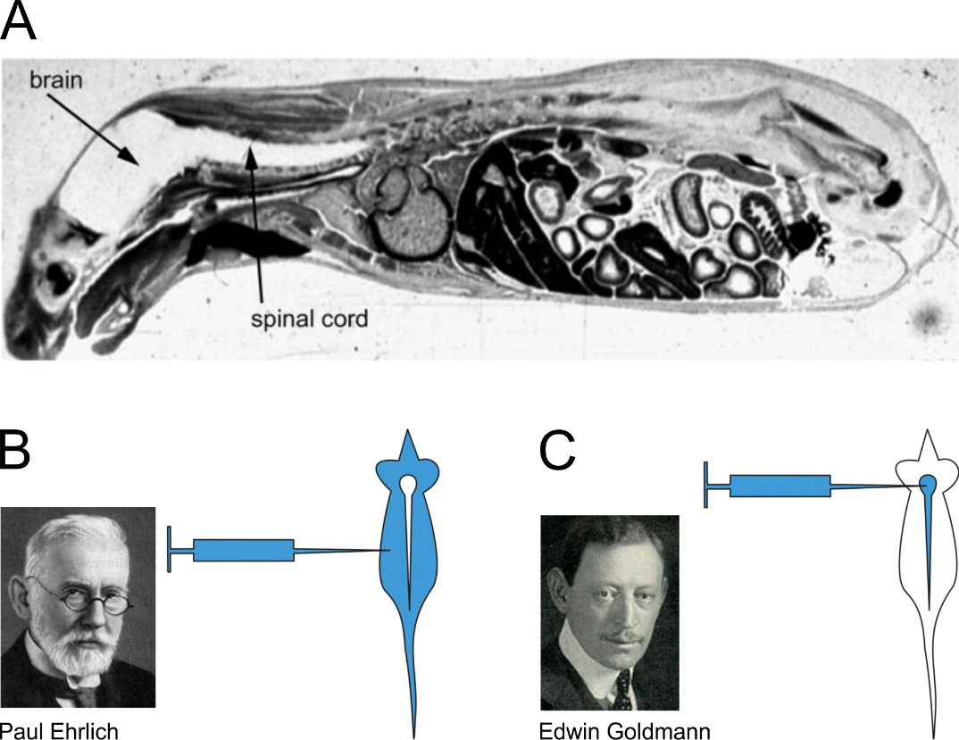
The blood-brain barrier guards our central nervous system
The blood-brain barrier restricts body distribution of substances. A Intravenous injection of radiolabelled histamine in mouse (figure copied from Pardridge 2005). B Scheme of first experiment that hinted at the existence of a blood-brain barrier. C Correct verification experiment.
Notes:
A really tight barrier exits in our body called the blood-brain barrier. The blood-brain barrier restricts the body distribution of the substances. In picture A you can see a intravenous injection of radiolabeled histamine. Al parts of the body were colored exepted the brain and the spinal cord. At the end of the 19th century Paul Ehrlich´s experiment gaves the first hind at the existence of the blood-brain barrier. He injected aniline dyes into mices and sawed that all parts of the body were colored exepted the brain and the spinal cord. His student Edwin Goldmann did the correct verifying experiment and injected the dye into the brain and could detect that only the brain and the spinal cord were stained. Thus, the existance of the blood-brain barrier was verfied.

Slide 4
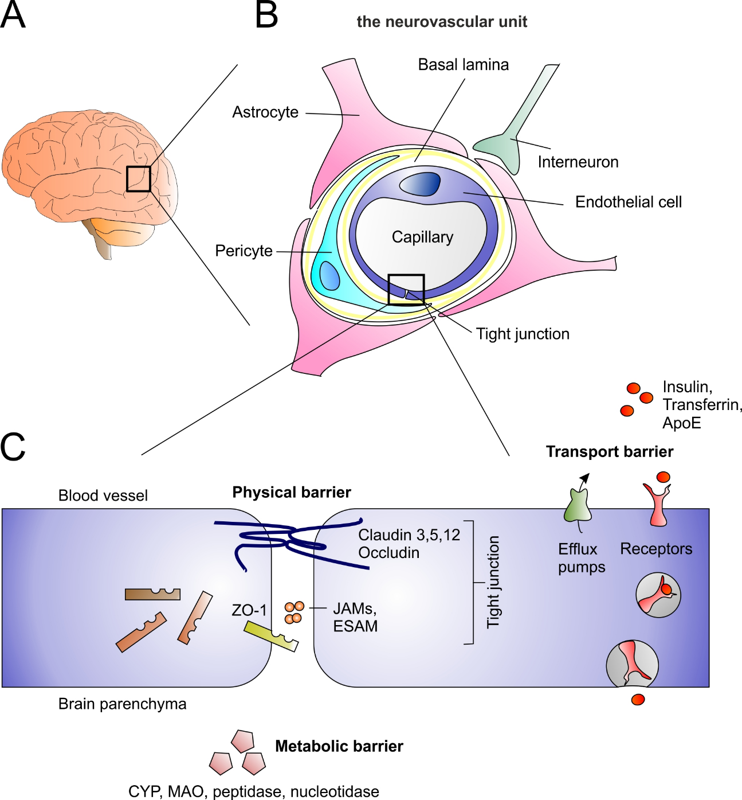
    One barrier with manifold faces:
    Physical, Transport and Metabolic barrier
Modified after Abbott, Rönnbäck and Hansson 2006
Notes:
The BBB is a physical, transport and a metabolic barrier which mainly consists of the brain capillary endothelial cells. Tight junctions close the intercellular space between these cells and only substances of which a transporter or a receptor exists can be transported over the BBB.

Slide 5
    Today’s strategies for blood-brain barrier circumvention
 | Invasive | Non-invasive
Possibilities | Osmotic disruption of BBB integrity Intraventricular / intracerebral injection Intracerebral implantation of depots | Drug modification Intranasal application (olfactory route) Inhibition of efflux transporters Carrier-mediated transport
Concerns | High risk for complication Intracranial infections Brain endema Expensive Long reconvalescence phase | Possible loss of drug activity Adverse side effects (P-gp inhibition) Low bioavailability (olfactory route)
Adapted and modified after WOHLFAHRT et al., 2011
Notes:
Therefore many strategies for BBB circumvention exit. A really brute one are the invasive osmotic openting of the BBB or the intraventricular injection, for example. But these methods have a high risk for complications and more sophisticated are the non-invasive possibilities. For example the carrier-mediated transport of drugs over the BBB.

Slide 6
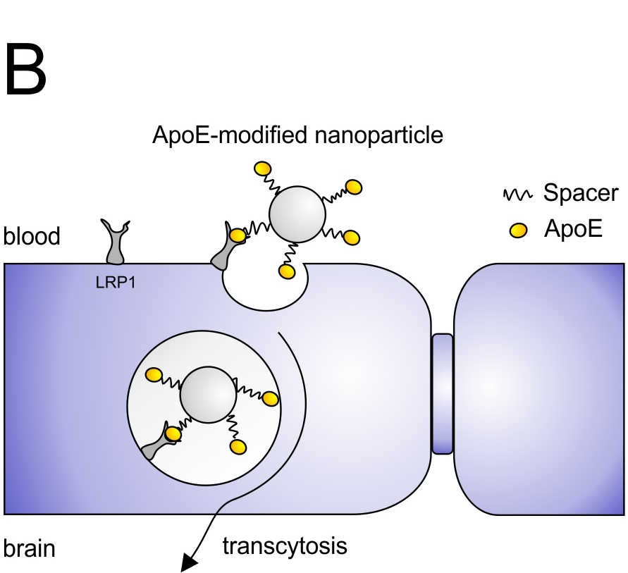
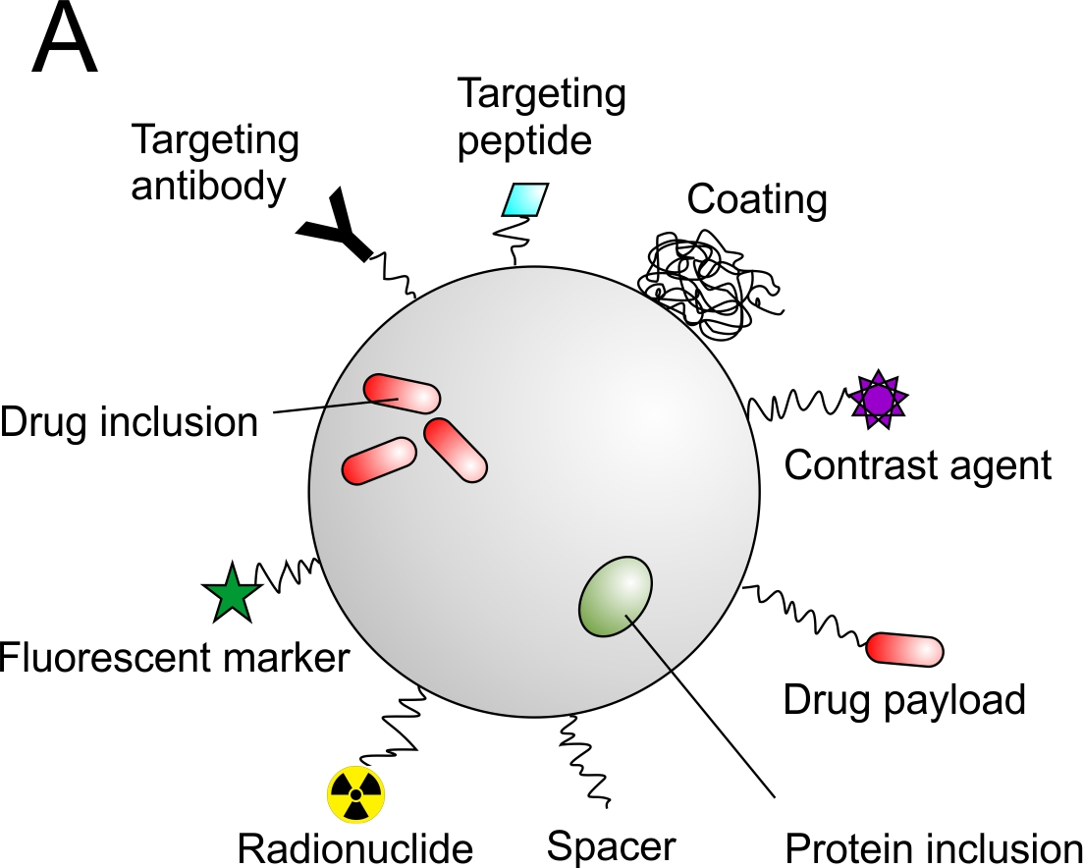
      Trick the body: Nanoparticles as drug carriers
Possible ligands for BBB transport:
ApoE
ApoAI
Transferrin
Insulin
Anti-Insulin receptor antibodies
…
< 1000 nm
Minimal expectations for clinical application :
non-toxic, biodegradable, non-immunogenic, non-inflammatory, functionally targeted,
prolonged circulation in the bloodstream
modified after RE et al., 2012
Notes:
We use nanoparticles in the range of 1 to 1000 nm as drug carriers. The matrix material are biodegradable polymers like human serum albumin, poly lactic acid or other natural and synthetic polymers. These nanoparticles are non-toxic, biodegradable, non-immunogenic, non-inflammatory, drugs or contrast agents can be incorporated or bound to the surface. Furthermore, they can be functionalized for a specific targeting with antibodies, peptides or other ligands. A really prominent example for crossing the BBB is the modification with ApoE. I will come up to this point later on.
But there are also some other ligands enabling the transport over the BBB like ApoAI, transferrin, insulin and some more.

Slide 7
      Trick the body: Nanoparticles as drug carriers
Table: Selected examples of drugs bound to nanoparticles for brain delivery in vitro/ in vivo. Adapted and modified after WOHLFAHRT et al. 2012
Drug | Type of action | Basis material | Surface modification
Campthotecin | Anticancer drug | SLN | Poloxamer 188
Dalargin | Analgesic drug | PBCA | Tween®80
Dexamethasone | Steroidal drug | PLGA | Alginate hydrogel
Doxorubicin | Anticancer drug | PBCA | Tween®80
Etoposide | Anticancer drug | Tripalmitin | Without coating
Gemcitabine | Anticancer drug | PBCA | Tween®80
Kyotorphin | Analgesic drug | PBCA | Tween®80
Loperamide | Opiate receptor agonist | PBCA, HSA, PLGA | Tween®80, ApoE3, ApoA1, ApoB100, (R)-g7 peptide
Methotrexate | Anticancer drug | PBCA | Tween®80
Obidoxime | Acetylcholinesterase reactivator | HSA | Apo E
Rivastigmine | Anti-Alzheimer's drug | PBCA | Tween®80
Sulpiride | Atypical antipsychotic drug | PLA | Maleimide PEG
Tacrine | Anti-Alzheimer's drug | PBCA | Tween®80
Temozolomide | Anticancer drug | PBCA | Tween®80
Tubocurarine | Muscle relaxants | PBCA | Tween®80
Notes:
This table gives you an overview about the different drugs which could be already transported over the BBB and the different basis materials and surface modifications.

Slide 8
  A plethora of nanoparticle applications -
  Painkillers for Alzheimer’s disease
A drug may impact positively, but cannot enter the brain
Pack the drug in nanoparticles and fasciliate transport via brain specific transporters!
Problem
Approach
Alzheimer's disease prevalence rises dramatically
Nanoparticles against Neurodegeneration:
Revisit flurbiprofen as an anti-Alzheimer’s disease drug
Notes:
Now, I will give you an example for an successful in vitro application of such nanoparticles in the field of Alzheimer´s disease therapy. The prevalence for Alzheimer´s disease rises dramatically in the next years, but promising drugs cannot enter the brain. Therefore, our approach was to incorporate the drug into nanoparticles and transport over the BBB. We revisited flurbiprofen as an anti-Alzheimer´s disease drug.

Slide 9
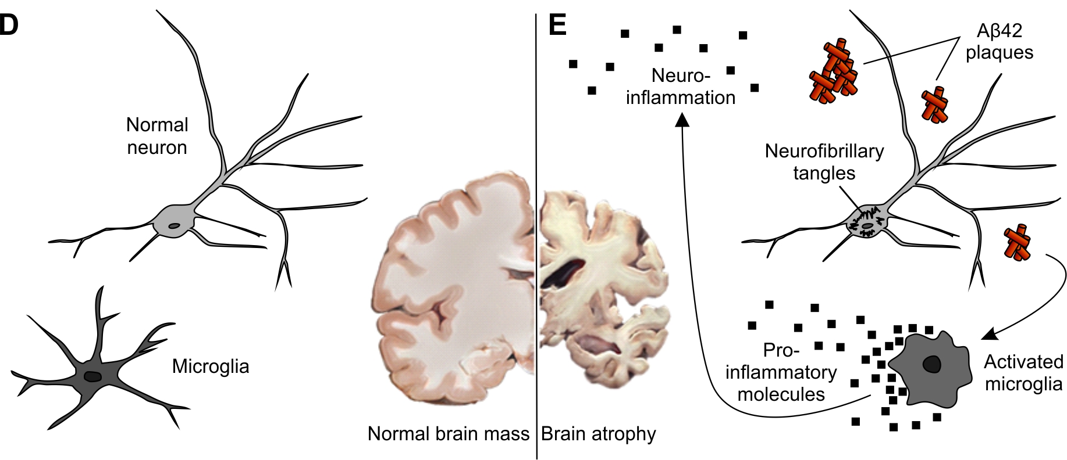
      Alzheimer’s disease pathology
Healthy
Diseased
Notes:
Why exactly people develop Alzheimer’s disease is not known up to today. Multiple factors seem to play a role. The age is the main risk factor, genetics play a role, but many questions remain. One fact is assuered, in the case of Alzheimer´s disease such Aß 42 plaques in the brain can be found. Which is today the most common hypothesis, that these aggregated amyloid β peptide plaques are a causing event in AD.

Slide 10
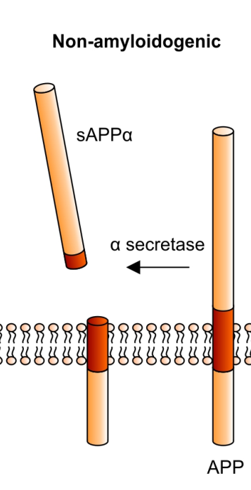
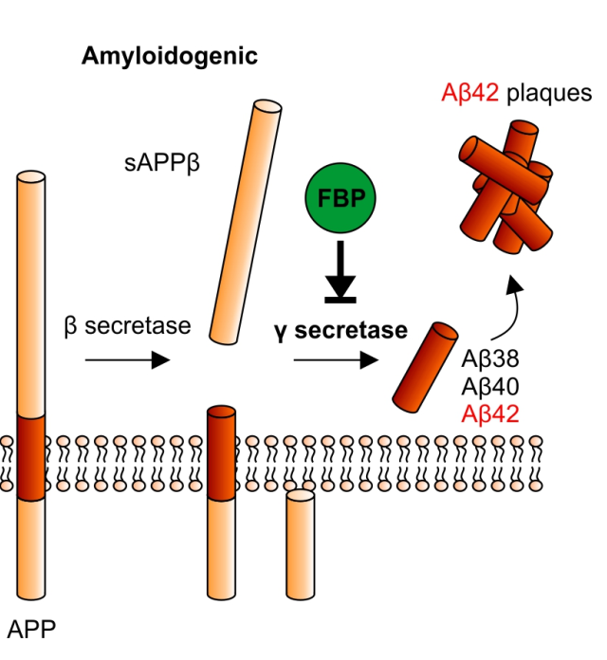
Who gets Alzheimer’s? Who doesn’t?
Long-term high-dose NSAID intake decreases risk for Alzheimer‘s disease
FBP
FBP= flurbiprofen
NSAID=non-steroidal antiinflammatory drug
Notes:
Aβ plaques derive from the amyloid precursor protein (APP) that is naturally expressed in the brain. α, β and γ secretases, sequentially cleave the transmembrane APP. α secretase cleaving results in a soluble APPα fragment, which will not form plaques. It is non-amyloidogenic. Cleaving of β and γ secretases results in the amyloidogenic pathway leading to the neurotoxic peptide composed of 42 amino acids the Aβ42, which is highly hydrophobic and tends to form complexes – resulting in the characteristic extracellular plaque formation.
The modulation of the secretase activity is one starting point for a future anti-Alzheimer’s disease therapy to reduce Aβ42 formation.
Retrospective, epidemiologic studies revealed that patients suffering from rheumatoid arthritis are less likely to develop Alzheimer’s disease, due to their pain medication.
Their long-term high-dose non-steroidal anti-inflammatory drug intake like R-flurbiprofen decreases the risk for Alzheimer’s disease because NSAID can modulate the γ secretase activity.

Slide 11
Long-term high-dose NSAID intake decreases risk for Alzheimer‘s disease
FBP
FBP
Embed flurbiprofen into nanoparticles for targeted transport across the BBB
Poly(lactic acid) nanoparticle
FBP
FBP
FBP
Phase III clinical trials failed (tarenflurbilTM) →
Flurbiprofen cannot reach the brain in sufficient doses
Notes:
But R-flurbiprofen failed in a phase III clinical trial because it did not reach the brain in a sufficient manner.
Therefore, we incorporated flurbiprofen in poly(lactic acid) based nanoparticles and used them as Trojan horses.

Slide 12
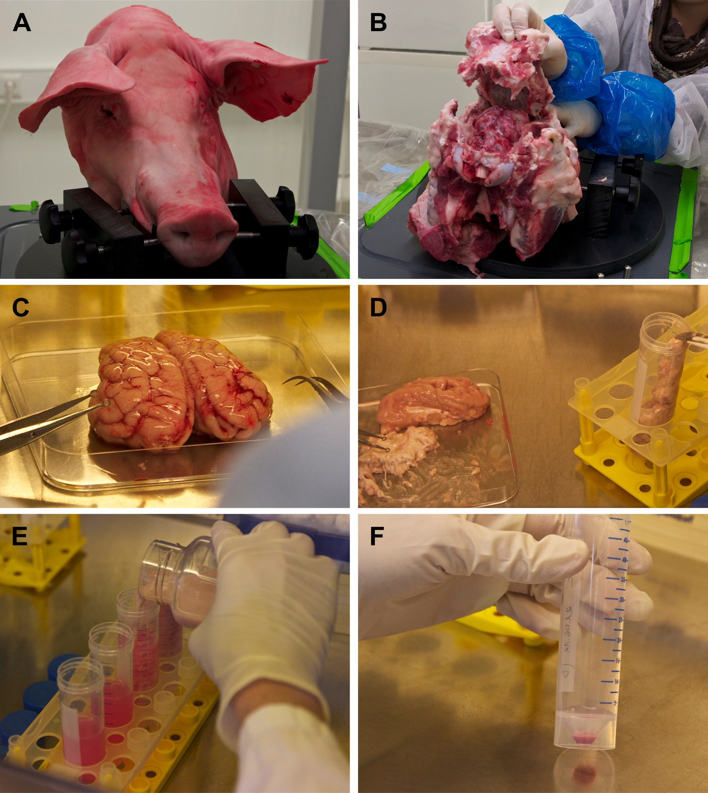
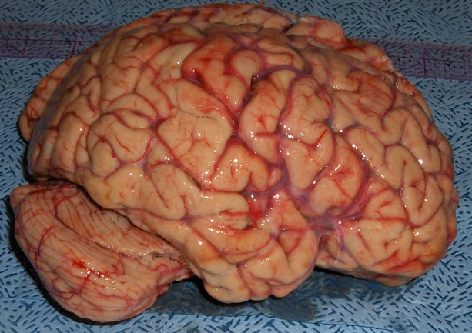
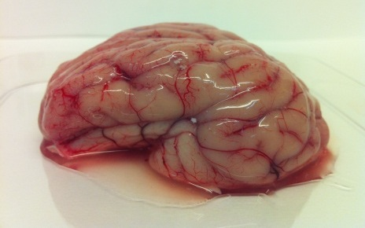
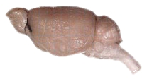
A primary porcine in vitro blood-brain barrier model
Human
>1000 g
Pig
~180 g
Mouse
~0.4 g
Brain weights: http://mste.illinois.edu/malcz/DATA/BIOLOGY/Animals.html
Notes:
Due to the similarity of the human brain and the pig brain, our in vitro BBB model, we used, consists of freshly isolated primary porcine brain capillary endothelial cells (pBCEC) and displays excellent barrier characteristics.

Slide 13
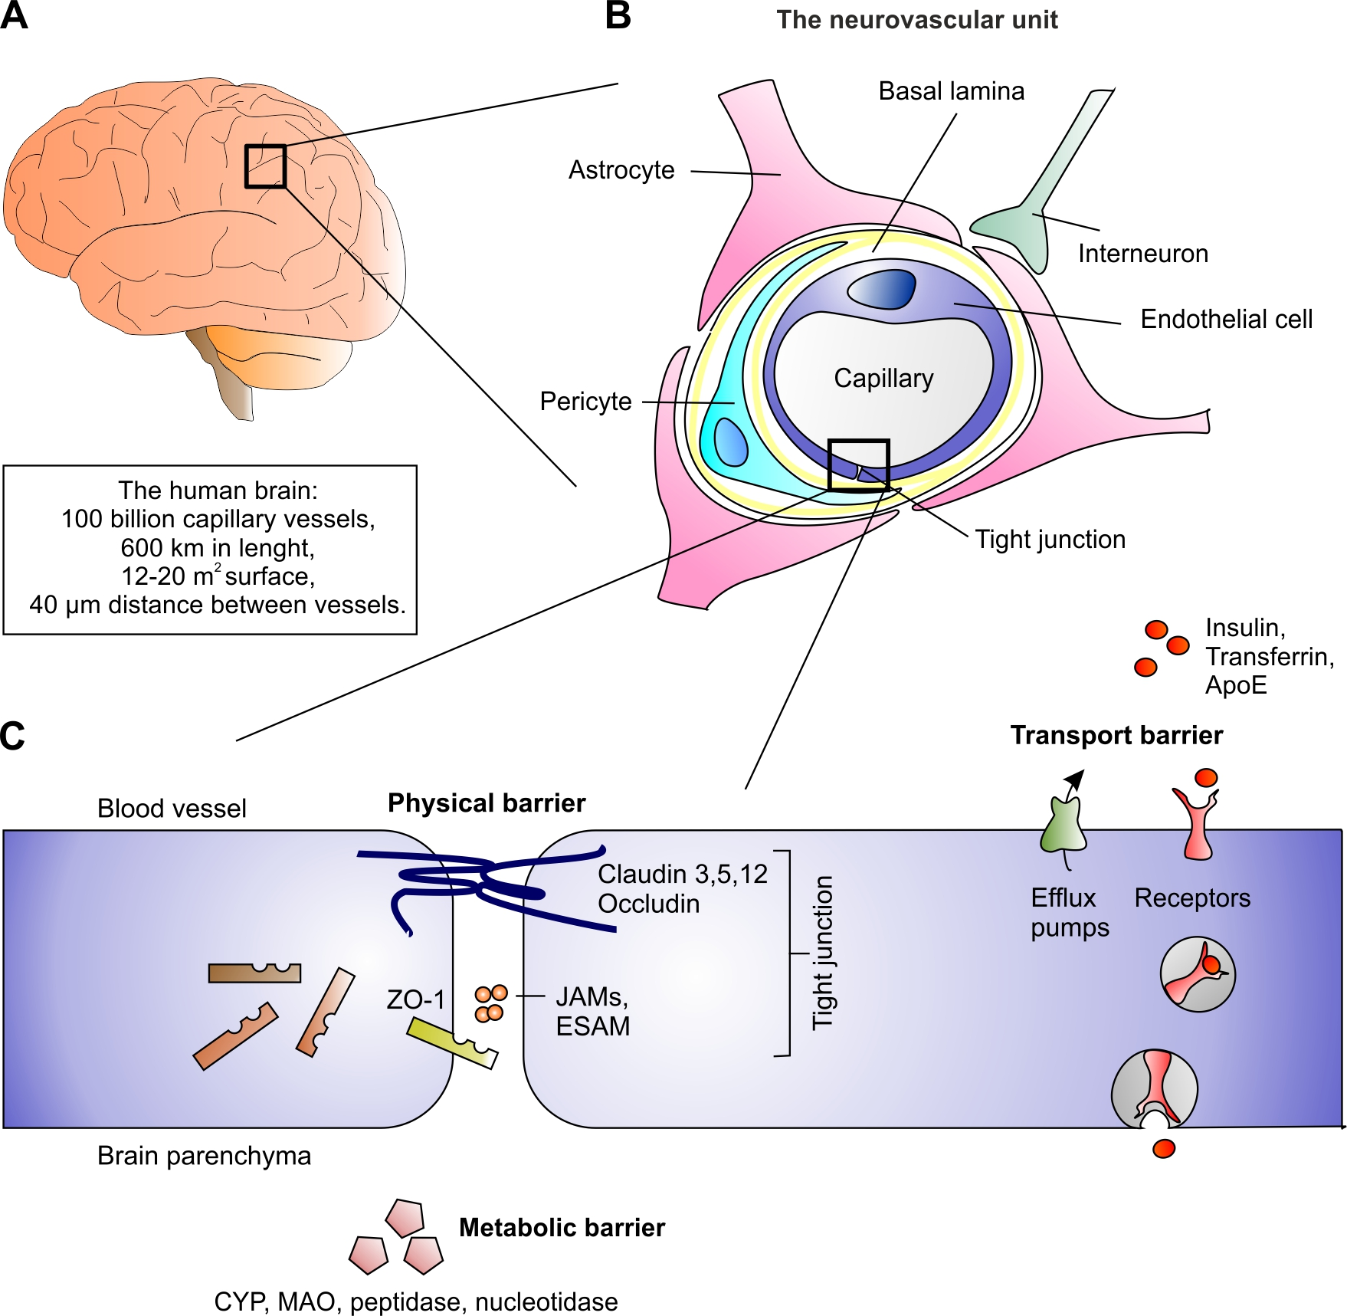
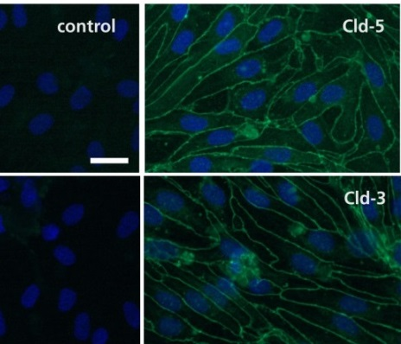
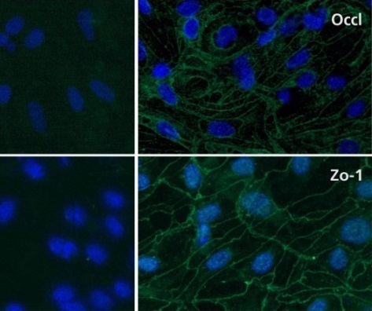
A primary porcine in vitro blood-brain barrier model – Quality checks
Scale bar = 50 µm.
Notes:
As showed before the tight junctions are really important for an intact BBB, therefore we checked for these tight junction proteins like claudins, occludin, ZO-1 and so on in our model cells
and found that pBCEC robustly express TJ proteins.
Here the most important ones: claudin 3 and 5 and occludin and ZO-1 in green .
The blue is of course the DAPI-staining of the nucleus.

Slide 14
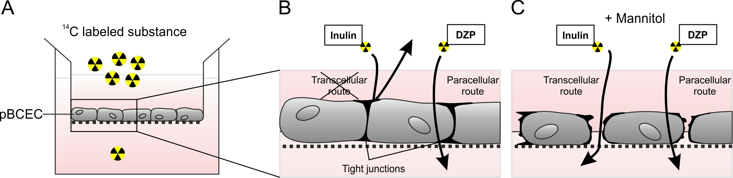
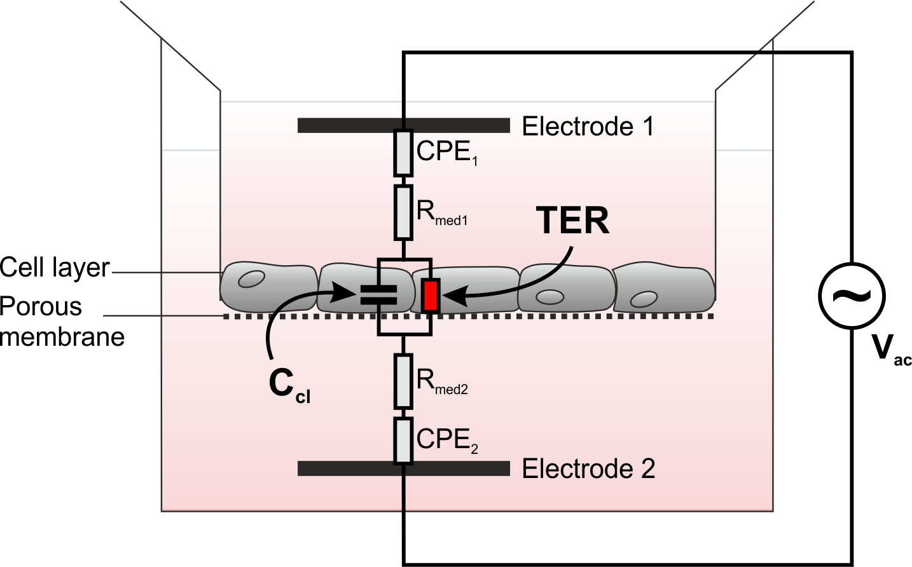
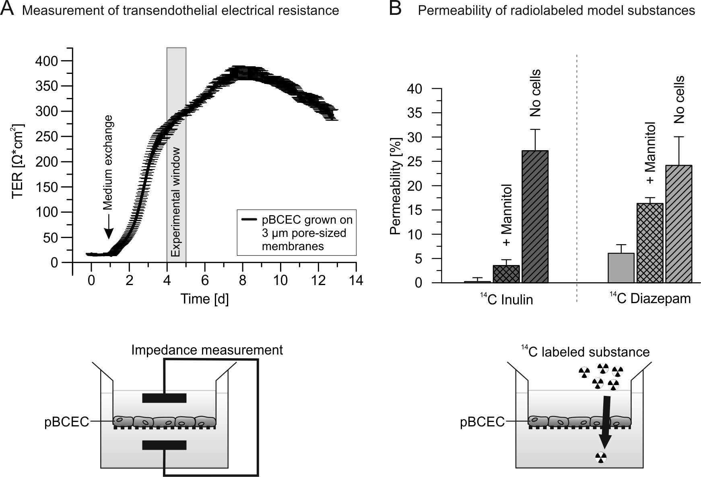
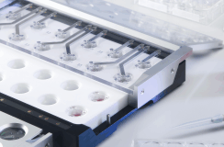
A primary porcine in vitro blood-brain barrier model – Quality checks
Transendothelial electrical resistance (TER)
Permeability assays
Paracellular route
Transcellular route
Paracellular route
Transcellular route
cellZscope® device, nanoAnalytics, Germany
DZP= Diazepam (Valium®)
Notes:
Furthermore, the transendothelial electrical resistance and the permeability are important characteristics.
We measured the TER by such an cellZscope device and get values above >300 Ω*cm², which is really sufficient for in vitro cell culture.
Furthermore the permeability assay with ¹⁴C inulin as paracellular marker and diazepam as transcellular marker confirmed the density of this barrier model. The permeability of inulin was below 0.2 %. The use of mannitol leads to an osmotic opening and disruption of the BBB.
These data verified the suitability of our model and therefore we used it for our experiments.

Slide 15
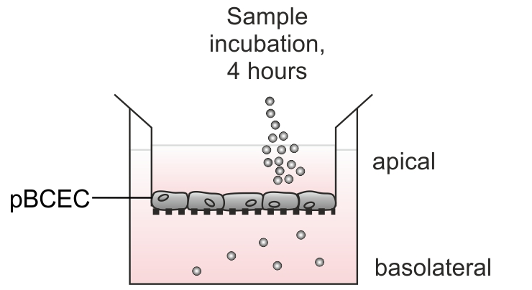

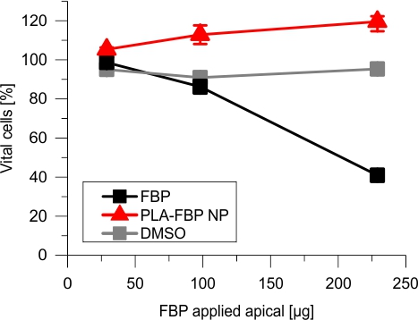
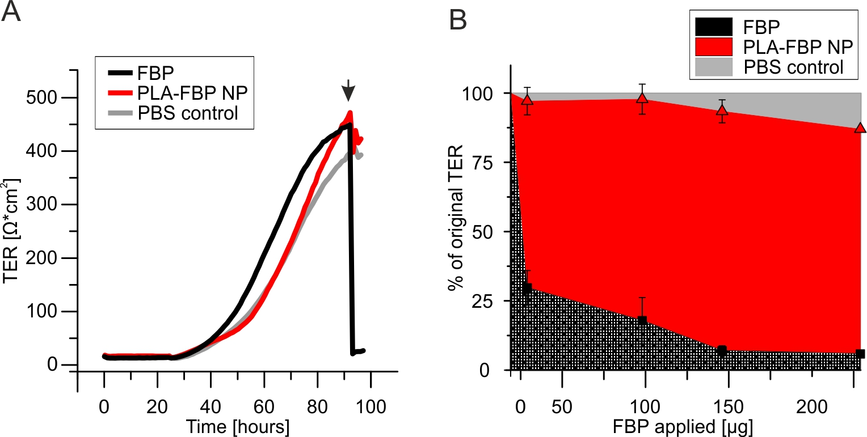
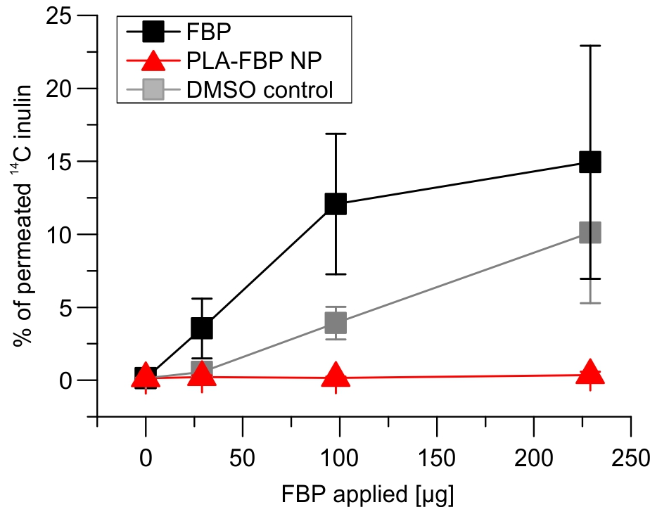
Do pBCEC tolerate flurbiprofen-loaded nanoparticles (PLA-FBP NP)?
+¹⁴C inulin
Cellular viability
Transendothelial electrical resistance
Permeability of paracellular marker
Notes:
First of all, we checked whether the pBCEC can tolerate the flurbiprofen-loaded nanoparticles.
For all experiments we used such a transwell system, where the cells grow on a microporous membrane. The apical compartment represents the blood compartment, where the nanoparticles were incubated and the basolateral compartment represents the brain side. This medium can be collected for further investigations.
The cellular viability assay shows you that the nanoparticles in red are not toxic for the cells, but the free drug is cytotoxic.
PLA‑FBP NP application hardly influences the TER as well as the still low ¹⁴C inulin permeability implying low cytotoxic potential of the nanoparticles.

Slide 16
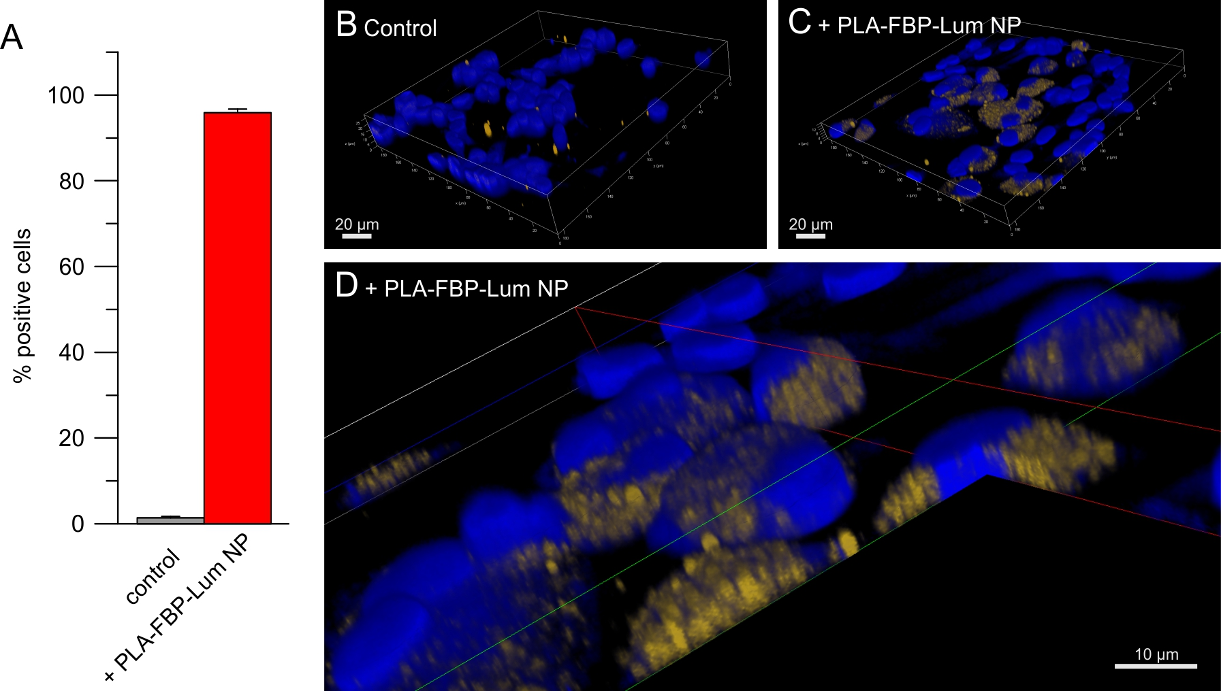
Do PLA-FBP NP interact with in vitro BBB cells?
Flow cytometry and confocal laser scanning microscopy
Notes:
The next step was to check whether the nanoparticles interact with our in vitro BBB model cells.
Indeed, we could verifiy by flow cytometry that they bind to the cells and were taken up, shown by confocal laser scanning microscopy. You can see in picture D the intracellular uptake of the yellow-labelled nanoparticles into the blue stained cells.

Slide 17
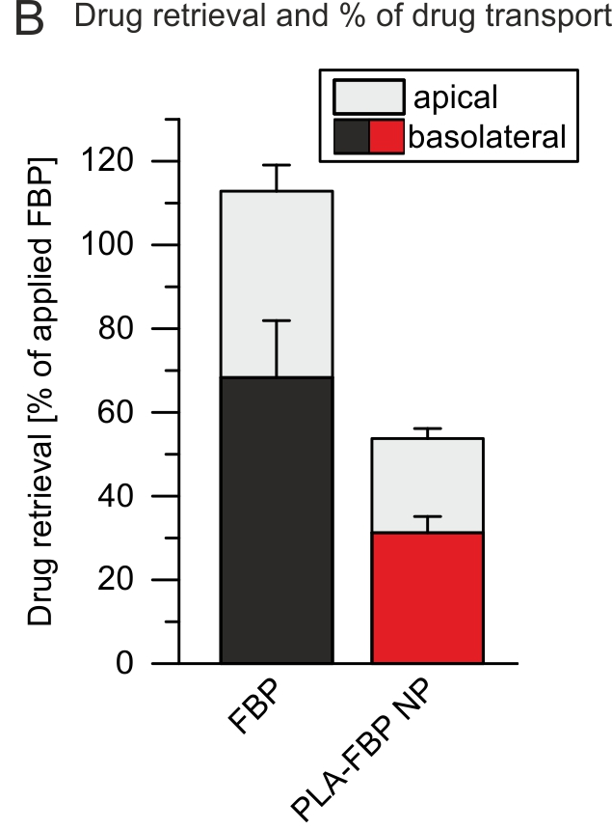
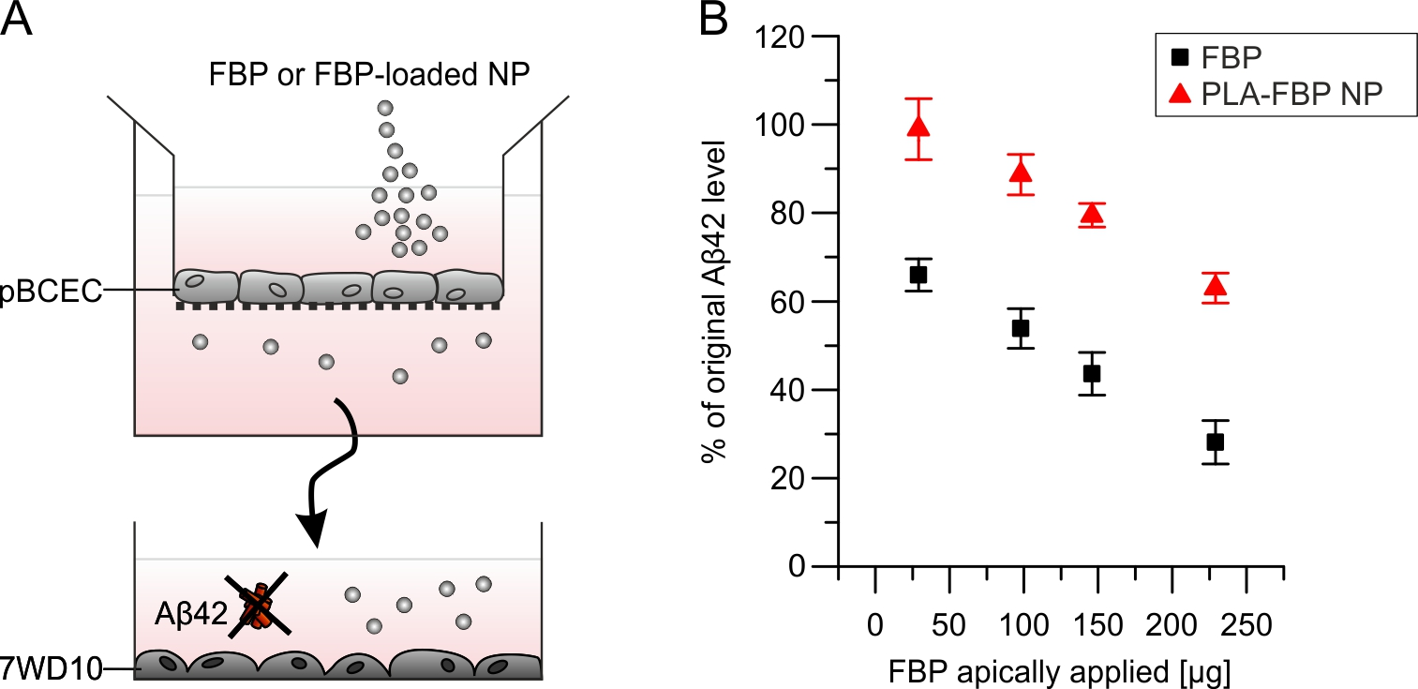
Can PLA-FBP NP cross the BBB and lower Aβ42 burden?
HPLC analysis, Aβ42-detecting ELISA
Drug transport & retrieval
Aβ42 reduction
Less total drug retrievable:
NP still endocytosed?
Actual drug content lower?
Optimization Potential!
Alzheimer‘s disease model
PLA-FBP NP lower Aβ42
FBP destroys TER and impairs barrier → No suitable control
Notes:
But the most interesting question was: Can the flurbiprofen loaded nanoparticles cross the BBB model and lower the Aß 42 burden?
When we incubated PLA‑FBP NP in the “blood” compartment, we detected FBP in the “brain” compartment after 4 hours by high-performance liquid chromatography. However we have to notice, that we could not findthe total amount of incubated drug in the case of nanoparticle application. Maybe the nanoparticles are still endocytosed and did not release completely the incorporated drug. At this point, it is still optimization potential.
In a next step we collected the medium from the lower compartment and transfer it to Aß 42 producing Alzheimer´s disease model cells. By ELISA, we could measure the Aß 42 reduction. Ostensibly, the free drug seems to reduce the Aß42 level better than the nanoparticles. But please keep in mind the free drug was cytotoxic for the upper endothelial cells. Therefore, in this case the BBB was leaky and the free drug is not the suitable control.
In conclusion, with this experiment we could show the transport of a usually nonpermeable drug across an advanced in vitro BBB model.

Slide 18
      Trick the body: Nanoparticles as drug carriers
< 1000 nm
Minimal expectations for clinical application :
non-toxic, biodegradable, non-immunogenic, non-inflammatory, functionally targeted,
prolonged circulation in the bloodstream
modified after RE et al., 2012
Notes:
Now let me say a few words to the ApoE-modification. We know from earlier experiments that modification of the nanoparticles with ApoE leads to an enhanced uptake of the nanoparticles due to the interaction between ApoE and the LRP1 receptor, expressed on the surface of brain capillary endothelial cells.

Slide 19
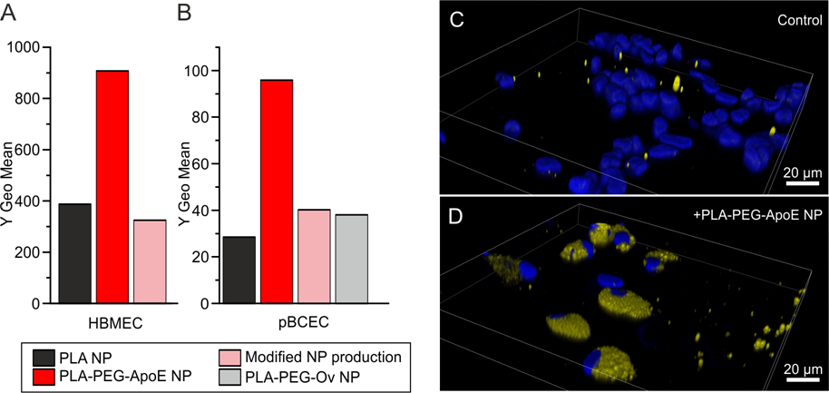
    ApoE3 -modified nanoparticles bind to and enter brain endothelial cells
Pilot experiments n=1
Notes:
In a pilot experiment we therefore modified our nanoparticles with ApoE and did the same binding and uptake studies by flow cytometry and confocal laser scanning microscopy. As you can see, the binding of the ApoE-modified nanoparticles to the cells is much better than the unmodified ones and they were also taken up.
In the future we have now to combine the drug loading with the ApoE modification.

Slide 20
Résumé
pBCEC
  Are suited as an in vitro BBB model
  Tolerate PLA-FBP NP
  Bind to and take up PLA-FBP NP
PLA-FBP NP
  Do not impair barrier integrity
  Transport the incorporated drug across the BBB model
  Reduce Aβ42 in the „brain“-compartment
ApoE
  Is a suitable ligand for PLA-FBP NP
  Increases binding and uptake capacity of PLA NP
Notes:
Let me summe up:
The freshly isolated porcine brain capillary endothelial cells are a suitable BBB model.
They tolerate the flurbiprofen-loaded nanoparticles, the free drug is cytotoxic for them.
The nanoparticles bind to the cells and were taken up.
The drug-loaded nanoparticles do not impair the barrier integrity,
They transport the incorporated drug across the in vitro BBB model
And reduce the Aß42 level in an AD model.
ApoE is a suitable ligand for poly(lactic acid) nanoparticle modification
And for improvement of the binding and the uptake.
In summary:
Nanoparticles are a rea.lly promissing tool for transport drug over the BBB

Slide 21
Acknowledgement
Fraunhofer IBMT:
  H. von Briesen
  J. Bungert and S. Wien
  J. Stab
Westfälische Wilhelms-University:
  K. Langer
  I. Zlatev
  B. Raudszus
Goethe-University:
  J. Kreuter
  A. Zensi
  J. Kufleitner
  M. Dadparvar
Johannes Gutenberg-University:
  C. Pietrzik
  S. Meister
  W. Maier
NIH:
  T. Vogel
Bundeswehr Institute of Pharmacology and Toxicology:
  F. Worek
Funding
Bundesministerium für Bildung und Forschung (BMBF) (Project 01EW1009 and 01EW1010)
Bundesamt für Wehrtechnik und Beschaffung (Project U2.3 E/UR3G/5G031/5A802)
Notes:
Last but not least, I would like to thank all my colleagues and partners who have collaborated on these projects.
And thank you for your attention.
Are there any questions?

