Slide 1
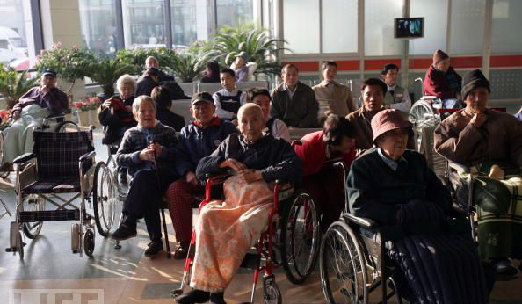
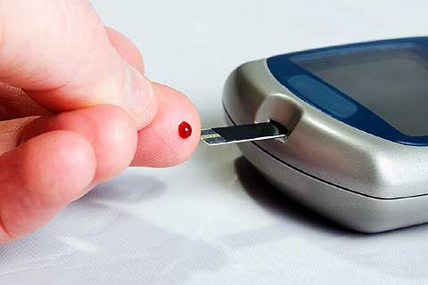
User profiles and personal in the design and development of consumer health technologies
Sweta Sneha, PhD

Slide 2

Notes:
Graying of the globe

Slide 3

Notes:
Rising expenses in healthcare across the globe

Slide 4
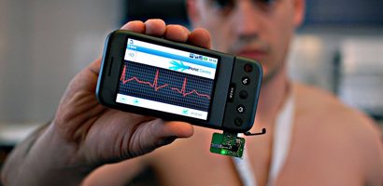
Notes:
Consumer Health Technologies (CHTs)

Slide 5
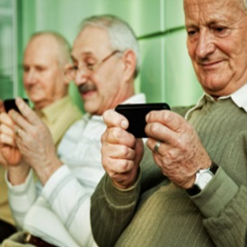
Notes:
Problems with Adoption and Frustration among Chronic ill aging population with CHTs

Slide 6
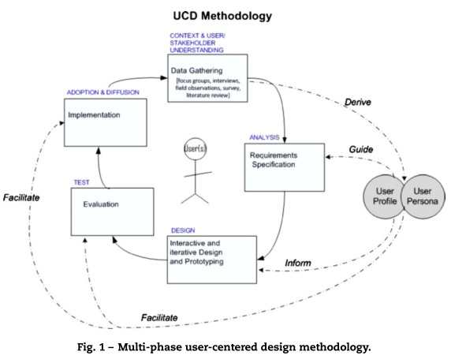
Notes:
User Centered Design - apotentil way to mitigate design issues

Slide 7
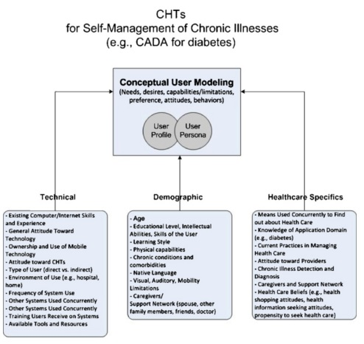
Notes:
User Profile and Persona - Study participants

Slide 8
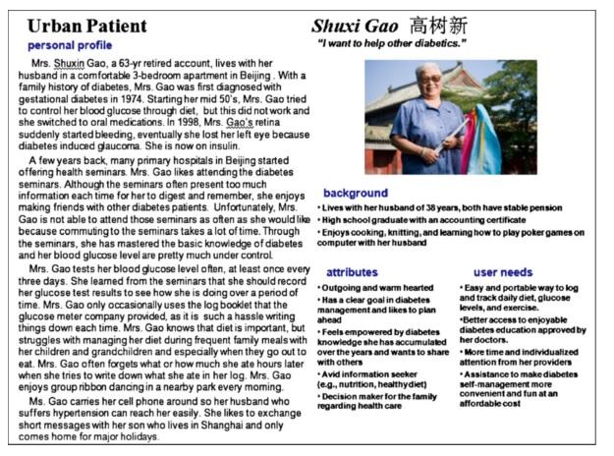
Notes:
User Profile and Persona - Study participants

Slide 9
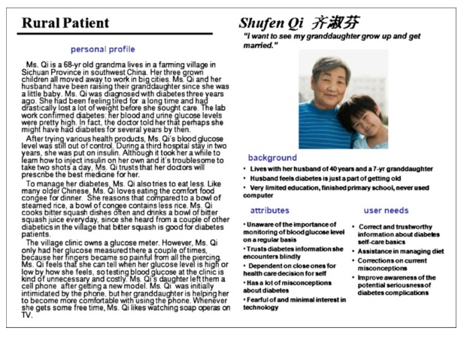
Notes:
User Profile and Persona - Study participants

Slide 10

Notes:
Result an Application reflecting user needs

Slide 11
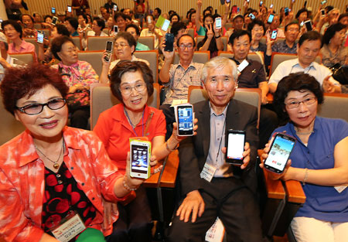
Notes:
high adoption and usage

Slide 12
Thank you!

