Slide 1

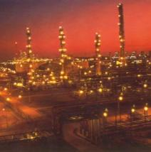
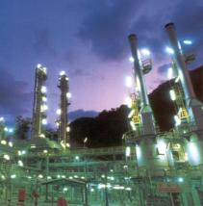
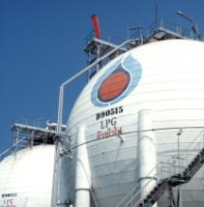
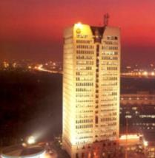
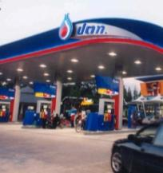


5th World Congress on Biotechnology, Valencia, Spain
June 25th -27th , 2014
Production and Application of Lipopeptide Biosurfactant for Dispersing Oil Spill in Seawater
Suwat Soonglerdsongpha¹, Witchaya Rongsayamanont², Nichakorn Khondee²,
Onruthai Pinyakong², Ekawan Luepromchai²
¹ Environmental Research and Management Department, PTT Research and Technology Institute, Thailand
² Department of Microbiology, Faculty of Science, Chulalongkorn University, Thailand

Slide 2
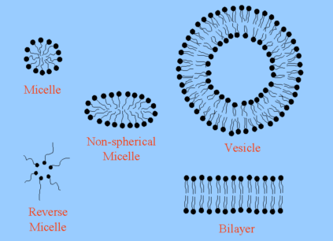
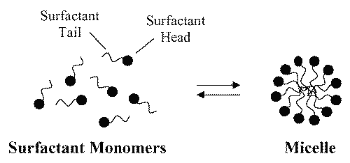
Biosurfactant
Biosurfactants are surface-active biomolecules produced by microorganisms.
Biosurfactant
Hydrophilic Moiety
Hydrophobic Moiety
Acid
Peptide cations or anions
Mono-, di- or polysaccharides
Unsaturated or saturated hydrocarbon chains
Fatty acids
Hydrophilic Moiety
Hydrophobic Moiety
(Surfactant head)
(Surfactant tail)
CMC
(http://www.ualberta.ca/~csps/JPPS8(2)/C.Rangel-Yagui/solubilization.htm)
CMC = Critical Micelle Concentration
(http://people.umass.edu/mcclemen/Group.html)

Slide 3
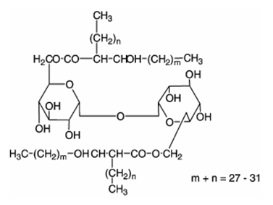
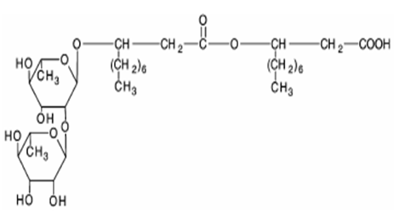
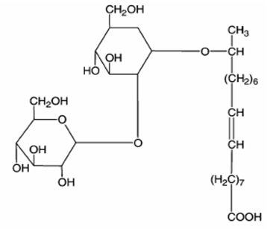
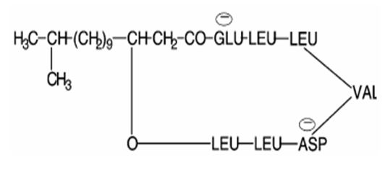
Biosurfactant
Classification of Biosurfactants
Glycolipids – Sophorolipids, Trehalolipids, and Rhamnolipids
Lipopeptides and Lipoproteins
Fatty acids
Phospholipids
Neutral lipids
Polymeric biosurfactants
Particulate biosurfactants
Trehalolipid
Rhamnolipid
Sophorolipid
Surfactin (Lipopeptide)
http://biotechsupportbase.com/wp-content/uploads/2014/02/surfactants.png

Slide 4
Biosurfactant
Advantages
Non-toxic or low in toxicity
Biodegradable
Wastes can be used as raw materials
Able to work at critical condition
Wide applications
Limitations
Low production yield
High production cost

Slide 5
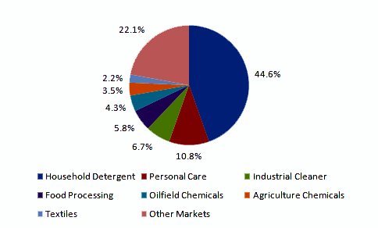
Applications of Biosurfactants
Biosurfactant applications
Household detergent
Personal care
Industrial cleaner
Food processing
Oilfield chemicals
Agriculture chemicals
Textiles
Others
Environmental applications
Soil bioremediation
Oil dispersant
Biosurfactant market volume share (by application, 2013)
(http://www.grandviewresearch.com/industry-analysis/biosurfactants-industry)

Slide 6
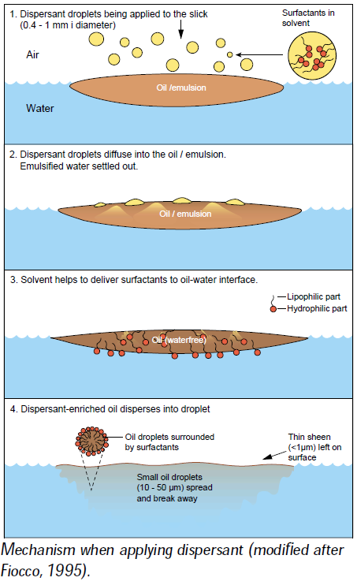
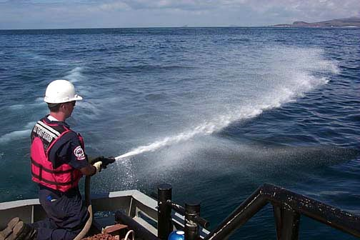
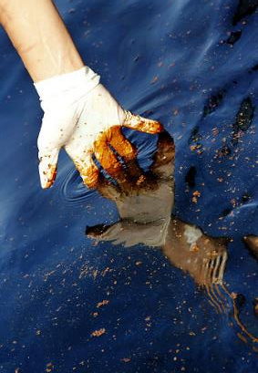
Dispersant use for oil spill
Blend of two or three surfactants
Ex. nonionic /anionic/solvent
Oil droplets
Increase natural attenuation and biodegradation by microorganism.
However, synthetic dispersants are usually toxic and may decrease biological activity of microorganisms.

Slide 7

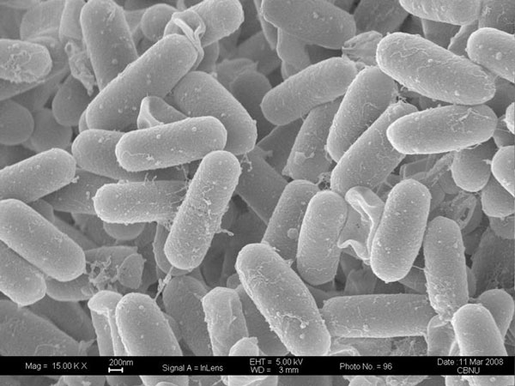
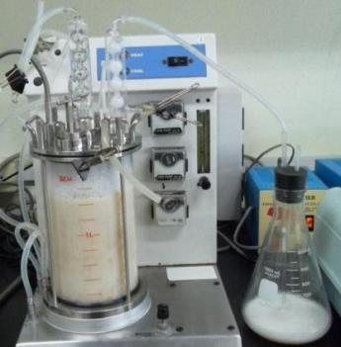
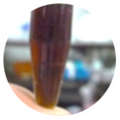
Objectives
Low cost substrates???
Substrates
Microorganisms
Production & downstream processes
Biosurfactants
Biosurfactant producing
Microorganisms???
Dispersing oil
application???
Production & downstream
Processes???

Slide 8
Scope of Experiment
Isolation of biosurfactant-producing bacteria
Evaluation of substrate utilization
Production of biosurfactant by chitosan-immobilized cell
Purification of biosurfactant by Foam fractionation and Freeze-drying
Biosurfactant
Characterization of biosurfactant
Properties & stabilities of biosurfactant
Application of biosurfactant for dispersing oil

Slide 9

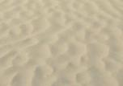


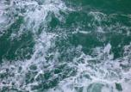

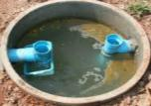
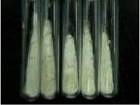
Biosurfactant producing microorganisms & Substrate selection
Isolation of microorganisms
Microbial screening
ดิน
ทราย
ดินป่าชายเลน
ใบไม้
น้ำทะเล
น้ำคลอง
น้ำเสีย
คลังเก็บจุลินทรีย์
Substrate Selection
107
species
Surface tension
< 40 mN/m
58 species
Pure substrate
Organic waste
Glycerol
Soybean oil
Palm oil
Crude oil
Diesel
Lube
Slop oil
Bottom glycerol
Bacillus sp. GY19
Highest yield
High yield
Low cost
Waste reduction
-PTT Group Use only-

Slide 10
Screening of biosurfactant-producing bacteria
Surface tension
< 40 mN/m
Highest yield
Pure glycerol
107
strains
58 strains 20 genus
Bacillus sp. GY19
Yield
0.13 g/l
Surfactin
Bottom glycerol + palm oil
Surfactin
Yield 2.8 g/l
Lipopeptide biosurfactant
Biosurfactant from pure glycerol

Slide 11

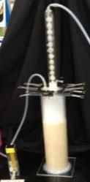
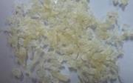
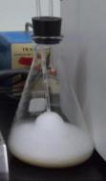
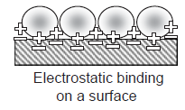
Lipopeptide production and recovery processes
Substrate
Production
Downstream
Low cost substrate
Waste utilization
High production yield
Efficient recovery and purification methods
Immobilized bacteria on cheap and effective materials
Foam fractionation
→ Solvent-free method
Foamate → easy to use and effective for further application
Develop
Cheap, easy and effective bioprocess
Waste from biodiesel production
Bottom glycerol
(10% glycerol + fatty acids and etc.)
Chitosan-immobilized cells
Foam fractionation

Slide 12
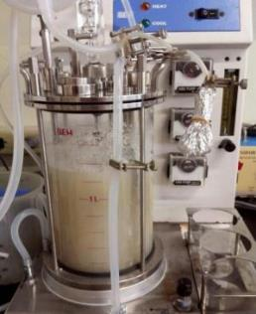
Lipopeptide production by chitosan immobilized cells
in stirred tank bioreactor
Palm oil was added as precursor
Maximum lipopeptide yield 6.65 g/L

Slide 13
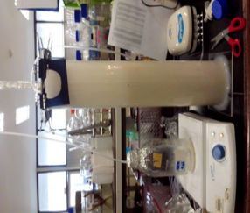
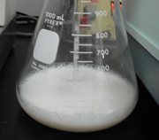
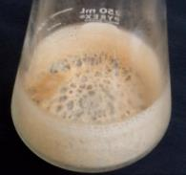
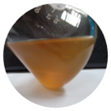
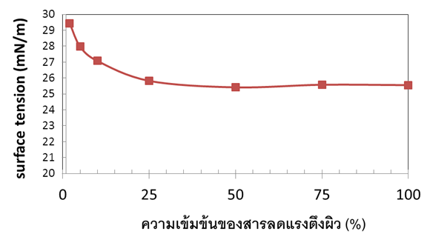
Properties of lipopeptide biosurfactant
Freeze-drying
Foamate
Biosurfactant powder
50% lipopeptide (w/w)
Cell free supernatant
Foam-fractionation
Lowest SFT ~ 26 mN/m
Concentration of foamate (%)

Slide 14
Stabilities of lipopeptide biosurfactant
Surface activity was stable at
Temperature (40-100ºC)
Electrolytes (> 6% NaCl)
pH 7-11.

Slide 15
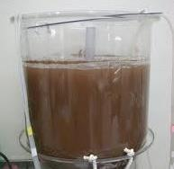
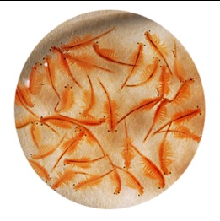
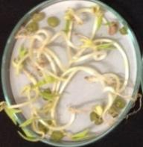
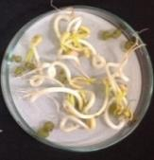
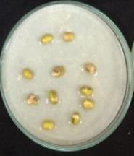
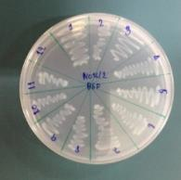
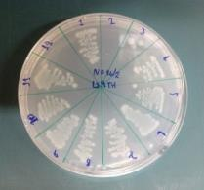
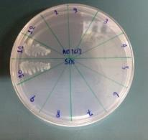
Lipopeptide toxicity tests
Toxic to brine shrimp at very high concentrations
Brine shrimp
No brine shrimp survive
Artimia assay (Luna et al., 2013)
Control
No toxicity to plant seedlings
No toxicity to PAH-degrading bacteria
Water
Biosurfactant
SDS
Biosurfactant
LS9TH
SDS

Slide 16

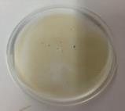
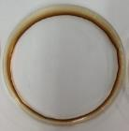

Lipopeptide based dispersant
lipopeptide conc.
Varying from 0.25-10 % (w/v)
Petroleum type
Oman light crude oil
Fuel oil
Arabian light crude oil
Diesel oil
Seawater
Oil 20 µl
BSF
10 µl
0 %
oil displacement
100 %
oil displacement

Slide 17
Lipopeptide based dispersant
Oil displacement activities of foamate and powder were comparable to a commercial dispersant (Slickgone NS) and much higher than a synthetic surfactant (Tween 20).

Slide 18
Conclusions
  Lipopeptide biosurfactant could be produced from chitosan-immobilized Bacillus sp. GY19 in stirred tank fermenter.
1
  Lipopeptides could be recovered from cell-free culture medium by foam fractionation process.
2
  Lipopeptides have good surface activity, low toxicity, and stable under various conditions.
3
  Both foamate and powder containing lipopeptides could be used directly as dispersants for oil spill remediation
4
-PTT Group Use only-

Slide 19

Acknowledgements
Sarintip Vaewhongs Project advisor
Chatree Tankunakorn Project leader
Komkrit Suttiponparnit Researcher
Witchaya Rongsayamanont
Nichakorn Khondee
Onruthai Pinyakong
Ekawan Luepromchai

