Slide 1



Nanomedicines in the European Translational Process
Susanne Bremer-Hofmann
The European Commission’s
science and knowledge service
Joint Research Centre
JRC-Directorate F:
Health, Consumers and
Reference Materials

Slide 2

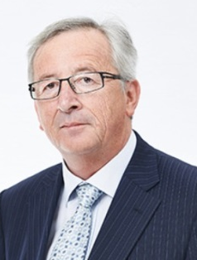
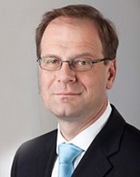
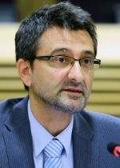
©XXX
© artjazz
President
Jean-Claude JUNCKER
28 Commission Members (President, 7 Vice Presidents + 20 Commissioners)
Commissioner for Education, Culture, Youth and Sport
Tibor NAVRACSICS
Joint Research Centre
Director-General
Vladimír ŠUCHA
DG Education and Culture

Slide 3
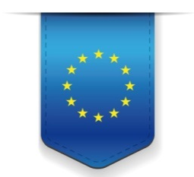
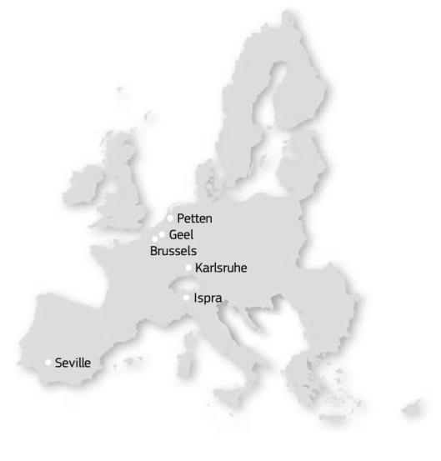






DG Joint Research Centre
Established in
1957
Around
3000
Staff
10
Directorates
>1000
Publications
per year
6
42
Large scale
facilities
Locations in 5 Member States
Notes:
7 institutes in 6 locations
Around 3000 staff, including PhDs and visiting scientists
1370 publications in 2014
Directorate F – Health, Consumers and Reference Materials
Consumer Products Safety

Slide 4

DG JRC's Vision:
"To play a central role in creating, managing and making sense of the collective scientific knowledge for better EU policy."
DG JRC's Mission:
"As the science and knowledge service of the Commission our mission is to support EU policies with independent evidence throughout the whole policy cycle."
Notes:
Stimulate inovation through the development of new standardssuch as methods, reference materials etc

Slide 5
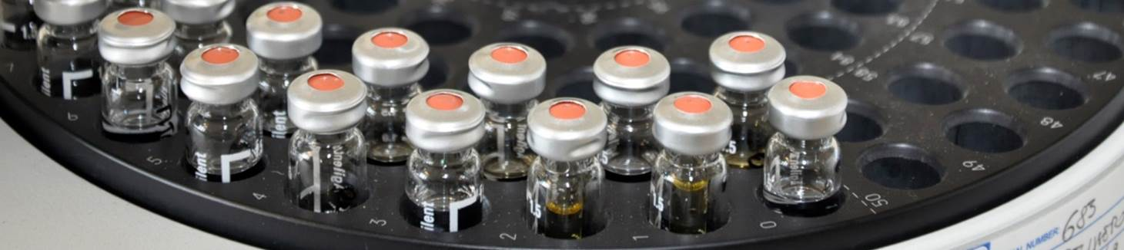
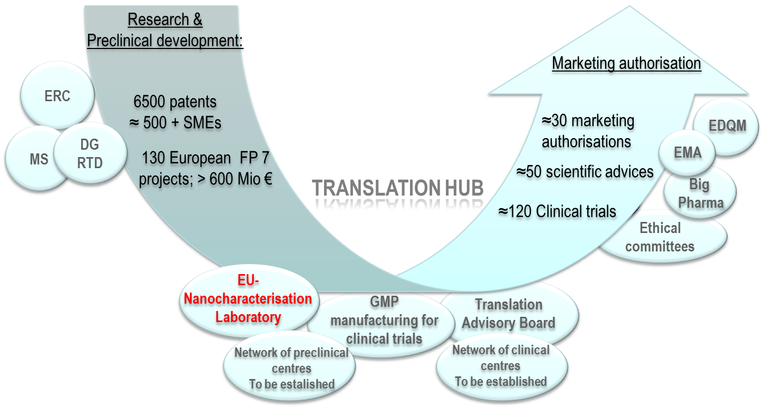
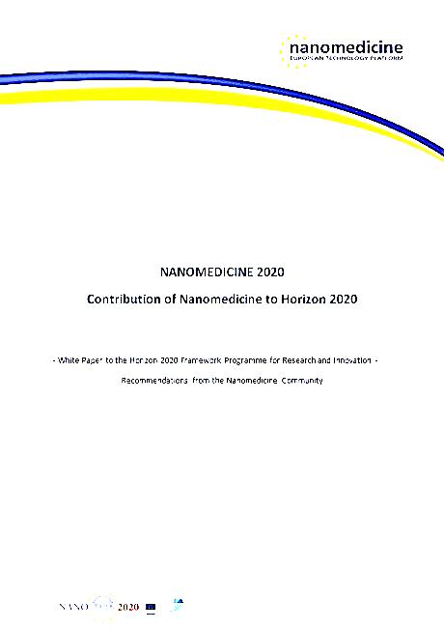
Nanomedicines in the European Translational Process (2014)

Slide 6
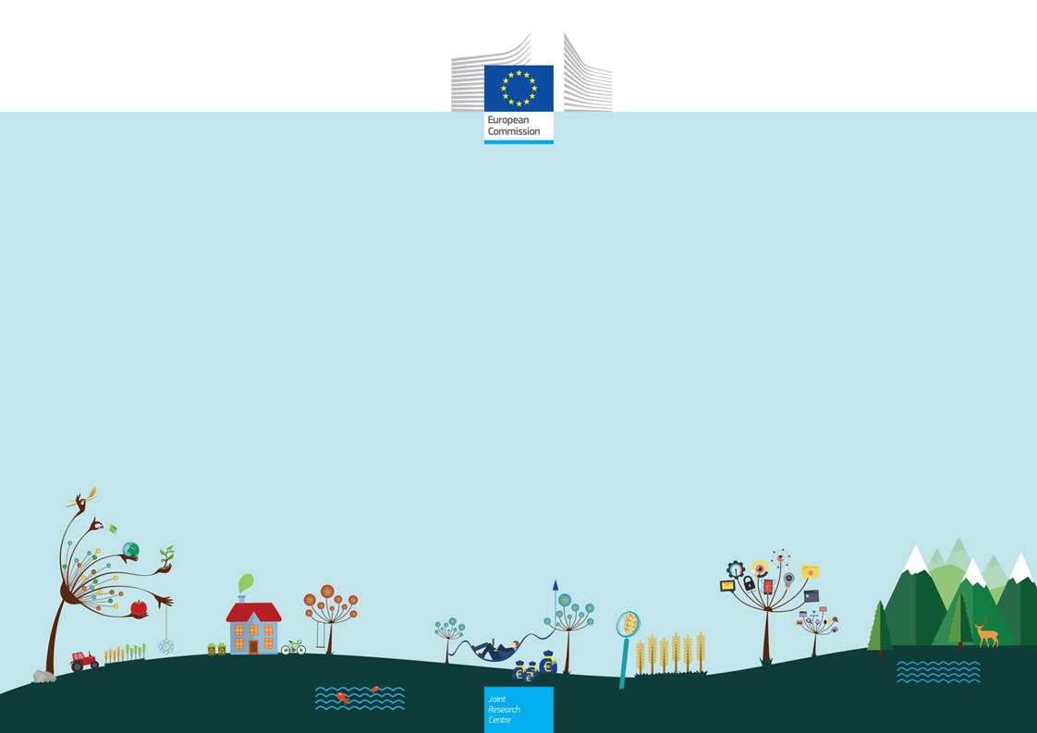
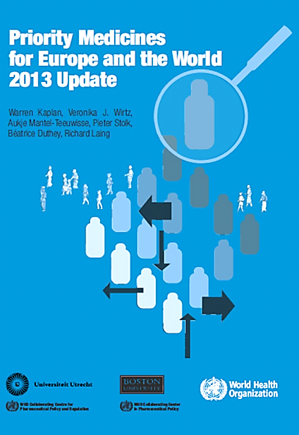
Methodology
 | Reference Documents and Databases
Drug development projects (n= 131) | Community Research and Development Information Service (Cordis) Project specific websites Information retrieved from Frima et al 2012
Clinical trials (n=69) | Information retrieved from the databases of Etheridge et al 2013; Hafner et al 2014 EU Clinical Trials Register
Authorisation (n= 30) | European Medicines Agency Heads of Medicines Agencies

Slide 7
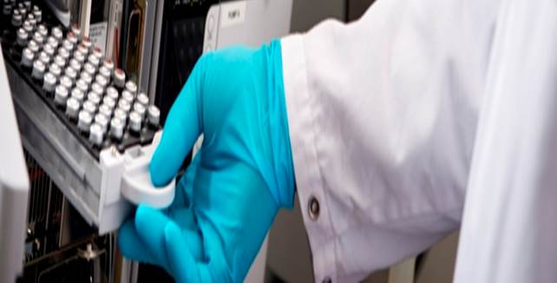
Nanomedicines addressing WHO identified treatment gaps

Slide 8
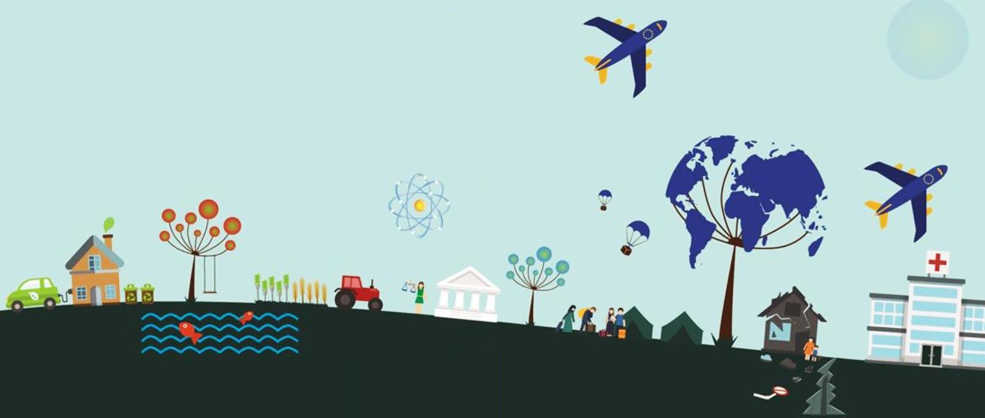
Evolution of nanotechnology applications in medicinal products
(1996-2014)
Authorised products
(n≈ 30)
Clinical Trials
(n>120)
R&D
(n>130 FP7 projects)
Reduction of side effects
Stability, solubility etc
Increased bioavailability
In vivo diagnostics
Change/enlargement in applications
New therapeutic concepts based on phys. properties
Theranostics
Combination/borderline
products
Multifunctionalisation
Remote control of therapeutic action
Notes:
Authorised products: nanocrystals (rapamune) increased solubility
Calyx-doxil patents expired generics are approaching the market
Clinical trials
Magnetic Nanoparticle Thermoablation-Retention prostate cancer phase 0 safety study magnablate
ferumoxytol for imaging cardiovascular inflammation phase 2 before it was used to treat iron deficiency in chronic kidney diseases

Slide 9
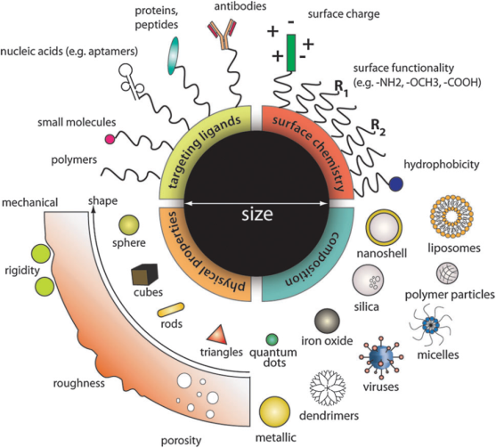
Complexity of Characterization of nanomaterial in contact with biological fluid
What makes toxicity testing so complex?
Nanoparticle core:
Inorganic
Polymeric
Lipid based
Medium:
water
buffer
serum
biological fluid
Shell, surface:
passivating molecules
functionalization (e.g. –COOH,-NH2, targeting moieties)
surface properties (surface charge, hydrophobicity)
protein corona
What is the relation with observed cellular effects?

Slide 10
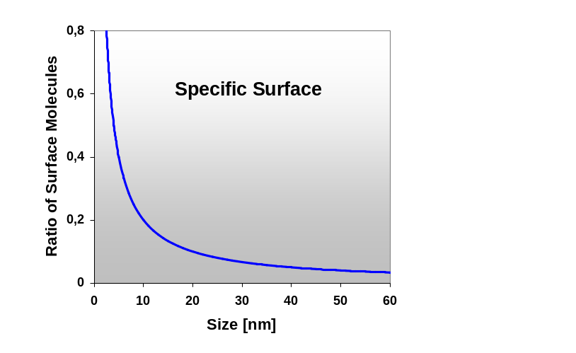
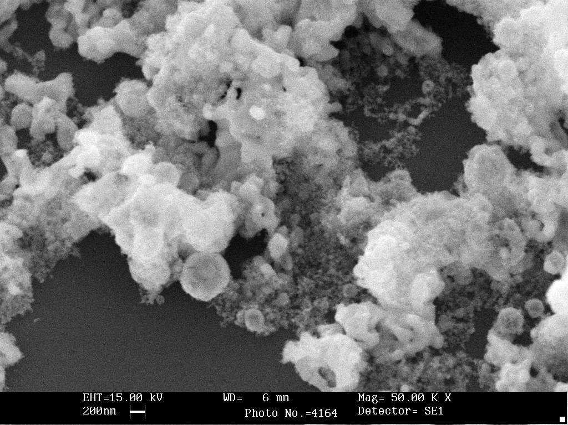
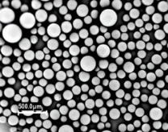
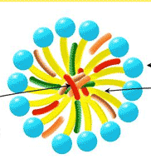
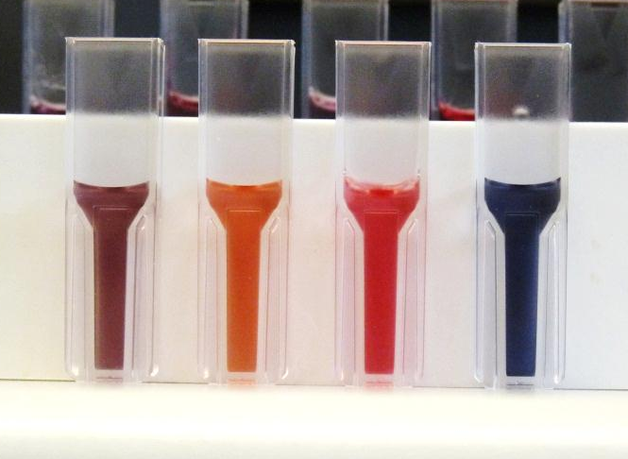
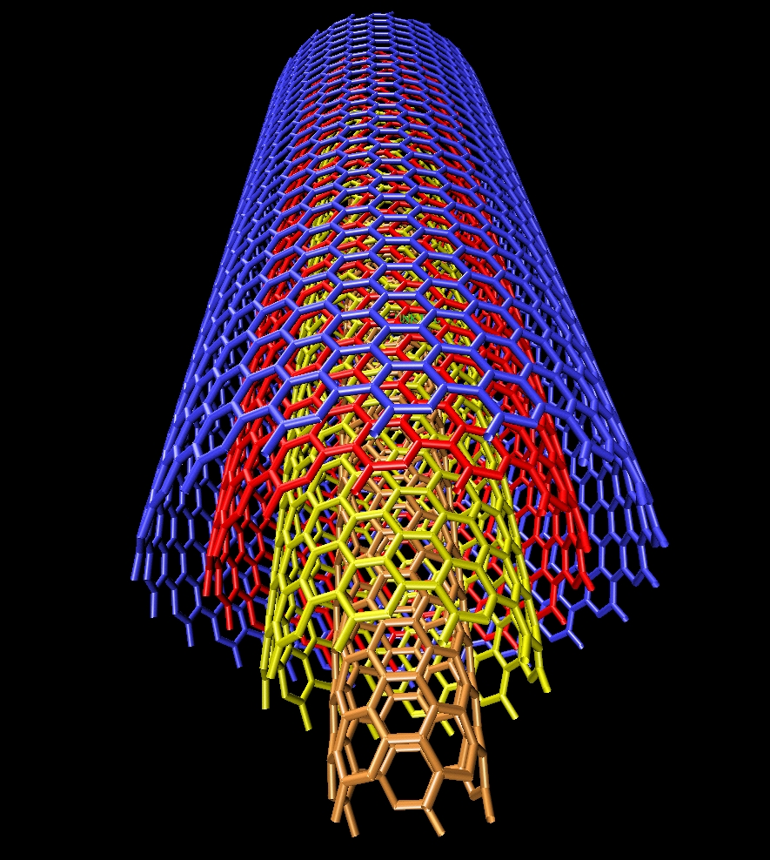
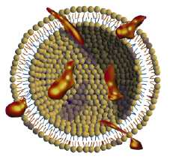
Nanomaterials: what makes them different?
Large specific surface area
Chemical reactivity different compared to bulk material
Quantum effects lead to special properties (electronic, magnetic, mechanical, optical)
Many forms: spherical nanoparticles, nanorods, fullerenes, nanotubes, nanoplates, nano-encapsulates, …….
2-3 nm
4-6 nm
10-20 nm
>30 nm
Increasing Au nanoparticle size

Slide 11
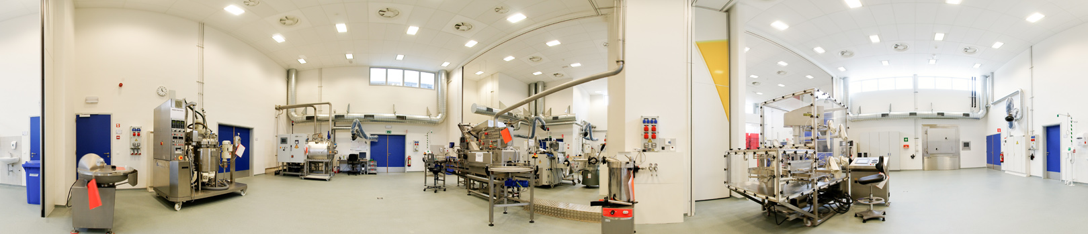
Scientific infrastructure facilities
State-of-the-art laboratories for analytical chemistry, toxicology, nano-biosciences and molecular biology
Modern infrastructure for production of reference materials
Cell production facility
High-throughput screening facility
Nuclear magnetic resonance spectrometers, other spectroscopic techniques, electron microscopes

Slide 12
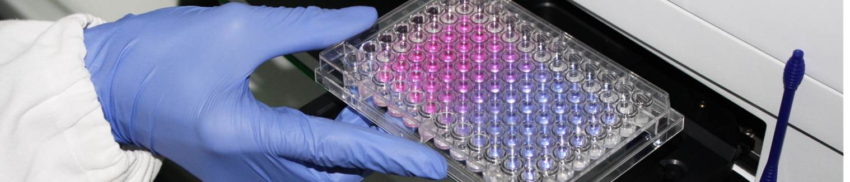
Toxicity testing of nanomaterials in vitro
    Identification of the NMs, phys-chem characterisation of NMs
    Relation of the phys-chem characteristics to the biological effects observed
    Testing of possible interferences with the biological test system
    Contamination (e.g. chemical impurities, endotoxin)
    NMs dispersion before and during the in vitro test
    Dosimetry of nanomaterials, calculation of cellular dose
    Cellular uptake, bioaccumulation, cellular fate
    HARMONISATION OF PROTOCOLS AND TEST CONDITIONS!!!!
H. Krug, Angew.Chem 53, 2014

Slide 13
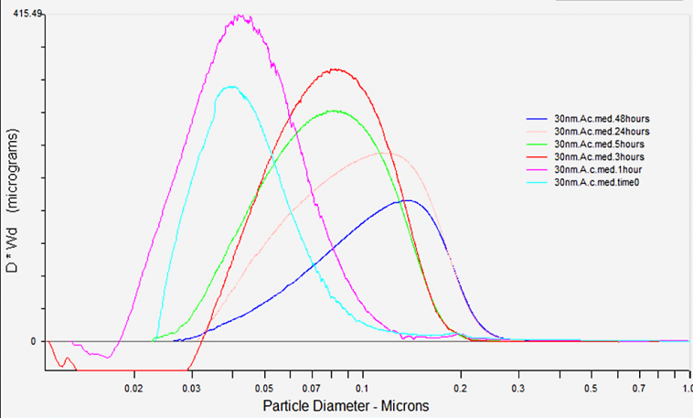
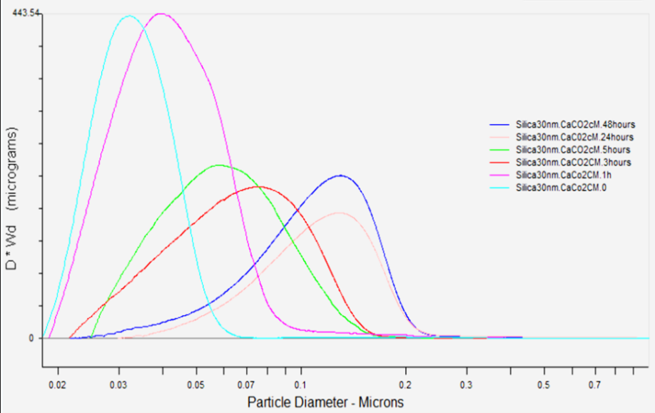
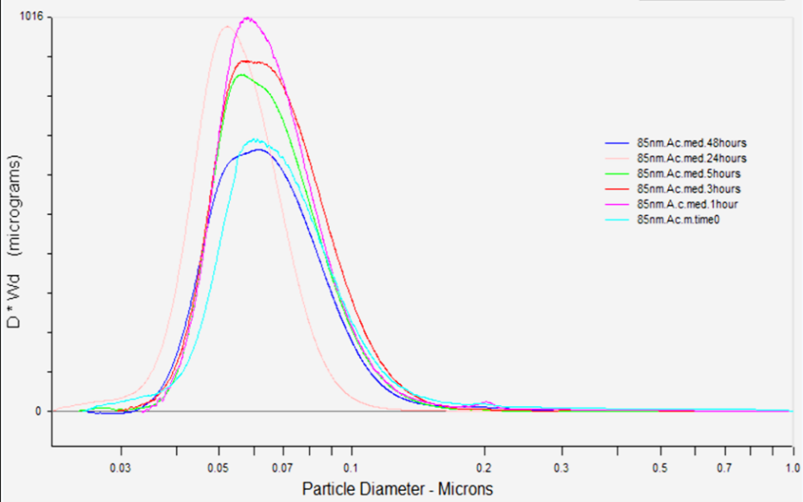
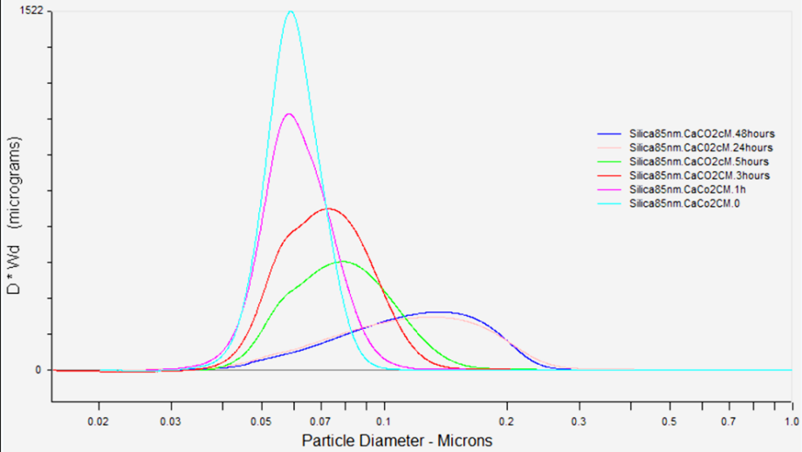
SIO₂ NPs: size distribution in medium
SiO₂ 30 nm A549 CCM
SiO₂ 30 nm CaCo-2 CCM
SiO₂ 80 nm A549 CCM
SiO₂ 80 nm CaCo-2 CCM
Halamoda B, Kinsner-Ovaskainen A et al, PLOS One (2015)

Slide 14
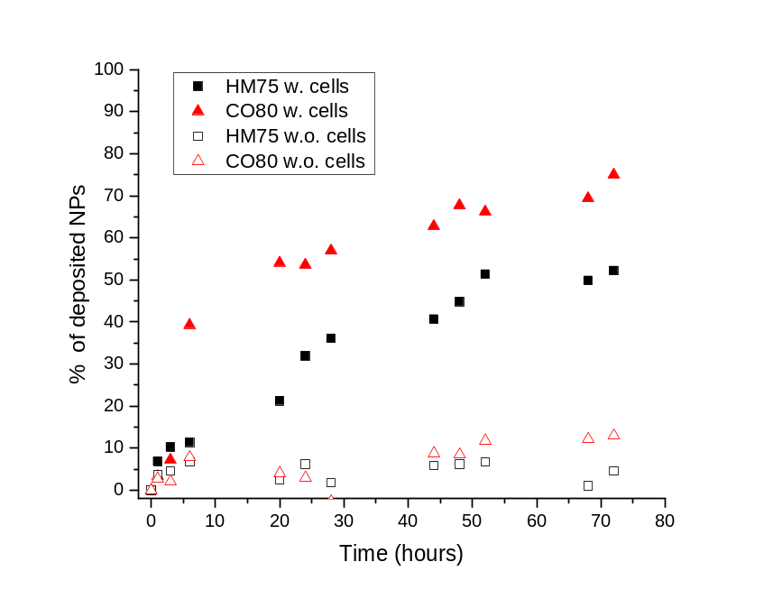
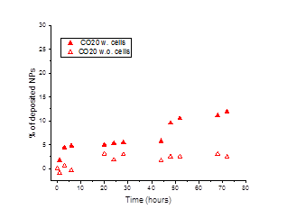
Dosimetry of nanomaterials in vitro
Chemicals
Nanoparticles
Chemicals
diffusion
gravity
Administrated dose ≈ cellular dose
Administrated dose >> cellular dose
Gold NPs 80 nm
Gold NPs 20 nm
Cellular dose is an essential parameter for obtaining reliable results from NPs toxicity studies in vitro
80% of the dose of 80 nm NPs is in contact with A549 cells after 72 hours
12% of the dose of 20 nm NPs is in contact with A549 cells after 72 hours
Rischitor G., Colpo P. et al, 2016 Particle and Fibre Toxicology

Slide 15
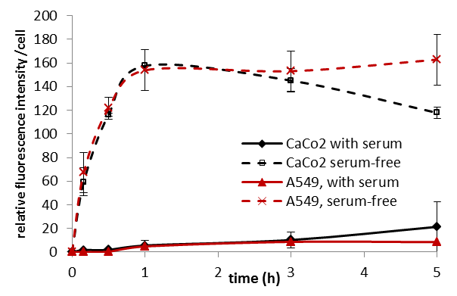
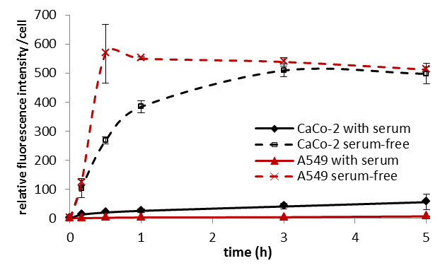
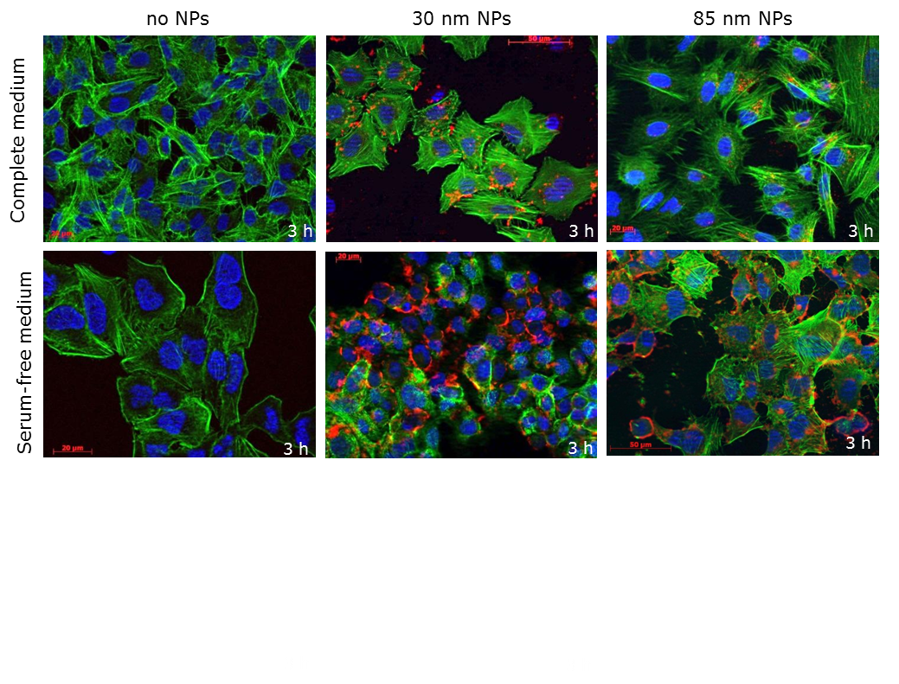
Kinetics of the NPs cell uptake
in serum-free medium
SiO₂ NPs 30 nm
SiO₂ NPs 80 nm
Increased and fast cell uptake of SiO₂ NPs in serum-free conditions in both cell lines
Halamoda B, Kinsner-Ovaskainen A et al, PLOS One (2015)
Notes:
In serum free media the uptake is much higher compared with the uptake when in complete CCM

Slide 16
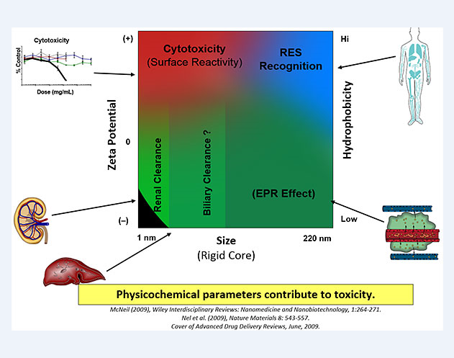
How phys.chem parameter contribute to toxicity
Graph S.McNeill Head NCI-NCL

Slide 17
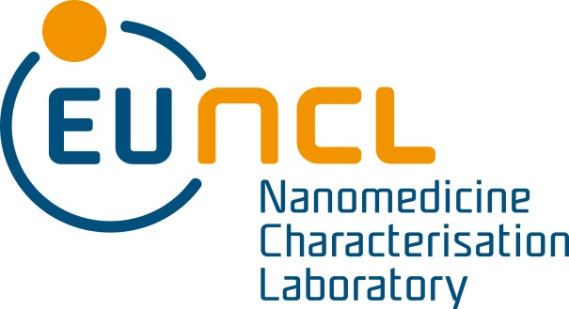
EU Nanomedicine Characterization Laboratory
(EU-NCL)
the first European transnational
infrastructure in nanomedicine-

Slide 18
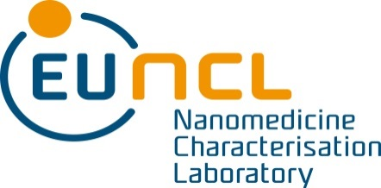
Our Objectives
To perform and standardize the pre-clinical characterization of nanomaterials intended for medical therapies in Europe
To accelerate translation of engineered nanoparticles for medicine applications to medicinal products
To support product developer by addressing feedback of decision makers regarding nanospecific properties
To identify and to characterize critical parameter related to
nanomaterial interaction with biological systems

Slide 19
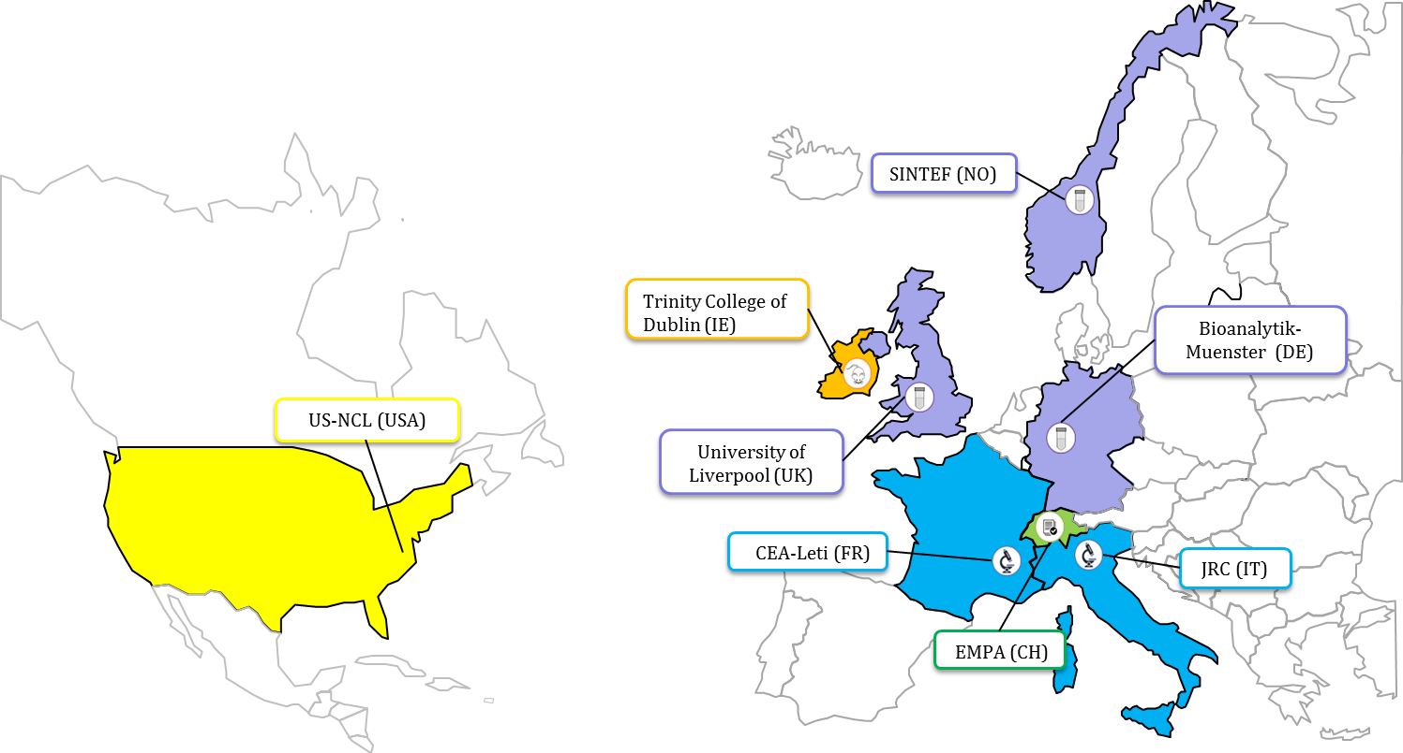




Who we are
Physico-chemistry
Biological in-vitro
Biological in-vivo
Quality
EU-NCL: a distributed infrastructure combining complementary expertise

Slide 20
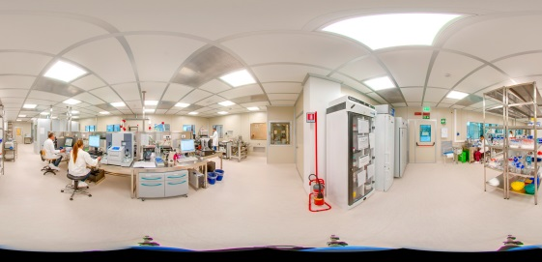
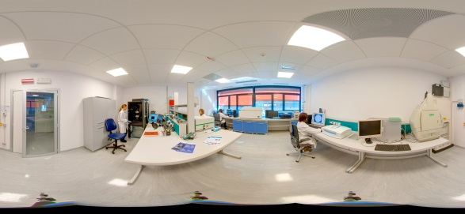
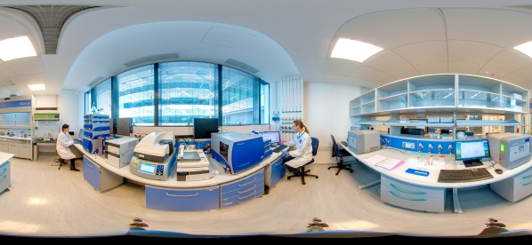
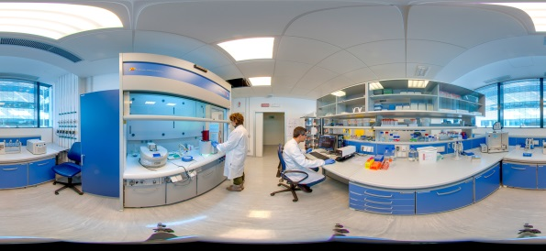
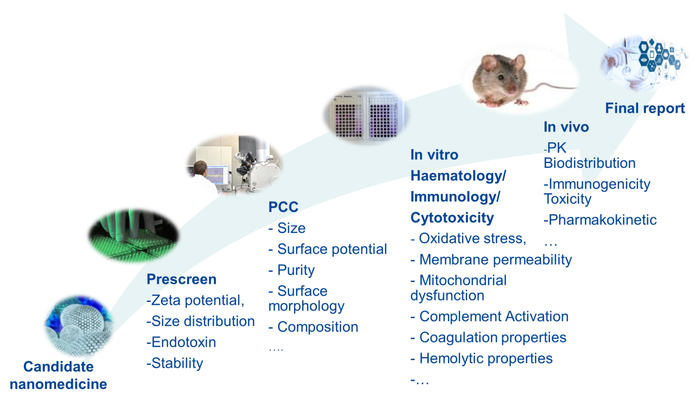

What will the EU-NCL offer

Slide 21

Networking
International regulatory bodies
International Pharmaceutical Regulators Forum (working group "nanomedicine")
European Medicines Agency and
EU Member States
EU-NCL
Food and Drug Administration
NCI-NCL

Slide 22

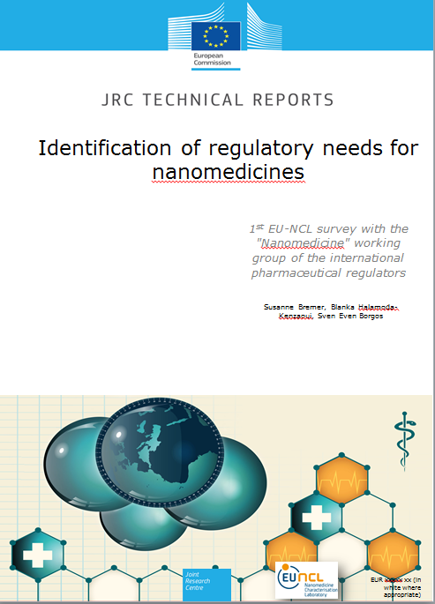
Survey with Regulators
30 Questions to the working group "nanomedicine" of IPRF:
Addressing current status of applications
First recommendations of the regulators on information needs
Expectations of regulators
Survey management
The European Commission's management tool "EUSurvey"
Launch from October 2015 until November 2015.
Governmental organisation
Health Canada (Market Health Products), Canada
European Medicines Agency
Swiss Agency for Therapeutic Products (Switzerland)
Health Canada (Health Products and Food Branch), Canada
United States Food and Drug Administration, USA
Pharmaceuticals and Medical Devices Agency, Office of New Drug II; Japan
Brazilian Health Surveillance Agency, Brazil
Ministry of Food and Drug Administration, Korea
Center for Drug Evaluation, Taiwan
National Institute for Public Health and the Environment, Netherlands
Federal Institute for Drugs and Medical devices, Germany
The Medicines and Healthcare products Regulatory Agency, United Kingdom
National Health laboratory, Luxembourg
Spanish Medicines Agency, Spain
Ministry of Health, labour and welfare, Japan
Australian Government, department of Health therapeutic goods administration, Australia
National Agency for food and drug administration and control, Lagos
Health Science Authority, Singapore
Notes:
Recommendations of the Scientific Committee on Emerging and Newly Identified Health Risks (SCENIHR)
EMA's reflection paper relevant for nanomedicines
Similar Survey performed within NanoReg

Slide 23

Results
Notes:
Recommendations of the Scientific Committee on Emerging and Newly Identified Health Risks (SCENIHR)
EMA's reflection paper relevant for nanomedicines
Similar Survey performed within NanoReg

Slide 24
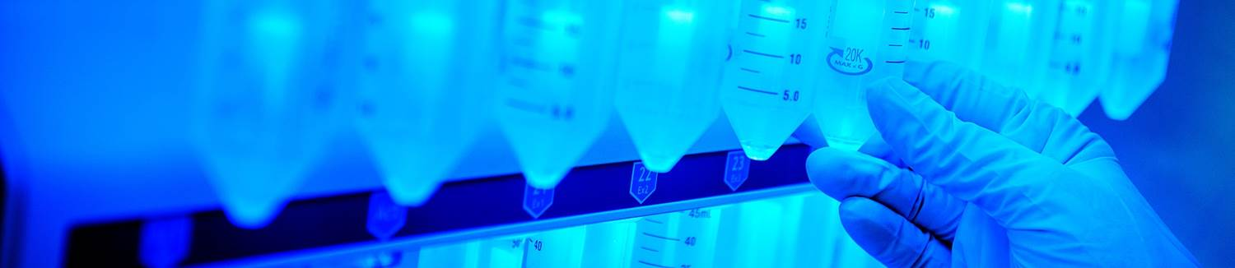

Slide 25
Is it relevant to harmonise testing requirements of medicinal products and medical devices for nanomedicines in the various regions
What functions could an EU NCL fullfill to support regulatory authorities, whit the aim of facilitating the introduction of nanomedicines into clinical trials and on the market

Slide 26
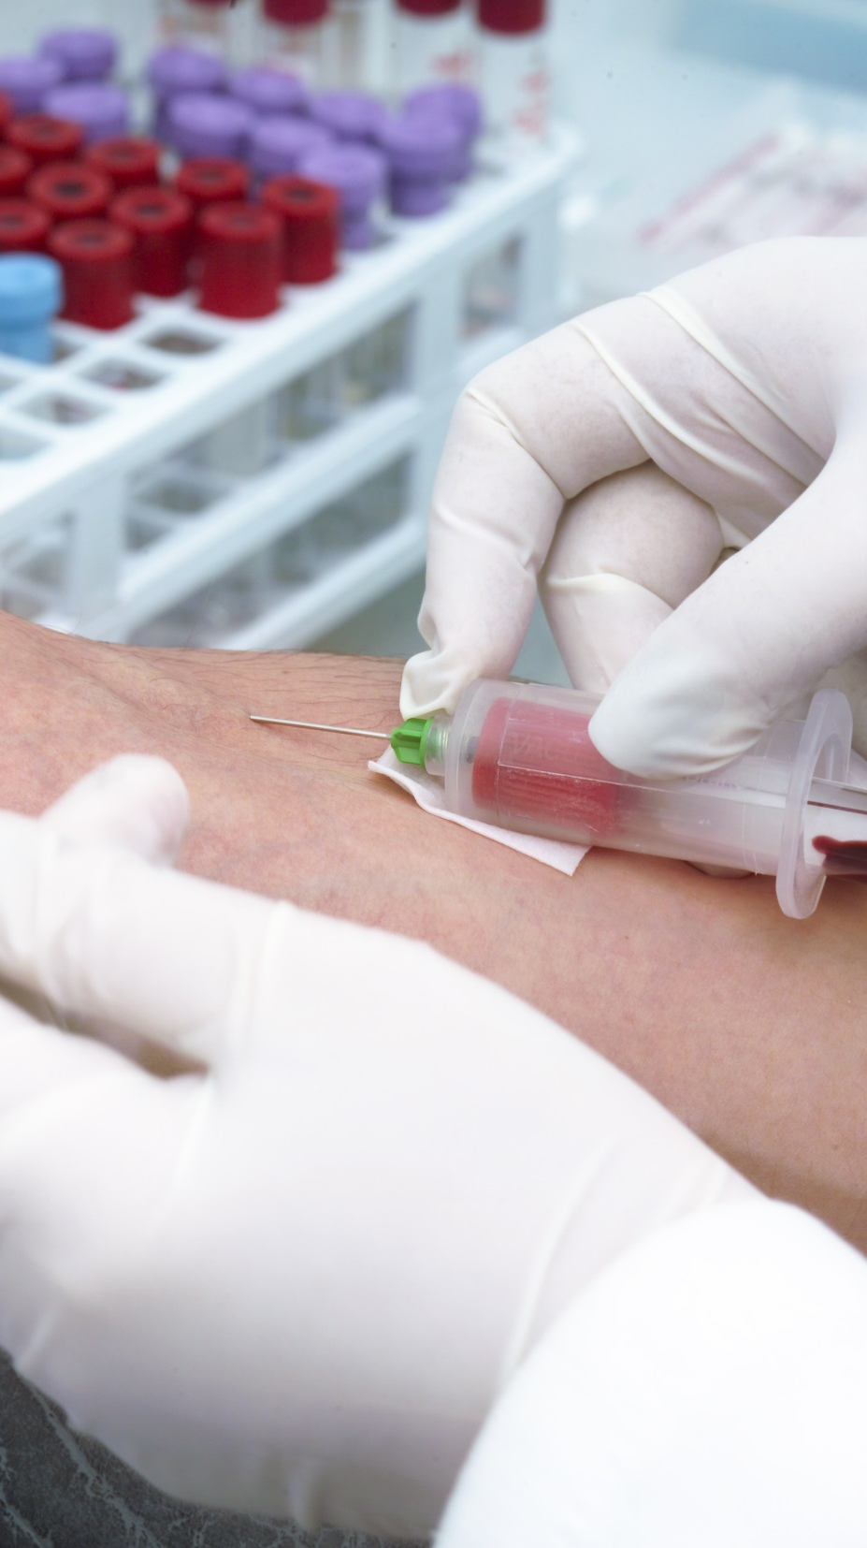
Conclusion:
Conclusion
Nanomedicines are promising to address unmet medical needs
They are highly complex with a sophisticated manufacturing process
The European Nanomedicine Laboratory offers the characterisation of nanomedicines free of charge
The regulatory community is well aware of the need to define the information requirements and standardisation needs

Slide 27
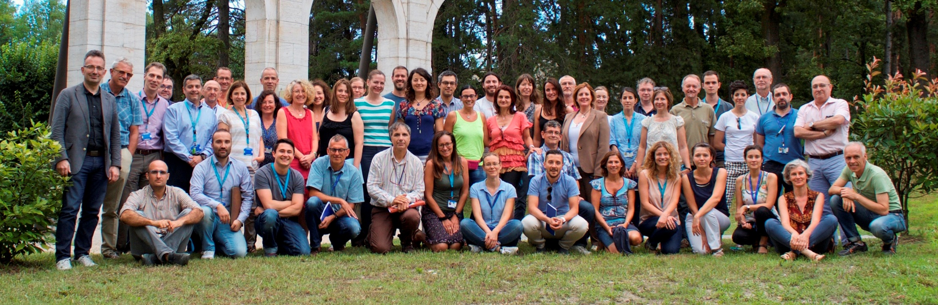

Thank you for your attention!

Slide 28
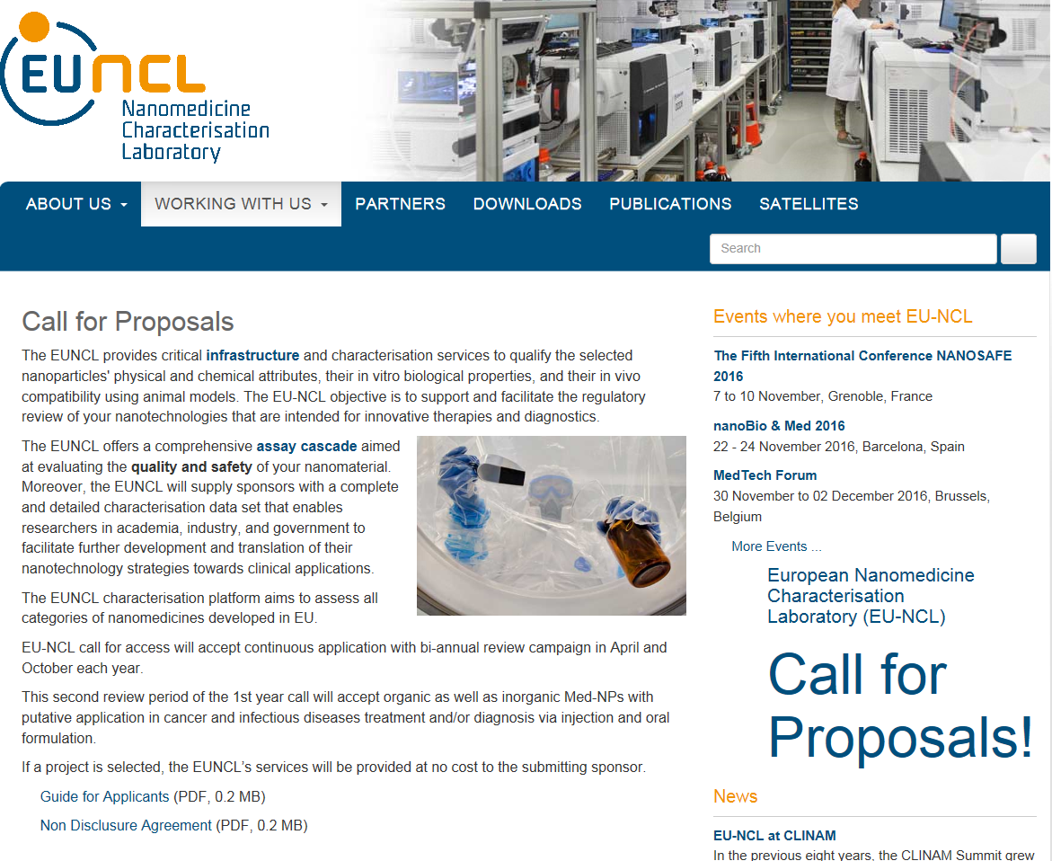






Stay in touch!
JRC Science Hub:
ec.europa.eu/jrc
Twitter and Facebook:
@EU_ScienceHub
LinkedIn:
european-commission-joint-research-centre
YouTube:
JRC Audiovisuals
Vimeo:
Science@EC
http://euncl.eu

Slide 29
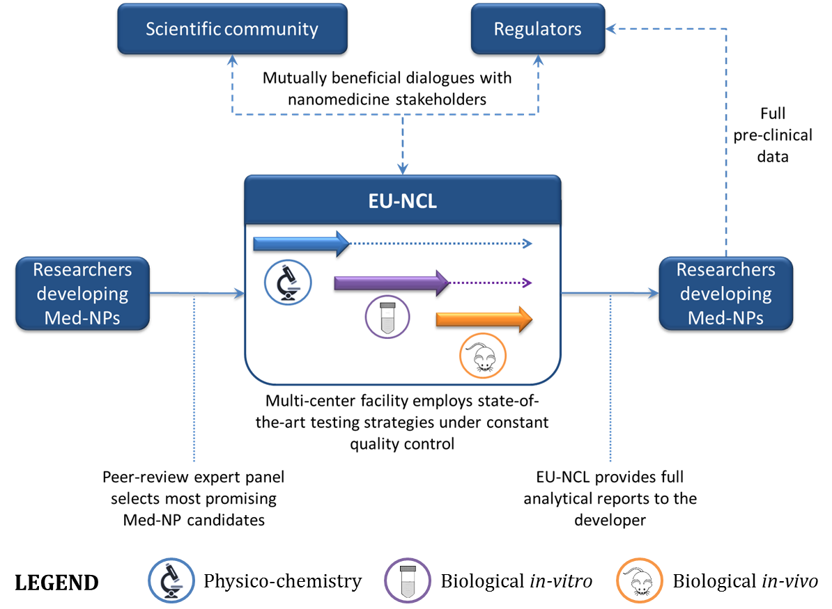

EU-NCL Concept
Regulators
(EMA, FDA, National Agencies)

Slide 30
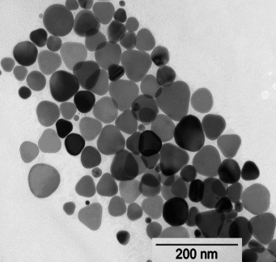
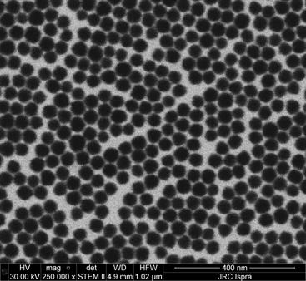
Nanomaterials phys-chem characterisation
Parameter Technique/Instrument
Size DLS, SEM, TEM, DSC, PTA, CPS
Morphology SEM , STEM, TEM
Phase XRD
Surface Charge Zpotential
Concentration, Purity, solubility ICP-MS
Surface composition XPS, ToF SIMS
Specific area BET,
Chemistry FTIR, Raman
…
Notes:
30

