Slide 2
Motion Capture Assessment of Athletic Injury Risk
Susan Giblin, Dara Meldrum, Mark McGroarty, Friedrich Wetterling
Kitman Labs Ltd., Joyce’s Walk, Dublin 1, Ireland
Royal College of Surgeons, Stephen’s Green, Dublin 2, Ireland

Slide 3
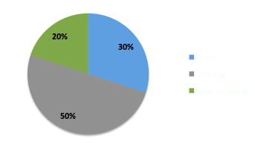
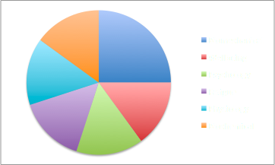
Injury Risk in Elite Sport
What are we trying to solve?
Stress
Stress Response
Notes:
Ok, so what are we here at Kitman labs actually trying to solve?
Well, in elite sports several different stresses are placed on an athlete in the hope of eliciting a positive physiological response. While we can carefully periodise and plan the amount and type of stress that we place on athletes, we cannot predict an athlete's response to this stress.
Stress response is multifactorial in nature such as biomechanical, physiological and psychological to name a few. The careful monitoring of this stress response is the key in reducing athlete injury rates and in sports science terms we consider this stress response as DATA.
The type of data gathered is crucial to gaining a holistic picture of athlete health. Each player’s response to training and competition demands, is individual and research has shown that perceived stress, anxiety and fatigue has similar effects on injury risk as physiologically defined ‘actual’ stress, thus collecting both subjective and objective information provides value.
The interlinking nature of physical, physiological and psychological risk factors is an important facet of understanding how injuries manifest. Unfortunately, these variables are often tested and analysed in isolation.
However, movement and the mechanics of movement can provide a combined measure of these variables. With the Microsoft Kinect we use low-cost markerless 3D depth sensor technology to measure movements that require both physical control and neuromotor activation.

Slide 4
Movement Assessment - Injury risk?
Movement assessment is an important part of the athlete screening process used to identify precursors to injury.
Both non-contact and contact injuries can originate from abnormal movement patterns.
The most common dysfunctional movement patterns for the lower body include excessive hip adduction, hip internal rotation and knee valgus/varus.

Slide 5
Limitations of current methods?
Despite progress in theoretical and practical movement assessment, there is a clear lack of definitive standardisation for assessing movement competence and injury risk.
For example, movement screens are often only designed to test basic levels of function (or rule out pain/dysfunction).
Such tests often fail to offer the discriminant validity needed to identify subtle variations in movement parameters that precede injury in high level athletes.

Slide 6
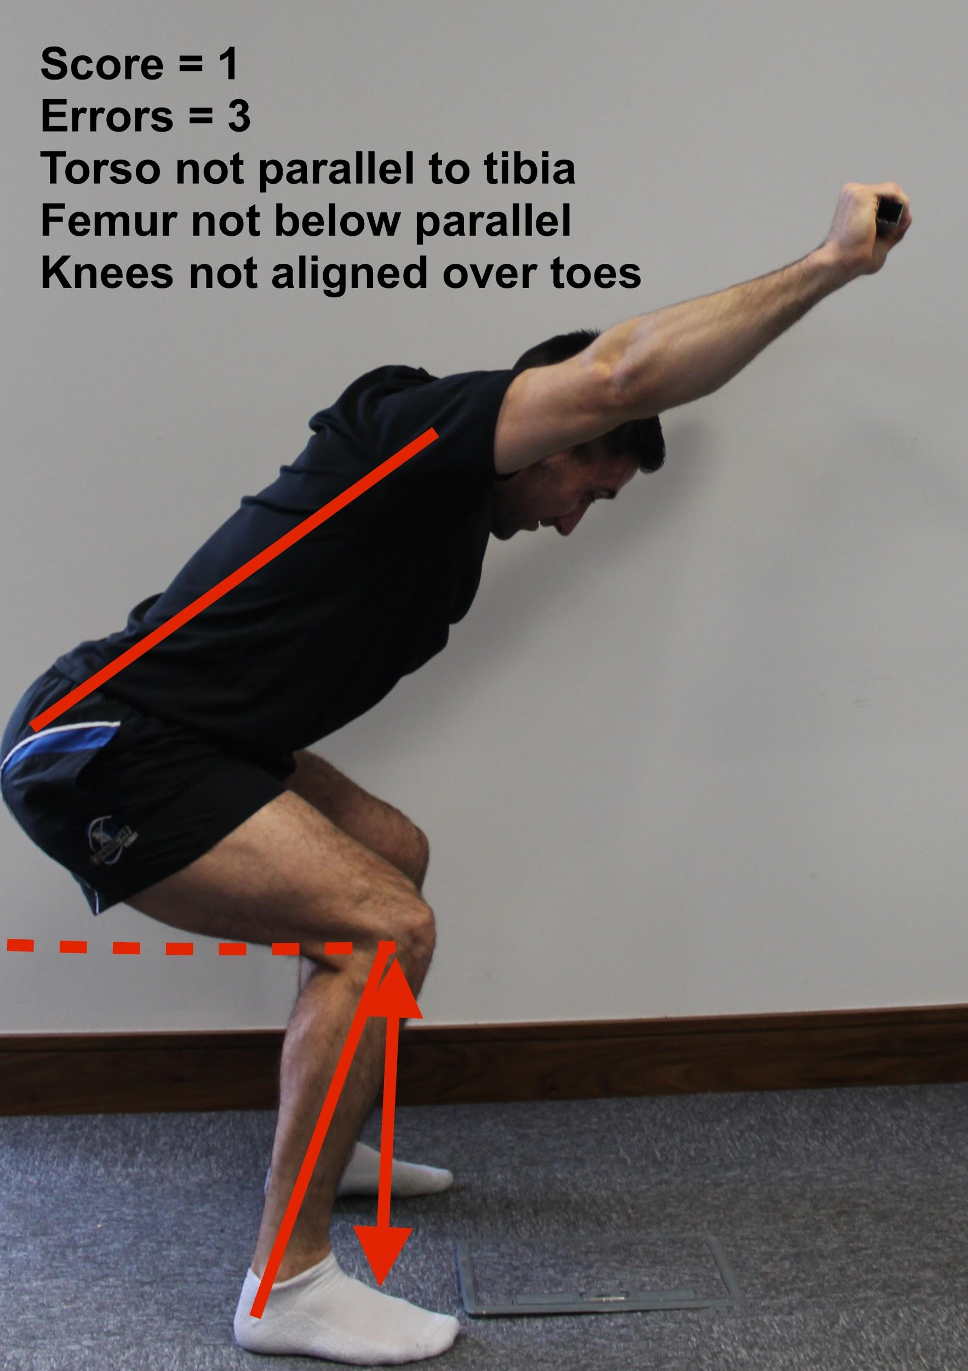
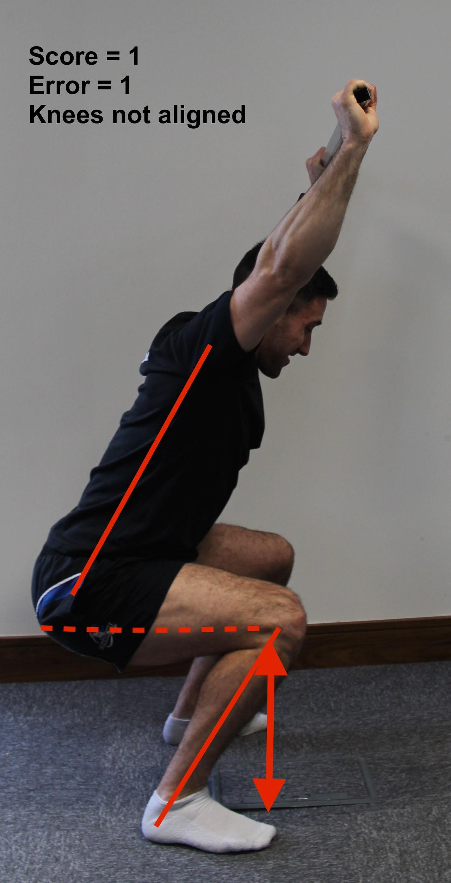
Time
Specificity
Sensitivity
Notes:
Time, specificity and sensitivity

Slide 7
Motion Capture - a potential solution?
The tangible value in screening lies in identifying specific root causes of maladapted movement patterns.
The proliferation of low-cost motion capture devices provides optimism for gathering and monitoring movement data objectively within sports settings.

Slide 8
Movement Function for Sports?
Overhead Squat
The overhead squat is a multi-joint, multi-level movement that requires triple flexion-extension of the lower limbs, thoracic extension and core stability to perform successfully.
Overhead squat is commonly used to detect asymmetry and immobility during functional movement.

Slide 9
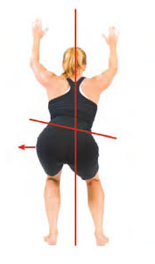
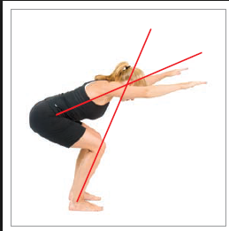
Assessment content?
Knee valgus/varus at peak squat
Trunk angle
Ankle Dorsiflexion
Knee flexion

Slide 10
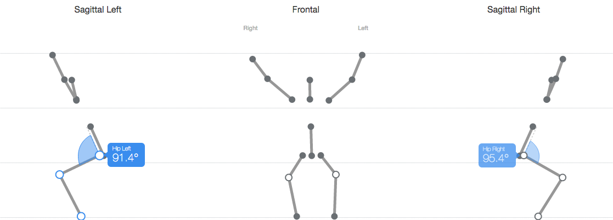
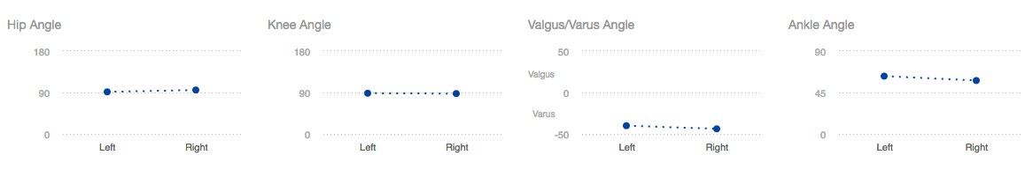
Data Display

Slide 11
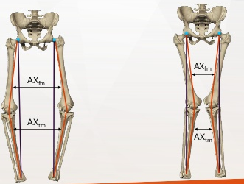
Limitations of Motion Capture?
‘Accuracy deficits larger than 5° indicate missing important kinematic information..’
.... 5° inaccuracies can mean
Varus is recorded as Valgus...
Varus
Valgus

Slide 12
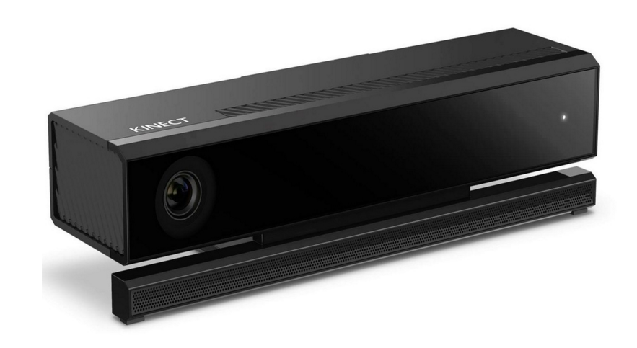
Marker-less
Notes:
Advantages & disadvantages

Slide 13
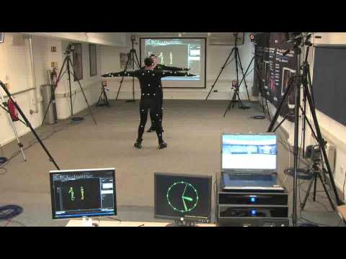
Marker-based
Notes:
Advantages & disadvantages

Slide 14
Vicon V Kinect
Vicon | Kinect
Marker-based motion capture. | Markerless motion capture.
Accepted reference standard lab system for measuring movement. | Requires correction algorithms to improve accuracy for measuring movement.
Uses global coordinate systems | Does not use a global coordinate system

Slide 15
What has been done so far?

Slide 16
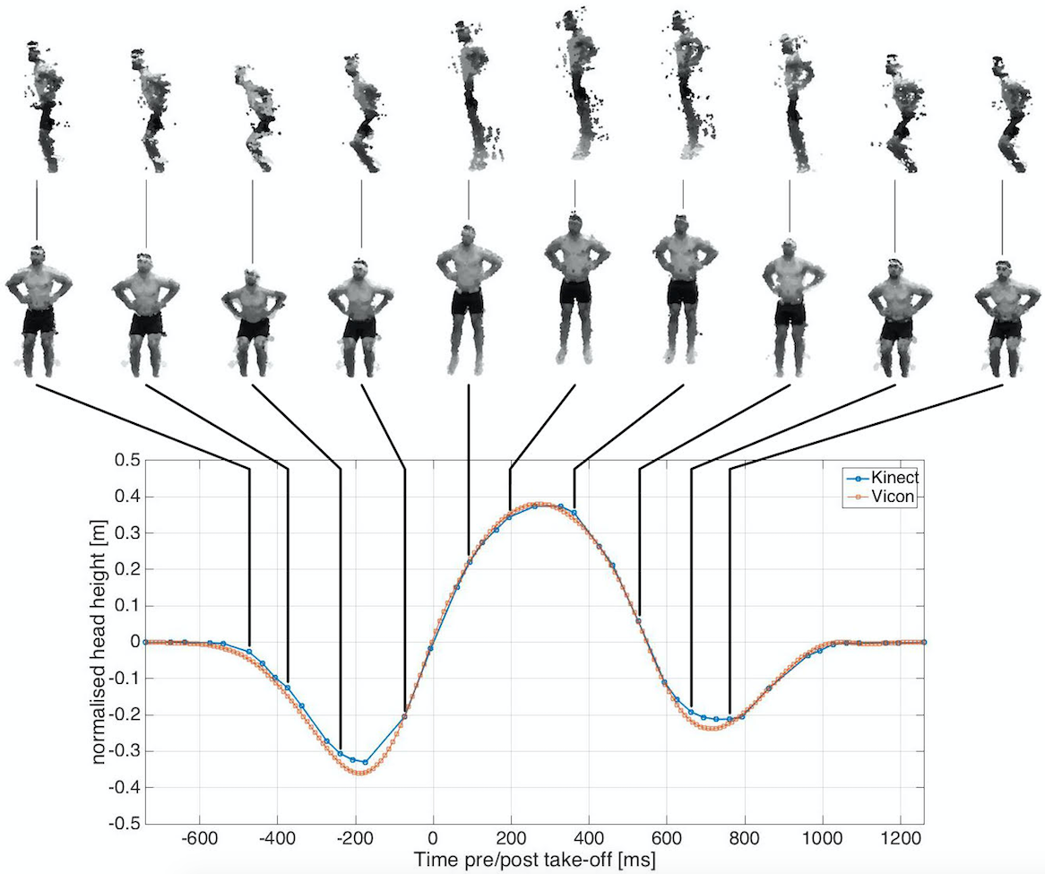
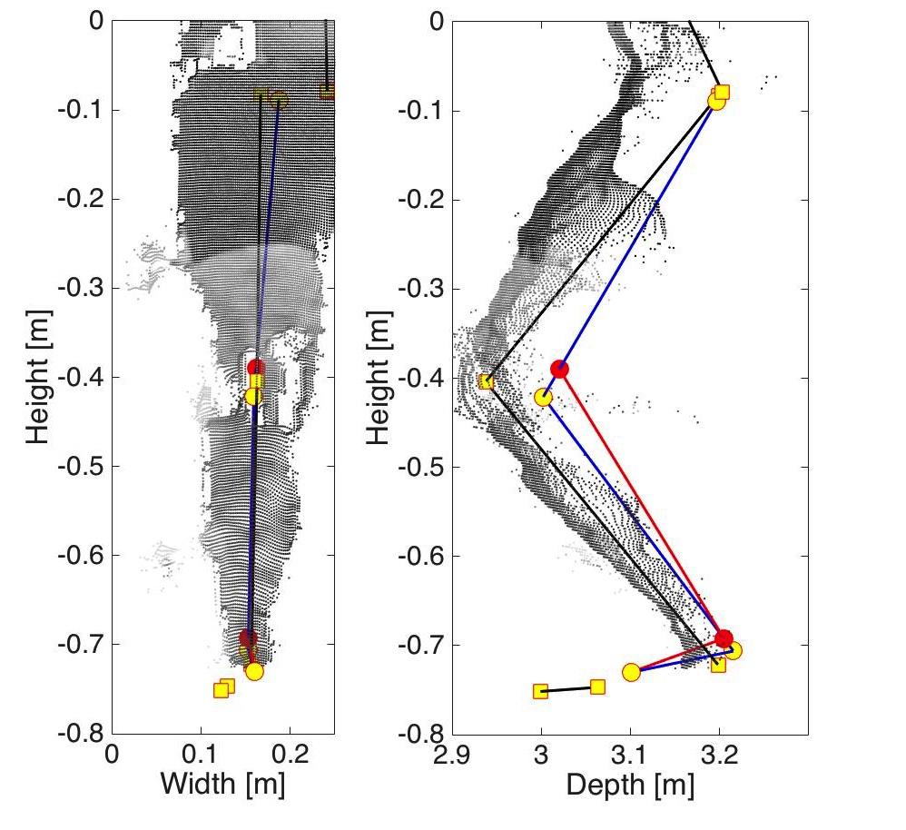
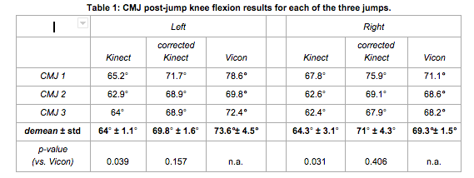
Calibration & correction for dynamic movements
Rationale:
During dynamic movement limb length discrepancy is evident between vicon and Kinect for knee measurements.
Objectives:
To examine the impact of a calibration procedure to correct limb length on knee joint position during CMJ.
Outcomes:
For corrected data, the accuracy was improved to less than the intra-individual variation measured using VICON. The precision was < 3 degrees indicating excellent repeatability for this measurement in the athlete.

Slide 17
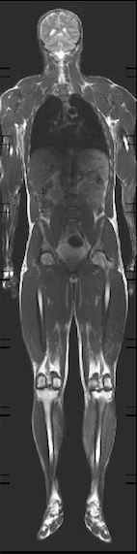
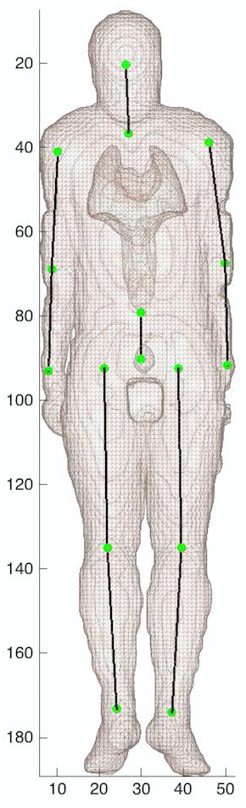
Improved joint localisation
Our research study:
Whole-body magnetic resonance imaging enables assessing spatial accuracy and precision of skeletal joint locations inferred from motion capture systems’
Objectives:
To assess the accuracy of Kinect skeleton and investigate potential improvements
Outcomes:
Large deviations were found between Kinect joint centre and MRI joint centre.
Correction for joints covered by large muscle mass is necessary. This could be implemented with a volumetric calibration scan using Kinect depth data.

Slide 18
Current Investigation?
Methods: A single-case comparison was completed between Vicon and Kinect.
Processing & Analysis: The raw data is processed to correct for limb length variations using the calibration information. A coordinate transformation was used to convert the joint localisation data from Kinect space to real world coordinate space. The precision and accuracy of measurements was assessed between both systems using Matlab.

Slide 19
Methods
A single-case comparison was completed between Vicon and Kinect.
A 6 camera Vicon system was positioned in a circular fashion around the athlete so that all body segments were visible enabling 3D reconstruction. Markers were placed on the athlete.
The markers tracked multiple body segments in the sagittal, coronal and transverse planes using the calibrated anatomical system technique. The movement was captured using a Vicon system (operating at 100fps).

Slide 20
Processing & Analysis
The raw data is processed to correct for limb length variations using the calibration information.
A coordinate transformation was used to convert the joint localisation data from Kinect space to real world coordinate space.
The precision and accuracy of measurements was assessed between both systems using Matlab.

Slide 21
Results
Angle at max squat | Accuracy ( Vivon V Kinect)
Knee Flexion [°] | 0 (Left) 1(Right)
Knee Valgus/Varus [°] | 10 (Left) 4 (Right)
Ankle Dorsiflexion[°] | -6 (Left) -6 (Right)
Trunk Angle[°] | 5 (Left) 4(Right)

Slide 22
Implications?
Traditionally, motion capture systems are expensive, technically demanding and require a specialised laboratory setting with highly trained individuals.
The markerless motion capture approach offers sufficient precision to reliably measure biomechanical outputs from the overhead squat.
Further refinements to measurement procedures using depth corrections will be investigated to improve accuracy between the reference standard Vicon and Capture.

Slide 23
Future Directions
Larger cohort investigation (10 participant study completed )
Future post-processing development (enhanced depth correction)
Longitudinal study using EMR data (200 participant study in University of Oregon)

Slide 24
References
Eltoukhy M, Kelly A, Kim CY, Jun HP, Campbell R, Kuenze C. Validation of the Microsoft Kinect® camera system for measurement of lower extremity jump landing and squatting kinematics. Sports Biomech. 2016 Mar;15(1):89-102. doi:
10.1080/14763141.2015.1123766. Epub 2016 Feb 2. PubMed PMID: 26835547.
Clifton DR, Grooms DR, Onate JA. OVERHEAD DEEP SQUAT PERFORMANCE PREDICTS FUNCTIONAL MOVEMENT SCREEN™ SCORE. Int J Sports Phys Ther. 2015 Oct;10(5):622-7. PubMed PMID: 26491612; PubMed Central PMCID: PMC4595915.
Dill KE, Begalle RL, Frank BS, Zinder SM, Padua DA. Altered knee and ankle kinematics during squatting in those with limited weight-bearing-lunge ankle-dorsiflexion range of motion. J Athl Train. 2014 Nov-Dec;49(6):723-32. Doi: 10.4085/1062-6050-49.3.29. PubMed PMID: 25144599; PubMed Central PMCID: PMC4264643.

Slide 25
References
Giblin, S., Meldrum, D., McGroarty, M., O’Brien S., Wetterling, F. ‘A markerless motion capture system to enhance injury monitoring in professional sports: a single case validation study on the example of external and internal shoulder rotation’ Functional Sports & Exercise Medicine conference September 19th 2015
Giblin, S., Meldrum, D., McGroarty, M., O’Brien S., Wetterling, F. ‘Wholebody magnetic resonance imaging enables assessment of spatial accuracy and precision of skeletal joint locations inferred from motion capture systems’ 6th Int. Conference on 3D Body Scanning Technologies October 2015.
Giblin, S., Meldrum, D., McGroarty, M., O’Brien S., Wetterling, F. ‘Bone length calibration can significantly improve the measurement accuracy of knee flexion angle when using a marker-less system to capture the motion of countermovement jump’ IEEE International Conference on Biomedical and Health Informatics

Slide 26


