Slide 1


Compassion Satisfaction:
Taking Care of Our Physios Means Better Patient Care
Sue Klappa, PT, PhD
Professor
Chair
Developing DPT Program
Davenport University
Grand Rapids, MI

Slide 2
Objectives
Review some research regarding Compassion Satisfaction and Compassion Fatigue
Discuss a possible conceptual model on Compassion Satisfaction – Fatigue Continuum
Review strategies for preventing CF

Slide 3
Compassion Fatigue . . .
Compassion fatigue is when I have no patience for the complaints of the people I care for because they just feel so trivial. I remember one day I had a bunch of patients cancel, there were productivity marks to hit, and I was just in a huff. My husband asked, “How was your day?” I replied, “It was such a waste of my time.” That was my answer. Why did I even bother going to work?
To have people just cancel on you last minute or complain about how horrible their life was because they had back pain once in the last two weeks was really, really difficult. After stepping away, I think it probably took me about a month and a half to feel like I had the same passion for my patients at work. You know, my patience was better, I could listen to them, but I couldn’t empathize with them for a while. It was a difficult time in my practice. I probably didn’t give them the care they needed until I took care of myself. (Healthcare provider)

Slide 4

Some Operational Definitions (Stamm, 2010)
Compassion Satisfaction (CS): Pleasure derived from doing work well & helping others
Compassion Fatigue (CF): Reduction in capacity to bear sufferings of others
Burnout (BO): Emotional exhaustion, depersonalization, & low feelings of personal accomplishment
Secondary Trauma Stress (STS): Residual stress of working with traumatized individuals

Slide 5

CS Study Purposes
To investigate levels of CS & CF in physical therapists & physiotherapists (PTs) who are:
Disaster Relief Workers (DRW)
New Graduates (NG)
PTs from Around the World (WPT)

Slide 6

Research Questions
What are the levels of CS, secondary trauma stress (STS), and burnout (BO) experienced by PTs in their everyday practice?
Can we predict PTs and healthcare workers at risk for CF based on scores for burnout and secondary trauma on the PROQOL?
What are some strategies to help mitigate CF?

Slide 7

Methods: Mixed-Methods
Phase 1:
Professional Quality of Life (ProQOL) Survey
(Stamm & Hundall, 2010)
  Participants: 304 surveys
    DRW: n=90 (63 females, 27 males)
    NG: n=151 (112 females, 38 males)
    WPT: n=63 (39 females, 24 males)
Phase 2: Phenomenological interviews
  Participants: 34 interviews
    DRW: n=15 (12 females, 3 males)
    NG: n=12 (12 females, 0 males)
    WPT: n=7 (4 females, 3 males)

Slide 8
Mixed Methods Paradigm:
ProQOL Survey (Phase 1) and Phenomenological Interviews (Phase 2)
IRB Ethics Clearance
Bracketing: Interview & Reflection
Participant screening
Written informed consent
Survey (Phase 1)
Interviews (Phase 2)
Responses
Interview Transcription
What is the experience of CS among PTs?
What are the levels of CS, ST, BO, & CF experienced by participants?
Can we predict who might be at risk for CF?
What strategies are used to mitigate CF?
SPSS 20, 22, M+
Correlations, Factor Analysis, Regression Analysis, Predictions
Saturation of interviews & immersion in experiences
Understanding
Abstraction and Synthesis
Constituents/Theme Development
Understanding Re-entry
Horizontal Analysis
Thick, rich descriptions of PT experiences
Levels of CS and CF
Recommendations to ease CF
Vertical Analysis

Slide 9

Results
Quantitative
  ProQOL Survey (Phase 1)
Qualitative
  Phenomenological Interviews (Phase 2)

Slide 10

Results
Disaster Relief Workers
New Graduates
PTs Around the World
Compassion Satisfaction
Burnout
Secondary Trauma Stress
Burnout
Secondary Trauma
Compassion Fatigue

Slide 11


Participant Practice Settings
OP Ortho
Acute Care
Neuro Rehab
Pediatrics
Long Term Care
Home Health
Sports Medicine
Research
Public Health
Global Health
Education
Australia
Belgium
Canada
Dominican Republic
Germany
Guatemala
India
Italy
Jamaica
Japan
Netherlands
Rwanda
South Africa
Turkey
USA

Slide 12
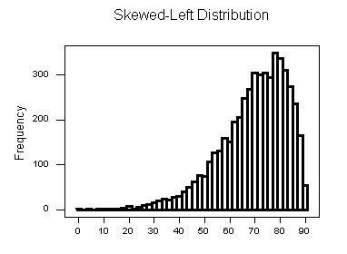
Phase I Quantitative Results: CS
Variable | Mean Score | Standard Deviation | Level Relative to Normal | Cronbach’s α p < .001
Compassion Satisfaction DRW NG WPT | 43.40 53.31 40.92 | 5.89 10.81 5.71 | High High High | .930 .896 .900

Slide 13
Phase I Quantitative Results: STS
Variable | Mean Score | Standard Deviation | Level Relative to Normal | Cronbach’s α p < .001
Secondary Trauma Stress* DRW NG WPT | 21.04 40.79 20.78 | 7.64 5.83 .5.28 | Low Ave to Low Low | .900 .778 .807
* Factor analysis revealed STS was a component of Compassion Fatigue (CF) among participants in all studies.

Slide 14
Phase I Quantitative Results: BO
Variable | Mean Score | Standard Deviation | Level Relative to Normal | Cronbach’s α p < .001
Burnout* DRW NG WPT | 19.25 42.06 22.25 | 6.58 6.40 5.26 | Low Ave to Low Low | .870 .789 .768
* Factor analysis revealed BO was a component of Compassion Fatigue (CF) among participants in all studies.

Slide 15
Correlations: CS with BO
Variable | CS with BO Pearson Correlation Coefficient* | P Value
Compassion Satisfaction & Burnout DRW NG WPT | -.589 -.720 - | p < .001 p < .001 -
*As BO increased, CS decreased.
Could CS be protective from CF?

Slide 16
Correlations: CS with STS
Variable | CS with BO Pearson Correlation Coefficient* | P Value
Compassion Satisfaction & Secondary Trauma Stress DRW NG WPT | -.230 -.793 - | p < .05 p < .001 -
*As STS increased, CS decreased.

Slide 17
Correlations: STS with BO
Variable | STS with BO Pearson Correlation Coefficient* | P Value
STS & BO DRW NG WPT | .637 .872 .548 | p < .001 p < .001 p < .001
*As STS increased, BO also increased.

Slide 18
Results
Burnout
Secondary Trauma Stress
Compassion Fatigue

Slide 19
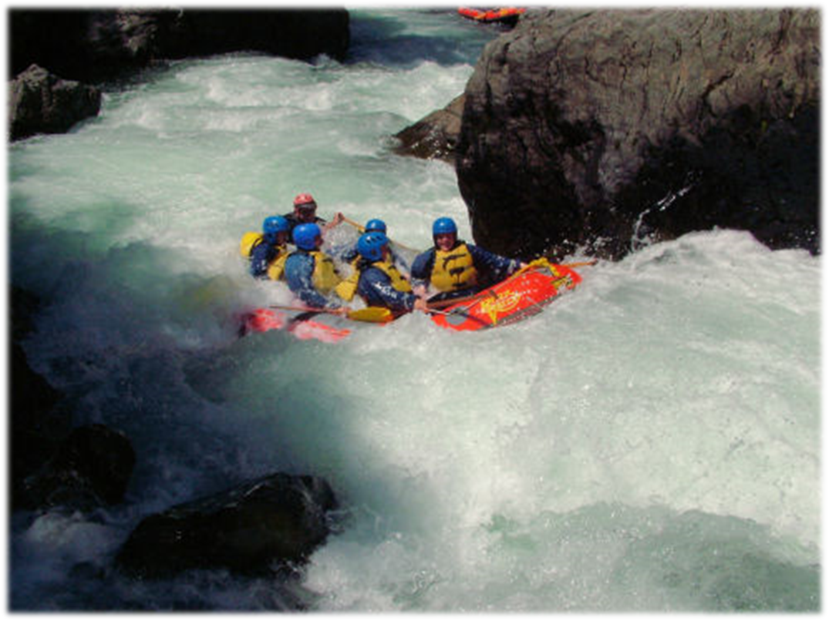
Phase 2: Qualitative Themes
1. Personal
2. Family
3. Professional
4. Creative Coping Strategies
5. Suggestions for Maintaining Life-Work Balance

Slide 20

Creative Coping Themes
Journaling
Social Networking
Creative Writing/Song Writing/Dance
Giving Presentations
Exercise, Mindfulness, Yoga

Slide 21

Qualitative Data
Factors Contributing to CF:
  It is a big burden to have someone's entire life in your hands… but I think that so far it is just important to confide in other people because if not that's how you get to the point of being overwhelmed. (Hazel, p. 9)

Slide 22

Qualitative Data
Personal Coping Strategies
  I try to do things outside of work that help fill up my tank of being able to give to other people. And so are the things I enjoy doing like playing piano or cooking or going for a run. Things like that. (Jessica, p. 6)
  So if there's something really heavy that I'm dealing with, I often journal or I write which is a good way for me to deal with it. (Christine, p. 11)

Slide 23
Qualitative Data
Professional Work Environment
  There is a chaplain who is very involved with us and if there is something that happened, they will send an e-mail to all employees, “I'm here, whatever you need. You're more than welcome to come to me. I'm happy to help you.” (Sara, p. 12)
  I have these incredibly supportive co-workers. We're like a little family and our environment is conducive for learning and teaching. (Jessica, p. 4)
  I also had a mentor who kept me in check and helped me understand and dialogue with me to be sure I wasn't getting influenced negatively. (Christine, p. 7)

Slide 24
Less Helpful Strategies. . .
Drinking excessively
Smoking
Illegal drugs
Unprotected sex outside committed relationships

Slide 25

Qualitative Data
Advice for Educators, Clinicians, and Workplace:
  I think that PTs need to know they have to take time for themselves. You need to have something outside of work to look forward to, too. (Kirstin)
  You can't fix everybody and that's okay… it's not necessarily your specific responsibility to go and fix everybody. (Jessica)
  I would say if at all possible find somebody who has some experience to help rather than going it alone. (Kristin)

Slide 26
Regression Analysis
Regression Analysis: Compassion Fatigue (CF) could be predicted from a participant's BO and STS scores on the ProQOL.

Slide 27
DRW Model:
Predicting Compassion Fatigue
CF = 5.219 + .174 (Trauma Ave.) - .650 (Burnout Ave)
Prediction Model:
CF = 5.219 + .174 (Trauma Avg) - .650 (Burnout Avg)
Trauma (.174)
Burnout
(-.650)
Compassion Fatigue
Internal Control Factors
Internal
Strategies
Compassion Satisfaction
5.219
External Control Factors
External
Strategies

Slide 28
NG Model: Predicting Compassion Fatigue
Internal & External Control Factors
Compassion Satisfaction
Compassion Satisfaction
Compassion Fatigue
1.471 (x) + 40.7934 = Compassion Fatigue
Via Secondary Trauma
1.216 (x) + 42.0636 = Compassion Fatigue
Via Burnout
Compassion Fatigue
Internal & External Coping Strategies

Slide 29


Discussion
CF among PTs was prevalent
PTs, like other health care professionals, lacked an awareness of CF and its influence on care
Factors contributing to CF in PTs
  Lack of adequate coping mechanisms
  Busy work schedules
  Productivity
Preventative Factors = Better Patient Care
  Healthy life-work balance
  Mentors
  Colleague support

Slide 30
Strengths & Limitations
STRENGTHS
  Adequate sample size, allowing for saturation
  Thick, rich descriptions of PT experiences
  Experienced phenomenological interviewer
  Appropriate bracketing by investigators
  High internal consistency by Cronbach α
LIMITATIONS
  Results of this study does not apply to every PT
  ProQOL is meant to be administered within 30 days of a stressful event
  Some overlap in correlations existed; consider adding a more sensitive BO tool

Slide 31

Conclusion
By understanding the experience of PTs, we can better anticipate the support needed for these individuals as they engage in their caregiving careers.
The importance of having social support at work and home cannot be underestimated.

Slide 32
Thank You! sklappa@davenport.edu

Slide 33
References
Stamm BH. The Concise ProQOL Manual, 2nd edition. Updated 2010. Retrieved from: http://proqol.org/uploads/ProQOL_Concise_2ndEd_12-2010.pdf. Accessed September 30, 2014.
Stamm BH. The concise ProQOL manual, 2nd edition. Updated 2010. Accessed November 12, 2011.
Jensen GM, Gwyer J, Hack LM, Shepard KF. Expertise in Physical Therapy. 2nd ed. St Louis, MO: Saunders Elsevier; 2007.
Potter P, Deshields T, Divanbeigi J, Berger J, Cipriano D, Norris L, Olsen S. (2010). Compassion fatigue and burnout: Prevalence among oncology nurses. Clinical Journal of Oncology Nursing, 14(5), E56-62. Retrieved fromhttp://search.proquest.com/docview/757194777?accountid=45723. Accessed January 27, 2015.
Lombardo B, Eyre C. Compassion fatigue: A nurse's primer. Online Journal of Issues in Nursing. 2011;16(1):8-3. http://search.proquest.com/docview/878058735?accountid=4572. Accessed January 27, 2015.
Hooper C, Craig J, Janvrin DR, Wetsel MA, Reimels E. Compassion satisfaction, burnout, and compassion fatigue among emergency nurses compared with nurses in other selected inpatient specialties. Journal of Emergency Nursing. 2010;36 (5): 420-427.
Sprang G, Clark JJ, Whitt-Woosley A. Compassion fatigue, compassion satisfaction, and burnout: Factors impacting a professional's quality of life. Journal of Loss and Trauma. 2007;12(3):259-280.
Sprang G, Craig C, Clark J. Secondary traumatic stress and burnout in child welfare workers: A comparative analysis of occupational distress across professional groups. Child Welfare. 2011;90(6):149-68. http://search.proquest.com/docview/1016368116?accountid=45723. Accessed January 27, 2015.
Abendroth M, Flannery J. Predicting the risk of compassion fatigue. Journal of Hospice & Palliative Nursing [serial online]November 2006;8(6):346-356. Available from: CINAHL with Full Text, Ipswich, MA. Accessed April 12, 2014.
Deighton R, Gurris N, Traue H. Factors affecting burnout and compassion fatigue in psychotherapists treating torture survivors: Is the therapist's attitude to working through trauma relevant? Journal of Traumatic Stress [serial online]. February 2007;20(1):63-75. Available from: PsycINFO, Ipswich, MA. Accessed April 12, 2014.

Slide 34
References
Peterson U, Demerouti E, Bergström G, Samuelsson M, Asberg M, Nygren A. Burnout and physical and mental health among Swedish healthcare workers. Journal of Advanced Nursing. April 2008;62(1):84-95. Accessed January 27, 2015.
Sorenson S. and Garman K. Engaging Employees After the Honeymoon Period. Business Journal. 2013. Available at: http://www.gallup.com/businessjournal/163463/engaging-employees-honeymoon-period.aspx?utm_source=WWW&utm_medium=csm&utm_campaign=syndication. Accessed January 27, 2015.
van Manen M. Researching lived experience: Human science for an action sensitive pedagogy. 2nd Ed.
London, Canada: Althouse Press; 1997.
Dahlberg K, Drew N, Nyström M. Reflective Lifeworld Research. Lund, Sweden: Studentlitteratur; 2001.
Thomas SP, Pollio HR. Listening to patients: A phenomenological approach to nursing research and
practice. New York, New York: Springer Publishing Company; 2002:294.
Rosenblatt P. Ethics of qualitative interviewing with grieving families. Death Stud. 1995;19:139-155.
Giorgi, A. An application of phenomenological method in psychology. In: Giorgi A, Fischer CT, Murray EL, editors. Duquesne Studies in Phenomenological Psychology. Vol. 2. Pittsburgh PA: Duquesne University Press; 1975.
Giorgi, A. The theory, practice and evaluation of the phenomenological method as a qualitative research procedure. Journal of Phenomenological Psychology. 1997;28:235-260.
Muthén LK, Muthén BO. Mplus User's Guide. 6th Ed. Los Angeles, CA: Muthén & Muthén; 1998-2012.
Bonanno GA, Moskowitz JT, Pappa A, et al. Resilience to loss in bereaved spouses, bereaved patients, and bereaved gay men. Journal of Personality and Social Psychology. 2005; 88:827-843.

Slide 35
References
21. Laschinger H, Finegan J, Wilk P. New Graduate Burnout: The impact of professional practice environment, workplace civility, and empowerment. Nursing Economic$ [serial online]. November 2009;27(6):377-383. Available from: Health Source: Nursing/Academic Edition, Ipswich, MA. Accessed on April 12, 2014.
Melvin C. Professional compassion fatigue: What is the true cost of nurses caring for the dying? International Journal of Palliative Nursing [serial online]. December 2012;18(12):606-611. Available from: CINAHL with Full Text, Ipswich, MA. Accessed on April 12, 2014.
Hyman O. Perceived social support and secondary traumatic stress symptoms in emergency responders. J Trauma Stress. 2004;17(2):149-156.
Von Rueden K,T., Hinderer KA, McQuillan KA. Secondary traumatic stress in trauma nurses: Prevalence and exposure, coping, and personal/environmental characteristics. J Trauma Nurs. 2010;17(4):191-2000.
Schaufeli W, Leiter M, Maslach C. Burnout: 35 years of research and practice. Career Development International. 2009;14(3):204-204-220.
Eriksson CB, Bjorck JP, Larson LC, et al. Social support, organisational support, and religious support in relation to burnout in expatriate humanitarian aid workers. Ment Health Religion Cult. 2009;12(7):671-686.
Figley CR. Compassion fatigue: Psychotherapists' chronic lack of self-care [SUP 1]. J Clin Psychol. 2002;58(11):1433-1441.
Campbell C, Campbell D, Krier D, Kuehlthau R, Hilmes T, Stromberger M. Reduction in burnout may be a benefit for short-term medical mission volunteers. Ment Health Religion Cult. 2009;12(7):627-637.
Ballenger-Browning K, Schmitz KJ, Rothacker JA, Hammer PS, Webb-Murphy J, Johnson DC. Predictors of burnout among military mental health providers. Military Med. 2011; 176(3):253-260.
Maddi SR. On hardiness and other pathways to resilience. American Psychologist. 2005;60:261-262.
Florian V, Mikulincer M, Taubman O. Does hardiness contribute to mental health during a stressful real-life situation? The roles of appraisal and coping. Journal of Personality and Social Psychology. 1995;68:687-695.

Slide 36




Questions?

