Slide 1
Palliative Medicine Fellowship: A study of resident choices
Susan B. LeGrand
Cleveland Clinic Taussig Cancer Institute, Cleveland Ohio, USA
Inova Health System, Fairfax Virginia, USA

Slide 2
Hospice and Palliative Medicine
Diversity Unclear
  New Field gains momentum
    Tension in the field itself to define HPM
HPM as new medical Sub- Specialty 2006
  10 Primary Boards recognition
Studies reveal growing demand with predicted workforce shortages
Notes:
Tension in the field itself
Recognition then the real work begins
Unique! 10 boards!
Picture of growth CAPC… NHPCO
Press release ACGME

Slide 3
Hospice and Palliative Medicine
Diversity Unclear
Who are we and what do we need?
How do we identify and recruit interested practitioners?

Slide 4
WHY Palliative Medicine?
Objectives:
  Define the characteristics of individuals pursuing fellowship training in HPM
    Demographic profile
    Drivers
    Barriers
    Interests
  Incorporate findings into strategies to interest fellows
  Consider opportunities to engage a larger pool to define needs of our field
Notes:
HPM FELLOWS – those demonstrating willingness/ability to fully engage in committing to career change as well as

Slide 5
METHODS
  Survey of current fellows in 2009
    AAHPM forwarded link to online survey to registered HPM fellowship Program Directors
    A follow up email was sent approximately 2 weeks later to enhance recruitment
    Free text answers were reviewed by the authors to identify themes
Notes:
40 items piloted and reduced to 39

Slide 6
Results
125 out of 185 total fellow slots filled out of 86 accredited programs
Respondents:
76 surveys initiated
62 completed all questions
Notes:
(May have been larger pool as non-accredited programs were included but do not have knowledge on number of fellows)

Slide 7
Results: Demographics
24%
21%
39%
61%

Slide 8
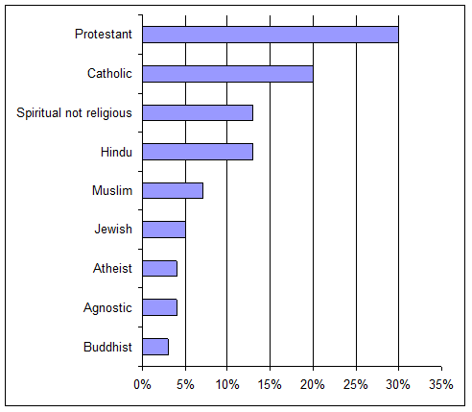
Table #1: Religious/Spiritual Preference

Slide 9
Results: primary Specialty
Notes:
4 of the IM were Oncologists
No Geriatricians
ONE FELLOW specifically ,mentioned frustration that certain programs were not able to accept him as a rad oncologist

Slide 10
Stage of Training/career at decision making
72 respondents answered the stage they were at the time they decided to pursue fellowship training in HPM
33%
67%
Notes:
Majority straight through, but significant proportion of Fellows coming from decision to change from another career

Slide 11
Timing of decision
Notes:
45, 40, 15% for Residents
Roughly 20% AND 38% for greater than 10y

Slide 12
Experience during Training
Impact on decision making
63% Said they did not feel prepared to manage dying patients after their residency
41% said they felt personal regret or sense of failure for care they provided to a dying, critically ill or symptomatic patient
The care of a dying, critically ill, or symptomatic person contributed to the decision to enter HPM in 86% (59/69) of respondent

Slide 13
Experience during Training
Impact on decision making
5 Major themes emerged
  1) the desire to improve communication skills,
  2) to improve care in the ICU or avoid overly aggressive care
  3) to improve symptom control
  4) to improve end-of-life (EOL) care for all patients,
  5) to improve patient and family support

Slide 14
HPM Exposure during Training
Medical School
Residency
58% no HPM exposure
50% were elective
In cases where HPM available 90% had taken advantage
1-4 weeks in length
Roughly 60% had HPM rotation available
80% were elective
In cases where HPM available 90% had taken advantage
2 or 4 weeks in length

Slide 15
HPM as a specialty option
46% HPM faculty mentor
29% Personal Experience with HPM
16% Rotation in HPM during training
Notes:
When asked how residents first learned of the field as an option for specialization - The majority of respondents – in other words you have to stumble upon it…

Slide 16
HPM Fellowship search factors
Table # 3 What was important to you as you were searching for a fellowship program?
 | n (%) | n (%)
 | 4 | 5
Hospital palliative medicine service | 22 (37) | 30 (51)
Strength of education | 23 (40) | 30 (53)
Broad spectrum of experience | 24 (40) | 27 (45)
Accredited program | 9 (14) | 43 (66)
0 – very unimportant, 1 – somewhat unimportant, 2 – neutral, 3 – somewhat important, 4 – very important, 5 - required
Notes:
Required – Accredited program, Hospital based pall med, Strength of edu
Very important – Same things and - Broad exposure, inpatient hospice
Very unimportant – potential job and research

Slide 17
HPM Fellowship search factors
Table # 3 What was important to you as you were searching for a fellowship program?
 | n (%) | n (%)
 | 4 | 5
Inpatient hospice | 21 (36) | 18 (31)
Geography | 14 (25) | 24 (43)
Name/reputation of program | 17 (30) | 16 (28)
Outcomes of prior fellows | 17 (30) | 11 (17)
0 – very unimportant, 1 – somewhat unimportant, 2 – neutral, 3 – somewhat important, 4 – very important, 5 - required
Notes:
Required – Accredited program, Hospital based pall med, Strength of edu
Very important – Same things and - Broad exposure, inpatient hospice
Very unimportant – potential job and research

Slide 18
HPM Fellowship search factors
Table # 3 What was important to you as you were searching for a fellowship program?
 | n (%) | n (%)
 | 4 | 5
Call/work load | 15 (27) | 9 (16)
Research opportunities | 8 (14) | 13 (23)
Potential job offer | 7 (13) | 2 (4)
Visa concerns | 0 (0) | 3 (6)
0 – very unimportant, 1 – somewhat unimportant, 2 – neutral, 3 – somewhat important, 4 – very important, 5 - required
Notes:
Required – Accredited program, Hospital based pall med, Strength of edu
Very important – Same things and - Broad exposure, inpatient hospice
Very unimportant – potential job and research

Slide 19
Detractors
Negative comments
  Too Depressing
  Lack of income potential
  Lack of professional respect / Perception that you are not really doing anything
  “waste of my talent/ability to manage patients”,
  “all you do is give morphine”.
  “all your patients will be dying”
Notes:
Multi select and free text

Slide 20
HPM search factors
# of applications
# of interviews

Slide 21
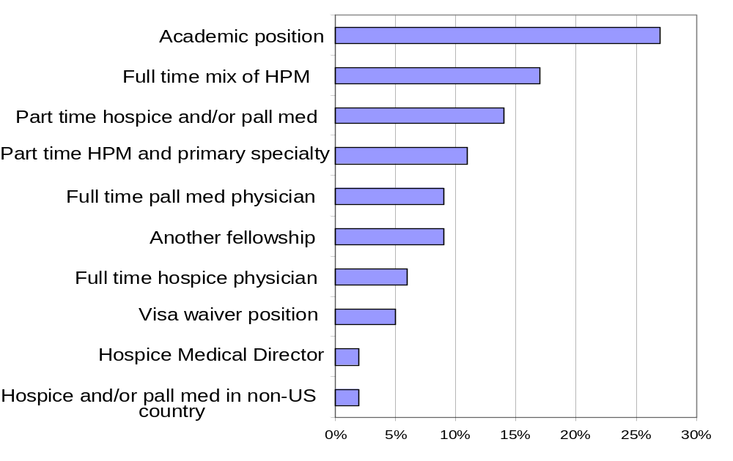
Table # 5 What kind of position do you hope to get when your training is complete?

Slide 22
60 % stated they expected to perform research in the future despite 36% stating it was important in their search for a fellowship program

Slide 23
Conclusions
Minorities are underrepresented
Older group
Diverse religious backgrounds
Heavily primary care specialties – care needed to attract and meet the needs of diverse learners
  Mid career learners
    Barriers real - Unique ways to accommodate training opportunities for second career physicians are being investigated by the AAHPM
only 62 % of our fellowship responders felt they were well prepared to manage dying patients as residents
Fellows’ experience of caring for dying, critically ill or symptomatic patients in residency was a substantial factor in their choice of the specialty

Slide 24
In focus groups looking at subspecialty choice in Canada, four factors were associated with choice of a particular specialty (17). These included lifestyle, role models, mentorship and the experience with the specialty.
Simple exposure appeared to play a key role in decision making and should be prioritized through curriculum development and rotation availability
Decision making later in residency – and implications for the match

Slide 25
Non validated survey tool
Did not query life style
Not certain how many actually received the survey
Educational exposure causative of decision to enter HPM or self selection…

