Slide 1
Spectroscopic Techniques for Archaeological Analysis
LIBS
Raman
LIF

Slide 2
Laser Induced Breakdown Spectroscopy (LIBS)
Intense laser pulse on the sample
Ablation
Generation of characteristic plasma
Plasma emission collected
Electronics and software to display the emission spectrum
Analysis of the spectrum

Slide 3
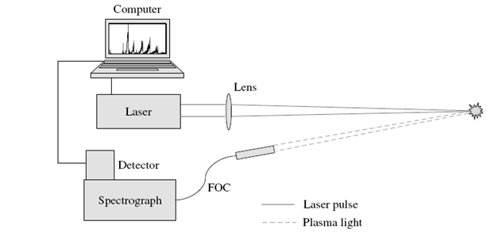
LIBS set-up

Slide 4
Fast
Low detection limit
Multielemental analysis
Minimal /no sample preparation
Minimal loss of sample
Insitu investigation
Remote Operation
Simple set-up
LIBS
Advantages

Slide 5
LIBS in Pigment Identification
Chemical Identification
Pigment Identification
Dating

Slide 6
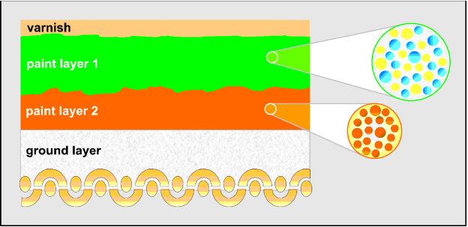
Laser Induced Breakdown Spectroscopy in Art and Archaeology, Demetrois Anglos, Focal Point, Volume 55, Number 6, 2001

Slide 7
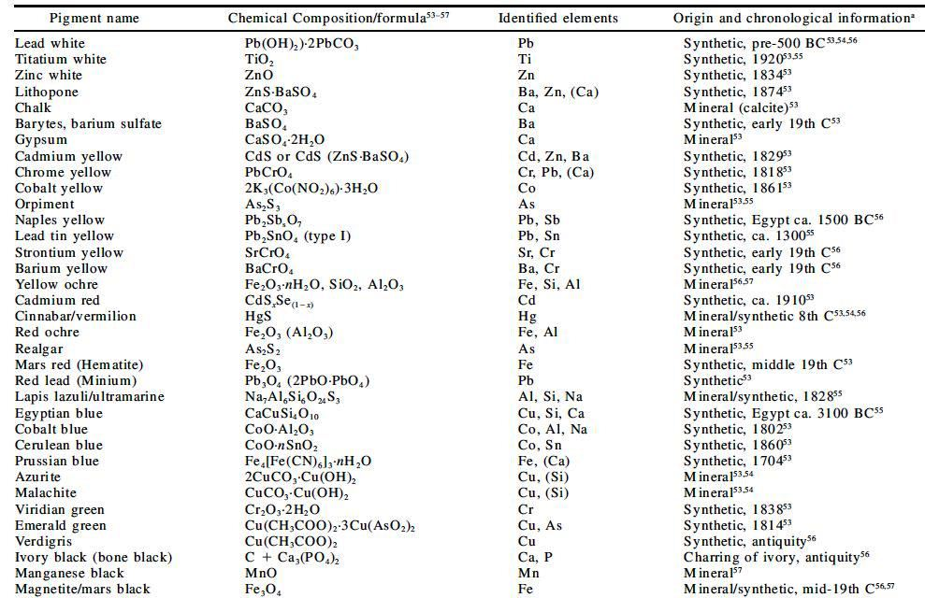

Slide 8
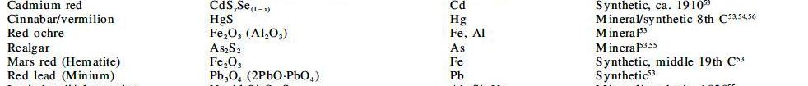
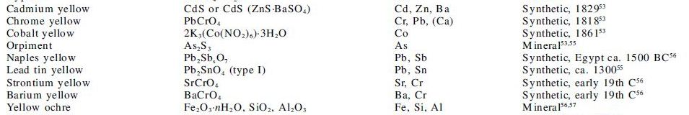

Slide 9
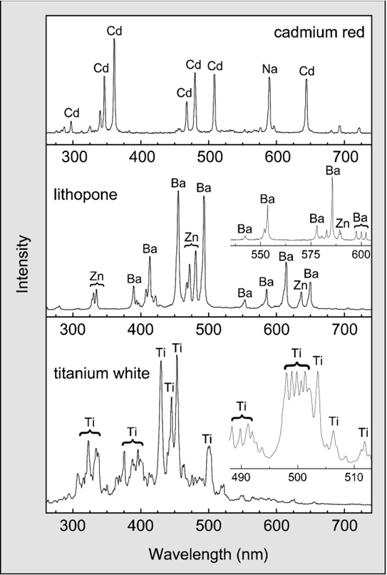

Slide 10
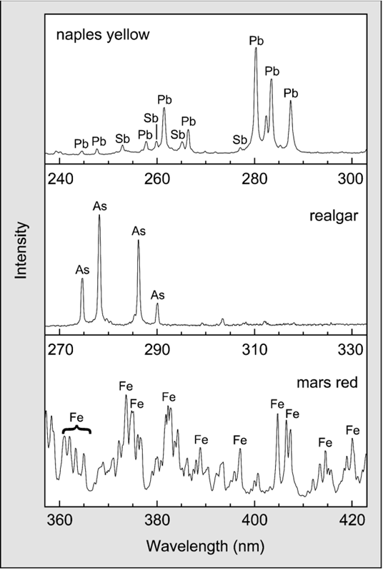

Slide 11
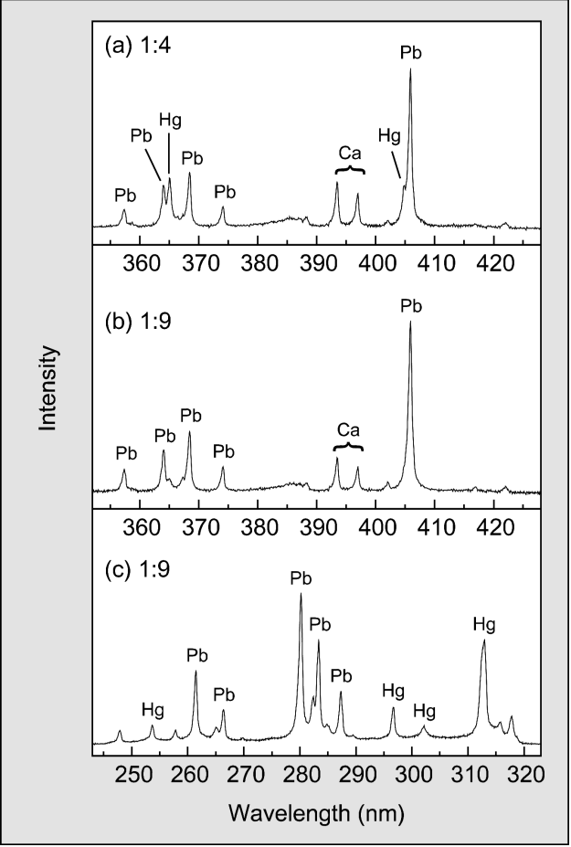
Pigment Mixtures
Vermilion –
HgS (Hg lines at 253.65nm,296.73nm,302.15nm, 312.57nm, 365.02nm 404.66nm)
and Lead White –
Pb (OH)₂.2PbCO₃
Pb lines at 261.42nm,
266.32nm, 280.2nm,
283.3nm, 287.33nm,
357.27nm, 363.96nm, 367.15nm, 368.35nm, 373.99nm, 405.78nm

Slide 12
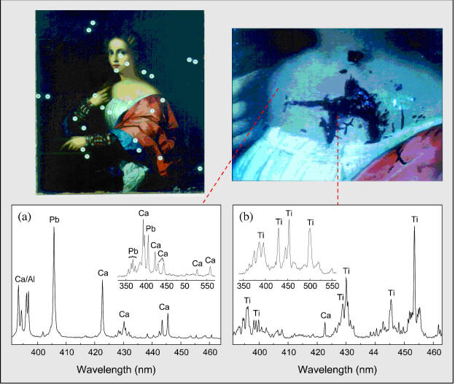
“La Bella” – Late eighteenth century
Lead Vs Titanium
Restored in 20th century

Slide 13
Optimisation
Value and fragility of the sample
Sampling of multiple layers give complex matrix
Single pulse measurement, optimisation of detection parameters being most crucial

Slide 14
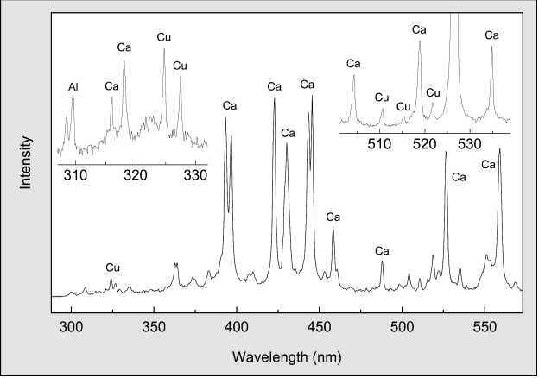
LIBS on Wall Paintings
Intense emission from calcium dominates the emission from the pigment due to the CaCO₃ matrix used

Slide 15
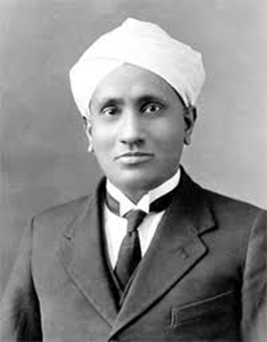
Raman Spectroscopy
Raman Effect
Inelastic scattering of light by certain materials
Scattered light gives information about the molecules
composition
bonding
crystalline structure
environment

Slide 16
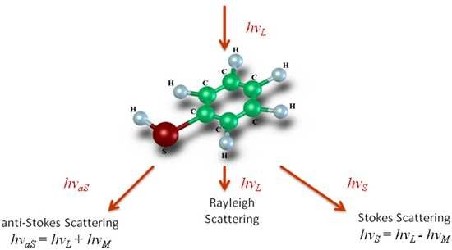
Raman Scattering
crozier.seas.harvard.edu

Slide 17
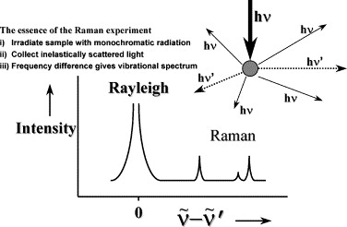
Raman Scattering
http://www.sciencedirect.com/science/article/pii/S0010854506001378

Slide 18
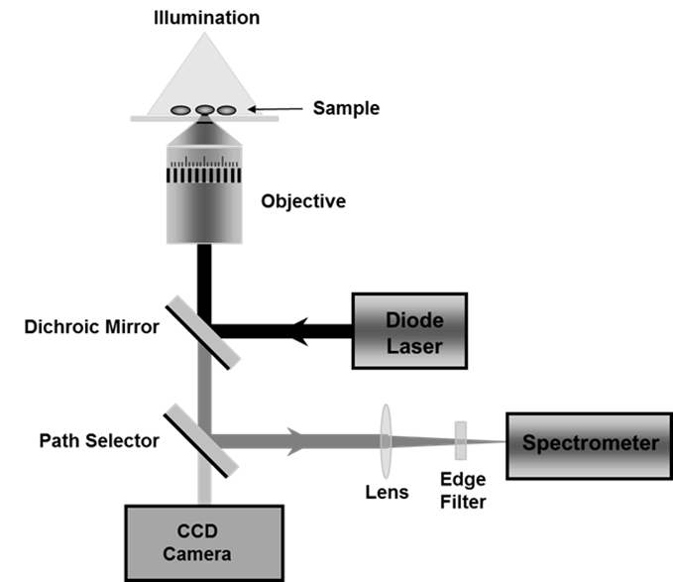
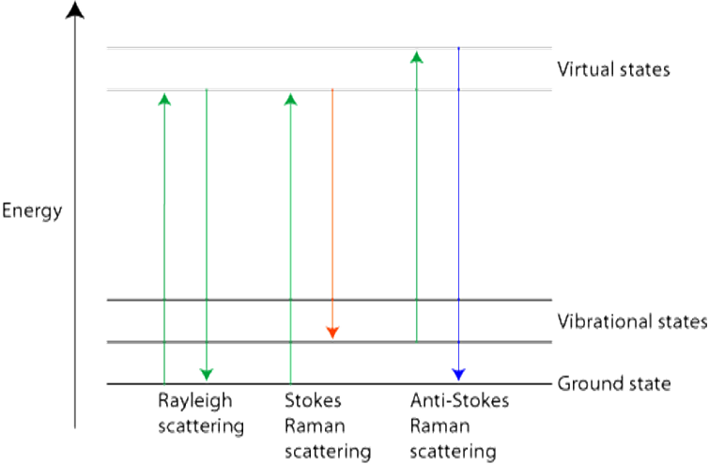
Raman Spectroscopy – Set up
Probing oxidative stress in singe erythrocytes with Raman Tweezers, E.Zacharia, Aseefhali Bankapur et.al , Centre for Atomic and Molecular Physics, Journal of Photochemistry and Photobiology B:Biology 100 (2010)

Slide 19
Raman Spectroscopy
Analysis Criteria
Position of peak
Width of peak
Height of peak

Slide 20
No sample preparation
Nondestructive
Any kind of sample
Confocality
Minimal sample
In-situ analysis possible on macro samples
Mobility of instrumentation
VIS-NIR
Raman Spectroscopy
Advantages

Slide 21
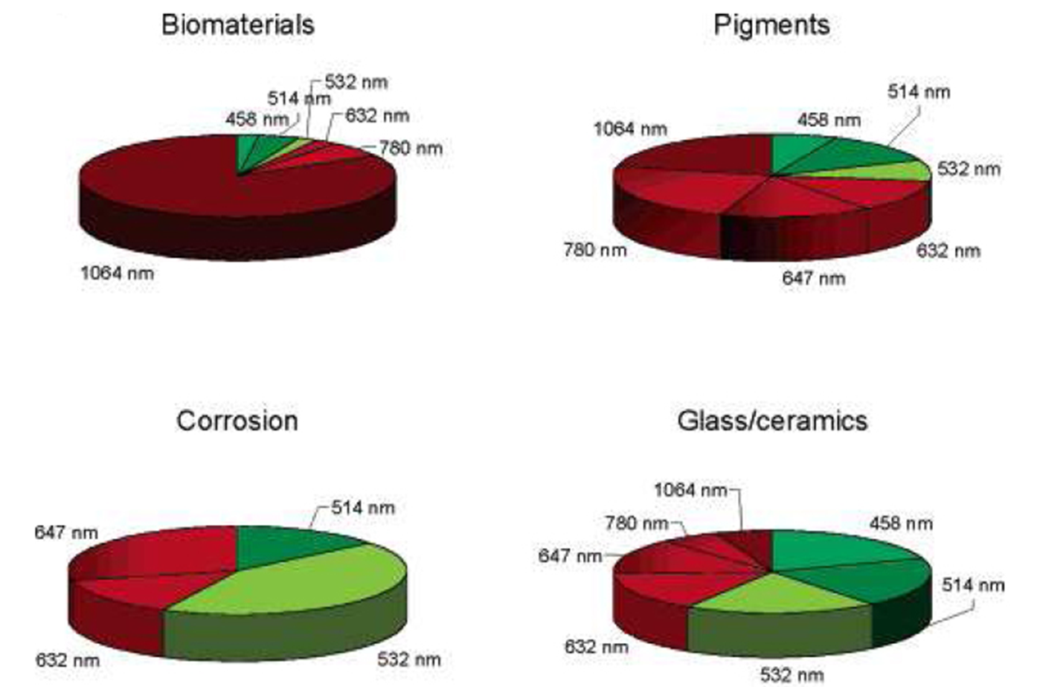
Choice of Wavelength
A Decade of Raman Spectroscopy in Art and Archaeology, P. Vandenabeele et.al.,Chemical Reviews , 2007, Vol107, No.3

Slide 22
Raman Analysis
Pigments and Paints
Choice based on availability
Minerals used:
Charcoal or carbon - C
Manganese dioxide - MnO₂
Hematite or iron red oxide -Fe₂O₃
Limonite or yellow ocher – FeO(OH)·nH₂O
Red lead (Pb₃O₄)
  Malachite (CuCO₃)
  Orpiment (As₂S₃)
Egyptian Blue (CaCuS₄O₁₀)

Slide 23
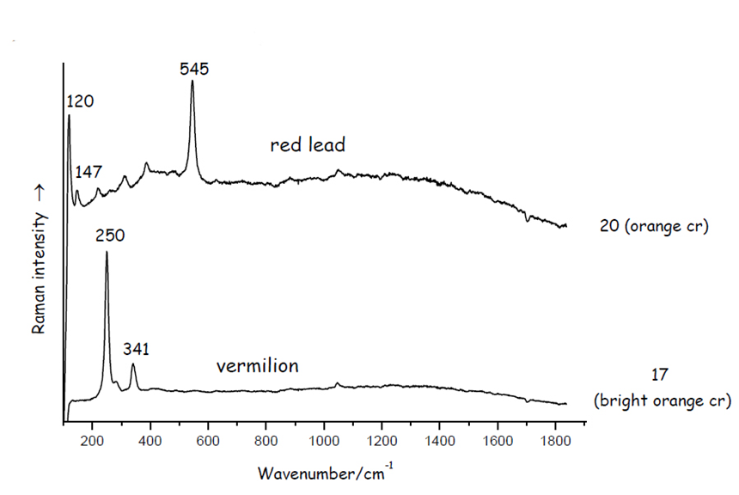
Raman spectra for the original painting (above) and for the miniature (below) were recorded.
The original signature - red lead pigment
Miniature- vermilion.
Conclusion: the miniature painting was a fake.
Comparison of English portrait miniatures using Raman microscopy and other techniques , L.Burgio et.al;,Journal of Raman Spectroscopy

Slide 24
Laser Induced Fluorescence
(LIF)
Information from fluorescence of the sample induced by laser
The wavelength and bandwidth of the emitted light is characteristic of the materials
The spectral bands of compounds rather than elements are analysed
Applicable on both organic and inorganic specimens.

Slide 25
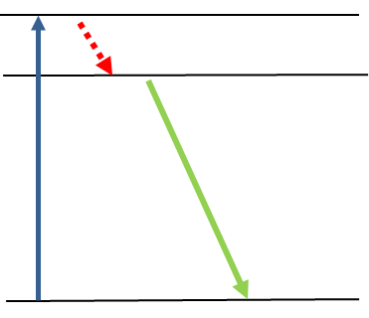
Laser Induced Fluorescence
(LIF)
Excitation from ground to upper level caused by photon energy
De-excitation to the lower levels with the emission of light i.e., fluorescence.
Nonradiative Transitions
Fluorescence

Slide 26
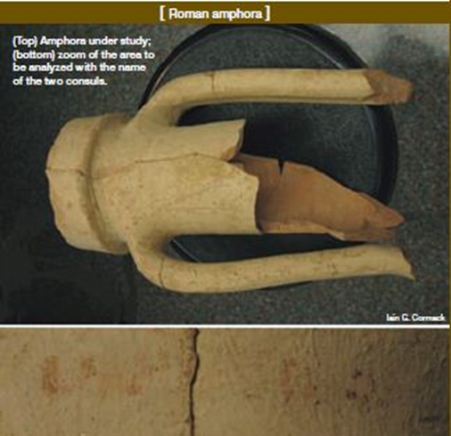
ArchaeoLIF
Problem: To find the time of foundation of the Roman village of Iesso (now a city in Guissona, Catalonia, northeast Spain)
Specimen: Wine Amphora
with the consular Date on the
neck of the amphora –
indicates the quality
of the wine
Historical Data Base: Names and
time frames of Roman consuls

Slide 27
ArchaeoLIF
Bottlenecks:
Barely readable paint
Natural photobleaching
Paint quality degraded due to earlier investigations
Results of earlier Investigations:
Q.FAB. ..………… . COS
Quintus Fabius ? Consolibus

Slide 28
LIF /LIBS/Raman
LIBS – semi-destructive
Raman – weak signal against the background
LIF – Fluorescence from the agglutinant which persisted

Slide 29
ArchaeoLIF
More hurdles in the choice of wavelength:
Easily prone to photo-damage
High energy photons for excitation X
Roman agglutinants fluoresce in the visible
Though required, green – UV excitation X
Femtosecond laser pulses for 2-photon
excitation with near Infrared light ✓

Slide 30
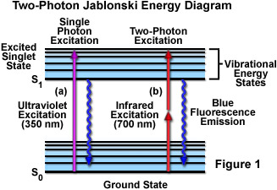
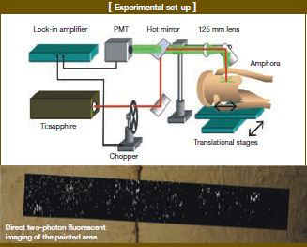
ArchaeoLIF
http://www.microscopyu.com/articles/fluorescence/multiphoton/multiphotonintro.html
Archaeophotnics: Lasers unveil the past, David Artigus et.al., CPN, July-August 2007

Slide 31

ArchaeoLIF
From previous experiments on the amphora fragments found in the same area:
Photo damaged threshold
Fluorescence only from painted region only
Imp
Fluorescence from agglutinants, inhibited by pigments

Slide 32
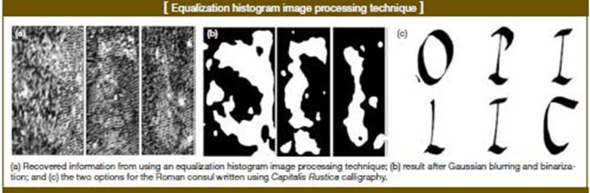
ArchaeoLIF
Resulting Images
Possibilities as suggested by historical database
O P I Lucius Opimius (Quintus Fabius Maximus Allobrogicus in 121 BCE)
L I C Caius Licinius Geta ( Quintus Fabius Maximus Eburnus in 116 BCE)

Slide 33

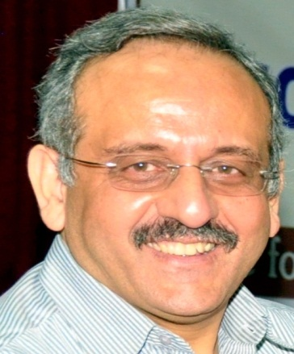


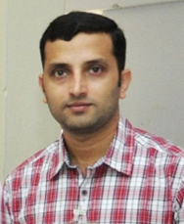

I Acknowledge OMICS group and
Prof. Deepak Mathur
Dr. Srikumar Menon
Mr. Aseefhali Bankapur
Prof. Santhosh Chidangil
Dr. Unnikrishnan
V.K.
Mr. Ajeetkumar Patil

Slide 34
“Statements that will hold good for all time are difficult to obtain in archaeology. The most that can be done at any one time is to report on the current state of knowledge.”
-Jennifer K McArthur,
“Place Names in the Knosses Tablets
Identification and Location”
Thank you

