Slide 1
Atypical Familial Hyperaldosteronism in a Family
Dr. Surjit Tarafdar
General Physician and Nephrologist
Blacktown Hospital
Blacktown
Sydney
Australia
Conjoint lecturer
Department of Medicine,Western Sydney University

Slide 2
Back to the basics first
Let us remind ourselves of the Renin Angiotensin System (RAS)
What causes aldosterone secretion?
What does aldosterone do?
How is the aldosterone synthesis pathway linked to cortisol and androgen synthesis?

Slide 3
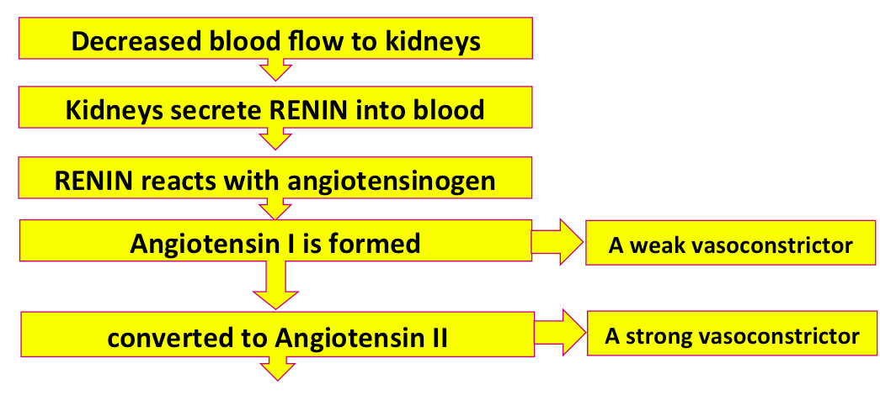
Renin-Angiotensin System (RAS)

Slide 4
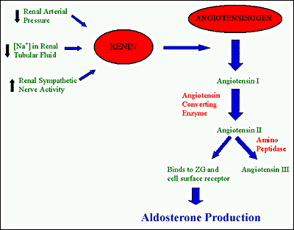
Aldosterone refresher
Angiotensin II is the most powerful stimulus for adrenal aldosterone secretion

Slide 5
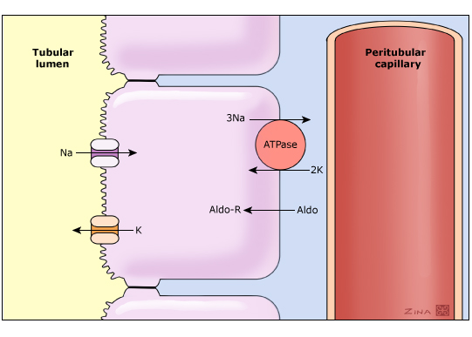
Aldosterone (Aldo), after combining with the cytosolic mineralocorticoid receptor (Aldo-R), leads to enhanced sodium reabsorption and potassium secretion by increasing both the number of open sodium channels and the number of Na-K-ATPase

Slide 6
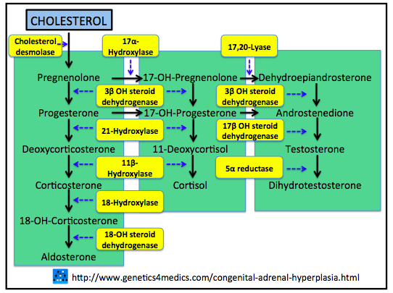
Adrenal steroid synthesis

Slide 7
Primary Aldosteronism (Conn’s Syndrome)….still underdiagnosed
Classic presentation: hypertension and metabolic alkalosis with/without hypokalaemia
Prevalence : 5-13% of all patients with hypertension
The most frequent causes of primary aldosteronism include:
  Bilateral idiopathic hyperaldosteronism (or idiopathic hyperplasia of adrenal gland-60 to 70%)
  Unilateral aldosterone producing adenoma (-30 to 40%)
Clin Endocrinol (Oxf) 2007 May;66(5):607-18. Primary aldosteronism: renaissance of a syndrome, Young WF

Slide 8
Primary Aldosteronism
Less common causes of primary aldosteronism include:
    Familial hyperaldosteronism (FH) types I , II, III and IV
    Pure aldosterone-producing adrenocortical carcinomas and ectopic aldosterone-secreting tumours (e.g. neoplasms in the ovary or kidney)
    Unilateral hyperplasia or primary adrenal hyperplasia (caused by hyperplasia of the zona glomerulosa of predominantly one adrenal gland)- The clinical presentation and outcome of these patients is similar to Conn’s Syndrome

Slide 9
Who to screen for Primary Aldosteronism?
Hypertension and spontaneous or low-dose diuretic-induced hypokalaemia/alkalosis
Severe hypertension (>150 mmHg systolic or >100 mmHg diastolic) or drug-resistant hypertension
Hypertension with adrenal incidentaloma
Hypertension and a family history of early-onset hypertension or cerebrovascular accident at a young age (<40 years)
All hypertensive first-degree relatives of patients with primary aldosteronism
Onset of hypertension at age < 30 years

Slide 10
Diagnosis of Primary Aldosteronism
Initial test: Plasma aldosterone concentration/plasma renin activity or concentration (PAC/PRA or PRC) ratio >20 suggestive of primary aldosteronism
REMEMBER the PAC/PRA ratio is denominator dependent
  Interfering drug for PAC/PRA: aldosterone antagonists the only one to really worry about…
  Undetectable PRA in someone taking ACEI or ARB is a strong indicator for primary aldosteronism as normally ACEI or ARB causes high PRA
Confirmation of diagnosis: Oral sodium loading OR saline infusion test

Slide 11
Imaging in Primary Aldosteronism
Adrenal computed tomography (CT) to determine subtype (adenoma versus hyperplasia versus adrenal carcinoma)
- unilateral large (>4 cm) adrenal mass suggests carcinoma
- abnormality in both glands suggests adrenal hyperplasia
Limitations of CT : From 203 patients evaluated with CT and Adrenal Vein Sampling (AVS)
  CT was accurate in only 53 % of patients
  Based upon CT, 42 patients (22 %) would have been incorrectly excluded from adrenalectomy
  48 (25 %) might have had unnecessary or inappropriate surgery
Role for adrenal venous sampling in primary aldosteronism. Young WF, Stanson AW, Thompson GB, Grant CS, Farley DR, van Heerden JA , Surgery. 2004;136(6):1227.

Slide 12
Adrenal Vein Sampling (AVS) in Primary Aldosteronism
Indications: To confirm unilateral lesion in patients who would like to pursue surgical management (unilateral adrenalectomy) when:
- CT scan is normal
- Bilateral but asymmetric abnormalities
- Unilateral abnormality but the patient is over age 35 years of age
Aldosterone ratio of more than 4:1 between the right and left lobes of adrenal gland suggests unilateral adrenal adenoma
NOTE- if patient does not desire surgery then NO need for AVS

Slide 13
Familial Hyperaldosteronism (FH)
FH type I or glucocorticoid-remediable aldosteronism (GRA) due to a CYP11B1/CYP11B2 chimeric gene
FH type II, which has been localized to chromosome 7p22, but exact location of mutation(s) is unknown to date
FH type III caused by germline mutations in the potassium channel subunit KCNJ5
FH type IV caused by germline mutations in the CACNA1H gene, which encodes the alpha subunit of an L-type voltage-gated calcium channel (Cav3.2)

Slide 14
FH type I or glucocorticoid-remediable aldosteronism(GRA)
Humans synthesize cortisol in the zona fasciculata with CYP11B1 involved in the last step
Humans synthesize aldosterone in the zona glomerulosa with CYP11B2 involved in the last step
Cortisol production is controlled by adrenocorticotrophic hormone(ACTH) while aldosterone production is NOT controlled by ACTH
Normally CYP11B1 and CYP11B2 are 95% similar

Slide 15
FH type I or Glucocorticoid-Remediable Aldosteronism (GRA)
In GRA unequal crossovers between CYP11B1 and CYP11B2 lead to both aldosterone and cortisol production being controlled by the same hybrid CYP11B1/CYP11B2 enzyme
Both cortisol and aldosterone are THERFORE under control of ACTH
Autosomal dominant inheritance
Hypertension develops before age of 21 and strong family history
Dexamethasone suppression testing now replaced by genetic testing
Treatment with prednisolone and/or mineralocorticoid receptor antagonists

Slide 16
Familial Hyperaldosteronism Type II
Autosomal dominant inheritance
Familial occurrence of aldosterone-producing adenoma or bilateral idiopathic hyperplasia, or both, in the same family
Clinically indistinguishable from sporadic primary aldosteronism
Exact mutation not known but suspected linkage to chromosome 7p22
Further evidence for linkage of familial hyperaldosteronism type II at chromosome 7p22 in Italian as well as Australian and South American families.
Sukor N, Mulatero P, Gordon RD, So A, Duffy D, Bertello C, Kelemen L, Jeske Y, Veglio F, Stowasser M, J Hypertens. 2008 Aug;26(8):1577-82

Slide 17
Familial Hyperaldosteronism Types III and IV
FH Type III
- Children and young patients present with massive adrenal hyperplasia
- Autosomal dominant inheritance
-Caused by mutation in potassium channel KCNJ5
FH IV
- Caused by germline mutations in CACNA1H
-CT may show cortical adenoma, bilateral hyperplasia, or normal-appearing adrenal glands
- Adrenal venous sampling shows bilateral aldosterone hypersecretion
K+ channel mutations in adrenal aldosterone-producing adenomas and hereditary hypertension.
Choi M, Scholl UI, Yue P, Björklund P, Zhao B, Nelson-Williams C, Ji W, Cho Y, Patel A, Men CJ, Lolis E, Wisgerhof MV, Geller DS, Mane S, Hellman P, Westin G,Åkerström G, Wang W, Carling T, Lifton RP , Science. 2011;331(6018):768

Slide 18
Congenital Adrenal Hyperplasia (CAH)
A group of autosomal recessive disorders involving deficiency of enzyme involved in the synthesis of cortisol, aldosterone or both
Commonest CAH: >90% of cases due to deficiency of 21-hydroxylase deficiency (21OHD)

Slide 19
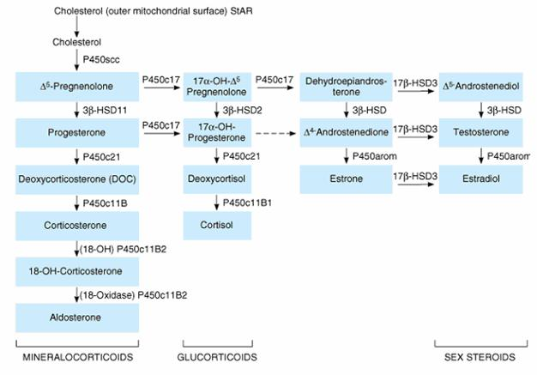
Steroid Synthesis Pathway

Slide 20
CAH due to deficiency of 21-hydroxylase deficiency (21OHD)
Defective conversion of 17-hydroxyprogesterone to 11-deoxycortisol results in decreased cortisol synthesis and increased ACTH secretion
Increased ACTH leads to adrenal stimulation and increased production of androgens
Most have associated salt losing due to aldosterone deficiency
Classic 21OHD presents in neonates/infants with adrenal insufficiency, toddlers with virilization or female children with genital ambiguity
Non-classic or late-onset 21OHD may present as hirsutism and menstrual irregularity in young women, early pubarche or sexual precocity in school-age children
High level of 17-hydroxyprogesterone diagnostic

Slide 21
Uncommon Congenital Hyperplasia
CYP17A1 DEFICIENCIES: HTN and low K due to accumulation of cortisol precursors with mineralocorticoid activity upstream of block
  Sexual ambiguity or infantilism
3-BETA-HYDROXYSTEROID DEHYDROGENASE TYPE 2 DEFICIENCY : Synthesis of all active steroid hormones is impaired
  hypotension and high K with genital ambiguity in newborns

Slide 22
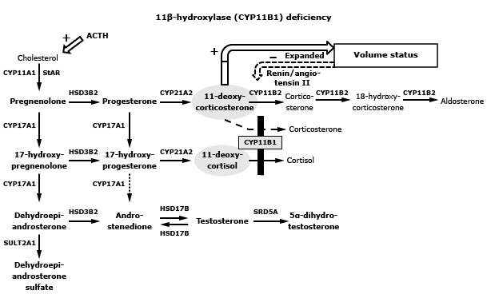
Uncommon CAH due to 11-Beta Hydroxylase deficiency
Block in conversions of 11-deoxycorticosterone (DOC) and 11-deoxycortisol to corticosterone and cortisol respectively

Slide 23
11-BETA-HYDROXYLASE DEFICIENCY
11-deoxycorticosterone or DOC (which has intrinsic mineralocorticoid activity) causes hypokalemic hypertension and supressed aldosterone production
Ambiguous genitalia or sexual precocity due to excess androgens
Characterised by high serum concentrations of 11-deoxycortisol, DOC, DHEA and DHEAS, androstenedione, and testosterone, with low cortisol and corticosterone

Slide 24
Our Case
27-year-old male from Philippines migrated with parents to Australia at the age of ten with diagnosis of HTN from the age of 21 (non-compliance with treatment)
Admitted with pneumonia, noted to have BP 180/100 with following biochemistry
K : 3.3 mmol/L ( Ref range 3.2 to 5.0)
HCO3: 30 mmol/L ( Ref range 22 to 32)
Normal urea, creatinine, sodium, liver function test, calcium, phosphate, magnesium and haemoglobin

Slide 25
Our Case
Father had difficult to control HTN from young age
Younger brother diagnosed to have HTN from the age of 22
Patient smoked 15 cigarettes/ day for last seven years, drank alcohol socially and had a BMI of 32
Apart from the HTN, rest of clinical examination was unremarkable
Started on amlodipine 10 mg and Telmisartan 80 mg and discharged with clinic follow up
Evaluated for secondary HTN

Slide 26
Our Case
No evidence of renal artery stenosis, pheochromocytoma or Cushing syndrome
Plasma aldosterone: 547 pmol/L (Ref range: 61 - 978 pmol/L)
Plasma renin concentration < 2 mIU/L (Ref range upright: 4.4 – 46.1 mIU/L)
Plasma aldosterone concentration/plasma renin concentration (PAC/PRA) ratio > 270 is consistent with diagnosis of primary aldosteronism
0800 serum cortisol levels normal

Slide 27
Further investigation
Confirmation with saline infusion test: Plasma aldosterone 393 pmol/L after IV infusion of 2 L isotonic saline consistent with primary aldosteronism (levels will fall below 139 pmol/L in normal subject)
CT scan showed hyperplastic right adrenal gland
Patient refused to have AVS
HTN responded well to a combination of spironolactone 50mg and Telmisartan 80 mg
Genetic test given the young age of onset of HTN and strong family history

Slide 28
Genetic test revealed
Presence of rs61751131 and deletion in position 4946-4954 - CYP11B1 NG_007954, Exon1 – Intron area
Normally large mutation in CYP11B1 is consistent with uncommon CAH due to 11 beta hydroxylase deficiency and characterised by hypokalemic hypertension due to high DOC and supressed aldosterone production
Is this Uncommon CAH or familial hyperaldosteronism?

Slide 29
A reminder of uncommon CAH due to 11 beta hydroxylase deficiency
Characterised by high serum concentrations of
- 11-deoxycortisol
- 11-DOC (hypokalemic HTN due to the mineralocorticoid effect of DOC)
- DHEA
- DHEAS
- androstenedione
- Testosterone
low concentrations of
- cortisol
Clinically associated with ambiguous genitalia or sexual precocity due to excess androgens

Slide 30
Patient’s Biochemistry Tests
Biochemistry Tests | Results
Morning Cortisol | 251 nmol/L ( 100- 540 nmol/L)
11 Deoxycortisol | 2.7 nmol/L (< 4.6 nmol/L)
11 DOC (Deoxycorticosterone) | 0.12 nmol/L (< 0.4 nmol/L)
DHEA | 34.4 nmol/L (4.5-48 nmol/L)
DHEAS | 16.1 umol/L (4.6- 16.1 umol/L)
Androstenedione | 5.1 nmol/L ( 2.8 – 6.7 nmol/L)
Testosterone | 11.4 nmol/L (Adult>10nmol/L)

Slide 31
More in the family…..
52 year old father says has had poorly controlled HTN for > 20 years
On Telmisartan 80 mg and metoprolol 25 mg BD (has been on different anti-HTN combinations in the past)
Family history:
- Sister: hypertensive (unsure of age of diagnosis)
- Mother: HTN
- Father: HTN, CVA
O/E- BP 201/94 with rest of clinical examination unremarkable

Slide 32
Father’s Investigation
Plasma aldosterone | 400 pmol/L (61 - 978 pmol/L)
Plasma renin concentration | 2.8 mIU/L (4.4 – 46.1 mIU/L)
Aldo/renin ratio | 143
Cortisol | 212 nmol/L at 0800 (Range before 10:00am: 100 to 540 nmol/L)
Short synacthen- | 834 nmol/L at 0910 and 874 nmol/L at 0940 (adequate response)
ACTH- | 5.5 pmol/L (0 to 12)
Testosterone | 29.4 nmol/L (adult>10 nmol/L)
DHEA | 10.1 nmol/L (4.5-48 nmol/L)
11 DOC | 0.12 nmol/L (< 0.4 nmol/L)
11 Deoxycortisol | 1.3 n mol/L (< 4.6 nmol/L)
Corticosterone | 4.3 nmol /L (< 55 nmol/L)
CT scan showed 11 mm lesion in right adrenal gland suggestive of adenoma

Slide 33
First documentation of Familial Hyperaldosteronism in a family with 11β-OH1 mutation
11β-OH1 mutation causes CAH characterised by hyperandrogenism along with accumulation of 11 –deoxycortisol and 11-deoxycorticosterone and supressed aldosterone production
11-deoxycorticosterone (which has intrinsic mineralocorticoid activity) causes hypokalemic hypertension
Both father and son have 11β-OH1 mutation with
Hypokalemic hypertension
Raised aldosterone with suppressed renin suggesting primary aldosteronism
Normal 11 – deoxycortisol ,11-deoxycorticosterone and cortisol which rule out CAH

Slide 34
Discussion Continues
The defect in CYP11B1 in this family rather than pushing the steroid pathway into androgen excess at the cost of low cortisol and aldosterone as is expected in CAH, lead the pathway into the aldosterone route
Could be due to gain of function mutation of CYP11B1 in the aldosterone pathway or a partial block in cortisol pathway with the pathway going predominantly into the aldosterone route
Exome sequencing being done for both father and son

Slide 35
Outcome for son and dad
Both father and son responded well to combination of spironolactone and RAS blockade
Are we looking at type V Familial Hyperaldosteronism?

Slide 36
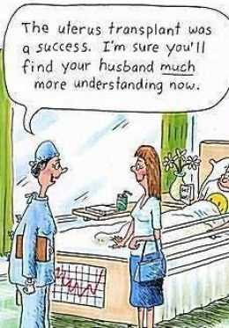
Thank you

