Slide 1
COMPUTATIONAL FUNCTIONAL and structural annotation OF HYPOTHETICAL PROTEINS OF Neisseria Meningitidis MC58
Suresh Kumar*
Senior lecturer,
Department of Diagnostic and Allied Health Sciences,
Faculty of Health and Life Sciences,
Management & Science University, Shah Alam,
Malaysia

Slide 2
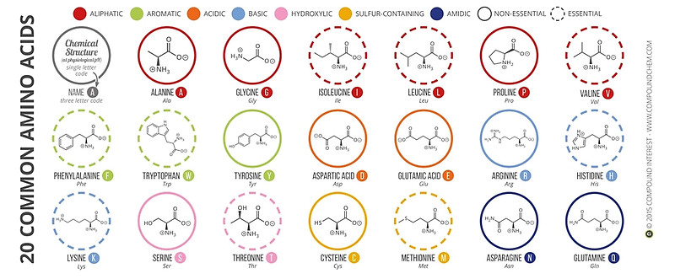
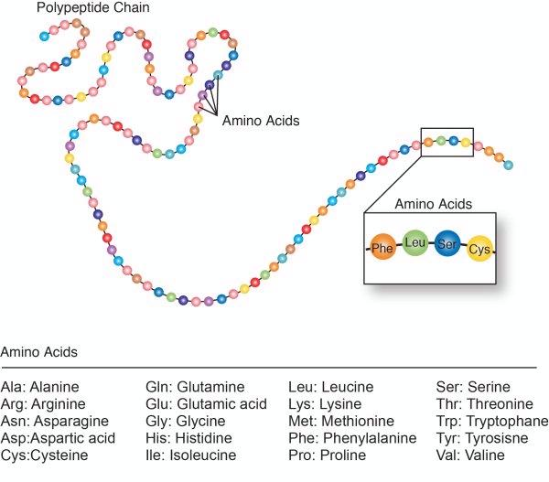
Background – Amino acids

Slide 3
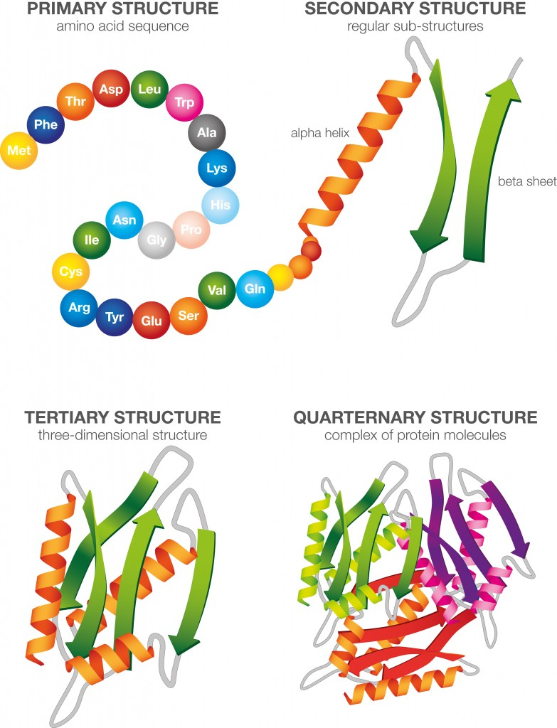
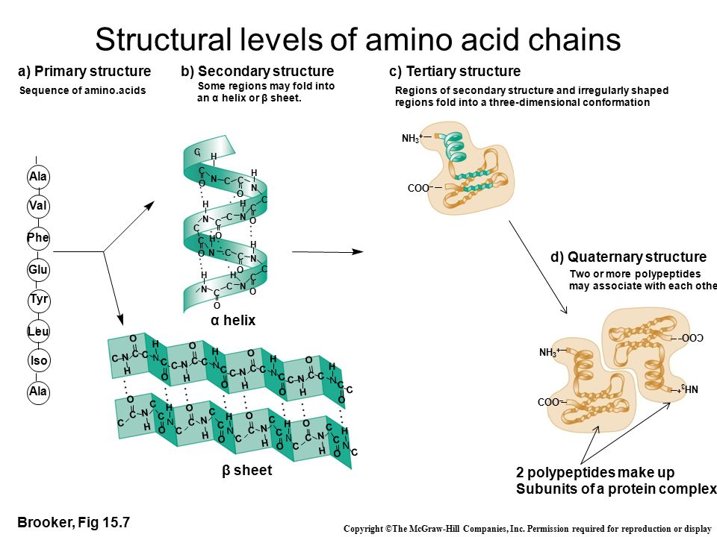
Background- Protein structure

Slide 4
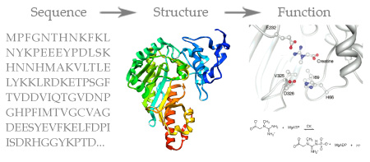
Background- Sequence-structure-function paradigm

Slide 5
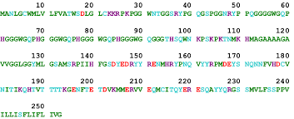
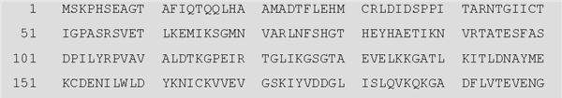
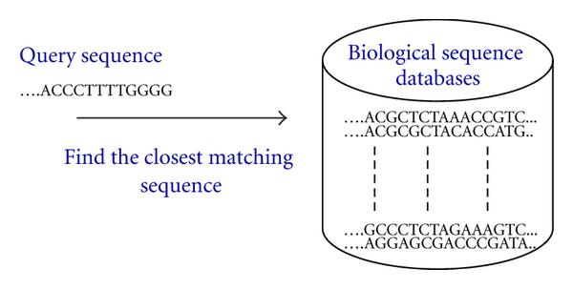
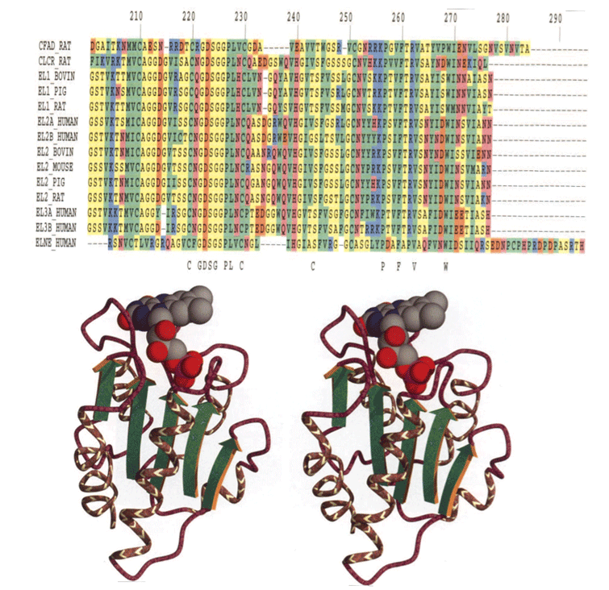
Annotated sequence in database
New sequence

Slide 6
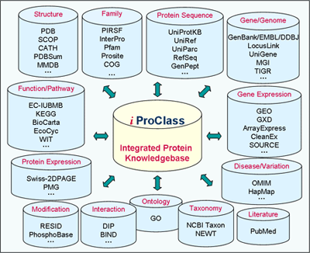

Slide 7
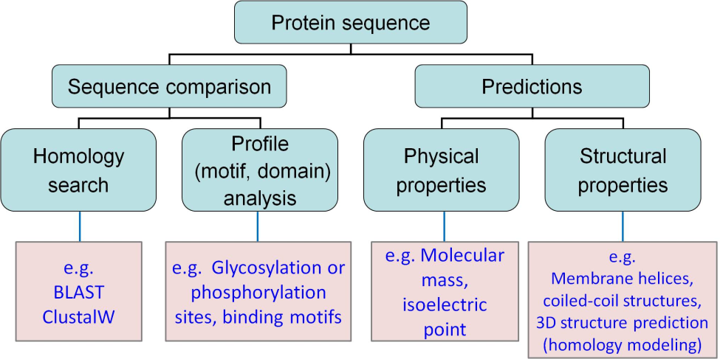

Slide 8
Introduction
Neisseria meningitidis is a gram negative parasitic bacterium of the family Neisseriaceae and it is a restrict nasopharyngeal human pathogen, which leads to severe diseases like septicemia and meningitis.
It can be passed to the brain especially among children and infants by invading the respiratory epithelial tissue and then crossing the blood brain barrier.
Some of the common symptoms are high fever, lethargy, confusion, nausea, neck stiffness, vomiting and petechial rash.

Slide 9
Neisseria meningitidis
Neisseria meningitidis, often referred to as meningococcus, is a gram negative bacterium that can cause meningitis and other forms of meningococcal disease such as meningococcemia, a life-threatening sepsis. The bacterium is referred to as a coccus because it is round, and more specifically, diplococcus because of its tendency to form pairs.
The 2,272,351-base pair genome of Neisseria meningitidis strain MC58 (serogroup B), a causative agent of meningitis and septicemia, contains 2158 predicted coding regions, 1158 (53.7%) of which were assigned a biological role.

Slide 10
Antibiotic resistance
Continued selective pressure by a variety of antibiotics has resulted in bacteria developing resistance mechanisms that lead to multidrug resistance
The rapid development of antimicrobial resistance amongst Neisseria species has been reported worldwide
A major obstacle for the control of Neisseria Sp.

Slide 11
Hypothetical proteins
Analysis of antibiotic resistance and resistance genes can help us to understand drug resistance mechanisms, thereby helping to guide clinical treatment of the disease.
Sequencing of several genomes has resulted in numerous predicted open reading frames to which functions cannot be readily assigned.
A hypothetical protein is a protein whose existence has been predicted, but for which there is a lack of experimental evidence that it is expressed in vivo.
The aim of this study to analyse using various bioinformatics tools and databases for function prediction of previously not assigned proteins in the genome of Neisseria meningitidis strain MC58.

Slide 12
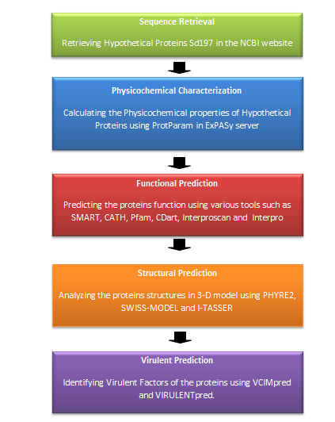
Methodology

Slide 13
S.No. | Tools/Servers/Databases | URL
Sequence Retrieval
1 | NCBI Genome Database | http://www.ncbi.nlm.nih.gov/genome
2 | UniProt Database | http://www.uniprot.org/uniprot
Physicochemical Characterization
3 | ExPASy – ProtParam tool | http://www.web.expasy.org/protparam/
Sub-cellular Localization
4 | PSORT B v3.0 | http://www.psort.org/psortb/
5 | PSLpred | http://www.imtech.res.in/raghava/pslpred
6 | CELLO | http://cello.life.nctu.edu.tw/

Slide 14
7 | SignalP 4.1 | http://www.cbs.dtu.dk/services/SignalP/
8 | SecretomeP | http://www.cbs.dtu.dk/services/SecretomeP/
9 | HMMTOP | http://www.enzim.hu/hmmtop
10 | TMHMM | http://www.cbs.dtu.dk/services/TMHMM/
Protein Categorization
11 | SMART | http://smart.embl-heidelberg.de/
12 | INTERPRO | http://www.ebi.ac.uk/interpro
13 | CATH | http://www.cathdb.info/search
14 | Pfam | http://pfam.xfam.org/
15 | Conserved Domain Database | http://www.ncbi.nlm.nih.gov/Structure/cdd/wrpsb.cgi
Virulence Prediction
16 | VICMpred | http://www.imtech.res.in/raghava/vicmpred/
Structure Prediction 17
 | Phyre2 Server | http://www.sbg.bio.ic.ac.uk/phyre2/html/page.cgi?id=index

Slide 15
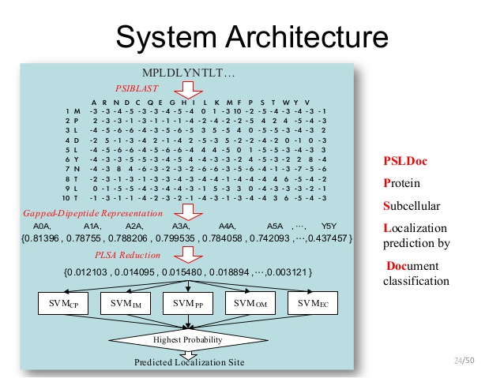
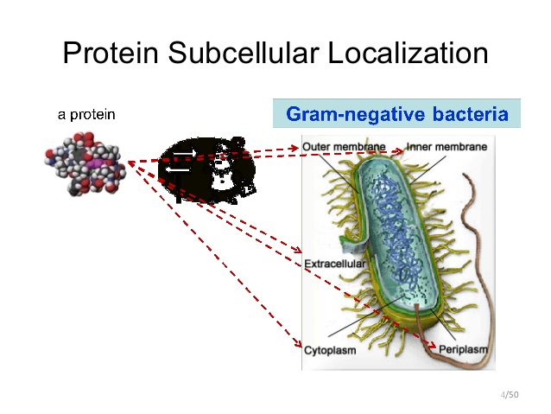
Sub-cellular localization

Slide 16
Result- Sub-cellular localization

Slide 17
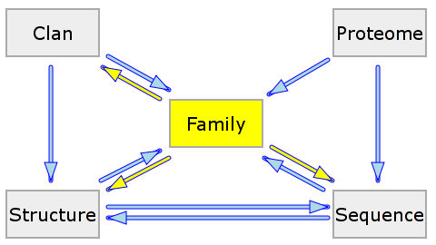
Protein categorization –PFAM
Pfam is a collection of mulitple sequence alignments and hidden markov models covering many common protein domain and familiies
The PFAM database may be search for similarity to a query protein sequence
PFAM may also be used to analyze proteomes and domain architectures

Slide 18
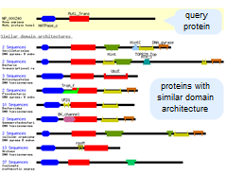
Protein categorization –CDD
CDD is a protein annotation resource that consists of a collection of well-annotated multiple sequence alignment models for ancient domains and full-length proteins. These are available as position-specific score matrices (PSSMs) for fast iden3D-structuprovide insights into sequence/structure/function relationships, as well as domain models imported from a number of external source databases (Pfam, SMART, COG, PRK, TIGRFAM.

Slide 19
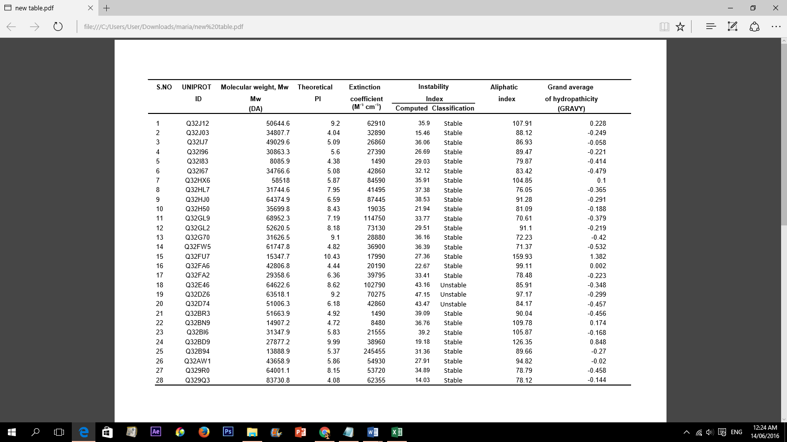
Results & Discussion -Physicochemical Characterization

Slide 20
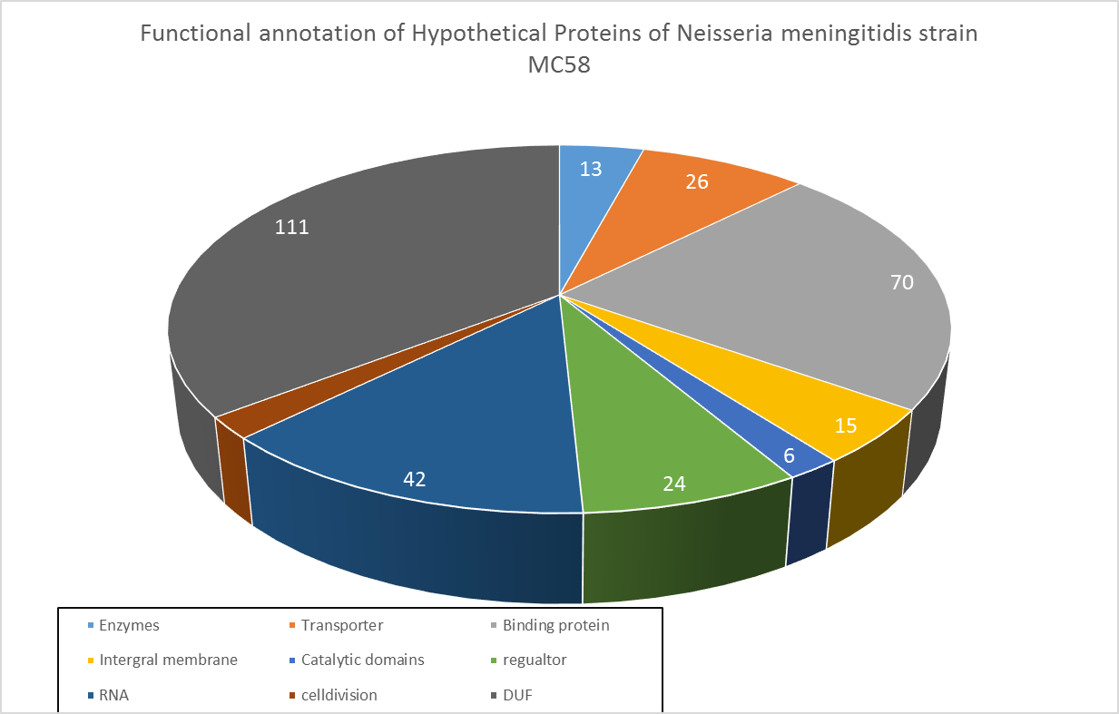

Slide 21
Results & Discussion
Enzymes : (13). Survival, for they provide nutrients for growth and are responsible for multiplication of the organism.
Hydorolase: Play decisive role in synthesis, lysis, invasion of host cells. These processes are essential for survival, growth and development of living organism. We have identified 85 HPs as hydrolase protein.
Lyase: Enzymes playing that may be involved in the repair of oxidative DNA damage
Transporters: (26)- Play an essential role in the cellular transport like uptake of nutrients and excretion of metabolic and toxic waste.
Binding proteins: (70) The RNA binding protein plays a crucial role in the RNA metabolism and indirectly contributes to virulence by binding to various riboregulators that modulate the stability or translation efficiency of RNA transcripts. DNA binding proteins play role in protein metabolism and immune to the host.
Other proteins: (26) - proteins that are involved in cell cycle, cell adhesion, protein assembly, transcription regulation, etc. These proteins are crucial for the normal life cycle of pathogens as well as for host-pathogen relationship

Slide 22
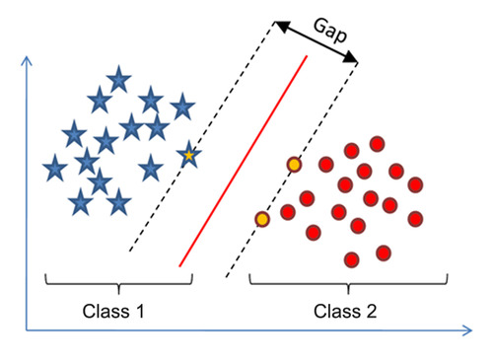
Virulent prediction
Virulence factors are molecules produced by pathogens that contribute to the pathogenicity of the organism and enable them to achieve the colonization of a niche in the host (this includes attachment to cells) immuno-evasion, evasion of the host's immune response.
Virulent factor predicted through VirulentPred tool which uses Support Vector Machine (SVM) to check the virulence like amino acid composition, dipeptide composition of proteins.
We have predicted about 38 proteins containing virulent factor among hypothetical proteins of Nisseria sp.

Slide 23
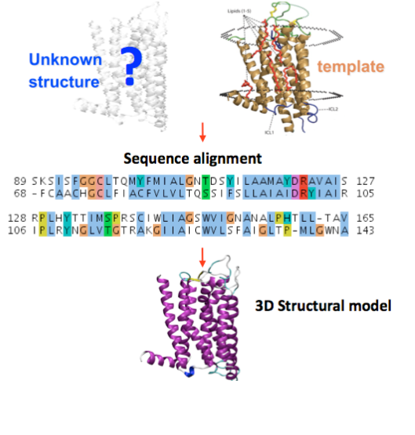
STRUCTURE pREDICTION –Phyre2

Slide 24
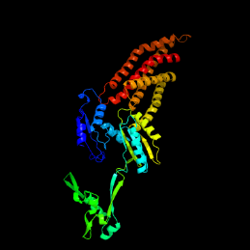
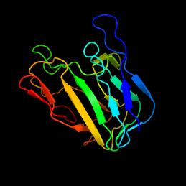
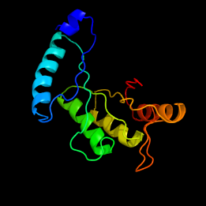
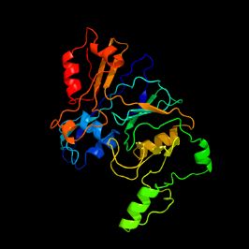
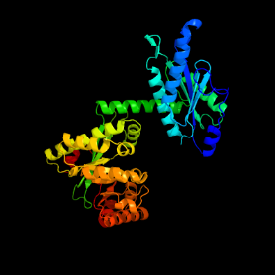
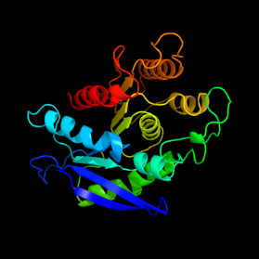
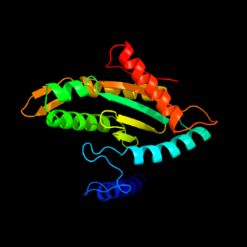
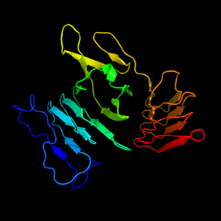
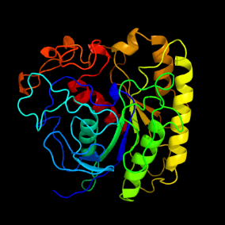
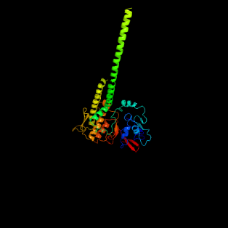
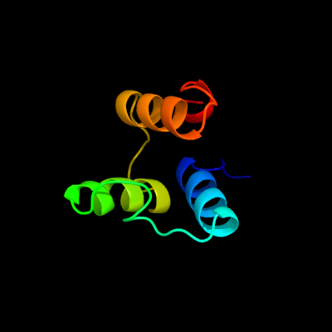
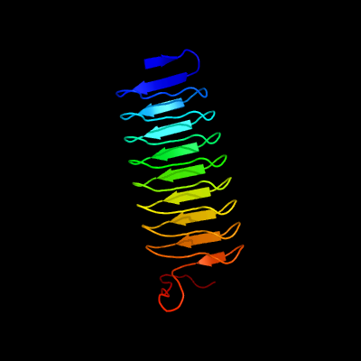
Results & Discussion - Structural annotation of virulent proteins
transport protein
protein transport
TIM beta/alpha-barrel
transferase
transferase, hydrolase
hydrolase
signaling protein
hydrolase
hydrolase
protein binding
transferase
cell adhesion

Slide 25
Conclusion
We have successfully analyzed all 681 hypothetical proteins available in Neisseria meningitidis strain MC58 using advance computational prediction tools.
These hypothetical proteins were analysed for functional prediction, structural prediction and virulent prediction by using bioinformatics tools.
We have identified 38 virulent proteins and predicted their function and structure. These virulent proteins are predicted as potential putative drug targets.
This study will facilitate in the better understanding of the drug resistance and the pathogenesis mechanism in Neisseria meningitidis strain MC58 as well as to discover drugs targets for treatment of the disease.

Slide 26
Thank you

